Slide 1
SQL Bootcamp
Locking

Slide 2
No Concurrency Control (1)
Could lead to the following effects:
Lost Update
Two update transactions on same row, based on original value, one overwrites the other
Dirty Reads
Read data from an uncommitted transaction (could be rolled back)
Non-repeatable Reads
When a transaction reads the same row more than once and gets difference values each time, caused by another transaction updating the row in between reads

Slide 3
No Concurrency Control (2)
Could lead to the following effects:
Phantom Reads
Similar to Non Repeatable Reads, When a transaction reads the same range of rows more than once and gets different results each time, caused by another transaction inserting or deleting rows in the range between reads
Double Reads
If a row is read in a scan operation, then during the scan the row is updated and moved further along the index, then the same row could be read again.

Slide 4
Concurrency models
Pessimistic
Default
Takes locks
Readers block Writers
Optimistic
Readers don’t block Writers (don’t lock data)
Writers block Writers
Readers see committed data whilst updates are occuring

Slide 5
Lock Isolation Levels (1)
Read Uncommited
Read uncommitted data - With(Nolock)
Read Committed
Default
Shared locks are held only when data is being read, they are released straight after
Repeatable Read
Shared locks are held on data read and only released when transaction is complete
Serializable
Range locks are held on data read, this blocks any data being inserted in the range

Slide 6
Lock Isolation Levels (2)
Snapshot
Uses Row Versioning
The data read by any statement in a transaction will be the transactionally consistent version of the data that existed at the start of the transaction
Whenever a transaction modifies a row, the image of the row before modification is copied into a page in the version store.
The version store is a collection of data pages in tempdb
Tempdb usage will increase

Slide 7
Lock Isolation Levels (3)
Isolation level | Dirty reads | Non Repeatable reads | Phantom
Read Uncommitted | Yes | Yes | Yes
Read Committed | No | Yes | Yes
Repeatable Read | No | No | Yes
Serializable | No | No | No
Snapshot | No | No | No

Slide 8
Row Versioning
Read_Commited_Snapshot
Allow_Snapshot_Isolation
Benefits
Read operations have consistent data
Readers don’t block writers
Reduced deadlocks
Reduced managed locks (reduce system overhead)
Reduces lock escalations
Costs
Increased tempdb usage
Can affect Read performance
Additional IO, Memory, CPU overhead, storage
(additional 14bytes added to each row for versioning)
Turning on can lead to page splits
If tempdb runs out of space Read operations can fail

Slide 9
Lock Modes
Intent
Used to Establish a lock Hierarchy
Shared
Used for read only operations
Update
Used on resources that can be Updated
Exclusive
Used for data modifications

Slide 10
Lock Modes
Bulk Update
Used to bulk copy data into a table (use tablock hint)
Key Range
Used on data ranges when using serializable isolation level. Stop Phantom reads
Schema
Used when an operation dependent on the table schema is executed

Slide 11
Lock Types (1)
IS
S
SIX
IX
X
UIX
IU
U
SIU
Sch-S
Sch-M
BU

Slide 12
Lock Types (2)
RS-S
RS-U
RI-N
RI-S
RI-U
RI-X
RX-S
RX-U
RX-X

Slide 13
Lock Granularity
Key
Range
Row
Page
Extent
Hobt
Object
Database

Slide 14
Lock Compatibility (1)
 | Existing granted mode
Requested mode | IS | S | U | IX | SIX | X
Intent shared (IS) | Yes | Yes | Yes | Yes | Yes | No
Shared (S) | Yes | Yes | Yes | No | No | No
Update (U) | Yes | Yes | No | No | No | No
Intent exclusive (IX) | Yes | No | No | Yes | No | No
Shared with intent exclusive (SIX) | Yes | No | No | No | No | No
Exclusive (X) | No | No | No | No | No | No

Slide 15
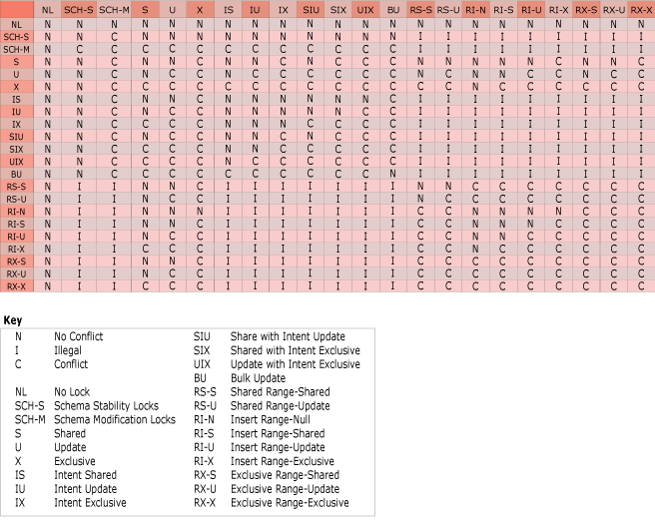
Lock Compatibility (2)

Slide 16


Locking Hierarchy
UPDATE
S
Database
INSERT
IX
Table
INSERT
IU
Page
INSERT
S
UPDATE
INSERT
U
IX
Row
X
IX
Row
INSERT
S
IX
IX
X

Slide 17
Lock Escalation

Slide 18
Locking Hints (1)
Force Server to hold lock longer or at a higher level (eg Table)
Dirty reads possible (Nolock)
Locked rows skipped (Readpast)

Slide 19
Locking Hints (2)
Holdlock - Similar to Serializable
Updlock - hold update locks instead of shared locks
Tablock - shared table lock instead of page or row lock
Paglock - shared page lock instead of table lock
TablockX - exclusive table lock
Rowlock - shared row lock instead of table or page lock
Readuncommitted - set isolation level for statement or table

Slide 20
Locking Hints (2)
Repeatableread - set isolation level for statement or table
Serializable - set isolation level for statement or table
Readcommitted - set isolation level for statement or table
Readcommittedlock - set isolation level for statement or table (takes shared locks)
Nolock - shared locks not held (dirty reads)
Readpast - locked rows are skipped
Xlock - can be combined with Paglock and Tablock to make them exclusive

Slide 21
What is a Deadlock?

