Slide 1
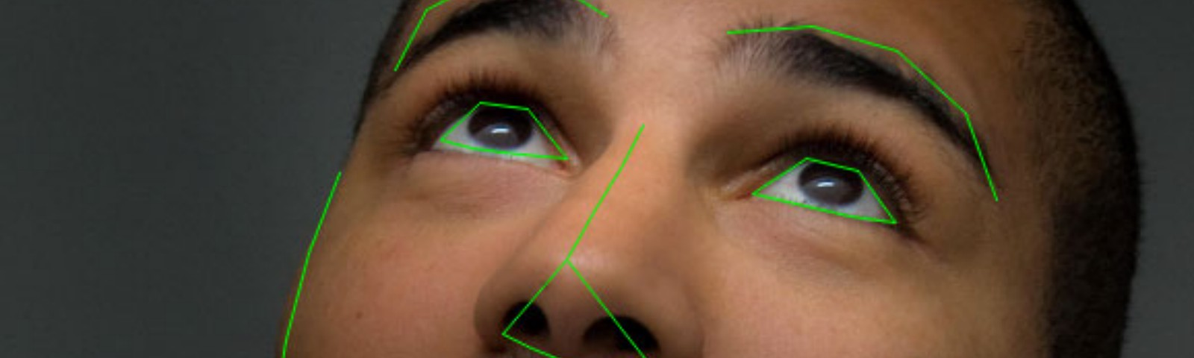
Balaji Institute of Technology and Science
Department of Computer Science and Engineering
Mini Project
On
Drowsiness Alert
System
By:
M.Arunkumar (17C31A0562)
T.Swetha (18C35A0523)
N.ChandraPrakash(17C31A0578)
P.Sravan (17C31A0589)
Under The Guidance of
Mrs. B.CHANDINI
Asst. Professor

Slide 2
ABSTRACT
Every year many peoples lose their lives due to harmful road accidents around the world, drowsiness of the drivers is the main primary cause of the road accidents and deaths. Due to the lack of sleep and tiredness, drowsiness will occur while driving.
Detection of drowsiness of a driver is a vehicle safety technology, it helps to prevent accidents which are caused by the driver being drowsy or sleepy.

Slide 3
Therefore, there is a need to develop the systems that will detect and notify a driver of her/him bad psychophysical condition, which could significantly reduce the number of drowsy related accidents.
The best way to avoid accidents caused by drivers' drowsiness is to detect drowsiness of the driver and warn him before fall into sleep. However, the development of such systems encounters many difficulties related to fast and proper recognition of a driver’s drowsy symptoms. One of the best way to implement drowsiness detection is to use the vision based approach.

Slide 4
INTRODUCTION
Vehicle accidents are more common if the driving is insufficient.
These happen on most factors if the driver is drowsy or if he is alcoholic.
It was shown that driver performance was lower with increased of drowsiness with that resulting crashes found more than 20% of all vehicle accidents.

Slide 5
EXISTING SYSTEM
The Existing System of driver drowsiness detection has following disadvantages :
Using of two cameras in the system one for monitoring the head movement and other for facial expressions.
Aging of sensors and all these sensors are attached to the driver’s body which may affect the driver.

Slide 6
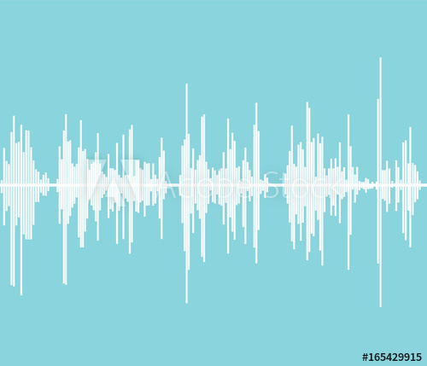
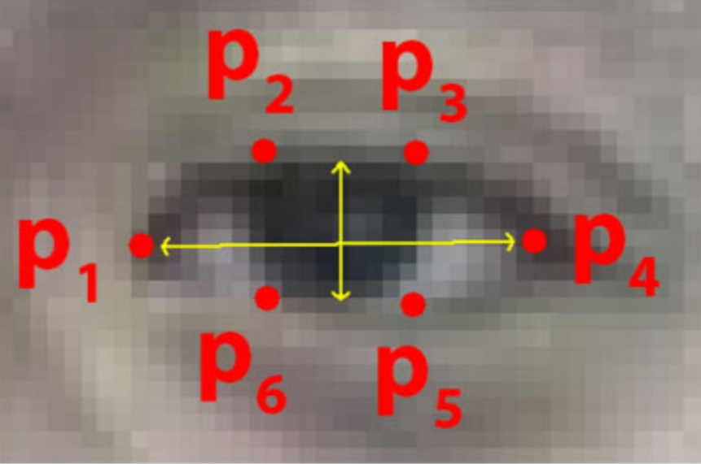
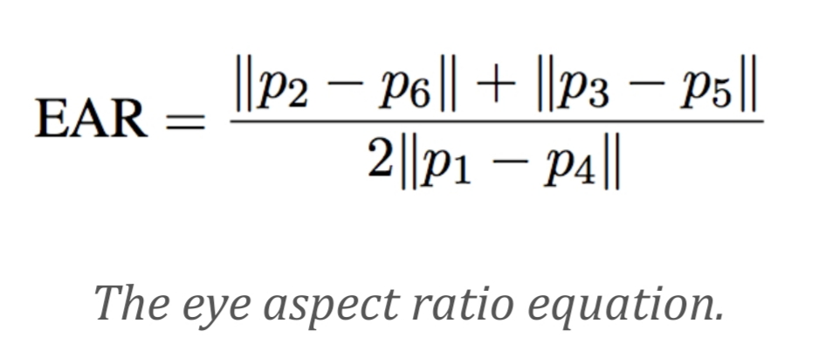
PROPOSED SYSTEM
This project involves controlling vehicle accidents and saving driver’s life by alerting him
Whenever the driver’s eye blinking period is more, we consider this condition under drowsiness
Immediate action will be taken and buzzer will blow up alerting the driver.

Slide 7

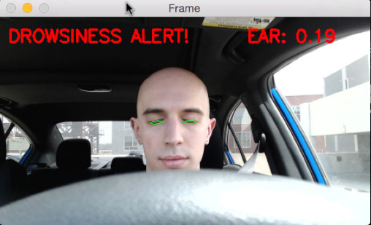

Slide 8
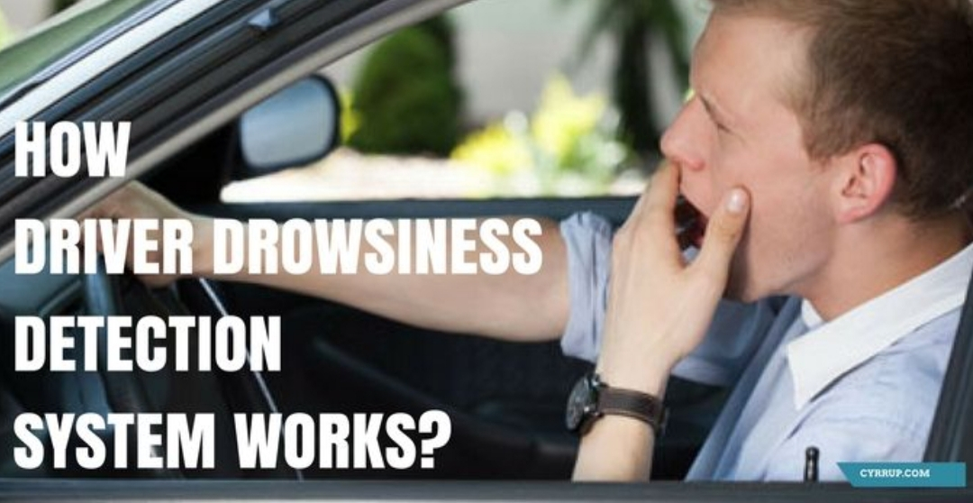

Slide 9
SOFTWARE REQUIREMENTS
Python IDE
Anaconda
HARDWARE REQUIREMENTS
Processor : Intel core I processor or above
RAM : 512 MB
Hard Disk : 80 GB
System embedded with a webcam

Slide 10
Conclusion
In this project, we are developing a machine learning model for drowsiness alert system using python and opencv. We are developing the drowsiness alert system to identify whether the driver is feeling drowsy or not. If the driver is drowsy it detects eyes blinking using webacm and generate buzzer to alert the driver from drowsy.

Slide 11

Thank You

