Slide 1
COSUMER’S EQUILIBRIUM IN TERMS OF UTILITY ANALYSIS
Utility
Utility is the capacity to satisfy a human desire or serve a human purpose.
It is the want satisfying power of a commodity.
In the words of S.C Maurice
“utility is a consumer’s perception of his or her own happiness or satisfaction”.

Slide 2
Utility and Usefulness
Utility and Usefulness are not synonymous. A commodity may be regarded by society as useless or even positively undesirable.
The commodity may be frivolous, injurious or even pernicious, but if it satisfies an economic want, it possesses utility.
For example, a cigarette will yield tremendous utility to a smoker, but zero or negative utility to a non-smoker. Therefore, utility has no moral, legal or ethical connotation.

Slide 3
Diamond rings and paintings by Picasso may be useless in the functional sense of the term, yet be of tremendous utility to brides and all connoisseurs.
Since utility is ‘subjective’ and not ‘objective’, it is not susceptible to precise quantitative measurement. Utility is a relative phenomenon, which varies from person to person, from time to time and from place to place depending upon the intensity of people’s respective needs. It also depends to a large extent on culture and civilisation.
Likewise, the term utility should not be confused with satisfaction. Utility implies ‘expected satisfaction’ whereas ‘satisfaction’ stands for realised satisfaction. A consumer thinks of utility when he is contemplating the purchase of a commodity, though he obtains satisfaction only after the consumption of the commodity.

Slide 4
LAW OF DIMINISHING MARGINAL UTILITY
The objective of every consumer is to get maximum utility or satisfaction from spending his limited income.
He would like to spend his limited income on a commodity or several commodities in such a way as to get maximum satisfaction.
When he gets maximum satisfaction, he is said to be in equilibrium.

Slide 5
Two fundamental laws to explain Consumer’s Equilibrium:-
1. The law of Diminishing Marginal Utility (single Commodity)
2. Law of Equi- Marginal Utility (2 or more Commodities)

Slide 6
LAW OF DIMINISHING MARGINAL UTILITY
It is based on general observation of human behaviour. The assertion that commodities are characterised by diminishing marginal utility as consumption rises is an empirical one.
Eyes become tired of beautiful pictures or scenes and ears are deadened by even the sweetest music in course of time.
The Law states that as we have more of a thing the less is the utility we derive from the additional increments of it.

Slide 7
A German economist H.H.Gossen was the first to explain this law. Hence, it is also known as Gossen’s first law.
Alfred Marshall, in his book ‘Principles of Economics’ (1890) gave a precise explanation of this law.
“ The additional benefit which a person derives from a given increase in his stock of a thing diminishes with every increase in the stock that he already has.”

Slide 8
The law states that as a person consumes more of any good, the total utility he derives increases but the increase in total utility is not proportionate to the increase in his consumption.

Slide 9
Assumptions of the Law
1. The consumer is rational. ie, he aims at maximisation of his utility and satisfaction subject to his limited income.
2. All units of the commodity should be homogeneous in size and quantity.
There should not be any time lag in the consumption of the successive units of the commodity.
The Habits, Tastes, Income and Fashion of the consumer should remain constant.
There should not be any change in the price of the commodity and related commodities.
Utility is measurable in cardinal numbers.

Slide 10
Explanation of the Law
Suppose a hungry man eats oranges one by one. The first orange gives him great pleasure. By the time he starts taking the second, the intensity of his desire diminishes to a certain extent and the second orange yields less satisfaction. The satisfaction derived from the third will be less than that of the second. Again, the satisfaction will be less from the fourth when compared to the third and so on. In this way, the incremental utility will go on decreasing till it drops to zero, and if he takes more, the satisfaction may become even negative or disutility may creep in.

Slide 11
The following table shows the utility derived from the consumption of a commodity, say,oranges.
Number of Oranges | Marginal Utility | Total Utility
1 | 10 | 10
2 | 8 | 18
3 | 6 | 24
4 | 4 | 28
5 | 2 | 30
6 | 0 | 30
7 | -2 | 28

Slide 12
As per the above table, the consumption of the first unit of orange provides 10 units of satisfaction. The second unit provides an additional 8 utils; the third an additional 6. thus, if 3 units are consumed, total utility is equal to 24 utils. When the 6th unit is consumed, total utility reaches a maximum of 30(saturation point) and marginal utility falls to zero. The marginal utility of consuming the 7th unit is negative. When the 7th unit is consumed, the total utility falls.

Slide 13
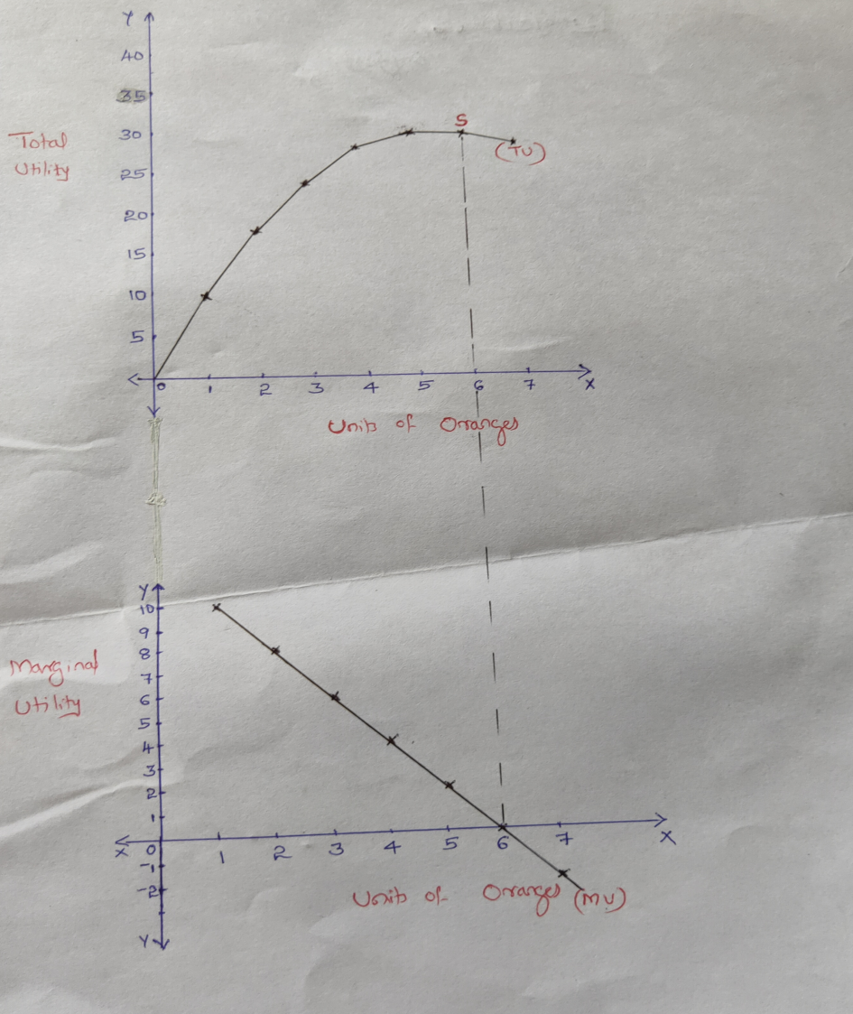
The law of Diminishing Marginal Utility can be described through the following diagram

Slide 14
It is clear from the diagram that as the units of oranges increase, the Total Unity increases but at a decreasing rate.
However, at point ‘S’, the total utility curve becomes flat indicating Zero marginal utility.ie, Zero utility from the 6th unit.
It implies that at point ’S’ the slope is zero indicating saturation point.
From the graph it is clear that Total Utility is maximum when the marginal utility is zero.
At the 6th unit, the consumer stops further consumption.
If he consumes the 7th unit, he will derive negative utility.
Thus, at 6th unit of consumption, he enjoys the maximum utility.
This is the point of Consumer’s Equilibrium.

Slide 15
Limitations and Exceptions of the Law of DMU
The Law of Diminishing Marginal Utility depends on a large number of assumptions. If these assumptions are not fulfilled, the law does not hold.
The major limitations of the LDMU are the following.
If different units of a commodity consumed are not homogeneous, the law will not operate.
If there is a time gap between the consumption of successive units, utility will not exhibit a diminishing tendency.
There should be no change in the Tastes and Preferences of the consumers. A change in these factors may increase utility.
The consumer should be rational. Otherwise, the law does not hold good.
The income of the consumer should remain the same. A change in income will adversely affect the operation of the law.

Slide 16
Limitations and Exceptions of the Law of DMU
6. Prices of different units of the commodity and the substitutes of the commodity should not change. If prices change, this law does not operate.
7. This law is not applicable to money. This is due to the fact that people have a tendency to accumulate more money.
8. The law of diminishing marginal utility is not applicable in the case of rare collections like ancient coins, paintings, stamps etc.
9. This law does not apply to a miser. The miser has immense love for money. He gets more and more satisfaction from getting more ans more money.
10. The marginal utility increases as a result of an increase in otrher people’s stock of a commodity. For example, the utility of one’s telephone increases with increasing number of telephones in his place of residence.

