Slide 1
MONOSTABLE MULTIVIBRATOR USING 555 TIMER

Slide 2
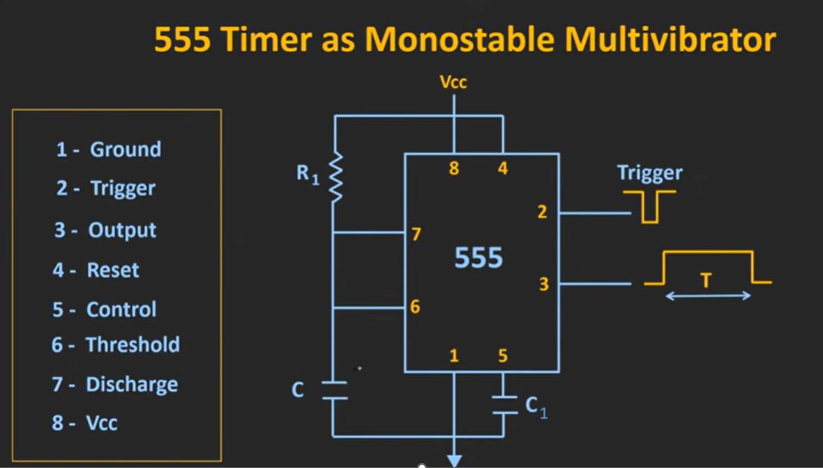

Slide 3
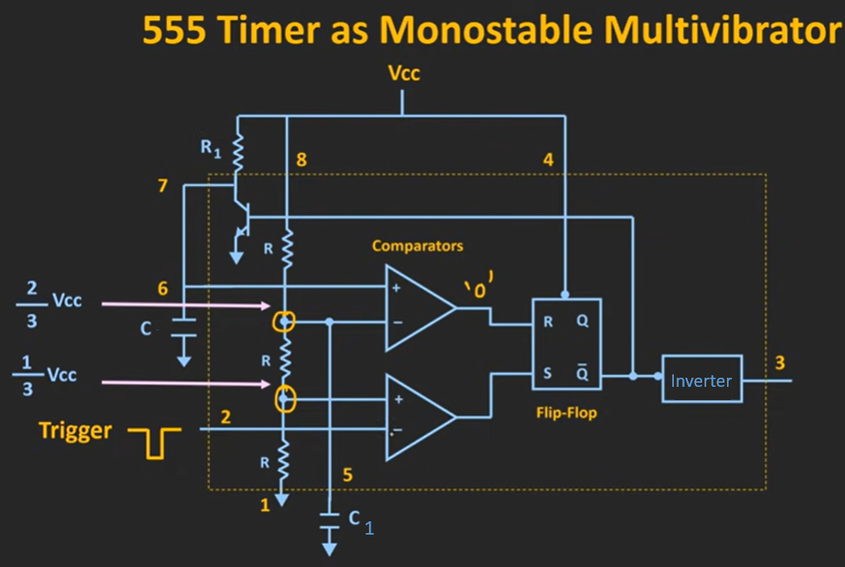

Slide 4
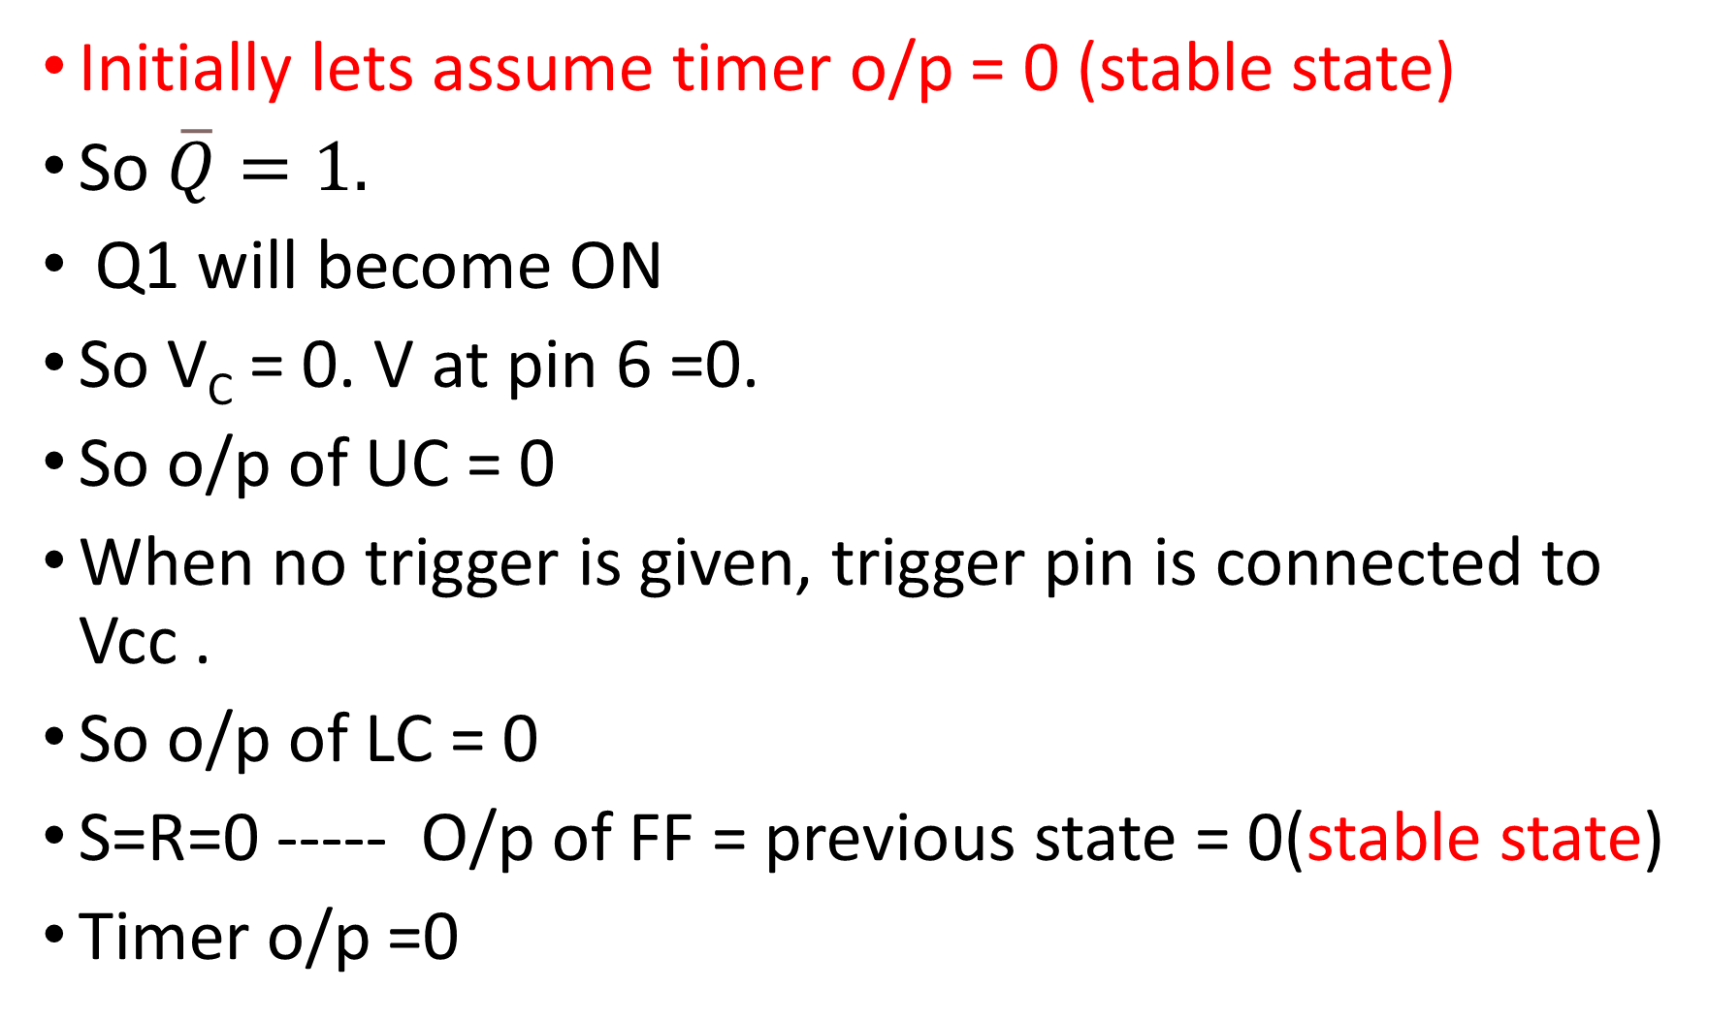
Initially lets assume timer o/p = 0 (stable state)
So $\overline{Q}=1.$
Q1 will become ON
So V_{C} = 0. V at pin 6 =0.
So o/p of UC = 0
When no trigger is given, trigger pin is connected to Vcc .
So o/p of LC = 0
S=R=0 ----- O/p of FF = previous state = 0(stable state)
Timer o/p =0

Slide 5
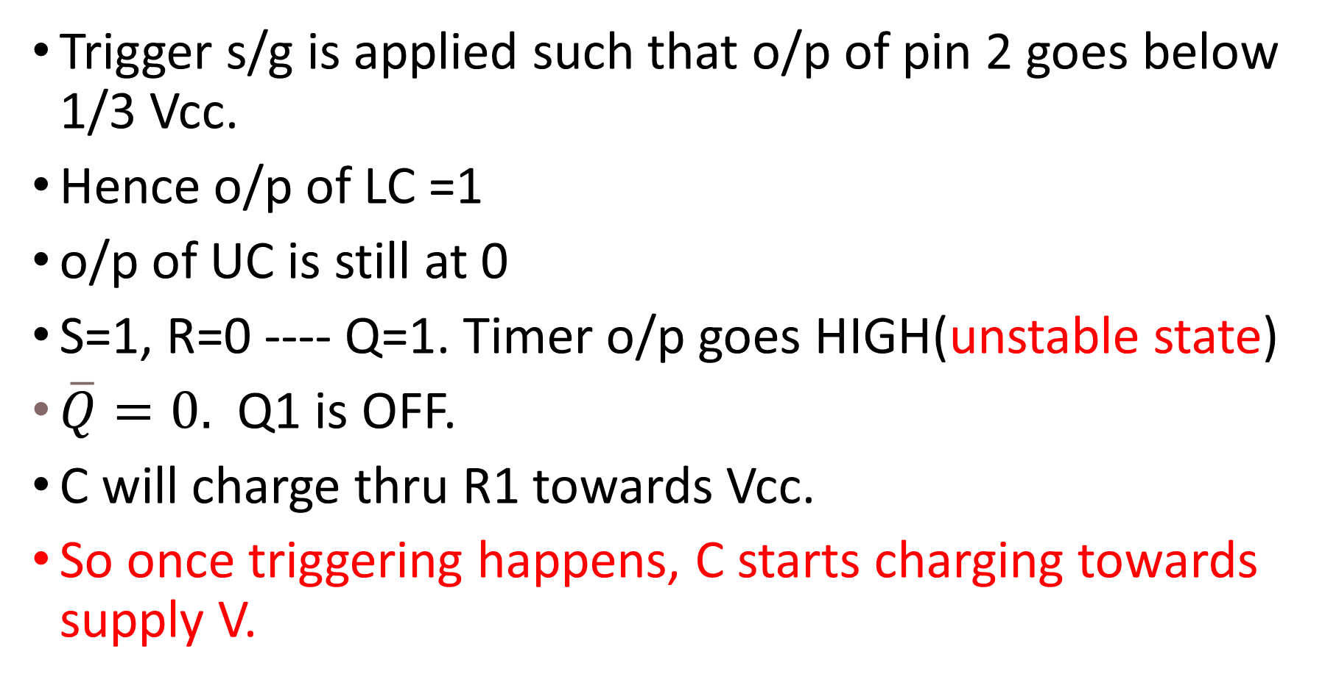
When trigger is applied
Trigger s/g is applied such that o/p of pin 2 goes below 1/3 Vcc.
Hence o/p of LC =1
o/p of UC is still at 0
S=1, R=0 ---- Q=1. Timer o/p goes HIGH(unstable state)
$\overline{Q}=0.$ Q1 is OFF.
C will charge thru R1 towards Vcc.
So once triggering happens, C starts charging towards supply V.

Slide 6
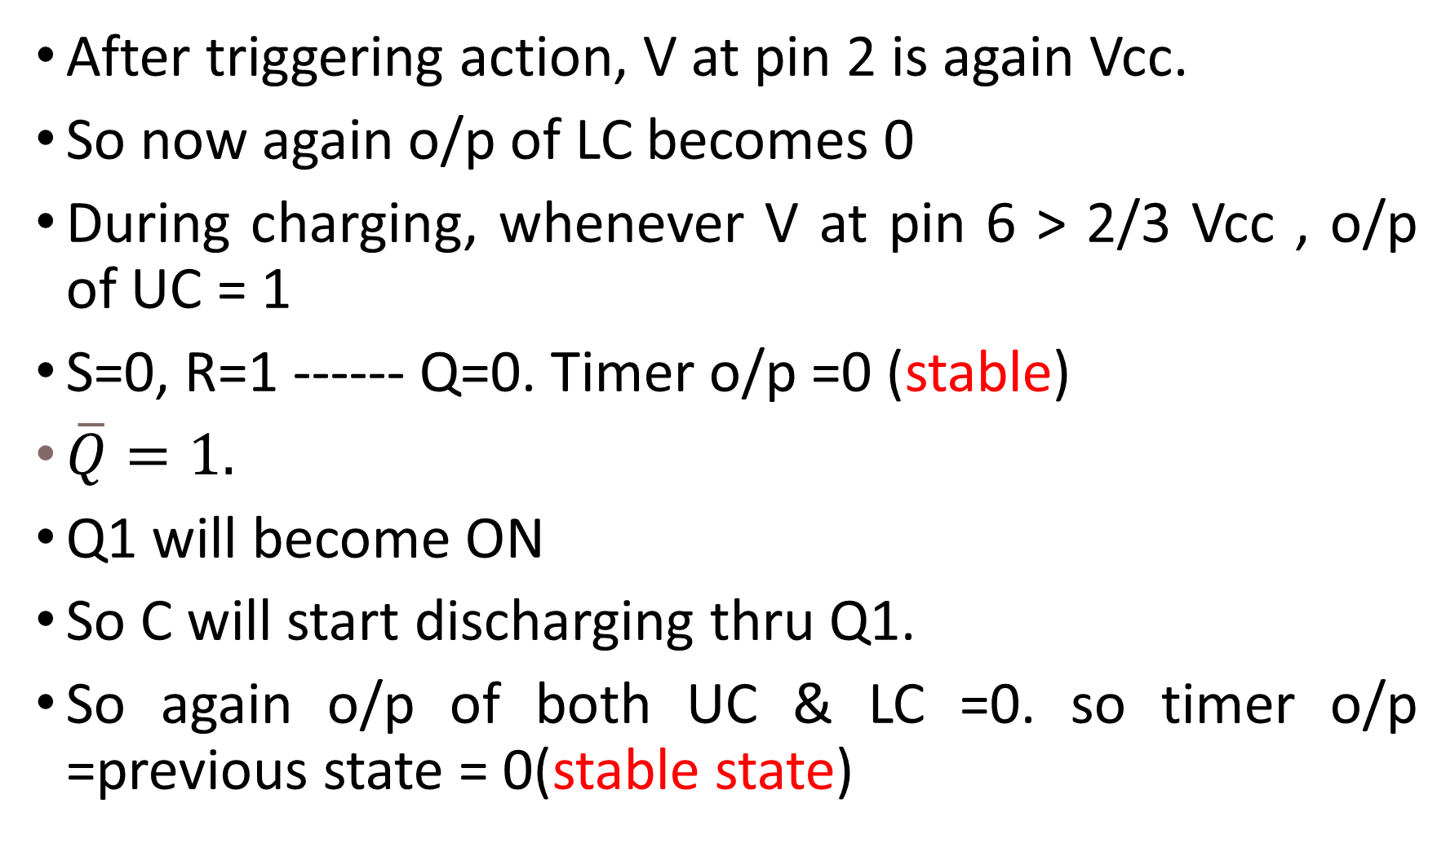
After triggering action, V at pin 2 is again Vcc.
So now again o/p of LC becomes 0
During charging, whenever V at pin 6 > 2/3 Vcc , o/p of UC = 1
S=0, R=1 ------ Q=0. Timer o/p =0 (stable)
$\overline{Q}=1.$
Q1 will become ON
So C will start discharging thru Q1.
So again o/p of both UC & LC =0. so timer o/p =previous state = 0(stable state)

Slide 7
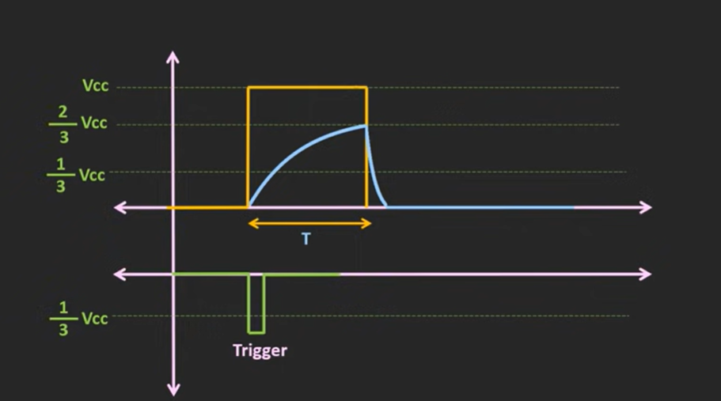
T = 1.1 R₁C

Slide 8
When trigger is applied, a pulse is obtained for a short duration.
Duration of pulse depends upon charging of the capacitor.
T = 1.1 R₁C
In this way, by changing R1 and C, we can design a MMV and we can change the timing of the pulse.

Slide 9
Applications of MMV
For generating timing delays.
(By changing R1 and C, we can design a MMV and we can change the timing of the pulse. )
For frequency division.
(If we are applying a periodic trigger s/g at pin 2)
Time duration of o/p pulse T shud be slightly more than that of triggering s/g t. (T > t).
In that case o/p s/g freq will be half than the trigger s/g freq.

Slide 10
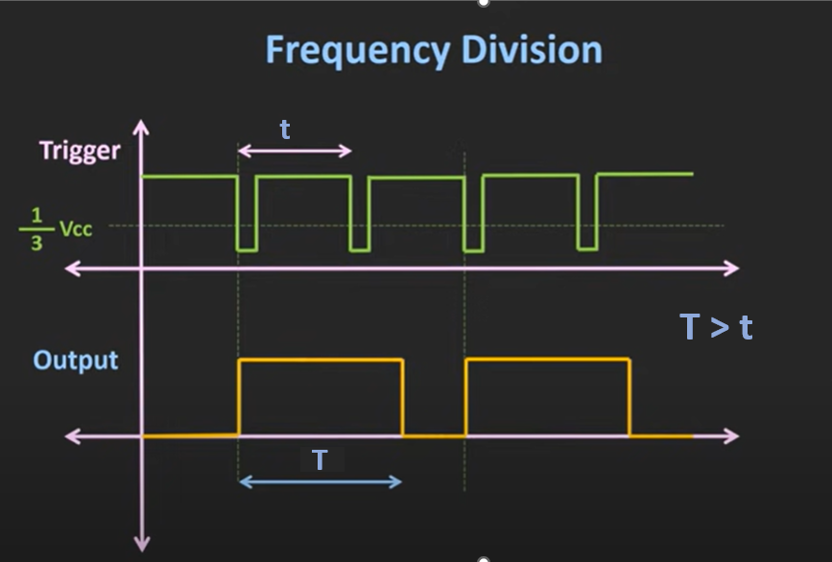

Slide 11
For pulse width modulation (PWM)
Till now we used only internal reference voltages.
If we apply a modulating s/g at control pin, it is possible to generate PW modulated o/p.
Here ref V will continuously change based on this modulating s/g.
Depending on that o/p PW will continuously change.

Slide 12
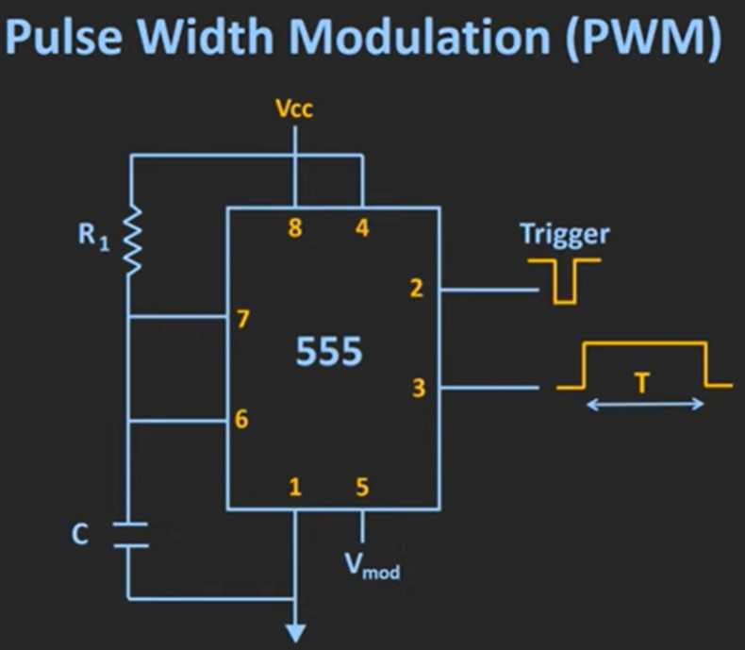

Slide 13
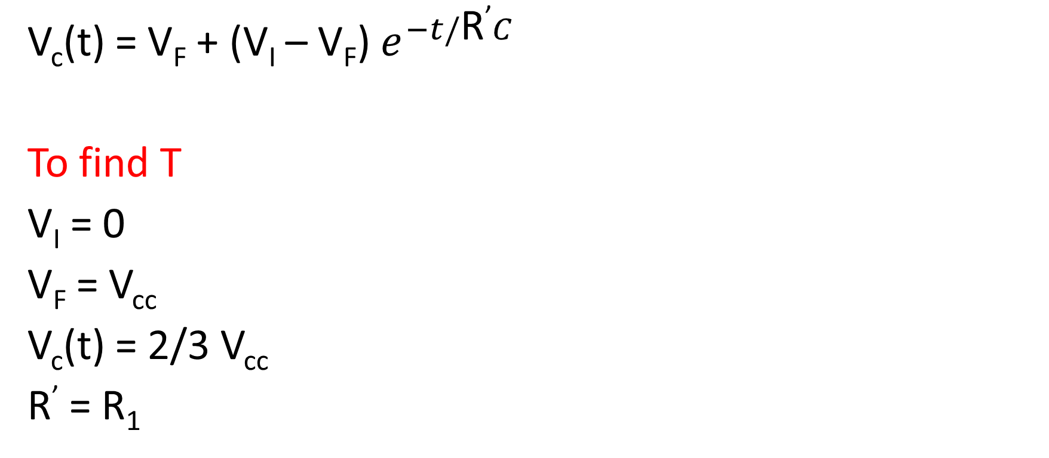
DESIGN
V_{c}(t) = V_{F} + (V_{I} – V_{F}) $e^{−t/\text{R}\text{’}C}$
To find T
V_{I} = 0
V_{F} = V_{cc}
V_{c}(t) = 2/3 V_{cc}
R’ = R₁

Slide 14
T = 1.1 R₁C

