Slide 1
ASTABLE MULTIVIBRATOR USING 555 TIMER

Slide 2
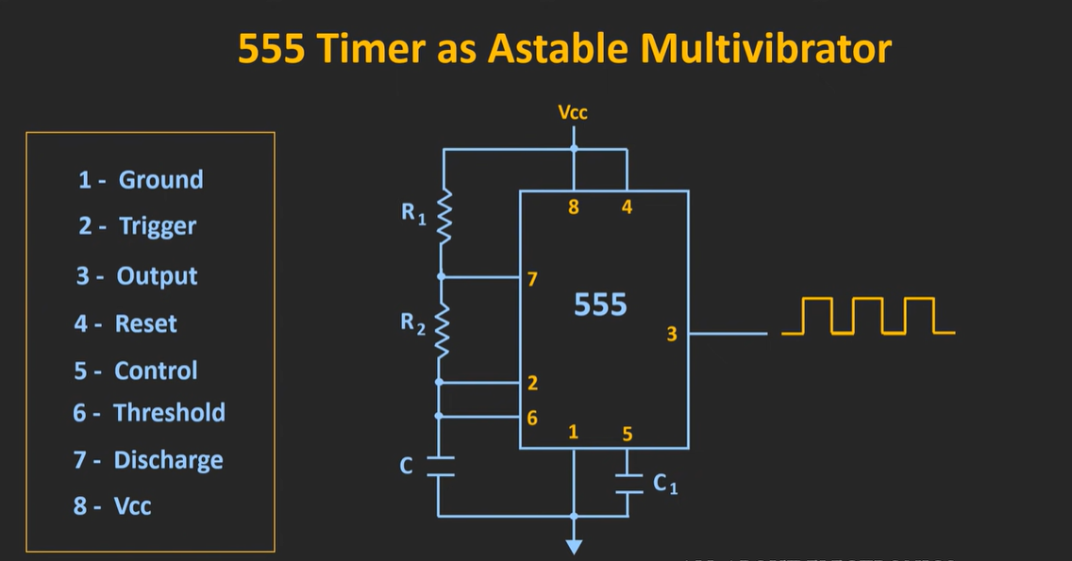

Slide 3
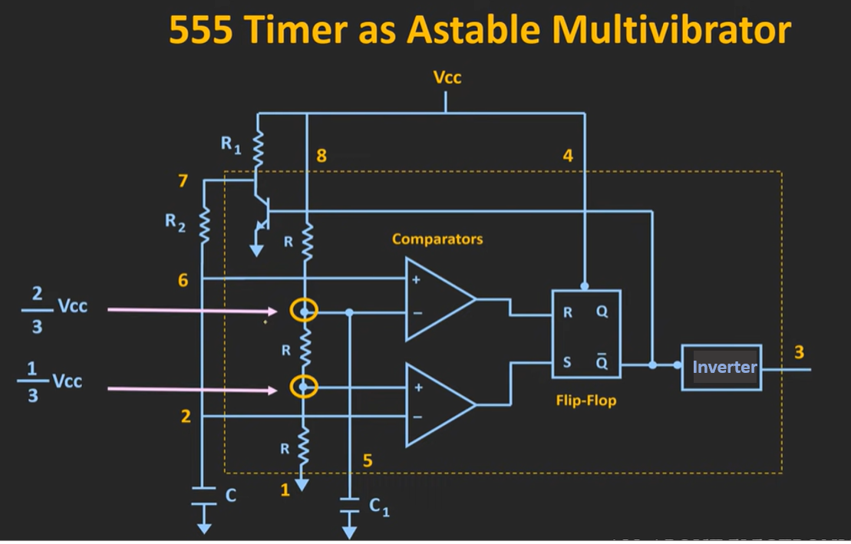

Slide 4
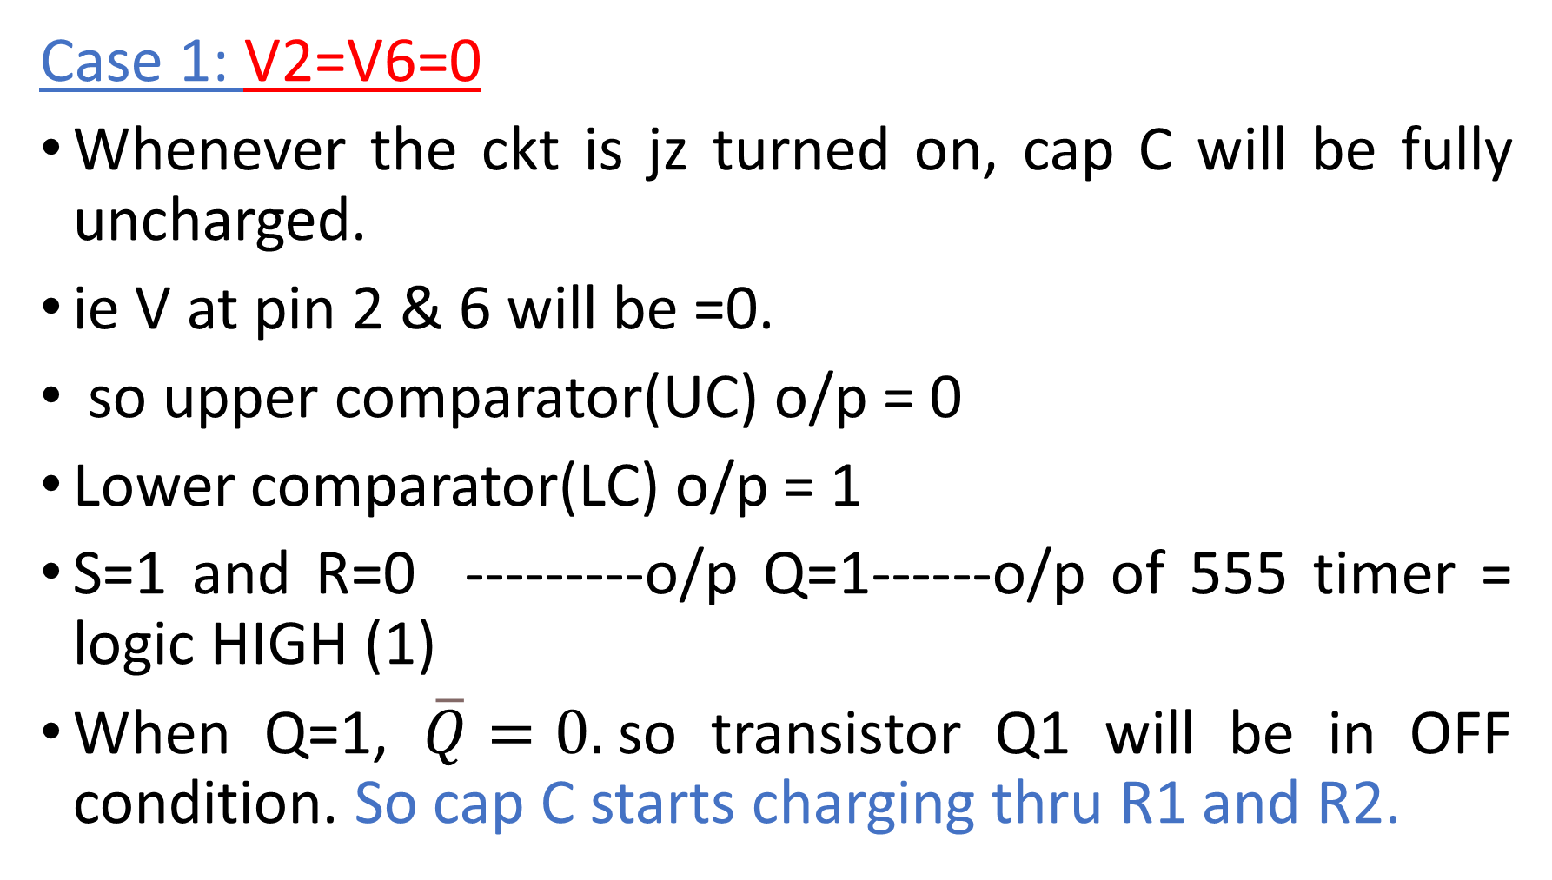
Case 1: V2=V6=0
Whenever the ckt is jz turned on, cap C will be fully uncharged.
ie V at pin 2 & 6 will be =0.
so upper comparator(UC) o/p = 0
Lower comparator(LC) o/p = 1
S=1 and R=0 ---------o/p Q=1------o/p of 555 timer = logic HIGH (1)
When Q=1, $\overline{Q}=0.$so transistor Q1 will be in OFF condition. So cap C starts charging thru R1 and R2.

Slide 5
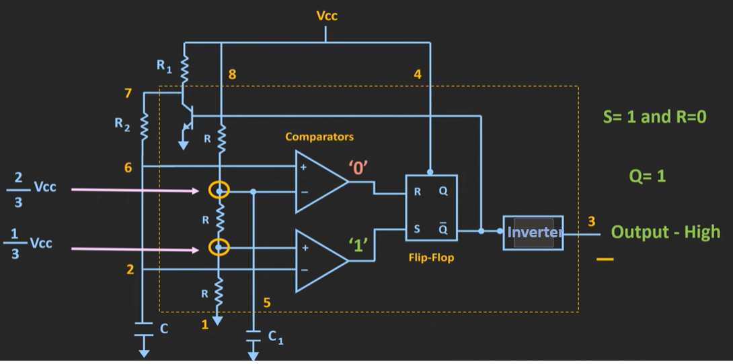
Case 1: V2=V6=0

Slide 6
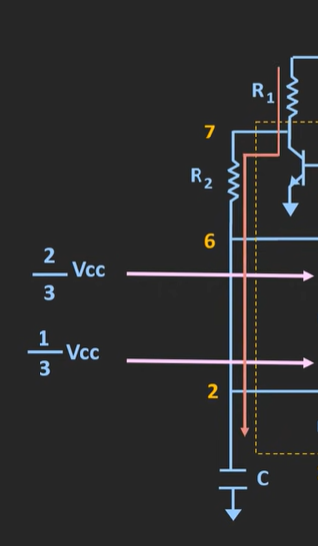
Gradually V at pin 2 & 6 will start increasing.
Case 2: 1/3 Vcc < V2=V6 < 2/3 Vcc
Whenever V at pin 2 > 1/3 Vcc, o/p of LC =0.
Let V at pin 6 < 2/3 Vcc, then o/p of UC = 0.
S=0 and R=0 ----o/p Q =1 (previous state). Timer o/p = High.

Slide 7
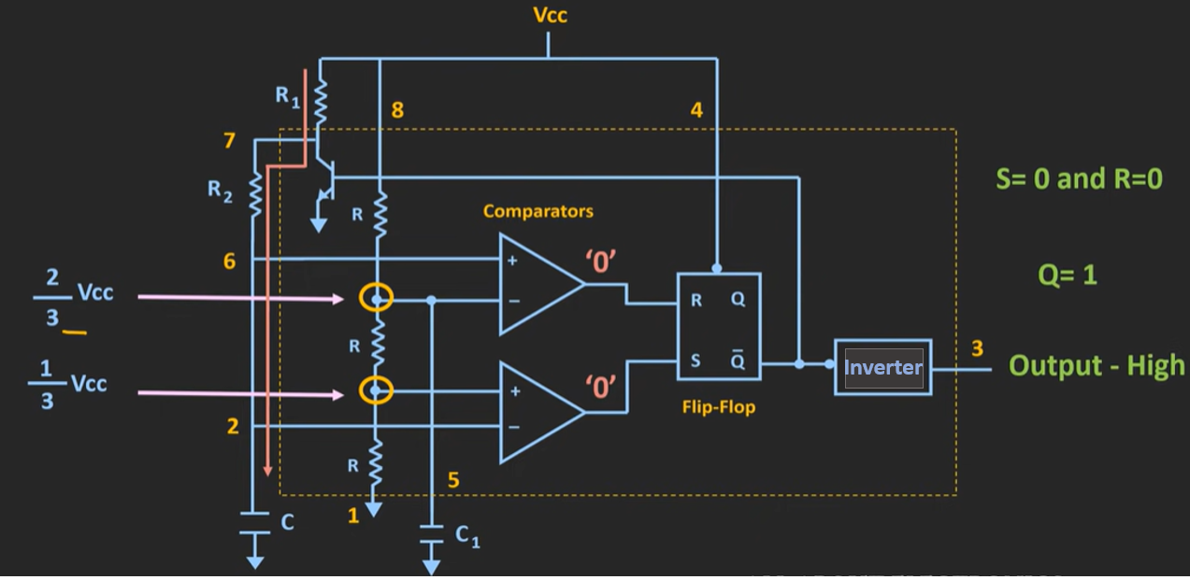
Case 2: 1/3 Vcc < V2=V6 < 2/3 Vcc

Slide 8
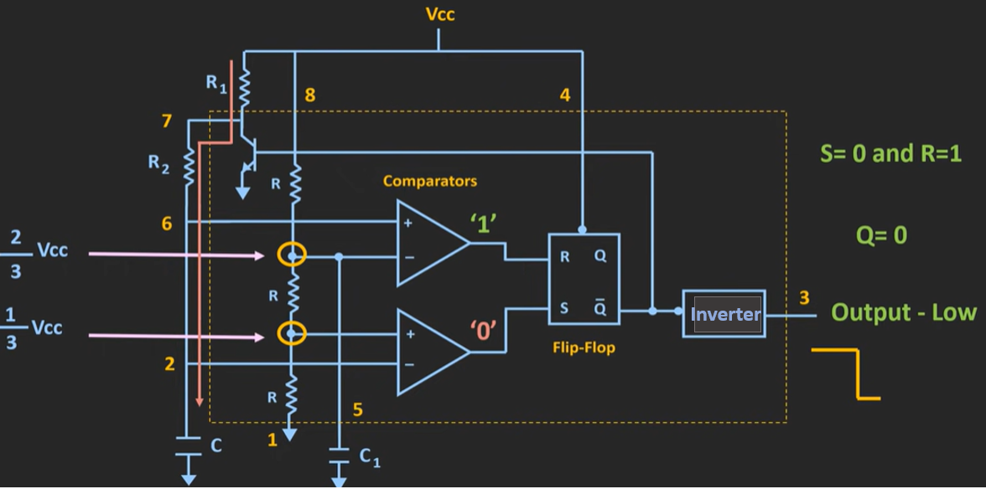
Case 3: V_{c} > 2/3 Vcc

Slide 9
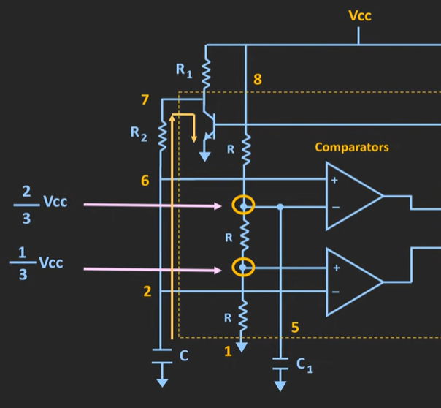
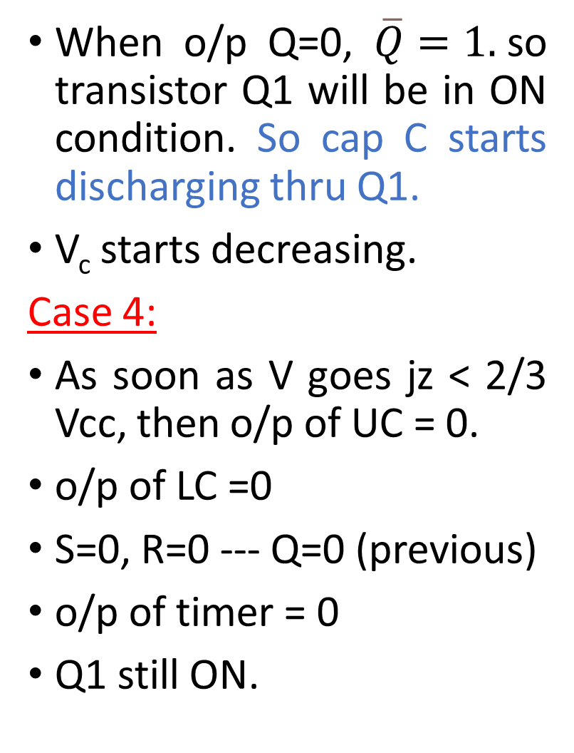
When o/p Q=0, $\overline{Q}=1.$so transistor Q1 will be in ON condition. So cap C starts discharging thru Q1.
V_{c} starts decreasing.
Case 4:
As soon as V goes jz < 2/3 Vcc, then o/p of UC = 0.
o/p of LC =0
S=0, R=0 --- Q=0 (previous)
o/p of timer = 0
Q1 still ON.

Slide 10
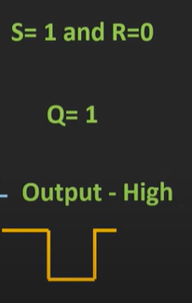
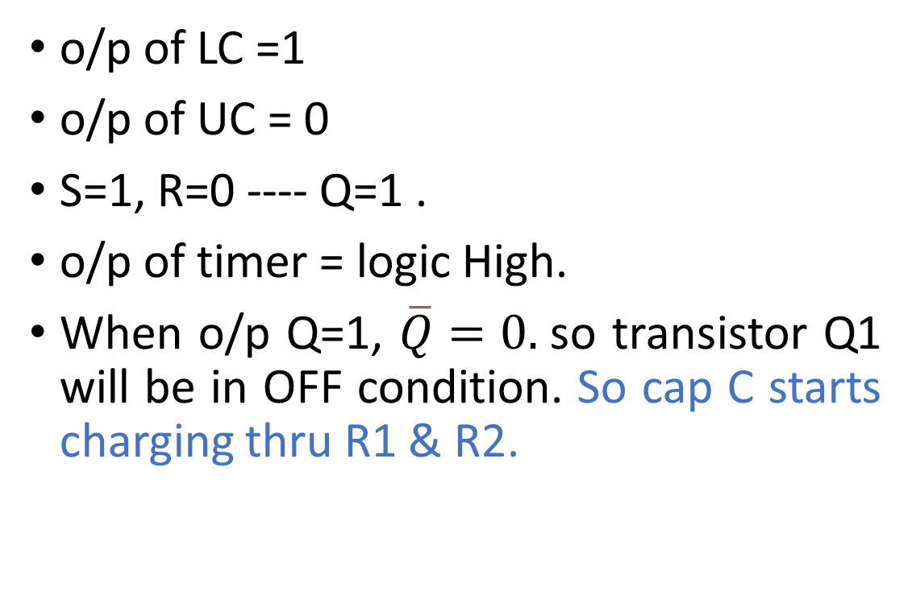
Case 5: when V_{c} goes jz < 1/3 Vcc
o/p of LC =1
o/p of UC = 0
S=1, R=0 ---- Q=1 .
o/p of timer = logic High.
When o/p Q=1, $\overline{Q}=0.$so transistor Q1 will be in OFF condition. So cap C starts charging thru R1 & R2.

Slide 11
In this way, cap is charging btw 1/3 Vcc and 2/3 Vcc.
Bcoz of this charging & discharging of cap, we will see a transition in the o/p V.
During charging process, whenever V_{c} > 2/3 Vcc, there is a transition in the o/p from logic high to logic low.
During discharging process, whenever V_{c} < 1/3 Vcc, there is a transition in the o/p from logic low to logic high.

Slide 12
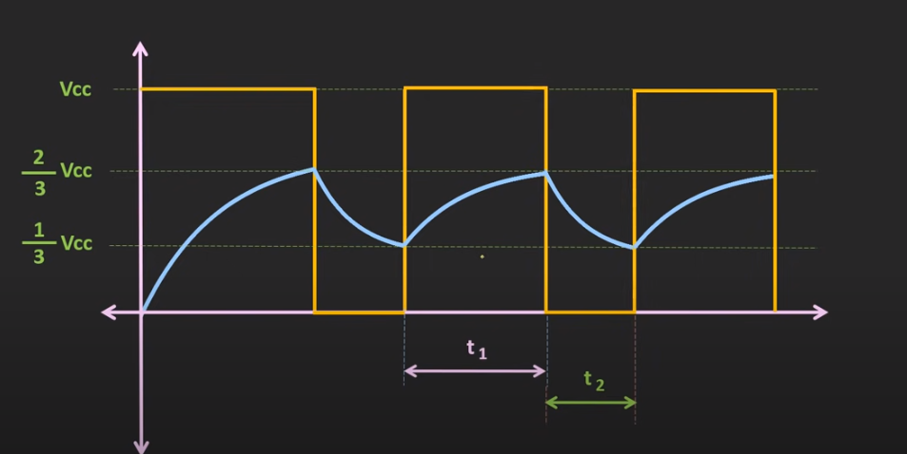

Slide 13
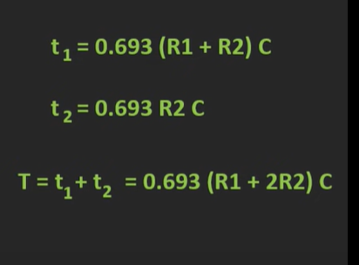
Time t₁ – time for which o/p of timer remains HIGH
Time t₂ – time for which o/p of timer remains LOW
t₁ >t₂
Time t₁ - time taken by cap to charge from 1/3 Vcc to 2/3 Vcc
Time t₂ - time taken by cap to discharge from 2/3 Vcc to 1/3 Vcc

Slide 14
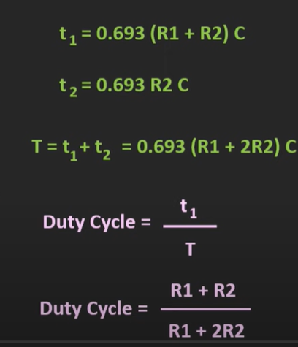
t₁ >t₂
Charging is thru R1 and R2
Discharging thru R2 only.
Duty cycle is always > 50%
For 50 % duty cycle(symm square wave), R1 shud be =0. But in this case, pin 7 is directly connected to Vcc and extra current will flow thru Q1 when it is ON. This may damage Q1 and hence the timer.

Slide 15
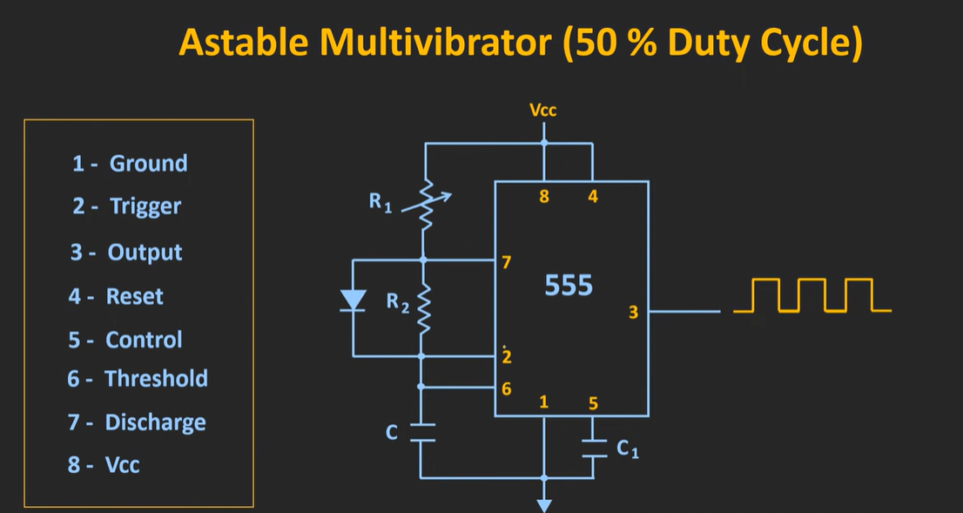

Slide 16
During the charging of this capr, diode will be ON.
Fwd res of diode R_{D} < R₂. so C will charge thru R1 and D.
t₁ = 0.693(R₁+R_{D})C
During the discharging of this capr, diode will be OFF.
C will discharge thru R₂.
t₂ = 0.693R₂C
If we adjz R1 value such that (R₁+R_{D}) =R₂ , then duty cycle =50%

Slide 17
Or if we assume diode is ideal, R_{D} =0.
t₁ = 0.693R₁C
t₂ = 0.693R₂C
Duty cycle = R1 / (R1+R2)
If we take R1 = R2, then duty cycle =50%
If we take R1 > R2, then duty cycle >50%
If we take R1 < R2, then duty cycle <50%

Slide 18
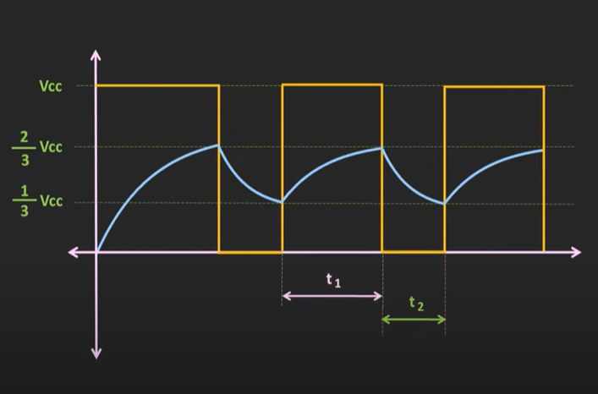

Design
V_{c}(t) = V_{F} + (V_{I} – V_{F}) $e^{−t/\text{R}\text{’}C}$
To find t₁
V_{I} = 1/3 V_{cc}
V_{F} = V_{cc}
V_{c}(t) = 2/3 V_{cc}
R’ = R₁ + R₂

Slide 19
t₁ = 0.693 (R₁ + R₂) C
To find t₂
V_{I} = 2/3 V_{cc}
V_{F} = 0
V_{c}(t) = 1/3 V_{cc}
R’ = R₂
t₂ = 0.693 R₂C

Slide 20
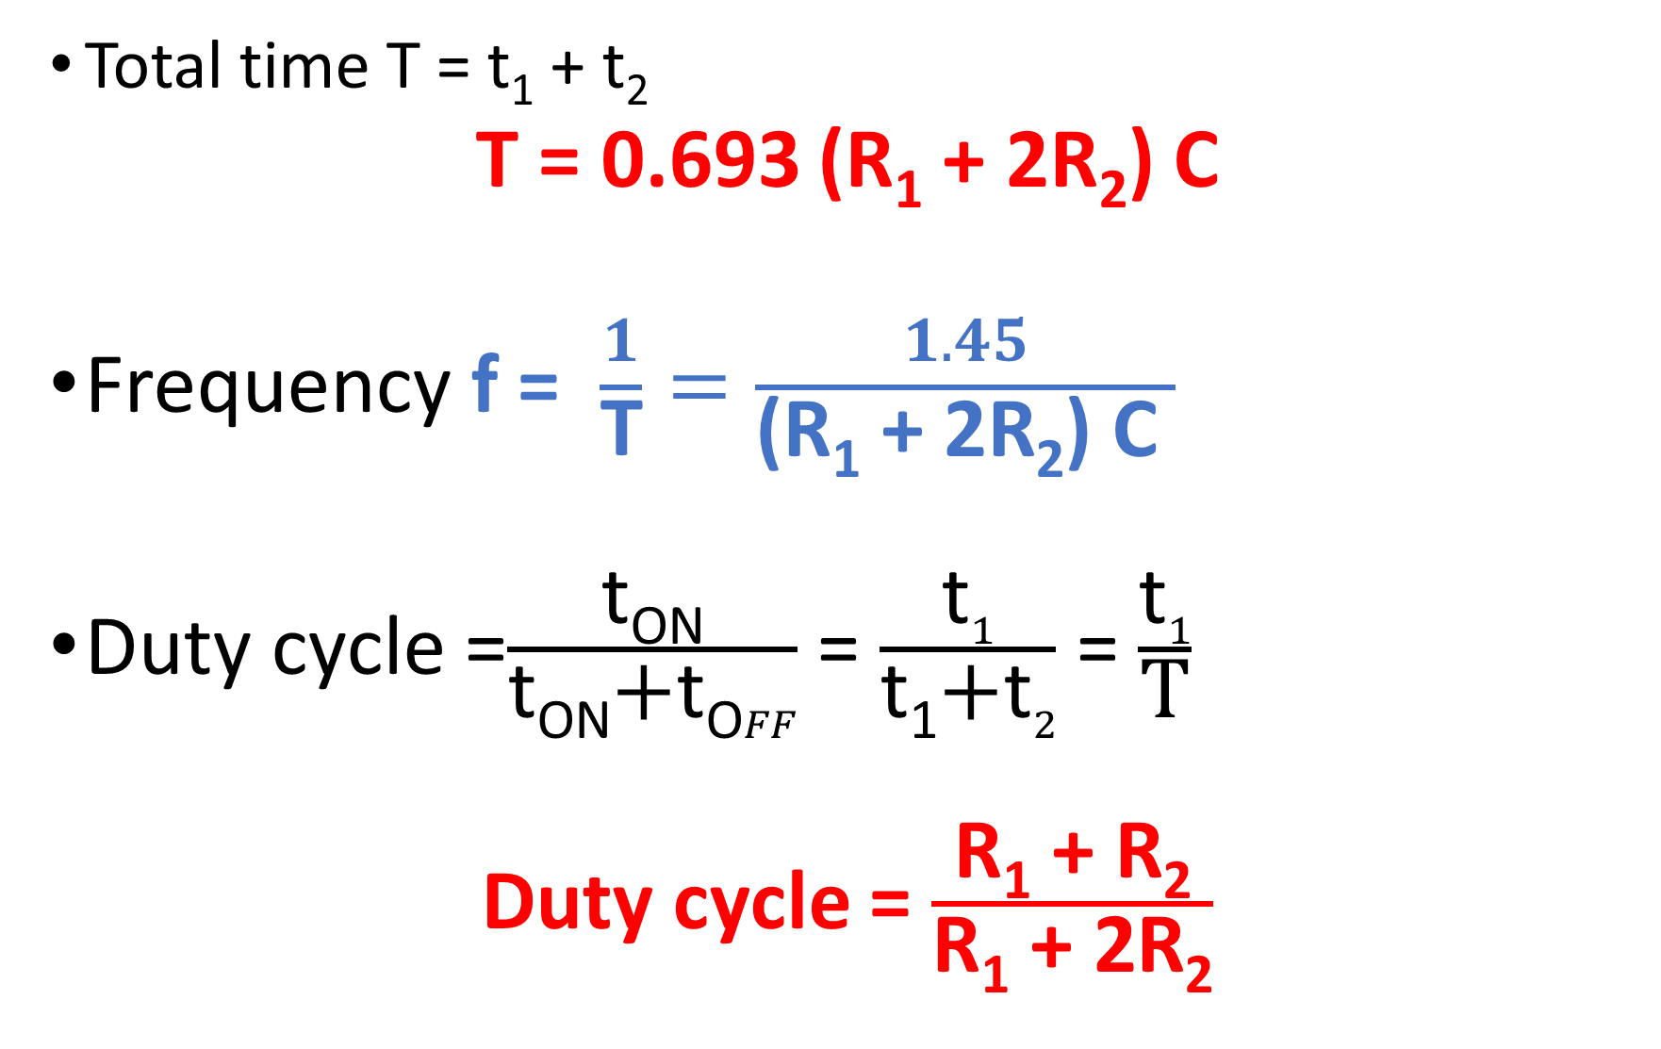
Total time T = t₁ + t₂
T = 0.693 (R₁ + 2R₂) C
Frequency f = $\frac{1}{\text{T}}=\frac{1.45}{\text{(}\text{R}\text{1}\text{ + 2}\text{R}\text{2}\text{)} \text{C} }$
Duty cycle =$\frac{\text{t}\text{ON}}{\text{t}\text{ON}\text{+}\text{t}\text{O}FF}$ = $\frac{\text{t}1}{\text{t}\text{1}\text{+}\text{t}2}$ = $\frac{\text{t}1}{\text{T}}$
Duty cycle = $\frac{\text{R}\text{1}\text{ + }\text{R}\text{2}}{\text{R}\text{1}\text{ + 2}\text{R}\text{2}}$

