Slide 1
BAND REJECT FILTER

Slide 2
Band Reject Filter/ Band Stop/ Band Elimination Filter
In this filter ckt, frequencies are attenuated in the stop band and passed outside this band.
wide and
narrow band reject .

Slide 3
Wide Band Reject Filter
Fig. (a) shows wide band reject filter circuit using a low pass filter, a high pass filter and a summing amplifier.
For a proper band reject response,
the low cutoff frequency f_{L} of the high pass filter must be larger than the high cutoff frequency f_{H} of the low pass filter.
Also, the pass band gain of both high pass and low pass sections must be equal.

Slide 4
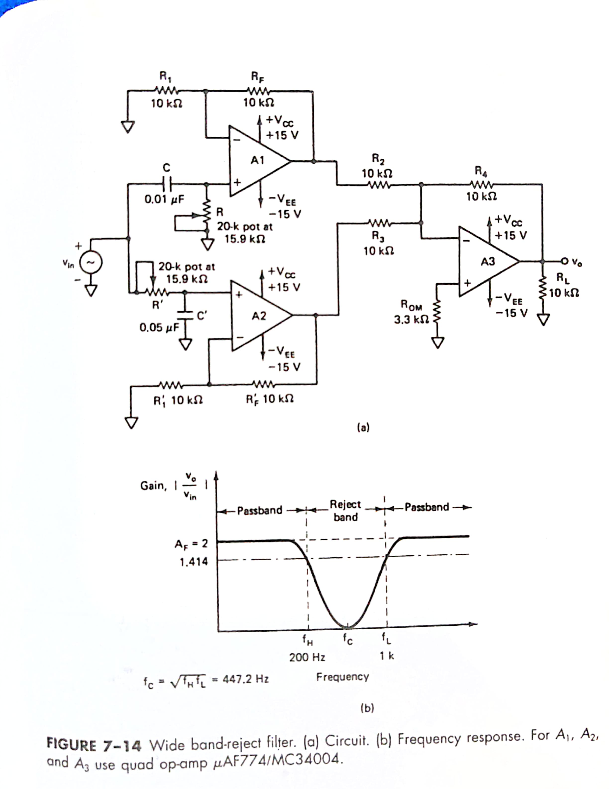

Slide 6
Design a wide band reject filter having f_{H} = 200Hz and f_{L} = 1 KHz.

Slide 7
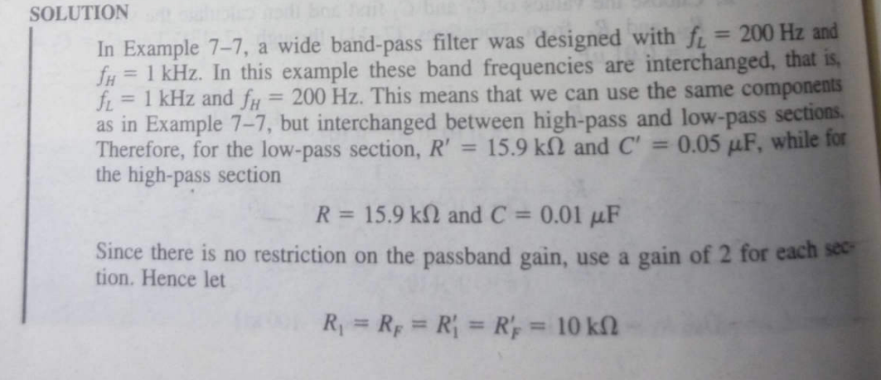

Slide 8
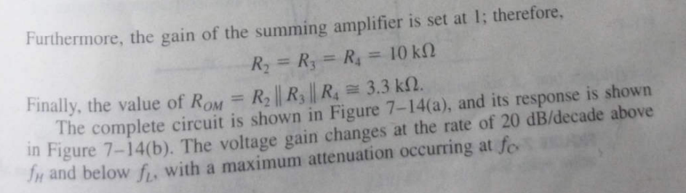

Slide 9
Narrow Band Reject Filter
Also called the notch filter.
commonly used for the attenuation of a single frequency.
For eg:, it may be necessary to attenuate 60 Hz or 400 Hz noise or hum signals in a circuit.
The most com­monly used notch filter is the Twin T network, shown in Fig.(a), which is a passive filter composed of two T shaped networks.

Slide 10

One T network is made up of two resistors and a capacitor, while the other is made of two capacitors and a resistor.
The frequency at which maximum attenuation occurs is called the notch-out frequency, given by

Slide 11
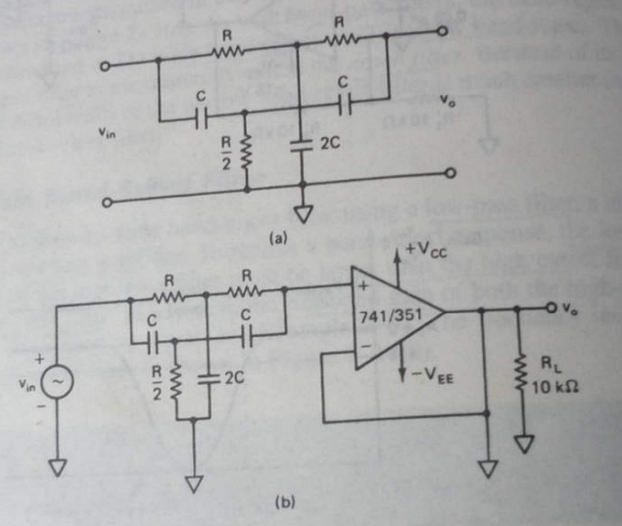

Slide 12
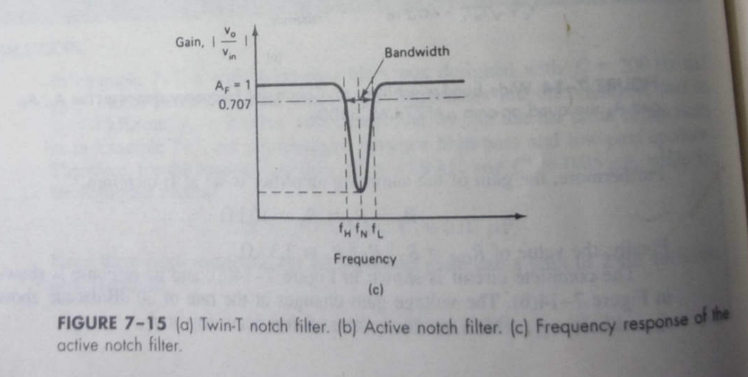

Slide 13
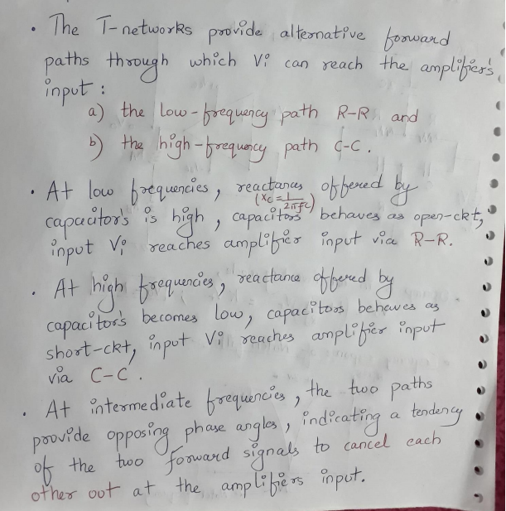

Slide 14
One disadvantage of the passive twin T network is that it has a relatively low figure of merit, Q.
Higher the value of Q, the more selective is the filter. Therefore, to increase the Q of the twin T network sig­nificantly, it should be used with a voltage follower, as shown in Fig.(b).
Fig (c) shows the frequency response of a notch filter.

Slide 15
The Notch filters are used in communications, biomedical instruments, etc. where the elimination of certain frequencies is necessary.

Slide 16
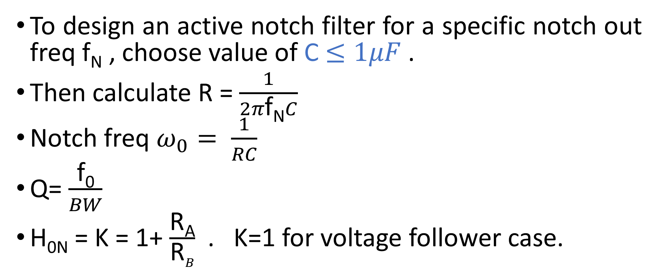
Design
To design an active notch filter for a specific notch out freq f_{N} , choose value of C$≤1μF$.
Then calculate R = $\frac{1}{2π\text{f}\text{N}C}$
Notch freq $ω_{0}= \frac{1}{RC}$
Q= $\frac{\text{f}\text{0}}{BW}$
H_{0N} = K = 1+ $\frac{\text{R}\text{A}}{\text{R}B}$ . K=1 for voltage follower case.

Slide 17

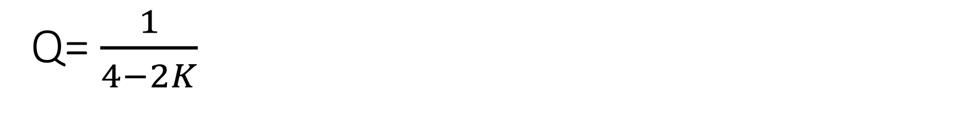
Q= $\frac{1}{4−2K}$
From freq response it is clear that ckt reject freq around $ω=ω_{0}$ with max attenuation while passes all other freqs with max pass band gain.

Slide 18
Design a 60Hz active notch filter.

Slide 19
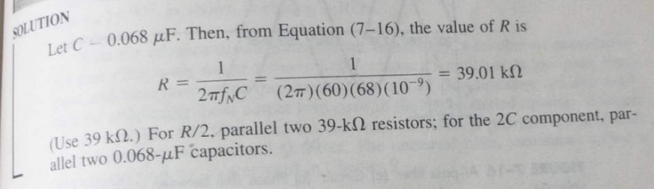

Slide 20
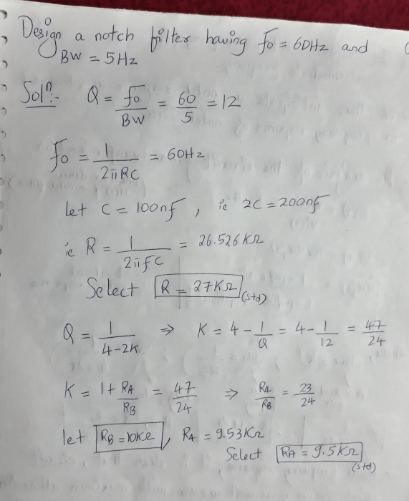

Slide 21
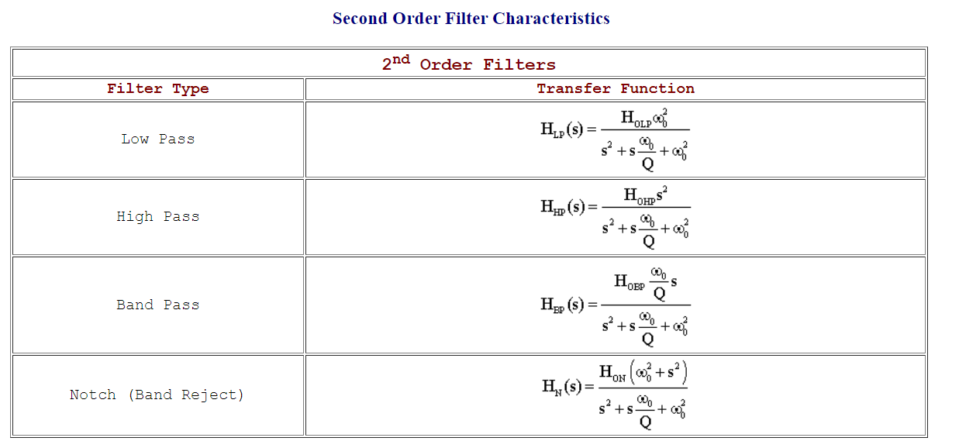

Here $2ξ$ $=α= \frac{1}{Q}$

