Slide 1
FIRST ORDER HIGH PASS BUTTERWORTH FILTER

Slide 2
First order HP Butterworth filter:
High pass filters are often formed simply by interchanging frequency-determining resistors and capacitors in low-pass filters.
1st order HPF is formed from a I order LPF by interchanging components R & C.
2nd order HPF is formed from a II order LPF by interchanging R & C.

Slide 3
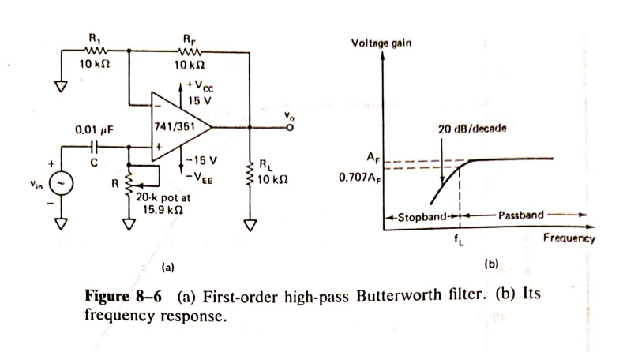

Slide 4
I order HPF with a low cut off frequency of f_{L}.
This is the frequency at which the magnitude of the gain is 0.707 times its passband value.
Here all the frequencies higher than f_{L} are passband frequencies, with highest freq determined by the closed loop BW of op amp.

Slide 5
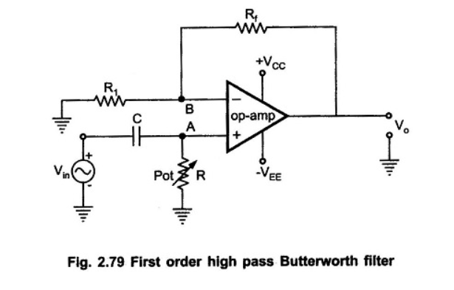
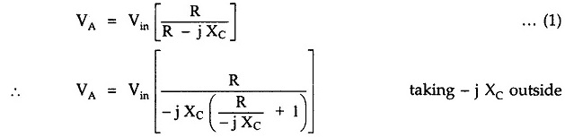
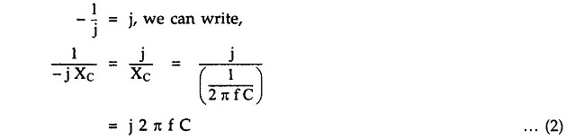
Analysis of the Filter Circuit:

Slide 6
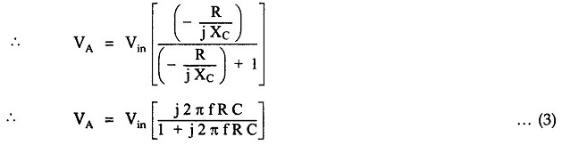
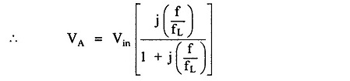

Slide 7
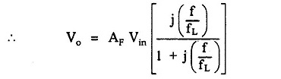
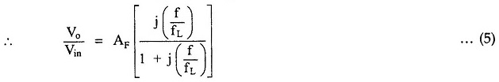

Slide 8
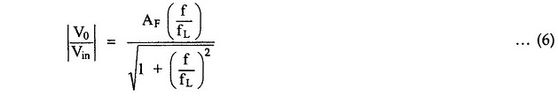
This is the required expression for the transfer function of the filter. For the frequency response, we require the magnitude of the transfer function which is given by,

Slide 9
The equation (6) describes the behavior of the high pass filter.
1.At low frequencies, i.e. f < f′_{L}
2) At f = f′_{L}

Slide 10
3) At f > f_{L}, i.e. high frequencies, 1 can be neglected as compared to (f/f_{L}) from denominator.
Thus, the circuit acts as high pass filter with a passband gain as A_{F}.

Slide 11
For the frequencies, f < f_{L}, the gain increases till f = f_{L} at a rate of + 20 dB/decade.
Hence, the slope of the frequency response in stop band is + 20 dB/decade for first order high pass filter.
As HPF is basically a LPF ckt with positions of R and C interchanged, the design steps and the frequency scaling method for LPF is equally applicable to the first order high pass Butterworth filter.

Slide 12
NUMERICALS
a) Design a HPF with cut off freq of 1 KHZ with a pass band gain of 2.
b) Also plot the freq response of HPF.

Slide 13
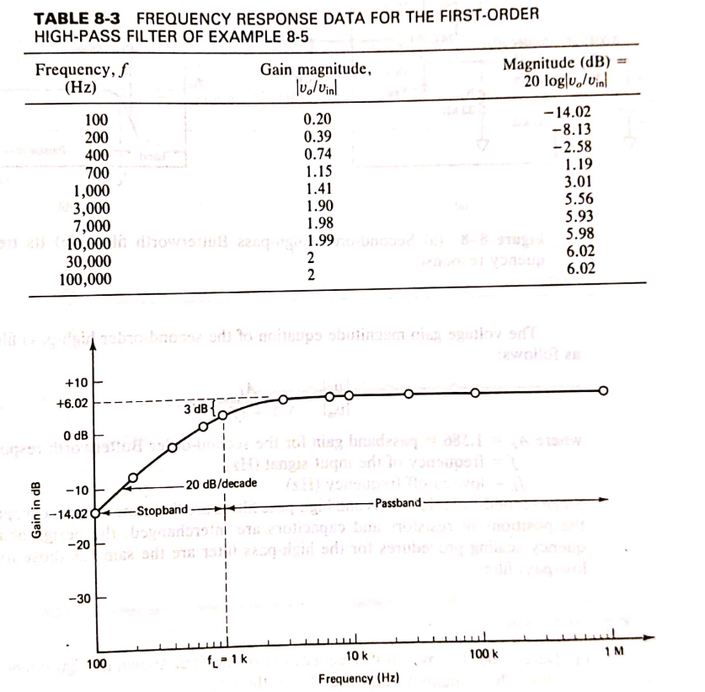

Slide 14
2ND ORDER HIGH PASS BUTTERWORTH FILTER

Slide 15
2nd order HP Butterworth filter:
The second order high pass Butterworth filters produces a gain roll off at the rate of + 40 dB/decade in the stop band.
This filter also can be realized by interchanging the positions of resistors and capacitors in a 2nd order low pass Butterworth filters.

Slide 16
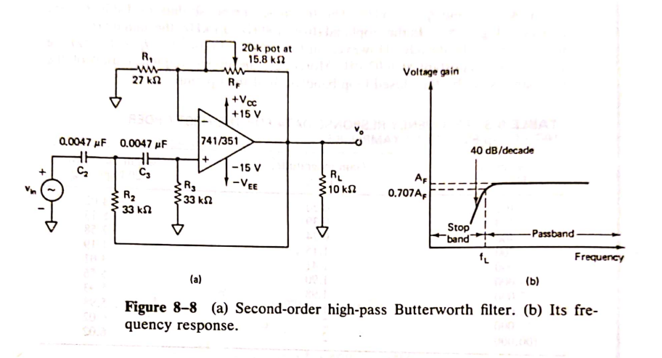

Slide 17

The analysis, design and the scaling procedures for this filter is exactly same as that of second order low pass Butterworth filter.
The voltage gain magnitude equation for the second order high pass filter is

Slide 18
where
f = input frequency in Hz
f_{L} = lower cut off frequency in Hz ≈1/2πRC
R₂ = R₃ = R and C₂ = C₃ = C
A_{F} = passband gain = 1.586 to ensure second order Butterworth response
R_{F} = 0.586 R₁

Slide 19
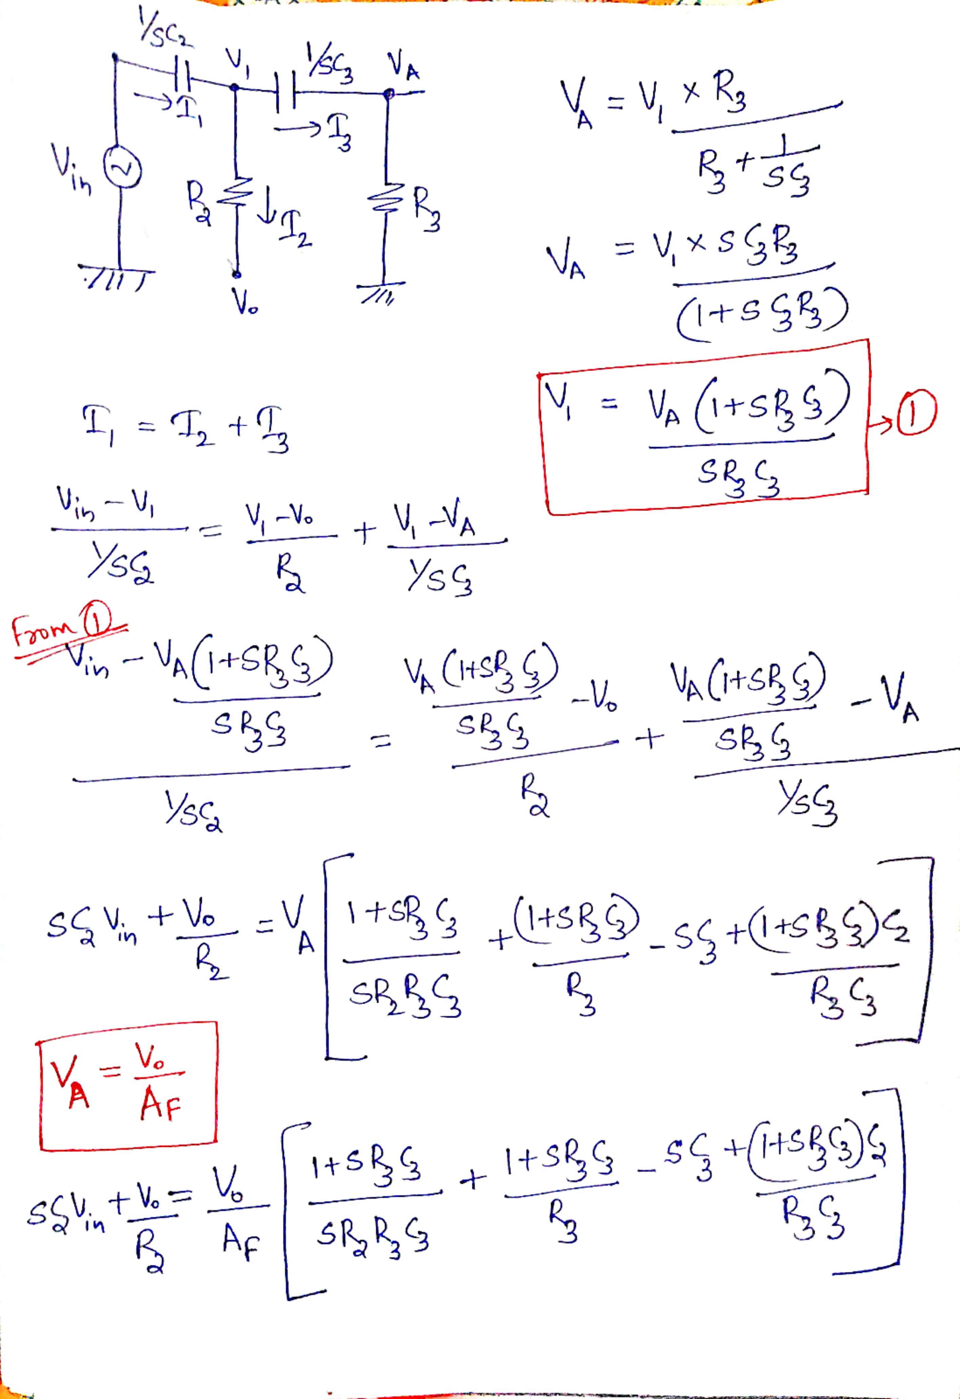

Slide 21
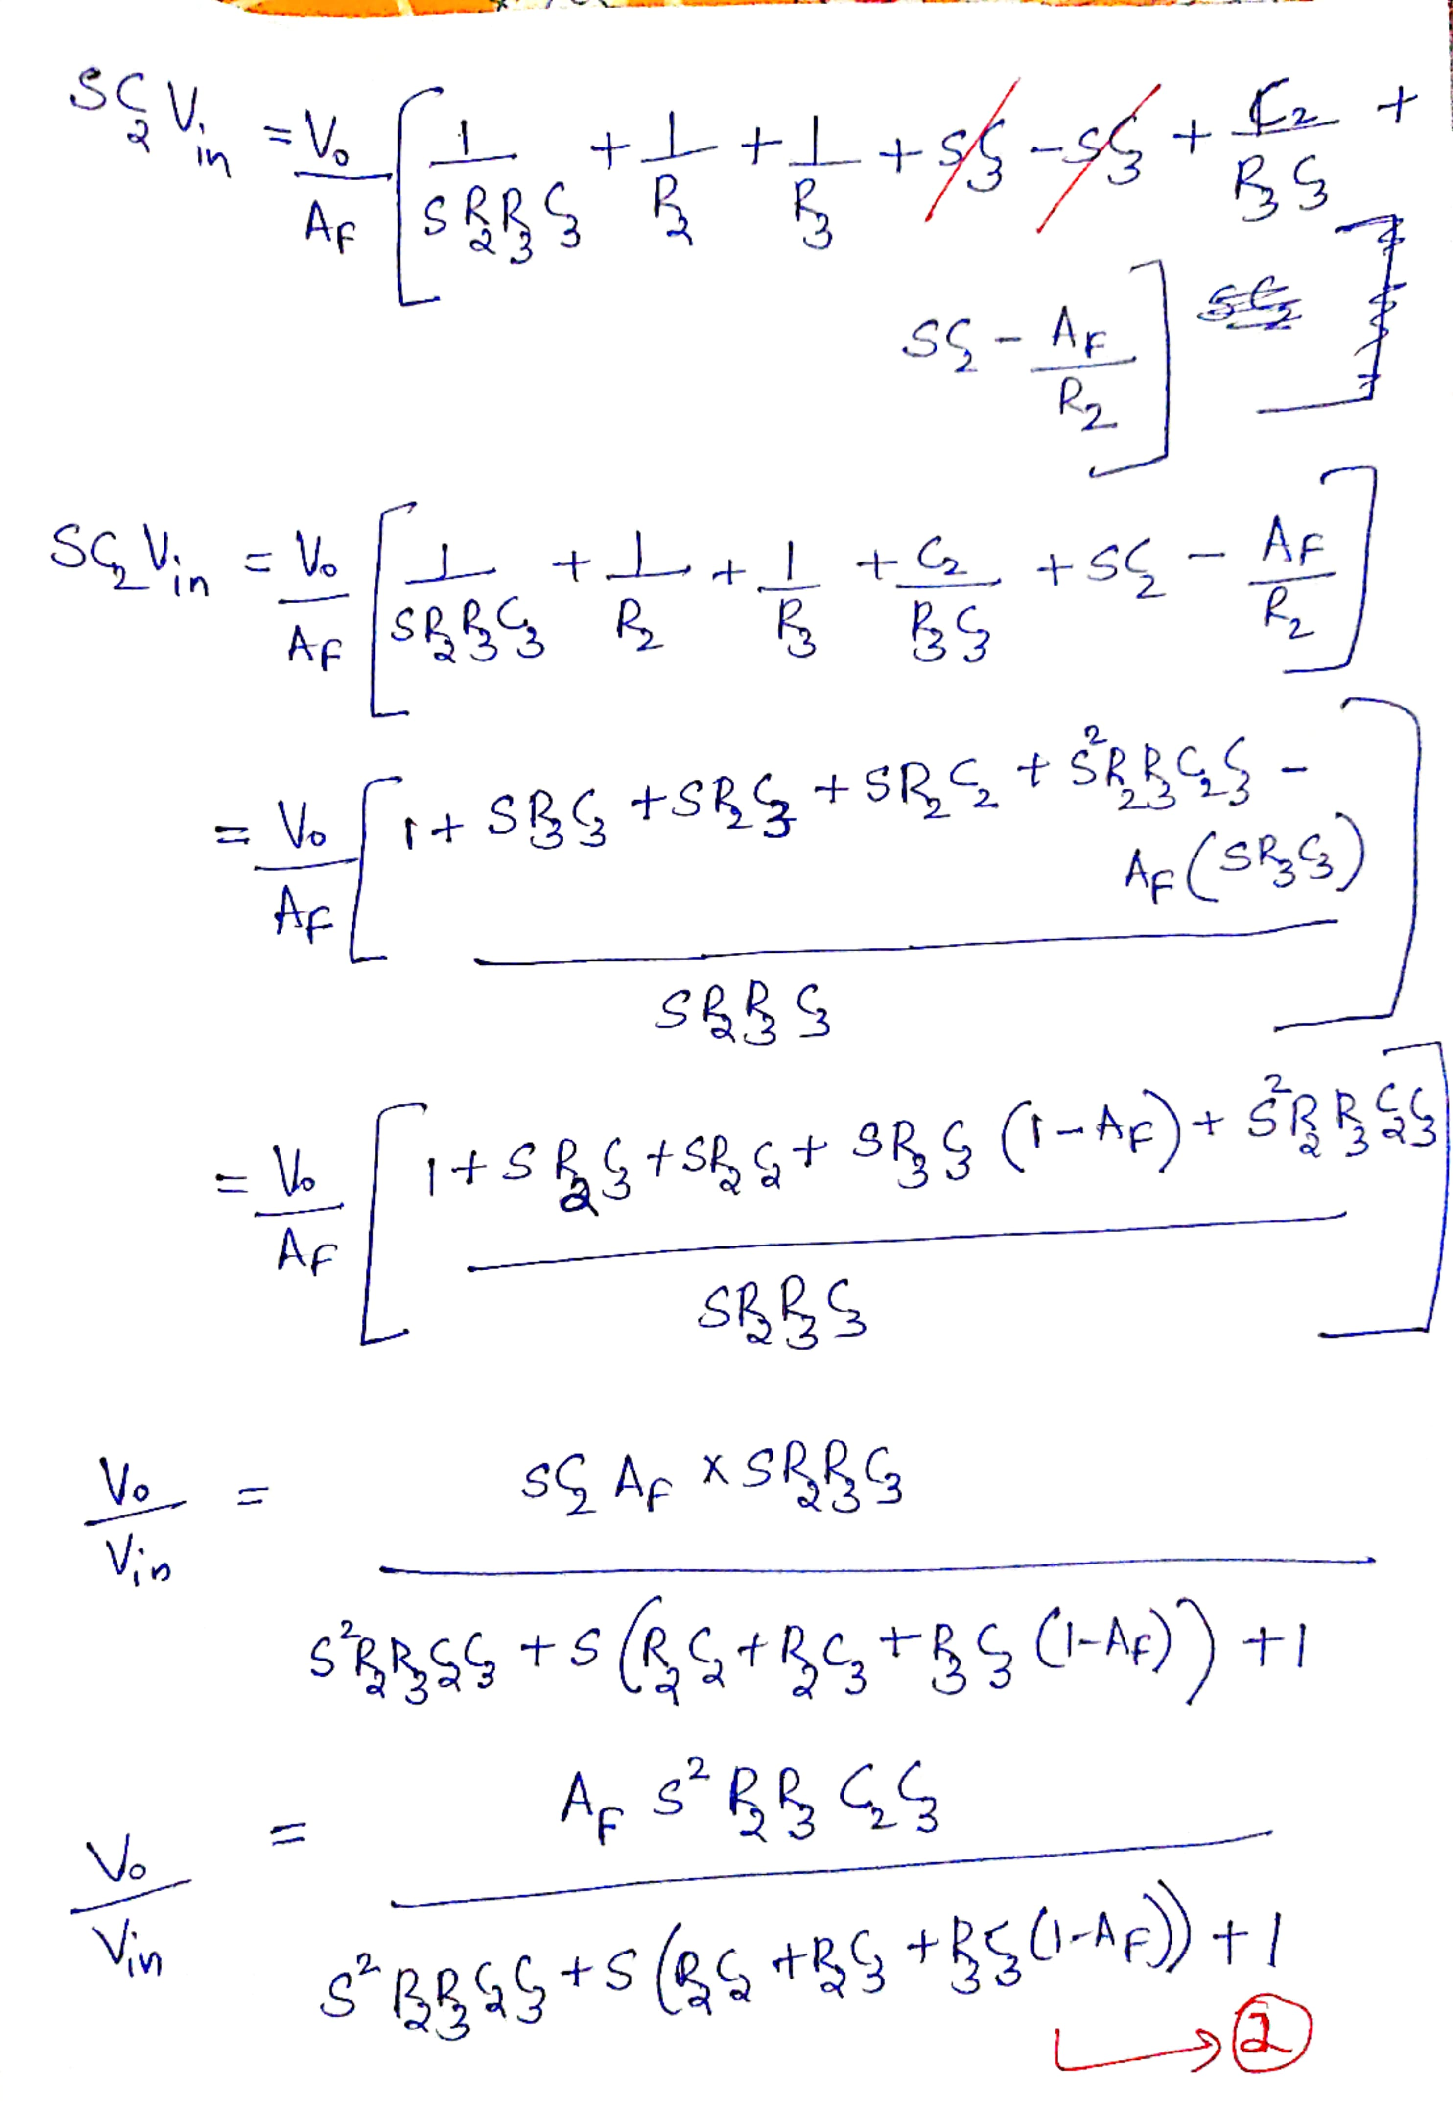

Slide 23
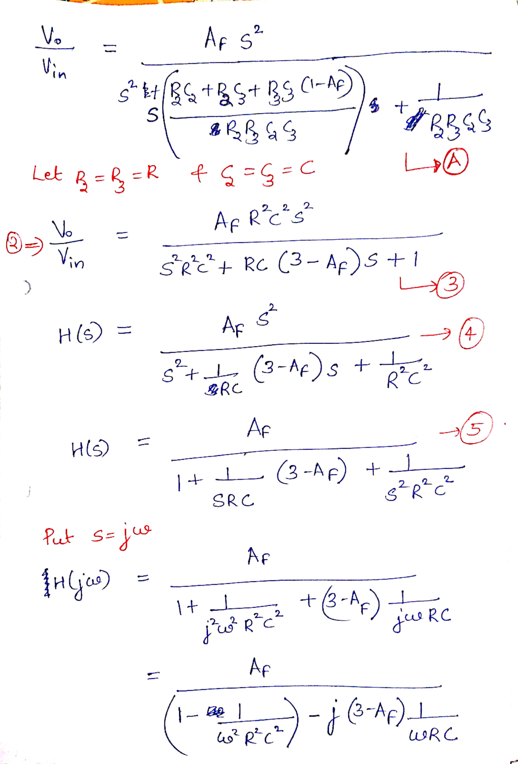

Slide 25
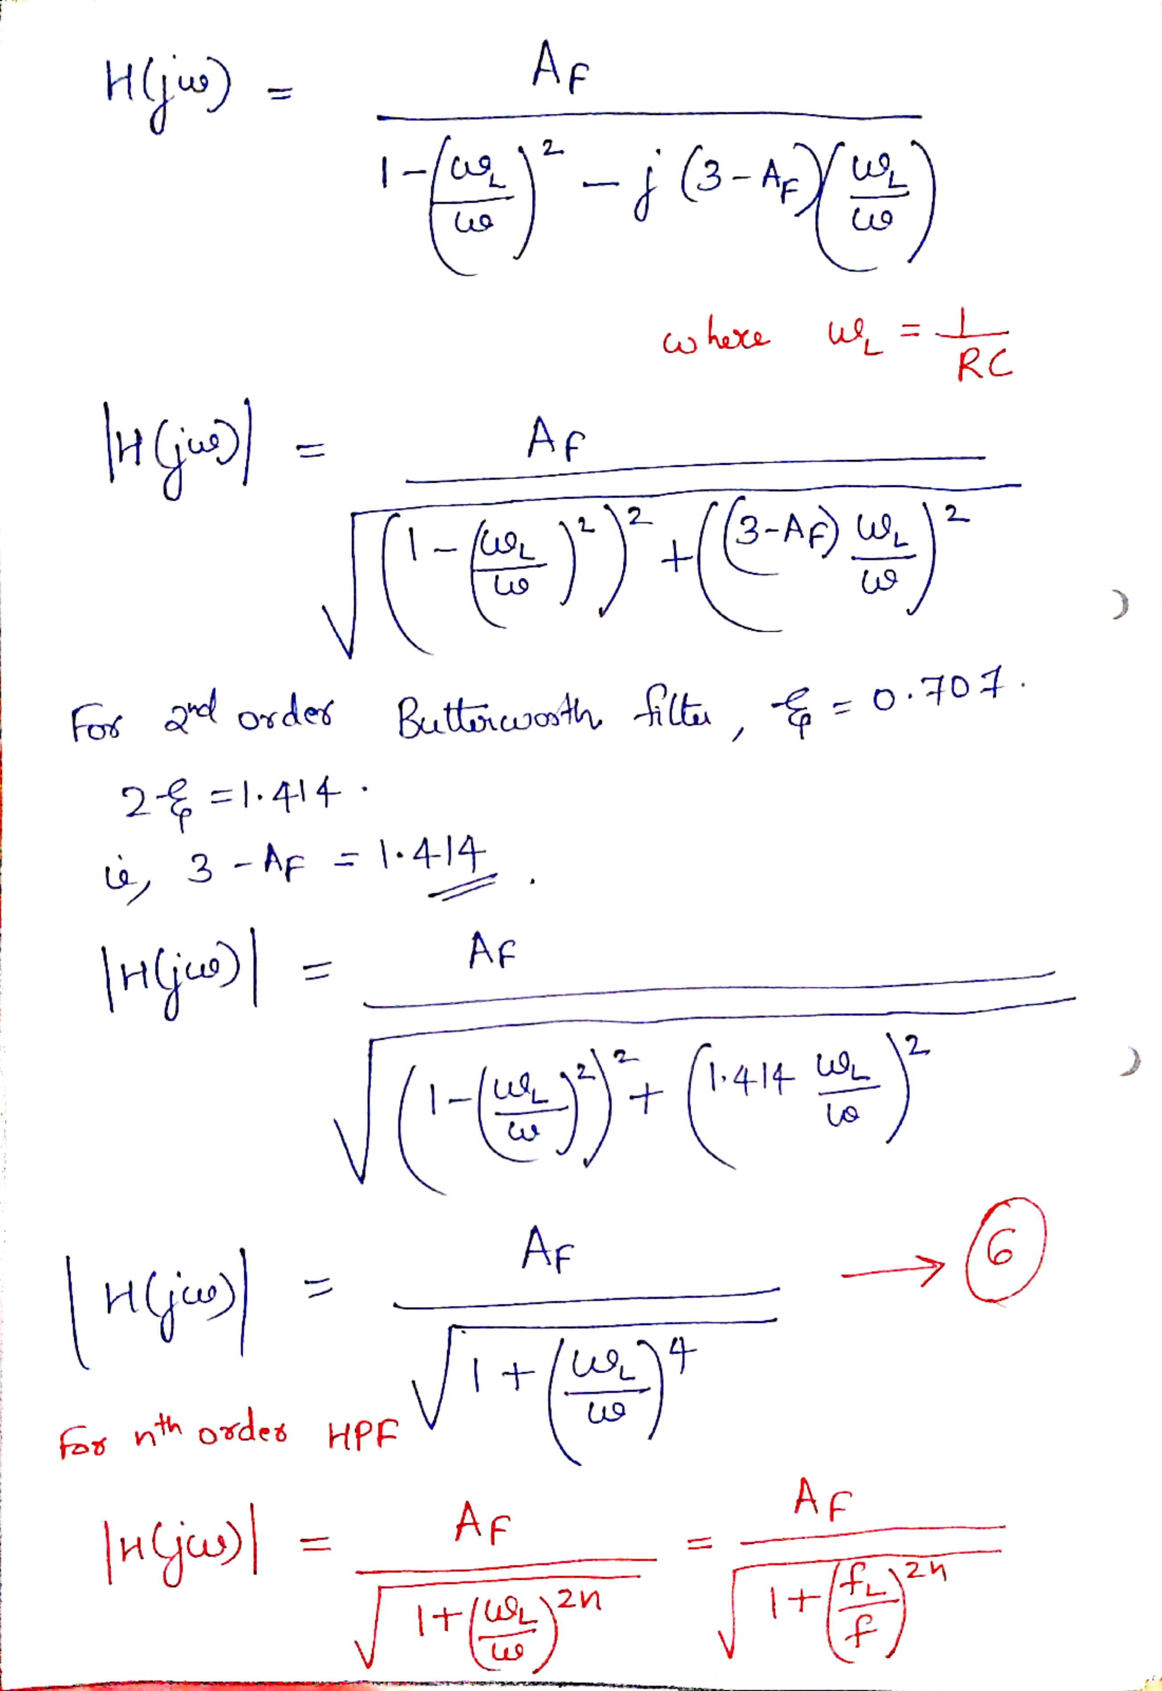

Slide 27
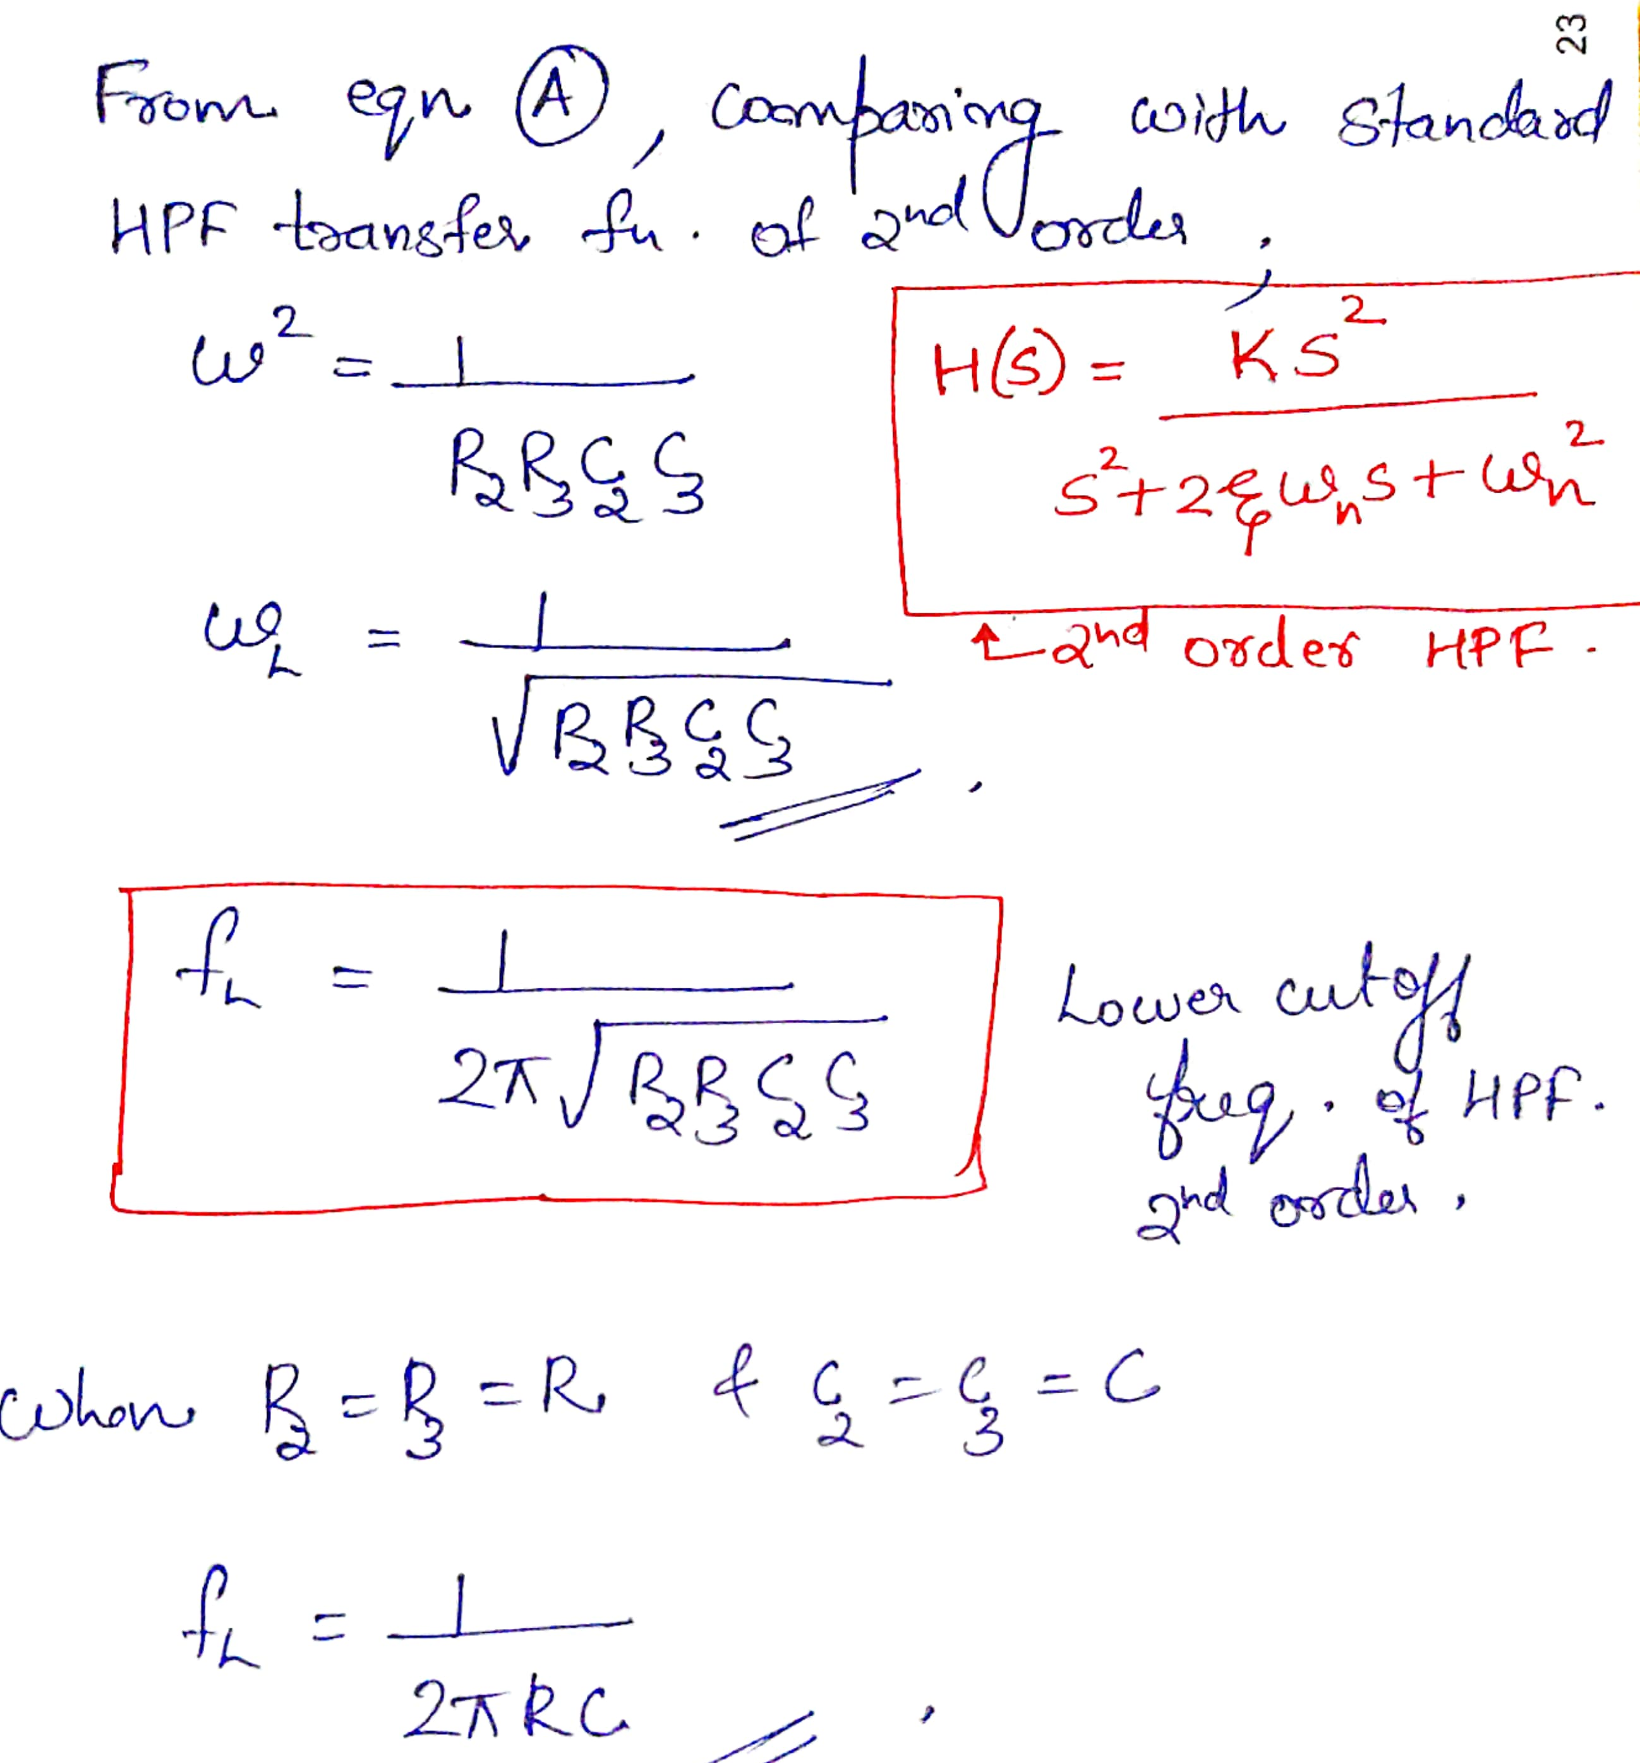

Slide 28
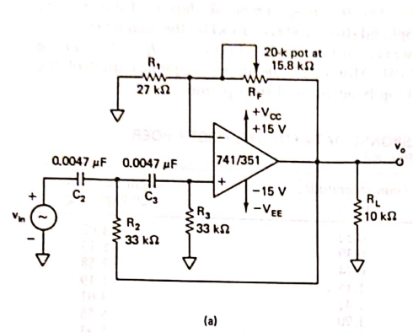
NUMERICALS
a) Determine low cut off freq f_{L} of the filter shown in fig.
b) Also plot the freq response of HPF.

Slide 29
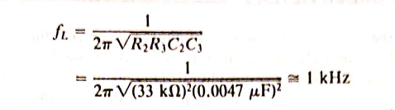

Slide 30
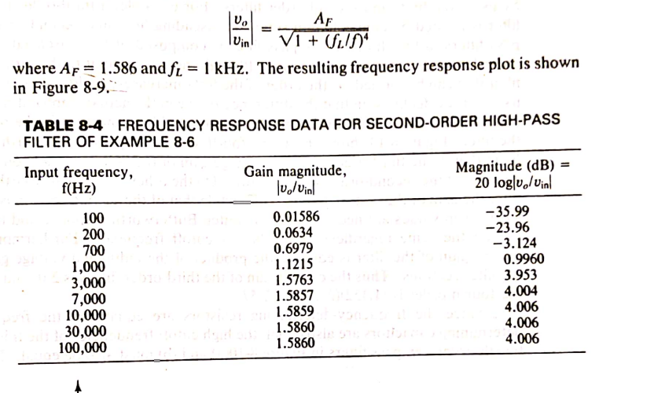

Slide 31
