Slide 1
OP-AMP OSCILLATORS AND MULTIVIBRATORS

Slide 2
Oscillators uses:
Used in laptop and smartphone processors for generating the clock signals.
Used in radio & mobile receivers for generating the local carrier frequency.
Used in signal generators used in lab.

Slide 3
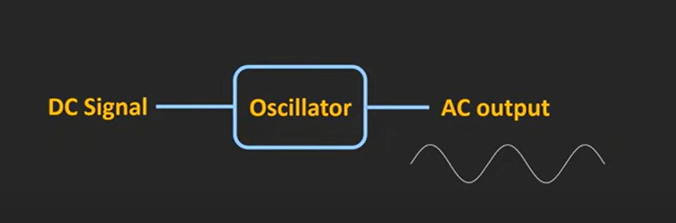
OSCILLATOR

Slide 4
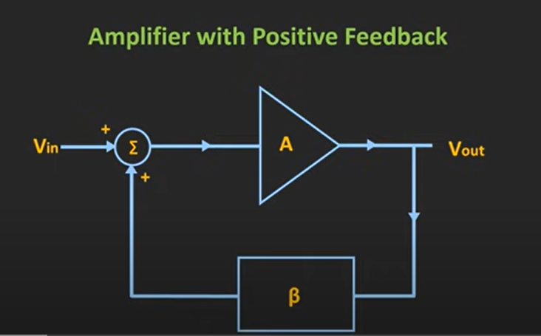

Slide 5
Accepts DC voltage and it generates periodic AC s/g of the desired freq.
Can generate freqs from few Hz to even GHz.
o/p of oscr can be sinusoidal or non sinusoidal s/gs (like square and triangular wave)
Oscr – amplifier with a positive feedback.

Slide 6
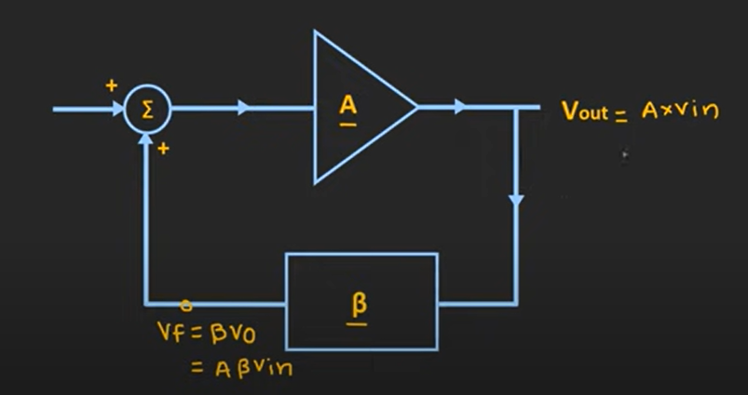
BASIC PRINCIPLE OF SINE WAVE OSCILLATORS

Slide 7
If the oscillator produces sinusoidal oscillations, it is called as a sinusoidal oscillator.
Let’s say some input sinusoidal s/g is applied to this amplifier.
At o/p, we get i/p multiplied by gain of this ampr.
V_{out} = AV_{in}
This o/p s/g is given as i/p to f/b ckt with gain β.
A freq selective f/b n/w (having inductive or capacitive components) with transfer ratio β.
o/p of f/b ckt V_{f} = βV_{out} = AβV_{in}
Aβ is known as loop gain

Slide 8
If the values of A and β are adjusted so that Aβ =1, then V_{f} = V_{in} .
Now if the original external s/g V_{in} is removed and only this f/b is connected, then the ckt will continue to provide o/p as the ampr cannot distinguish whether input V_{in} is coming from ext source or f/b ckt.
Thus o/p can be continuously obtained w/o any i/p s/g if we can satisfy the condition on the loop gain Aβ =1.
This is called as Barkhausen criterion for oscillations.
The condition Aβ =1 can be satisfied only at one specific freq f₀ for the given component values.

Slide 9
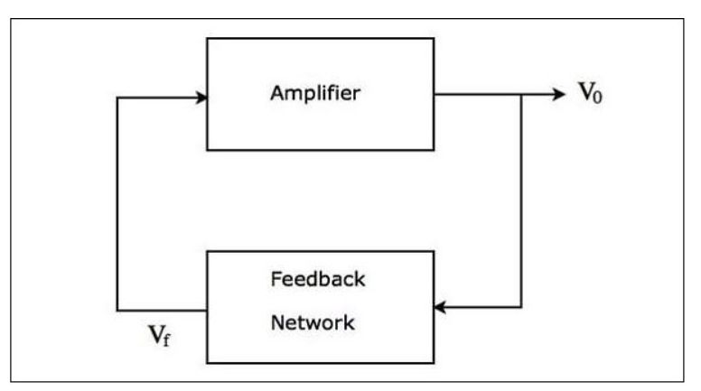

Slide 10
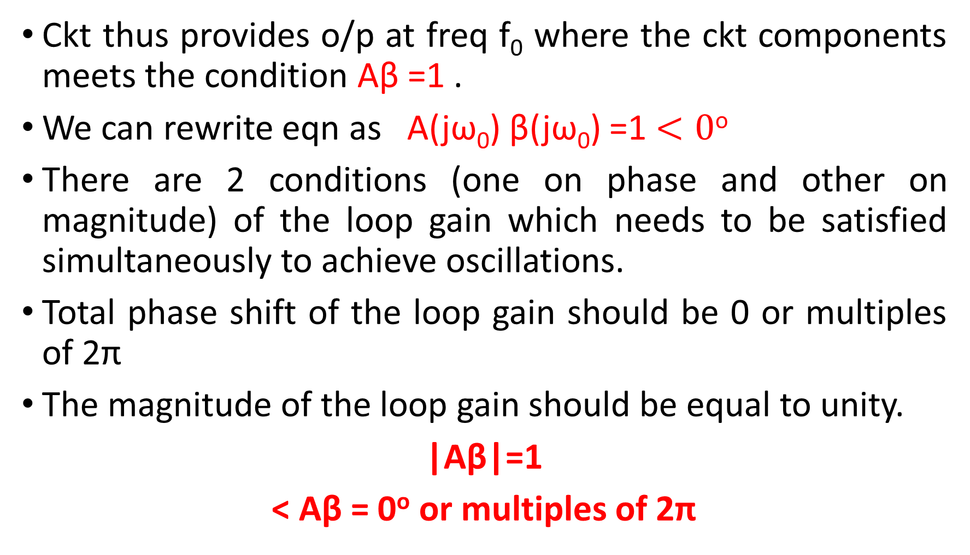
Ckt thus provides o/p at freq f₀ where the ckt components meets the condition Aβ =1 .
We can rewrite eqn as A(jω₀) β(jω₀) =1 $<0$º
There are 2 conditions (one on phase and other on magnitude) of the loop gain which needs to be satisfied simultaneously to achieve oscillations.
Total phase shift of the loop gain should be 0 or multiples of 2π
The magnitude of the loop gain should be equal to unity.
|Aβ|=1
< Aβ = 0º or multiples of 2π

Slide 11
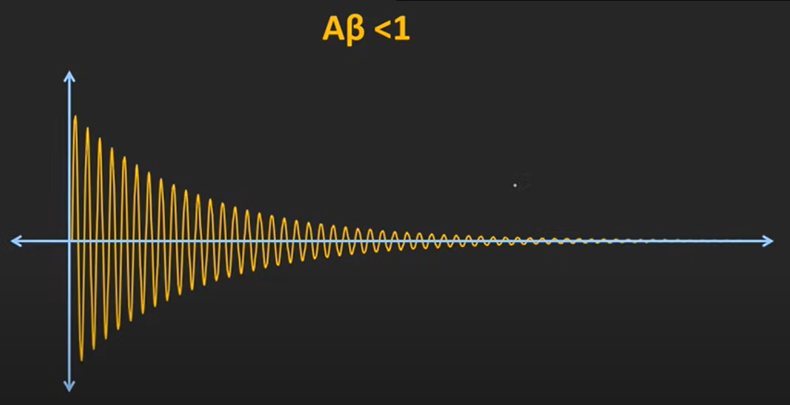
The condition |Aβ|=1 is usually difficult to maintain in the ckt as the values of A and β vary due to temp variations, aging of components, change of supply voltage, etc.
if |Aβ|<1, f/b s/g V_{f} goes on reducing in each f/b cycle and the oscns will die down eventually.

Slide 12
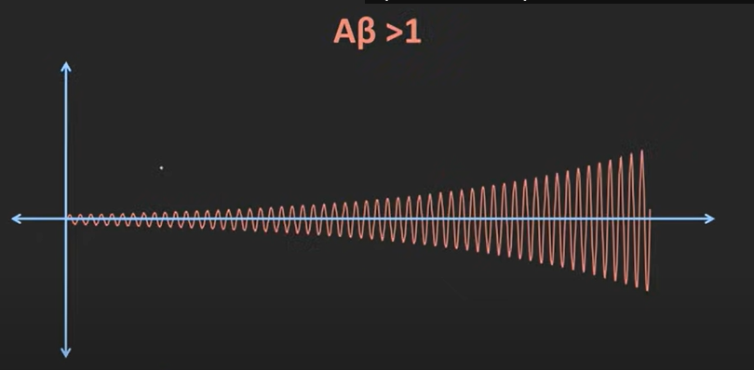
When |Aβ| >1, oscn in the ckt will build up.
So in both cases we are not getting sustained oscns.

Slide 13
In order to ensure sustained oscns inspite of variations, the ckt is designed so that |Aβ| is slightly >1.
Now the o/p amp will go on increasing with every f/b cycle.

Slide 14
The s/g however cannot go on increasing & gets limited due to the non linearity of the device (ie, as transistor enters into saturation).
It is the non linearity of the transistor bcoz of which the sustained oscns can be achieved.
The value of |Aβ| is usually kept greater by abt 1 to 5% to ensure that |Aβ|does not fall below unity.
Till now, we had assumed that we first connect a s/g source to start the oscn and later remove it.
In practical oscr, it is not done so.

Slide 15
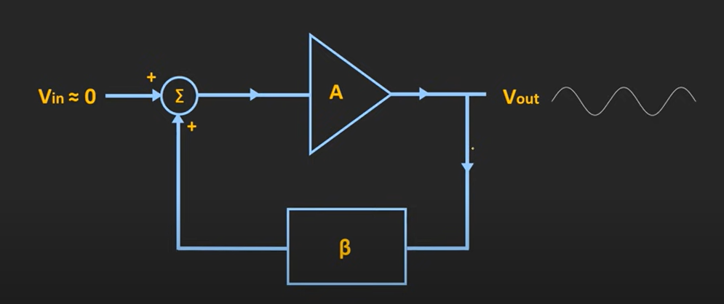

Slide 16
o/p waveform is obtained as soon as power is turned ON.
Actually there is noise signal always present at input (ie, base) of the transistor due to temp (called Johnson’s noise) or variation in the carrier conc(Schottky noise).
Thermal noise contains all freqs(few Hz to even hundreds of GHz).
So initially when this oscr is turned on, all the freq components of this noise will get amplified by the ampr.
The noise s/g at the freq at which the ckt satisfies the condition |Aβ|=1 is picked up and amplified.

Slide 17
SINE WAVE OSCILLATORS
RC phase shift oscillator
Wein Bridge oscillator
Both are audio frequency oscillators.

Slide 18
RC PHASE SHIFT OSCILLATOR
RC ckt is used in the f/b path.
Generates stable sine wave.
Usually used in the low freq generations. Typically in the AF range.
The op amp is used in inverting mode and hence provides 180⁰ phase shift.
The additional 180⁰ phase shift is provided by RC n/w.

Slide 19
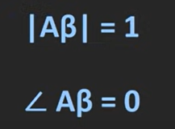
To satisfy Barkhausen criterion, phase shift introduced by ampr & f/b ckt should be 0 or multiples of 2π .
So to get sustained oscn, f/b ckt shud also provide 180⁰ phase shift.
So overall phase shift = 360⁰
By tuning the gain of ampr and f/b ckt, we can achieve loop gain |Aβ|=1.

Slide 20
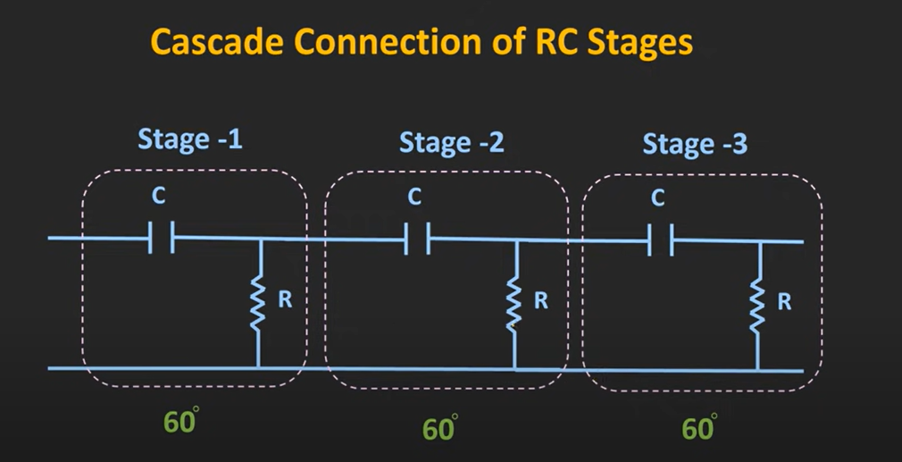

Slide 21
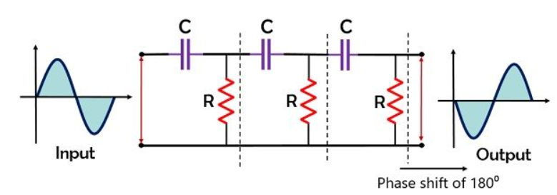

Slide 22
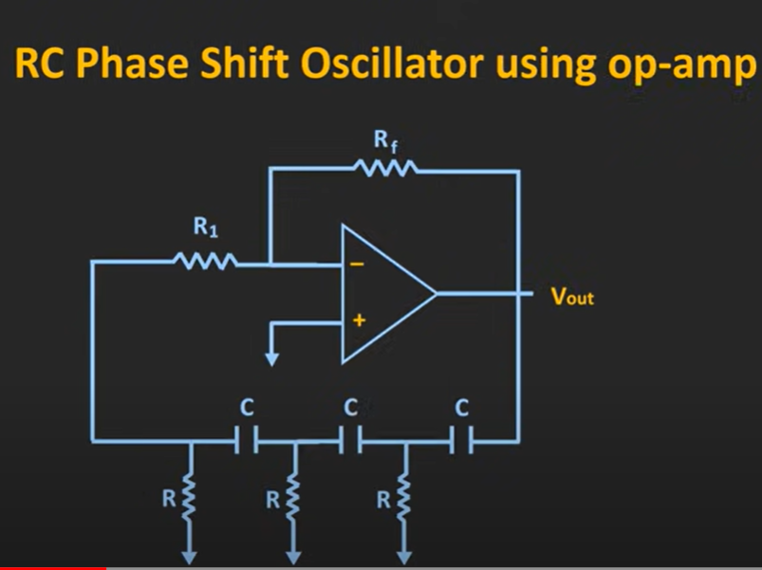

Slide 23
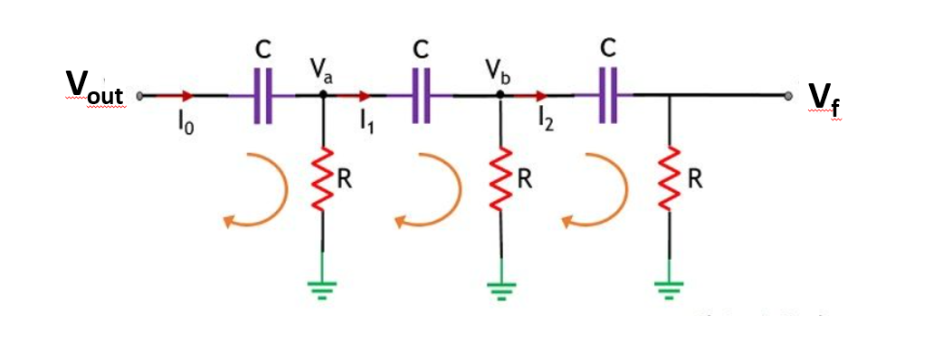
Feedback network

Slide 24
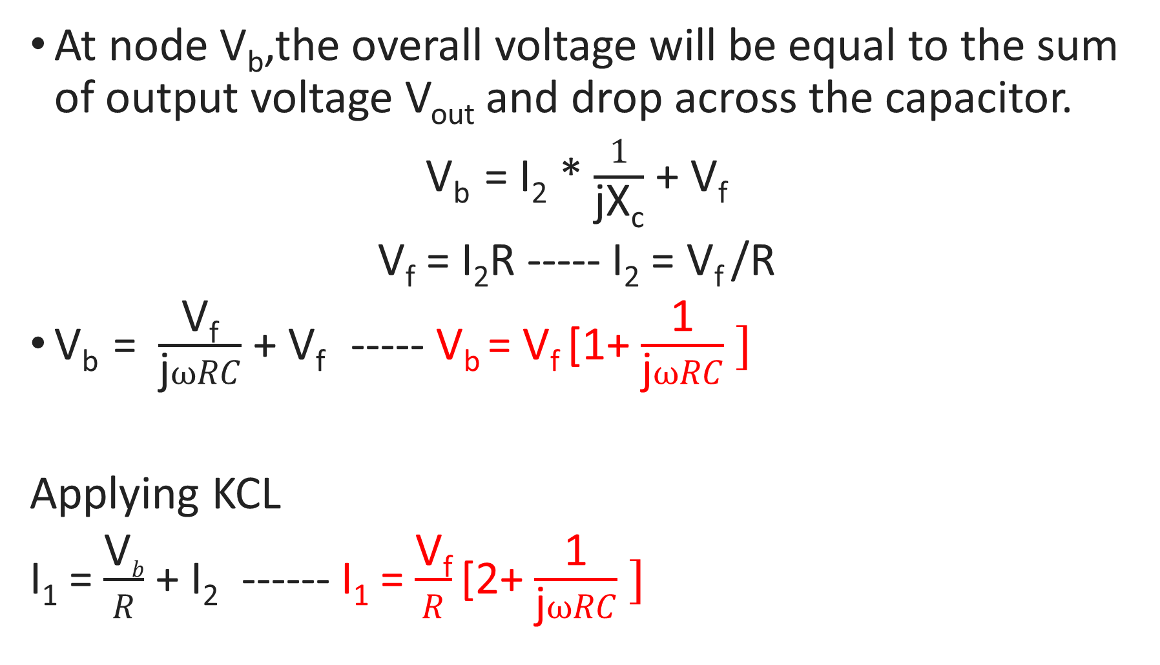
At node V_{b},the overall voltage will be equal to the sum of output voltage V_{out} and drop across the capacitor.
V_{b} = I₂ * $\frac{1}{\text{jX}\text{c}}$ + V_{f}
V_{f} = I₂R ----- I₂ = V_{f} /R
V_{b} = $\frac{\text{V}\text{f}}{\text{j}ωRC}$ + V_{f} ----- V_{b} = V_{f} [1+ $\frac{\text{1}}{\text{j}ωRC} ]$
Applying KCL
I₁ = $\frac{\text{V}b}{R}$ + I₂ ------ I₁ = $\frac{\text{V}\text{f}}{R}$ [2+ $\frac{\text{1}}{\text{j}ωRC} ]$

Slide 25
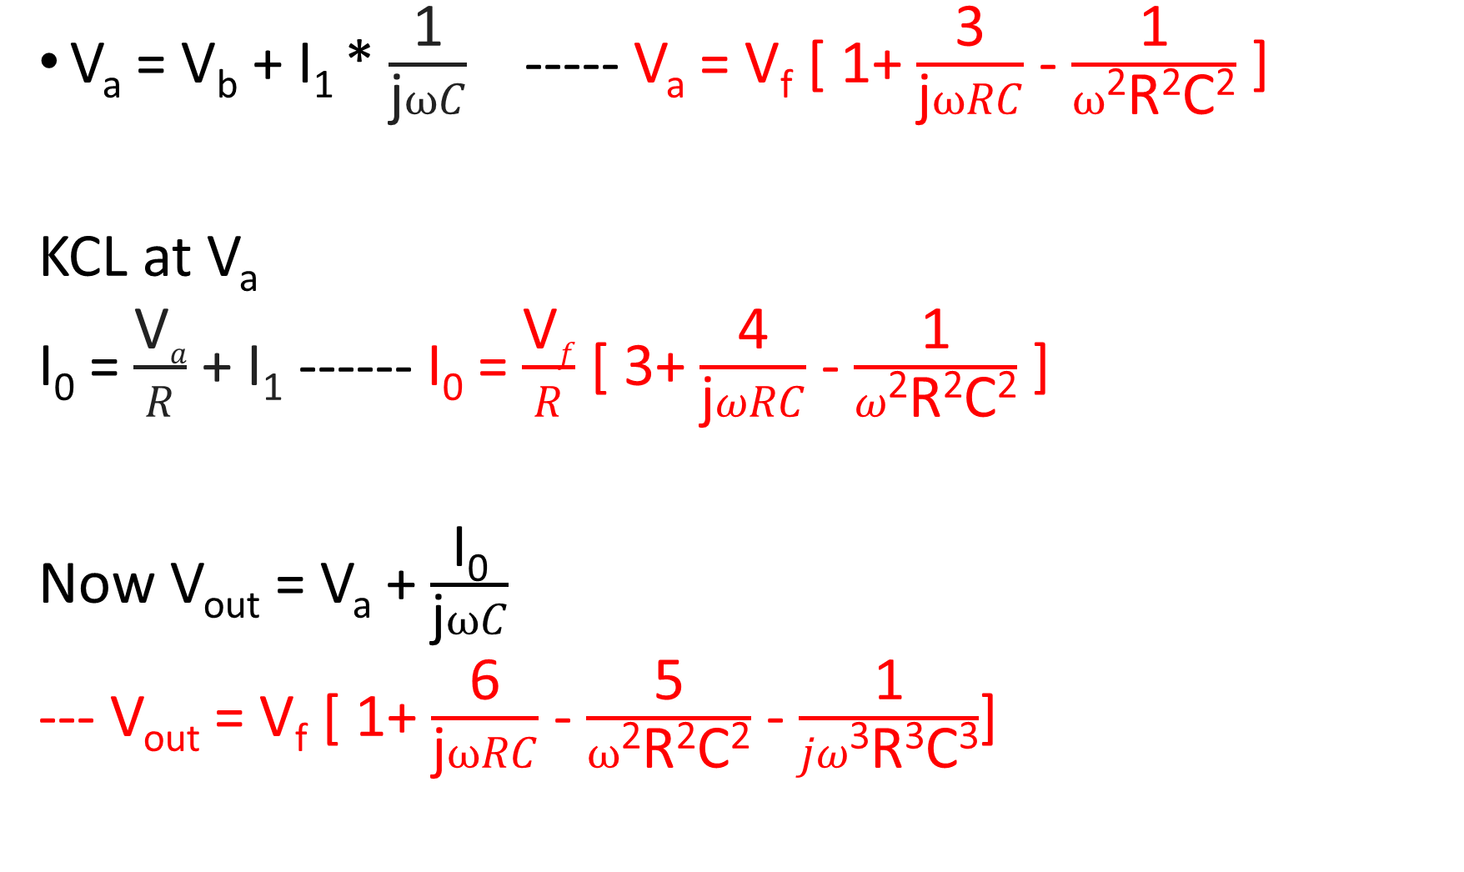
V_{a} = V_{b} + I₁ * $\frac{\text{1}}{\text{j}ωC}$ ----- V_{a} = V_{f} [ 1+ $\frac{\text{3}}{\text{j}ωRC}$ - $\frac{\text{1}}{ω\text{2}\text{R}\text{2}\text{C}\text{2}}$ ]
KCL at V_{a}
I₀ = $\frac{\text{V}a}{R}$ + I₁ ------ I₀ = $\frac{\text{V}f}{R}$ [ 3+ $\frac{\text{4}}{\text{j}ωRC}$ - $\frac{\text{1}}{ω\text{2}\text{R}\text{2}\text{C}\text{2}}$ ]
Now V_{out} = V_{a} + $\frac{\text{I}\text{0}}{\text{j}ωC}$
--- V_{out} = V_{f} [ 1+ $\frac{\text{6}}{\text{j}ωRC}$ - $\frac{\text{5}}{ω\text{2}\text{R}\text{2}\text{C}\text{2}}$ - $\frac{\text{1}}{jω\text{3}\text{R}\text{3}\text{C}\text{3}}$]

Slide 26
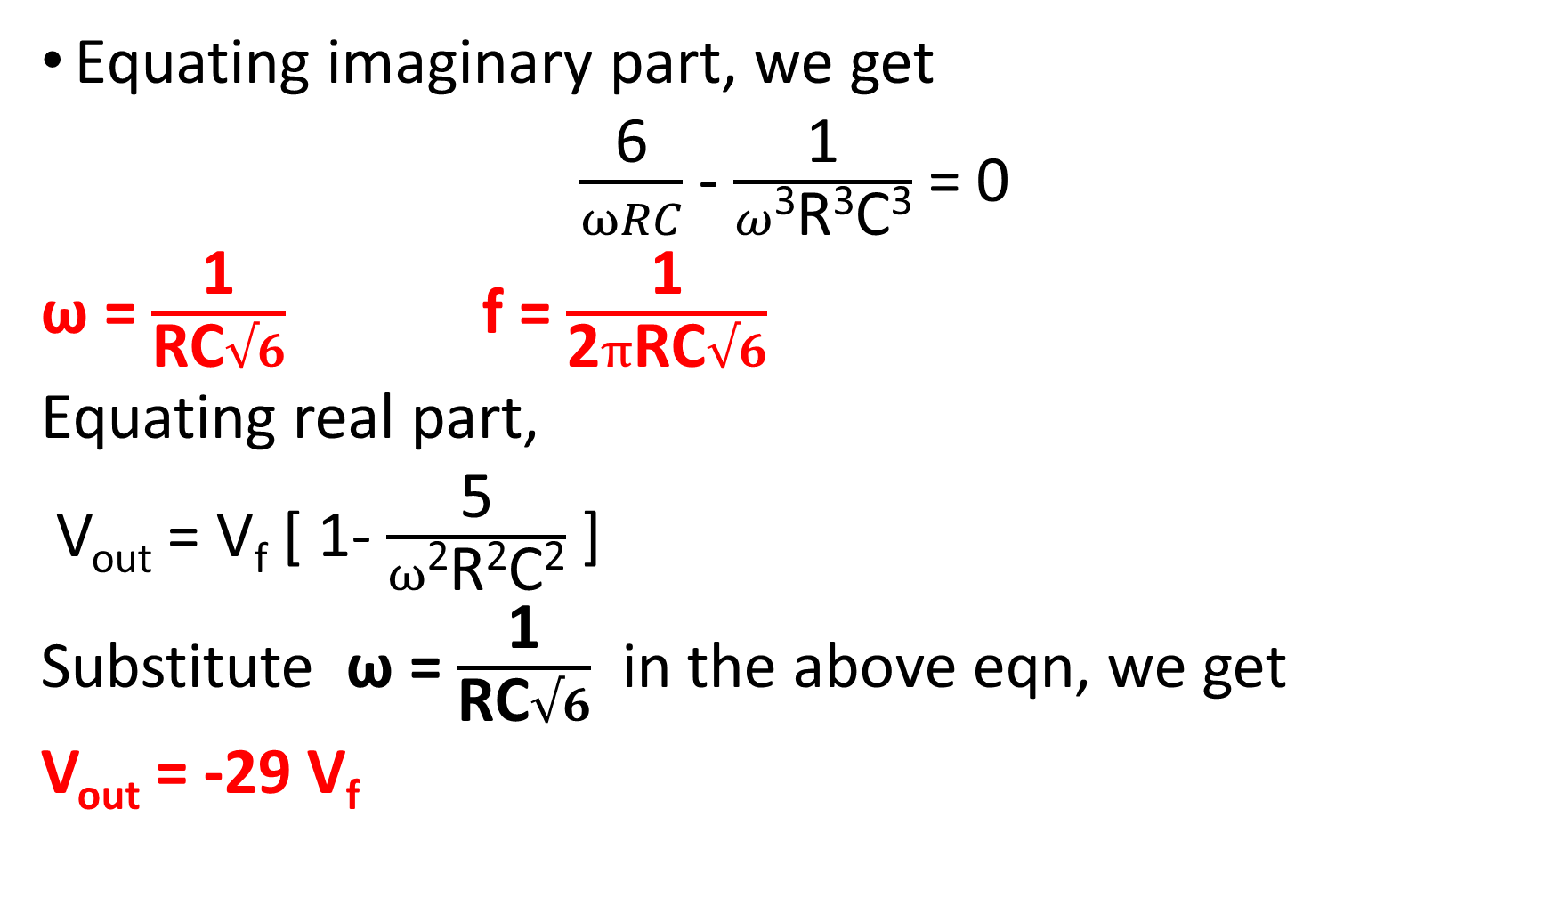
Equating imaginary part, we get
$\frac{\text{6}}{ωRC}$ - $\frac{\text{1}}{ω\text{3}\text{R}\text{3}\text{C}\text{3}}$ = 0
ω = $\frac{\text{1}}{\text{RC}√6}$ f = $\frac{\text{1}}{\text{2}π\text{RC}√6}$
Equating real part,
V_{out} = V_{f} [ 1- $\frac{\text{5}}{ω\text{2}\text{R}\text{2}\text{C}\text{2}}$ ]
Substitute ω = $\frac{\text{1}}{\text{RC}√6}$ in the above eqn, we get
V_{out} = -29 V_{f}

Slide 27
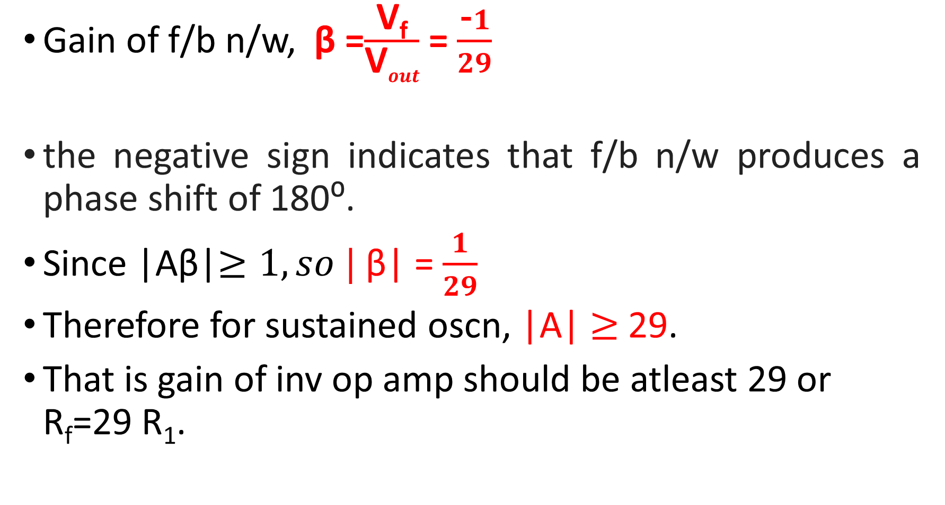
Gain of f/b n/w, β =$\frac{\text{V}\text{f}}{\text{V}out}$ = $\frac{\text{−}1}{29}$
the negative sign indicates that f/b n/w produces a phase shift of 180⁰.
Since |Aβ|$≥1, so |$ β| = $\frac{1}{29}$
Therefore for sustained oscn, |A| $≥$ 29.
That is gain of inv op amp should be atleast 29 or R_{f}=29 R₁.

Slide 28
Gain A_{v} is kept greater than 29 to ensure that the variations in ckt parameters will not make | A_{v} β| <1, otherwise oscns will die out.

Slide 29
WIEN BRIDGE OSCILLATOR
Harmonic oscr – o/p of oscr is sinusoidal s/g.
AF oscr – generates sine wave typically in the range of AF.

Slide 30
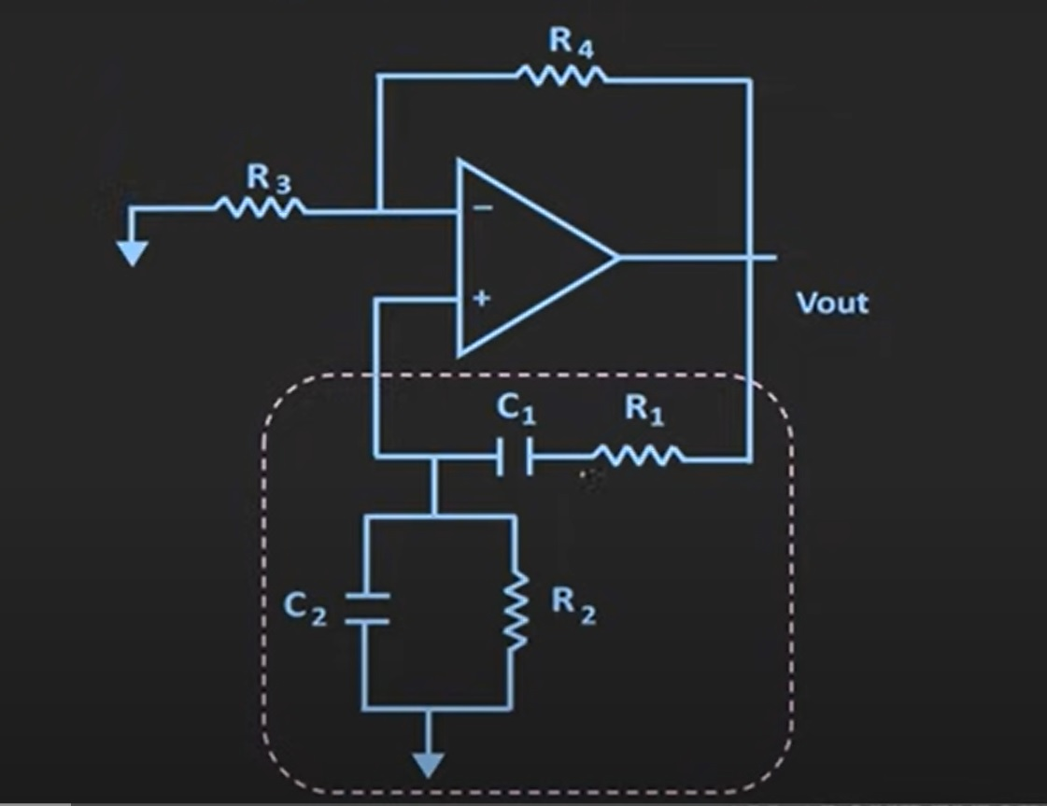
WIEN BRIDGE OSCILLATOR

Slide 31
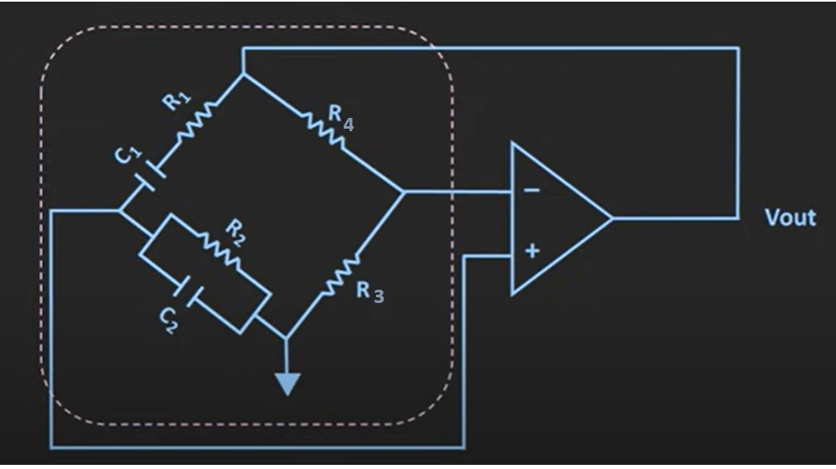
Wien Bridge Oscillator Showing The Bridge Network

Slide 32
Feedback RC n/w is connected to non inv terminal . So op amp – non inv ampr.
Therefore f/b n/w need not provide any phase shift.
Ckt can be viewed as a Wien bridge with a series RC n/w in one arm and a parallel RC n/w in the adjoining arm.
Condition of zero phase shift around the ckt is achieved by balancing the bridge.

Slide 33
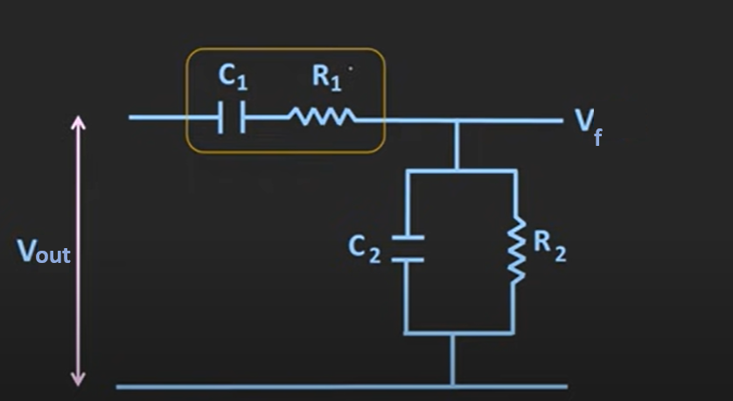

Slide 34
Series RC n/w acts like HPF .
At low freq, 1/jX_{c} is high. So capr C1 acts like OC. So it doesnot pass low freq s/gs.
At high freq, impedance provided by capacitor is low. So easily allows HF.
Parallel RC n/w acts like LPF
At low freq, 1/jX_{c} is high. So capr C2 acts like OC. So o/p is taken across R2.
At high freq, impedance provided by capacitor is very low. So o/p gets short ckted to grnd terminal.

Slide 35
So this RC n/w doesnot allow low as well as high freqs.
So there must be a frequency point between these two extremes of C1 being open-circuited and C2 being short-circuited where the output voltage, V_{OUT} reaches its maximum value.
The frequency value of the input waveform at which this happens is called the oscillator’s Resonant Frequency (ƒr).

Slide 36
At this resonant frequency, the phase difference between the input and output equals 0 deg.
The magnitude of the output voltage of f/b n/w is therefore at its max and is equal to one third (1/3) of the input voltage as shown.
β = 1/3

Slide 37
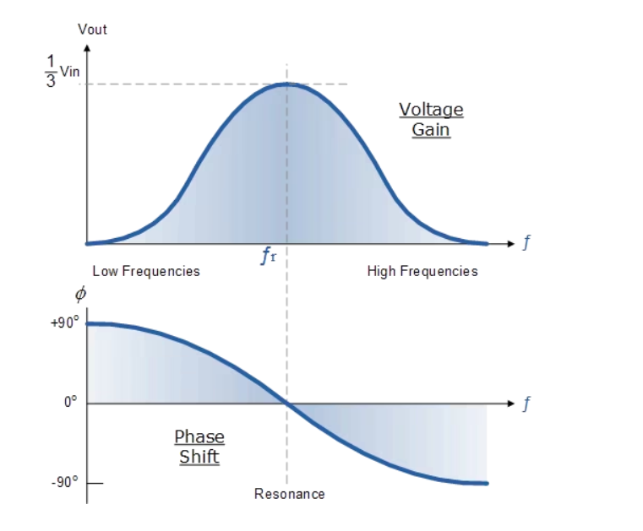
Oscillator o/p gain and phase shift

Slide 38
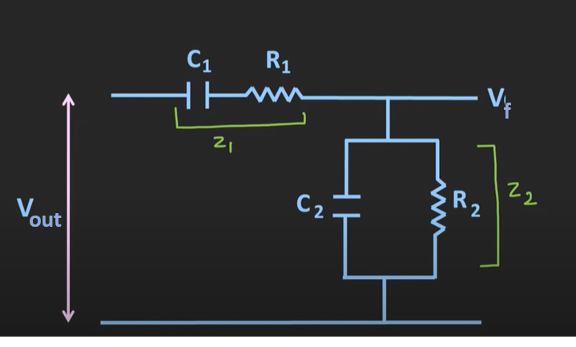
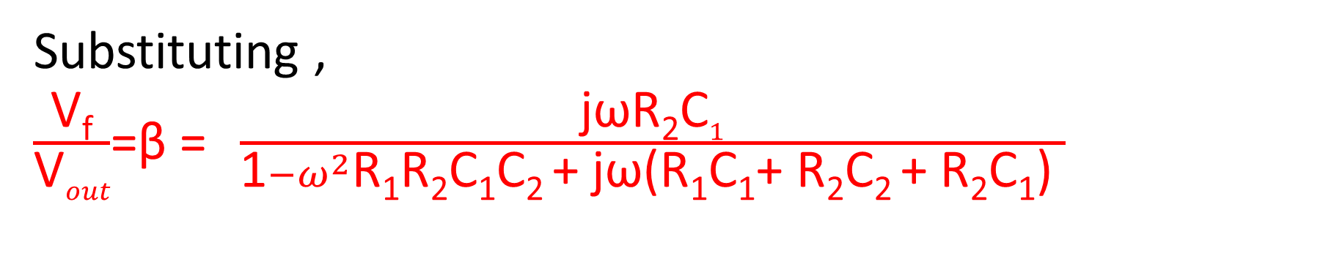
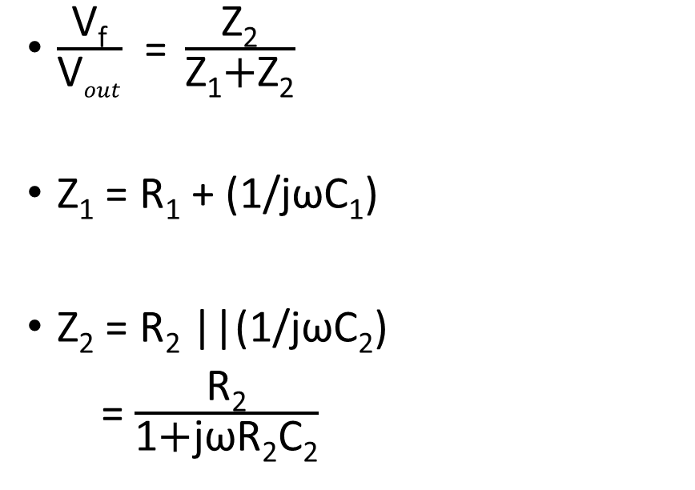
$\frac{\text{V}\text{f}}{\text{V}out}$ = $\frac{\text{Z}\text{2}}{\text{Z}\text{1}\text{+}\text{Z}\text{2}}$
Z₁ = R₁ + (1/jωC₁)
Z₂ = R₂ ||(1/jωC₂)
= $\frac{\text{R}\text{2}}{\text{1}\text{+}\text{j}\text{ω}\text{R}\text{2}\text{C}\text{2}}$
Substituting ,
$\frac{\text{V}\text{f}}{\text{V}out}$=β = $\frac{\text{j}\text{ω}\text{R}\text{2}\text{C}1}{\text{1}−ω^{2}\text{R}\text{1}\text{R}\text{2}\text{C}\text{1}\text{C}\text{2 }\text{+ }\text{j}\text{ω}\text{(}\text{R}\text{1}\text{C}\text{1}\text{+ }\text{R}\text{2}\text{C}\text{2 }\text{+ }\text{R}\text{2}\text{C}\text{1}\text{) }}$

Slide 39
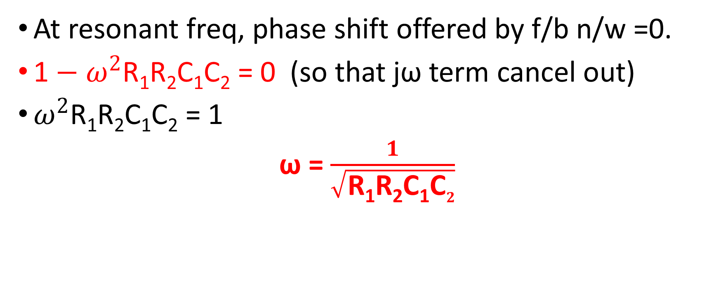
At resonant freq, phase shift offered by f/b n/w =0.
$\text{1}−ω^{2}\text{R}\text{1}\text{R}\text{2}\text{C}\text{1}\text{C}\text{2}$ = 0 (so that jω term cancel out)
$ω^{2}\text{R}\text{1}\text{R}\text{2}\text{C}\text{1}\text{C}\text{2}$ = 1
ω = $\frac{1}{\sqrt{\text{R}\text{1}\text{R}\text{2}\text{C}\text{1}\text{C}2}}$

Slide 40
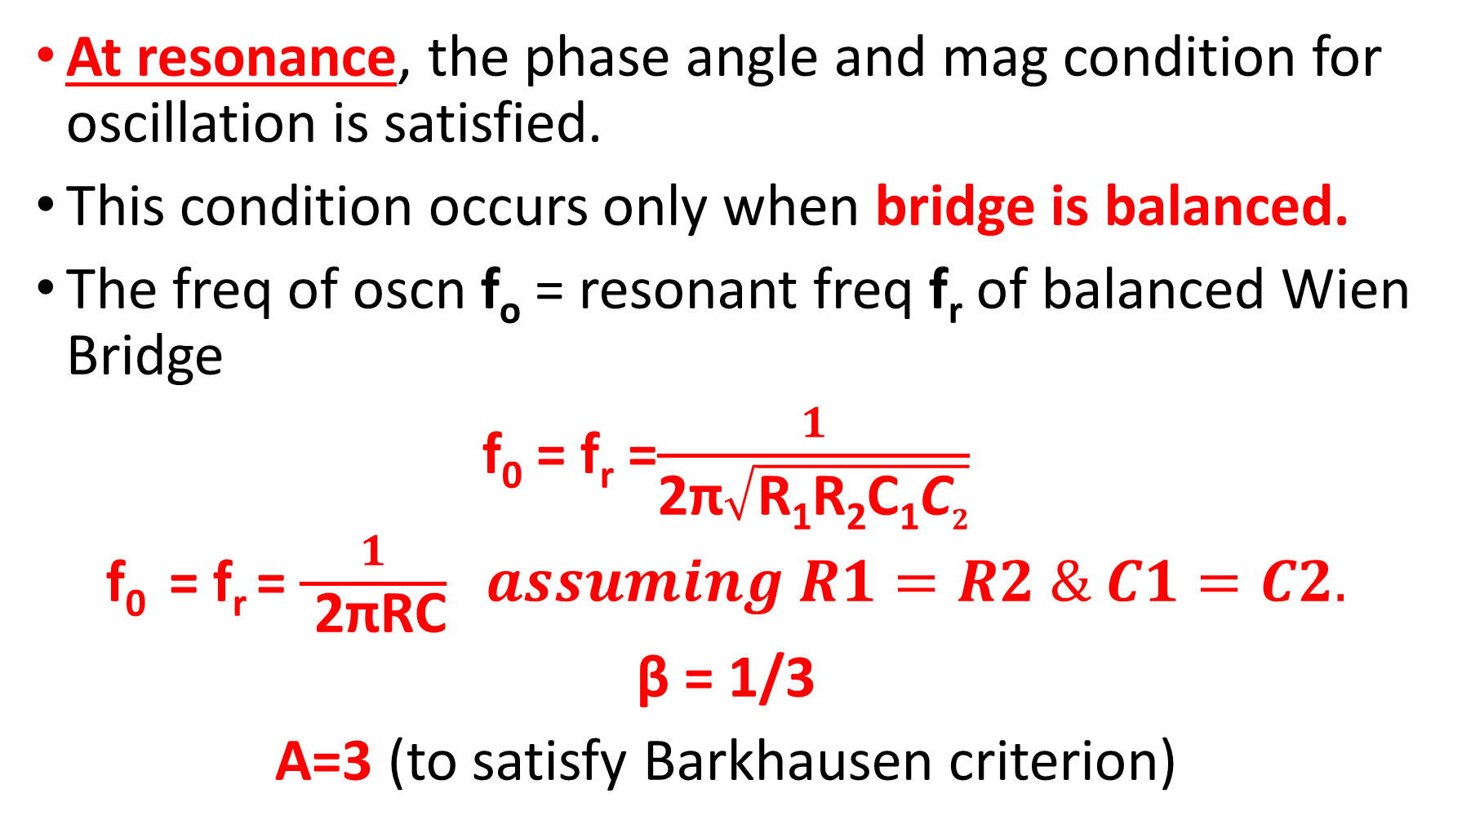
At resonance, the phase angle and mag condition for oscillation is satisfied.
This condition occurs only when bridge is balanced.
The freq of oscn f_{o} = resonant freq f_{r} of balanced Wien Bridge
f₀ = f_{r} =$\frac{1}{\text{2}\text{π}\sqrt{\text{R}\text{1}\text{R}\text{2}\text{C}\text{1}\text{C}2}}$
f₀ = f_{r} = $\frac{1}{ \text{2}\text{π}\text{RC}} assuming R1=R2 \& C1=C2.$
β = 1/3
A=3 (to satisfy Barkhausen criterion)

Slide 41

At resonance, β = 1/3
$\frac{\text{V}\text{f}}{\text{V}out}$=β = $\frac{\text{R}\text{2}\text{C}1}{ \text{(}\text{R}\text{1}\text{C}\text{1}\text{+ }\text{R}\text{2}\text{C}\text{2 }\text{+ }\text{R}\text{2}\text{C}\text{1}\text{) }}=1/3$

Slide 42
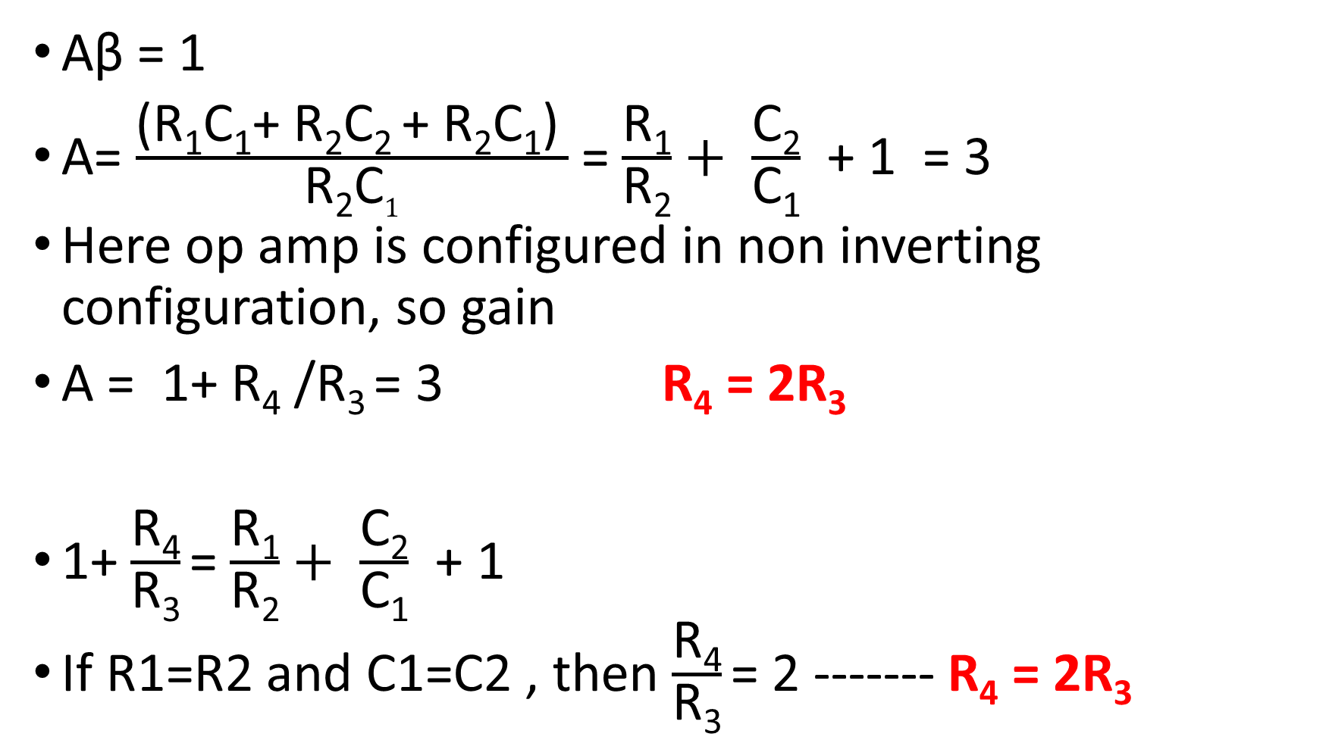
Aβ = 1
A= $\frac{\text{(}\text{R}\text{1}\text{C}\text{1}\text{+ }\text{R}\text{2}\text{C}\text{2 }\text{+ }\text{R}\text{2}\text{C}\text{1}\text{)} }{\text{R}\text{2}\text{C}1}$ = $\frac{\text{R}\text{1}}{\text{R}\text{2}}+ \frac{\text{C}\text{2}}{\text{C}\text{1}}$+ 1 = 3
Here op amp is configured in non inverting configuration, so gain
A = 1+ R₄ /R₃ = 3 R₄ = 2R₃
1+ $\frac{\text{R}\text{4}}{\text{R}\text{3}}$= $\frac{\text{R}\text{1}}{\text{R}\text{2}}+ \frac{\text{C}\text{2}}{\text{C}\text{1}}$+ 1
If R1=R2 and C1=C2 , then $\frac{\text{R}\text{4}}{\text{R}\text{3}}$= 2 ------- R₄ = 2R₃

Slide 43
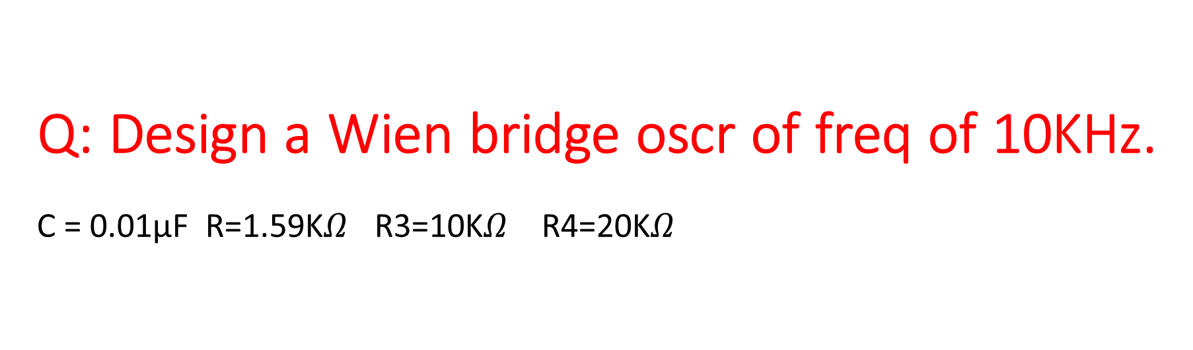
Q: Design a Wien bridge oscr of freq of 10KHz. C = 0.01µF R=1.59K$Ω$ R3=10K$Ω$ R4=20K$Ω$

