Slide 1
INFLATION 5.6%(Economic Survey January 2022)(CPI)
Meaning and Types

Slide 2
Inflation is a situation in which there is a persistent rise in the general price level.
It’s a situation in which there is an upward movement in the average level of prices.
Prof.Coulborn- “too much money chasing too few goods.”
Availability of goods is less when compared to the supply of money.
When there is inflation value of money decreases persistently. Value of money is the purchasing power of money or the quantity of goods and services that a unit of money can buy.

Slide 3
Based on rate, Inflation can be classified in the following way
Creeping Inflation:- When the rise in price is very slow, ie., less than 3% per annum, it is called creeping inflation. Mild inflation acts as a tonic for economic development and growth.
Walking inflation:- When prices rise moderately and the annual inflation rate is 3% to 10%, it is called walking inflation. Inflation at this rate is a warning signal for the government.
Running Inflation:- When prices rise rapidly and the rate of increase is 10% to20% per annum, it is called running inflation. Its control requires strong Monetary and Fiscal measures and it is a dangerous situation.
Galloping or Hyper inflation:- When prices rise between 20% to 100% per annum or even more, it is called Galloping or Hyper Inflation. Such a situatuin brings a total collapse of the monetary system.

Slide 4
DEMAND PULL INFLATION
Demand Pull inflation is the result of an increase in the Aggregate Demand in the absence of an increase in Aggregate Supply or a relatively less increase in Aggregate Supply. Suppose the government is following an expansionary fiscal policy and the government spends more money in the field of education, health etc. by printing more currency notes. In this situation, there will be a sudden increase in Aggregate Demand in the economy but the Aggregate Supply will not increase to that extent. Therefore, the price level goes up. Once the economy reaches in full employment level any further increase in aggregate demand will lead to price rise without any increase in output.

Slide 5
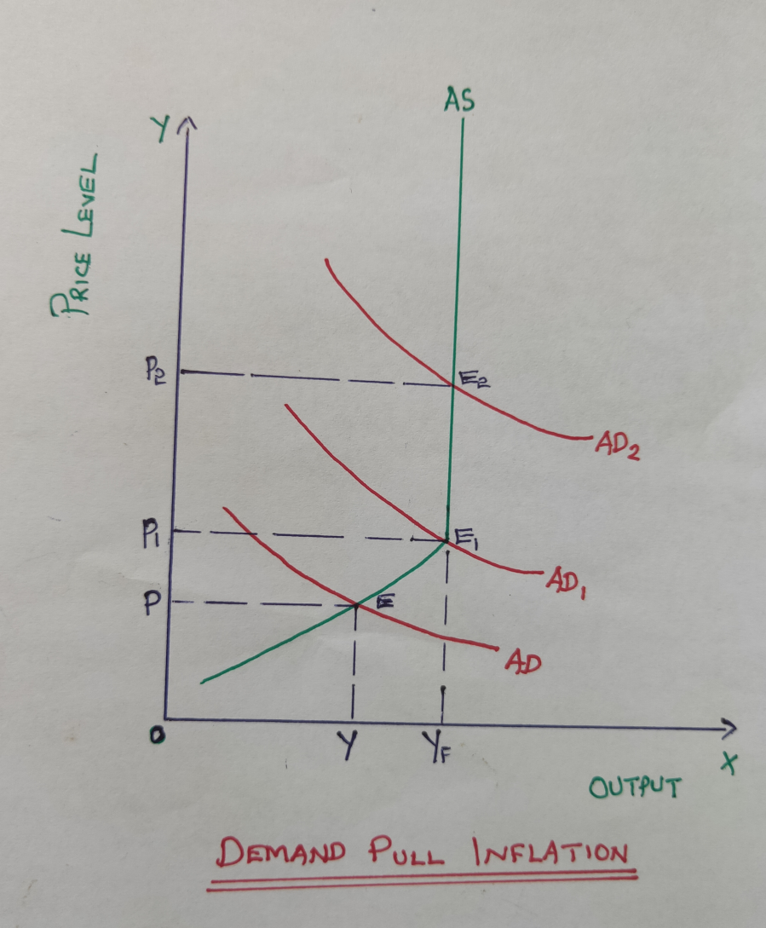
DEMAND PULL INFLATION….continued
In the diagram, AD is the Aggregate Demand Curve, AS is the Aggregate Supply Curve. Initially, the economy is in equilibrium at point ‘E’. Y is the equilibrium level of output and ‘P’is the price level. When aggregate demand increases, AD curve shifts upwards and the new AD1 curve intersects the AS curve at point E1.Here, price level increases to P1 and there is an increase in output from Y to YF. Beyond Yf level of output, AS curve becomes perfectly inelastic. Hence, Yf is the full employment level of output. Any increase in the aggregate demand beyond this level will push the price up without any change in output.

Slide 6
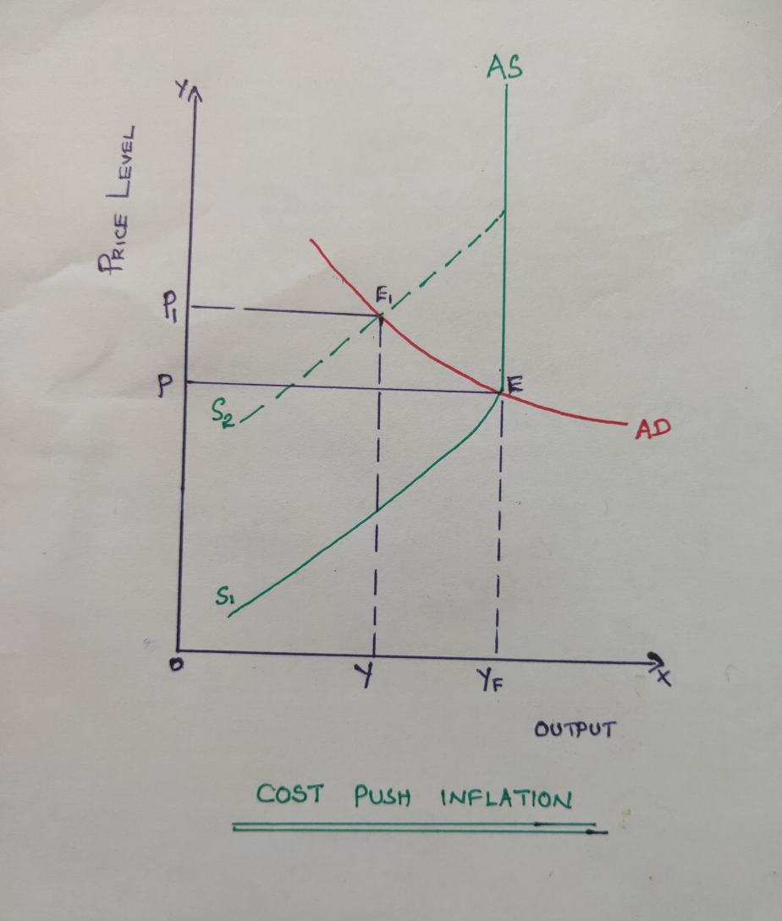
COST PUSH INFLATION
It is the result of increase in cost of production. Cost of production increases mainly due to increase in wages, increase in profit margin, or due to a sudden fall in supply. Increase in cost of production decreases the supply and when supply decreases the supply curve shifts leftwards. Therefore, the price level goes up.
In the diagram, initially the economy is in equilibrium at point E where the AS1 curve intersects with AD curve. This is full employment equilibrium where output is Yf and P is the price level. When aggregate supply decreases the AS curve shifts leftwards and the new supply curve is AS2 which intersects the Ad curve at E1. Therefore, the price level goes up to P1 and output decreases to Y

Slide 7
CAUSES OF INFLATION
DMAND SIDE CAUSES
1. Increase in Money Supply.
2. Increase in Disposable Income.
3. Increase in Govt. Expenditure.
4. Deficit Financing.
5. Cheap Money Policy.
6. Increase in Population.
SUPPLY SIDE CAUSES
Shortage of Capital and other complementary factors.
Increase in wages.
Speculative Hoarding.
Natural Calamities.
Increase in Exports.
Industrial Disputes.

Slide 8
Effects of Inflation
1.Effects on Distribution of Income:-
The effects of inflation on distribution of income and wealth can be viewed as the effects on fixed income group and flexible income group. When there is inflation the poor and middle class whose income is relatively fixed will lose but
the flexible income group categories businessmen, industrialists, traders, real estate holders and speculators gain and the income distribution change in favour of them. These categories are analysed one by one.

Slide 9
Debtors and Creditors:-
During inflation, debtors gain and creditors lose. Because of inflation value of money decreases and therefore, people who lend their money, when they it back its value will be lwss and they can purchase only less amount of goods and services.
b) Salaried classes and wage earners:-
Since the income of these two groups will adjust to inflation very slowly they lose when there is inflation.

Slide 10
c) Investors:-
Those who invest in shares will gain because companies will make more profit when there is inflation. On the other hand, those who invest in bonds and debentures which carry fixed returns will lose.
d) Businessmen:-
Since price goes up business people get more profit and they gain from inflation.
e) Farmers:-
When there is inflation, price of agricultural product increases at a faster rate. Hence farmers get more income.

Slide 11
2) Effects on Investment and Production:-
When there is inflation, people will have tendency to spend more and save less. Hence, there will be less savings and less investment in the economy which will adversely affect production. Inflation also discourages foreign investment.
However, in the initial stages, producers and traders get more profit because of price rise. Hence they produce their maximum and thus production goes up. But later, inflation increases wage rate and price of raw materials. Hence, cost of production increases and as a result output may decrease.
besides, inflation may lead to misallocation of resources because producers will divert their resources from the production of essential commodities to those goods which gives them maximum profit. Another adverse impact of inflation is black marketing. Traders may hoard stock of goods to create artificial scarcity to make more profit by selling it at a higher price.

Slide 12
3.Social and Political impact:- Inflation makes the rich richer and poor poorer. Hence, people will be unhappy. Because of the rising cost of living, workers resort to strikes which lead to loss in production. To make more profits, people resort to hoarding, black marketing, adulteration, manufacture of substandard commodities, speculation etc. Corruption spreads in every walk of life. All this reduces the efficiency of the economy. Thus there will be social unrest in the economy.
If hyperinflation persists and the value of money continues to fall, it ultimately leads to the collapse of the monetary system. Further, rising prices also encourage agitations and protests by political parties opposed to the government. This may lead to the downfall of the government.

Slide 13
MEASURES TO CONTROL INFLATION
I.Monetary Policy Measures
Quantitative Measures:-
1.Bank rate Policy
2.Open Market Operations.
3.Variations in Cash reserve ratio.
Qualitative Measures:-
1.Fixation of Margin Requirements.
2.Regulation of Consumer Credit.
3.Rationing of Credit.
4.Control through Directives.
5.Moral suasion.
6.Publicity.
7.Direct action.
II.Fiscal Policy Measures
1.Public Revenue.
2.Public Expenditure
3.Public Borrowing.
III.Other Measures
1.Increasing the Supply of Goods and services.
2.Price Control.
3.Wage Control.

Slide 14
Monetary policy Measures (Methods of Credit Control)
Credit control is an important function of Central Banks. Monetary policy measures are the measures adopted by the Central Bank of a country to control credit and money supply in an economy.
Objectives of Credit Control (Monetary Policy):-
Price Stability 2)Economic Stability 3)Exchange rate Stability 4)Money Market Stability 5)Economic Growth 6)Maximisation of Employment
Monetary policy measures can be classified as
a) Quantitative credit control methods and
b) Qualitative credit control methods.

Slide 15
1.Quantitative or General Methods
The methods used by the Central bank to influence the total volume of credit in the banking system, without considering the purpose for which the credit is used.
The important quantitative credit control methods are:
Bank rate policy
Open Market Operations
Variations in Cash Reserve Ratio

Slide 16
Bank Rate Policy:-
Bank rate(4.25%, January 2022) is the rate at which the central bank rediscounts the first class bills of exchange of the commercial banks and discount houses. In simple words, bank rate is the lending rate of the Central Bank. If the bank rate is raised, then the market rate of interest tends to rise. On the other hand, if the bank rate is lowered, then the market rate of interest tends to fall.

Slide 17
During times of inflation, the Central Bank raises the Bank rate. As a result, market rate of interest tends to rise. This discourages new loans. The businessmen reduce their production and some factors will be thrown out of employment. As a result, the purchasing power of the people is reduced. This will lead to fall in demand for goods and thereby price level falls. Thus, Central Bank can check inflationary rise in price level by increasing the bank rate.
During times of deflation, the Central bank reduces the bank rate so that the commercial banks can cutshort the rate of interest. This will encourage businessmen to borrow heavily from banks. They invest the borrowed money in different fields of production, which increases the purchasing power of the people- more output- more employment- and finally a rise in the price of goods. Thus it will check the deflationary trend in the country.

Slide 18
b) Open market Operations:-
Open Market Operations refer to the deliberate and direct buying and selling of securities in the money market by the central bank. In the narrow sense, OMO refer to the purchase and sale by the Central Bank of government securities in the money market. In the broader sense, OMO imply the purchase and sale by the Central bank of any kind of eligible paper like govt. securities, bills and securities of private concerns etc.

Slide 19
During times of Inflation, the Central bank sells in the Money market eligible securities which are possessed by it with a view to reduce the volume of money supply or credit. The buyers of the security are the commercial banks, insurance companies, individual firms etc. who make payments by drawing cheques on the account with the banks. When the commercial banks make payments to the central bank towards the cost of the securities, the cash reserves of commercial banks fall and this reduce its capacity to create credit and further advancement of loans.
In times of deflation, Central bank buys securities from the open market. When the central bank buys the securities from the commercial banks or general public, it pays cash to the sellers of securities. Thus, cash will now flow from central bank to commercial banks or general public. With increased cash reserves commercial banks are free to lend liberally. This increases production, investment, employment and price level etc.

Slide 20
C)Variations in Reserve Ratio:-
Depending upon the economic conditions, Central Bank increases or decreases the reserves that every commercial bank should keep in the central bank. There are two types of reserve ratios:
i)Cash Reserve Ratio(4%):- Every commercial bank should keep a certain percentage of their total deposits in the central bank in the form of cash reserve. This is mandatory and this percentage is called CRR.
During times of inflation, the central bank will raise the cash reserve ratio which the commercial banks are require to maintain with the central bank. This will affect the credit creating capacity of the commercial banks. In this way, the central bank can control the credit expansion by commercial banks.
During times of deflation, central bank reduces the reserve requirements of commercial banks. The central bank will also release excess cash at the disposal of commercial banks to create credit. Credit creation by commercial banks boosts up economic activity and pushes the price level, employment, output etc. up and finally save the economy from depression.

Slide 21
ii) Statutory Liquidity Ratio(SLR)(18%):-
This is another type of reserve that every commercial bank should keep. A commercial bank should keep a certain percentage of their total deposits in the form of safe and liquid assets such as unencumbered government securities, cash and gold.
When there is inflation, SLR is increased and it helps to decrease bank credit and to ensure solvency of government securities. Increase in SLR compels commercial banks to invest in government securities.
When there is deflation, SLR is decreased and it helps to increase bank credit.

Slide 22
2.Qualitative or Selective Credit Control methods
Qualitative or selective credit control methods aim at maintaining the quality of credit. It distinguishes between desirable and undesirable uses of credit/ or productive and unproductive uses of credit.
It implies imposing direct control on certain types of bank lending. It diverts the flow of credit to socially desirable uses.
They are called selective credit control methods because they are selectively applied to control specific situations without having its impact on the economy as a whole.

Slide 23
1.Regulation of Consumer Credit:-
This method is used to control the demand for durable consumer goods when their supply is limited. As is well-known, goods like refrigerators, Television sets, Two-wheelers, Four Wheelers etc. are purchased on installment credit system. According to this system, a certain percentage of the price of the good is paid by the buyer as downright cash and the balance is financed by bank credit, which is repayable by the customer on installments spread over a specific period of time.
It is well-known that during times of prosperity and inflationary conditions, consumer’s purchases on installment will tend to be large, while during periods of depression, they may fall of dangerously worsening the depression still further. It is, therefore, generally considered essential to regulate consumer’s purchases by prescribing stiffer terms in a boom period and permitting easier terms during a deflation and thus reduce the negative effects of extreme fluctuations in business conditions.

Slide 24
2.Fixation of Margin Requirements:-
Margin refers to the difference between the market value of the security and the amount of loan sanctioned on the security. The essence of this method is that, a bank while advancing money against a security does not lend the entire market value of the security. It lends only a certain percentage of the market value of the security. It always keeps a margin by giving a lesser amount than the market value. If a security has a market value of Rs.10,000/- and if the margin requirement is 60%, the maximum loan that can be advanced would be Rs.4000/-. Similarly, a margin requirement of 80% would allow borrowing of only 20% of the price of the security. Thus, if margin is raised, that will curtail the lending capacity of the commercial bank. Conversely, if margin is lowered, that will activate the credit creating capacity of the banks and the borrowing capacity of the security holder.

Slide 25
3.Rationing of credit:-
Rationing of credit is a system under which the central bank seeks to limit the total amount of loans and advances to specific categories granted by commercial banks. Credit rationing is generally of two types:
Variable portfolio ceiling
Variable Capital-Asset ratio
Under variable portfolio ceiling, the central bank fixes a ceiling on the amount of loans and advances for each bank.
Under the variable capital-asset ratio, the central bank prescribes the minimum capital-asset ratio that is to be maintained by commercial banks.

Slide 26
4.Control through Directives:-
The directives of the central bank to the commercial banks may be in the form of written orders, appeals or warnings by the central banks. These directives are issued in order to achieve the following goals.
To control the lending policies of commercial banks.
To divert the flow of credit from less urgent uses to more urgent uses or from less productive to more productive uses.
To prohibit lending for speculative and other dangerous sectors.
To fix maximum limit of credit for certain purposes.

Slide 27
5.Moral Suasion:-
This method involves advice, request, persuasion etc. with commercial banks to co-operate with the central bank in implementing credit policies. The method of moral suasion is purely informal in character and no compulsion or threat is used. Under this method, central bank cannot take any legal action against non-cooperating banks.

Slide 28
6.Publicity:-
The central bank also uses publicity as a method of credit control.through publicity the central bank seeks to:
Influence the credit policies of the commercial banks.
Educate people regarding the economic and monetary condition of the country and
To influence the public opinion in favour of its monetary policy.
The central bank regularly publishes the statement of assets and liabilities of the commercial banks, reviews of credit and business conditions, reports of their own activities, money market and banking conditions etc. From the published material, the banks and the general public can anticipate the future changes in the policies of the central bank.

Slide 29
7.Direct action:-
Direct action, generally implies coercive measures taken by the central bank against an offending commercial bank or other financial institutions. Central bank can take action against erring banks in the following ways.
The central bank may refuse altogether to grant rediscounting facilities to such banks;
The central bank may refuse to sanction further financial accommodation to a bank whose existing borrowings are found to be excess of its capital and reserves.
The central bank may start charging penal rate of interest on money borrowed by a bank beyond the prescribed limit, and
The central bank issue general instructions to all the banks concerning their lending and investment operations.

Slide 30
The RBI has extensive powers under the law to control and regulate the lending policies of commercial banks. Infact, it has been following a ‘carrot & stick’ policy. To encourage lending to priority sectors, it has been offering ‘carrots’ to commercial banks, in the form of certain incentives. To discourage lending to the big borrowers in the private sector, RBI is applying ‘ big stick’ policy in the form of special scrutiny and even penalties in the case of violation of the terms of loans.

Slide 31
Fiscal policy measures
Fiscal Policy is the policy of the government regarding taxation, public expenditure and borrowing. Fiscal policy measures can be used to control the aggregate demand in the economy.
The main instruments of fiscal policy are:
Public revenue(taxation)
Public expenditure
Public borrowing

Slide 32
1) Public revenue:-
The main source of public revenue is tax. When there is inflation the government want to reduce the total spending in the economy and hence tax is increased. Increase in direct taxes decreases the disposable income of the people and hence they spend less money.

Slide 33
2.Public expenditure:-
During inflation the government cut down its expenditure on developmental activities and welfare programmes. This reduces government demand for goods and services as well as private income. When the government spend less money, income of the individuals decreases. Hence, aggregate demand decreases.
3.Public Borrowing:-
when there is inflation the government will delay the repayment of public debt. At the same time the government should borrow more money from the public.

Slide 34
3.Other measures
Increasing the supply of goods and services:-
When there is price rise government takes various measures to increase the supply of goods and services. This can be done by importing essential products, banning the export of such items and by encouraging the production of essential commodities.
2) Price control:-
Direct measures can be taken to control the price of goods and services. Essential commodities can be distributed through the PDS at reduced prices.
3) Wage control:-
wage control helps to prevent the escalation of cost of production during inflation and thus cost push inflation can be controlled.

Slide 35
Repo rate and Reverse Repo rate
Repo rate(4.25%):-
Repo rate is the rate at which RBI provides overnight liquidity to banks against the collateral of government and other approved securities. In other words, it is simply the rate at which RBI lends short term funds to commercial banks when they are facing a financial crunch. In this case, a repurchasing agreement is signed by both the parties stating that the securities will be repurchased by the commercial banks on a later date at a predetermined price.
Bank rate and repo rate are not the same. In general, repo rate focuses on providing funds to banks for a very short period where as bank rate focuses on long term fund requirements of the commercial banks. In the case of bank rate there is no repurchasing agreement signed and bank rate is usually higher than Repo rate.

Slide 36
2) Reverse repo rate(3.35%):-
Reverse repo rate is the rate at which the RBI absorbs liquidity on an overnight basis from commercial banks. In other words, when a commercial bank has excess funds, they can deposit the same in central bank and earn interest in the form of reverse repo rate.
The RBI uses this tool when it feels that there is too much money floating in the banking system. An increase in the reverse repo rate means that the banks will get a higher rate of interest from RBI. As a result, banks prefer to deposit their money to central bank.
Repo rate and reverse repo rate are also used to control money supply in the economy. Ehen there is excess money in the economy these two rates are increased.

