Slide 1
MULTIVIBRATOR
Electronic ckt which is used to implement 2 state devices like oscillator, timer and flip flop.
It is nothing but a switching circuit.
It generates non-sinusoidal waves such as Square waves, Rectangular waves and Saw tooth waves etc.
Used as frequency generators, frequency dividers and generators of time delays and also as memory elements in computers etc.

Slide 2
2 states refer to 2 voltage levels of multivibrator (high and low).
In digital electronics, 1 & 0.
Depending upon the no. of stages, MV can be divided into 3 types:
Astable MV
Monostable MV
Bistable MV

Slide 3
Astable Multivibrator
Astable multivibrator does not remain stable in any of the two states.
And the output of the multivibrator continuously changes between the two states.
This type of multivibrator is used in the design of a relaxation oscillator.
Time for which o/p remains in the particular state can be determined by the passive components like R and C.

Slide 4
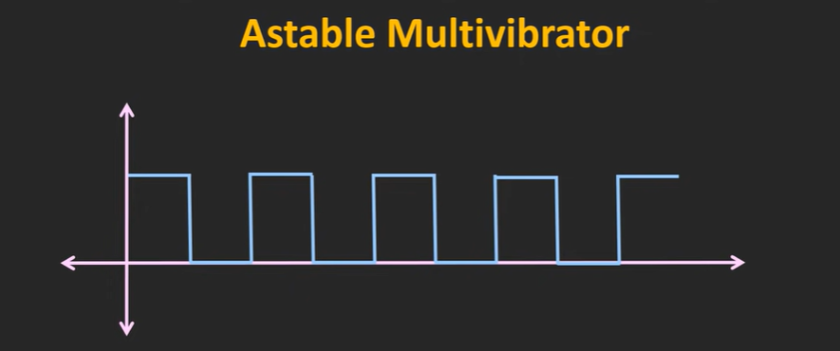

Slide 5
Monostable Multivibrator (One shot MV)
In this, there is one stable state and one astable state.
The MV o/p remains in the stable state but whenever an external trigger signal is applied, the output momentarily goes into the astable state. And after some time it comes back into the stable state.
The time required to come back into the stable state depends on the passive components like R and C.
Used as a timer in many applications.

Slide 6
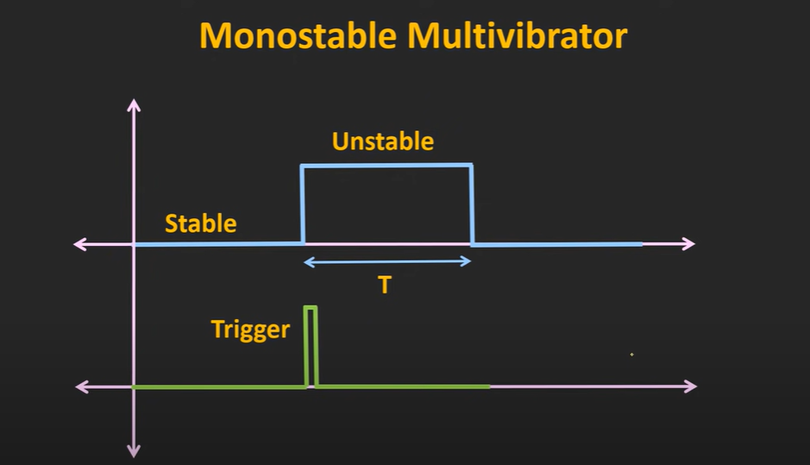
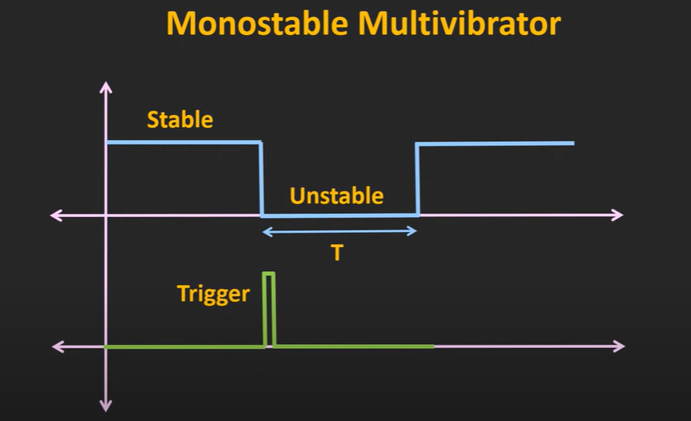

Slide 7
Bistable Multivibrator
Has two stable states.
The output used to be in any one of the two stable states.
Whenever an external trigger signal is applied, the output goes from one stable state to another stable state.
If no triggering action is applied thereafter, then it remains in the new stable state.
The bistable multivibrator is one kind of flip-flop circuit.

Slide 8
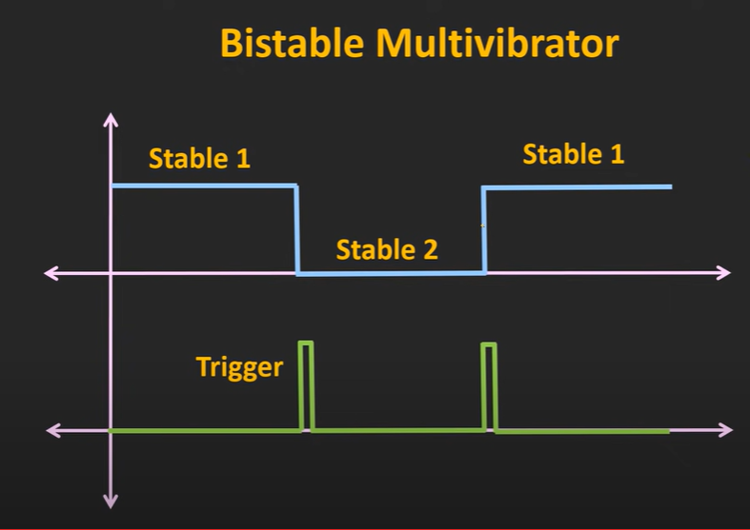

Slide 9
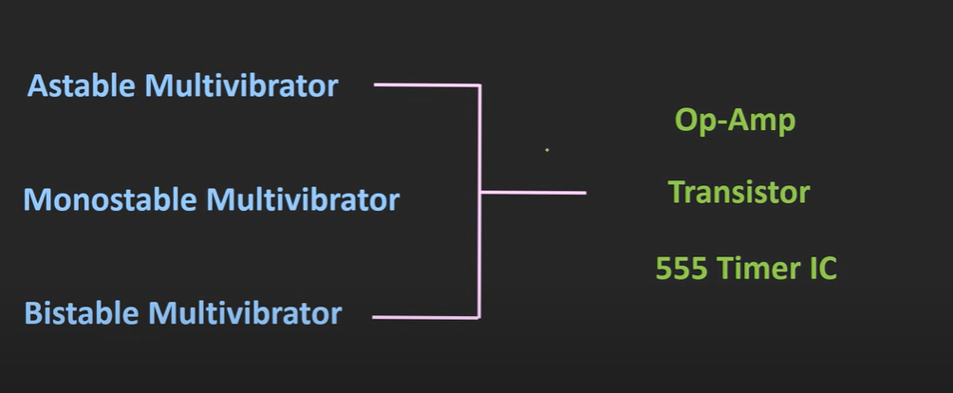
All the three types of multivibrators can be designed using either op-amp, transistor pairs or 555 timer IC.

Slide 10
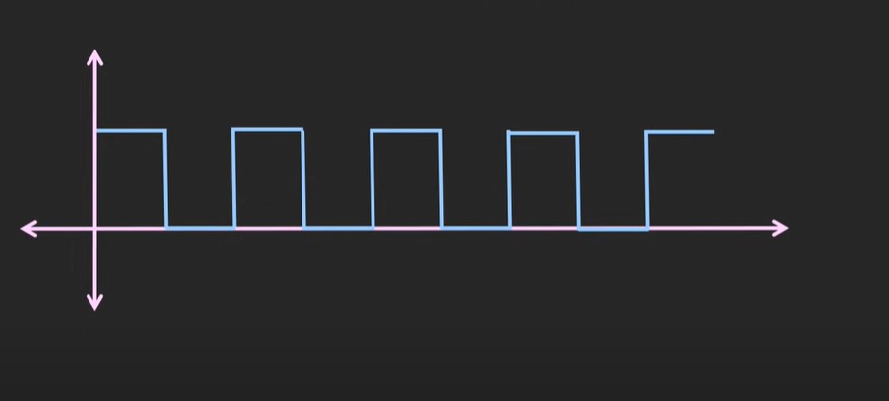
SQUARE WAVE GENERATOR (ASTABLE MULTIVIBRATOR)
Both states are astable state and output used to change continuously between the two states.
Used to design relaxation oscr (o/p is non sinusoidal). A relaxation oscillator is an oscillator based upon the behavior of a physical system's return to equilibrium after being disturbed.
Op amp used with +ve f/b.

Slide 11
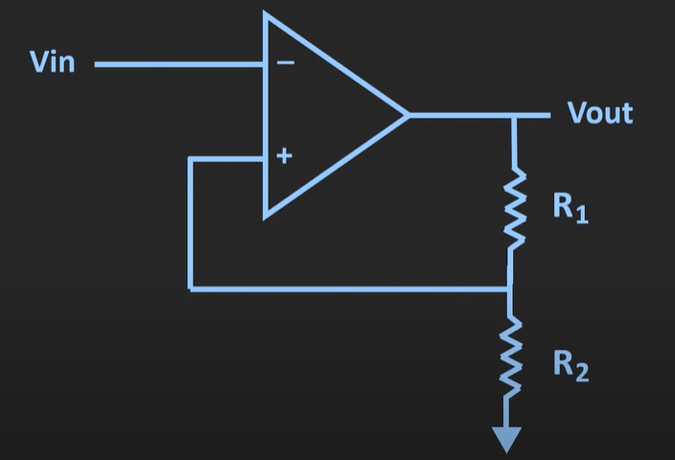

Slide 12
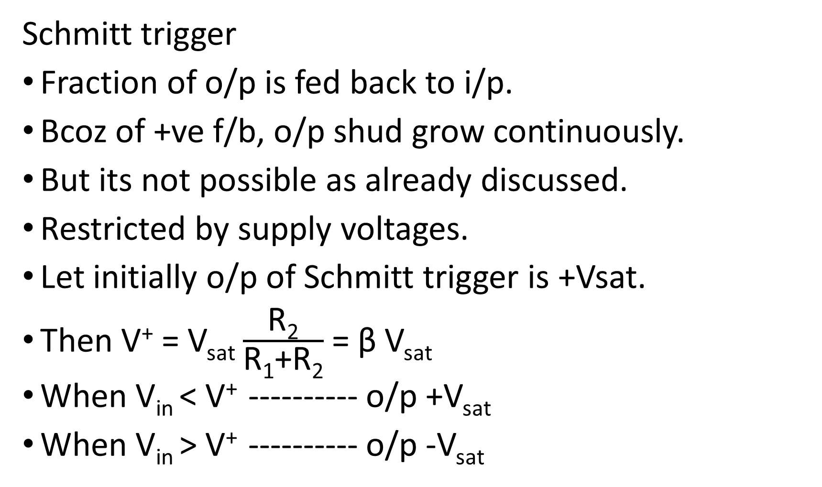
Schmitt trigger
Fraction of o/p is fed back to i/p.
Bcoz of +ve f/b, o/p shud grow continuously.
But its not possible as already discussed.
Restricted by supply voltages.
Let initially o/p of Schmitt trigger is +Vsat.
Then V⁺ = V_{sat} $\frac{\text{R}\text{2}}{\text{R}\text{1}\text{+}\text{R}\text{2}}$ = β V_{sat}
When V_{in} < V⁺ ---------- o/p +V_{sat}
When V_{in} > V⁺ ---------- o/p -V_{sat}

Slide 13
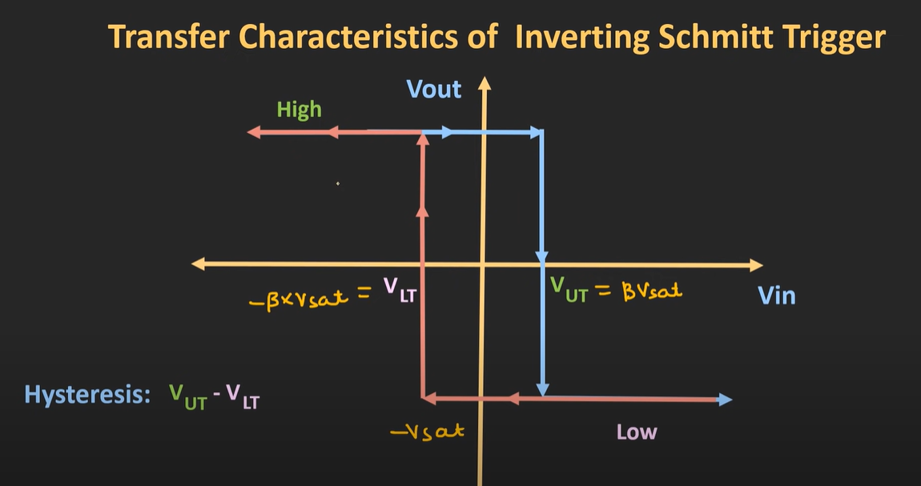

Now V⁺ = -V_{sat} $\frac{\text{R}\text{2}}{\text{R}\text{1}\text{+}\text{R}\text{2}}$ = -β V_{sat}
This again changes when V_{in} < V⁺

Slide 14
In the Schmitt trigger, i/p is applied externally.
But if we provide f/b from o/p to i/p via R and C, then the same ckt can be used as an astable MV.

Slide 15
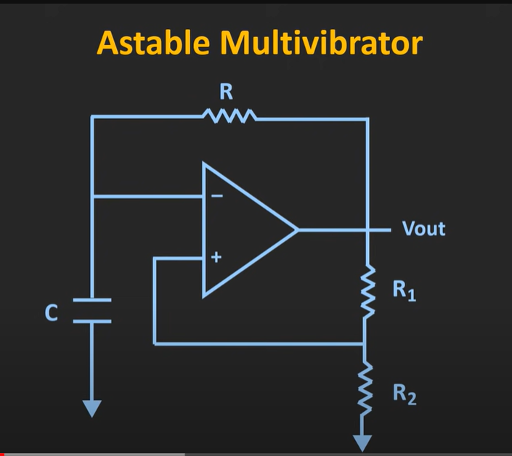

Slide 16
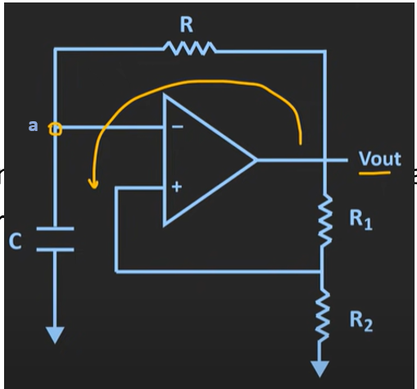
Working
Lets assume initial voltage across this ckt is +V_{sat} .
So capacitor starts charging thru this path.
Assume ideal op amp. So no current flow into op amp.
As soon as cap starts charging, the V will get build up across this capr.

Slide 17
V at node a will also build up.
Whenever V_{a} reaches V_{UT} or in this case lets say equal to β V_{sat} , then V at inv node will be slightly > that at non inv node.
So o/p changes to –V_{sat}.
Now capr starts charging to the –ve saturation voltage.
As soon as the voltage jz goes below –V_{sat} , at that time V at non inv terminal is slightly > that of inv terminal.
Once again o/p switch from –V_{sat} to + V_{sat} .

Slide 18
In this way, by charging and discharging of capacitor, we will get a square wave at o/p.
Time period of astable MV depends on the value of this R and C.
It also depends on the value of the upper & lower threshold voltage.
So eventually we can say that it depends on R1 and R2.

Slide 19
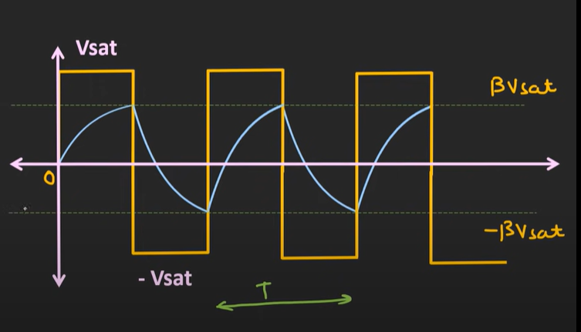

Slide 20
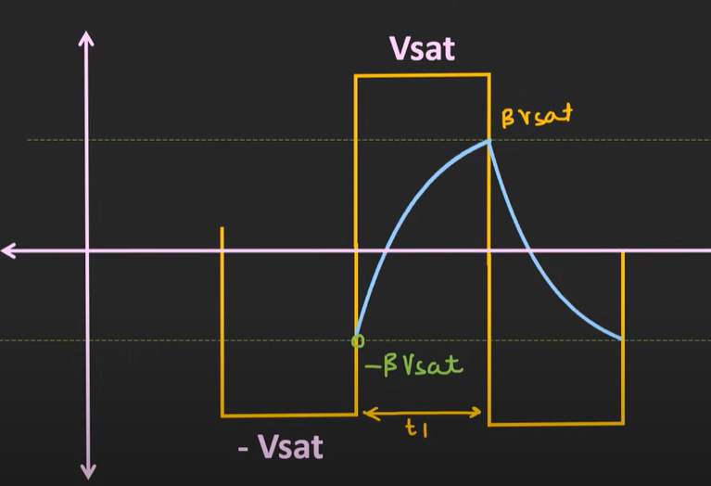
Derivation

Slide 21
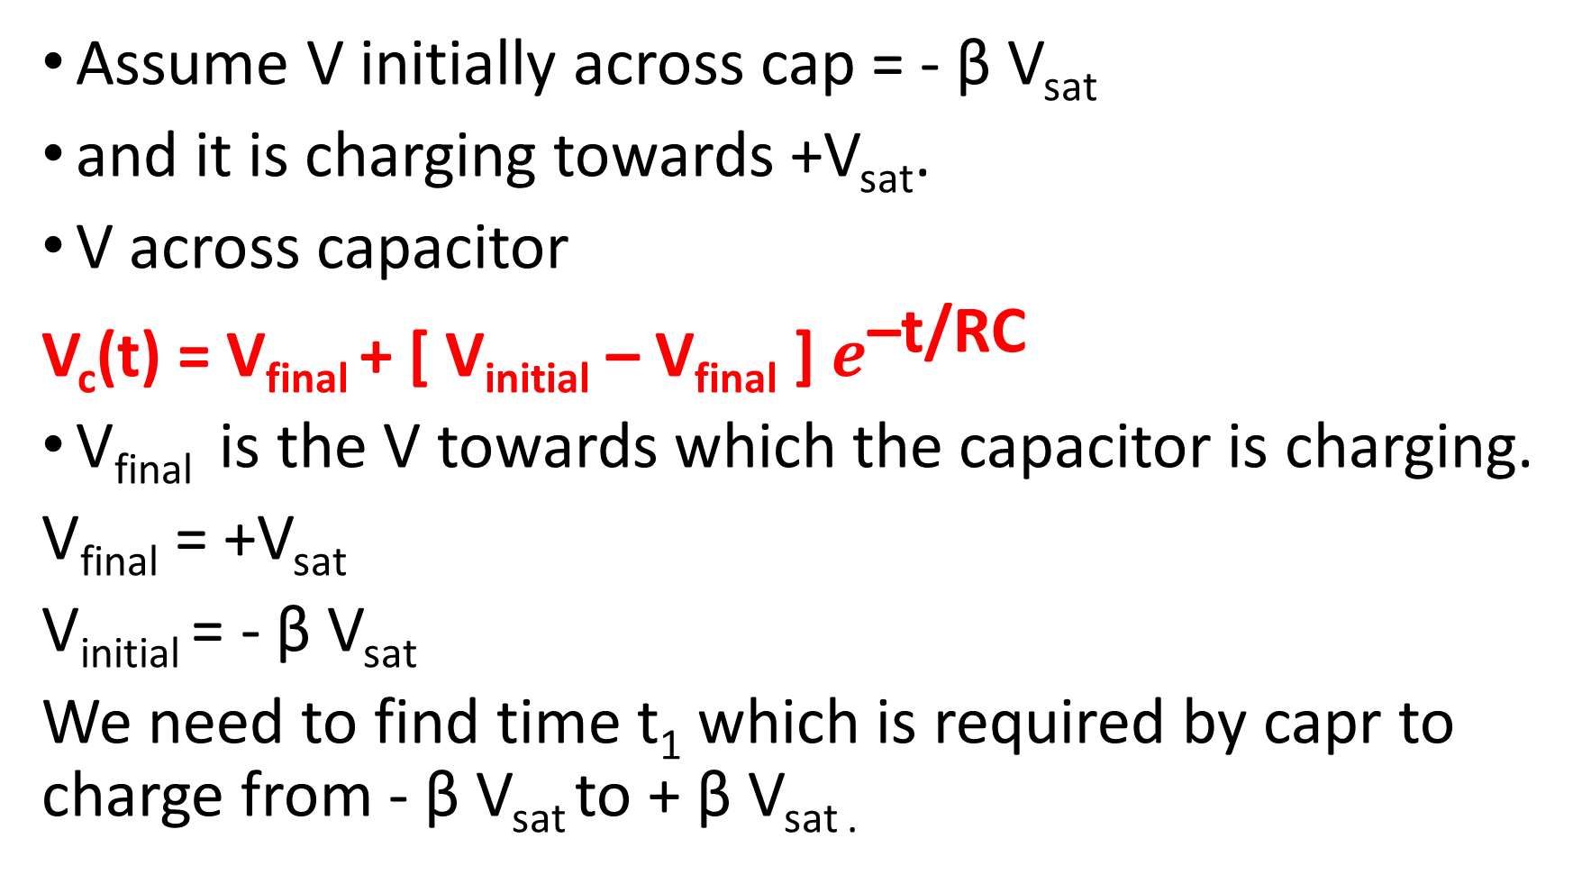
Assume V initially across cap = - β V_{sat}
and it is charging towards +V_{sat}.
V across capacitor
V_{c}(t) = V_{final} + [ V_{initial} – V_{final} ] $e^{\text{–}\text{t}\text{/}\text{RC}}$
V_{final} is the V towards which the capacitor is charging.
V_{final} = +V_{sat}
V_{initial} = - β V_{sat}
We need to find time t₁ which is required by capr to charge from - β V_{sat} to + β V_{sat .}

Slide 22

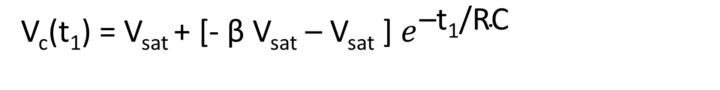
V_{c}(t₁) = V_{sat} + [- β V_{sat} – V_{sat} ] $e^{\text{–}\text{t}\text{1}\text{/}\text{RC}}$
β V_{sat} = V_{sat} + [- β V_{sat} – V_{sat} ] $e^{\text{–}\text{t}\text{1}\text{/}\text{RC}}$
β -1 =- [1+β ] $e^{\text{–}\text{t}\text{1}\text{/}\text{RC}}$
$\left(\frac{1+β}{1−β}\right)$ = $e^{\text{t}\text{1}\text{/}\text{RC}}$
t₁ = RC ln $\left(\frac{1+β}{1−β}\right)$

Slide 23
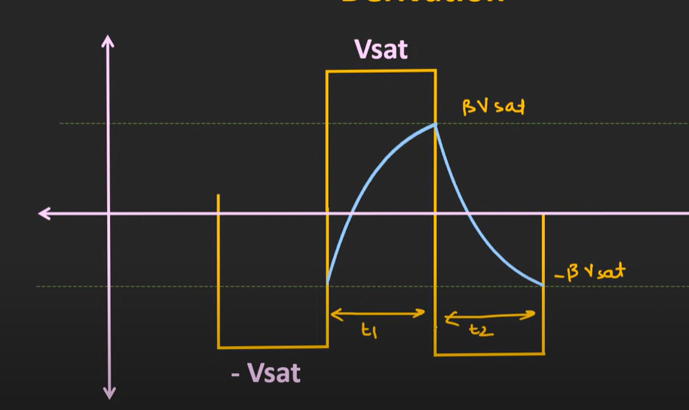

Slide 24
Here as the +ve and –ve saturation voltages are equal, duty cycle of square wave will be 50%.
If upper and lower threshold V are different, then duty cycle will be > or < 50%.
Here as duty cycle is 50% , we can say that t₁ = t₂.
V_{initial} = β V_{sat}
V_{final} = -V_{sat}

Slide 25
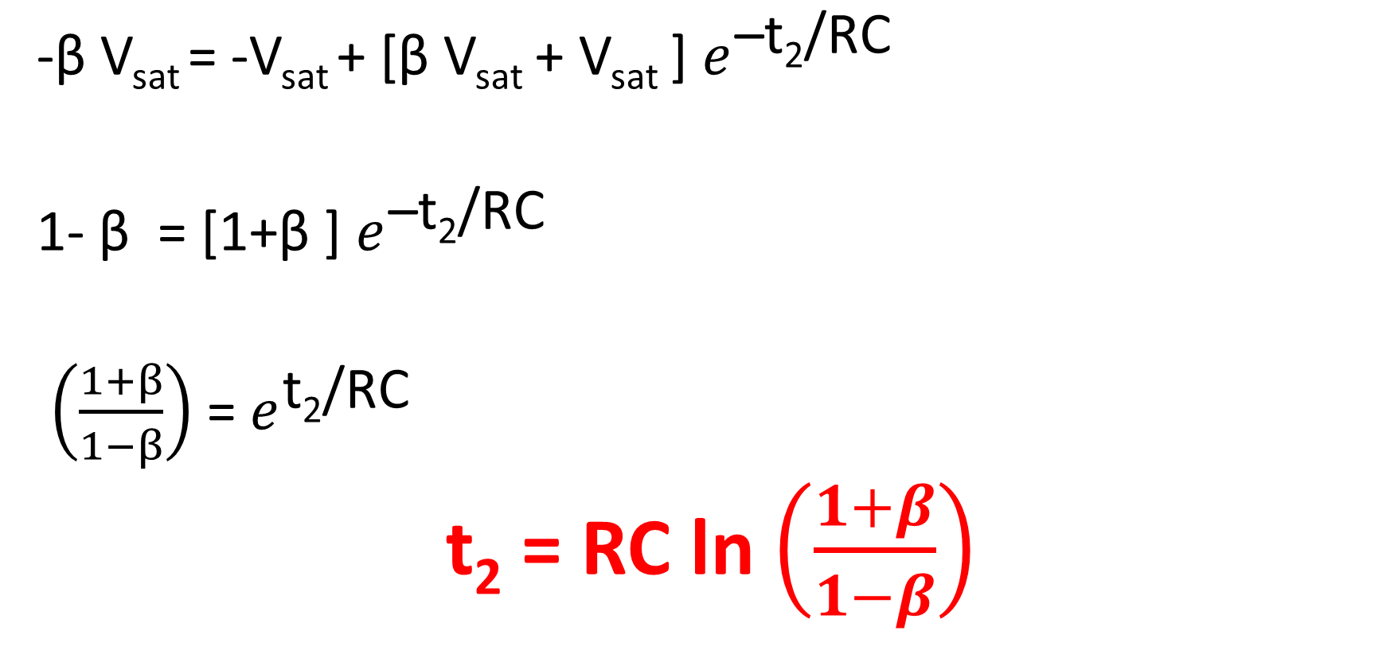
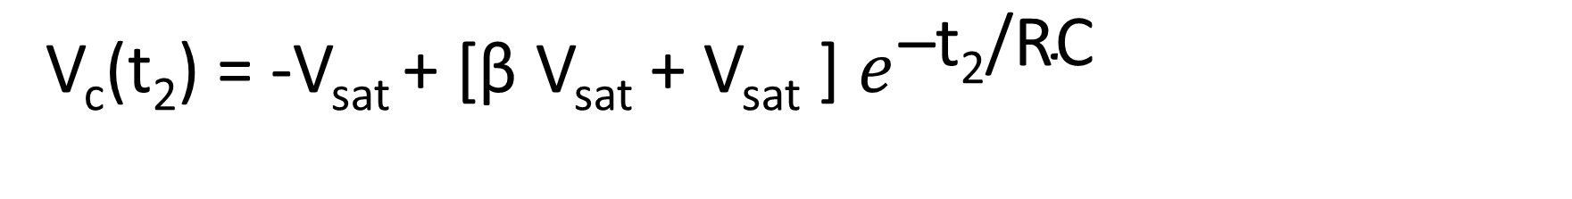
V_{c}(t₂) = -V_{sat} + [β V_{sat} + V_{sat} ] $e^{\text{–}\text{t}\text{2}\text{/}\text{RC}}$
-β V_{sat} = -V_{sat} + [β V_{sat} + V_{sat} ] $e^{\text{–}\text{t}\text{2}\text{/}\text{RC}}$
1- β = [1+β ] $e^{\text{–}\text{t}\text{2}\text{/}\text{RC}}$
$\left(\frac{1+β}{1−β}\right)$ = $e^{\text{t}\text{2}\text{/}\text{RC}}$
t₂ = RC ln $\left(\frac{1+β}{1−β}\right)$

Slide 26
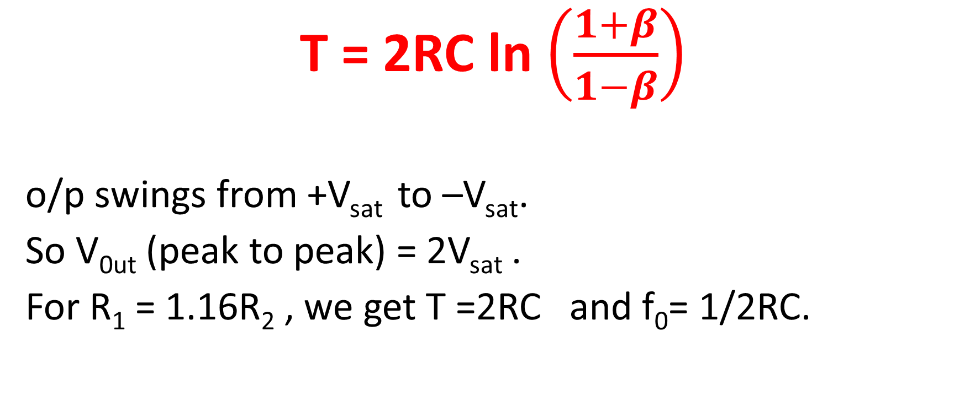
Time period of square wave T = t₁ + t₂
T = 2RC ln $\left(\frac{1+β}{1−β}\right)$
o/p swings from +V_{sat} to –V_{sat}.
So V_{0ut} (peak to peak) = 2V_{sat} .
For R₁ = 1.16R₂ , we get T =2RC and f₀= 1/2RC.

Slide 27

Q: Design astable MV having freq of 1 KHz.
R1=R2
T=1ms
β = ?
C = 0.1 µF
R=4.5 K$Ω$
R1=R2=10 K$Ω$

Slide 28
Monostable Multivibrator
There is one stable state.
When the trigger signal is applied then momentarily the output goes into the unstable state and once again comes back into the stable state.

Slide 29
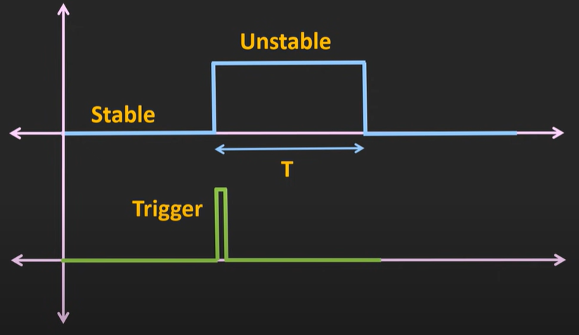
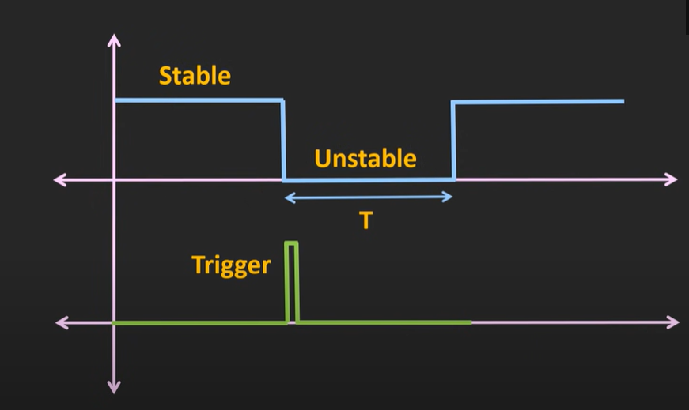

Slide 30
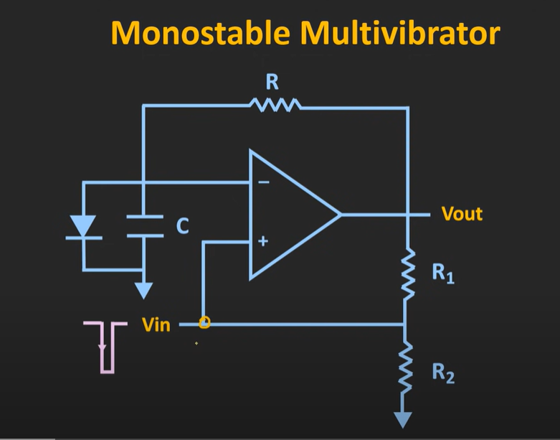

Slide 31
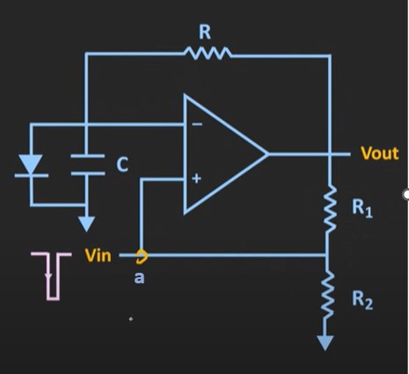
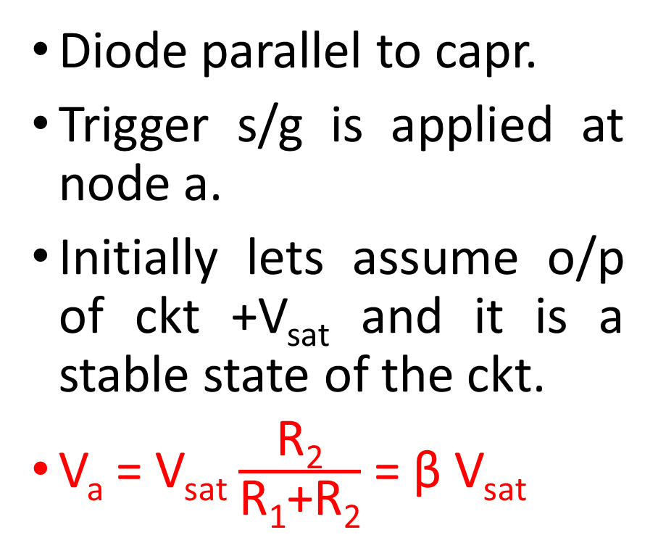
Working Principle
Diode parallel to capr.
Trigger s/g is applied at node a.
Initially lets assume o/p of ckt +V_{sat} and it is a stable state of the ckt.
V_{a} = V_{sat} $\frac{\text{R}\text{2}}{\text{R}\text{1}\text{+}\text{R}\text{2}}$ = β V_{sat}

Slide 32
Whenever o/p is +V_{sat} , diode is FB.
V across capr will be forward V drop of diode.
So inv node V = forward V drop of diode.
As β V_{sat} > forward V drop of diode, o/p remains at +V_{sat}.
Now, lets say after a certain time the trigger s/g is applied at this node.
When a –ve trigger is applied, then momentarily o/p at non inv node will be less than V at inv node.

Slide 33
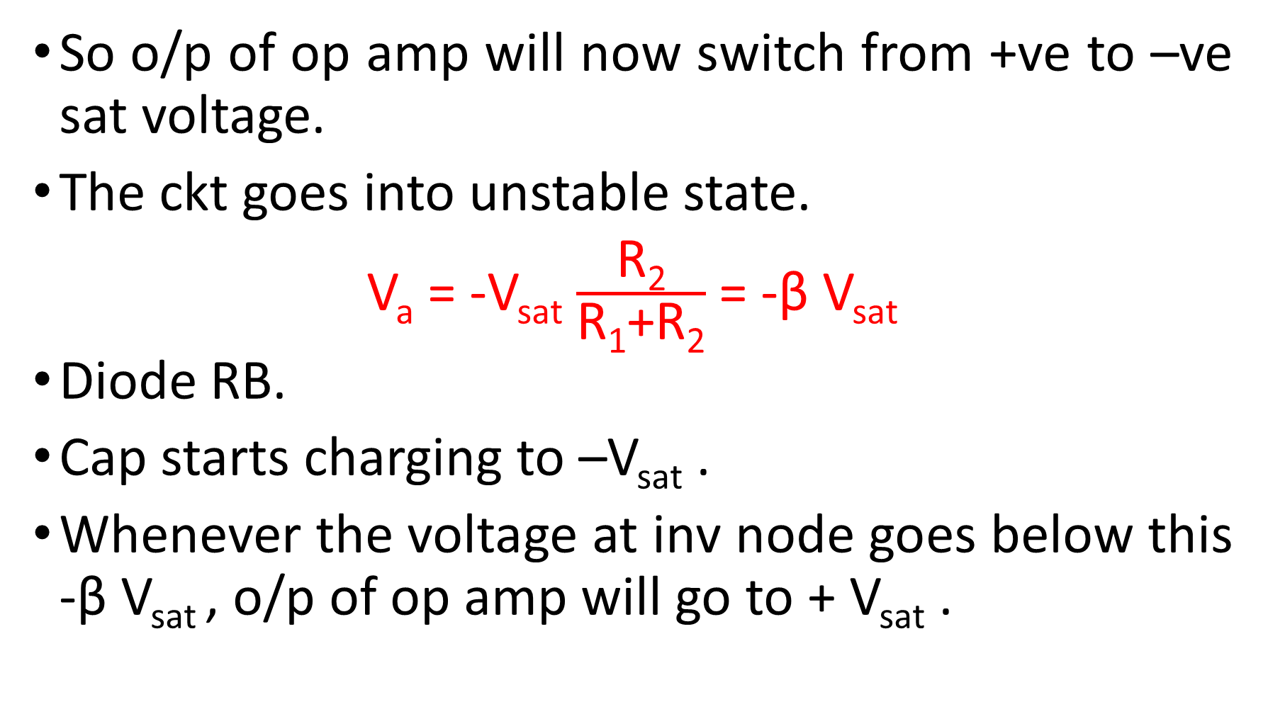
So o/p of op amp will now switch from +ve to –ve sat voltage.
The ckt goes into unstable state.
V_{a} = -V_{sat} $\frac{\text{R}\text{2}}{\text{R}\text{1}\text{+}\text{R}\text{2}}$ = -β V_{sat}
Diode RB.
Cap starts charging to –V_{sat} .
Whenever the voltage at inv node goes below this -β V_{sat} , o/p of op amp will go to + V_{sat} .

Slide 34
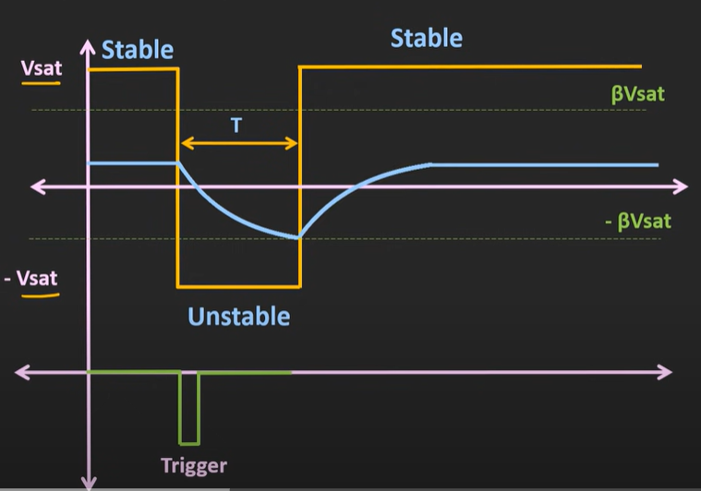

Slide 35
Only for this time T, the o/p will remain in unstable state.
Now again in stable state. Capr voltage = forward V drop of diode.
Here T is only time duration of pulse (Not a time period).

Slide 36
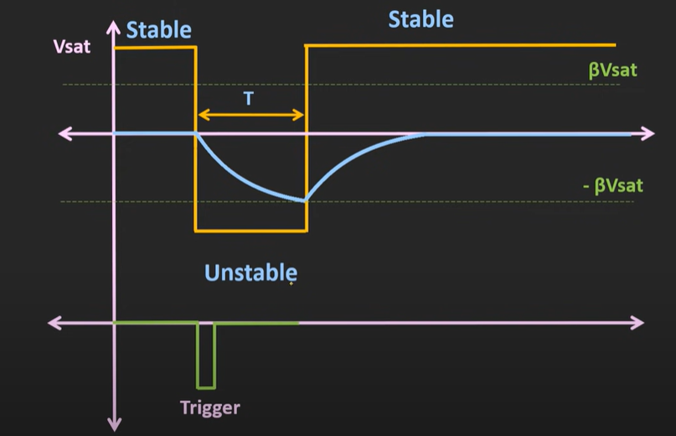
Derivation
Assumed that diode which is used in the ckt is an ideal diode.
So drop across diode =0V
So whenever the –ve trigger is applied to MMV, cap starts charging from 0 to –V_{sat}.

Slide 37
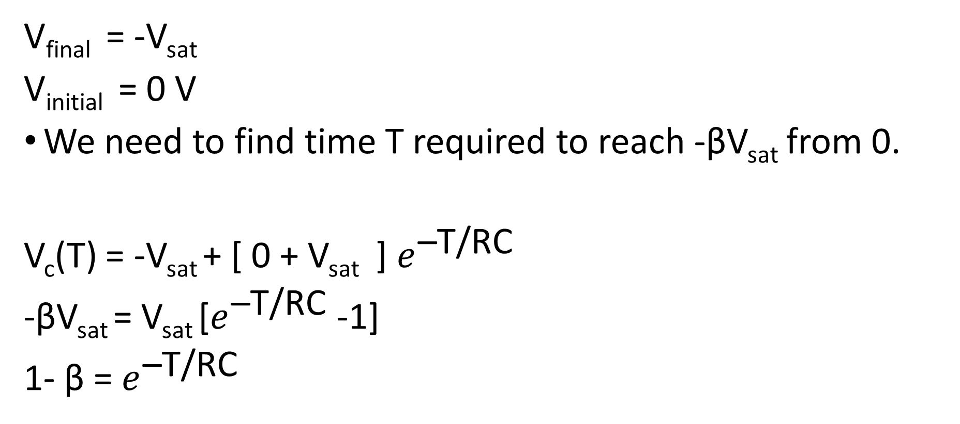
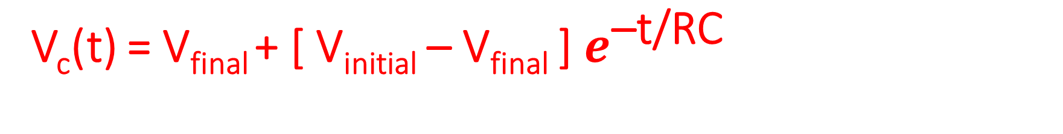
V_{c}(t) = V_{final} + [ V_{initial} – V_{final} ] $e^{\text{–}\text{t}\text{/}\text{RC}}$
V_{final} = -V_{sat}
V_{initial} = 0 V
We need to find time T required to reach -βV_{sat} from 0.
V_{c}(T) = -V_{sat} + [ 0 + V_{sat} ] $e^{\text{–}\text{T}\text{/}\text{RC}}$
-βV_{sat} = V_{sat} [$e^{\text{–}\text{T}\text{/}\text{RC}}$ -1]
1- β = $e^{\text{–}\text{T}\text{/}\text{RC}}$

Slide 38
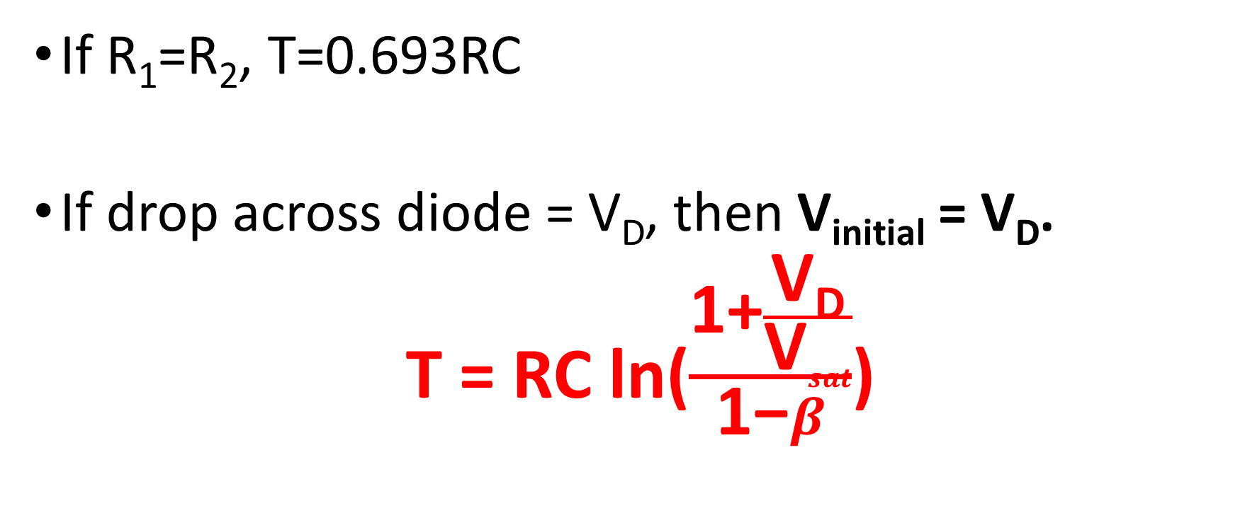

T = RC ln($\frac{\text{1}}{\text{1−}β}$)
If R₁=R₂, T=0.693RC
If drop across diode = V_{D}, then V_{initial} = V_{D}.
T = RC ln($\frac{\text{1+}\frac{\text{V}\text{D}}{\text{V}sat}}{\text{1−}β}$)

Slide 39
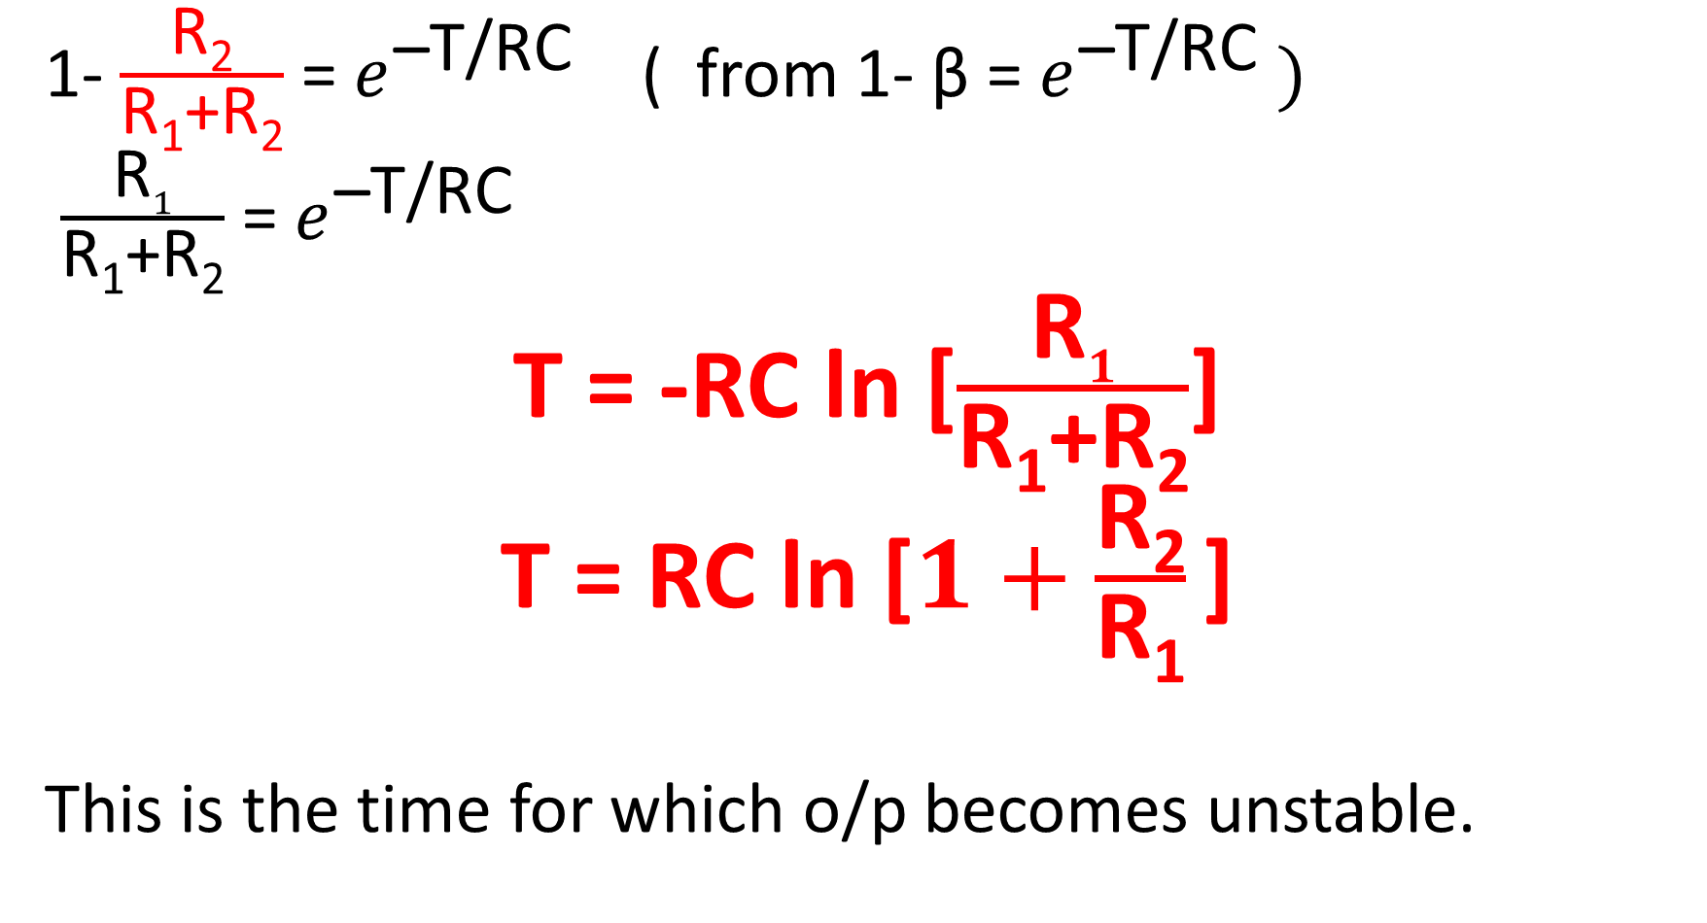
1- $\frac{\text{R}\text{2}}{\text{R}\text{1}\text{+}\text{R}\text{2}}$ = $e^{\text{–}\text{T}\text{/}\text{RC}}$ ( from 1- β = $e^{\text{–}\text{T}\text{/}\text{RC}} )$
$\frac{\text{R}1}{\text{R}\text{1}\text{+}\text{R}\text{2}}$ = $e^{\text{–}\text{T}\text{/}\text{RC}}$
T = -RC ln [$\frac{\text{R}1}{\text{R}\text{1}\text{+}\text{R}\text{2}}$]
T = RC ln [$1+\frac{\text{R}\text{2}}{\text{R}\text{1}}$]
This is the time for which o/p becomes unstable.

Slide 40
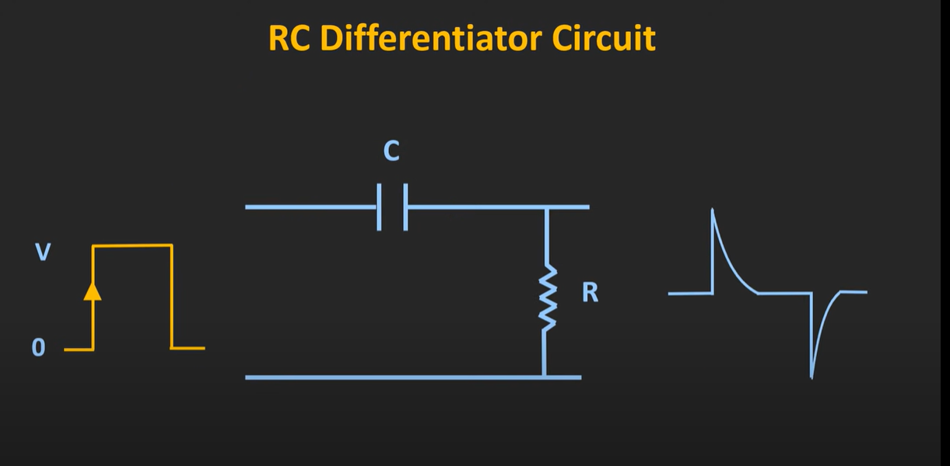
Trigger s/g required to change the state of MMV.
Duration of trigger s/g shud be much < time period for which MMV to go into unstable state.
One way to get this trigger s/g is using differentiator ckt .
When we give a pulse going from 0 to V, we get 2 spikes like this. But we need only (–ve) spike. So we go for next fig.

Slide 41
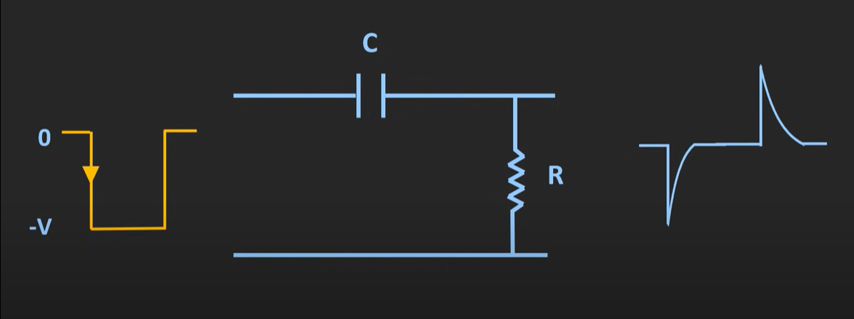
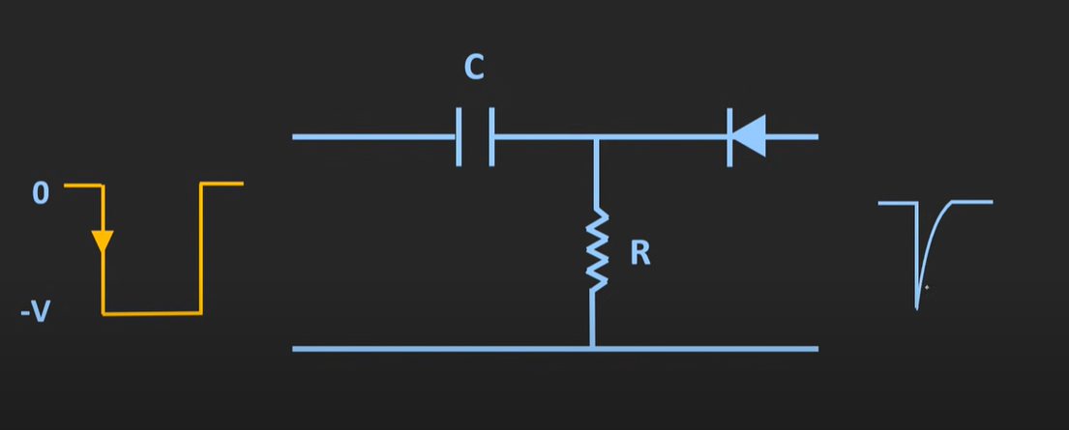
To get only the –ve spike as trigger s/g, use the following ckt with a diode (to eliminate +ve spike).

Slide 42
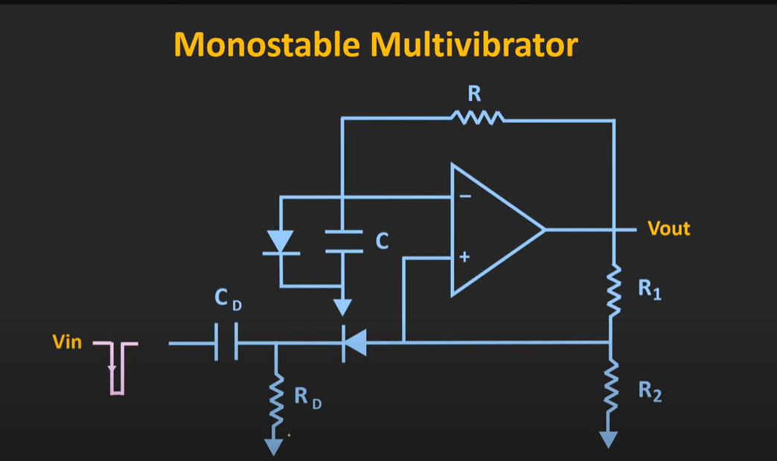

Slide 43
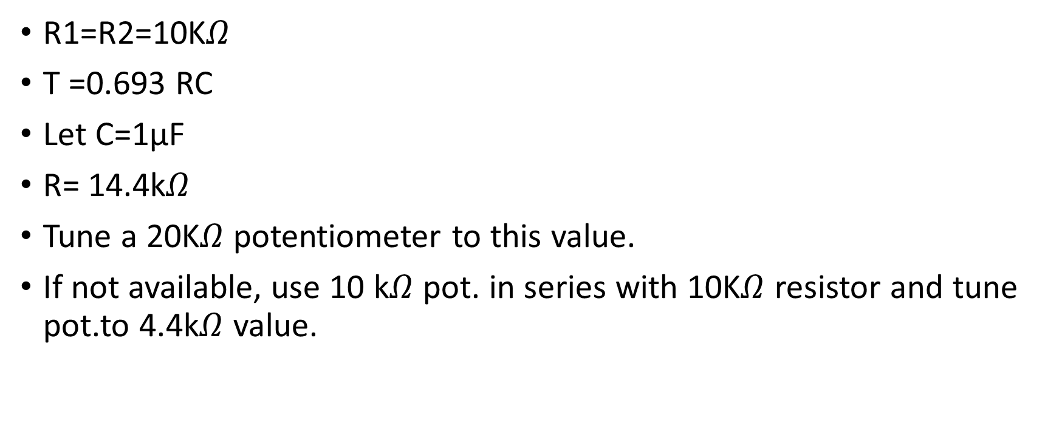
Q: Design a monostable MV which has time T =10ms.
R1=R2=10K$Ω$
T =0.693 RC
Let C=1µF
R= 14.4k$Ω$
Tune a 20K$Ω$ potentiometer to this value.
If not available, use 10 k$Ω$ pot. in series with 10K$Ω$ resistor and tune pot.to 4.4k$Ω$ value.

