Slide 1
FUEL CELLS
JINCEY PRAKASHAN
S3, ECE A
51

Slide 2
CONTENT
INTRODUCTION
• FUEL CELL CONFIGURATION
• TYPES
WORKING
ADVANTAGES
DISADVANTAGES
APPLICATIONS
REFERENCE

Slide 3
WHAT IS FUEL CELLS?
A fuel cell is a electrochemical device that converts chemical energy in to electrical energy
Every fuel cell has two electrodes one positive and negative,called,respectively,The cathode and anode.The reactions that produce electricity take place at the electrodes
In all types of fuel cell,hydrogen is used as fuel and can be obtained from any source of hydrocarbon.
The fuel cell transform hydrogen and oxygen into electric power,emitting water as their only waste product

Slide 4
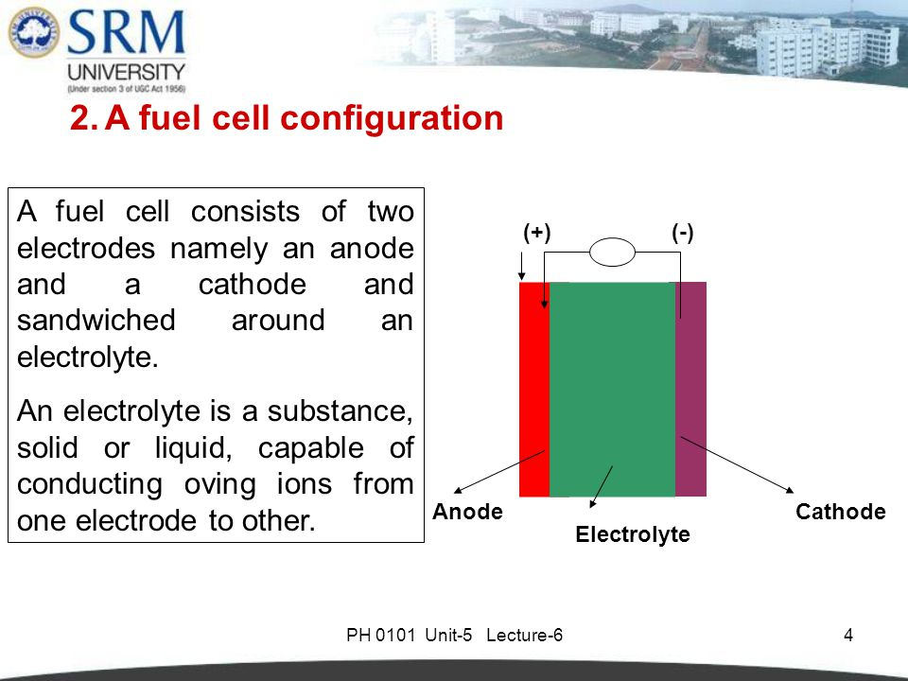
FUEL CELL CONFIGURATION
A fuel cell consists of two electrodes namely an anode and a cathode and sandwiched around an electrolyte.
An electrolyte is a substance that dissociates into ions in solution and acquires the capacity to conduct electricity.

Slide 5
TYPES OF FUEL CELLS
There are different types of fuel cells,differentiated by the types of electrolyte seperating the hydrogen from the oxygen.The types of fuel cells are:
Alkaline fuel cells(AFC)
Direct methanol fuel cells (DMFC)
Molten carbonate fuel cell(MFFC)
Phospheric acid fuel cells(PAFC)
Polymer electrolyte membrane fuel cells(PEMFC)
Solid oxide fuel cells(SOFC)

Slide 6
WORKING OF FUEL CELLS
The reactions between hydrogen and oxygen can be used to generate electricity via a fuel cell.
The working of this fuel cell involved the passing hydrogen and oxygen into a concentrated solution of sodium hydroxide via carbon electrodes

Slide 7
WORKING OF FUEL CELLS
The cell reactions can be written as follows:
Cathode Reactions: O₂+2H₂O+4e →4OH
Anode Reaction: 2H₂+4OH⁻ →4H₂O +4e-
Net Cell Reaction :2H₂+O₂ →2H₂O

Slide 8
ADVANTAGES
The coversion efficiency is high (70 to 80%)
Eco friendly and sustainable as water is one of the by product
Number of fuel cells are stacked(Cascaded)to generate required output voltage

Slide 9
DISADVANTAGES
High initial cost
High cost of electricity generated
If gas is used as fuel they have to be stored in big tanks under high pressure

Slide 10
APPLICATIONS
Fuel cell electric vehicles
They have been used to power many space expeditions including the appolo space program.
Generally,the by products produced from these cells are heat and water.The probability of some fuel cells is extremely useful in some military applications.
These electrochemical cells can also be used to power several electronic devices.
Fuel cells are also used as primary or backup sources of electricity in many remote areas.

Slide 11
REFERENCE
WIKIPEDIA
KTU NOTES

Slide 12
THANK YOU

