Slide 1
Introduction to Version Control
Problems Without Version Control
Real-World Examples
Benefits of Version Control
No history of changes
Difficult collaboration
Risk of losing work
Confusion with file versions
Multiple document versions
Team collaboration issues
Breaking working code
No way to revert mistakes
Complete history tracking
Easy collaboration
Safe experimentation
Time travel to any version

Slide 2

History of Git
1
2005 - The Problem
Linux kernel development relied on the proprietary version control system BitKeeper, but in 2005 the free license for Linux developers was revoked after a licensing dispute, forcing the project to find an alternative.
2
April 2005 - Creation
In April 2005, Linus Torvalds created Git to manage Linux kernel development. The first working version was built extremely quicklywithin about 10 days, and continued evolving over the following months.
3
2008-Present - Growth
Since the late 2000s, Git has become the most widely used version control system, powering millions of projects and platforms like GitHub and GitLab.
Git was created because the Linux team suddenly lost their version control tool.

Slide 3

Git Fundamentals
Repository
Commit
A repository (repo) is a folder that stores your project files and the complete history of all changes.
A saved snapshot of your project at a specific point in time with a message describing the changes.
Branch
Merge
A separate version of the project used to develop features without affecting the main code.
Combines changes from one branch into another (usually into the main branch).
Remote Repository
Local vs Remote
A copy of your repository stored on a server (e.g., GitHub) for collaboration and backup.
Local: repository on your computer.
Remote: repository stored online.
Use push and pull to synchronize them.

Slide 4
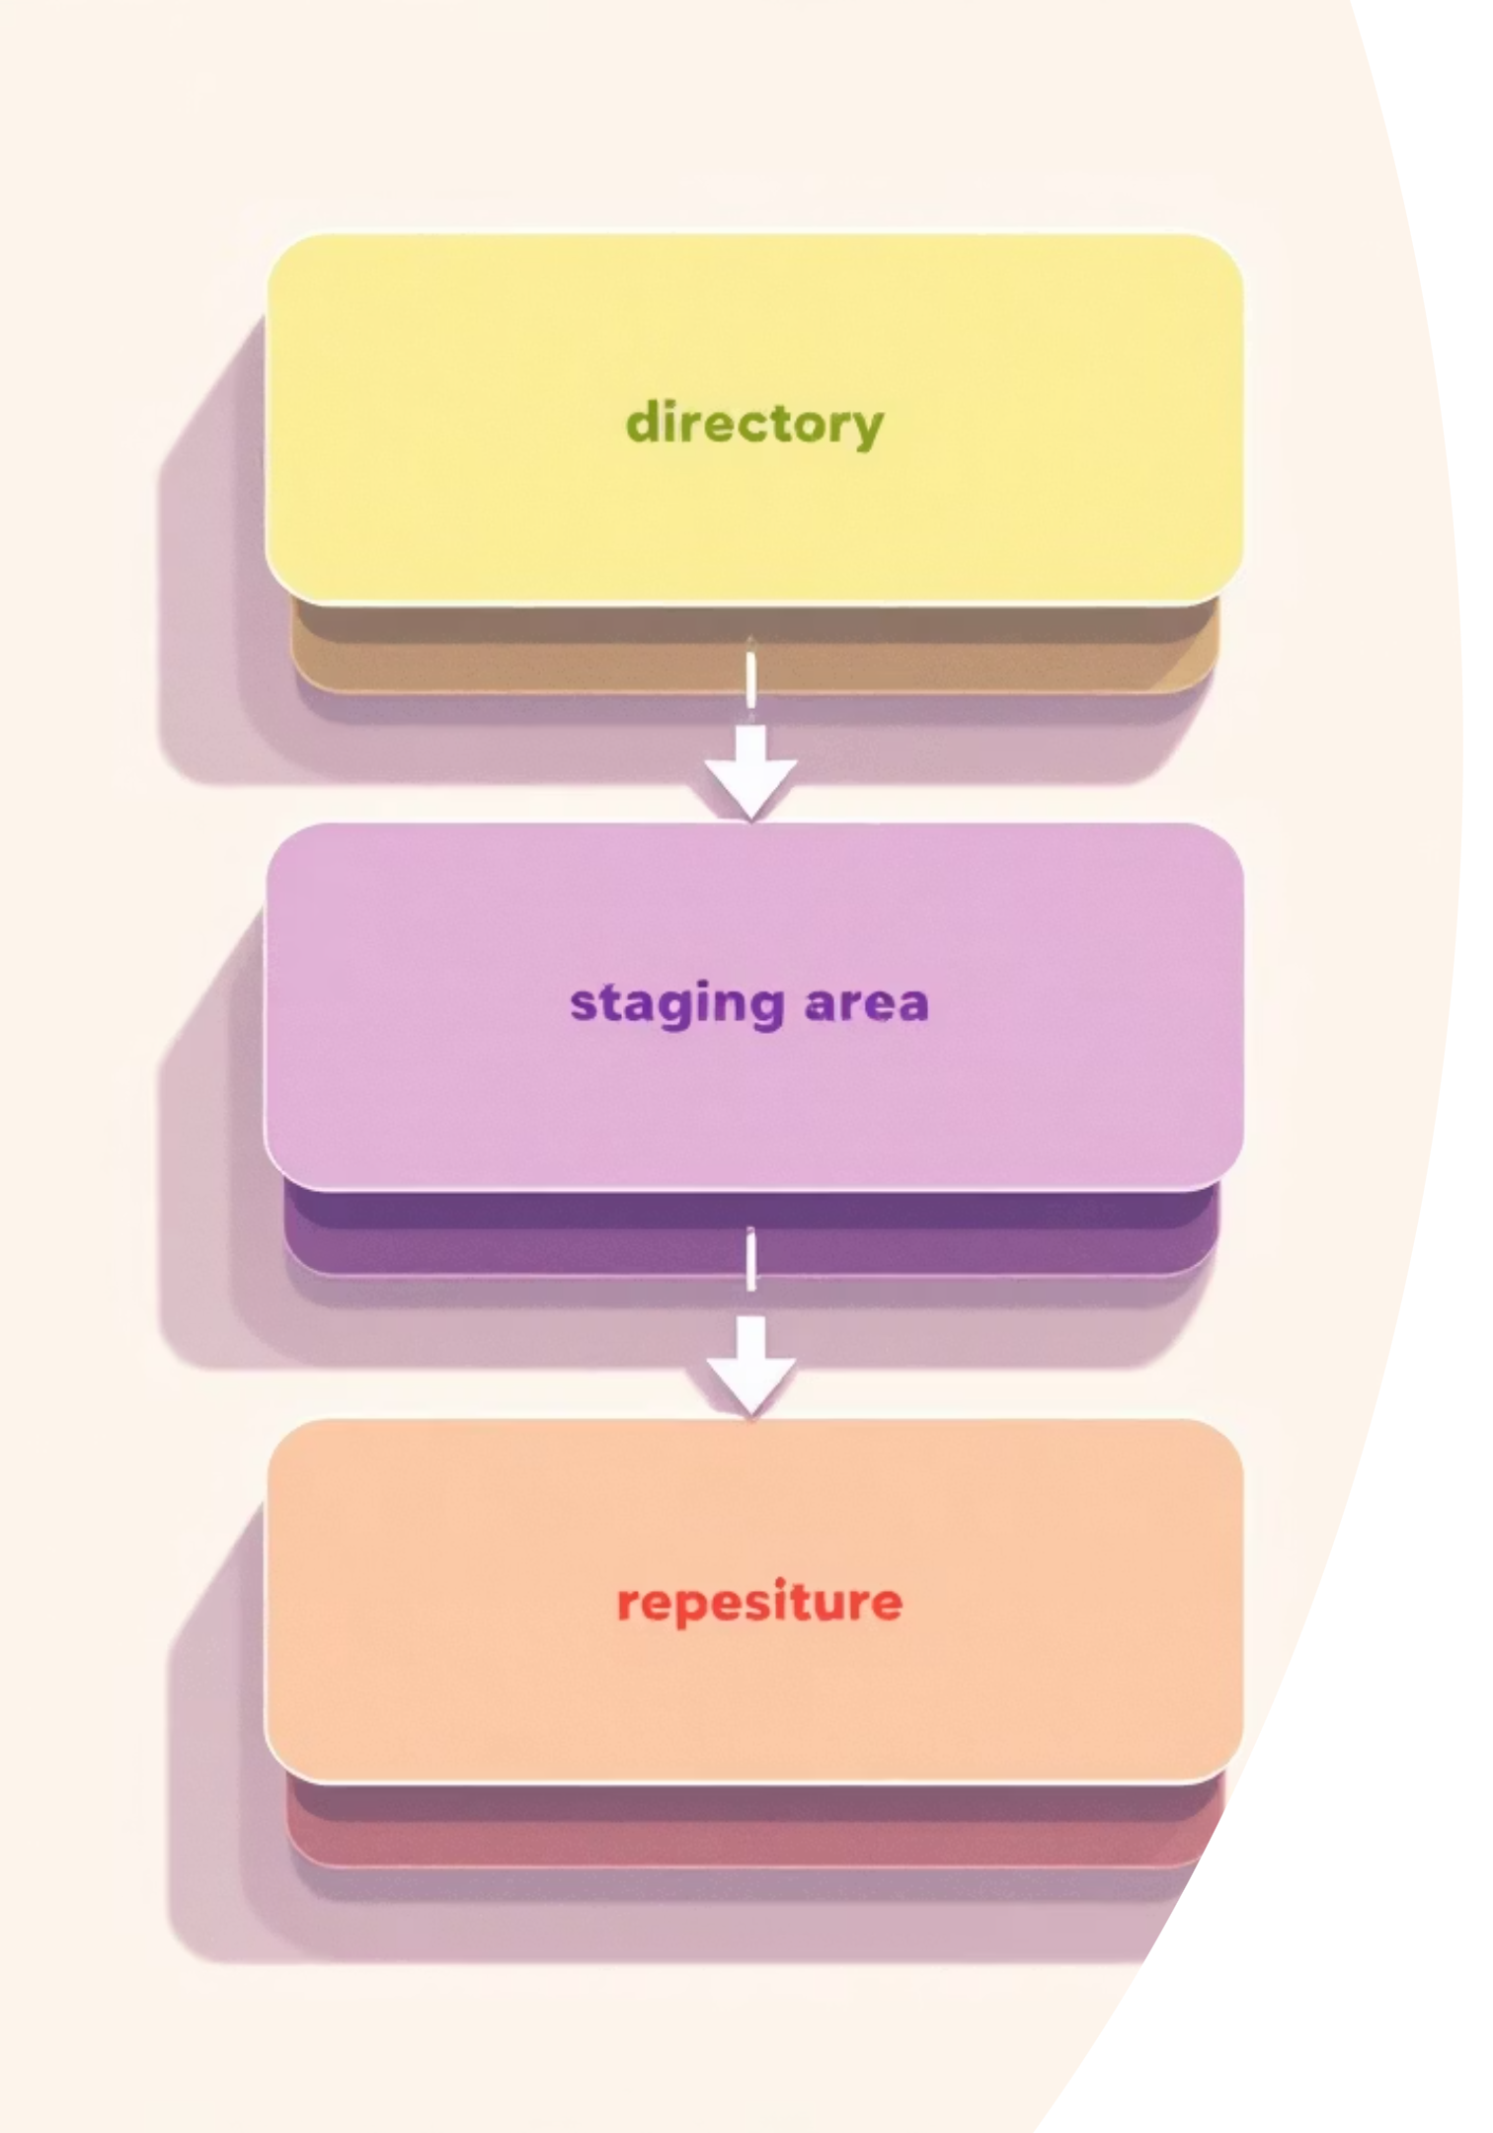



How Git Works: The Three Areas
Working Directory
The project files on your computer that you can create, edit, or delete.
Staging Area
A place where you select and prepare changes before creating a commit.
Git Repository
The database that stores all commits and the complete project history.
Notes:
Question : Why do you think Git has a staging area instead of committing directly?

Slide 5
Installing Git
01
02
Download Git
Run Installer
Visit git-scm.com and download the appropriate installer for your operating system
Follow the installation wizard, keeping default settings for most options
03
04
Verify Installation
Initial Configuration
Open terminal and run git --version to confirm Git is installed.
git config --global user . name "Arun "
If Git is installed correctly, it will show the installed version.
git config --global user . email "arun@neupane.com"
Check configuration:
git config --list
Git uses this information to label your commits so collaborators know who made each change.

Slide 6
Essential Git Commands
git init
Initializes a new Git repository by creating a hidden .git folder that tracks project history.
git init
# Creates .git folder for tracking
git clone
Downloads a remote repository and creates a local working copy.
git clone https://github.com/user/repo.git
# Downloads entire project
git status
Shows the current state of your working directory and staging area
git status
# Lists modified, staged, and untracked files
git add
Adds changes to the staging area for the next commit
git add file.txt
git add .
# stages all changes in the current directory, including: new files, modified files, deletions
git commit
Saves a snapshot of staged changes with a descriptive message
git commit -m "Add new feature"
# Creates permanent record of changes
# Commits are stored in the repository history.
git log
Displays the commit history with messages, authors, and dates
git log
# Shows all commits from newest to oldest
git log --oneline
Notes:
Which command do you think developers use the most? Ans : git status

Slide 7
More Git Commands
git diff
Shows the differences between file versions that have not yet been committed.
git diff
# Displays line-by-line changes
git branch
Lists, creates, or deletes branches in your repository
git branch -> list branches
git branch new-feature -> create new branch with name new-feature
git branch -d new-feature -> Deletes a branch
git checkout / switch
git checkout (older command) and git switch (newer command) are used to change branches.
git checkout main
git switch main
# Changes to main branch
git merge
Combines changes from one branch into the current branch
git checkout main
git merge new-feature
# Merges feature into main
git pull
Downloads changes from remote and merges them into your local branch
git pull = git fetch + git merge
git pull origin main
# Fetches and merges remote changes
git push
Uploads your local commits to the remote repository
git push origin main
# Sends commits to remote
Notes:
What do you think happens if two people push changes at the same time? merge conflicts.

Slide 8

Typical Git Workflow
Clone Repository
Start with a fresh copy of the project from remote
Create Feature Branch
Make a new branch for your work to keep main stable
Make Changes
Edit files and test your modifications in the working directory
Stage Changes
Add your modifications to the staging area with git add
Commit Changes
Save a snapshot with a clear message describing what you did
Push to Remote
Upload your commits so others can access your work

Slide 9
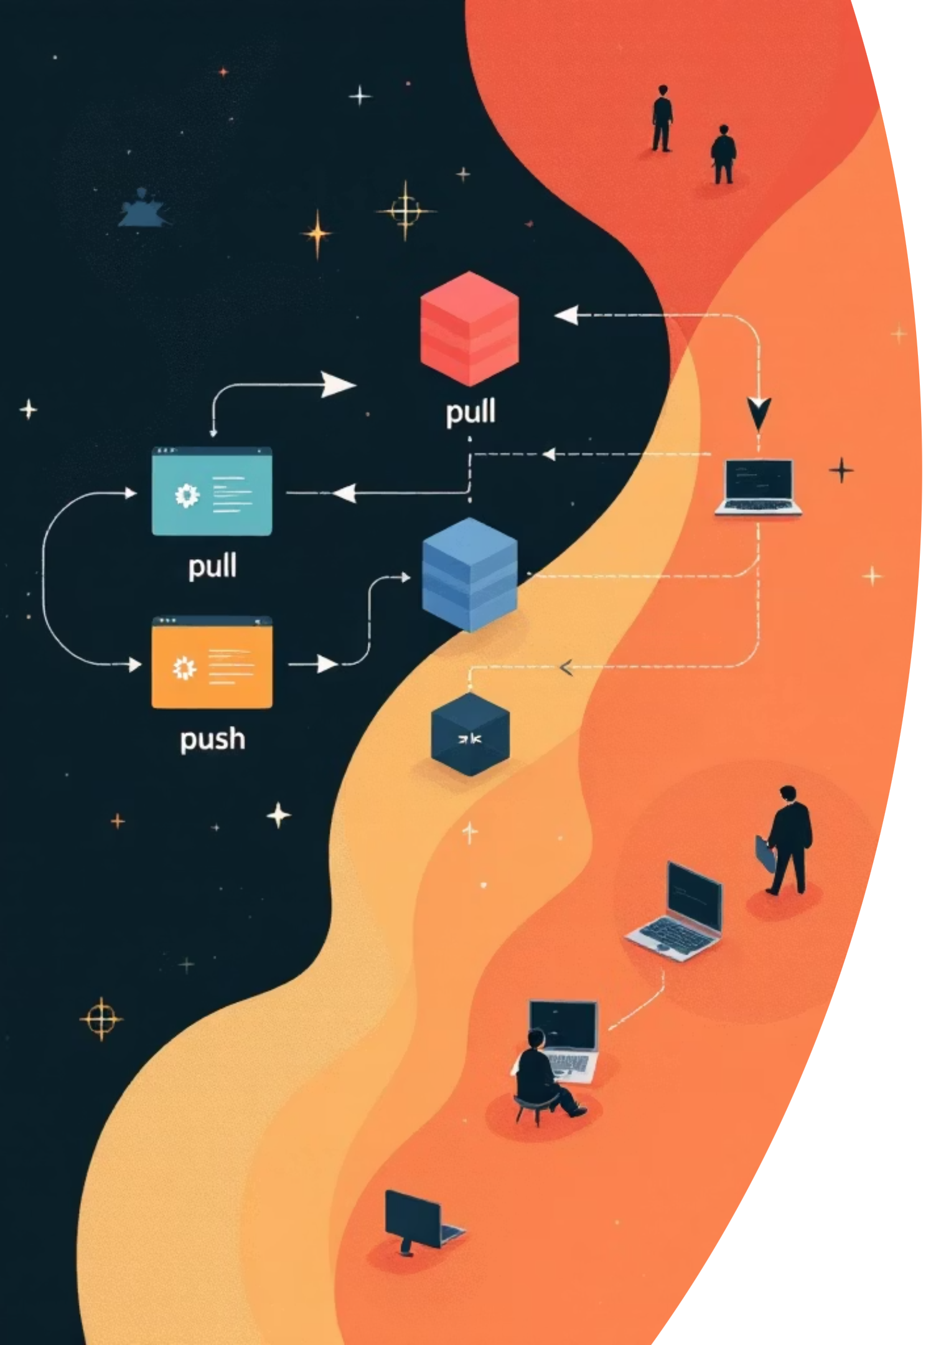



Collaboration with Git
Remote Repositories
git pull
Central locations like GitHub, GitLab, or Bitbucket store your code in the cloud
Always pull latest changes before starting work to avoid conflicts
Merge Conflicts
When changes overlap, Git flags conflicts requiring manual resolution

Slide 10
Hands-On Exercises
Task 1: Initialize and Commit
Task 2: Branch and Merge
Practice the basic Git workflow with these steps:
Practice branching workflow with these steps:
Create a new folder and initialize Git
Add a text file with some content
Stage the file and commit with a message
Verify your commit with git log
Create a new feature branch
Modify the README file in the branch
Commit your changes
Switch back to main and merge the branch
mkdir my-project
cd my-project
git init
echo "Hello World" > README.txt
git add README.txt
git commit -m "Add README"
git branch new-feature
git checkout new-feature
echo "New feature" >> README.txt
git commit -am "Add feature to README"
git checkout main
git merge new-feature

