Slide 1
Airline Management System Module Code: 7CS082 100614702@unimail.derby.ac.uk

Slide 2
Table of Content Assessment 1 :- MySQL Database Changes in Database:- Implementation 1. Home Page 2. Add Passenger Detail 3. View Passenger Details 4. Add Flight Details 5. View Flight Details

Slide 3
Assessment 1 :- MySQL Database

Slide 4
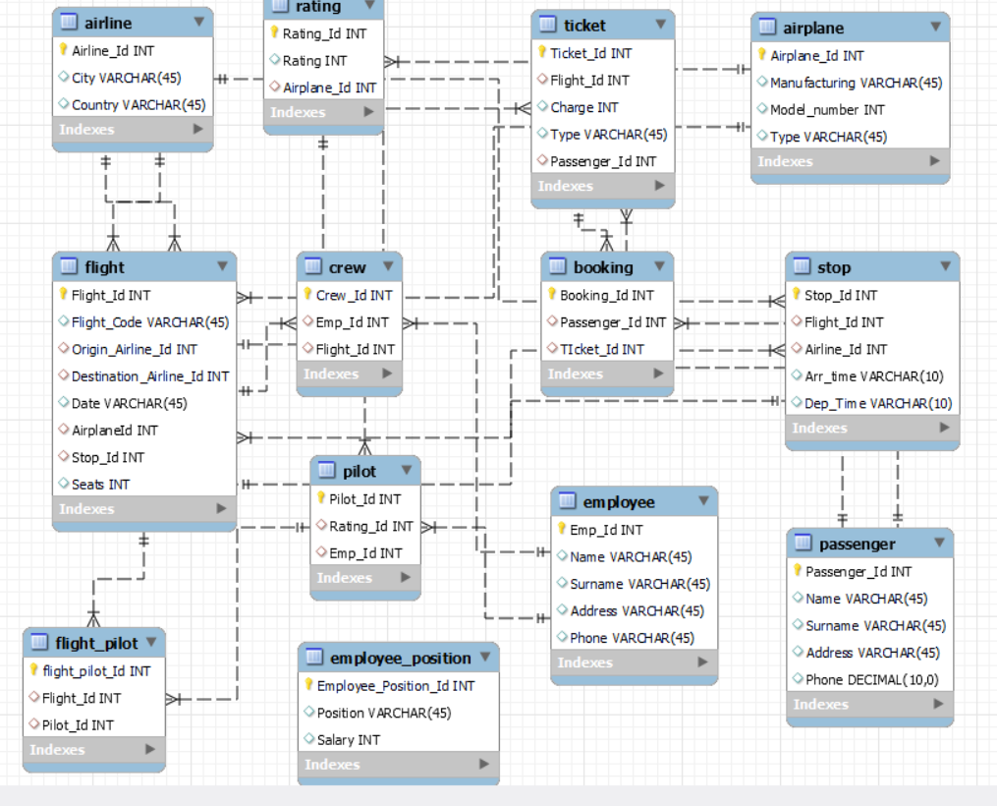
Changes in Database:- 1:- employee_position table to differentiate pilot among staff. 2:- Add stop column to flight table to introduce stops.

Slide 5
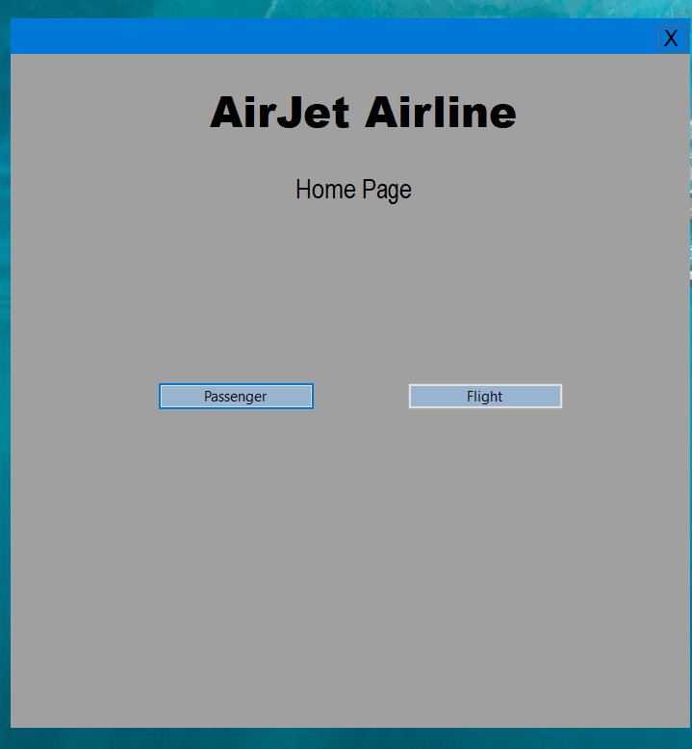
Implementation 1. Home Page

Slide 6
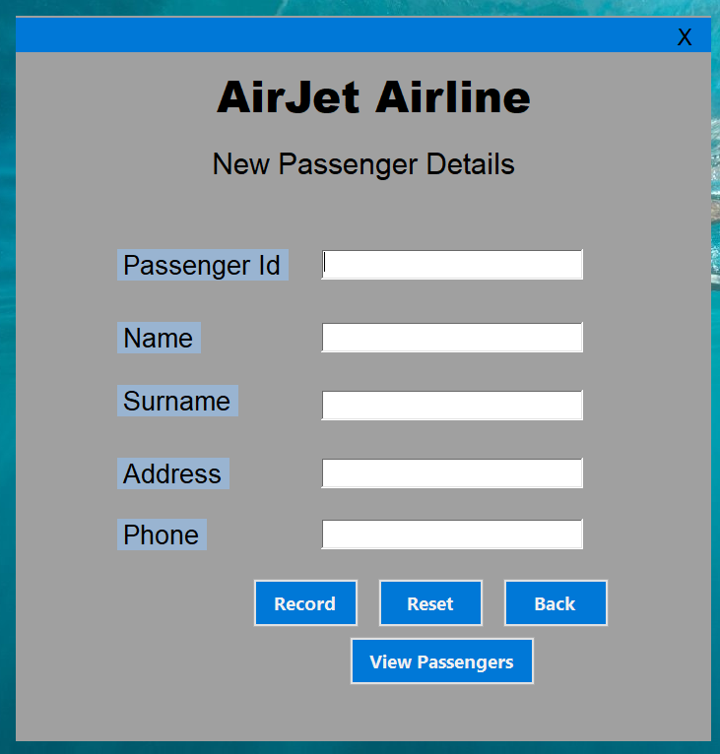
2. Add Passenger Detail

Slide 7
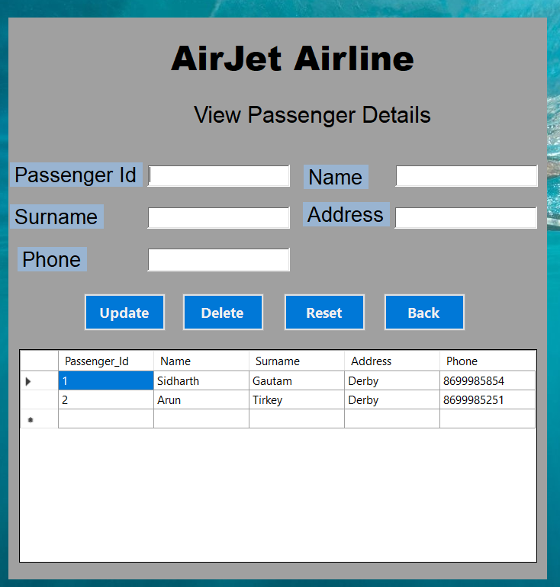
3. View Passenger Details

Slide 8
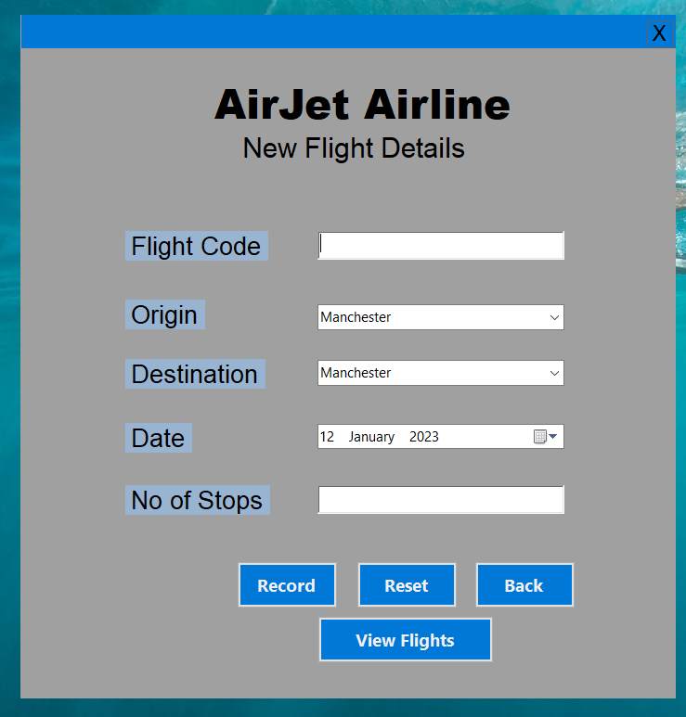
4. Add Flight Details

Slide 9
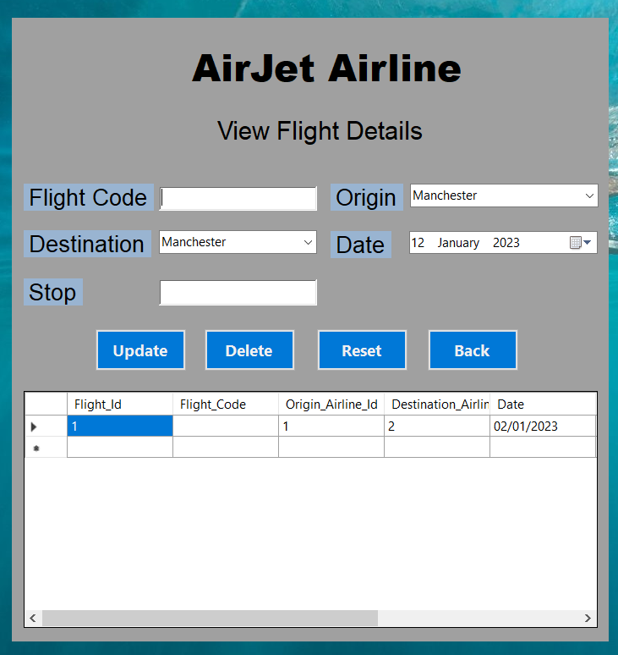
5. View Flight Details

Slide 10

Thank you

