Slide 1
IVY PROFESSIONAL SCHOOL
ADVANCE EXCEL INTERNSHIP
ON
LONDON_HOUSE_SALES PROJECT
Submitted To :- Mrs. Eeshani Sood Agarwal Submitted By :- Arun Deepak Tirkey
and Student Id :- 3644
Mr Yajat Goswami Branch :- Delhi

Slide 2
About Dataset
Dataset of LONDON_HOUSE_SALES having rows 77954 in 2014 and 71155 in 2015.
It has feature name as ‘unique_id’, ‘Sale price’, ‘Sales date’, ‘Postcode’, ‘property type’, ‘new_build’, ‘estate_type’, ‘district’.
It also has data dictionary for column’s value as ‘property type’ {C:Cottage, F:Flat, D:Detached, S:Semi-detached, T:Terrace house}, ‘estate_type’ {F:Freehold, L:Leasehold}, ‘new_build’ {Y:Yes, N:No}

Slide 3
Objective
What is the total sales in 2014 and 2015 ?
What is the monthly sales in property_type wise ?
What is the sales in estate_type wise with district to see whether leasehold property having low sale price or vise versa ?
Which district having less and more sales ?
Proportion of sale_price with respect to property_type.
Which district having down trends in 2014 and 2015 ?
What is the total number of hotels sold in district ?
What is the average sales in district ?
Compare 2014 and 2015 year to find quarterly sales in topmost pricey district.

Slide 4
ANSWER FROM PIVOT
Answer 1 :- Total sales in both year will be found from subtotal of year in pivot table1 of ‘pivot 1’ sheet.
Answer 2 :- From pivot table1 of ‘pivot 1’ sheet.
Answer 3 :- Will get after applying filter to Estate_Type category in pivot table2 of ‘pivot 1’ sheet.
Answer 4 :- It can be seen from pivot table2 of ‘pivot 1’ sheet. As most sale district is CITY OF WESTMINISTRY and least sale district is SUTTON.
ANSWER 5 :- From pivot table2 of ‘pivot 2’ sheet.
ANSWER 6 :- Trends can be seen from chart3.
ANSWER 7 :- Number of house sold in district can be seen in chart5.
ANSWER 8 :- Average sale of house in district can be seen in chart6.
ANSWER 9 :- Topmost pricey district can be found from chart6 then set filter of that city and collapse quarterly sales to get clear comparison graph of 2014 and 2015.

Slide 5
STEPS FOLLOWED
Firstly, data was cleaned by replacing blank space with NULL. Postcode feature was showing blank space and this was also insignificant feature as District feature gives the same.
Secondly, merged two dataset into one using consolidate function.
Thirdly, wrote down 12 objective and according to it built pivot summary. Validate objective’s answer from pivot table.
Fourthly, built dashboard on pivot table summary and chose bar chart for comparison, line chart for trend and pie chart for proportion. Added slicer for district and timeline for year to got separate insight according to selected category.
Fifthly, removed similar looking charts.
Lastly, business insight was introduced from dashboard.

Slide 6
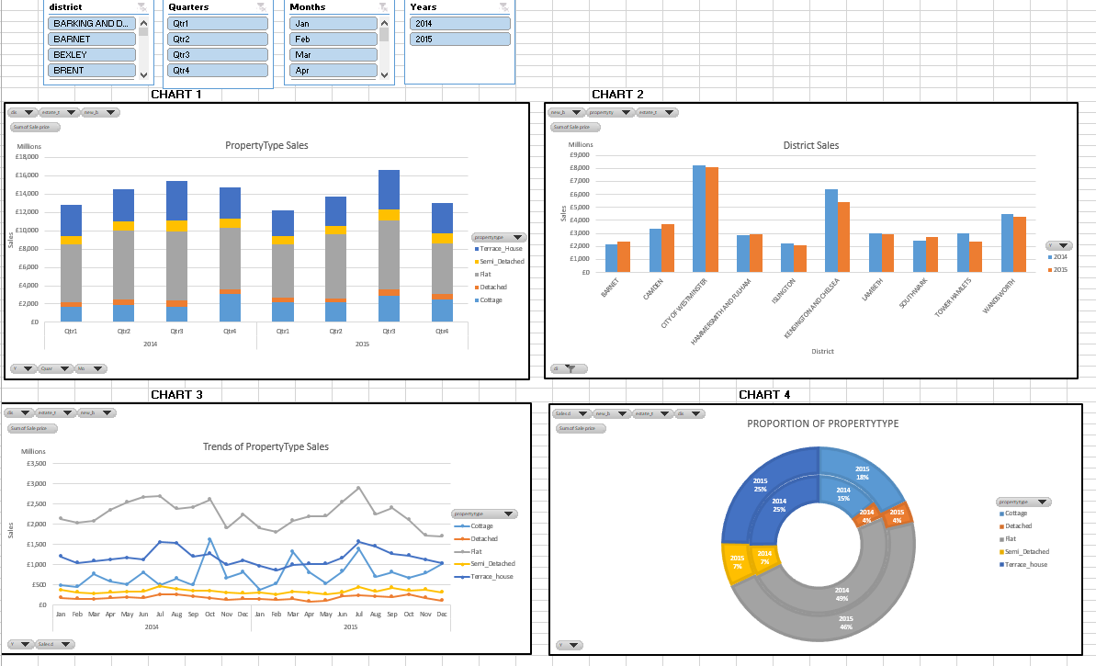
DASHBOARD
SCREENSHOT 1

Slide 7
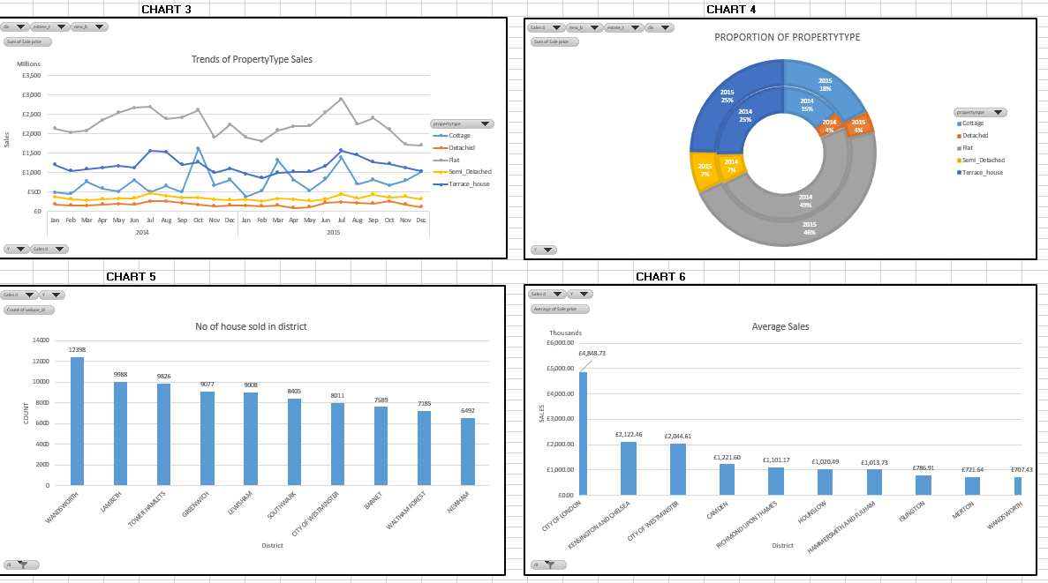
SCREENSHOT 2

Slide 8
BUSINESS INSIGHT
CHART 1
As seen from PropertyType-Sales chart quarter 3 is showing high sales in both 2014 and 2015 . So, company should focus in this quarter most and deploy more strength in it if needed.
Districtwise sale in both year is almost equal.
Most revenue generating district is CITY OF WESTMINISTRY followed with KENSINGTON AND CHELSEA and WANDSWORTH respectively. These are the hotspot for client.
From trends, FLAT segment is the most valuable and should priorities in advertisement. After that TERRACE_HOUSE is priorities.
Also in flat segment , it's having high demand throughout year and generate high revenue.
Client preference in PROPERTY_TYPE is FLAT -> TERRACE_HOUSE -> COTTAGE -> SEMI_DETACHED -> DETACHED
More number of client are investing in WANDERSWORTH and LAMBETH. So, if client wants cheap property then can suggest in that district as from charts average price is low and counts of buying is high
CHART 2
CHART 2
CHART 3 & CHART 1
CHART 4
CHART 5 & CHART 6

Slide 9
THANK YOU

