Slide 1
STROKE ANALYSIS
22071A3210-RISHITHA SHETTY
22071A3218-NAGA ARUNDHATHI
22071A3240-BHAVITHA
22071A3244-NISHA

Slide 2
INTRODUCTION
INTRODUCTION
Application : Public Health Management (HealthCare)Heart Stroke Prediction Analysis. We aim to predict the likelihood of a stroke revolves around historical health data-including blood pressure, age, smoking status, and cholesterol levels.
Technical Approach : Techniques of data mining can be applied in the meaningful extraction of patterns from huge health care datasets, for example, risk factors like age, lifestyle, and history of previous diseases and machine learning algorithms like decision trees, logistic regression, or neural networks can be applied for predicting the likelihood of stroke.
Dataset : The dataset consists of both numerical and categorical values like age,gender,bmi,hypertension.
Challenges : 1.Missing Data:Columns such as bmi contains missing values which need to be addressed2.Categorical Data:Features such as gender,smoking status needs to be encoded.

Slide 3
PROBLEM STATEMENT
PROBLEM STATEMENT
Heart strokes rank among the deadliest causes of death worldwide, wherein millions of individuals are vulnerable to the risk based on age, hypertension, diabetes, and other lifestyle aspects. Early forecasting of heart strokes will consequently bring down the mortality rate. However, the diversity of various factors and lack of early symptoms present significant challenges in precise prediction.
Justification and Feasibility:
The proposed technical solution is not only feasible but necessary in the sense that it exploits readily available machine learning algorithms and data preprocessing techniques well-suited to the task of dataset-based stroke prediction. While there is an alarming trend of increasing cases of heart strokes and critical necessity to provide early intervention, it is this solution that is called upon to enable doctors to make data-driven decisions that can save lives. It helps to improve the effectiveness of the analysis and prediction of at-risk patients, making the process very efficient so that it goes to the field on time. Real-time monitoring is done, and resource utilization is optimised, which makes it a significant tool of preventive care and keeps it friendly in terms of clinical decisions.

Slide 4
PROBLEM STATEMENT
ABSTRACT
In today's healthcare landscape, predicting the likelihood of a stroke has become vital due to the high mortality and morbidity rates associated with cardiovascular diseases. However, the diversity of various factors and lack of early symptoms present significant challenges in precise prediction. This project aims to forecast stroke risks based on historical health data, utilizing machine learning algorithms such as decision trees, logistic regression, and hybrid Support Vector Machine (SVM) models enhanced with Synthetic Minority Over-sampling Technique (SMOTE) to detect patterns associated with stroke risk. Key challenges include handling missing values (e.g., in BMI) and encoding categorical variables, such as gender and smoking status, to ensure data integrity. A unique feature of this project is the development of a composite health score, derived from metrics like age, BMI, and glucose levels, which may provide a more comprehensive view of health status than individual metrics. By efficiently processing these predictors and utilizing advanced methodologies, this solution will empower healthcare providers to deliver timely and targeted preventive care, potentially reducing the stroke-related mortality rate.

Slide 5
OBJECTIVES
OBJECTIVES
Building an Accurate Predictive Model: Develop a robust machine learning model utilizing patient health records and a composite health score from age, BMI, and glucose levels to enhance stroke prediction accuracy.
Data Preprocessing and Feature Engineering: Employ advanced data preprocessing techniques and feature engineering to improve model performance by creating new variables that capture health metrics and risk factors effectively.
Early Risk of Stroke Detection: Equip healthcare professionals with analytical tools for timely stroke risk detection, enabling personalized treatment plans based on individual risk profiles identified through a hybrid SVM model enhanced by SMOTE.
Contributing to Public Health Efforts: Provide health officials with actionable insights from analytics to develop educational programs and early detection strategies, promoting healthy behaviors and improving overall population health outcomes.

Slide 6
OBJECTIVES
PROPOSED IDEA
This project aims to build a reliable stroke prediction model using Support Vector Machine (SVM), leveraging patient health records with key factors like age, BMI, hypertension, and glucose levels. Data preprocessing will include handling missing values, scaling features, and encoding categorical variables for optimal SVM compatibility.
A unique composite health score will be created from metrics like age, BMI, and glucose levels to serve as a holistic indicator, adding predictive depth to the model. SMOTE (Synthetic Minority Over-sampling Technique) will address the dataset’s class imbalance, improving the model’s sensitivity to stroke cases and ensuring accurate predictions across different patient profiles.
STEPS IN IDEA PROPOSED:-

Slide 7
OBJECTIVES
PROPOSED IDEA
1)Data Collection
Gather a dataset containing patient health records.
Key features should include age, BMI, hypertension status, glucose levels, blood pressure, and lifestyle factors like smoking.
Ensure both numerical and categorical variables are included, covering diverse stroke risk factors.
2)Data Preprocessing
Handling Missing Values: Use imputation techniques (e.g., mean or K-nearest neighbors) to fill missing data, especially in important features like BMI.
Scaling and Normalization: Standardize continuous features (e.g., age, glucose) to bring them into a similar range, which is important for SVM.
Encoding Categorical Variables: Convert categorical features (e.g., gender, smoking status) to numeric form using encoding (like one-hot encoding) so the model can understand them.
3)Feature Engineering
Composite Health Score: Create a new feature by combining age, BMI, and glucose levels into a single score, representing an overall risk factor.
Interaction Features: For added complexity, create new features that combine existing ones (e.g., an interaction between hypertension and glucose) to capture relationships that may impact stroke risk.
4)Data Balancing with SMOTE
Addressing Class Imbalance: Since stroke cases are typically fewer, use SMOTE (Synthetic Minority Over-sampling Technique) to generate synthetic stroke instances.
Impact: This helps balance the dataset, ensuring the model does not overly focus on non-stroke cases, improving prediction accuracy for stroke cases.

Slide 8
OBJECTIVES
PROPOSED IDEA
5)SVM Model Training
Select the SVM Model: Choose Support Vector Machine (SVM) for its strong performance in classification tasks.
Kernel Selection: Test different SVM kernels (e.g., linear, radial basis function) to find the best fit for the dataset, as each kernel has unique advantages.
Model Training: Train the SVM model on the balanced and preprocessed dataset to classify patients as high or low stroke risk.
6)Evaluation and Tuning
Cross-Validation: Evaluate the model with cross-validation to check for reliability and prevent overfitting.
Performance Metrics: Use metrics like accuracy, precision, recall, and F1-score to measure the model’s effectiveness in identifying stroke risk accurately.
Hyperparameter Tuning: Adjust parameters like the regularization constant (C) and kernel parameters to optimize model performance, balancing sensitivity and specificity.
7)Risk Detection Interface
Develop a User Interface: Create an easy-to-use interface where healthcare providers can input patient data and receive instant risk predictions.
Real-Time Insights: The interface should display the SVM model's output immediately, helping doctors make timely decisions for at-risk patients.
Intervention Planning: This tool can help healthcare providers plan personalized care and preventive strategies.

Slide 9
PROPOSED ARCHITECTURE/FRAMEWORK
RELATED WORKS/LITERATURE STUDY
https://www.researchgate.net/publication/236676962_Prediction_and_Control_of_Stroke_by_Data_Mining
https://ieeexplore.ieee.org/document/10112495/
https://scholar.google.co.in/scholar_url?url=https://www.ncbi.nlm.nih.gov/pmc/articles/PMC3678226/&hl=en&sa=X&ei=Oq3OZo-cLt2W6rQPwJ-w4AY&scisig=AFWwaeb3Xm4PVnJkaiLqP-ATZwty&oi=scholarr

Slide 10

TIMELINE(S) / WORK DISTRIBUTION
TIMELINE(S)/WORK DISTRIBUTION
Data Collection
Gather Data
Validate Data
Import Data
Data Preprocessing
Clean Data
Normalize Data
Encode Data
Feature Selection
Analyze Features
Select Key Features
Validate Selection
Model Building
Train Model
Test Model
Refine Model

Slide 11
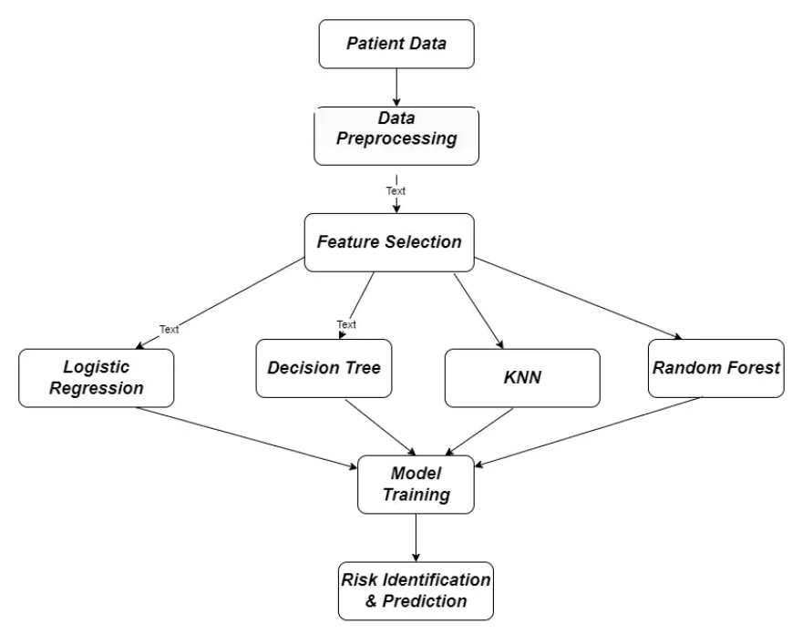
RELATED WORKS/LITERATURE STUDY
PROPOSED ARCHITECTURE/FRAMEWORK

Slide 12
DATASET DESCRIPTION
DATASET DESCRIPTION
Name of the Dataset: Stroke Analysis
Source: https://www.kaggle.com/datasets/samueltaiwograce/stroke-dataset
Tasks: Data preprocessing,feature selection
Detailed Specification:
Gender : Male, Female, or Other
Age : Age of the patient
Hypertension : If the patient is suffering from hypertension or not (1 for yes, 0 for no).
Heart Disease : If the patient is having heart diseases or not (1 for yes, 0 for no).
Ever Married : If the patient is ever married or not.
Work Type : Whether the patient doing private or self employed job
Residence Type : Urban or Rural
Average Glucose Level : The Average glucose level in the blood.
BMI : BMI of the patient.
Smoking Status: Patient smokes, never smoked, or some time in the past smoked?
Stroke : Patient ever had a stroke? 1= yes , 0 = no.

Slide 13
REFERENCES
REFERENCES
https://www.ncbi.nlm.nih.gov/pmc/articles/PMC9268898/
https://www.sciencedirect.com/science/article/pii/S2772442522000090
https://www.warse.org/IJATCSE/static/pdf/file/ijatcse289952020.pdf

Slide 14
THANK YOU

