Slide 1


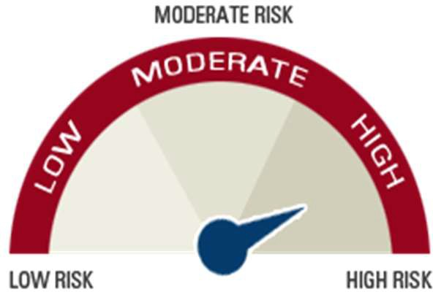


ICICI Pru India Fund - Large Cap
COMP/DOC/Mar/2026/133/2182
SFIN - GIFT 007 251125 InLargeCap 105
Inception date: 27th January, 2026
Objective
To provide superior long-term returns through focused funds which invest in large-cap stocks, ADRs, and GDRs of Indian companies listed in global equity markets.
Fund Composition
Risk Meter
Asset Mix | Min% | Max%
Equity | 90 | 100
Money market and cash | 0 | 10
Debt | 0 | 10
Fund Performance (Back-tested)
Illustrative List of Companies
State Bank of India Vedanta Ltd
Oil & Natural Gas Corp Ltd NTPC Ltd
Torrent Pharmaceuticals Ltd Ashok Leyland Ltd
Coal India Ltd Indus Towers Ltd
Hindalco Industries Ltd
Max Financial Services Ltd
14%
12%
10%
8%
6%
4%
2%
0%
10.28%
11.61%
8.62%
3 Years
5 Years
10 Years
Back-tested returns are calculated based on the historical performance that the strategy would have generated had the funds been deployed across different time periods. The above mentioned returns are as on September 30, 2025 and are shown prior to the deduction of the applicable fund management charges.
Disclaimer: The Fund(s) is a part of investment-linked insurance products offered by ICICI Prudential Life Insurance Company Limited, GIFT City – IFSC.
Fund values may fluctuate based on market performance and other factors. Past performance of the Fund(s) is not indicative of future results. Returns shown are for illustrative purposes only and are not guaranteed. In this policy, the investment risk in the portfolio is borne by the policyholder.

