Slide 1


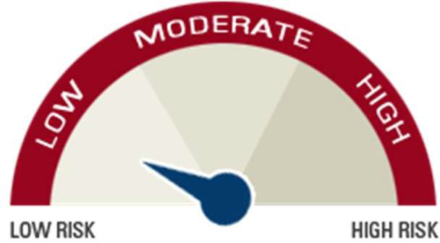


ICICI Pru US Medium Term Treasury Bond Fund
COMP/DOC/Mar/2026/133/2182
SFIN - GIFT 005 251125 USMedTreas 105
Inception date: 27th January, 2026
Objective
To generate steady income through investments in global fixed income funds which invest in medium-term US Government bonds.
Fund Composition
Risk Meter
Asset Mix | Min% | Max%
Equity | 0 | 0
Money market and cash | 0 | 10
Debt | 90 | 100
Fund Performance (Back-tested)
4%
3%
2%
1%
0%
-1%
-2%
-3%
3.62%
1.27%
-1.82%
3 Years
5 Years
10 Years
Back-tested returns are calculated based on the historical performance that the strategy would have generated had the funds been deployed across different time periods. The above mentioned returns are as on December 31, 2025 and are shown prior to the deduction of the applicable fund management charges.
Disclaimer: The Fund(s) is a part of investment-linked insurance products offered by ICICI Prudential Life Insurance Company Limited, GIFT City – IFSC.
Fund values may fluctuate based on market performance and other factors. Past performance of the Fund(s) is not indicative of future results. Returns shown are for illustrative purposes only and are not guaranteed. In this policy, the investment risk in the portfolio is borne by the policyholder.

