Slide 1


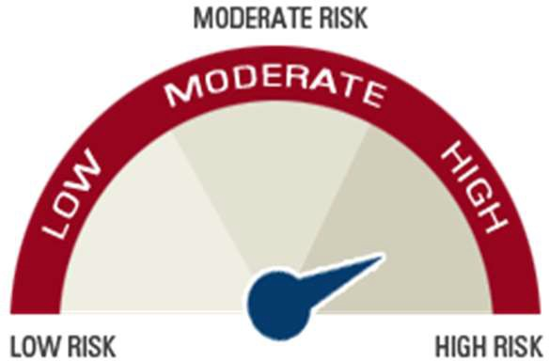


ICICI Pru Global Diversified Fund
COMP/DOC/Mar/2026/133/2182
SFIN - GIFT 003 251125 GlobalDivF 105
Inception date: 27th January, 2026
Objective
To provide superior long-term returns through Global Equity funds which invest in equities listed in developed countries around the globe.
Fund Composition
Risk Meter
Asset Mix | Min% | Max%
Equity | 90 | 100
Money market and cash | 0 | 10
Debt | 0 | 10
Fund Performance (Back-tested)
Illustrative List of Companies
NVIDIA
Apple Alphabet Microsoft Amazon
Micron Technology GE Aerospace Shell PLC
Toyota Motor Corp
Hitachi Ltd
25%
21.31%
20%
15%
12.36%
12.40%
10%
5%
0%
3 Years
5 Years
10 Years
Back-tested returns are calculated based on the historical performance that the strategy would have generated had the funds been deployed across different time periods. The above mentioned returns are as on December 31, 2025 and are shown prior to the deduction of the applicable fund management charges.
Disclaimer: The Fund(s) is a part of investment-linked insurance products offered by ICICI Prudential Life Insurance Company Limited, GIFT City – IFSC.
Fund values may fluctuate based on market performance and other factors. Past performance of the Fund(s) is not indicative of future results. Returns shown are for illustrative purposes only and are not guaranteed. In this policy, the investment risk in the portfolio is borne by the policyholder.

