Slide 1
[BALTIMORE, MD]
[02/12/2020]:[How to Secure Mule API's With a Demo]

Slide 2
Agenda
Introductions
About Speaker
MuleSoft Connect 2020
How to Secure Mule API’s with a Demo
Review default security polices in API Manager
Auto discovery concepts & its internal working
Securing a non-secured external API
Using OAuth and JWT to protect API’s in Mulesoft.
Create and Apply custom policies
Q & A
Trivia Round

Slide 3
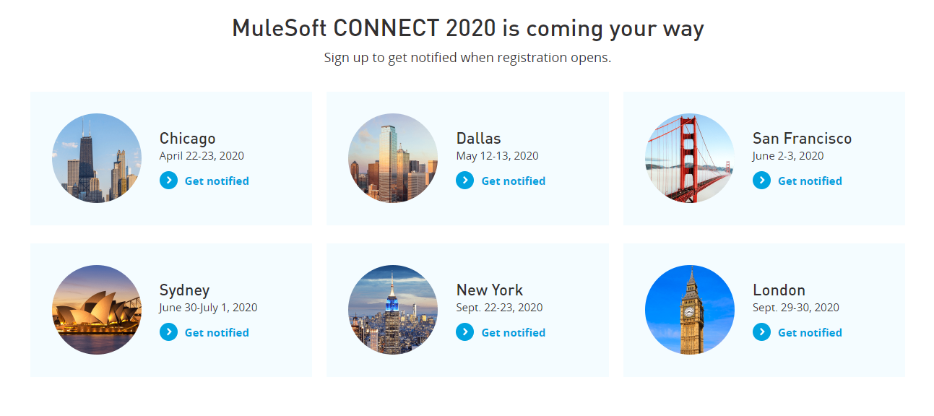
MuleSoft Connect 2020
A SHOW OF HANDS:
Who is new to this MeetUp?

Slide 4
Some Assumptions…
For this session, we are assuming audience have:
Familiarity with API’s. Why we need them, How we use them, etc.
Basic knowledge of REST, SOAP, HTTP/S.
Some understanding of security standards like Basic Auth, OAuth.
Familiar with data format’s like JSON, XML
Some familiarity with Anypoint Platform: Design Center, Exchange & Management Center (API Manager, Runtime Manger)
Some knowledge of RAML, Policies

Slide 5
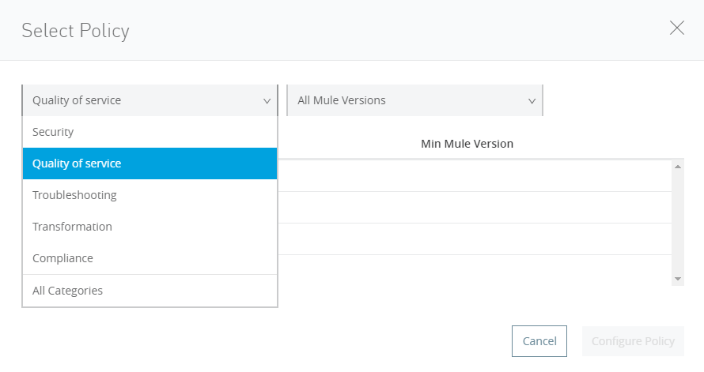
API Manager
Apply various polices for security, set throttling and rate-limiting, to ensure high performance and control.
Default Policies categories
Security
Quality of Service
Troubleshooting
Transformation
Compliance
Custom Policies - Deploy customized Policies as per your requirement, developed in Anypoint studio
Automated Policies - Feature of automated policies to apply same set of policies to many APIs
All contents © MuleSoft Inc.
9

Slide 6
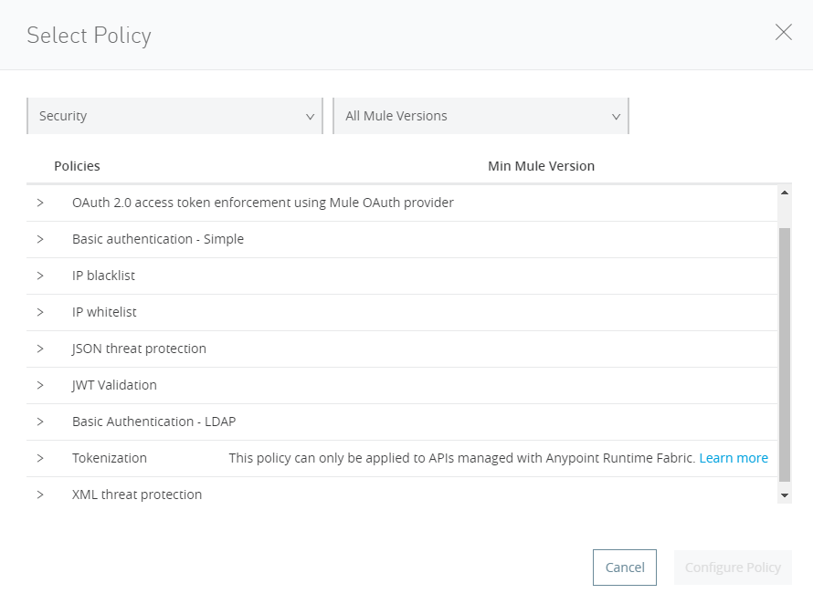
API Manager: Security Policies
Common Security Policies
Basic authentication – Simple, LDAP
JSON/XML Threat protection
IP whitelist/blacklist
JWT Validation
OAuth 2.0

Slide 7
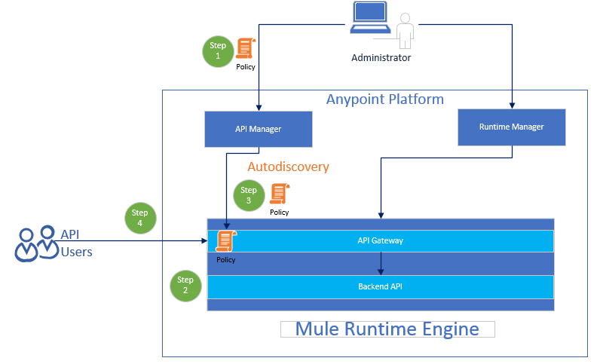
Autodiscovery
Autodiscovery steps:
Step 1: Admin configures a policy on API through API Manager
Step 2: Corresponding Mule API is deployed in Mule Runtime
Step 3: Through Autodiscovery (API Name, Version) this policy is paired with the deployed application.
Step 4: The policy is enforced every time a API user, tries to access a resource.

Slide 8
Demo 1: Auto-discovery in Action
Lets see what's happening under the hood, when we apply a policy in API Manager

Slide 9
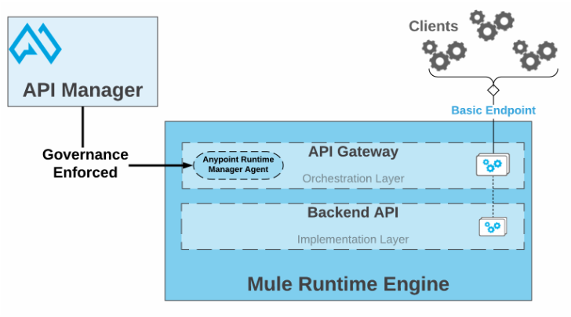
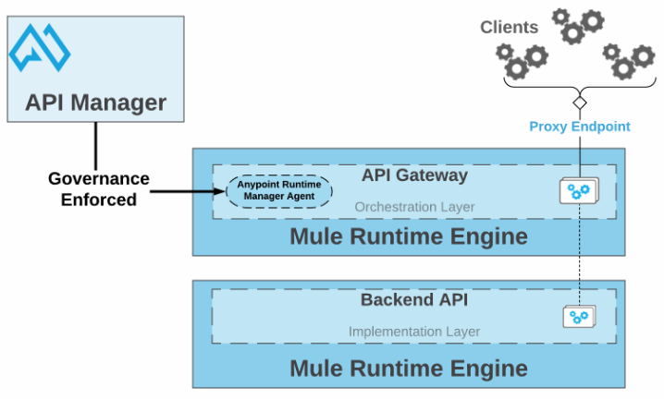
Basic Endpoint Vs Proxy Endpoint
You can set up one of the following types of endpoint management:
Basic endpoint
Set up a basic endpoint if you create the API using Mule Runtime, you don’t need a proxy.
Endpoint with proxy
When you want to leverage API Gateway capabilities and your backend API is not based on Mule Runtime
Or when your API is based on Mule Runtime but you are unable to define the corresponding Autodiscovery element because it is a closed code.

Slide 10
Demo 2: Securing External API
Configuring proxy in API Manager for an external API
Secure it by Basic Authentication
Test 1, without using the policy
Test 2, With Policy enabled
Test 3, with negative testing
Review Policy configurations

Slide 11
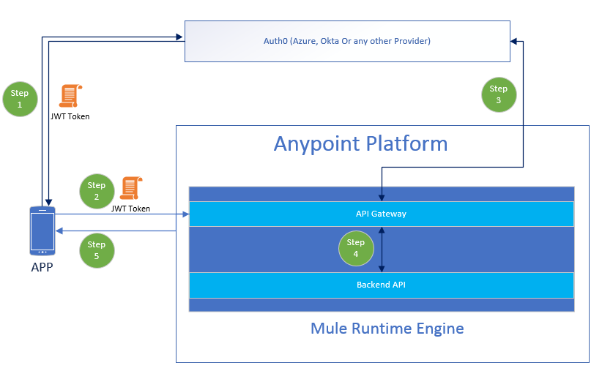
OAuth Protocol
Step 1: Client App requests an Access token from Authorization Server
It provide client id, secret, grant type and audience details in the request
Auth Server returns the access token
Step 2: Client App makes a request to the API using the access token as bearer token
Step 3: API Gateway intercepts the request and verify the token with Authorization Server
Step 4: If the token is valid the request can process to resource API
Step 5: Client App get the request resource back

Slide 12
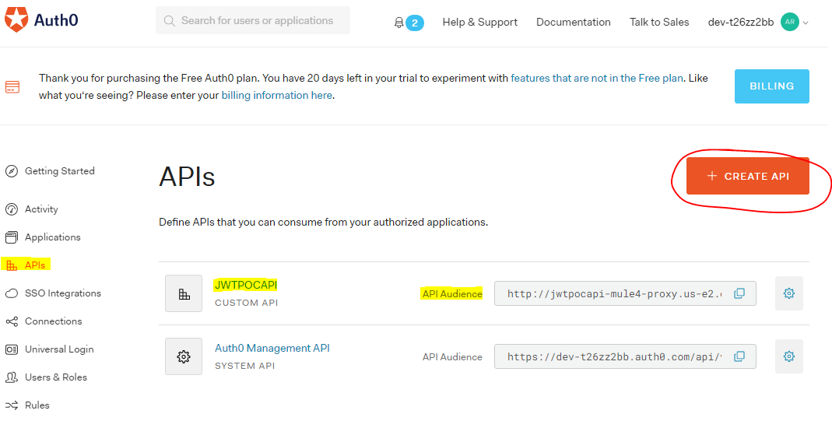
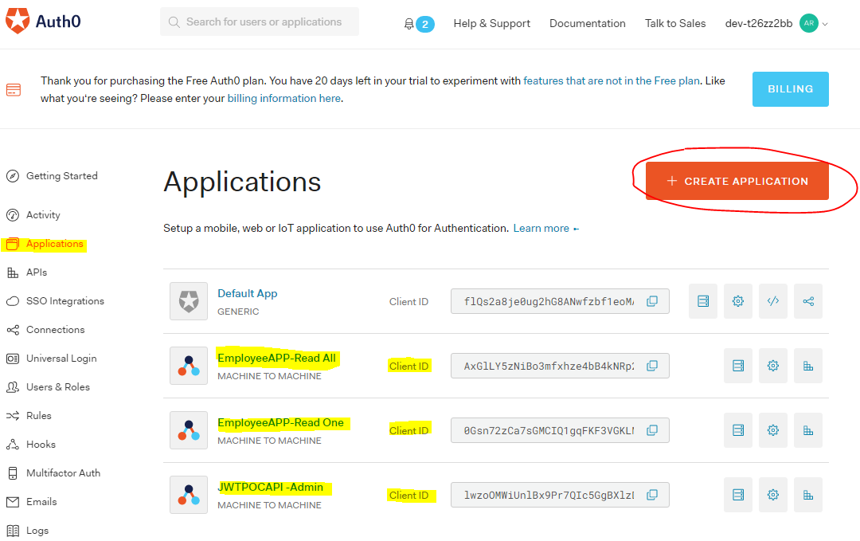
Auth0 Configuration
Step 1: Register API with unique audience details
Step 2: Register client App to receive client id & secret
Step 3: Grant access from API to the client App
Note down OAuth url, JWKS url (key set), signing method, key length

Slide 13
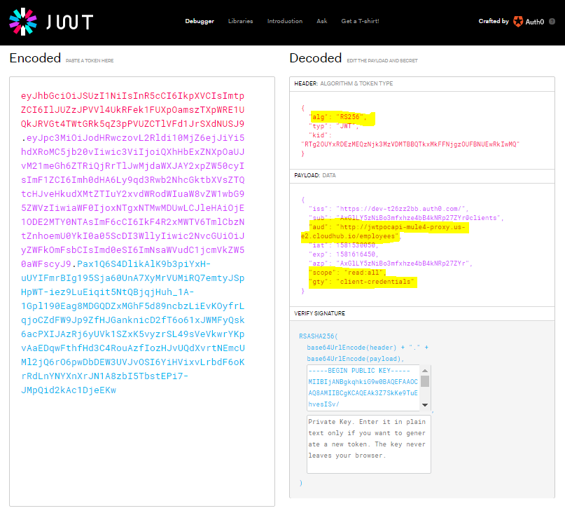
JWT Token Structure
Convenient and concise way of representing authorization and authentication claim for an application.
A well-formed JSON Web Token (JWT) consists of three concatenated Base64url-encoded strings, separated by dots (.):
Header: contains metadata about the type of token and the cryptographic algorithms used to secure its contents.
Payload (set of claims): contains verifiable security statements, such as the identity of the user and the permissions they are allowed.
Signature: used to validate that the token is trustworthy and has not been tampered with. You must verify this signature before storing and using a JWT.

Slide 14
Demo 3: OAuth 2.0 using JWT
Apply OAuth 2.0 , Validate a JWT token
Test 1, without using the policy
Test 2, With Policy enabled
Test 3, with negative testing
Review Policy configurations

Slide 15
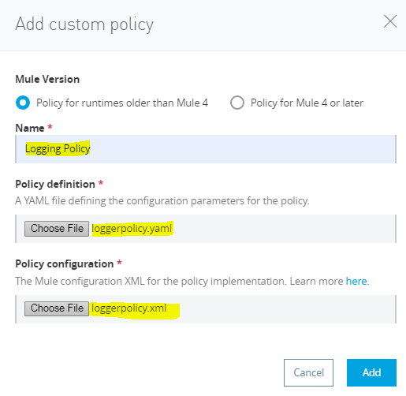
Custom Policy Configurations
Develop the policy.
Mulesoft Definition file (YAML) - File in which you define characteristics of the custom policy.
MuleSoft Configuration file(XML) - File in which you define the actual logic/implementation of your defined custom policy.
Upload the resulting policy to API Manager.
In API Manager, go to Custom Policies, and click Add Custom Policy.
Select the Policy for Runtimes olden than Mule 4.
In the Name field, type the name of your new policy version.
Upload your YAML and XML files for your custom policy's new version.
Click Add.
Apply the policy to any API through API Manager.

Slide 16
Demo 4: Custom Policy
Custom Policy developed using Anypoint studio
Test 1, without using the policy
Test 2, With Policy enabled
Test 3, with negative testing
Review Policy configurations

Slide 17
Q & A

Slide 18
What’s next
Share:
Tweet your pictures with the hashtag #MuleMeetup
Invite your network to join: https://meetups.mulesoft.com/baltimore/
Feedback:
Contact your organizer Manju Kumara to suggest topics
Contact MuleSoft at meetup@mulesoft.com for ways to improve the program
Our next meetup:
Date: TBD
Location: 7320, Parkway Drive , Hanover, MD - 21076
Topic: TBD

Slide 19
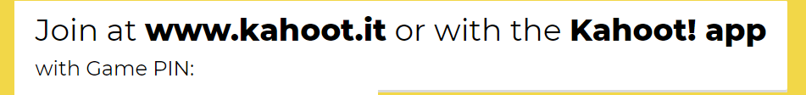
TRIVIA ROUND

Slide 20
Networking time
Introduce yourself to your neighbors!

Slide 21
See you next time
Please send topic suggestions to the organizer

