Slide 1


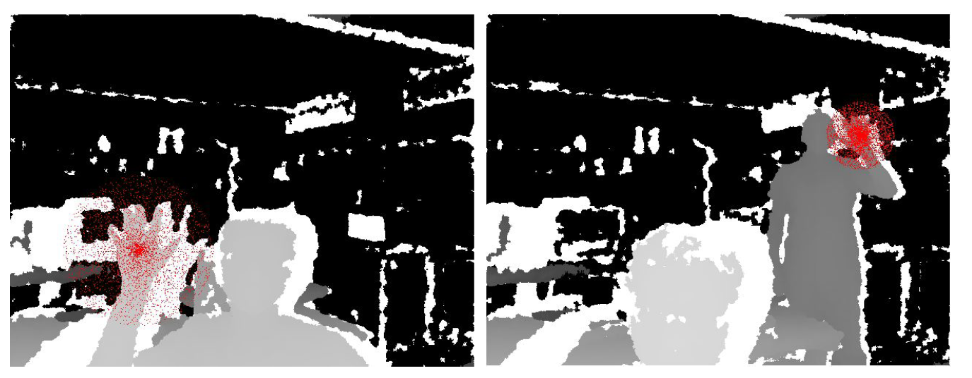
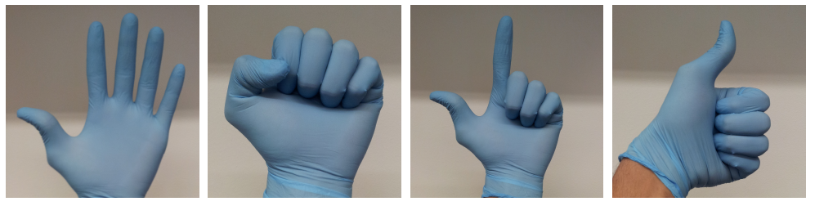
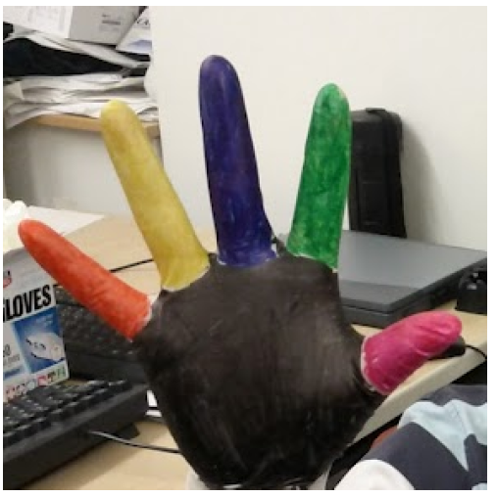
A Real-time Hand Gesture Recognition System
Arun Ganesan and Caoxie (Michael) Zhang
EECS Department University of Michigan, Ann Arbor
Introduction
System Architecture
Design goals:
- Real-time, Just-hands, Accurate
Methodology:
- Machine learning as opposed to rule-based system
- Train on a large amount of label data
- Use simple algorithm in prediction
Contributions:
- A system
- An inexpensive way to generate massive labeled data
- Extensive experiments
- Computational analysis between SVM and random forest
Developers
End Users
Training
Pooling
Per-pixel Classification
Feature Extraction
GPU
Labeled Image
Raw Image
Kinect Sensor
1
Color Gloves
Just Hands
2
Per-pixel Classification
Generating Training Sets
Feature extraction:
Color glove:
- an inexpensive approach to label gestures
- map RGB pixel to depth pixel
3
Random forest for classification
- Ensemble of decision trees
Prediction complexity:
- O(d_{level} n_{tree}) vs. linear SVM O(n_{class} n_{features})
Use GPU for real-time prediction:
- Massive parallelism: 307,200 threads a frame
- OpenCL: a general purpose computing for GPU
Experiments
3
Use EC2 to train many data sets
- Largest data set > 25 GB, our demo takes 24 hours train
Pooling & Experience
Number of trees doesn’t matter a lot
Number of feature doesn’t matter too much
Range of offset matters
Pool the per-pixel classifications to a single proposal of gesture position and type
Use clustering algorithms:
- Kmeans: not good
- Subject to outliers
- Assumes each cluster has equal size
- Density-based clustering
- No need to specify the number of clusters
Experience:
- Late optimization
- Adding a virtual wall
- Test accuracy is not enough
Random forest is much better than SVM
Random forest is always overfitting
The more training samples the better accuracy
4
5

