Slide 1


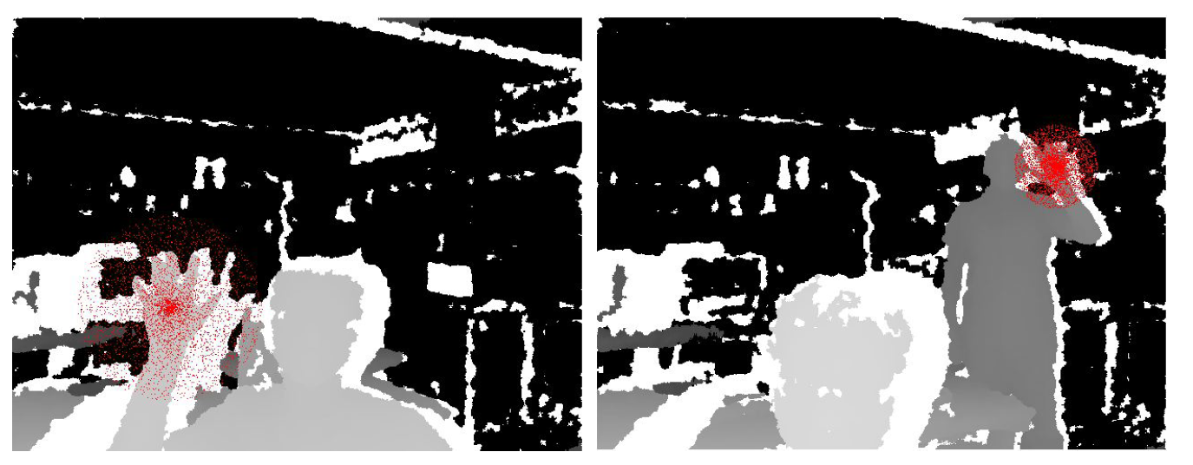
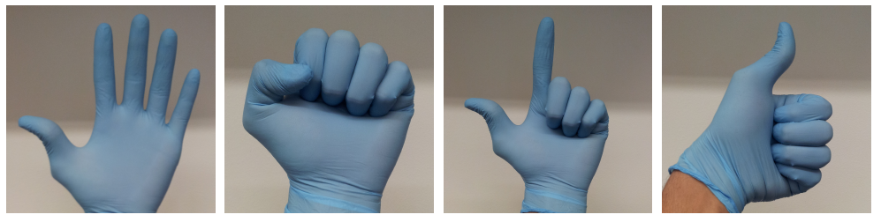
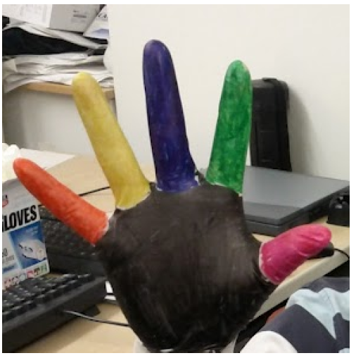
A Real-time Hand Gesture Recognition System
Arun Ganesan and Caoxie (Michael) Zhang
EECS Department University of Michigan, Ann Arbor
Introduction
System Architecture
Design goals:
- Real-time, Just-hands, Accurate
Methodology:
- Machine learning as opposed to rule-based
- Train on a large amount of label data
- Use simple algorithm in prediction
Contributions:
- A system
- A rapid way to generate massive labeled data
- Extensive experiments
- Computational analysis of SVM vs random forest
Developers
End Users
Training
Pooling
Per-pixel Classification
Feature Extraction
GPU
Labeled Image
Raw Image
Kinect Sensor
1
Color Gloves
Just Hands
2
Per-pixel Classification
Generating Training Sets
Feature extraction:
Color glove:
- An inexpensive approach to label gestures
- Map RGB pixel to depth pixel
4
Random forest for classification
- Ensemble of decision trees
Prediction complexity:
- O(d_{level} n_{tree}) vs. linear SVM O(n_{class} n_{features})
Use GPU for real-time prediction:
- Massive parallelism: 307,200 threads per frame
- OpenCL: general purpose computing for GPU
Experiments
3
Use EC2 to train many data sets
- Largest data set > 25 GB, our demo takes 24 hours to train
Pooling & Experience
Number of trees doesn’t matter
Number of features doesn’t matter
Range of offset matters
Propose gesture by pooling per-pixel classification
Use clustering algorithms:
- Kmeans
- Subject to outliers
- Fix number of clusters
- Density-based clustering
- No need to specify the number of clusters
- Resilient to noise
Experience:
- Late optimization
- Virtual wall
- Test accuracy is not enough
Random forest is much better than SVM
Random forest always overfits
Number of training samples matters
5
6

