Slide 1

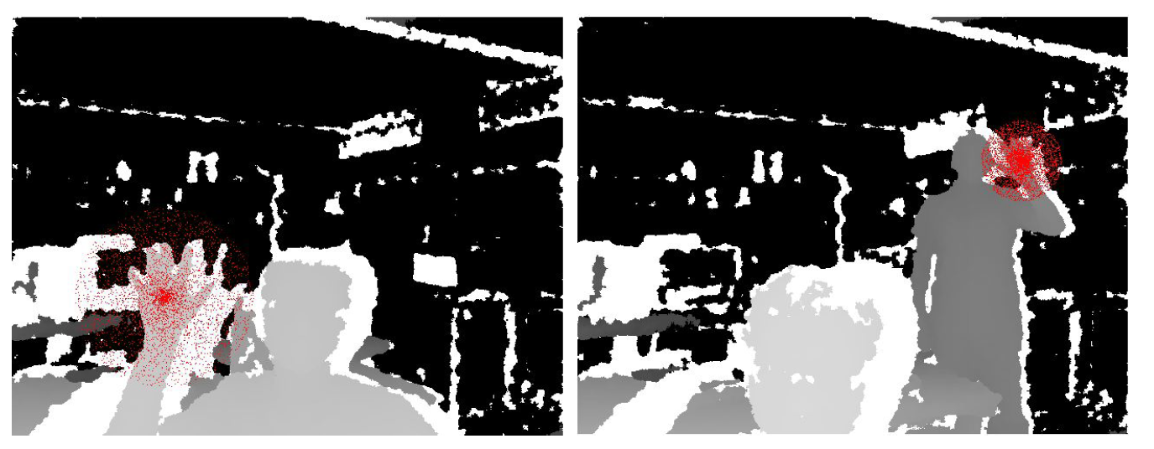
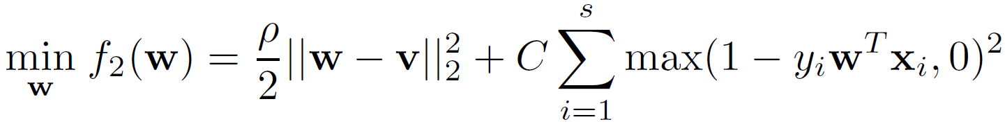
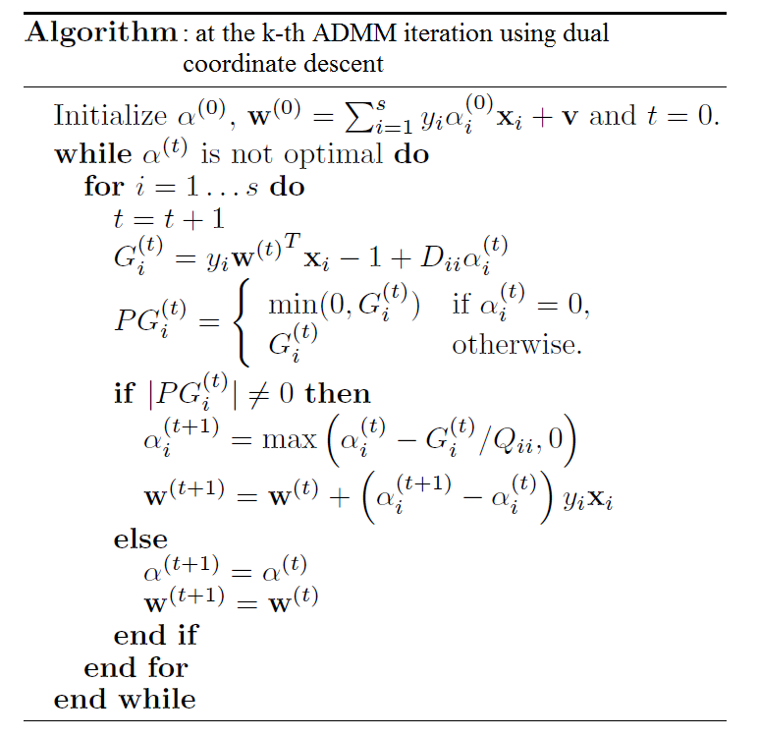

A Real-time Hand Gesture Recognition System
Arun Ganesan and Caoxie (Michael) Zhang
EECS Department University of Michigan, Ann Arbor
Introduction
System Overview
Design goals:
- Real-time
- Robust
- Accurate
Methodology:
- Data-driven: machine learning as opposed to rule-based system
- Depth image
- Per-pixel classification: GPU + random forest
- Pooling: density-based clustering
Contributions:
- A system
- An inexpensive way to generate massive labeled data
- Extensive experiments
- Computational analysis between SVM and random forest
Developers
End Users
Training
Pooling
Per-pixel Classification
Feature Extraction
GPU
Labeled Image
Raw Image
Kinect Sensor
Color Gloves
Just Hands
Per-pixel Classification
Experiments
Hello World
Use EC2
Efficient Subproblem Solvers
The subproblem is an SVM with a regularization towards consensus
Efficient solvers:
Say Something
- sequentially scan the data multiple times
- dual coordinate descent
- trusted region Newton’s method
Linear run time complexity:
Hello World

