Slide 1

Jenkins POC July 2019

Slide 2
Agenda
1. What is Jenkins? | Continuous Integration
2. How to set-up Jenkins?
3. What is plugins?
4. How to create Job ?
5. Jenkins integration with GIT
Tests are the best way to prevent software defect.

Slide 3
What is Jenkins?
Jenkins is an open source Continuous Integration server written in Java
What is Continuous Integration? - Continuous Integration is a development practice.
Great to build, deploy or launch anything async
Rich set of plugins with good documentation
Tons of integrations
Workflow plugin
The master slave architecture.
Jenkins is available with test built around JUnit; test results are available in graphical and tabular forms.

Slide 4
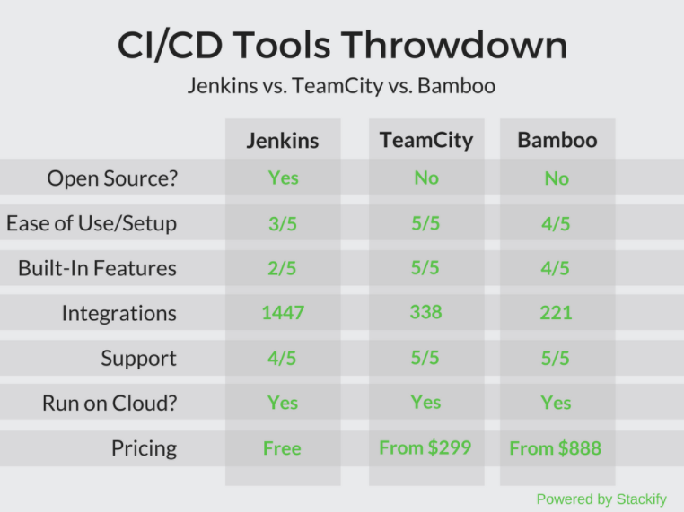
CI/CD Tools

Slide 5
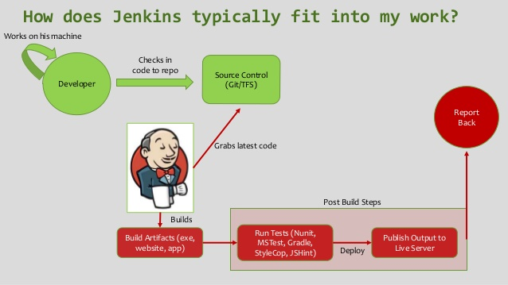
How it works ?

Slide 6
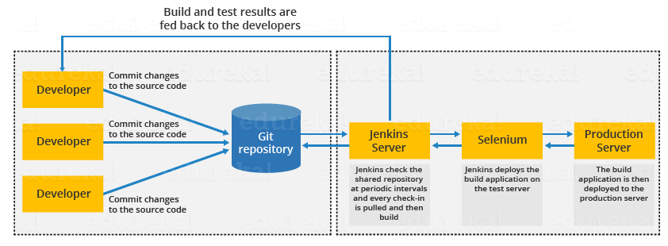
Flow diagram of Continuous Integration with Jenkins

Slide 7
Installing Jenkins
To download and run the WAR file version of Jenkins:
Download the latest stable Jenkins WAR file to an appropriate directory on your machine.
Open up a terminal/command prompt window to the download directory.
Run the command java -jar jenkins.war.
Browse to http://localhost:8080 and wait until the Unlock Jenkins page appears.
Continue on with the Post-installation setup wizard.

Slide 8
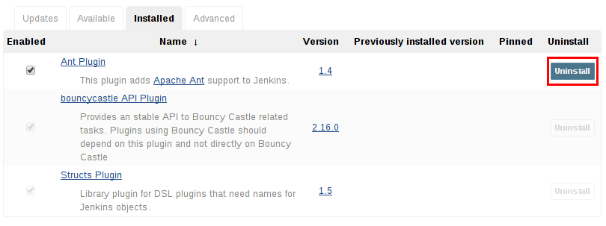
What is plugins?
Plugins are the primary means of enhancing the functionality of a Jenkins environment
Installing a plugin
- Using the "Plugin Manager" in the web UI.

Slide 9
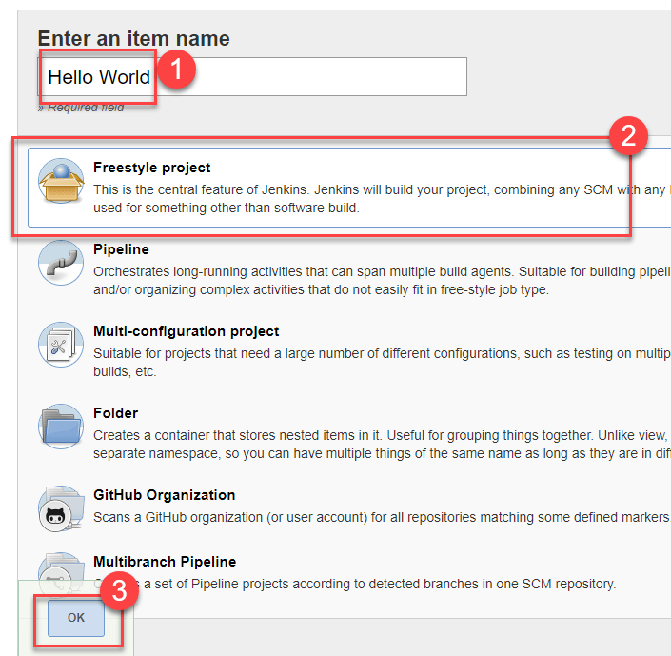
Creating a Freestyle Build Job
Enter the name of the item you want to create.
We shall use the "Hello world" for this demo.
Select Freestyle project

Slide 10
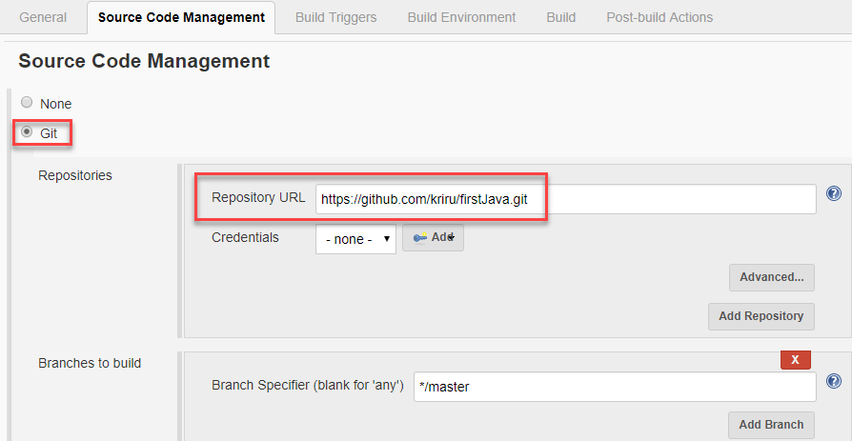
Source Code Management with Git
Under Source Code Management, Enter your repository URL. We have a test repository located at https://github.com/arungb84/firstJava
It’s time to build the code. Tweak the settings under the build section to build the code at the time you want. You can even schedule the build to happen periodically, at set times.

Slide 11
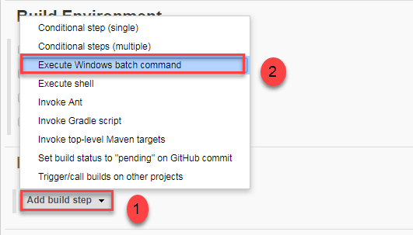
Under Build
Click on "Execute Windows batch command" and add the commands you want to execute during the build process.
I have added the following windows commands:
javac HelloWorld.java
java HelloWorld

Slide 12
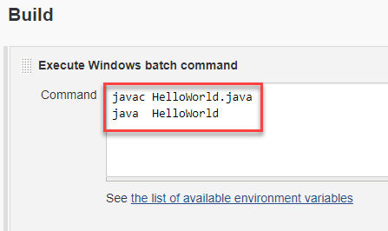
Build
Click Apply
Save the project.
Click the Build Now button on the left-hand side to build the source code.
After clicking on Build now, you can see the status of the build you run under Build History.

Slide 13
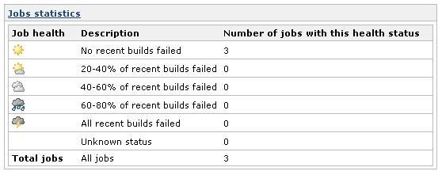
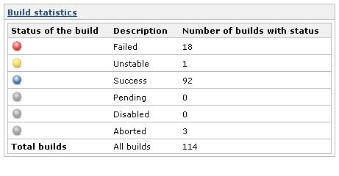
Statistics
Shows statistics based on jobs health.
Build statistics

Slide 14
Thank You

