Slide 1
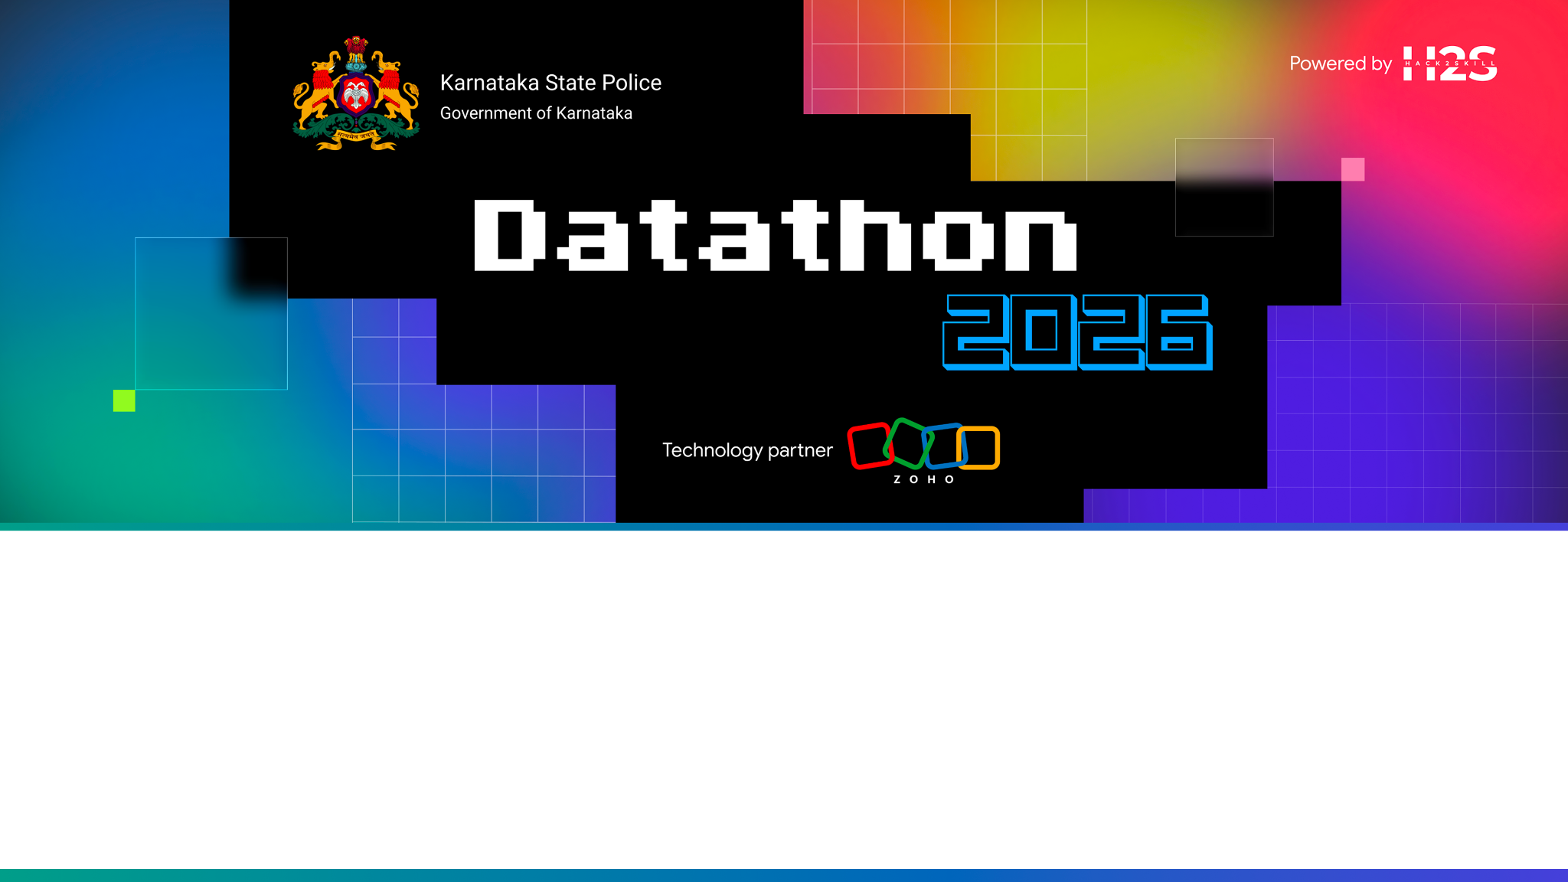
ANVESHAK · ಅನ್ವೇಷಕ
An AI that doesn't just answer questions — it works cases.
Team Zen — Hiran Vikraman S R · Arun G K | Challenge 1
Live: https://anveshak-api-50044329134.development.catalystappsail.in/ui/

Slide 2
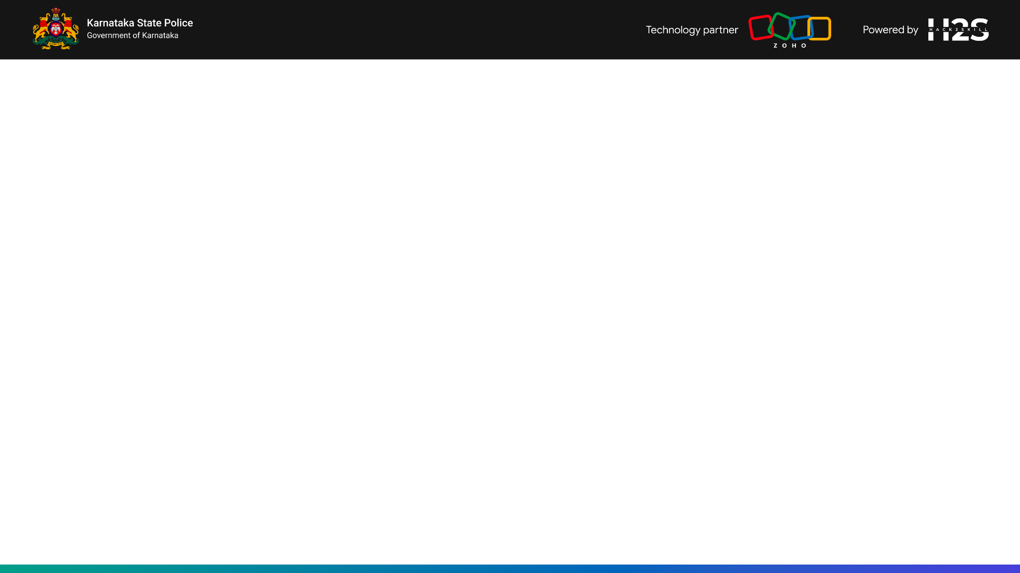
One night in Jayanagar
A woman's gold chain is snatched by two men on a motorcycle. The FIR is filed at Jayanagar station.
• The same men struck in Mandya last month, and Tumakuru before that.
• Nobody knows. The records sit in three district silos, and no one has time to read 15,000 narratives looking for a pattern.
• To even ask 'how many chain snatchings this year?', an officer needs someone who writes SQL — and English.
This is the gap ANVESHAK closes.

Slide 3
Ask. Then let it work the case.
• Ask in Kannada or English — voice or text, and every answer arrives with its SQL, its rows and its case IDs.
• Find the ring — MO fingerprinting links crimes across district boundaries that siloed records never connect.
• Work the case — six specialist agents assemble a court-ready Investigation Pack in about ten seconds.
• Patrol tonight — an overnight sweep raises ranked leads and turns them into a deployment plan.
• Prove it — role-scoped access, a tamper-evident audit log, and guardrails you are welcome to attack.

Slide 4
Live demo
From the FIR a constable files, to the pack an IO takes to court.
• The overnight sweep — and the morning briefing, in Kannada
• A question, answered with its evidence
• Try to break it: injection, exfiltration, profiling
• File a new FIR — in your own words — and watch it join the series
• Replay the ring crossing three districts
• Six agents work the case → the pack → the suspect
• Tonight's patrol plan · the same question as SHO, and as Analyst

Slide 5
What it would have changed
SH-07 · Operation Gold Chain Black Visor
ANVESHAK flags this ring at case #6, on 10 February 2026.
Nine further chain snatchings across Bengaluru City, Mandya and Tumakuru followed over the next 142 days — after the pattern was already visible.
Computed by replaying our own linkage engine over the corpus truncated at each of the series' case dates. A retrospective replay on synthetic data — not a prediction, and not a claim about a real case.

Slide 6
Built to be checked, not believed
• The model never computes a number — deterministic tools do; the model only narrates. Every figure traces to a tool result and a case ID.
• Attack it yourself — a red-team console in the product. 10 of 10 attack vectors blocked, re-tested on every page load.
• Religion and caste are never model features — a profiling question is refused, in English and Kannada, and the refusal is logged.
• Scope is enforced in the query — SHO sees a station, SP a district, Analyst sees masked names. Not hidden in the browser.
• History cannot be rewritten — the audit log is hash-chained; press 'Verify chain' and watch it recompute.
• Our ground truth is public — linkage precision 0.86, recall 12/14, checkable against the planted data in the repository.

Slide 7
Runs entirely on Zoho Catalyst
Officer (EN/KN, voice or text) → React SPA → FastAPI on AppSail
intent router → NL→SQL (guardrails · ADR-9 policy · role scope · self-repair)
→ typed tools: linkage · graph · forecast · hotspots · risk · similar
DuckDB analytical mirror ⟷ Catalyst Data Store (system of record)
Catalyst QuickML → GLM-4.7-Flash · SmartBrowz → pack PDF
Cron → Night Patrol → lead cards → morning briefing
No external inference API is ever called from the deployed app.

Slide 8
What we would build next
• CCTNS integration: live read connection + identity resolution on name / parentage / DOB, replacing our synthetic person key.
• Catalyst Auth issuing real officer identities into the scope layer that already enforces them.
• Kannada NL→SQL tuning with hand-curated examples from real officer phrasing — our clearest measured gap.
• Human-in-the-loop learning: every Confirm/Reject on a series becomes a label that improves precision.
• A pilot with one district's live data — that is the ask.

Slide 9
