Slide 1
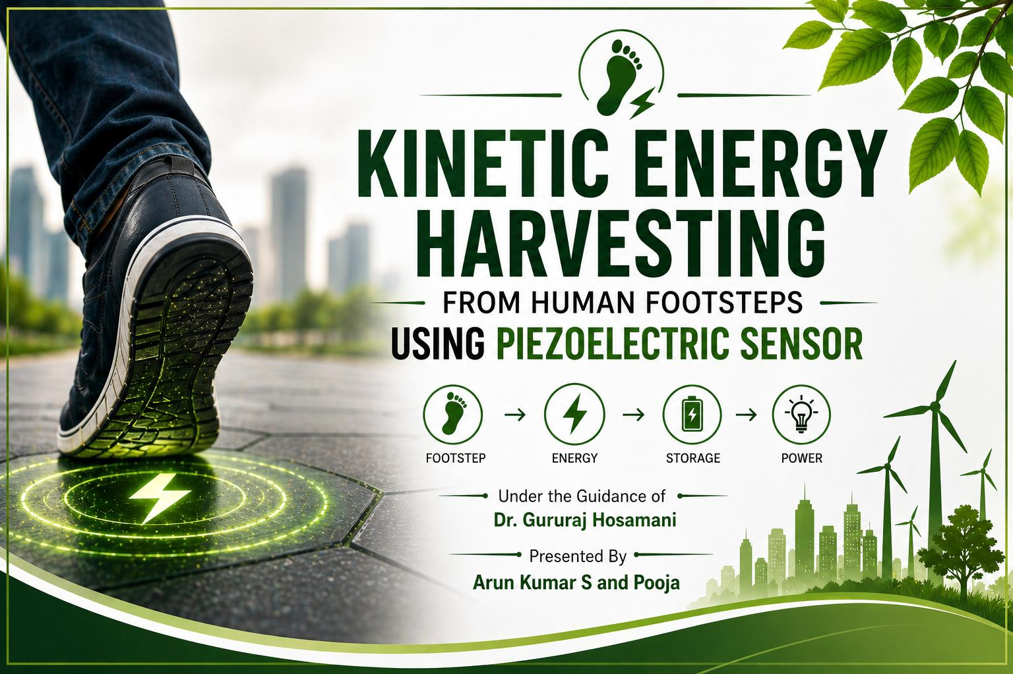

Slide 2
CONTENTS
Introduction Objectives Components Piezoelectric Sensor Piezoelectric Effect Working Principle Block Diagram
Circuit Connections Hardware Components Final Output Applications Advantages Disadvantages Real-World Examples Conclusion

Slide 3
Introduction
Energy demand is increasing rapidly Conventional energy sources are limited and polluting Need for alternative and renewable energy solutions Human footsteps contain unused mechanical energy Piezoelectric sensors convert this mechanical energy into electrical energy

Slide 4
Objectives
To design a footstep-based energy harvesting system To utilize the piezoelectric effect for power generation To convert and store electrical energy efficiently To display generated voltage and step count To develop an eco-friendly energy solution

Slide 5
Components
Piezoelectric Sensors Arduino Uno LCD Display (I2C) Bridge Rectifier Capacitor Rechargeable Battery Breadboard and Connecting Wires

Slide 6
Piezoelectric Sensor
Converts mechanical pressure into electrical energy Works based on the piezoelectric effect Generates AC voltage when force is applied Compact, durable, and highly sensitive

Slide 7
Piezoelectric Effect
Certain materials generate electric charge when mechanical stress is applied This phenomenon is called the piezoelectric effect
Example: Quartz crystal
Converts mechanical energy into electrical energy

Slide 8
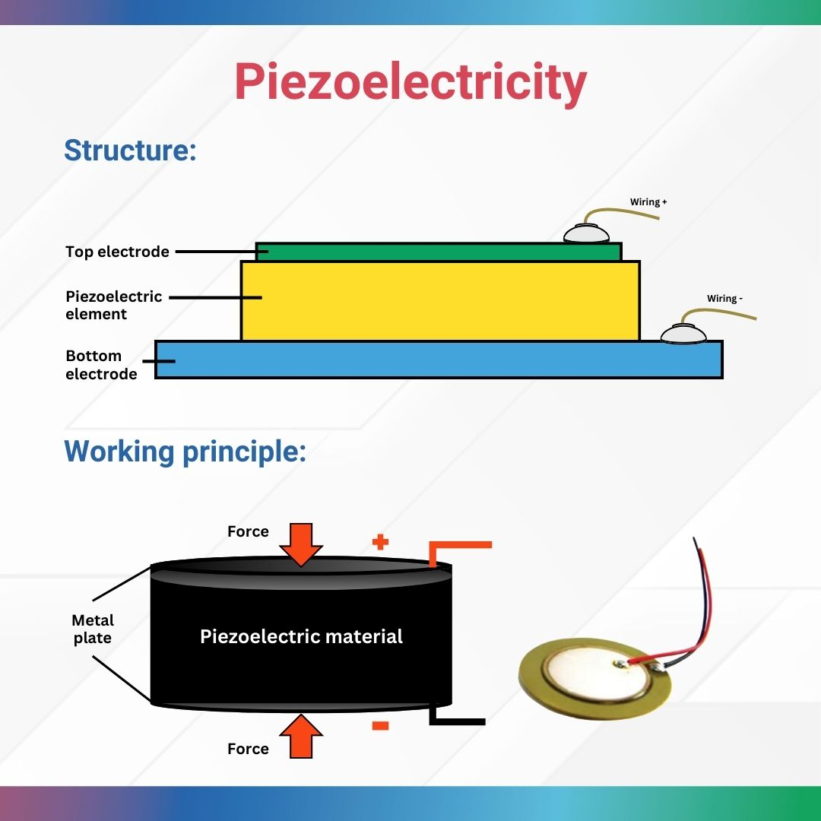
PIEZOELECTRIC EFFECT

Slide 9
Working Principle
Footstep applies mechanical pressure on sensors Piezoelectric sensors generate AC voltage Bridge rectifier converts AC to DC Capacitor smooths the output voltage Energy is stored in a rechargeable battery Arduino displays voltage and step count on LCD

Slide 10
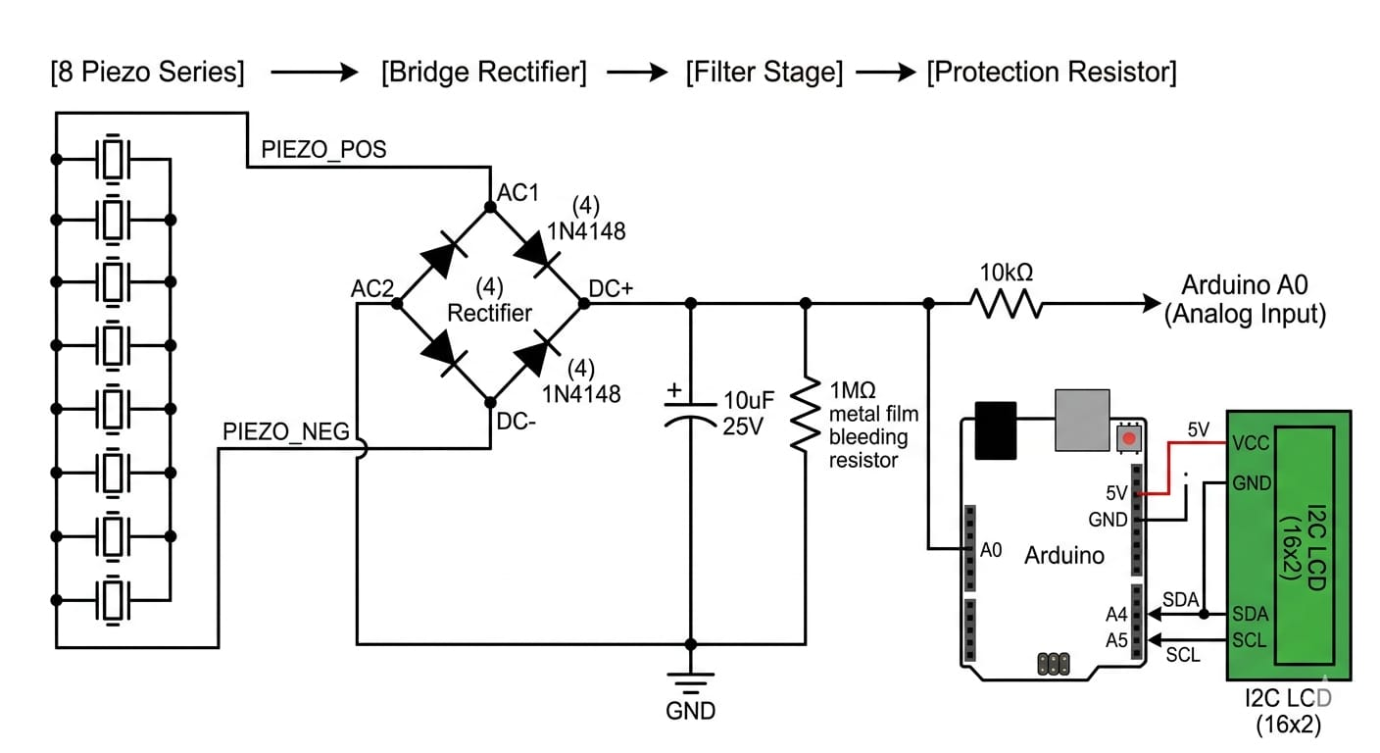
Block Diagram

Slide 11
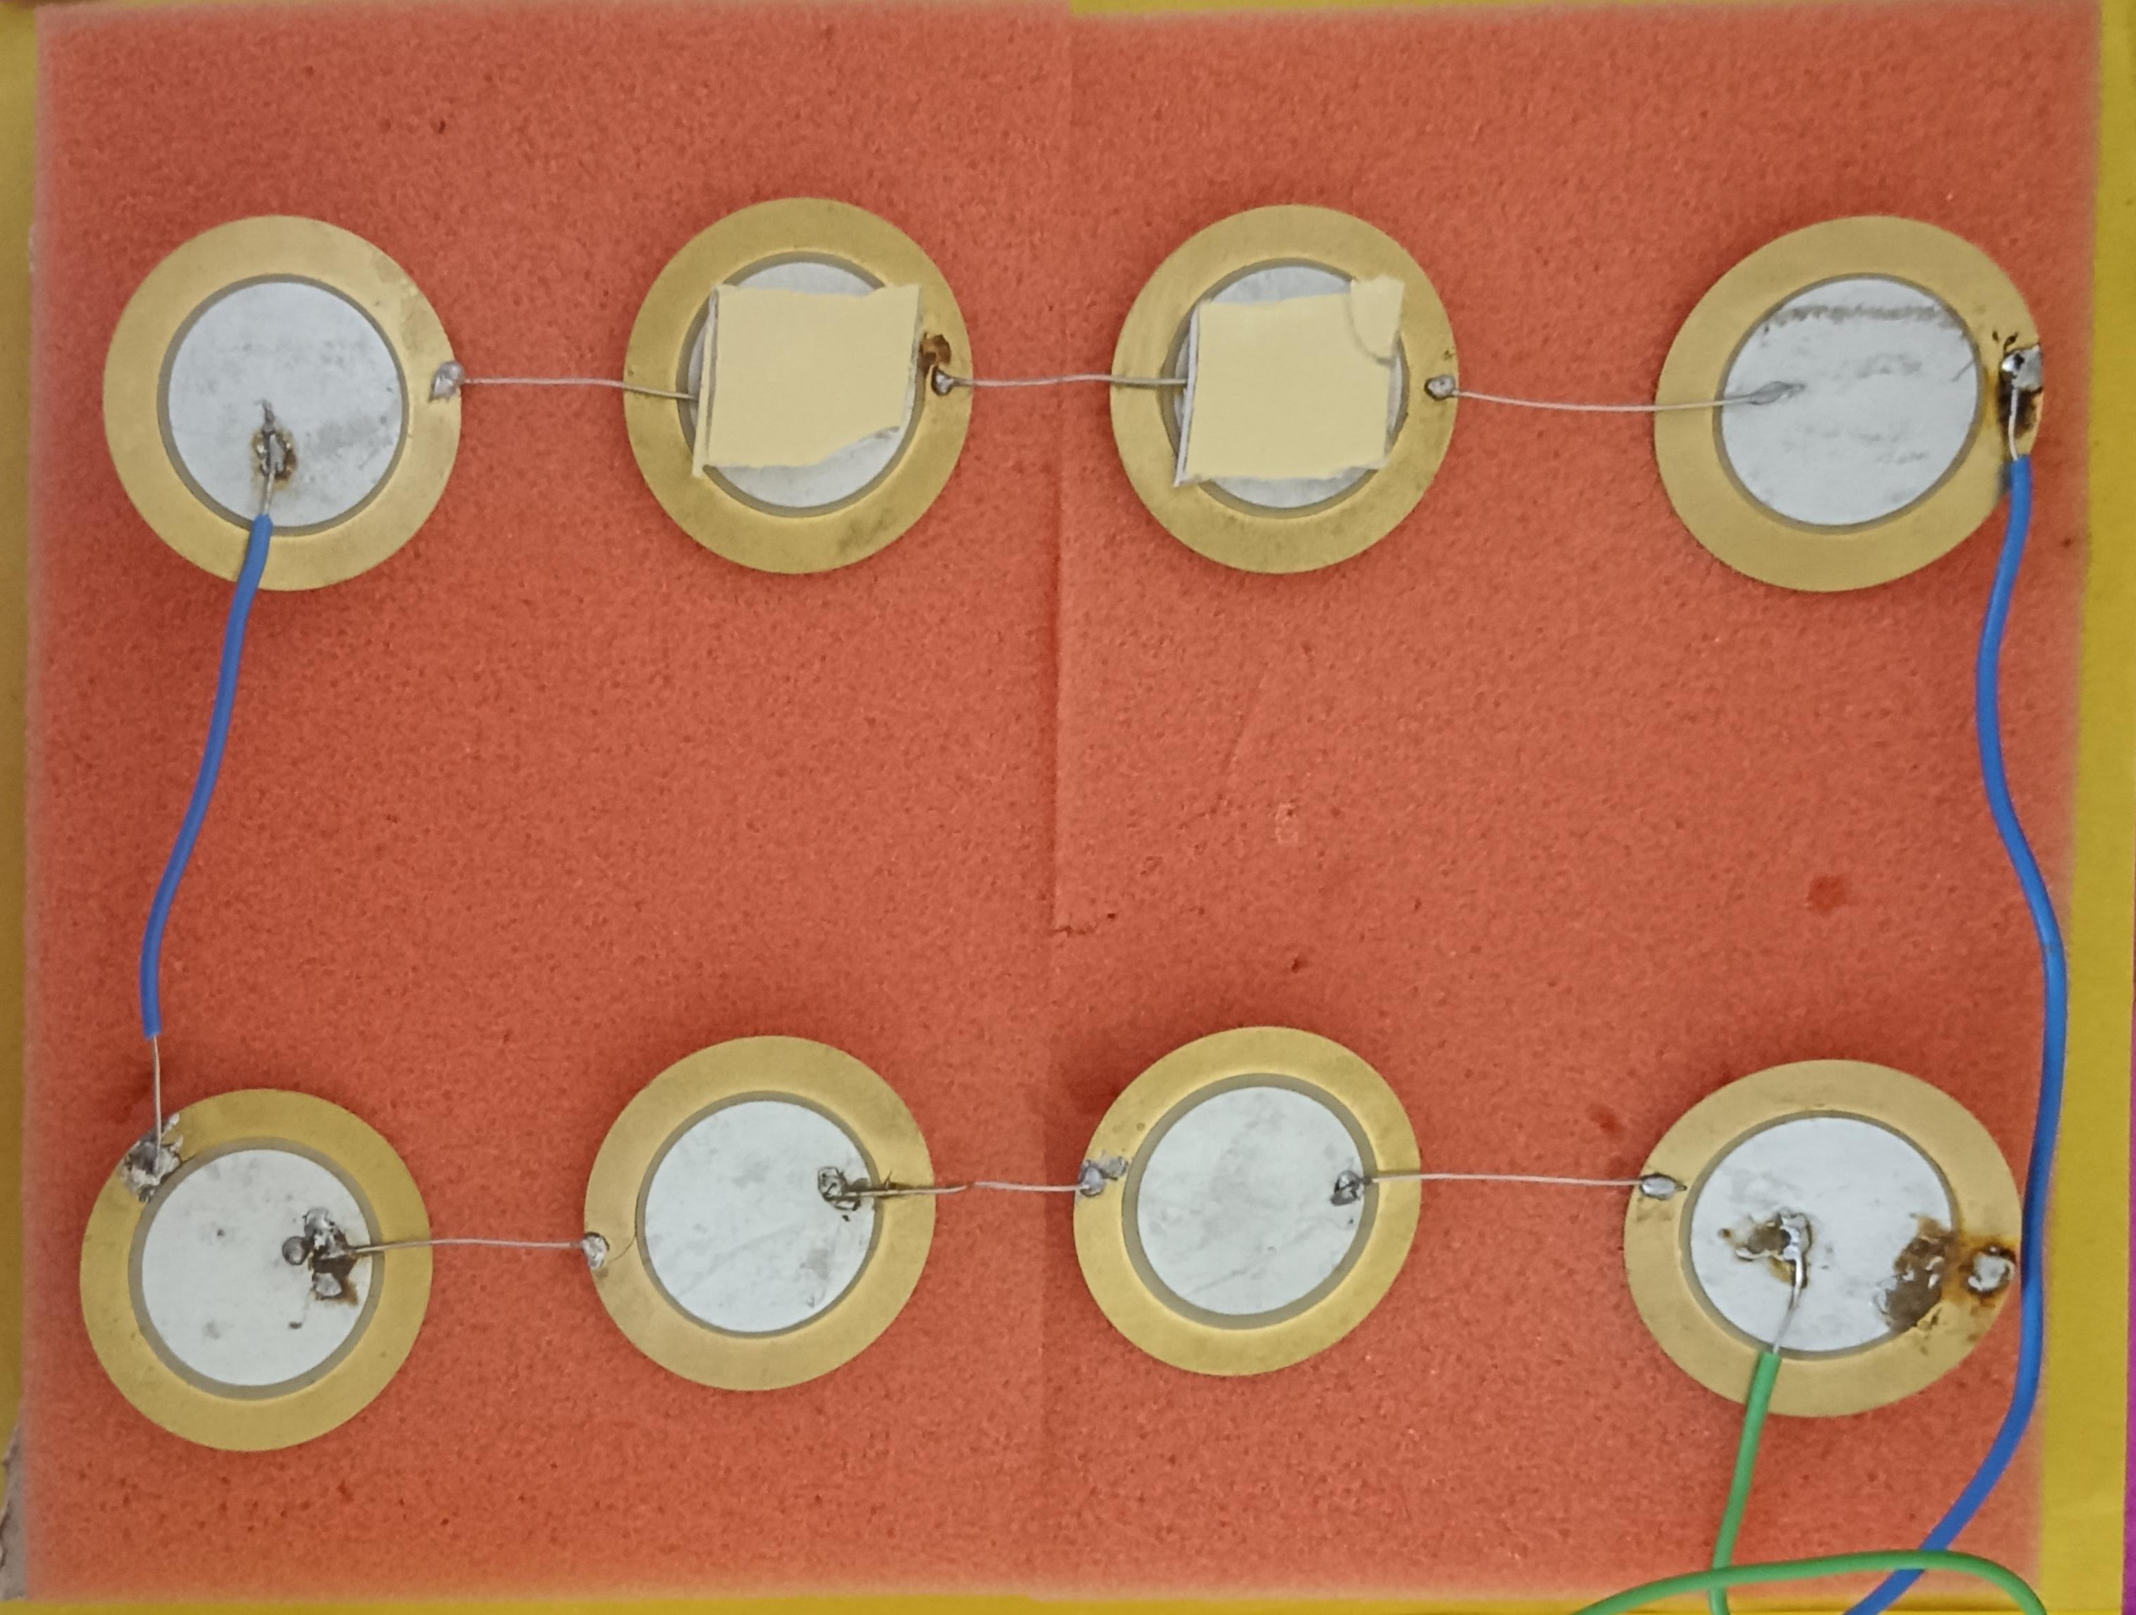
Connection of Piezoelectric sensor
Multiple piezo sensors are connected in Series to increase output voltage and current

Slide 12
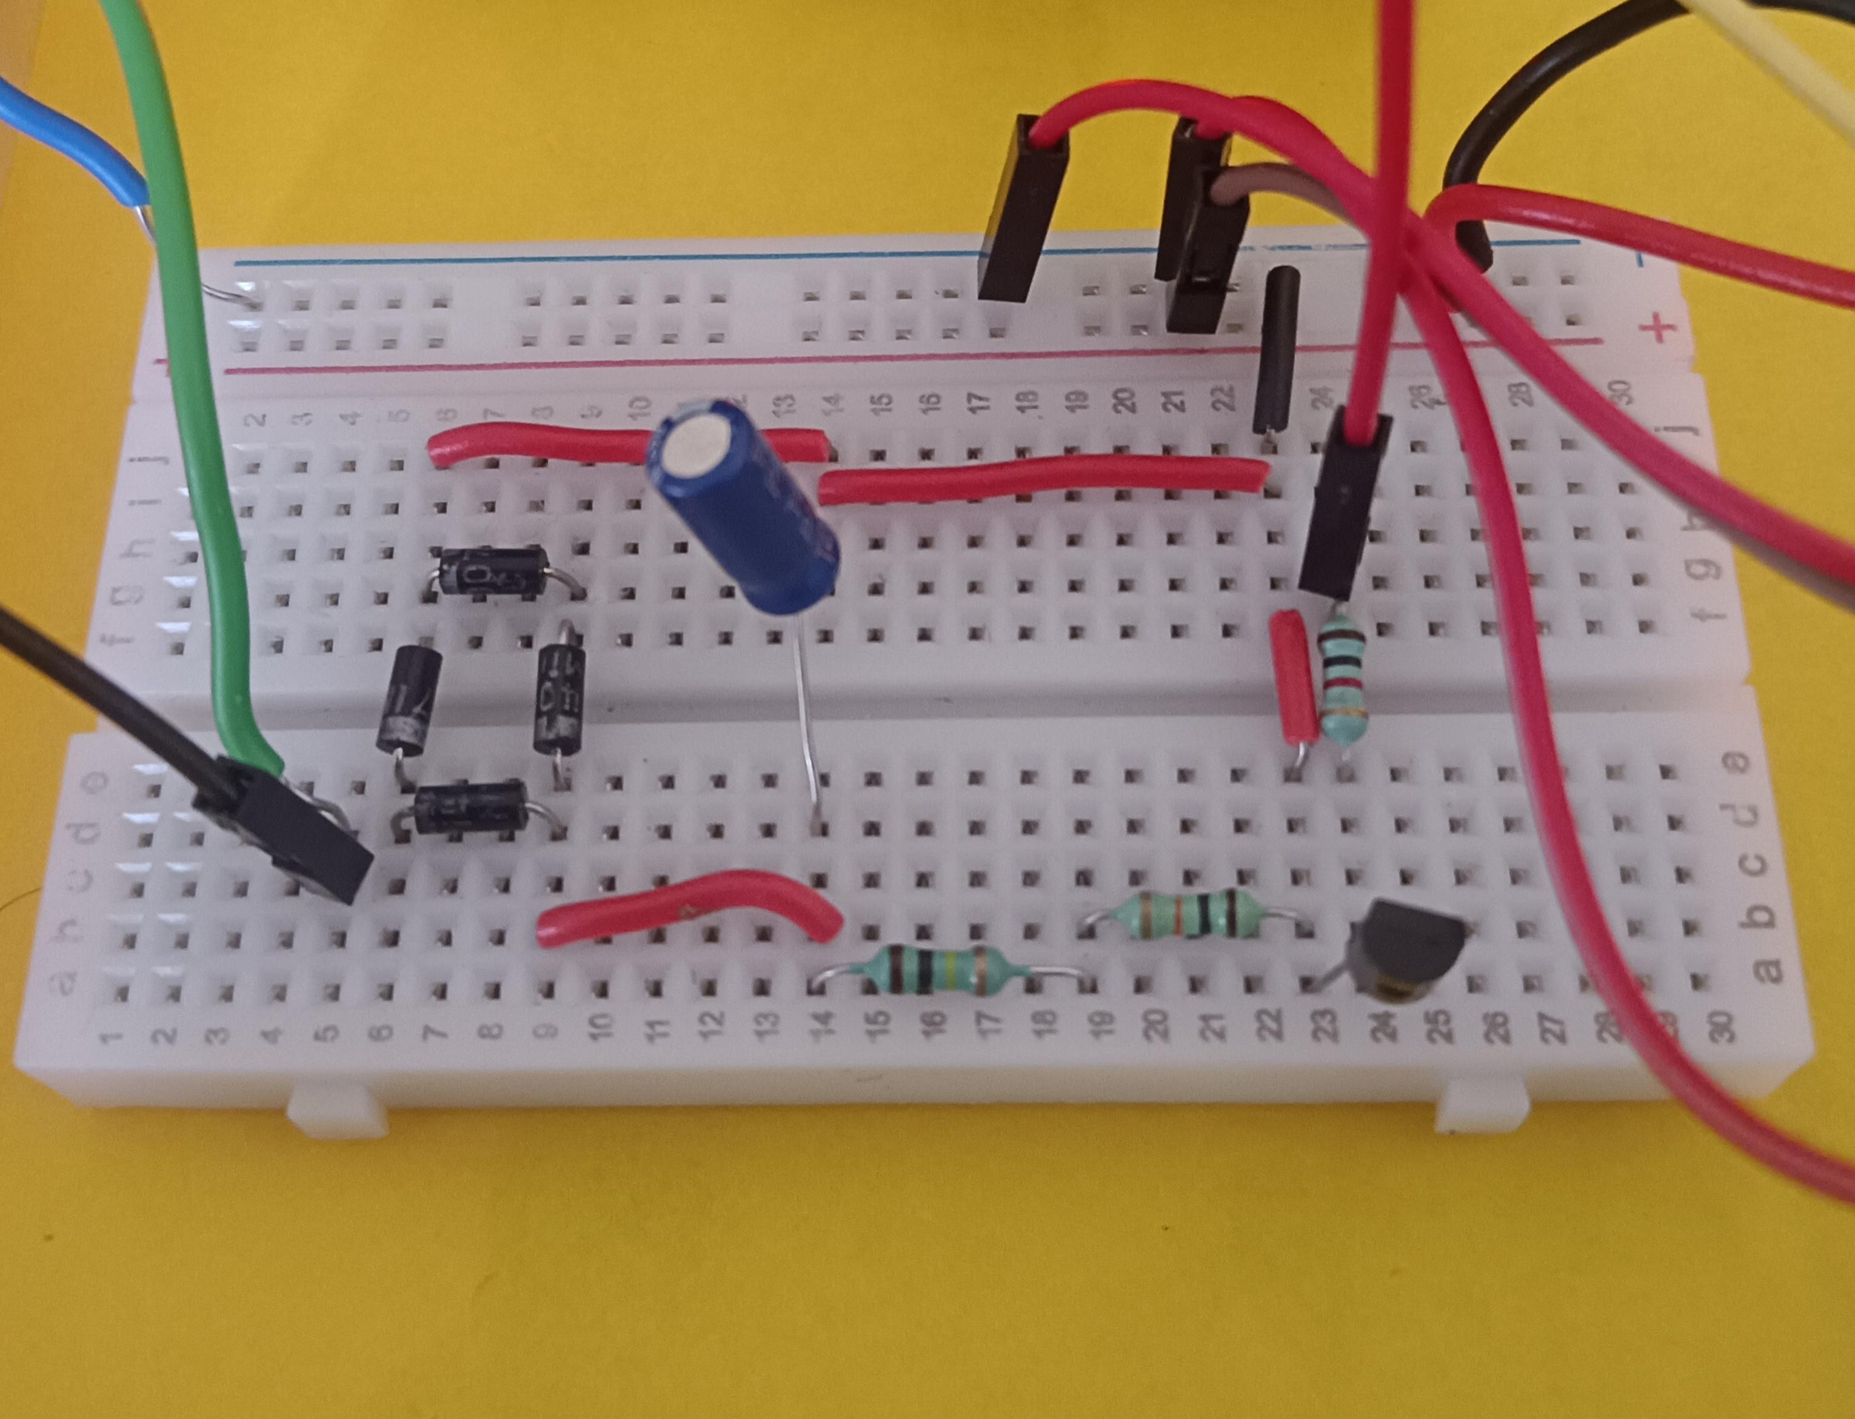
Breadboard connection usinG
Resistors Capacitors Diodes Jumper wires

Slide 13
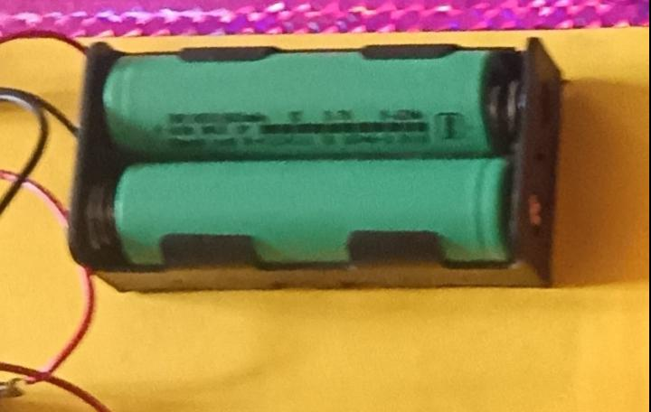
BatterY
Rechargeable battery is used to store generated energy Output voltage depends on number of sensors and pressure applied

Slide 14
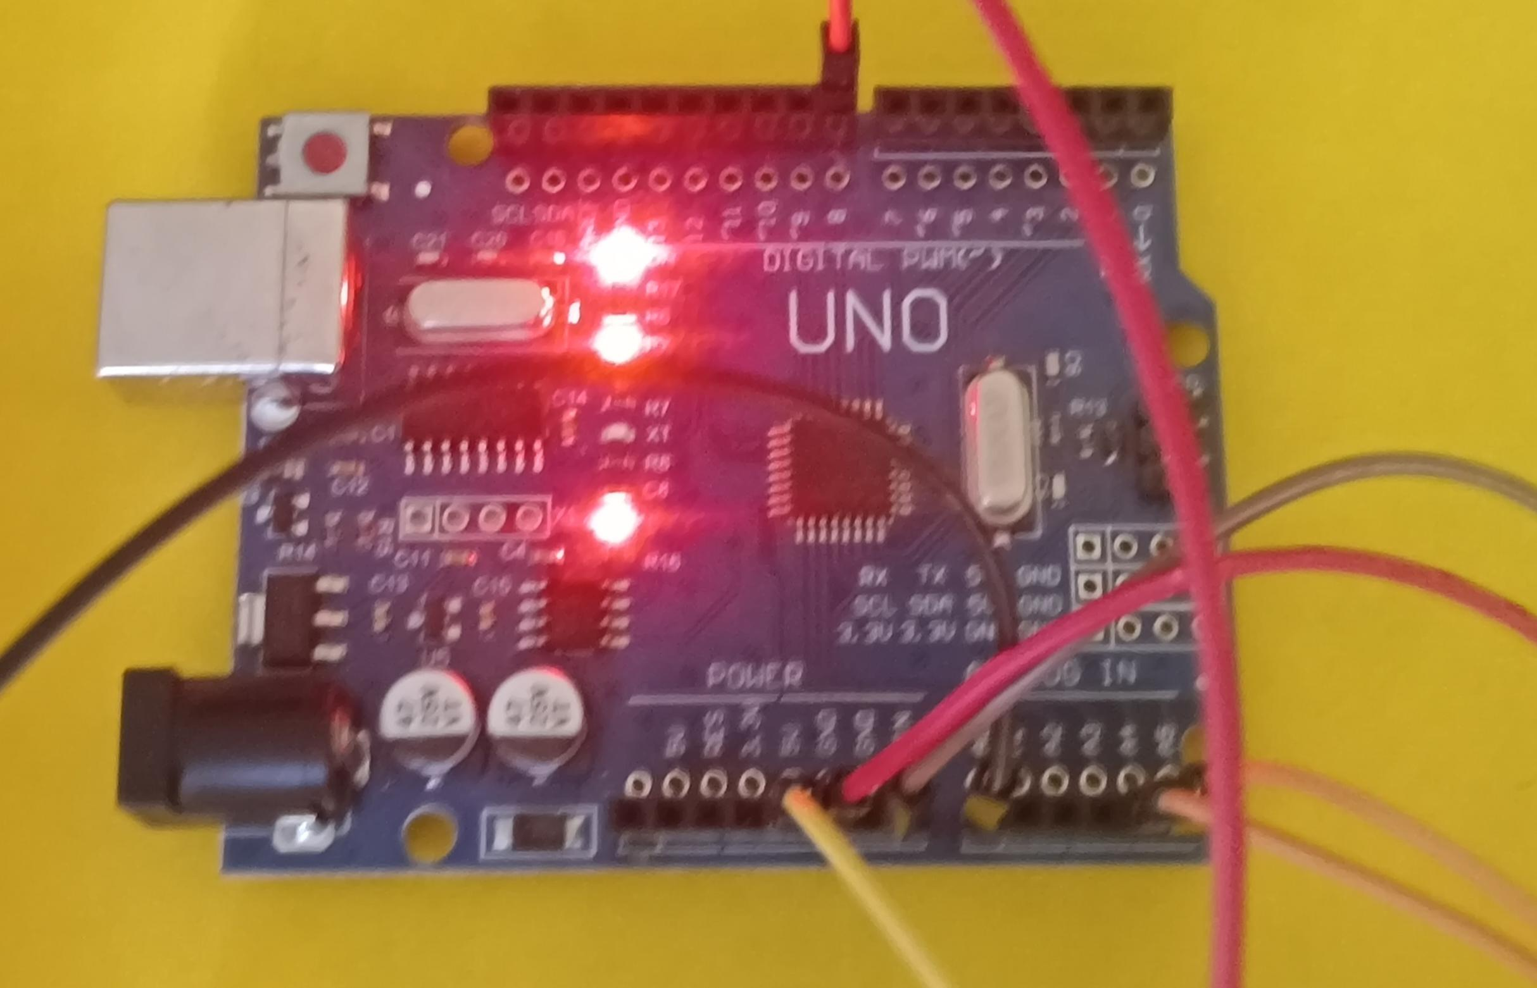
Arduino UNO r3 SDM
Arduino Uno is used to process the generated voltage It reads input from the circuit Sends data to LCD display

Slide 15
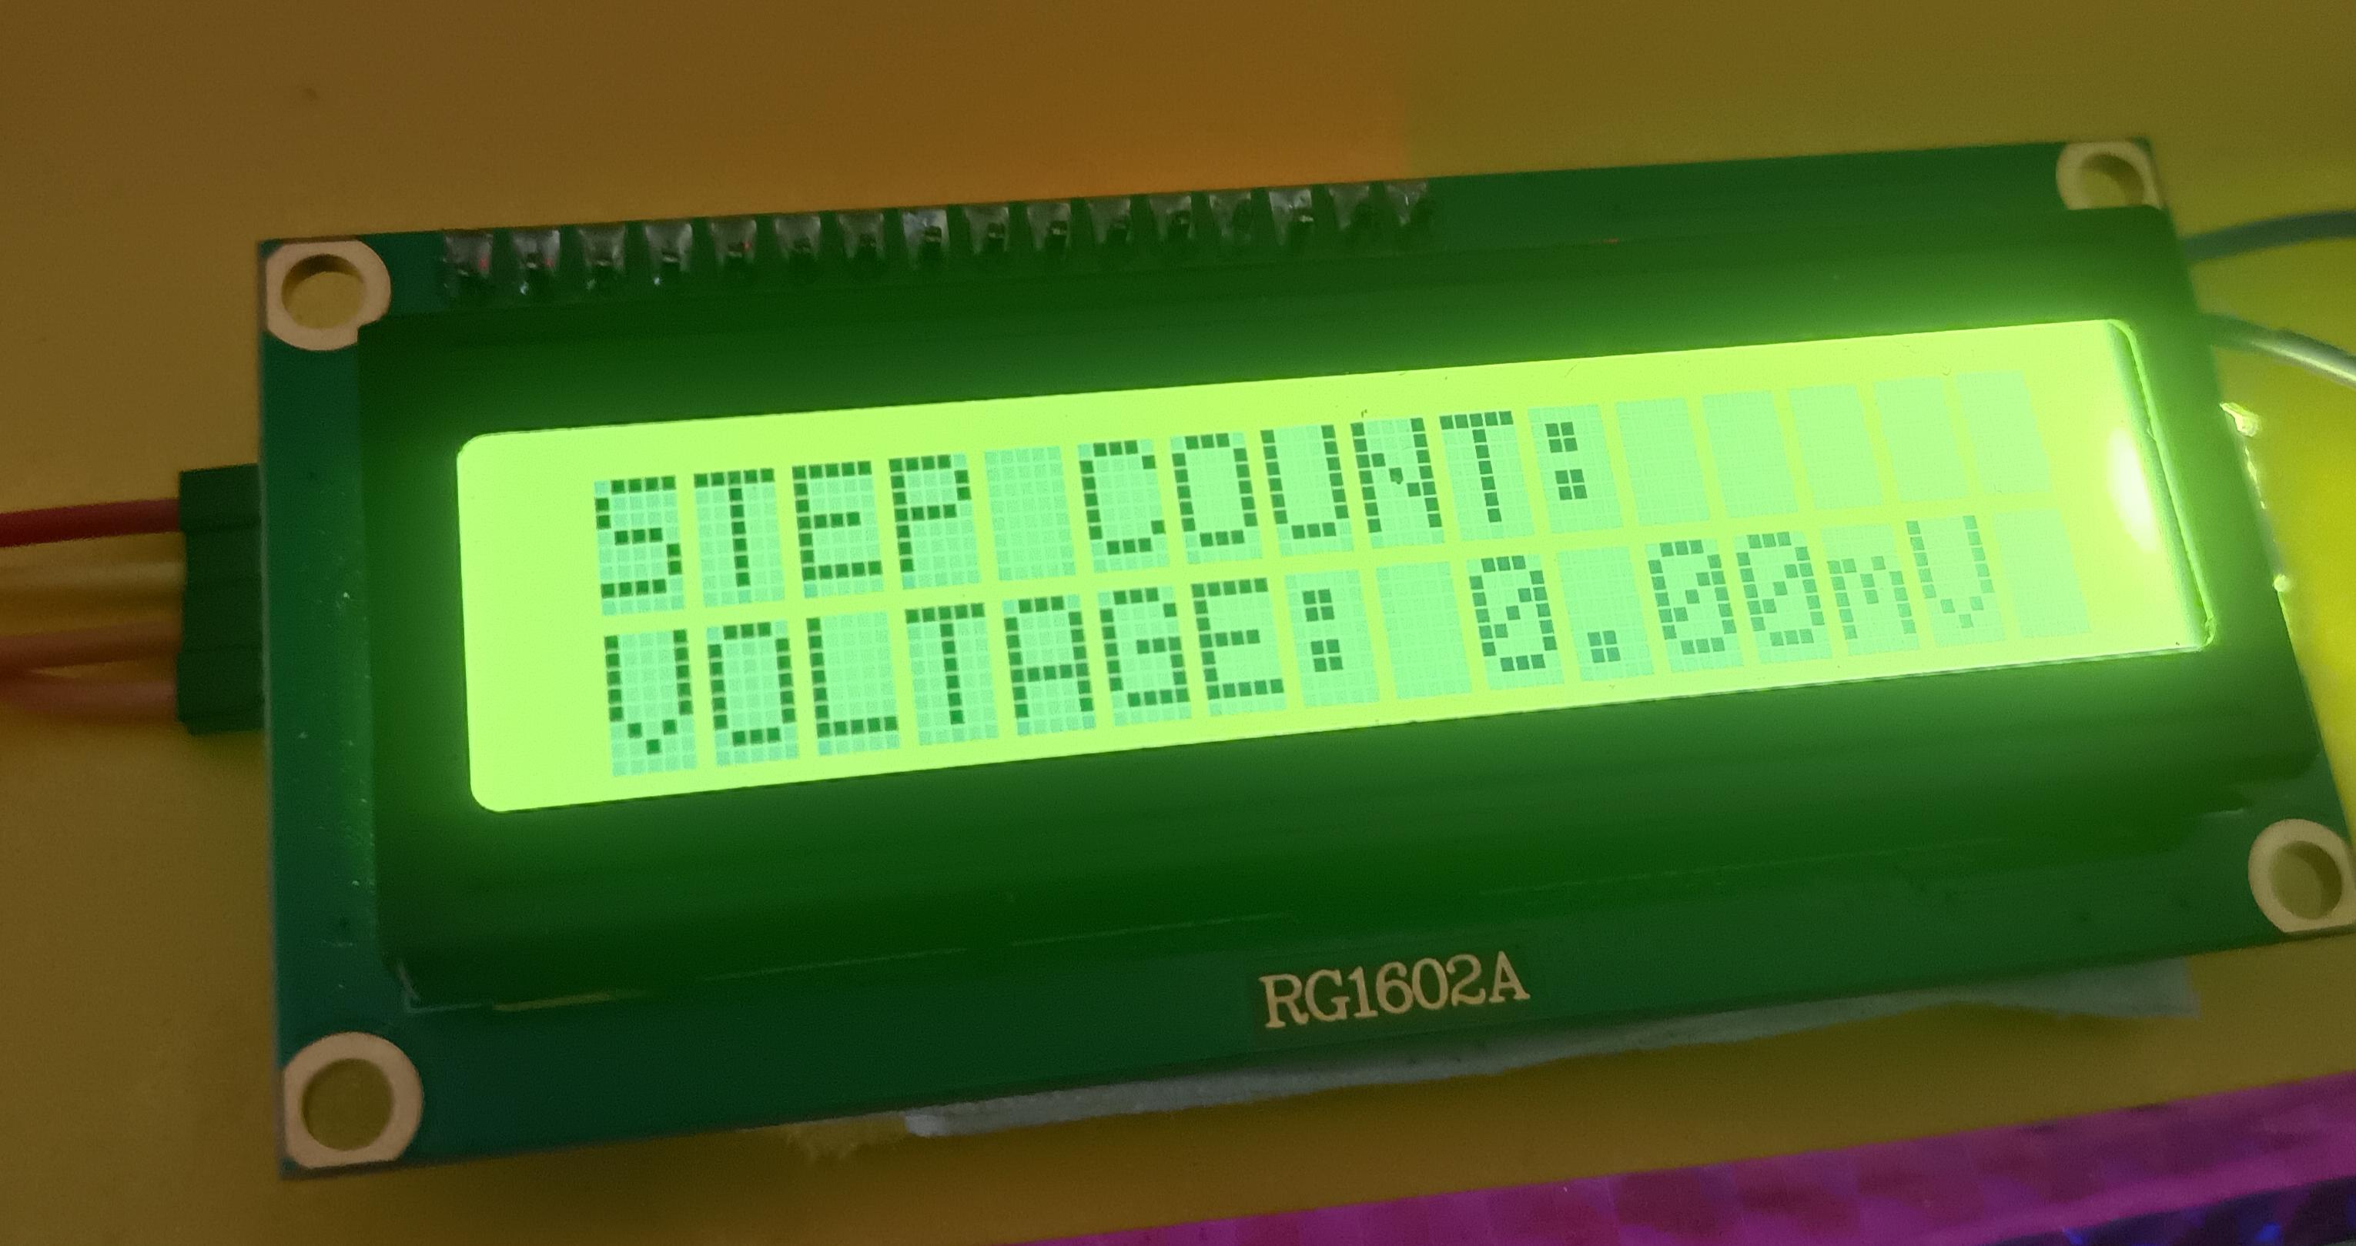
LCD Display
LCD display shows: - Generated voltage - Step count

Slide 16
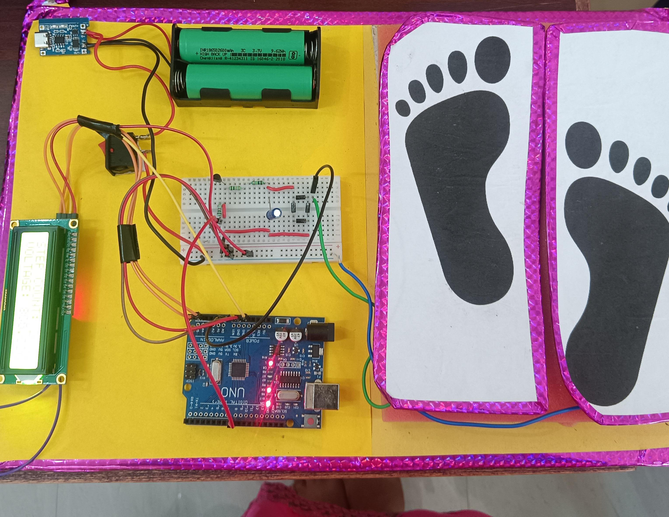
FINAL OUTPUT
System generates voltage when footsteps are applied Output is displayed in real-time on LCD

Slide 17
Applications
Railway stations Shopping malls Smart cities Street lighting systems Charging low-power devices

Slide 18
Advantages
Renewable energy source Eco-friendly Low maintenance Compact design Effective in high-footfall areas

Slide 19
Disadvantages
Low power output High initial cost Depends on human movement Mechanical wear and tear

Slide 20
Real-World Examples
Pavegen Smart Tiles (UK) --Installed in public places to generate electricity from footsteps London Underground (West Ham Station) --Uses footstep energy from daily commuters Airports (e.g., Heathrow Airport) --Installed in walkways to power lighting and displays Shopping Malls --Used in crowded areas for small power applications and interactive floors

Slide 21
Conclusion
Footstep energy can be converted into electrical energy using piezoelectric sensors The system is eco-friendly and uses renewable energy Suitable for low-power applications like LEDs and sensors Most effective in high footfall areas Has potential for future use in smart city infrastructure

Slide 22


