Slide 2
Minor Project Synopsis Presentation
CAR RENTAL SYSTEM
AND
ROUTE SUGGESTION USING DIJKSTRA’S ALGORITHM
Submitted by :
Aradhya Prakash Mahant - 500075151
Arjun Kapoor - 500075342
Arun Gera - 500075951
Harsh Kukretee - 500075266
Mentored by:
Dr. Ankur Gupta
Assistant Professor
School of Computer Science

Slide 3
Abstract
As the requirement in this difficult times of covid -19 where people were not able to travel because of high risk of getting affected we have developed this car rental system.
Car Rental System is based on the concept to rent cars, to select a car from the given list of cars along with the money you have to pay to rent a car from the company.
We have used dijkstra algorithm to make the car rental system more advance as now it is able to suggest shortest path to the user input destination from the source location.
Our aim with this project is to provide a better car renting system to the people of india.

Slide 4
Introduction
Transport facility is a matter of headache for those people who do not have any personal transport. On occasions like Wedding, Vacation, house shifting, and tour outside or on many other situations they feel the necessity of a vehicle to sort out the problems. So if it is possible to design or develop a application for availing transport whenever and wherever possible, then it will be beneficial for both renter and vehicle provider. Now a days, by some clicks only, we can get whatever you want at home. We already know about the online shopping, e-banking etc. Similarly, The Car Rental System is the online facility to book cars online within few clicks only. Some people can not afford to have a car, for those people this system becomes very helpful. This system includes various cars, as per the customer order and comfort, it place the order and deliver the car as per the location within the area. For travelling a long distance, booking can be done via internet service only.

Slide 5
Scope of the Project
The major purpose of this project is to provide a smart and efficient way of booking cars and providing the most appropriate route to the user with car booking and route suggestion system.
Help common people who do not have a personal vehicle and want to explore their country.
Easy to implement code so that it can be easily understood by the developers so that it can be used for further development.

Slide 6
Literature Review
System analysis is a thorough examination of a system's different processes and their interrelationships both within and outside the system. The key question here is – why are there so many flaws in the current system?
What measures should be taken to address the problem?
When a user or management begins a study of the software utilising the current system, analysis begins. Data was collected on numerous files, decision points, and transactions handled by the current system during the analysis. For example Data Flow Diagrams, etc. are widely utilised in the system. For the collection of important information needed to create the system, training, experience, and common sense are necessary. The system's success is primarily determined by how well the problem is identified, fully studied, and appropriately implemented via the selection of a solution. A good analytical model should include not just methods for comprehending the problem, but also the framework for solving it. As a result, it should be extensively investigated by gathering data about the system. The suggested system should next be extensively examined in light of the requirements.
System analysis is divided into four sections.
1) Initial research and system architecture.
2) Using analytic tools to do structured analysis.
3) Feasibility study.
4) Analyze the cost and benefits.

Slide 7
Problem Statement
A rental car is time specific, which means that the service could be used very specifically and also the rent increases with increase in time.
Making use of this kind of service is very convenient but for those who are not so connected with web, the service is of no use. Individual may require a smart device to make use of it.
The system is designed in the way that it automatically generates the fare according to the distance, so the passenger could not be cheated and will pay the right fare.

Slide 8
Objective
During this covid-19 pandemic it was need of the hour to follow social distancing and avoid as much contact as possible. This has motivated us to make a Simple car rental system that will help the common masses. This project will act as an application and would help small rental companies and shops to grow their business. With this motive we have made our project.
Develop A C++ code that will provide user with an interface to interact with.
Take users info and his travel location as an input.
Provide user with a specific shortest path to his destination and a invoice as a final output of the program.

Slide 9
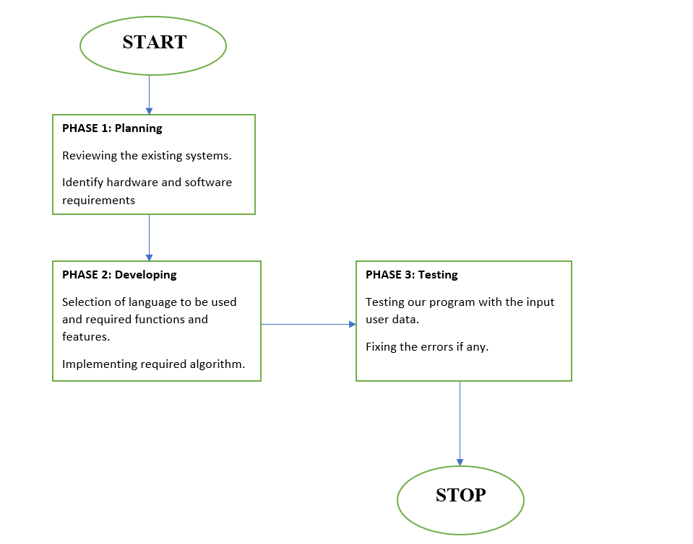
Methodology

Slide 10
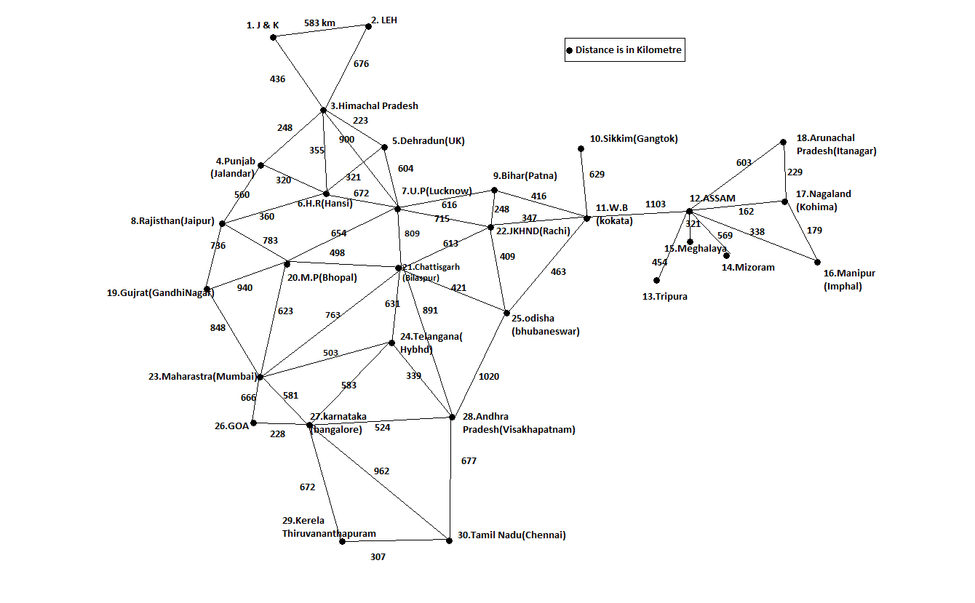
Dataset(Map)

Slide 11
Project Description
Through the implementation of this project, we aim to assist in the ease of understandability of various algorithms and C++ concepts with the help of Dev C++ software.
Here, in this project the user will be able to choose their ride and help themselves to navigate throughout their destination.
The system would provide us with a main screen where we have to fill our login details to get access.
The user has to provide the system with a password to make a successful login.
Now, the system would provide the customer with the list of cars according to the availability including details like model, color, minimum advance fare to book the car , etc.
The user will input his initial location and a final location then the system will calculate rent for total kilometers and the path for the users destination.
Finally, the customer will have the money he needs to pay and the route to his input destination.

Slide 12
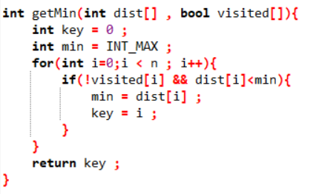
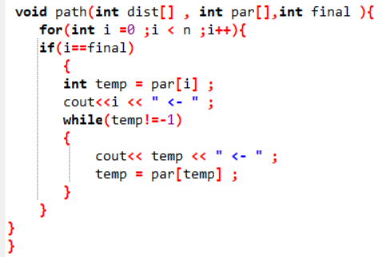
Screenshots
Dijkstra algo implemented :
Minimum distance function:
Shortest Path function :

Slide 13
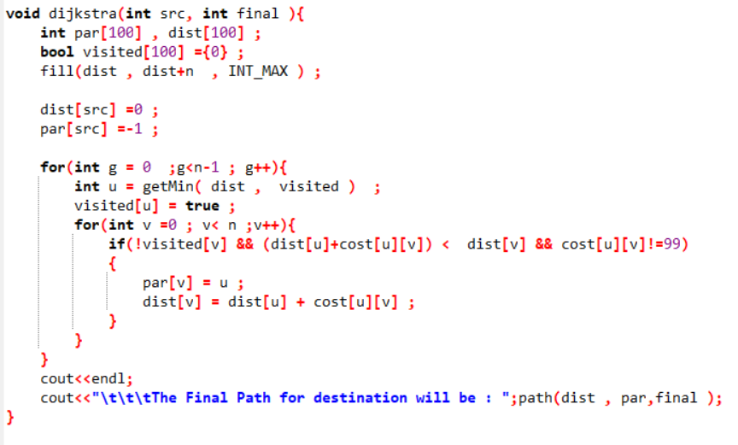
Dijkstra Algo Function :

Slide 14
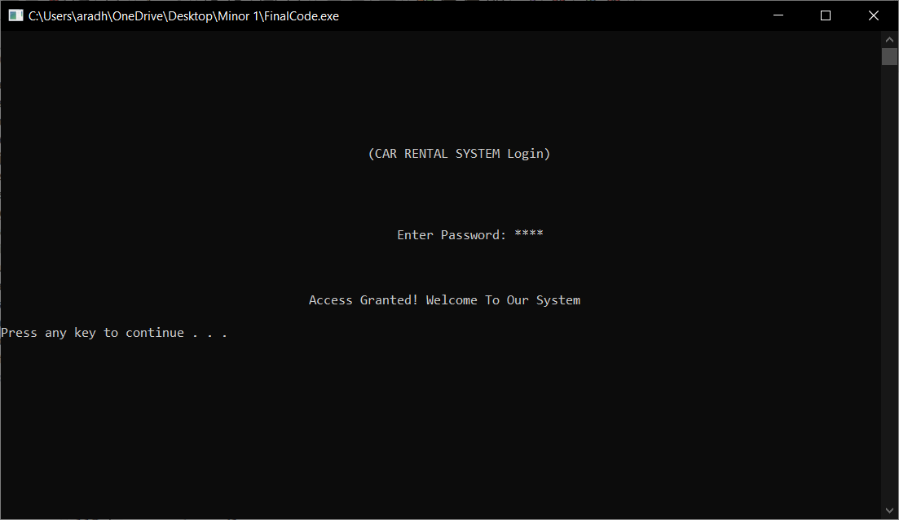
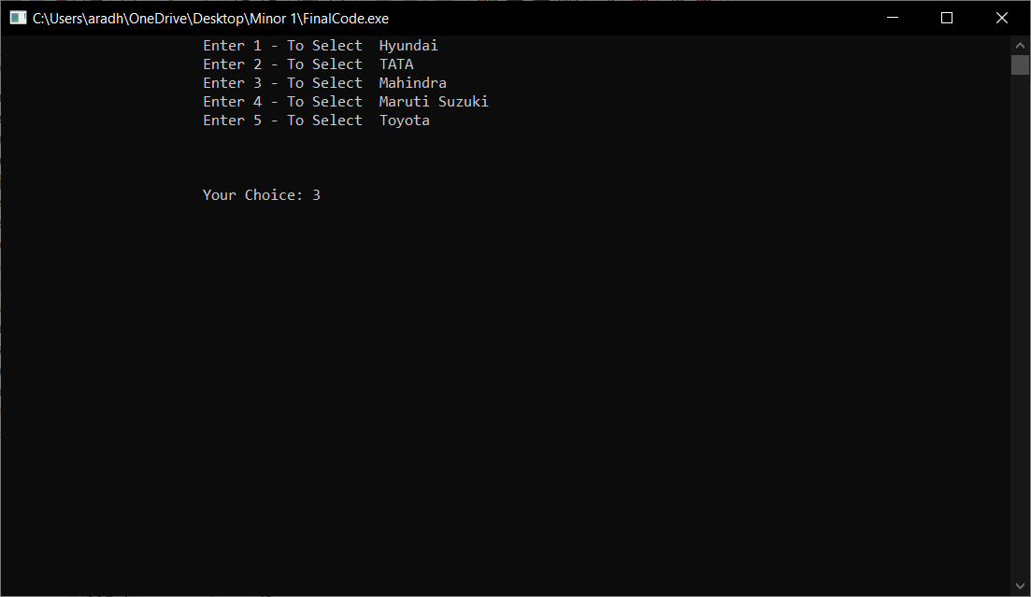
Outputs

Slide 15
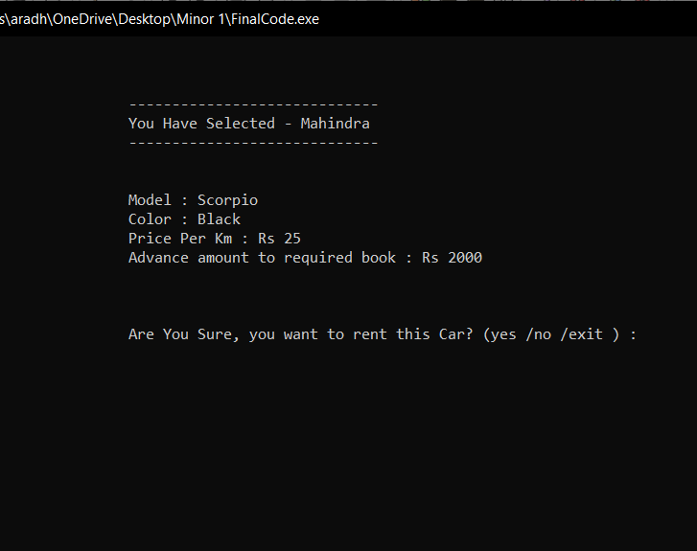
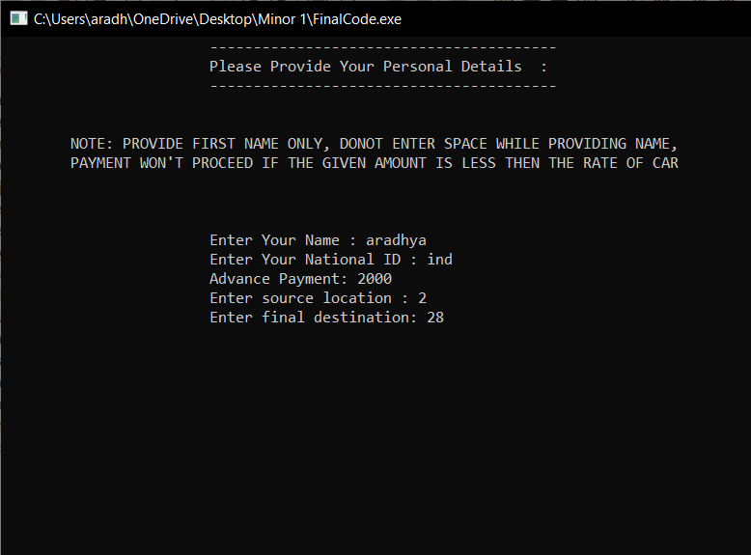

Slide 16
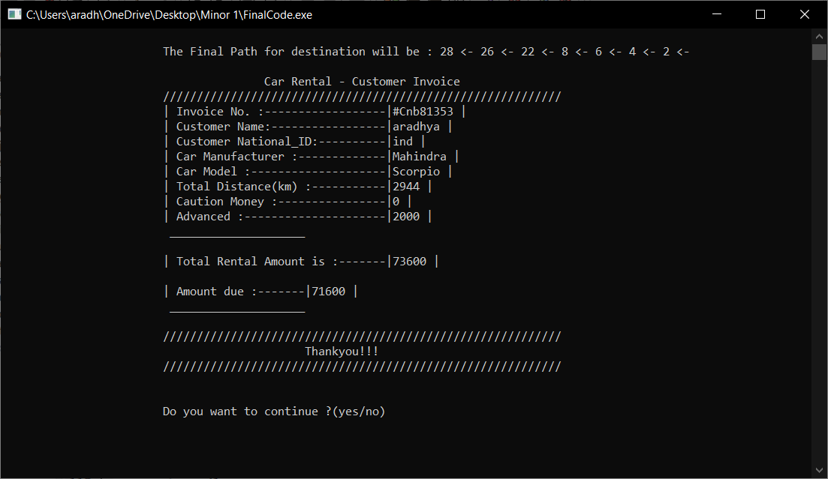

Slide 17
User Interface
The User Interface for project only requires a compiler. Dev C++, Turbo C++ are preferred.The project only requires user interface for selection of cars and other related details after which an invoice is printed.The project also requires user interaction for source and destination in order to suggest shortest route.

Slide 18
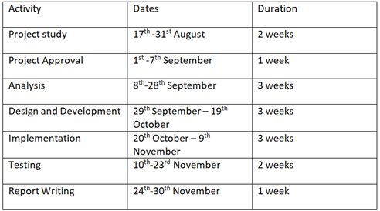
Work Timelines

Slide 19
References
1. Wikipedia: https://en.wikipedia.org/wiki/Dijkstra%27s_algorithm
2. Geeksforgeeks : https://www.geeksforgeeks.org/dijkstras-shortest-path-algorithm-greedy-algo-7/
3. https://www.projecttopics.org/design-and-implementation-of-a-car-rental-system.html
4. Let Us C++ a book by Yashavant Kanetkar.

