Slide 1
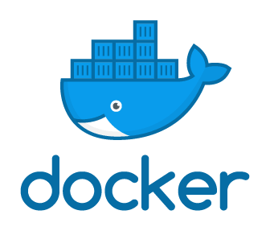
Docker Hands-On
Arun G
Version 0.1 Date 06-Feb-2019

Slide 2
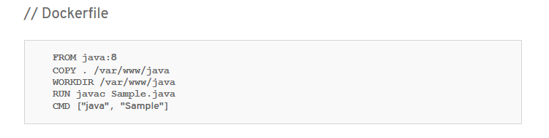
Docker File

Slide 3
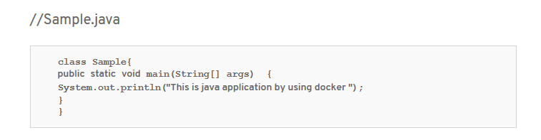
Java Application

Slide 4
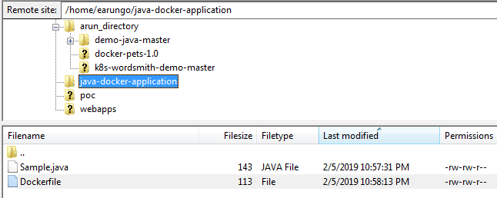
Deployment

Slide 5
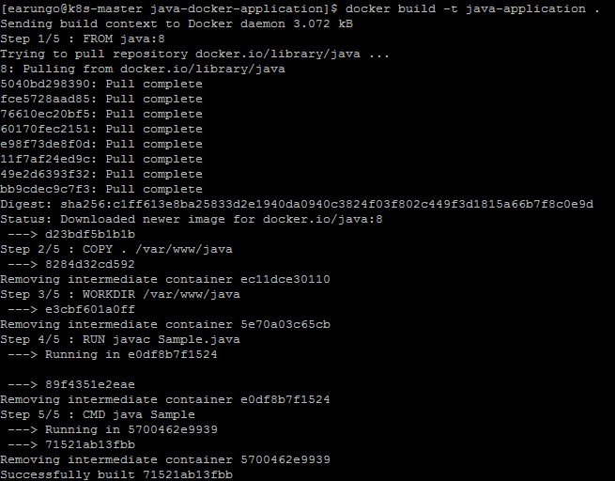
Docker Build Java Application

Slide 6
Docker Run

Slide 7
Thank You!

