Slide 1
Advanced Data Mining for Data-Driven Insights and Predictive Modeling
Dataset: Online Shoppers Purchasing Intention Dataset
Course: MSCS 634 – Advanced Big Data and Data Mining
University of the Cumberlands
Group Members
Arun Gyawali
Kashif Ali Syed
Jiwon Jung
Hanuman Sai Chanukya Srinivas Chilamkuri
12,205
18
15.63%
Cleaned sessions
Attributes
Purchase rate
Notes:
Speaker notes: Introduce the full project and mention that this presentation summarizes all four deliverables. [Sources] Project notebooks, README files, final report, and final notebook provided by the group.

Slide 2
Project Roadmap
Deliverable 1
Deliverable 2
Deliverable 3
Deliverable 4
Data Collection, Cleaning, and EDA
Feature Engineering and Regression
Classification, Clustering, and Pattern Mining
Final Insights, Recommendations, Report, and Presentation
• The same cleaned dataset was used across all modeling phases for consistency.
• Deliverable 1 prepared the data and identified important behavioral signals.
• Deliverable 2 predicted product-page engagement time using regression.
• Deliverable 3 predicted purchases, grouped sessions, and mined association rules.
• Deliverable 4 connects all findings into recommendations and responsible-use guidance.
Notes:
Speaker notes: Show that the presentation covers the whole project, not only Deliverable 4. [Sources] Project notebooks, README files, final report, and final notebook provided by the group.

Slide 3
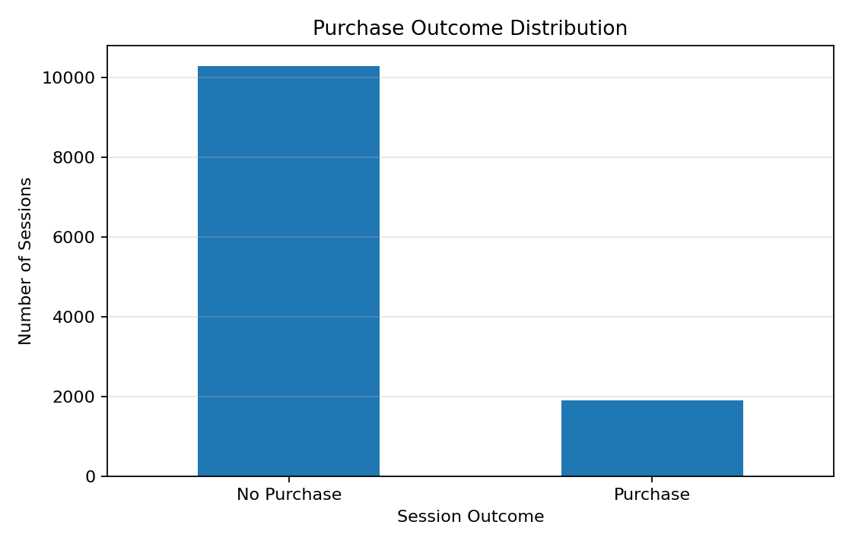
Dataset and Business Question
Each row represents one online shopping session
12,330
12,205
18
1,908
15.63%
Original records
Cleaned records
Features
Purchase sessions
Purchase rate
• Project goal: understand which browsing behaviors are connected with purchase intent.
• Revenue is imbalanced because most sessions did not end in a purchase.
• Evaluation therefore used F1 score, ROC-AUC, and confusion matrices along with accuracy.
Notes:
Speaker notes: Use this slide to explain the dataset and the main business problem. [Sources] Project notebooks, README files, final report, and final notebook provided by the group.

Slide 4
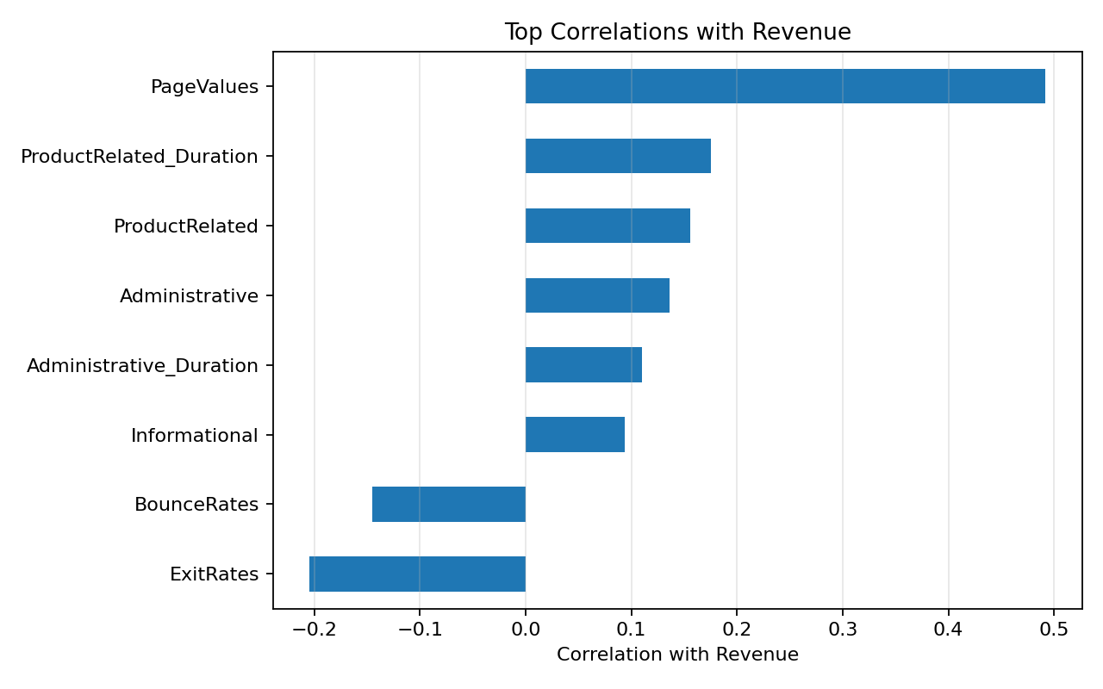
Deliverable 1: Data Preparation and EDA
Cleaning the data and finding the first purchasing signals
Removed 125 exact duplicate records.
No missing values, negative values, or invalid rate values were found.
Capped extreme duration values at the 99th percentile instead of deleting sessions.
Treated Browser, OperatingSystems, Region, and TrafficType as categorical codes.
EDA finding: PageValues was the strongest positive signal for Revenue, while BounceRates and ExitRates were negative signals.
Notes:
Speaker notes: Summarize what Deliverable 1 contributed: clean dataset and the first evidence of high-intent behavior. [Sources] Project notebooks, README files, final report, and final notebook provided by the group.

Slide 5
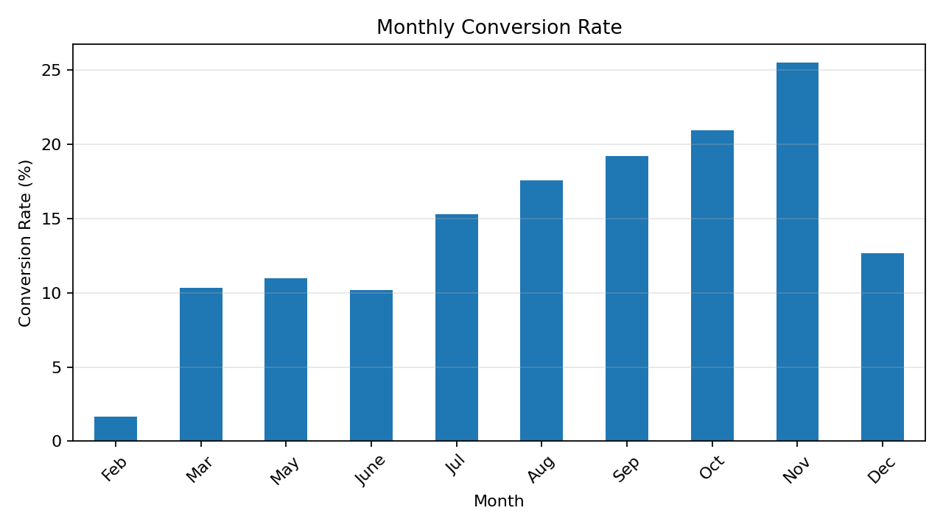
Deliverable 1: Seasonal and Engagement Insights
EDA showed when and how purchase behavior changed
November had the highest conversion rate, followed by October and September.
Purchasing sessions had more product-related pages and longer product-related duration.
Purchasing sessions also had lower bounce and exit behavior than non-purchase sessions.
These findings guided later feature engineering and model evaluation.
Notes:
Speaker notes: Explain seasonality and engagement. These EDA patterns connect to later models. [Sources] Project notebooks, README files, final report, and final notebook provided by the group.

Slide 6
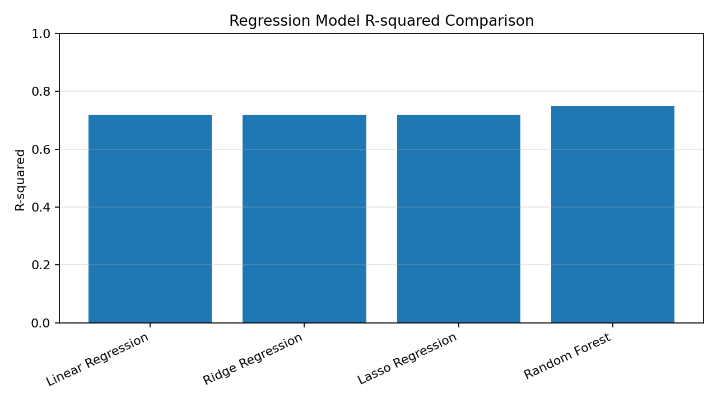
Deliverable 2: Feature Engineering and Regression
Regression predicted ProductRelated_Duration as an engagement outcome
Engineered Feature | Meaning
Total_Pages | Total Administrative, Informational, and ProductRelated pages
NonProduct_Duration | Combined Administrative and Informational duration
Avg_NonProduct_Duration_Per_Page | Average time spent per non-product page
BounceExitRatio | BounceRates divided by ExitRates
Engagement_Score | ProductRelated page count multiplied by PageValues
• Random Forest was the best regression model: test R² = 0.7506 and RMSE = 784.02 seconds.
• Cross-validation R² was 0.7702, which was stronger than the linear models.
• The result shows that engagement behavior contains non-linear patterns.
Notes:
Speaker notes: Describe the engineered features and the best regression result from Deliverable 2. [Sources] Project notebooks, README files, final report, and final notebook provided by the group.

Slide 7
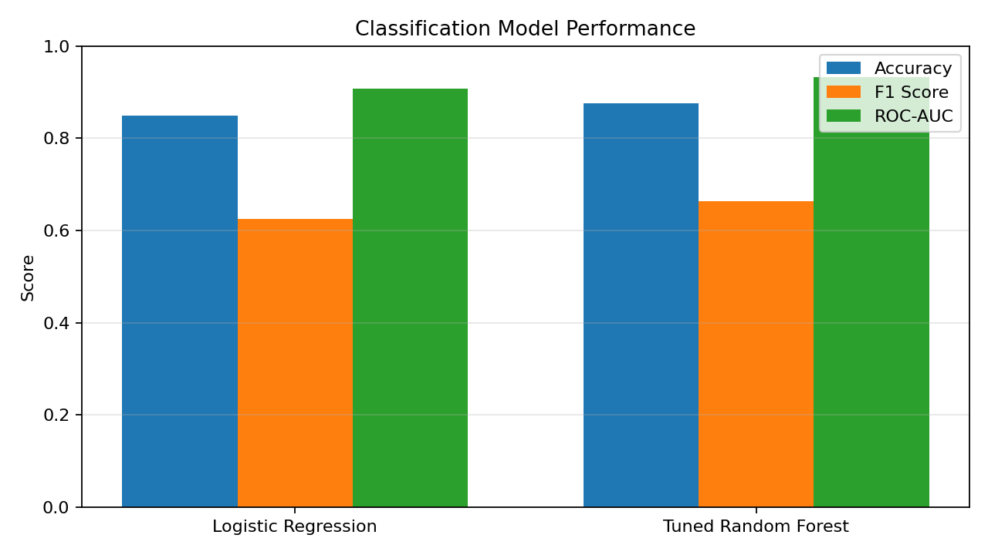
Deliverable 3: Classification and Tuning
Predicting whether a session resulted in a purchase
Model | Accuracy | F1 | ROC-AUC
Logistic Regression | 0.8484 | 0.6255 | 0.9084
Tuned Random Forest | 0.8751 | 0.6745 | 0.9341
• Purchases were the minority class, so balanced class weights and F1 score were important.
• The tuned Random Forest was selected because it had the best F1 and ROC-AUC.
• PageValues and Engagement_Score were the strongest model indicators.
Notes:
Speaker notes: Use the final notebook metrics here. Emphasize that F1 matters because purchases are imbalanced. [Sources] Project notebooks, README files, final report, and final notebook provided by the group.

Slide 8
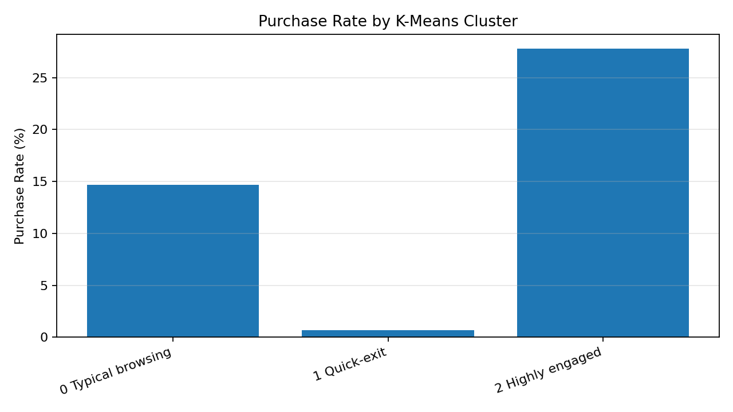
Deliverable 3: Clustering Results
K-Means separated browsing sessions into three useful groups
Cluster | Sessions | Share | Purchase Rate | Meaning
0 | 9,430 | 77.3% | 14.7% | Typical browsing
1 | 920 | 7.5% | 0.7% | Quick-exit
2 | 1,855 | 15.2% | 27.8% | Highly engaged
• Three clusters had the best silhouette score of 0.4885.
• The quick-exit group rarely purchased.
• The highly engaged group had the highest purchase rate and strongest product-page activity.
Notes:
Speaker notes: Explain the practical meaning of each cluster. This helps connect clustering to recommendations. [Sources] Project notebooks, README files, final report, and final notebook provided by the group.

Slide 9
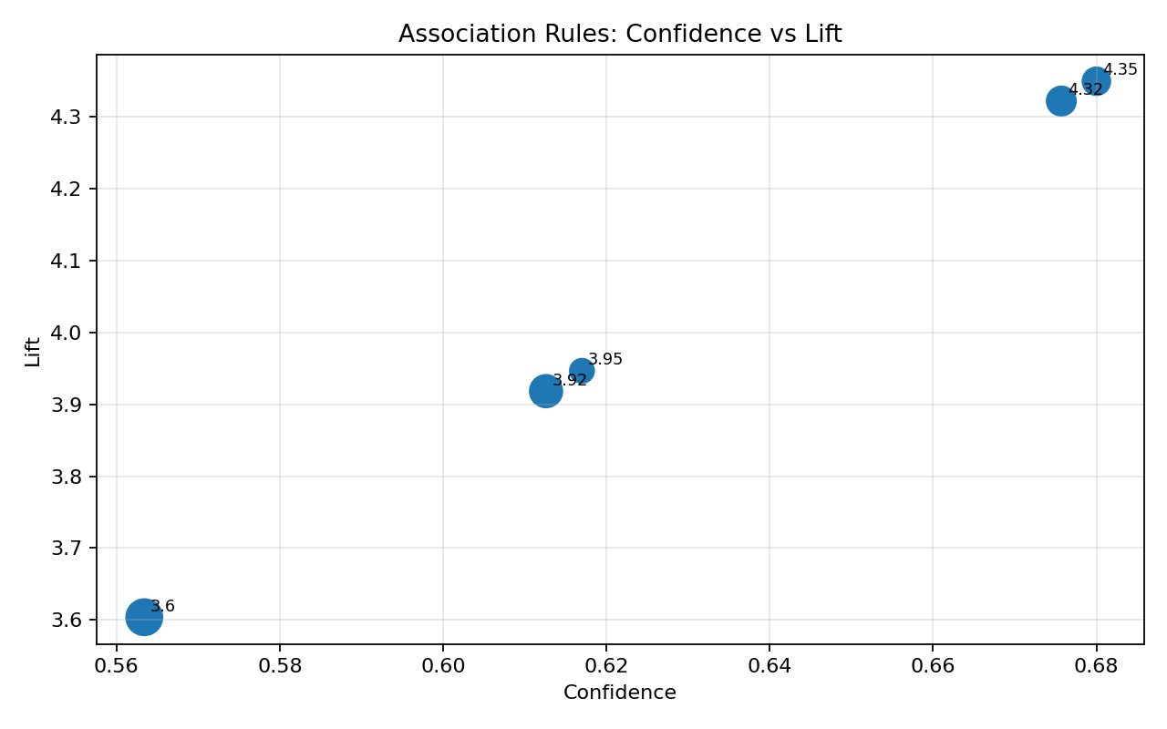
Deliverable 3: Association Rule Mining
Behavioral rules identified high-intent purchase patterns
Antecedent | Support | Confidence | Lift
Low Bounce + Low Exit + Positive PageValues | 0.0738 | 0.6800 | 4.3498
Low Bounce + Positive PageValues | 0.0818 | 0.6757 | 4.3222
Long Product Duration + Low Bounce + Positive PageValues | 0.0560 | 0.6170 | 3.9467
Low Exit + Positive PageValues | 0.1014 | 0.6126 | 3.9184
Positive PageValues | 0.1260 | 0.5634 | 3.6037
• Apriori identified 161 frequent itemsets.
• The strongest purchase rule had lift = 4.3498.
• The strongest rules combined positive PageValues with low bounce and low exit behavior.
• Rules show useful co-occurrence patterns, not guaranteed causes.
Notes:
Speaker notes: Clarify that session behavior was converted into Boolean items because the dataset was not a product basket dataset. [Sources] Project notebooks, README files, final report, and final notebook provided by the group.

Slide 10
Deliverable 4: Final Recommendations and Ethics
Final guidance was based on findings across the full project
Recommendations
Ethical Considerations
• Use PageValues, Engagement_Score, and ExitRates as high-intent signals.
• Use the tuned Random Forest as a decision-support tool for likely purchase sessions.
• Create offers, reminders, or assistance for highly engaged sessions.
• Improve landing pages and product discovery for quick-exit sessions.
• Retrain models over time because online behavior changes.
• Protect browsing data using access controls and data minimization.
• Avoid unnecessary personal information when session-level data is enough.
• Monitor model performance across visitor groups to reduce unfair outcomes.
• Use predictions as probabilities, not guarantees.
• Do not treat feature importance or rules as proof of causation.
Notes:
Speaker notes: Use this slide to show how the final project turns technical findings into responsible practice. [Sources] Project notebooks, README files, final report, and final notebook provided by the group.

Slide 11
Final Takeaways and Future Work
The project shows how data mining can support practical e-commerce decisions
Final Takeaways
Future Work
• Purchase sessions had stronger engagement and lower abandonment behavior.
• Random Forest performed best for both regression and classification.
• Clustering revealed typical browsing, quick-exit, and highly engaged session groups.
• Association rules confirmed that positive PageValues with low bounce/exit behavior is a strong high-intent pattern.
• Use product-level data for traditional market basket analysis.
• Tune classification thresholds based on business costs.
• Test Gradient Boosting and other advanced methods.
• Use time-based validation to measure model drift.
• Apply explainability methods such as SHAP for transparency.
Notes:
Speaker notes: Close the presentation by summarizing the project journey and future improvements. [Sources] Project notebooks, README files, final report, and final notebook provided by the group.

