Slide 1
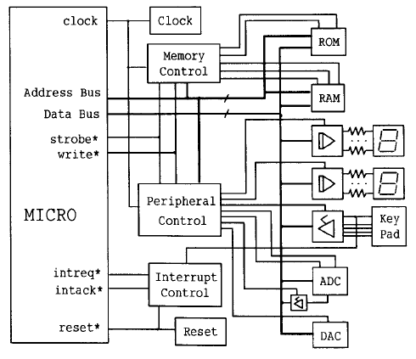
Peripheral and its characteristics

Slide 2
Outline
Introduction to peripheral
Non peripheral but outside MPU
Memory (RAM)
Type of peripheral (I/O)
Characteristics of peripheral (I/O)
Method of getting/sending data from/to I/O
Programmable Peripheral Interface
Peripheral controller (8255A)

Slide 3


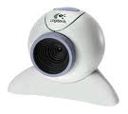


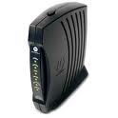



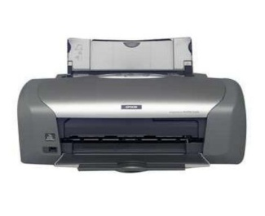
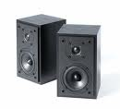
Introduction
R
A
M
Processor
Computer Systems
Internal (processor + memory (RAM) )
Peripheral (Disk, Display, Audio, Eth,..)

Slide 4
Hierarchy of I/O Control Devices
2 Port (A,B),
No Bidirectional
HS mode (C)
4 mode timer
8155
I/O + Timer
8253/54
Timer
8255
I/O
2 Port (A,B)
A is Bidirectional
HS mode (C)
Extra controls
6 mode timer
8259
Interrupt controller
8237
DMA controller
8251
Serial I/O USART controller

Slide 5
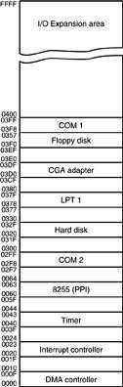
Personal Computer I/O Map
the PC uses part of I/O map for
dedicated functions, as shown here
I/O space between ports 0000H and 03FFH is normally reserved for the system and ISA bus
ports at 0400H–FFFFH are generally available for user applications, main-board functions, and the PCI bus
80287 coprocessor uses 00F8H–00FFH, so Intel reserves I/O ports 00F0H–00FFH
I/O map of a personal computer illustrating many of the fixed I/O areas.

Slide 6
Outside MPU
RAM Memory is integral part of MP System
MPU fetch instruction from RAM
MPU RD and WR data to RAM (same speed as MPU)
How Ram is interfaced
8085
MPU
A₁₅
Address Bus (16bit)
A₀
Memory
I/P
O/P
_{D7}
Data Bus (8bit)
_{D0}
Control Bus (8bit)

Slide 7
Primary function of MPU
Read Instruction from memory
Execute instruction
Read/Write data to memory
Some time send result to output device
LEDs, Monitor, Printer
Interfacing a peripheral
Why: To enable MPU to communicate with I/O
Designing logic circuit H/W for a I/O
Writing instruction (S/W)

Slide 8
Format of communications
Synchronous : At the same time, high speed I/O
Transmitter & Receiver Synchronized with same clock
7 Segment LEDs can work same/higher speed
RAM (may be I/O) can work at same speed as MPU (Not the current Processor & DRAM)
Asynchronous : Irregular interval, low speed I/O
I/O are slower
Keyboard, ADC/DAC, Disk

Slide 9
Type of I/O
Peripheral I/O
IN port (Instruction), OUT port (instruction)
Identified with 8 bit address (Immediate)
Example: IN 01H ; Receive data from port 1
Memory mapped I/O
A peripheral is connected as if it were a memory location
Identified with 16 bit address
Data transfer by : LDA, STA, MOV M R, MOV R M

Slide 10
Mode of Data transfer
Parallel
Entire 8bit or 16 bit transfer at one time
In 8085 entire 8 bit transferred simultaneous using 8 data lines
Seven Segment LEDs, Data converter (ASCIItoHEX), Memory
Serial
Data transferred one bit at a time
Parallel to serial conversion (parallel 8 bit to stream of serial 8 bit)
Serial to Parallel conversion
Modem, USB, SATA, and (sometimes monitor/printer)
UART: Universal Asynchronous Receiver & Transmitter

Slide 11
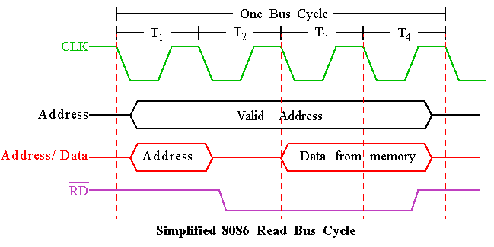
Timing Diagram : Read Cycle

Slide 12
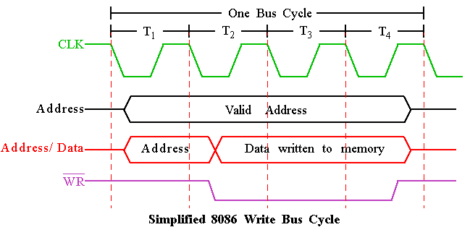
Timing Diagram : Write Cycle

Slide 13
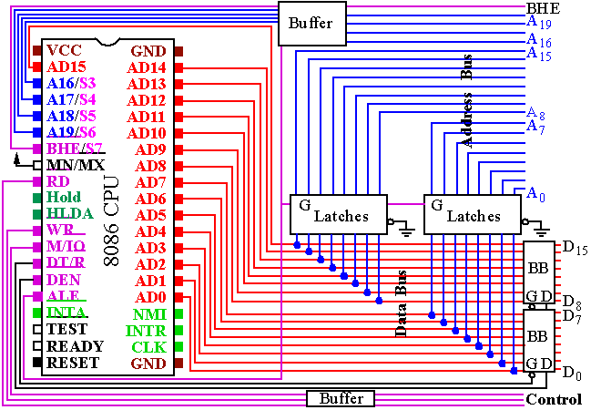
BUS Buffering and Latching

Slide 14
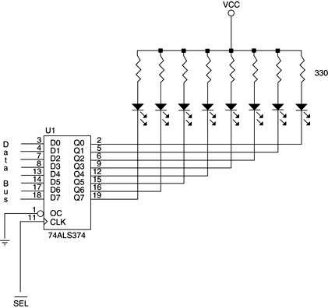
The basic output interface connected to a set of LED displays.

Slide 15
Stepper motor interface Diagram

Slide 16
8255 PPI
Programmable Peripheral Interface

Slide 17
Outline
8255 PPI
8255 PPI Pin Configuration
8255 operating modes
16-bit data bus to 8-bit peripherals
MODE 0 Application (Keyboard)
MODE 1 Application (Printer)
MODE 2 Application (Printer)

Slide 18
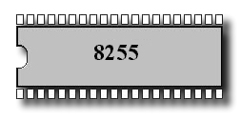
The 8255A is a programmable peripheral interface (PPI) device designed for use in Intel microcomputer systems. Its function is that of a general purposes I/O component to Interface peripheral equipment to the microcomputer system bush. The functional configuration of the 8255A is programmed by the systems software.

Slide 19
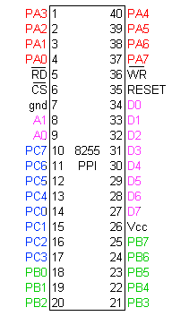
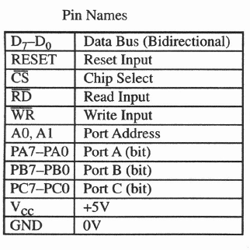
Pin Configuration

Slide 20
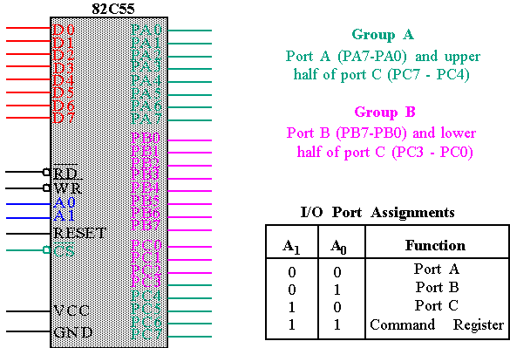
82C55 : Pin Layout

Slide 21
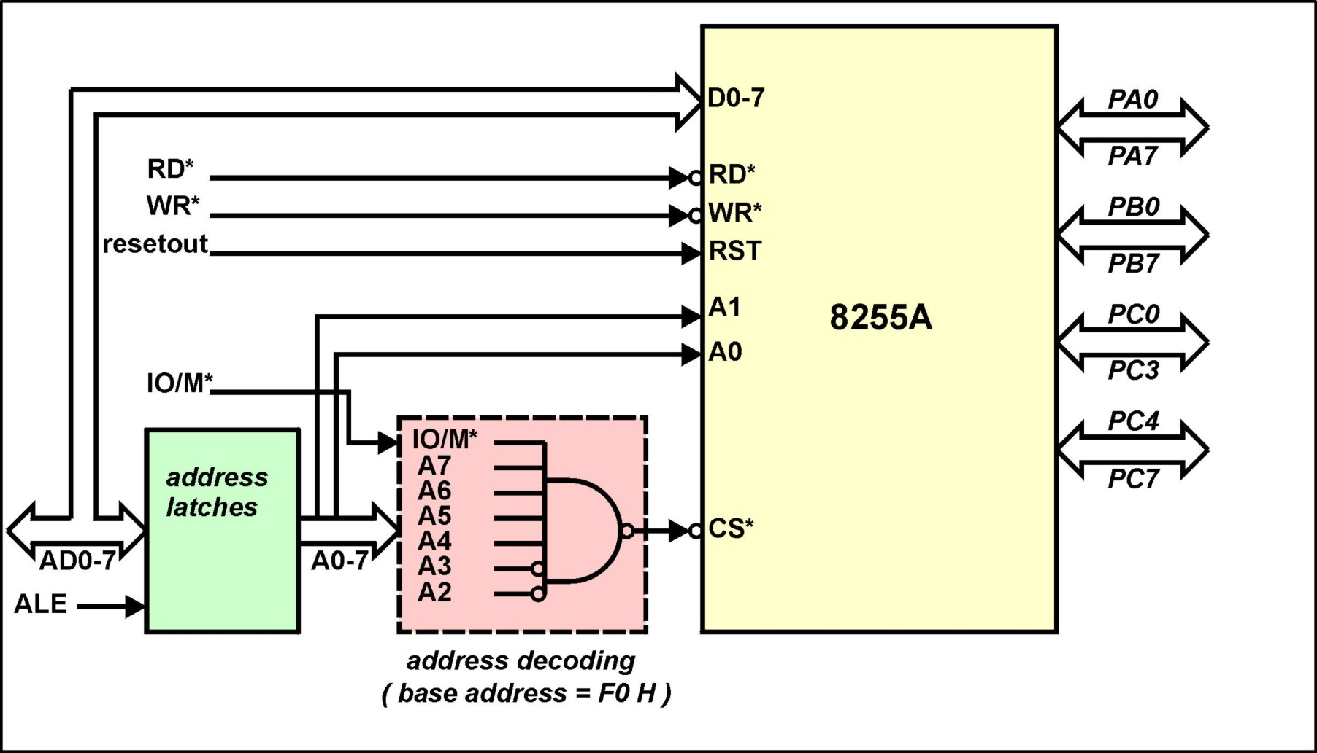
8255A - 8085A Interface

Slide 22
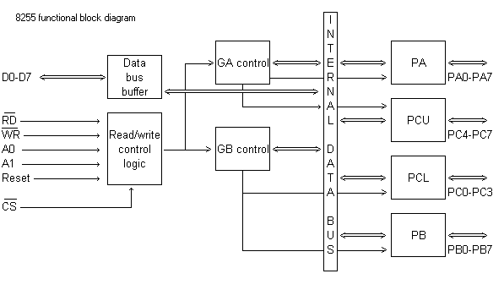
8255 A Block Diagram Showing Data Bus Buffer and Read/Write Control Logic Functions

Slide 23
Pin Configuration
(CS)Chip Select. A “low’ on this input pin enables the communication between the 8255A, and the CPU.
(RD) Read. A “low” on this Input pin enables the 8255A to send the data or status information to the CPU on the data bus. In essence, it allows the CPU to “read from the 8255A.
(WR) Write. A. “ low” on the input pin enables the CPU to write data or control words into the 8255A.
(A0 and A1)
Port Select 0 and Port Select 1. The Input signals, in conjunction with the RD and WR Inputs, controls the selection of one of the three ports or the control word registers. They are normally connected to the least significant bits of the address bus (A0 and A1).

Slide 24
Interface Registers
A1 A0 RD WR CS Input Operation (Read)
0 0 0 1 0 Port A - Data Bus
0 1 0 1 0 Port B - Data Bus
1 0 0 1 0 Port C - Data Bus
1 1 0 1 0 Control Word - Data Bus
Output Operation (Write)
0 0 1 0 0 Data Bus - Port A
0 1 1 0 0 Data Bus - Port B
1 0 1 0 0 Data Bus - Port C
1 1 1 0 0 Data Bus - Control

Slide 25
Ports A, B and C
Ports A, B, and C
The 8255A contains three 8-bit ports (A , B, and C). All can be configured in a wide variety of functional characteristics by the system software but each has its own special features or personally to further enhance the power and flexibility of the 8255A.
Port A. One 8 bit data output latch/buffer and one 8-bit data input latch.
Port B. One 8-bit data output latch/buffer and one 8-bit data input buffer.
Port C. One 8-bit data output latch/buffer and one 8-bit data input buffer (no latch for input). This port can be divided into two 4-bit ports under the mode control. Each 4-bit port contains a 4-bit latch and it can be used for the controls signal outputs and status signal inputs in conjunction with ports A and B.

Slide 26
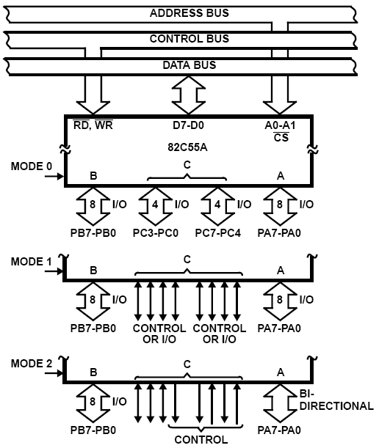
8255A OPERATIONAL DESCRIPTION
Mode Selection
There are three basic modes of operation that can be selected by the systems software:
Mode O – Basic Input/Output
Mode 1 – Strobed Input/Output
Mode 2 – Bi-Directional Bus

Slide 27
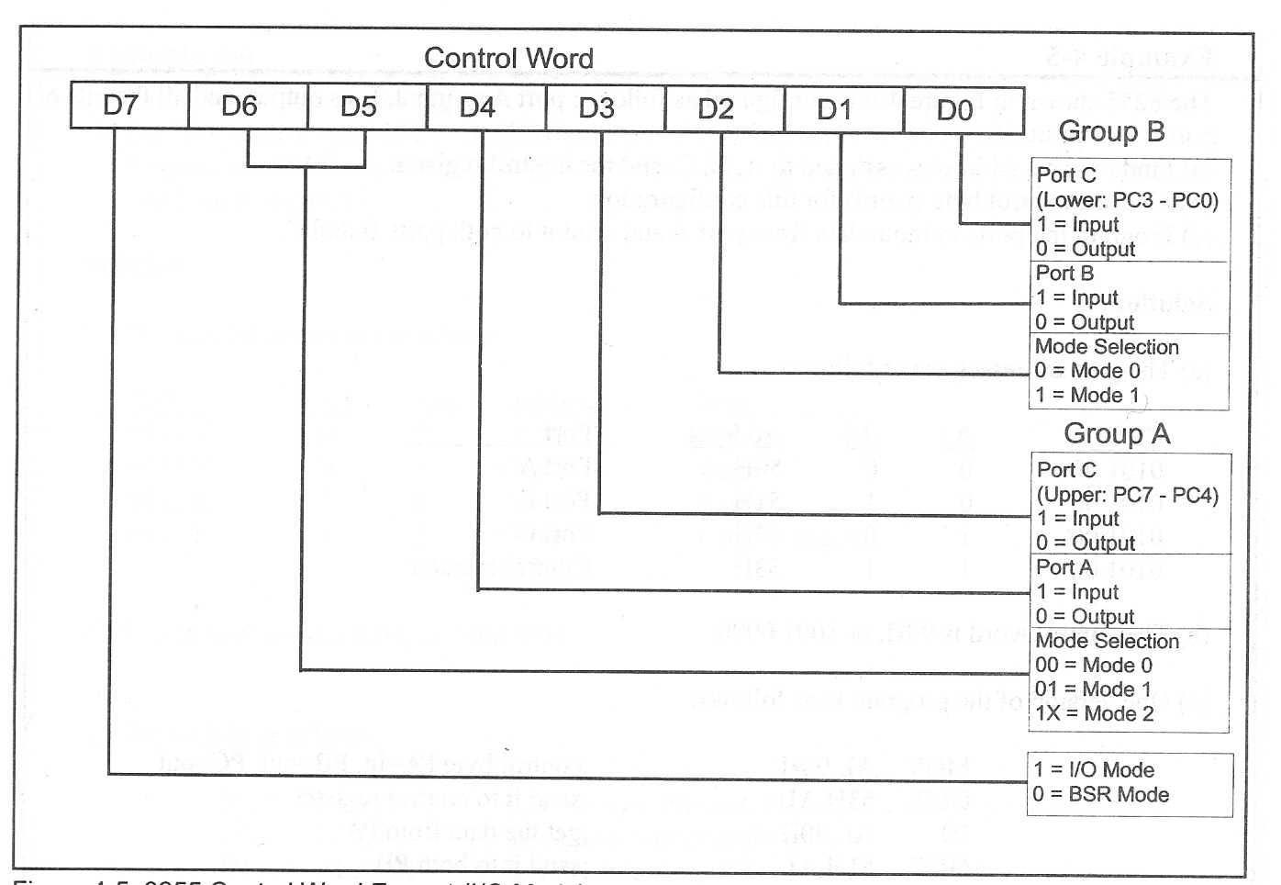
8255 Control Word
Mode Definition Format

Slide 28
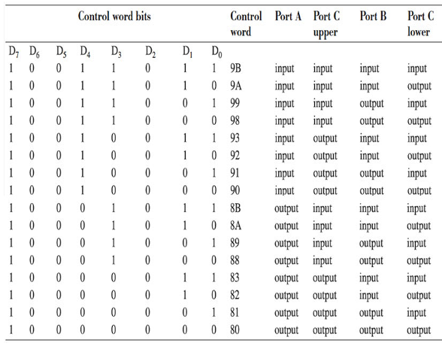
8255 Control Word

Slide 29
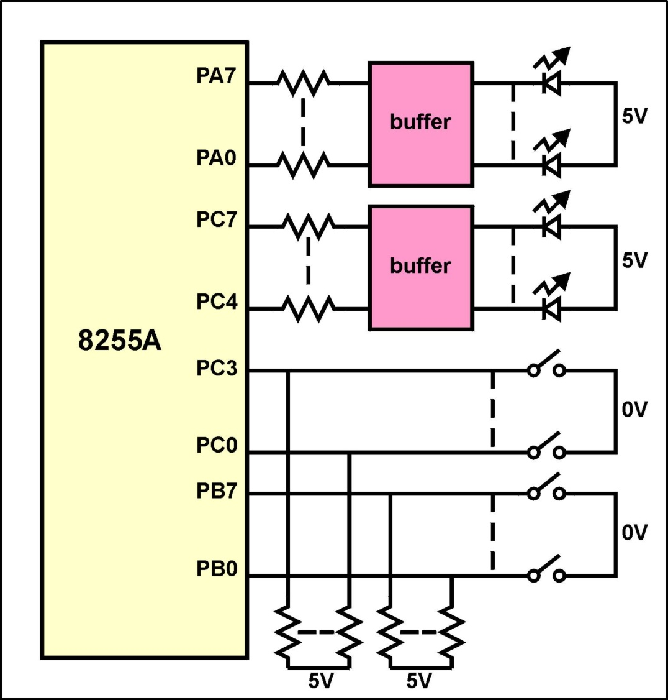
Example of 8255A Operating in Mode 0
Write a program that reads the state of the 12 switches and displays the switch state on the 12 LEDs
20/09/18

Slide 30
Example of 8255A Operating in Mode 0
The assembly language program is : MVI A, 83 H ;A= out B= in C(lo)= in C(hi)= out
OUT F3 H ; write the control word
IN F1 H ; read switches on port B
OUT F0 H ; display on port A
IN F2 H ; read switches on port C (lo)
ANI 0F H ; mask top 4-bits - not switch data
RLC RLC RLC RLC ; move bottom 4-bits of A to top
OUT F2 H ; output reg A to port C

Slide 31
Intel 8255 PPI
Chip Select Circuit
A7
M/IO*
A7=0, A6=1, A5=1, A4=1, A3=1, A2=1, & M/IO*= 0

Slide 32
8255 –port address
When CS (Chip select) is 0, 8255 is selected for communication by the processor. The chip select circuit connected to the CS pin assigns addresses to the ports of 8255. For the chip select circuit shown, the chip is selected when A7=0, A6=1, A5=1, A4=1, A3=1, A2=1, & M/IO*= 0 Port A, Port B, Port C and Control port will have the addresses as 7Ch, 7Dh, 7Eh, and 7Fh respectively.

Slide 33
Ex. :Circuit Diagram
D0-D7
8255
PPI
CS
RD#
WR#
A1
A0
D0-D7
A3
A4
A5
A0
0
1
2
3
4
5
6
7
A1
From CPU
A2
‘138
M/IO#
A0
E1
E2
A7
A6
E3
IORDC#
IOWRC#
A2
A1

Slide 34
Use only even addresses
Example: We want to use a 8255 PPI with the starting I/O address of F8h. Use even adresses only.
A7 A6 A5 A4 A3 A2 A1 A0
f8h 1 1 1 1 1 0 0 0 B : Port A
fah 1 1 1 1 1 0 1 0 B : Port B
fch 1 1 1 1 1 1 0 0 B : Port C
feh 1 1 1 1 1 1 1 0 B : Control Reg.
Register Select

Slide 35
Access to Interface Registers
Port B and C are programmed as Mode 0 input port.
Port A is programmed as Mode 0 simple latched output port.
Write a code to implement the operation
PortA=PortB-PortC
mov AL,8Bh ;control word
out FEh,AL ;written to control reg.
in AL,FCh ;Read Port C
mov BL,AL ;
in AL,FAh ;Read Port B
sub AL,BL ;PortB-PortC
out F8h,AL ;write PortA

Slide 36
Solution 2: Use only odd addresses
Example: We want to use a 8255 PPI with the starting I/O address of F9h. Use odd adresses only.
A7 A6 A5 A4 A3 A2 A1 A0
f9h 1 1 1 1 1 0 0 1 B : Port A
fbh 1 1 1 1 1 0 1 1 B : Port B
fdh 1 1 1 1 1 1 0 1 B : Port C
ffh 1 1 1 1 1 1 1 1 B : Control Reg.
Register Select

Slide 37
Circuit Diagram
D0-D7
8255
PPI
CS
RD#
WR#
A1
A0
D8-D15
A3
A4
A5
A0
0
1
2
3
4
5
6
7
A1
From CPU
A2
‘138
M/IO#
E1
A0
E2
A7
A6
E3
IORDC#
IOWRC#
A2
A1

Slide 38
Solution 3: Use consecutive even and odd address
Example: We want to use a 8255 PPI with the starting I/O address of C0h. Use even and odd adresses.
A7 A6 A5 A4 A3 A2 A1 A0
C0h 1 1 0 0 0 0 0 0 B : Port A
C1h 1 1 0 0 0 0 0 1 B : Port B
C2h 1 1 0 0 0 0 1 0 B : Port C
C3h 1 1 0 0 0 0 1 1 B : Control Reg.
Register Select

Slide 39
8255 MD Control word Contd.
Ex. 1: Configure Port A as i/p in Mode 0, Port B as o/p in mode 0, Port C (Lower) as o/p and Port C (Upper) as i/p ports.
Required MD control word:
 |  | 1 | 0 | 0 | 1 | 1 | 0 | 0 | 0 | =
MD control |  |  |  |  |  |  |  |  | PC Lower as o/p
 | PA in Mode 0 |  |  |  |  | PB as o/p Reqd. instrns.
 |  | PA as i/p |  |  | PB in Mode 0 | MOV AL, 98H
 |  |  |  |  |  | PC Upper as i/p

Slide 40
8255 MD Control word Contd.
Ex. 2: Configure Port A as i/p in Mode 1, Port B as o/p in mode 1, Port C7-8 as i/p ports. (PC5-0 are handshake lines, some i/p lines and others o/p. So they are shown as X)
Required MD control word:
 |  | 1 | 0 | 1 | 1 | 1 | 0 | X | =
MD control |  |  |  |  |  |  |  | PC3-0 as don’t care
 | PA in Mode 1 |  |  |  |  |  | PB as o/p Reqd. Instrns.
 |  | PA as i/p |  |  |  | PB in Mode 1 | MOV AL,BCH
 |  |  |  | PC Upper(C7-8) as i/p

Slide 41
Example - Port addresses

Slide 42
Solution

Slide 43
Example – Programming 8255

Slide 44
Solution

Slide 45
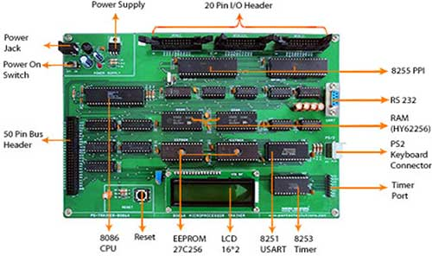

Slide 46
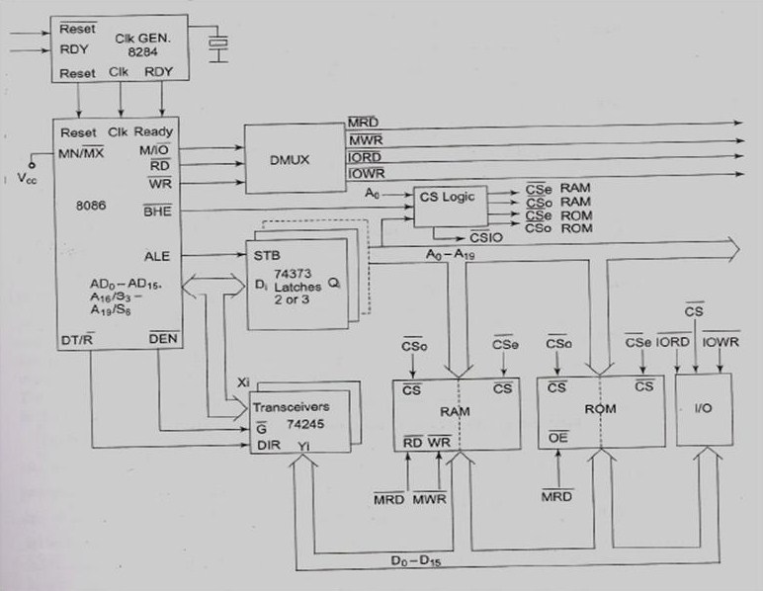

Slide 47
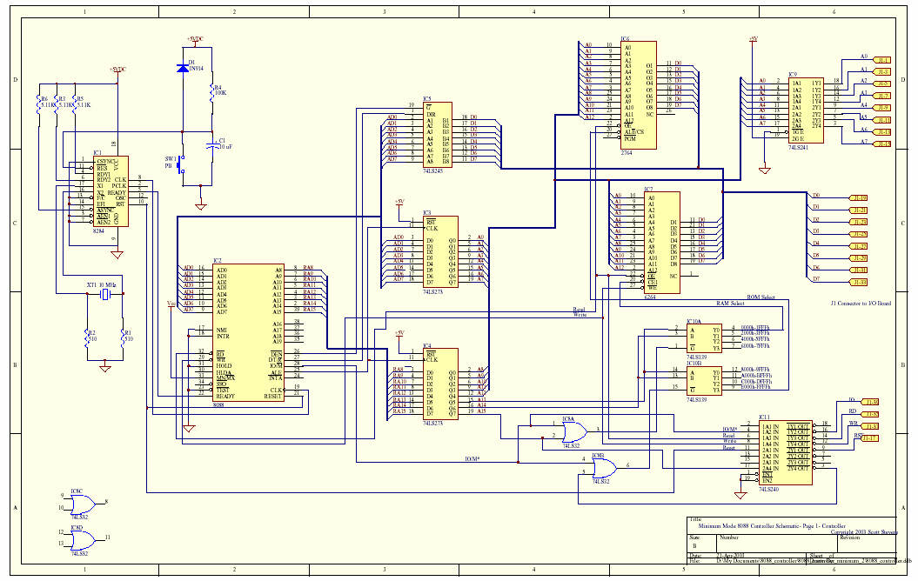

Slide 48
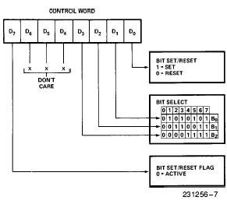
Bit Set Reset (BSR) mode

Slide 49
Example for BSR
Program 8255 for the following
A) set PC2 to high
B) Use PC6 to generate a square wave of 66% duty cycle
Solution
A)
MOV AL, 00000101B
OUT 92H,AL
B)
AGAIN MOV AL, 0xxx1101
OUT 92H, AL
CALL Delay
CALL Delay
MOV AL, 0xxx1100
OUT 92H, AL
CALL Delay
JMP AGAIN

Slide 50
Mode 0: Example
This functional configuration provides simple input and output operations for each of the three ports. No ``handshaking'‘ is required, data is simply written to or read from a specified port.
Mode 0 Basic Functional Definitions:
Two 8-bit ports and two 4-bit ports.
Any port can be input or output.
Outputs are latched.
Inputs are not latched.
16 different Input/Output configurations are possible
in this Mode.

Slide 51
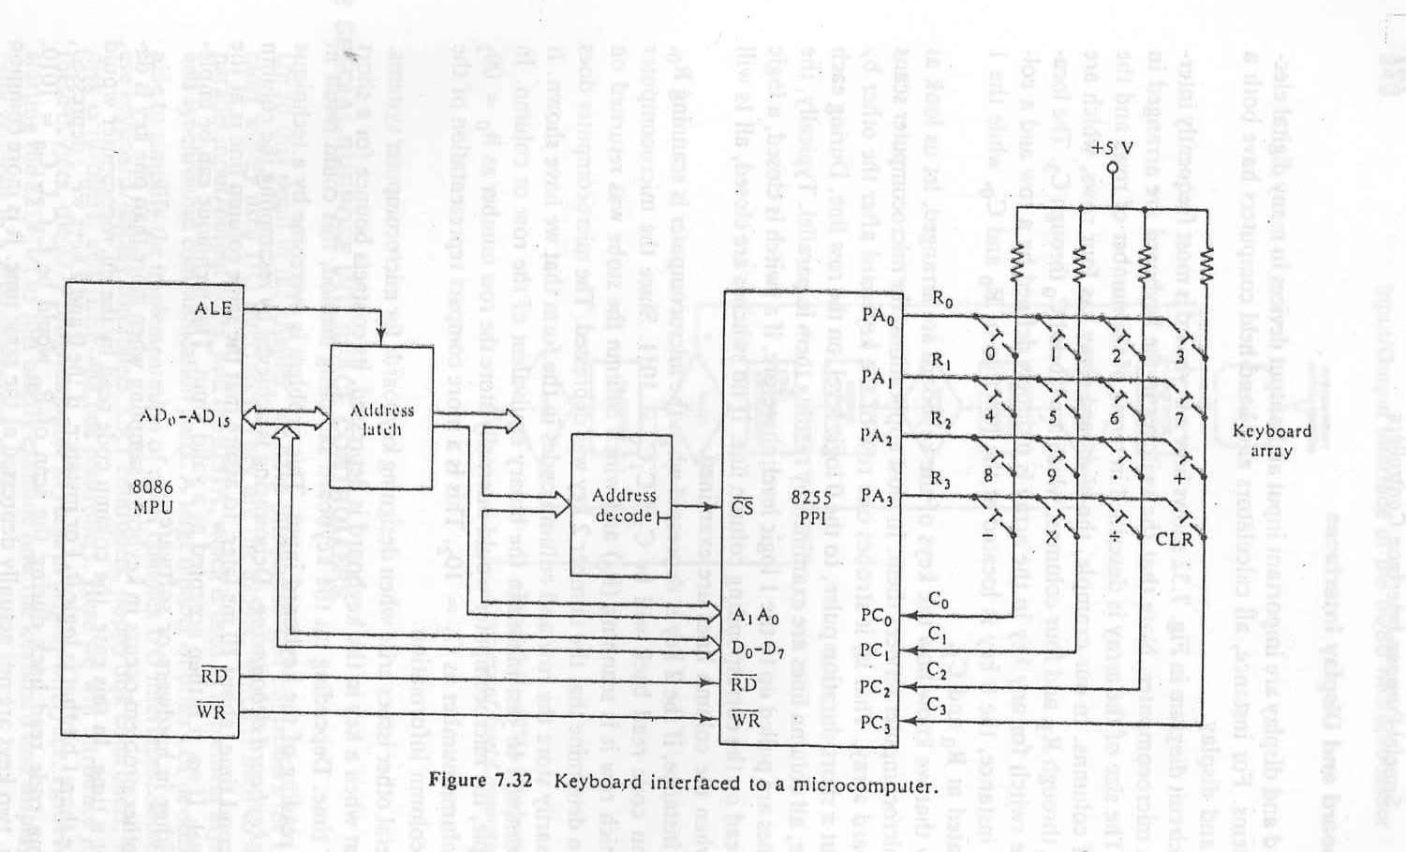
MODE 0 Application (Keyboard Interface)

Slide 52
MODE 0 Application (Keyboard Interface)
The switches in the keyboard are arranged in an array. The size of the array is described in terms of the number of rows and the number of the columns.
In our example, the keyboard array has four rows, which are labeled R₀ through R₃, and four columns, which are labeled C₀ through C₃. The location of the switch for any key in the array is uniquely defined by a row and a column.
For instance, the 0 key is located at the junction of R₀ and C₀, while the 1 key is located at R₀ and C₁.
In most applications, the microcomputer scans the keyboard array. That is, it strobes one row of the keyboard after the other by sending out a short-duration pulse, to the 0 logic level, on the row line. During each row strobe, all column lines are examined by reading them in parallel.
Typically, the column lines are pulled up to the 1 logic level; therefore, if a switch is closed, a logic 0 will be read on the corresponding column line. If no switches are closed, all 1s will be read when the lines are examined.

Slide 53
MODE 0 Application (Keyboard Interface)
The starting address for this I/O interface is 10H and consecutive even addresses are used.
10h: 0 0 0 1 0 0 0 0B -Port A (Output port)
12h: 0 0 0 1 0 0 1 0B -Port B (Unused output port)
14h: 0 0 0 1 0 1 0 0B -Port C (lower and higher input)
16h: 0 0 0 1 0 1 1 0B -Control Reg.
PORTA EQU 10h
PORTB EQU 12h
PORTA EQU 14h
CREG EQU 16h
CWD EQU 10001001b
MOV AL, CWD
OUT CREG,AL

Slide 54
MODE 0 Application (Keyboard Interface)
.
.
SCAN: MOV BL,FEH ; send a short-duration pulse, to the 0 logic level,
SCAN1: MOV AL,BL ; on the row line0.
OUT PORTA,AL
IN AL,PORTC ;Read PortC
XOR AL,FFH ;Complement AL
AND AL,0FH ;Mask unused nibble
CMP AL,0
JNE KEY ;if a key pressed go to KEY
ROL BL,1 ; if no key pressed, shift the ruration pulse to next row
CMP BL,FEH
JNE SCAN1
JMP SCAN
.
.
KEY: .
.

Slide 55
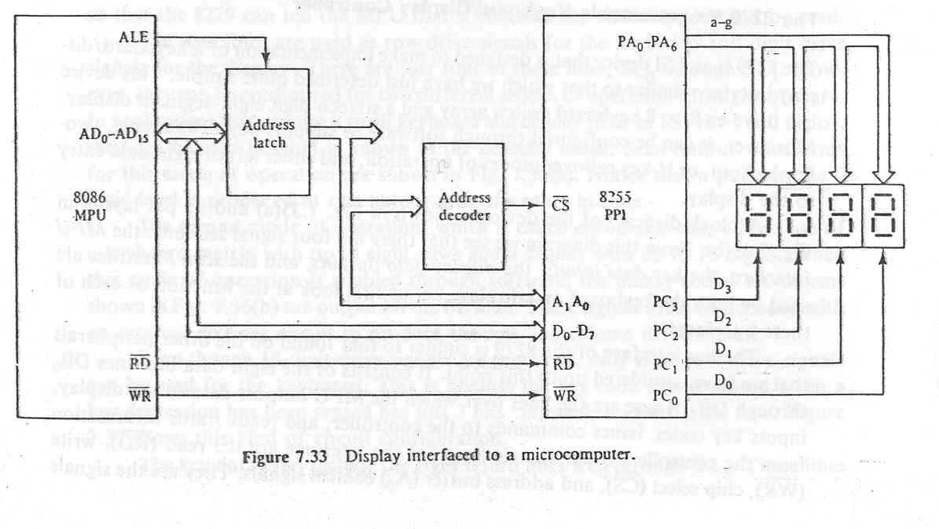
Mode 0 Application: Display Interface

Slide 56
MODE 1 (Strobed Input/Output).
This functional configuration provides a means for transferring I/O data to or from a specified port in conjunction with strobes or ``handshaking'' signals. In mode 1, Port A and Port B use the lines on Port C to generate or accept these ``handshaking'' signals.
Mode 1 Basic functional Definitions:
Two Groups (Group A and Group B).
Each group contains one 8-bit data port and one 4-bit control/data port.
The 8-bit data port can be either input or output
Both inputs and outputs are latched.
The 4-bit port is used for control and status of the 8-bit data port.

Slide 57
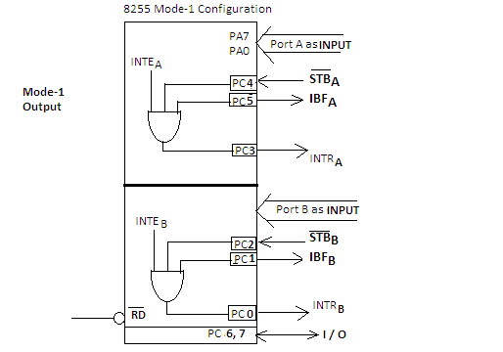
MODE 1 Input Operation
STB: This is an active low input to 8255A from the device to indicate that the device has transmitted a byte of data. 8255A in response generates an IBF and INTRA.
IBF: In response to STB, 8255A generates and transmits an active high signal ‘IBF’ as an acknowledgement for receipt of data. This is reset (‘0’) after the MPU reads the data.
INTE: 8255 has two internal flip-flops INTEA and INTEB. These are used to enable or disable the generation of INTR signal. These two FF are set/reset using the BSR mode. INTEA is enabled or disabled through PC4 and INTEB through PC2
INTR: For an interrupt driven I/O, an active high INTR signal is generated by 8255A that may be used to interrupt the MPU. As seen from figure, three signals STB’, IBF and INTE all at logic ‘1’ are input to an AND gate INTR is dropped when the data is read by the MPU at the falling edge of RD’ signal
Notes:
Status word is read from port c
Intea and inteb are written using PC6 and PC2

Slide 58
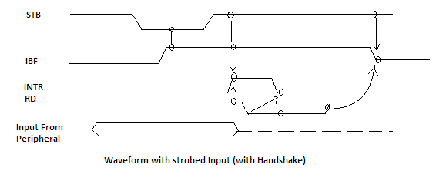
MODE 1 Timing (Input)
When a device is ready to send data using 8255 in mode-1 it sends the data on either port A or port B, the device also sends STB' signal to the 8255A to indicate that it has sent the data.
8255A sends an IBFA or IBFB signal depending on the port used for data transmission as an acknowledgement.
If the INTEA of INTEB flip-flop is set the 8255A generates an INTR signal which may be used to interrupt the MPU in interrupt driven I/O operation.
In status check I/O MPU continuously checks IBFA and/or IBFB for it to become high. When it finds IBF(A or B) high, MPU reads the data from PA or PB and resets the IBF(A or B). If mechanism of IO is interrupt based, in that case when the MPU is interrupted it reads the data from the port and disables the interrupt.

Slide 59
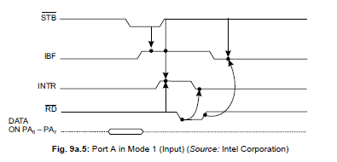
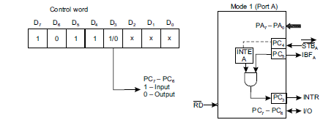
MODE 1 Timing (Input)

Slide 60
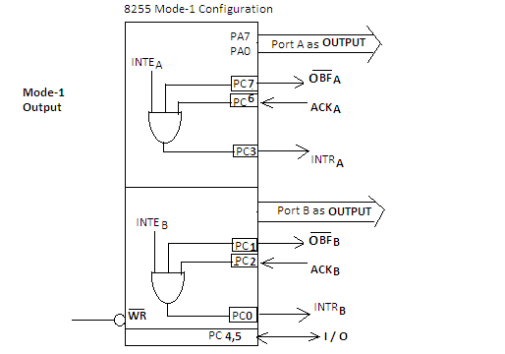
MODE 1 output Operation
INTE A :Controlled by bit set/reset of PC6.
INTE B: Controlled by bit set/reset of PC2.
Notes:
Status word is read from port c
Intea and inteb are written using PC6 and PC2

Slide 61
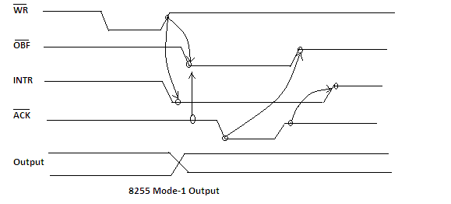
MODE 1 Timing (output)
During a write operation, the byte transmitted by the MPU, get stored in the output latch of port A or Port B. As the byte is written into the output latch of a port, the signal OBF' goes low to indicate that the output latch is full. The status of the oBF i.e. low or high indicate to the peripheral that it can read the data available in latch.
Now the MPU can transmit using either the status check I/O or Interrupt driven I/O.
If transmitting using the status check, OBF' is input to device, a low on OBF' indicate to the device that there is data byte in output buffer for the device. As the device get the data from the latch, it acknowledges it by sending a low ACK and then making it high and the OBF' becomes high after data read by peripheral device. The MPU can now transmit new data byte.
if transmitting using interrupt I/O when there is no data in output latch, then (OBF', ACK, INTE) are all high resulting in generation of INTR for the MPU for transmitting new data byte.

Slide 62
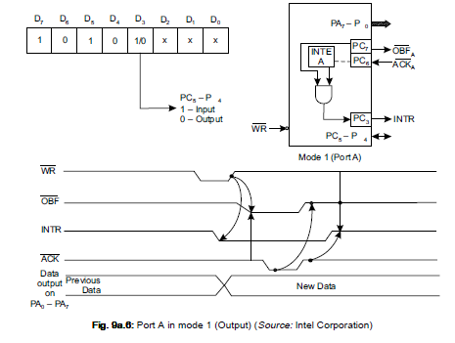
MODE 1 Timing (output)

Slide 63
Sample mode 1

Slide 64
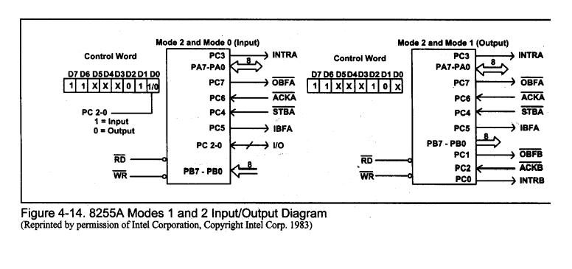
MODE 2 Operation

Slide 65
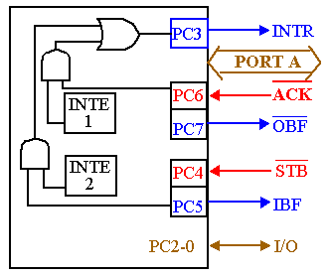
82C55: Mode 2 Bi-directional Operation
Timing diagram is a combination of the Mode 1 Strobed Input and Mode 1 Strobed Output Timing diagrams.

Slide 66
Summary of Port Connection for 8255

