Slide 1
Peripheral Interface Device 8155 (I/O Interface & Timer)

Slide 2
Outline
Review
Programmable Interface device 8155
Block diagram, Address Calculation diagram
Interfacing LED using 8155
8155 Timer
Modes of timer
Square wave generation using 8155 interfaced timer
8155 Handshake & Interrupt mode
Interfacing A/D Converter using Handshake mode using 8155

Slide 3
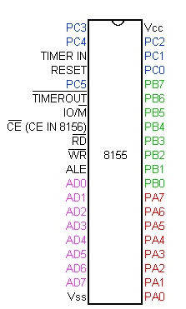
8155 Block Diagram
Reset in
RD
WR
8155
Port
A
RAM
CE
PA0-PA7
IO/M
Port
B
AD0-AD7
PB0-PB7
ALE
Port
C
PC0-PC5
Timer CLK
Timer
MSB LSB
Timer Out

Slide 4
Expanded Block Diagram
CE^{b}
CWR
A2 | A1 | A0 | Port (ALE high, AD0=A0)
0 | 0 | 0 | Command /Status Register
0 | 0 | 1 | PA
0 | 1 | 0 | PB
0 | 1 | 1 | PC
1 | 0 | 0 | Timer LSB
1 | 0 | 1 | Timer MSB
AD0-AD7
Latch
Port
A
A0-A7
PA0-PA7
3 to 8 Decoder
Port
B
0
1
2
3
4
5
ALE
A2
PB0-PB7
D7-D0
A1
A0
Port
C
PC0-PC5
Timer
MSB LSB
Timer Out
Clock for timer

Slide 5
Calculate Address of Port of 8155
A15
A14
5V
Reset in
RD
WR
Control
CWR
20H
IO/M
3 to 8
Decoder
CE
Latch
RAM
Port
A
A13
A12
A11
A2
A1
A0
0₄
IO/M
A0-A7
AD0-AD7
21H
PA0-PA7
ALE
3 to 8 Decoder
Port
B
22H
A2
PB0-PB7
D7-D0
A1
23H
A0
CS
Port
C
Instruction IN/OUT : Both Lower Address & Higher Address are same
PC0-PC5
Timer
MSB LSB
Clock for timer
Timer Out
D7/A15 | D6/A14 | D5/A13 | D4/D12 | D3/A11 | D2/A10 | D1/A9 | D0/A8
0 | 0 | 1 | 0 | 0 | 0 | 0 | 0
24H
25H

Slide 6
8155 Block Diagram
Reset in
RD
WR
Control
CWR
8155
20H
IO/M
CE
Latch
RAM
Port
A
IO/M
A0-A7
AD0-AD7
21H
PA0-PA7
ALE
3 to 8 Decoder
Port
B
22H
A2
PB0-PB7
D7-D0
A1
23H
A0
Port
C
PC0-PC5
Timer
MSB LSB
Timer Out
Clock for timer
24H
25H

Slide 7
Control word (command reg) format
D7 | D6 | D5 | D4 | D3 | D2 | D1 | D0
Timer Command |  | IEB | IEA | PC |  | PB | PA
D0, D1: mode for PA and PB, 0=IN, 1=OUT
D2, D3: mode for PC
D4, D5: interrupt EN for PA and PB, 0=disable 1=enable
D6, D7: Timer command:
00: No effect
01: Stop if running else no effect
10: Stop after terminal count (TC) if running, else no effect
11: Start if not running, reload at TC if running.
Port C bits
(D2, D3)
ALT | D3 | D2 | PC5 | PC4 | PC3 | PC2 | PC1 | PC0
1 | 0 | 0 | IN | IN | IN | IN | IN | IN
2 | 0 | 1 | OUT | OUT | OUT | OUT | OUT | OUT
3 | 1 | 0 | OUT | OUT | OUT | STB_{A} | BF_{A} | INTR_{A}
4 | 1 | 1 | STB_{B} | BF_{B} | INTR_{B} | STB_{A} | BF_{A} | INTR_{A}

Slide 8
8155 Decode Registers
Registers
A2 | A1 | A0 | Port (ALE high, AD0=A0)
0 | 0 | 0 | Command/Status Register
0 | 0 | 1 | PA
0 | 1 | 0 | PB
0 | 1 | 1 | PC
1 | 0 | 0 | Timer LSB
1 | 0 | 1 | Timer MSB

Slide 9
Interfacing 7 Segment LEDs to output port using 8155
A15
A14
5V
AD7
to
AD0
8155
7 Seg LED
Driver
PA7
PA6
PA5
PA4
PA3
PA2
PA1
PA0
3 to 8
Decoder
A13
A12
A11
A2
A1
A0
0₄
7 Seg LED
Driver
PB7
PB6
PB5
PB4
PB3
PB2
PB1
PB0
7 Seg LED
Driver
IO/M^{b}
ALE
RD^{b}
WR^{b}
RESET OUT
IO/M^{b}
ALE
RD^{b}
WR^{b}
RESET OUT
7 Seg LED
Driver

Slide 10
Interfacing LEDs Cntd..
Port Address
Control Register=20H, Port A= 21H, Port B= 22H
Control word:
Program
MVI A,03 ; initialize Port A &B for O/P
OUT 20H
MVI A, BYTE1 ; Display BYTE1 at port A
OUT 21H
MVI A, BYTE2 ; Display BYTE2 at port B
OUT 22H
D7 | D6 | D5 | D4 | D3 | D2 | D1 | D0
0 | 0 | 0 | 0 | 0 | 0 | 1 | 1
Timer |  | Not Applicable |  | Use for Port C |  | Port B Output | Port A Output

Slide 11
8155: Timers
MSB
M2 | M1 | T13 | T12 | T11 | T10 | T9 | T8
LSB
T7 | T6 | T5 | T4 | T3 | T2 | T1 | T0
M2, M1: mode bits:
00: Single square wave of wavelength TC/2 (TC/2,TC/2 if TC even; [TC+1/2],[TC-1/2] if TC odd)
01: Square waves of wavelength TC (TC/2,TC/2 if TC even; [TC+1/2],[TC-1/2] if TC odd)
10: Single pulse on the TC'th clock pulse
11: Single pulse on every TC'th clock pulse.

Slide 12
8155: Timer Modes Output
CLK
WR
Mode 00
N/2
N/2
Mode 01
N/2
N/2
N/2
N/2
Mode 10
N
Mode 11
N
N
00: Single square wave of wavelength TC/2 (TC/2,TC/2 if TC even; [TC+1/2],[TC-1/2] if TC odd)
01: Square waves of wavelength TC (TC/2,TC/2 if TC even; [TC+1/2],[TC-1/2] if TC odd)
10: Single pulse on the TC'th clock pulse
11: Single pulse on every TC'th clock pulse.

Slide 13
Designing of Square Wave Generator Using 8155
Design a square wave with pulse width 100μS
Mode 1
Clock Frequency 3 MHZ
Timer count: Pulse Period/Clock period
= 200x10⁻⁶/330x10⁻⁹= 606
= 25E H
= 02 (MSB), 5E (LSB)

Slide 14
Square Wave Generator Cntd..
Timer port address: LSB 24H & MSB 25H
Mode 1; M1=0, M2=1
M1 M2 T13 T12 T11 T10 T8 T7
0 1 0 0 0 0 1 0 == (42H)
Control word: (C0H)
Instructions to set counter & square wave generation
D7 | D6 | D5 | D4 | D3 | D2 | D1 | D0
Timer Command |  | IEB | IEA | PC |  | PB | PA
1 |  | 0 | 0 | 0 0 |  | 0 | 0
MVI A , 5E ; LSB of count
OUT 24H ; Load LSB of timer Register
MVI A, 42H ; MSB count with Mode 1
MVI 25H ; Load MSB of timer Register
MVI A, C3H ; Load the control word for register
OUT 20H ; Trigger the counter by loading to Ctrl word to ctrl Reg

Slide 15
Designing Interfacing Ckt Using 8155 to Read & Display from ADC to LEDs
Set up Port A in the handshake mode to read data from A/D Converter
Setup port B as output port to display data at seven segment LEDs
Use line PC3 from port C to initiate a conversion
Use the 8155 Timer to record conversation time

Slide 16
Control, Status & Timer
Control word
Status word
Timer (with effecting other I/O assignment)
Start timer
Stop timer
D7 | D6 | D5 | D4 | D3 | D2 | D1 | D0
0 | 0 | 0 | 0 | 0 | 1 | 1 | 0
Timer |  | NA (INTR not used) |  | Use for Port C |  | Port B OUT to LED | Port A IN from DAC
06H
CH=O/P
CL=Handshake Mode
D7 | D6 | D5 | D4 | D3 | D2 | D1 | D0
No | X | X | X | X | X | BFa | X
USe | Timer | INTEb | BFb | INTRb | INTAa | BFa | INTRa
Read the Data
Mask with 02H
1 | 1 | 0 | 0 | 0 | 1 | 1 | 0
C6H
0 | 1 | 0 | 0 | 0 | 1 | 1 | 0
46H

Slide 17
Interface Diagram
A15
A14
ADC
5790
V_{i}
AD7
to
AD0
8155
PA7
PA6
PA5
PA4
PA3
PA2
PA1
PA0
Analog
Input
3 to 8
Decoder
A13
A12
A11
A2
A1
A0
0₄
DR^{b}
B/C^{b}
PC2
PC3
Port CH = O/P
PC3 is used for Start Conversion
PB7
PB6
PB5
PB4
PB3
PB2
PB1
PB0
7 Seg LED
Driver
IO/M^{b}
ALE
RD^{b}
WR^{b}
RESET OUT
IO/M^{b}
ALE
RD^{b}
WR^{b}
RESET OUT
7 Seg LED
Driver
Port CL = HS mode
PC2 is STROBE

Slide 18
Interfacing Program
MVI A,06H ;Control world for I/O port
OUT 20H ; Set up port as specified
MVI A,00H ; Load 0000H in Timer Reg
OUT 24H
OUT 25H
MVI A,08H ;Byte to set PC3=1
OUT 23H ;Send start pulse
MVI A,C6H ;Control word to start timer
MVI 20H ; Start timer
MVI A,00H ;Byte to set PC3=0
OUT 23H ;Start conversion
ST:IN 20H ; Read Status Register
ANI 02H ;Check Status of DR^{b}
JZ ST ; If BF_{a}=0 wait in
MVI A,46H ; Byte to stop Counter
OUT 20H ;Stop Counter
IN 21H ; Read A/D output
OUT 22H ;Display data at port B (LEDs)
INT 24H ; Read LSB of Timer
MOV L,A
INT 25H ; Read MSB of Timer
ANI 3FH ;Mask the mode Bit D6,D7
MOV H,A ; Save MSB timer count in H
LHLD RWM ; Store the count at
;Memory location RWM
HLT

Slide 19
8253/4 Programmable Interval Timer

Slide 20
Hierarchy of I/O Control Devices
2 Port (A,B),
No Bidirectional
HS mode (C)
4 mode timer
8155
I/O + Timer
8253/54
Timer
8255
I/O
2 Port (A,B)
A is Bidirectional
HS mode (C)
Extra controls
6 mode timer
8259
Interrupt controller
8237
DMA controller
8251
Serial I/O USART controller

Slide 21
Outline
Basic Difference of 8155 I/O timer Vs 8254
8254 Brief
Architecture of 8254
Control register
Status register
Modes of Counters with example
Read-Back modes

Slide 22
8254 Description
The 82C54 solves one of the most common problems in any microcomputer system, the generation of accurate time delays under software control.
Instead of setting up timing loops in software, the programmer configures the 82C54 to match his requirements and programs one of the counters for the desired delay. After the desired delay, the 82C54 will interrupt the CPU. Software overhead is minimal and variable length delays can easily be accommodated

Slide 23
8254 Description
Some of the other counter/timer functions common to microcomputers which can be implemented with the 82C54 are:
Real time clock
Event counter
Digital one-shot
Programmable rate generator
Square wave generator
Binary rate multiplier
Complex waveform generator
Complex motor controller

Slide 24
8254 Chip
Main function:
Dividing clock frequency
Three independent 16-bit counters
Models
8253: 2 MHz
8254: 8 MHz
8254-2: 10 MHz

Slide 25
8155: Timer Modes Output
CLK
WR
Mode 00
N/2
N/2
Mode 01
N/2
N/2
N/2
N/2
Mode 10
N
Mode 11
N
N
00: Single square wave of wavelength TC/2 (TC/2,TC/2 if TC even; [TC+1/2],[TC-1/2] if TC odd)
01: Square waves of wavelength TC (TC/2,TC/2 if TC even; [TC+1/2],[TC-1/2] if TC odd)
10: Single pulse on the TC'th clock pulse
11: Single pulse on every TC'th clock pulse.

Slide 26
8254: Brief
Three independent 16-bit programmable counters (timers).
It generates accurate time delays and can be used for
Real time clock, an event Ctr, a digital one shot, a square wave gen, complex wave gen.
Programmable and work DC to 8 MHz
5 different modes of operation

Slide 27
The 8254 PIT
The 8254 Programmable Interval-timer is used by the PC system for (1) generating timer-tick interrupts (rate is 18.2 per sec), (2) performing dynamic memory-refresh (reads ram once every 15 microseconds), and (3) generates ‘beeps’ of PC speaker
When the speaker-function isn’t needed, the 8254 is available for other purposes

Slide 28
8254 Block Diagram
Internal
Bus
D0-D7
Data
Bus
Buffer
Counter
0
CLK 0
GATE 0
OUT 0
RD^{b}
WR^{b}
A0
A1
CS^{b}
Read/
Write
Logic
Counter
1
CLK 1
GATE 1
OUT 1
Control Word
Register
Counter
2
CLK 2
GATE 2
OUT 2

Slide 29
Control Logic
RD^{b}, WR^{b}, CS^{b}
A0, A1: Selection of Counter and Control Register
Suppose Address is (80H,81H,82H,83H) with interfacing Circuit
A1 | A0 | Selection
0 | 0 | Counter 0
0 | 1 | Counter 1
1 | 0 | Counter 2
1 | 1 | Control Register

Slide 30
Control Register
D7 | D6 | D5 | D4 | D3 | D2 | D1 | D0
SC1 | SC2 | RW1 | RW0 | M2 | M1 | M0 | BCD
Select Counter 00: Counter 0 01: Counter 1 10: Counter 2 11: Read-Back Command |  | Read Write 00: Counter latch Command 01:RW LSByte only 10: RW MSByte only 11:RW LSByte first then Msbyte |  | 000 : Mode 0 001 :Mode 1 X10 :Mode 2 X11 :Mode 3 100 :Mode 4 101 : Mode 5 |  |  | 0/1 = Binary / BCD Mode

Slide 31
Programming Counters
Each counter may be programmed with a count of 1 to FFFFH.
Minimum count is 1 all modes except 2 and 3 with minimum count of 2.
Each counter has a program control word used to select the way the counter operates.
If two bytes are programmed, then the first byte (LSB) stops the count, and the second byte (MSB) starts the counter with the new count.

Slide 32
Modes of 8254 Counter
Mode 0 : Interrupt on Terminal count
Mode 1 : Hardware Retriggerable One Shot
Mode 2 : Rate Generator
Mode 3 : Square wave generator
Mode 4 : Software Triggered Strobe
Mode 5 : Hardware Triggered Strobe

Slide 33
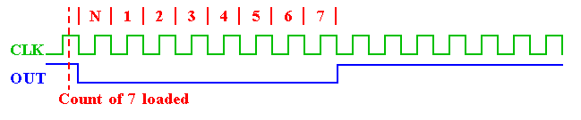
Mode 0: Interrupt on Terminal Count
The output becomes a logic 0 when the control word is written and remains there until N plus the number of programmed counts.
CLK
OUT
Count of 7 loaded

Slide 34
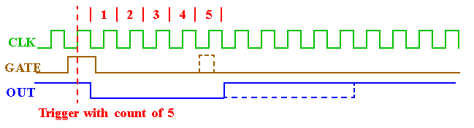
Mode 1: Hardware Retriggerable One Shot
The G input triggers the counter to output a 0 pulse for `count' clocks.
Counter reloaded if G is pulsed again.
CLK
GATE
OUT
Triggered with count of 5

Slide 35
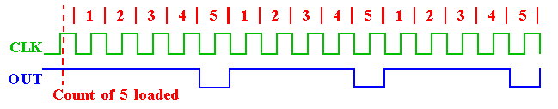
Mode 2: Rate Generator
Counter generates a series of pulses 1 clock pulse wide.
The separation between pulses is determined by the count.
The cycle is repeated until reprogrammed or G pin set to 0.
CLK
OUT
Count of 5 loaded

Slide 36
Write instruction to generate pulse every 50mcroS from Ctr0
Control word = 14H
D7D6=00 Select ctr 0
D5D4=01 load 8 bit count
D3D2D1=010 mode 2
D0=0 Binary
Count = 50x10⁻⁶/0.5x10⁻⁶=64H
PULSE: MVI A 14H ; Control word
OUT CTRAdd 83H
MVI A,64H ;Count value
OUT 80H ; load counter 0 with low
order byte
HALT

Slide 37
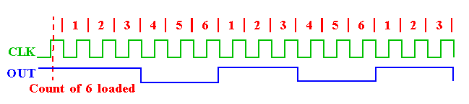
Mode 3: Square wave generator
Generates a continuous square-wave with G set to 1.
If count is even, 50% duty cycle otherwise OUT is high 1 cycle longer
CLK
OUT
Count of 6 loaded

Slide 38
Write instruction for 1KhZ square wave at Ctr 1
Control word = 76H
Count= 1x10⁻³/0.5x10⁻⁶=2000=07D0H
Instructions
MVI A,76H ; load Control word for Ctr 1 mode 3
OUT 83H ; write to Ctrl reg
MVI A, D0H; lower order byte cnt
OUT 81H
MVI A,07H ; higher order byte
OUT 81H
HLT
D7 | D6 | D5 | D4 | D3 | D2 | D1 | D0
SC1 | SC2 | RW1 | RW0 | M2 | M1 | M0 | BCD
01 |  | Load 16 bit (11) |  | 011 (mode 3) |  |  | 0

Slide 39
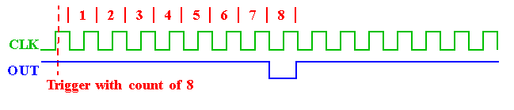
Mode 4: Software Triggered Strobe
Software triggered one-shot (G must be 1).
OUT goes initially High, it goes low for one clock at the end of count
The count must be reloaded for subsequent output
CLK
OUT
Triggered with count of 8

Slide 40
Mode 5: Hardware Triggered Strobe
Hardware triggered is one-shot
It is triggered by rising edge at the Gate
Initially the OUT is low and Gate triggered from low to high the count begins
OUT goes low for one clock period
CLK
OUT
H/W trigger with count of 8

Slide 41
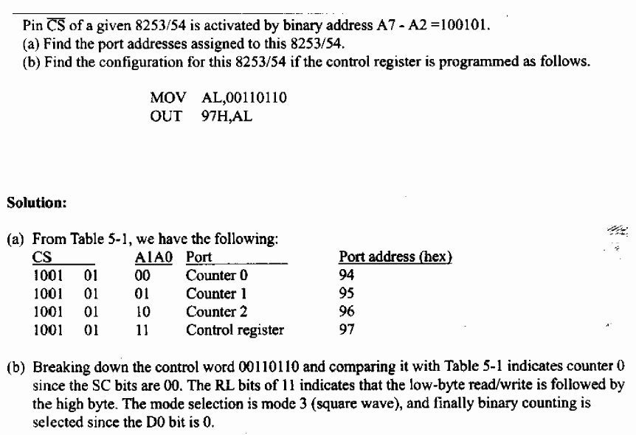
Example

Slide 42
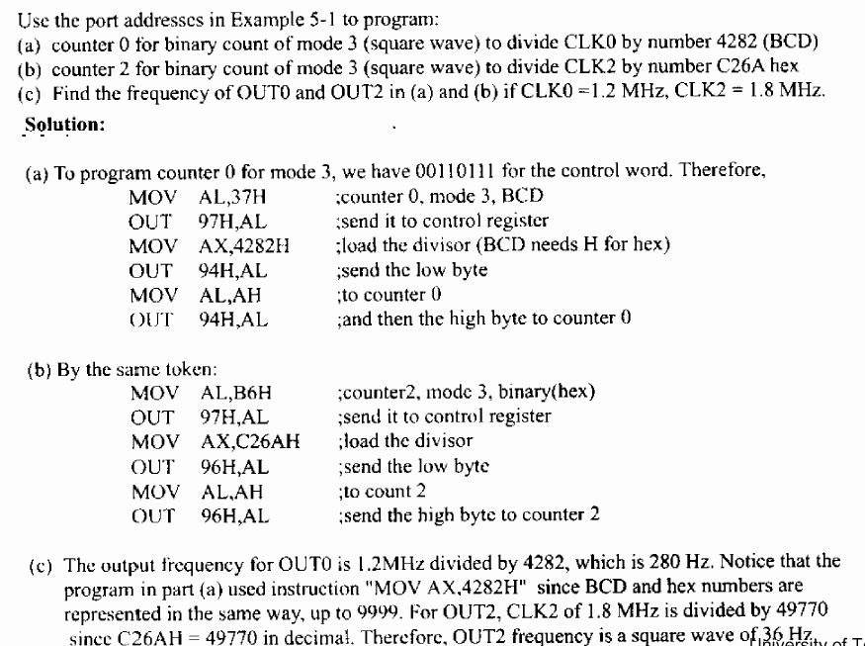
Example 2

Slide 43
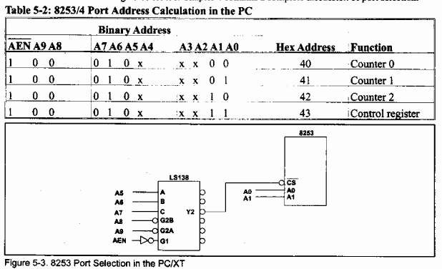
8253 Decoding in PC

Slide 44
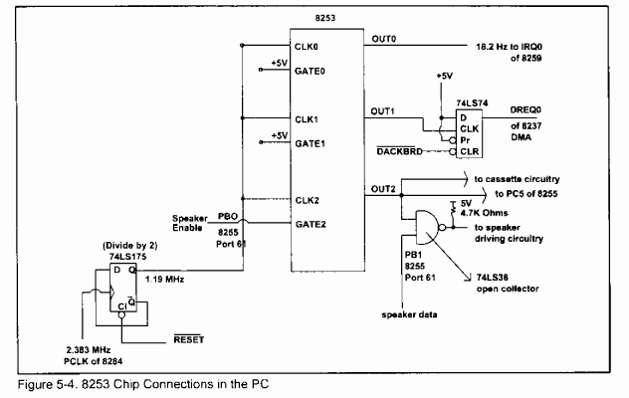
PC Board

Slide 45
Write a pgm to generate an interrupt every 1 Second
Assume Clock Freq=2MhZ
Count is too large
Counter 1 load with 50,000 to generate 25ms
CNTLOAD=50,000₁₀=C350H
Counter 2 load with 40 to generate 25msX40=-1S pulse (CNTLOAD=40₁₀=28H)
Counter1 input is to counter 2
Both Counter 1 & Counter 2 in Mode 2

Slide 46
Instruction to set up 1s interrupt
MVI A , 74H ; Mode for 1st CTR
OUT 83H ;Write in control register
MVI A,94H ; Mode for 2nd CTR
OUT 83H ; Write to control register
MVI A,50 ; low byte of CTR1=C350
OUT 81H ; load to CTR1 low byte
MVI A,C3 ; high byte of CTR1=C350
OUT 81H ; load to CTR1 high byte
MVI A,28H ; Count for Counter 2
OUT 82H ; Load Counter 2
RET

Slide 47
Gate Setting of Counter
Modes | Low or Going Low | Rising | High
Mode 0 | Disable Counting | - | Enable Counting
Mode 1 | ----- | 1. Initiate Counting 2. Reset O/P after next Clock | ---
 | Disable counting Set O/P immediately high | Reloads Counter Initiate Counting | Enable Counting
 | Disable counting Set O/P immediately high | Initiates Counting | Enable Counting
 | Disable Counting |  | Enable Counting
 |  | Initiates Counting

Slide 48
Read-Back Command
This allow user to read the count and status of the counter
Command Written in control register and count of the specified counter can be latched
Control word 11 01 011 0 (D6H) in control word will latch the count of CNT0 & CNT1
D7 | D6 | D5 | D4 | D3 | D2 | D1 | D0
SC1 | SC2 | COUNT^{b} | STATUS^{b} | CNT2 | CNT1 | CNT0 | 0
11: Read-Back Command |  | If (D5=0) count is lateched |  | D3=1 select counter 2 D2=1 select counter 1 D1=1 select counter 0

Slide 49
Read-Back Command
Status can be read if STATUS^{b} bit D4 =0
D7=1 : Outpin is 1, 0 Outpin is 0
D6=1: Null count, D6: 0= Count available for reading
D5-D0:Counter Programmed mode
D7 | D6 | D5 | D4 | D3 | D2 | D1 | D0
OUTPUT | NULL COUNT | RW1 | RW0 | M2 | M1 | M0 | BCD

Slide 50
Control word
Counter 1 (74H)
Counter 2 (94H)
D7 | D6 | D5 | D4 | D3 | D2 | D1 | D0
SC1 | SC2 | RW1 | RW0 | M2 | M1 | M0 | BCD
01 |  | Load 16 bit (11) |  | 010 (mode 2) |  |  | 0
D7 | D6 | D5 | D4 | D3 | D2 | D1 | D0
SC1 | SC2 | RW1 | RW0 | M2 | M1 | M0 | BCD
10 |  | Load 8 bit (01) |  | 010 (mode 2) |  |  | 0

Slide 51
Outline
Peripheral communications
DAC
Properties
Generic Model
Interfacing
ADC
Properties
Generic Model
Interfacing
Display

Slide 52
Digital to Analog Converter
Used for play sound in speaker
Used by AC97 (Audio codec)
MP3 Sound store digital format in HDD
Slow as compared to processor/MPU
Parameters
Resolution (8 bit/16 bit)
Settling time (1micro sec)

Slide 53
D/A converter
FS
7
6
D₂
Digital
to
Analog
Converter
5
LSB
V_{o}
4
D₁
Analog output
Analog Output
3
D₀
2
1
0
000
001
010
011
100
101
110
111
Digital Inputs
FullScaleOutput=(FullScaleValue – 1LSBValue)
1MSB Value=1/2 * FSV

Slide 54
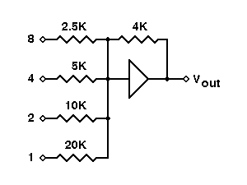
Circuit Realization
2.5K
4K
D₃=8
5K
D₂=4
V_{out}
10K
D₁=2
20K
D₀=1
Vo= Vref/R * ( A₁/2+ A₂/4+…A_{n}/2^{n})
Vo is proportional to values of Data Bits Value

Slide 55
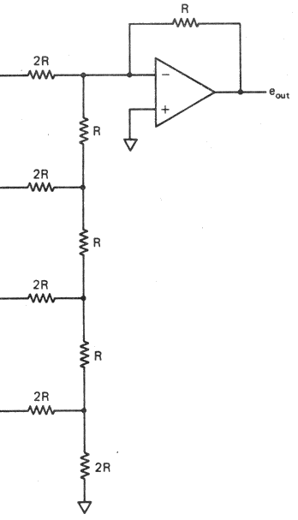
Practical DAC : R-2R ladder network
Resistive Ladder Network
Require two type Resistor
But small value
5KΩ and 10KΩ
R
R
E
G
I
S
T
E
R
2R
+
Vout
R
2R
R
Resistor
2R
R
R+R=2R
2R
2R||2R=R

Slide 56
Output Glitches
Cause: Signal and clock skew in circuits
Especially severe at MSB transition where all bits are switching –
0111…111 →
1000…000
Glitches cause waveform distortion, spurs and elevated noise floors
High-speed DAC output is often followed by a de-glitching SHA (Hold Buffer)

Slide 57
Performance of DAC
Resolution
Reference Voltages
Settling Time
Linearity
Speed
Errors

Slide 58
Resolution
Amount of variance in output voltage for every change of the LSB in the digital input.
How closely can we approximate the desired output signal(Higher Res. = finer detail=smaller Voltage divisions)
A common DAC has a 8 - 12 bit Resolution
N = Number of bits

Slide 59
Resolution
Poor Resolution(1 bit)
Better Resolution(3 bit)
Vout
Vout
Desired Analog signal
Desired Analog signal
111
110
110
2 Volt. Levels
1
8 Volt. Levels
101
101
100
100
011
011
010
010
001
001
0
0
000
000
Digital Input
Approximate output
Digital Input
Approximate output

Slide 60
Reference Voltage
A specified voltage used to determine how each digital input will be assigned to each voltage division.
Types:
Non-multiplier: internal, fixed, and defined by manufacturer
Multiplier: external, variable, user specified

Slide 61
Settling Time
Settling Time: The time required for the input signal voltage to settle to the expected output voltage(within +/- VLSB).
Any change in the input state will not be reflected in the output state immediately. There is a time lag, between the two events.

Slide 62
Settling Time
Analog Output Voltage
+VLSB
Expected Voltage
-VLSB
Time
Settling time

Slide 63
Linearity
Linearity(Ideal Case)
NON-Linearity(Real World)
Desired/Approximate Output
Desired Output
Analog Output Voltage
Analog Output Voltage
Approximate output
Digital Input
Digital Input
Perfect Agreement
Miss-alignment

Slide 64
Errors Gain
Gain Error: Difference in slope of the ideal curve and the actual DAC output
High Gain
High Gain Error: Actual slope greater than ideal
Desired/Ideal Output
Low Gain Error: Actual slope less than ideal
Analog Output Voltage
Low Gain
Digital Input

Slide 65
Speed
Rate of conversion of a single digital input to its analog equivalent
Conversion Rate
Depends on clock speed of input signal
Depends on settling time of converter

Slide 66
Generic Used: Audio player
Used when a continuous analog signal is required.
Signal from DAC can be smoothed by a Low pass filter
Piece-wise Continuous Output
Analog Continuous Output
Digital Input
n bit DAC
0 bit
011010010101010100101
101010101011111100101
000010101010111110011
010101010101010101010
111010101011110011000
100101010101010001111
Filter
n^{th} bit

Slide 67
Interfacing 8-bitDAC with 8085
Design an output port with Address FFH to interface 1408 DAC
Write a program to generate a continuous RAMP waveform
Output
Time

Slide 68
Interfacing Diagram
8085
MPU
A₁₅
Address Bus (16bit)
A₇
A₆
A₅
A₄
A₃
A₂
A₁
A₀
A₀
D₇
D₆
D₅
D₄
D₃
D₂
D₁
D₀
74LS373
Latches
1408
LE
_{D7}
Data Bus (8bit)
_{D0}

Slide 69
Program to generate continuous RAMP waveform
MVI A, 00H ; Load Acc with first I/P
DTOA: OUT FFH ; Output to DAC
MVI B, COUNT ; Setup Reg. for Delay
DCR B
JNZ DELAY
INR A ; Next Input
JMP DTOA ; Go back to Output
Slope of RAMP can be varied by changing Delay

Slide 70
Analog to Digital Conversion
111
110
Analog to Analog
Converter
101
LSB
Vi
D₂
100
Digital output
Analog Input
D₁
011
010
D₀
001
000
0 1 2 3 4 5 6 7
Analog Input
ADC are slower then DAC
Interfaced using Status Check

Slide 71
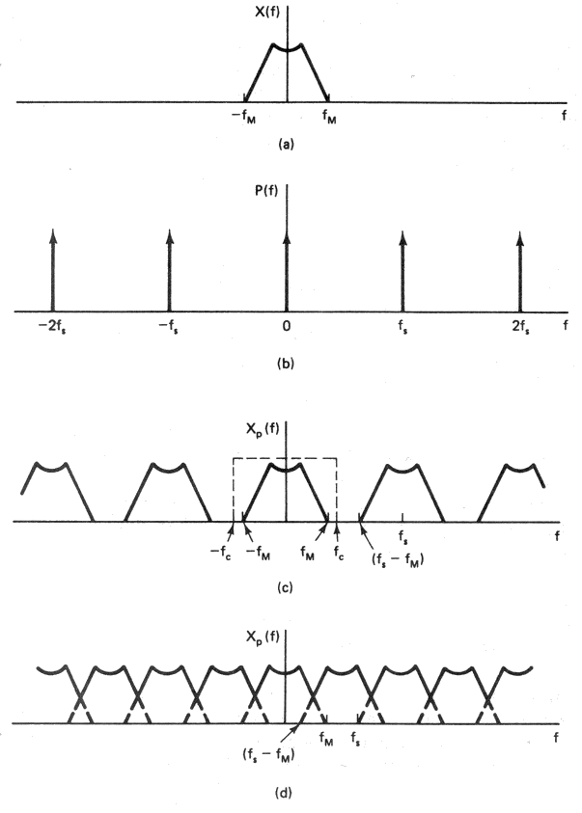
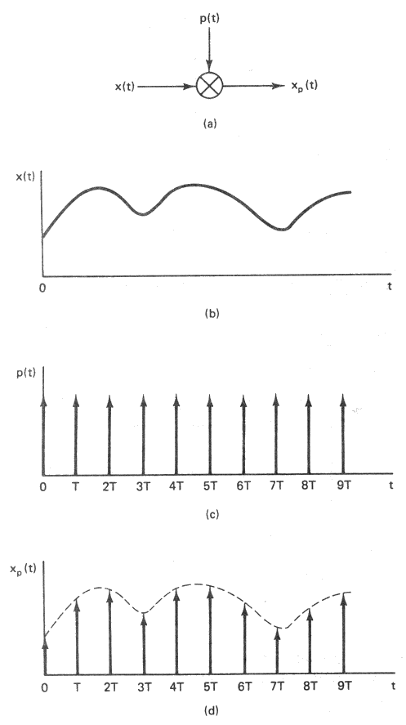
Sampling Concepts
Sampling
Fourier Transform

Slide 72
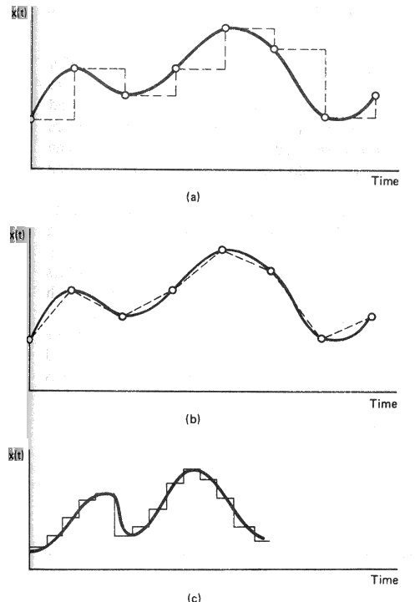
Interpolation
The process of reconstructing a signal from its values at discrete instants of time
Zero order hold or One Point
Linear or Two Point
Band limited or Low pass Filtering

Slide 73
A/D Conversion Techniques
Counter or Tracking ADC
Successive Approximation ADC
Most Commonly Used
Parallel or Flash ADC
Fast Conversion

Slide 74
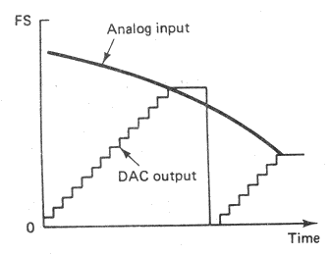
Counter Type ADC
Block diagram
Waveform
Operation
Reset and Start Counter
DAC convert Digital output of Counter to Analog signal
Compare Analog input and Output of DAC
Vi < V_{DAC}
Continue counting
Vi = V_{DAC}
Stop counting
Digital Output = Output of Counter
Disadvantage
Conversion time is varied
2^{n} Clock Period for Full Scale input
Clock
Control
Logic
Counter
DAC
V_{i}

Slide 75
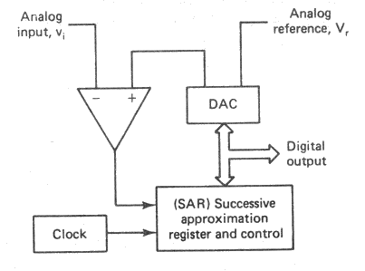
Successive Approximation ADC
Most Commonly used in medium to high speed Converters
Based on approximating the input signal with binary code and then successively revising this approximation until best approximation is achieved
SAR(Successive Approximation Register) holds the current binary value
Block Diagram

Slide 76
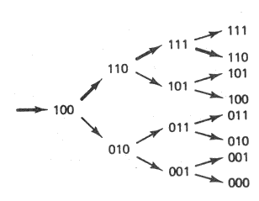
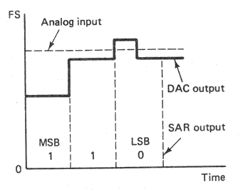
Successive Approximation ADC
Circuit waveform
Logic Flow
Conversion Time
n clock for n-bit ADC
Fixed conversion time
Serial Output is easily generated
Bit decision are made in serial order

Slide 77
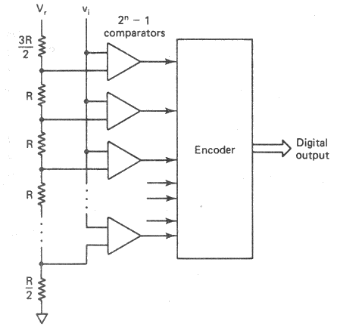
Parallel or Flash ADC
Very High speed conversion
Up to 100MHz for 8 bit resolution
Video, Radar, Digital Oscilloscope
Single Step Conversion
2^{n} –1 comparator
Precision Resistive Network
Encoder
Resolution is limited
Large number of comparator in IC

Slide 78
Generic ADC
V_{input}
A/D
Converter
Digital O/P
START
RD
Ready
Start

Slide 79
Interface ADC using Status Check
8085
MPU
A₁₅
Address Bus (16bit)
V_{input}
A₀
A/D
Converter
Tri-State
Buffer
Digital O/P
A₆
A₅
A₄
A₃
A₇
START
RD
Ready
Start
IO/W
82H
74
LS
138
E1
E2
E3
_{D7}
o₂
Data Bus (8bit)
_{D0}
o₁
81H
IO/R
o₀
80H

Slide 80
Program to Interface ADC
OUT 82H ; Start Conversion
TEST: IN 80H ;Read DR Status
RAR ; Rotate D_{o} to carry
JC TEST ; if Do==1 conv. done
IN 81H ; Read the output
RET ; Return

Slide 81
Interrupt Controller (8259)

Slide 82
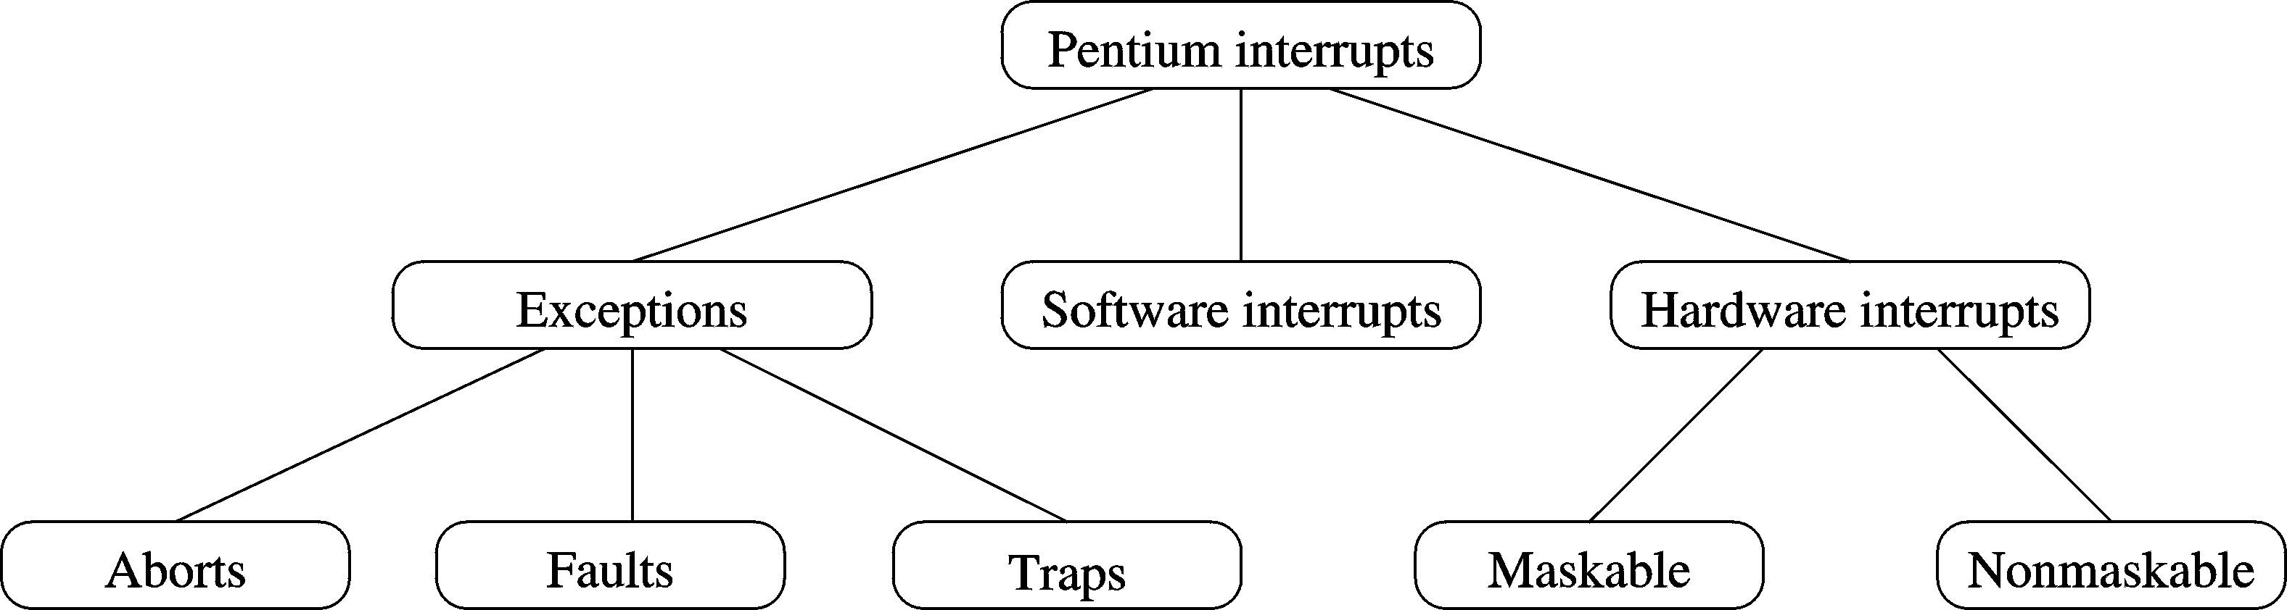
A Taxonomy of Interrupts

Slide 83
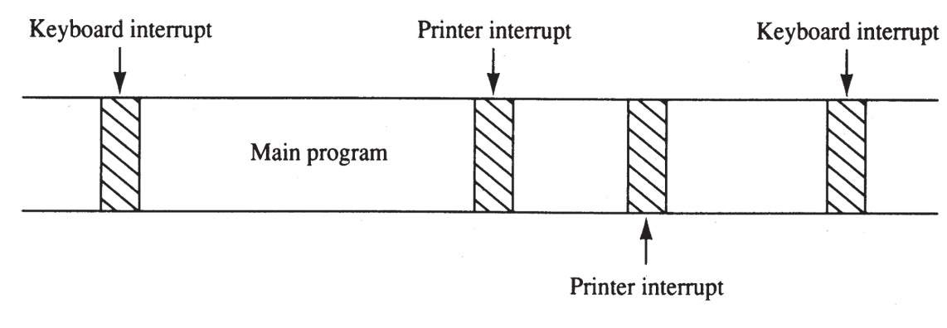
The Purpose of Interrupts
Interrupts are useful when interfacing I/O devices at relatively low data transfer rates, such as keyboard inputs
Interrupt processing allows the processor to execute other software while the keyboard operator is thinking about what to type next.
Notes:
a time line shows typing on a keyboard, a printer removing data from memory, and a program executing

Slide 84
Interrupt Vector Table
03FF
03FE
03FD
03FC
0007
0006
0005
0004
0003
0002
0001
0000
IP High Byte
CS Low Byte
int type 255
Int type 0
Int type 1
IP High Byte
IP Low byte
IP High Byte
CS Low Byte
IP High Byte
IP Low byte
IP High Byte
CS Low Byte
IP High Byte
IP Low byte
Memory in Hex

Slide 85
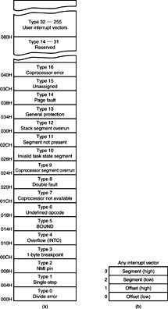
Figure 12–2 (a) The interrupt vector table for the microprocessor and (b) the contents of an interrupt vector.
the first five interrupt vectors are identical in all Intel processors
Intel reserves the first 32 interrupt vectors
the last 224 vectors are user-available
each is four bytes long in real mode and contains the starting address of the interrupt service procedure.
the first two bytes contain the offset address
the last two contain the segment address

Slide 86
Example
Question: A particular interrupt has a type number n=41H. If the corresponding ISR begins at address
FE00:0500H, determine the locations in the vector table to store this address.
Solution: The vector address is calculated by multiplying 41H by four.
00104:00; 00105:50; 00106:00; 00107:FE;

Slide 87
Interrupt Vector Table (x86)
Using the Interrupt Vector Table shown below, determine the address of the ISR of a device with interrupt vector 42H.
Answer: Address in table = 4 X 42H = 108H
(Multiply by 4 since each entry is 4 bytes)
Offset Low = [108] = 2A, Offset High = [109] = 33
Segment Low = [10A] = 3C, Segment High = [10B] = 4A
Address = 4A3C:332A = 4A3C0 + 332A = 4D6EAH

Slide 88
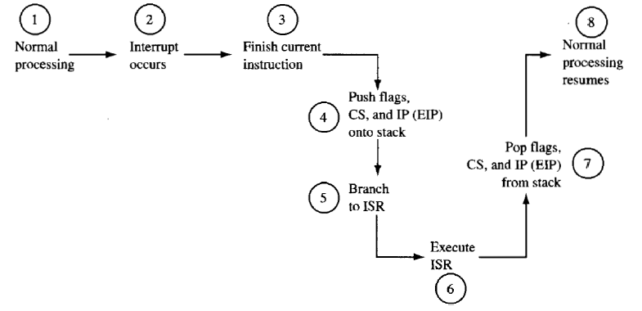
Interrupt Processing
When interrupt occurs, normal processing is suspended while a special Interrupt Service Routine (ISR) is executed. Normal processing resumes when this routine is completed.

Slide 89
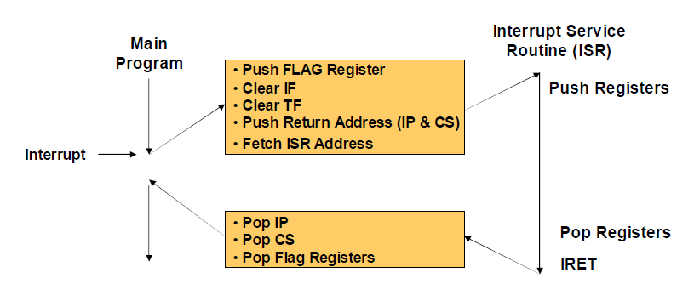
Interrupt Processing

Slide 90
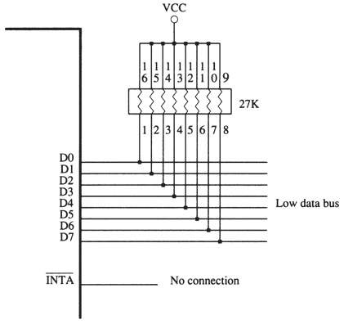
A simple method for generating interrupt vector type number FFH in response to INTR

Slide 91
Using a Three-State Buffer for INTA
Interrupt vector type number 80H is applied to the data bus (D₀–D₇) in response to an INTR.
In response to INTR, the processor outputs the INTA to enable a 74ALS244 three-state octal buffer.
The octal buffer applies the interrupt vector type number to the data bus in response.
The vector type number is easily changed with DIP switches shown in this illustration.

Slide 92
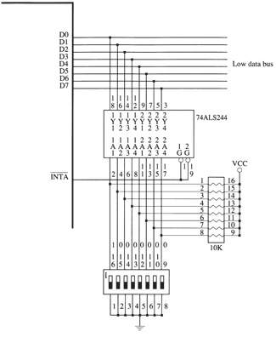
A circuit that applies any interrupt vector type number in response to INTA. Here the circuit is applying type number 80H.

Slide 93
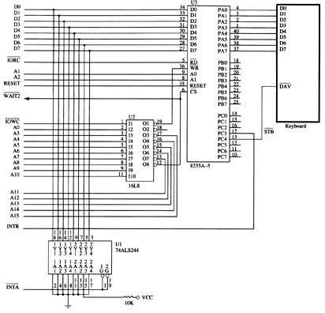
82C55 interfaced to a keyboard from the microprocessor system using interrupt vector 40H.
Every time a key is typed, 82C55 requests a type 40H interrupt through the INTR pin

Slide 94
EXPANDING THE INTERRUPT STRUCTURE
The common methods of expanding the interrupt structure of the processor.
Using the 74ALS244 to Expand Interrupts
expand the INTR input so it accepts seven interrupt inputs.
The only hardware change is the addition of an eight-input NAND gate, which provides the INTR signal to the microprocessor when any of the IR inputs becomes active

Slide 95
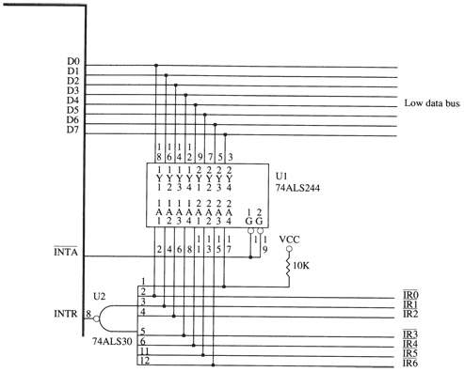
Expanding the INTR input from one to seven interrupt request lines

Slide 96
Operation
If any of the IR inputs becomes logic 0, the output of the NAND gate goes to logic 1 and requests an interrupt through the INTR input.
The interrupt vector that is fetched during the pulse depends on which interrupt request line becomes active.
the interrupt vectors used by a single interrupt request input
IR6 | IR5 | IR4 | IR3 | IR2 | IR1 | IR0 | Vector
1 | 1 | 1 | 1 | 1 | 1 | 0 | FE h
1 | 1 | 1 | 1 | 1 | 0 | 1 | FD h
1 | 1 | 1 | 1 | 0 | 1 | 1 | FB h
1 | 1 | 1 | 0 | 1 | 1 | 1 | F7 h
1 | 1 | 0 | 1 | 1 | 1 | 1 | EF h
1 | 0 | 1 | 1 | 1 | 1 | 1 | DF h
0 | 1 | 1 | 1 | 1 | 1 | 1 | BF h
What happens if two or more interrupt requests are active, a new interrupt vector is generated?
Notes:
The vector is address generated by the address group IR6_bar – IR0_bar

Slide 97
Block Diagram of 8259
8259A
Programmable
Interrupt
Controller
IRQ0
8 bit
Data Bus
IRQ1
RD^{b}
WR^{b}
CS^{b}
A0
INT
INTA^{b}
SP^{b}/EN^{b}
IRQ2
IRQ3
IRQ4
IRQ5
IRQ6
IRQ7

Slide 98
Block Diagram Architecture of 8259
INTA^{b}
INT
Control Logic
Interrupt Service
Register
Priority Resolver
Interrupt Request
Register
IRQ0
IRQ1
IRQ2
IRQ3
IRQ4
IRQ5
IRQ6
IRQ7
Interrupt Mask Register
Internal Bus

Slide 99
Connecting a single 8259A controller

Slide 100
Three internal registers
input-signals
8259A
IRR
output-signal
IMR
ISR
IRR = Interrupt Request Register
IMR = Interrupt Mask Register
ISR = In-Service Register

Slide 101
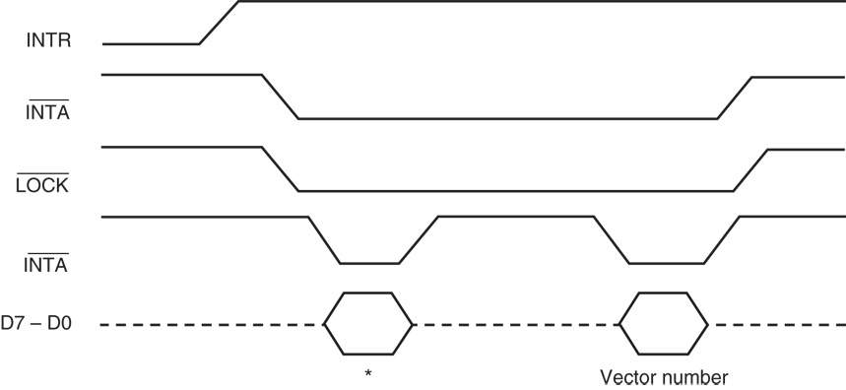
The processor responds to INTR by pulsing INTA output in anticipation of receiving an interrupt vector type number on data bus connections D₇–D₀.
Two INTA pulses generated by the system insert the vector type number on the data bus.

Slide 102
INTR:
The INTR input must be externally decoded to select a vector.
Intel has reserved interrupts 00H - 1FH for internal and future expansion.
Any interrupt vector can be chosen for the INTR pin, but we usually use an interrupt type number between 20H and FFH.
INTA:
it is an output used in response to INTR input to apply a vector type number to the data bus connections D₇–D₀

Slide 103
Adding Interrupts to the Hardware
Programmable Interrupt Controller: The 8259A chip
Each Chip supports eight interrupt request (IRQ) lines
Asserts INTR to CPU, responds to resulting INTA# with an 8-bit interrupt vector (“0xdd”) on the data bus
Industry Standard Architecture (ISA) Bus
Priority: highest to lowest order is IRQ0-1, IRQ8-15, IRQ3-7
IRQ0
IRQ8
IRQ1
IRQ9
IRQ10
To CPU
Master
8259
IRQ3
Slave
8259
IRQ11
IRQ4
IRQ12
IRQ5
IRQ13
IRQ6
IRQ14
IRQ7
IRQ15

Slide 104
Priority Modes
Fully Nested Modes
IR are arranged in IR0-IR7 and Any IR can be assigned Highest or lowest priority IR4=0 (high), IR3=7 (low)
Automatics Rotation Mode
A device after being served, receive the lowest priority with value 7 01234567➔12345670➔ 23456701
Specific Rotation Mode
User can select any IR for lowest priority 06734512➔67345120➔ 73451206
EOI: End of interrupt
Specific EOI Command
Automatic EOI: no command necessary
Non-Specific EOI: it resets the ISR bit

Slide 105
Control Word (initialization)
CS | A0 | Initialization
0 | 0 | ICW1
0 | 1 | ICW2,ICW3,ICW4
1 | X | Not Address

Slide 106
ICW1 & ICW2
AD0 | D7 | D6 | D5 | D4 | D3 | D2 | D1 | D0
0 | 0 | 0 | 0 | 1 | LTIM | 0 | SGNL | IC4
 | 0 for x86 |  |  |  | 1 for Level Trigger 0 for Edge Trigger |  | 1=single 0=Cascade
AD0 | D7 | D6 | D5 | D4 | D3 | D2 | D1 | D0
1 | T7 | T6 | T5 | T4 | T3 | T2 | T1 | T0
 | T7=T0 is the assign to IR0, Vector address for ISR

Slide 107
Masking and Prioritization
OCW (operation command word)
CS | A0 | Operation Command Word
0 | 0 | OCW1
0 | 1 | OCW2,OCW3,OCW4
1 | X | Not Address

Slide 108
Programming OCWs: OCW1, OCW2
AD0 | D7 | D6 | D5 | D4 | D3 | D2 | D1 | D0
1 | M7 | M6 | M5 | M4 | M3 | M2 | M1 | M0
 | Interrupt Masks: 1= Mask Set, 0 =Mask reset
AD0 | D7 | D6 | D5 | D4 | D3 | D2 | D1 | D0
0 | R | SL | EOI | 0 | 0 | L2 | L1 | L0
 | Roteate | Specific | EOI |  |  | IR Level to be acted Upon (0-7)

Slide 109
Example: Setting of control word
A₇
A₆
A₅
8259
IR0
IR1
IR2
IR6
Emergency
A/D converter
Keyboard
Printer
3-to-8
Decoder
E1^{b} E2^{b} E3
A₃
A₂
A₁
A₂
A₁
A₀
0₄
CS^{b}
A₀
A₀
ADDRESS= 80H, 81H
AD0 | D7 | D6 | D5 | D4 | D3 | D2 | D1 | D0
1 | M7=0 | M6=1 | M5=1 | M4=1 | M3=1 | M2=1 | M1=1 | M0=1
 | Interrupt Masks: 1= Mask Set, 0 =Mask reset
OCW1=7F

Slide 110
Initialization words (ICW1 & ICW2)
AD0 | D7 | D6 | D5 | D4 | D3 | D2 | D1 | D0
0 | 0 | 1 | 1 | 1 | 0 | 1 | 1 | 0
 | A7, A6,A5 Lower address bit of Vector Address |  |  |  | 0 for Edge Trigger | Call Address interval =4 | 1=single 0=Cascade
76H
AD0 | D7 | D6 | D5 | D4 | D3 | D2 | D1 | D0
1 | T7 | T6 | T5 | T4 | T3 | T2 | T1 | T0
 | 0 | 0 | 1 | 0 | 0 | 0 | 0 | 0
 | T7=T0 is the assign to IR0, Vector address for ISR Lower Byte of call address
20H
Vector Address 2060, 2064…. | 0100 0000 | 0 1 1 | 00000

Slide 111
Program to initialize
DI
MVI A, 76H ;move ICW1 byte to ACC
OUT 80H ; initialize 8259A ICW1
MVI A, 20H ; mov ICW2 byte to ACC
OUT 81H ; Initialize 8259A ICW2
MVI A, 7FH ; Put the OCW1
OUT 80H

Slide 112
Nested mode
By Default 8259 work in Nested modes
Unless we put a different OCW
Suppose IR2 has highest priority and IR6
IR6 is being serviced
IR2 can be nested iff IR6 IRS issue an EI command
Address of IR2=2068, IR2=2074

Slide 113
Nested Interrupt process
It wait up to EI instruction
EI
Interrupt at IR6
Interrupt at IR2
EI
EI
DI
EOI
RET
IR2 has highest priority
IR6 has lower priority
EI
RET

Slide 114
Maskable Interrupt
Those interrupt service can be temporarily disable to let the higher priority interrupt ISR to be executed without interruption
I want IR7 to be Non Maskable
AD0 | D7 | D6 | D5 | D4 | D3 | D2 | D1 | D0
1 | M7=0 | M6=1 | M5=1 | M4=1 | M3=1 | M2=1 | M1=1 | M0=1
 | Interrupt Masks: 1= Mask Set, 0 =Mask reset
OCW1=7F

Slide 115
DMA Controller (8237 )

Slide 116
Outline
DMA controller
DMA Architecture
Registers
Introduction to Programming DMA
How to configure

Slide 117
Data Transfer DMA mode
CPU
CPU
DMA
Controller
System Bus
System Bus
Memory
I/O
Memory
I/O

Slide 118
Data Transfer : DMA
Problems with programmed I/O
Processor wastes time polling
Lets take example of Key board
Waiting for a key to be pressed,
Waiting for it to be released
May not satisfy timing constraints associated with some devices : Disk read or write
DMA
Frees the processor of the data transfer responsibility

Slide 119
Basic DMA Definitions
Direct memory accesses normally occur between an I/O device and memory without the use of the microprocessor.
a DMA read transfers data from the memory to the I/O device
A DMA write transfers data from an I/O device to memory
Memory & I/O are controlled simultaneously.
which is why the system contains separate memory and I/O control signals

Slide 120
A DMA read causes the MRDC and IOWC signals to activate simultaneously.
transferring data from memory to the I/O device
A DMA write causes the MWTC and IORC signals to both activate.
The DMA controller provides memory with its address, and controller signal (DACK) selects the I/O device during the transfer.
8086/8088 require a controller or circuit (next slide) for control bus signal generation.

Slide 121
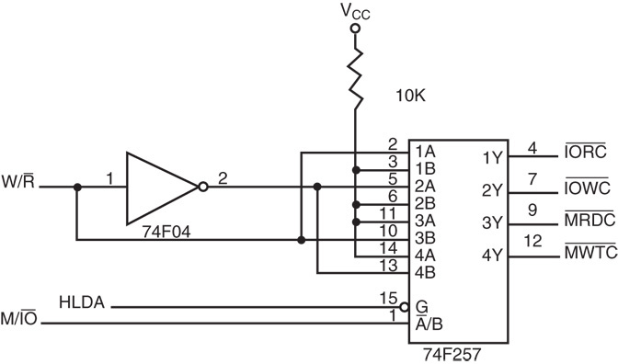
A circuit that generates system control signals in a DMA environment.

Slide 122
Data transfer speed is determined by speed of the memory device or a DMA controller.
if memory speed is 50 ns, DMA transfers occur at rates up to 1/50 ns or 20 M bytes per second
if the DMA controller functions at a maximum rate of 15 MHz with 50 ns memory, maximum transfer rate is 15 MHz because the DMA controller is slower than the memory
In many cases, the DMA controller slows the speed of the system when transfers occur.
Notes:
The switch to serial data transfers in modern systems has made DMA is less important.
The serial PCI Express bus transfers data at rates exceeding DMA transfers.
The SATA (serial ATA) interface for disk drives uses serial transfers at the rate of 300 Mbps
and has replaced DMA transfers for hard disks
Serial transfers on main-boards between components using can approach 20 Gbps for the PCI Express connection.

Slide 123
DMA Controller
Interrupt
Controller
IREQ
INTR
CPU
DMA
Controller
DREQ
DACK
IORD^{b}
IOWR^{b}
EOP^{b}
I/O Controller
HOLD
HOLDA
MEMRD^{b}
Memory
MEMWR^{b}
Data Bus
Address Bus

Slide 124
DMA Controller
DMA is implemented using a DMA controller
DMA controller
Acts as slave to processor
Receives instructions from processor
Example:
Reading from an I/O device
Processor gives details to the DMA controller
I/O device number
Main memory buffer address
Number of bytes to transfer
Direction of transfer (memory → I/O device, or vice versa)

Slide 125
DMA: HOLD and HOLDA
HOLD: DMA to CPU
DMA Send HOLD High to CPU
I (DMA) want BUS Cycles
HOLDA
CPU send HOLDA
BUS is granted to DMA to do the transfer
DMA became Slave to Master mode
HOLD Low to CPU
I (DMA) finished the transfer
Cycle Stealing if One BUS
Other wise Separate process independent of processing

Slide 126
Steps in a DMA operation
Processor initiates the DMA controller
Gives device number, memory buffer pointer, … Called channel initialization
Once initialized, it is ready for data transfer
When ready, I/O device informs the DMA controller
DMA controller starts the data transfer process
Obtains bus by going through bus arbitration
Places memory address and appropriate control signals
Completes transfer and releases the bus
Updates memory address and count value
If more to read, loops back to repeat the process
Notify the processor when done

Slide 127
8237 DMA Controller
Enable/Disable control of Individual DMA Req
Four Independent DMA Channel
Independent Auto initialization for all channel
Memory to Memory transfer
Memory Block initialization
Address Increment and Decrement
Cascade (Directly expandable to any #CHN)
End of Process input for terminating transfers
Software DMA requests

Slide 128
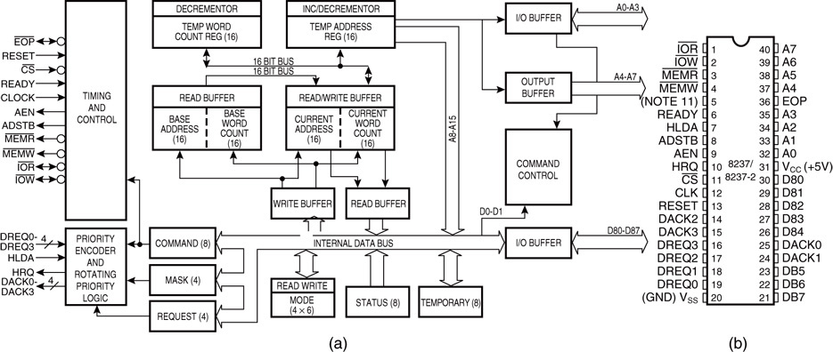
The 8237A programmable DMA controller. (a) Block diagram and (b) pin-out. (Courtesy of Intel Corporation.)

Slide 129
8237 DMA Controller
DB0-DB7
A0-A3
A4-A7
To data Bus
DMA Request 0
DMA Request 1
DMA Request 2
DMA Request 3
DREQ0
DREQ1
DREQ2
DREQ3
To Address Bus
ADSTB
HOLD
Address Strobe
Hold request
DMA ack0
DMA ack1
DMA ack2
DMA ack3
IO Read
I/O Write
Memory Read
Memory Write
End of Process
Hold Ack
Clock
Reset
Ready
Chip Select
HLDA
DACK0
DACK1
DACK2
DACK3
CLK
RESET
READY
IORD^{b}
IOWR^{b}
MemRD^{b}
MemWR^{b}
CS^{b}
EOP^{b}
Notes:
Address strobe functions as ALE, except it is used by the DMA controller to latch address bits A₁₅–A₈ during the DMA transfer.

Slide 130
DMA Controller with Internal Registers
IO/M^{b}
A7
A6
A5
A4
3 to 8
Decoder
CS^{b}
A4-A7
0₀
Reg Addr
Meaning
DREQ0
A3
A2
A1
A0
00
CH0 memory Add reg
DREQ1
01
CH0 Count reg
DREQ2
02
CH1 memory Add reg
DREQ3
03
CH1 Count reg
04
CH2 memory Add reg
05
CH2 Count reg
DACK0
DB7-DB0
DACK1
06
CH3 memory Add reg
ADSTB
07
CH3 Count reg
DACK2
AEN
08
status/Commnd reg
DACK3
MEMR^{b}
09
request reg
MEMW^{b}
10
Single mask reg
IOR^{b}
11
mode reg
IOW^{b}
12
Clear byte ptr F/F
13
Master Clear/Temp
EOP
READY
14
Clear Mask Reg
RESET
15
all Mask clear bits
CLK
HRQ
HLDA

Slide 131
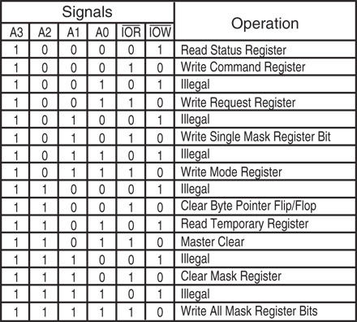
Figure 13–10 8237A-5 command and control port assignments. (Courtesy of Intel Corporation.)

Slide 132
DMA interface to I/O Device
MP
Latch/Transceiver
Control Logic
Address Bus
A8-A15
AD0-AD7
Data bus
Control Bus
I/O
0
I/O
3
ALE
RD^{b}
WR^{b}
IOM^{b}
Memory
Latch/Logic
AEN
MRW
DACK0
DREQ0
DACK3
DREQ3
8237A
ADSTB
IRW
HLD
HLDA
HLD
HLDA

Slide 133
8237 DMA channels
8237 supports four DMA channels
Handshake of I/O
DREQ3-DREQ0 (DMA Request)
DACK3-DACK0 (DMA Acknowledge)
AEN & ADSTB : Address Enable & Add Strobe
A3-A0 and A4-A7: Address line
HRQ and HLDA: Hold Request and Hold Ack
Request hold BUS
Notes:
The address enable (AEN) output of 8237 controls the output pins of the latches and outputs of the 74LS257 (E).
during normal operation (AEN=0), latches A & C and the multiplexer (E) provide address bus bits A₁₉–A₁₆ and A₇–A₀

Slide 134
Registers of 8237A
Command registers
Mode register
D7 | D6 | D5 | D4 | D3 | D2 | D1 | D0
0/1 | 0/1 | 0/1 | 0/1 | 0/1 | 0/1 | 0/1 | 0/1
DACK Sense Active Low/High | DREQ Sense Active Low/High | Late/Extended Write Selection | Fixed/ Rotating Priority | Normal/ Compressed Timing | Enable/Disable Controller | Dis/En CH0 Addres Hold | Dis/En Mem-mem Transfer
D7 | D6 | D5 | D4 | D3 | D2 | D1 | D0
 |  | 0/1 | 0/1
00=Demand Mode 01=Single Mode 10=Block Mode 11=Cascade mode |  | INC/DEC Address | Dis/Ena Auto Initialisation | 00=verify transfer 01=Write Transfer 10=Read transfer 11=Illegal |  | Channel Select 00=CH0, 01=CH1 10=CH2, 11=CH3

Slide 135
DMA Registers
Request register
Mask register: Used to disable a specific channel
Status register
D7 | D6 | D5 | D4 | D3 | D2 | D1 | D0
XXXXX Don’t Care |  |  |  |  | Reset/Set REQ bit | 00-11 Channel Select 00=CH0, 01=CH1, 10=CH2, 11 CH3
D7 | D6 | D5 | D4 | D3 | D2 | D1 | D0
XXXX Don’t Care |  |  |  | 0/1 | 0/1 | 0/1 | 0/1
 |  |  |  | Clear/Set CH3 Mask Bit | Clear/Set CH2 Mask Bit | Clear/Set CH1 Mask Bit | Clear/Set CH0 Mask Bit
D7 | D6 | D5 | D4 | D3 | D2 | D1 | D0
0/1, CH3 | 0/1,CH2 | 0/1, CH1 | 0/1, CH0 | 0/1, CH3 | 0/1, CH2 | 0/1, CH1 | 0/1, CH0
CH# Request |  |  |  | CH# Has reached TC

Slide 136
Registers
Temporary register
Used for memory-to-memory transfers
Current address register
One 16-bit register for each channel
Holds address for the current DMA transfer
Current word register
Keeps the byte count
Generates terminal count (TC) signal when the count goes from zero to FFFFH

Slide 137
Type of Data Transfer using 8237 DMA
Single transfer
Useful for slow devices,
Block transfer mode
Transfers data until TC is generated or external EOP^{b} signal is received
Demand transfer mode
Similar to the block transfer mode
In addition to TC and EOP, transfer can be terminated by deactivating DREQ signal
Cascade mode
Useful to expand the number channels beyond four

Slide 138
Four steps are required to program the 8237:
(1) The F/L flip-flop is cleared using a clear F/L command
(2) the channel is disabled
(3) LSB & MSB of the address are programmed
(4) LSB & MSB of the count are programmed
Once these four operations are performed, the channel is programmed and ready to use.
additional programming is required to select the mode of operation before the channel is enabled and started
Notes:
if F/L = 0, the low-order byte is selected
if F/L = 1, the high-order byte is selected

Slide 139
Programming the 8237
Write a control word in Mode registers
Select Channel, Type of Transfer (R,W, Verify)
DMA mode (block, single byte, demand mode)
Write a control word in Command registers
Priority among channel
Enable the 8237, DREQ & DACK active level
Write the starting address of the data block to be transferred in the Channel MAR
Write the count in the Channel Count Reg

Slide 140
Transfer 1K of memory from/ to Floppy disk at CH3
Disable DMA controller & begin initialization Instructions
Initialize CH3
Starting address of Memory Block (Say 4075H) and subsequent bytes are increasing address order
Command parameters: Normal timing, Fixed priority, late write, DREQ&DACK both active low
Set up the demand mode so that DMA can complete the transfer without any interruption

Slide 141
Program to transfer
MOV AL, 0000100B ; (Disable DMA)
OUT 08H, AL ; Send to Command Reg
MOV AL,00000111V ;00 Demand mode, increAddress,
0 Disable autoload, 01 write, 11=CH3
OUT 0BH, AL ; Send to Mode Reg
MOV AL,04H ; lower Address to
OUT 06H ; MAR CH3
MOV AL,75H ; 7504 Address
OUT 06H, AL
MOV AL,FFH ; lower byte of Tc =03FF, 1K Byte
OUT 07H,AL ; CH3 count Register
MOV AL,03H ; higher byte of 03FF
OUT 07H, AL ; CH3 Count Register
MOV AL, 1000000B ; Command for DACK High
OUT 08H,AL ; Send to command Register
Notes:
The address (ex 08) needs to be appended with the CS (address decoding)

Slide 142
8251 USART

Slide 143
Data Comm: Serial Vs Parallel
Data Transmission
Serial
Cheaper
Slower
Parallel
Faster
Data skew
Limited to small distances
Parallel
Serial
Synchronous
ASynchronous

Slide 144
Serial Communication: How ?
Two basic modes of data transmission
Parallel to serial
Conversion
Serial to parallel
Conversion
Sender
1
1
001001
1
1
001001
Receiver
Sender
1
1
001001
1
1
001001
Receiver
10010011
Serial Transmission
Parallel Transmission

Slide 145
Type of Serial Communication
Synchronous
Sender and receiver must synchronize
Done in hardware using phase locked loops (PLLs)
Block of data can be sent
More efficient : Less overhead than asynchronous transmission
Expensive
Asynchronous
Each byte is encoded for transmission
Start and stop bits
No need for sender and receiver synchronization

Slide 146
Type of Serial Communication
Transmission Gaps
Sender
Receiver
a
Data
Data
Data
Asynchronous transmission
CLK
Sender
Receiver
Data
Data
Data
Data
Data
Synchronous transmission

Slide 147
Type of Serial Communication
1 start
bit
Asynchronous transmission
1 or 2 Stop
bit
Source data
1 0 0 0 1 1 1 0
LSB MSB
Start Bit
Time
Start Bits
8 bit Data

Slide 148
Simplex and Duplex Transmission
Simplex
Data are transmitted in one directions
Example: CPU to printer
Duplex
Data flow in both direction
Half Duplex (Transmission goes on way at a time)
Full Duplex (Both ways simultaneously)

Slide 149
Rate of transmission
Rate at which bits are transmitted (BAUD)
Number of signal changes per second
Bit time: how long the Bit stay On or Off
Printer, Terminal Baud Adjustable (50-9600)
1200Baud means: Bit stay for 1/1200=0.83ms

Slide 150
Error Check
Parity Check
Even parity: When odd numbers of 1 make D7=1
Send Even number of 1
Odd parity: When even number of 1 make D7=1
Send Odd number of 1
Cyclic Redundancy Code (CRC)
Synchronous Communication
Stream of Data can be represented by Cyclic polynomial that divided by a constant polynomial
Reminder to set Bits and Send out as check for error

Slide 151
8251
The 8251A is a programmable serial communication interface chip designed for synchronous and asynchronous serial data communication.
It supports the serial transmission of data.
It is packed in a 28 pin DIP.

Slide 152
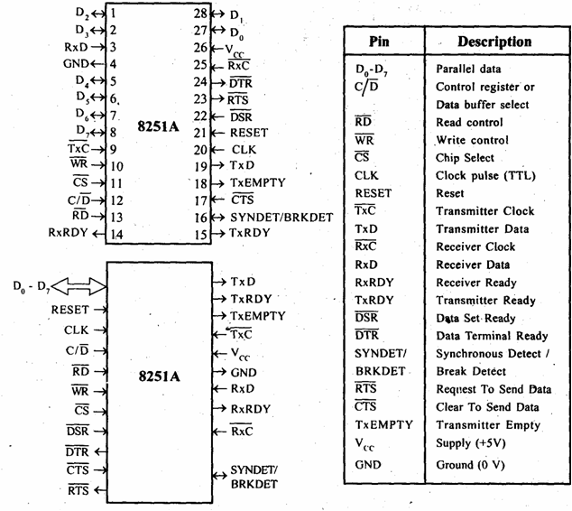
Pin details

Slide 153
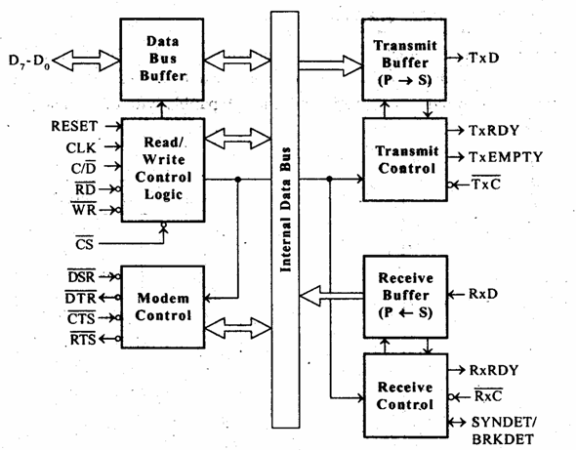
Architecture

Slide 154
Arch - details
The functional block diagram of 825 1A consists five sections.
They are:
Read/Write control logic
Transmitter
Receiver
Data bus buffer
Modem control.

Slide 155
Read/Write control logic
The Read/Write Control logic interfaces the 8251A with CPU, determines the functions of the 8251A according to the control word written into its control register.
It monitors the data flow.
This section has three registers and they are control register, status register and data buffer.
The active low signals RD, WR, CS and C/D(Low) are used for read/write operations with these three registers.

Slide 156
Read/Write control logic
When C/D(low) is high, the control register is selected for writing control word or reading status word.
When C/D(low) is low, the data buffer is selected for read/write operation.
When the reset is high, it forces 8251A into the idle mode.
The clock input is necessary for 8251A for communication with CPU and this clock does not control either the serial transmission or the reception rate.

Slide 157
Transmitter
If buffer register is empty, then TxRDY is goes to high.
If output register is empty then TxEMPTY goes to high.
The clock signal, TxC (low) controls the rate at which the bits are transmitted by the USART.
The clock frequency can be 1,16 or 64 times the baud rate.

Slide 158
Receiver
The receiver section accepts serial data and convert them into parallel data
The receiver section is double buffered, i.e., it has an input register to receive serial data and convert to parallel, and a buffer register to hold the parallel data.
When the RxD line goes low, the control logic assumes it as a START bit, waits for half a bit time and samples the line again.
If the line is still low, then the input register accepts the following bits, forms a character and loads it into the buffer register.

Slide 159
Receiver
The CPU reads the parallel data from the buffer register.
When the input register loads a parallel data to buffer register, the RxRDY line goes high.
The clock signal RxC (low) controls the rate at which bits are received by the USART.
During asynchronous mode, the signal SYNDET/BRKDET will indicate the break in the data transmission.
During synchronous mode, the signal SYNDET/BRKDET will indicate the reception of synchronous character.

Slide 160
8251 mode register
7
6
5
4
3
2
1
0
Mode register
Number of
Stop bits
Baud Rate
Parity enable
0: disable
1: enable
00: Syn. Mode
01: x1 clock
10: x16 clock
11: x64 clock
00: invalid
01: 1 bit
10: 1.5 bits
11: 2 bits
Character length
00: 5 bits
01: 6 bits
10: 7 bits
11: 8 bits
Parity
0: odd
1: even

Slide 161
8251 command register
EH
IR
RTS
ER
SBRK
RxE
DTR
TxE
TxE: transmit enable
DTR: data terminal ready
RxE: receiver enable
SBPRK: send break character
ER: error reset
RTS: request to send
IR: internal reset
EH: enter hunt mode

Slide 162
8251 status register
DSR
SYNDET
FE
OE
PE
TxEMPTY
RxRDY
TxRDY
TxRDY: transmit ready
RxRDY: receiver ready
TxEMPTY: transmitter empty
PE: parity error
OE: overrun error
FE: framing error
SYNDET: sync. character detected
DSR: data set ready

Slide 163
Initializing the 8251
To implement serial communication the MPU must inform the 8251 about the mode, baud, stop bits, parity etc. A set of control words must be loaded.
Mode Words
Specifies general characteristics of the operation.
Command Words
Enables the data transmission and/or reception
Status Word provides the information concerning register status and transmission errors.
Any control word written into the control register after a mode word is interpreted as a command word; that means a command word can be changed anytime, however 8251 should be reset prior to writing a Mode word.
8251 can be reset internally by using the Internal Reset Bit D6.

Slide 164
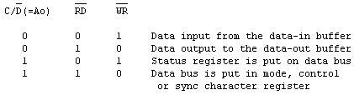
8251 A Serial Communication Interface
The 8251A internally interprets the C/D,RD and WR signals as follow:
Whether the mode, control or sync character register is selected depends on the accessing sequence.
A flowchart of the sequencing is given in Fig.

Slide 165
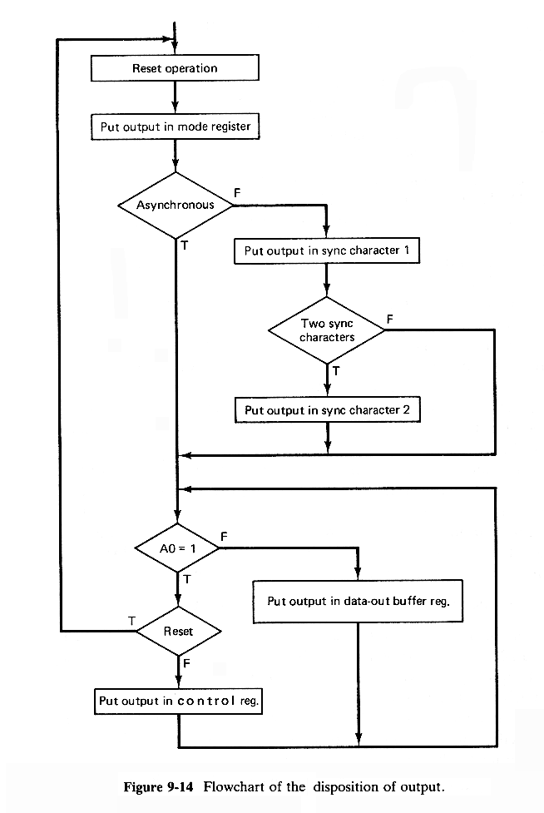

Slide 166
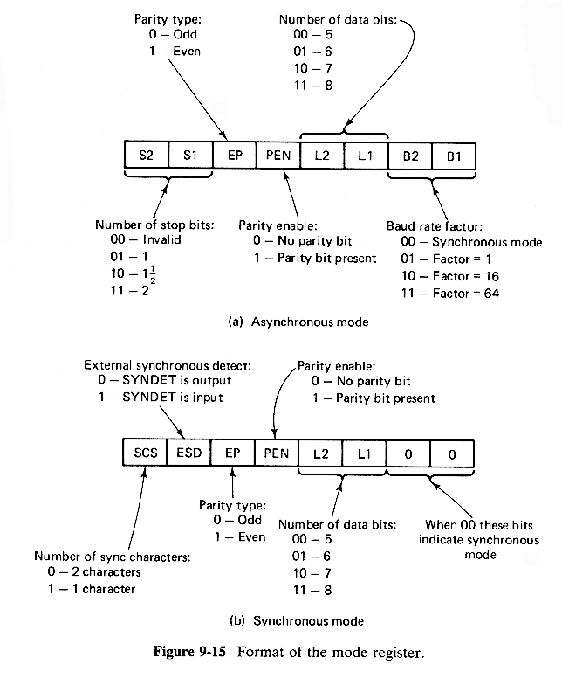
Summary: Format of the mode register
What value must be written into the mode control register with baud rate divided by 16, char. Size 16 bits, odd parity, one stop bit ?
------------------------------------
01011110 b = 5Eh

Slide 167
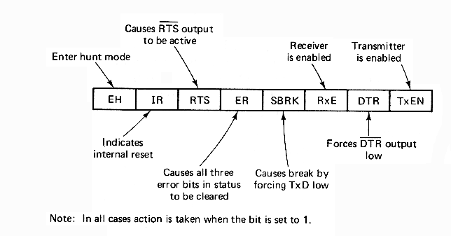
Format of the control register

Slide 168
Example 1
A program sequence which initializes the mode register and gives a command to enable the transmitter and begin an asynchronous transmission of 7-bit characters followed by an even-parity bit and 2 stop bits is:
MOV AL,11111010B
OUT 51H,AL
MOV AL,00110011B
OUT 51H,AL

Slide 169
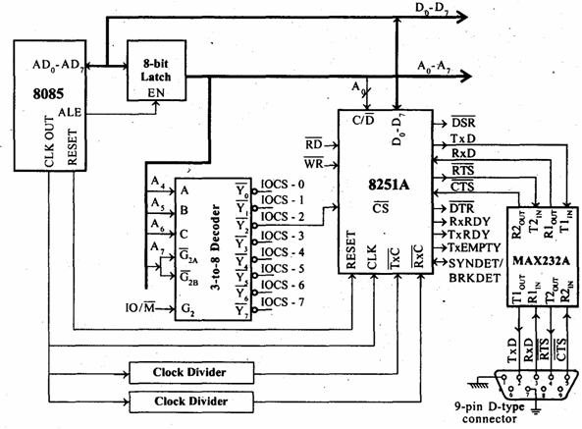
8251 interfaced with 8085

Slide 170
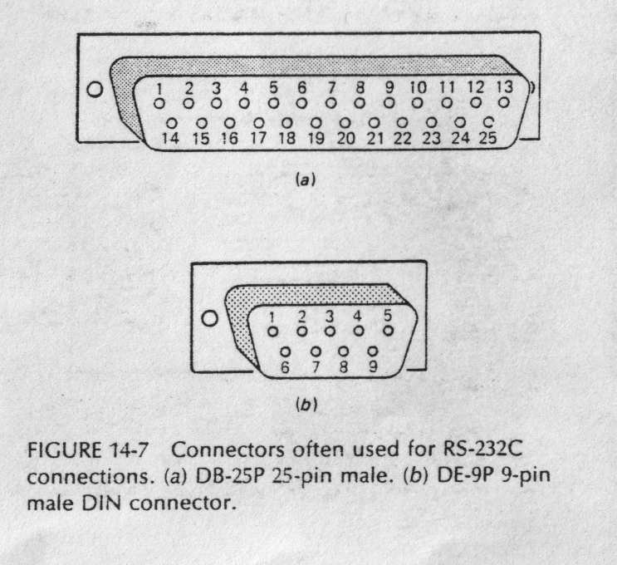
RS-232C standard

