Slide 1
Computer Networks CS358
Instructor: Joydeep Chandra

Slide 2
Course Outline
Theory
Basics of Interworking
Modern Networking Applications and Technologies
Advanced Concepts in Design of Network based Applications
Lab
Implementation of networking protocols
Use of simulators
Develop network based applications

Slide 3
Evaluation
Theory + Lab
Either 60-40 or 70-30 (TBD)
Theory
Quizzes and Class Tests 20%
MidSem 30%
End Sem 50%
Lab
Assignments 50%
MidSem 20%
EndSem 30%

Slide 4
Books and References
Text Book
James F. Kurose and Keith W. Ross, Computer Networking: A Top-Down Approach
Forouzan, Data Communications and Networking
References
Larry L. Peterson and Bruce S. Davie, Computer Networks, A Systems Approach
Tenenbaum and Wetherall, Computer Networks, Pearson India, 5th Edition
Some research articles and papers

Slide 5
Chapter 1 Introduction
A note on the use of these ppt slides:
We’re making these slides freely available to all (faculty, students, readers). They’re in PowerPoint form so you can add, modify, and delete slides (including this one) and slide content to suit your needs. They obviously represent a lot of work on our part. In return for use, we only ask the following:
If you use these slides (e.g., in a class) in substantially unaltered form, that you mention their source (after all, we’d like people to use our book!)
If you post any slides in substantially unaltered form on a www site, that you note that they are adapted from (or perhaps identical to) our slides, and note our copyright of this material.
Thanks and enjoy! JFK/KWR
All material copyright 1996-2007
J.F Kurose and K.W. Ross, All Rights Reserved
Computer Networking: A Top Down Approach , 4th edition. Jim Kurose, Keith Ross Addison-Wesley, July 2007.

Slide 6
Outline
Internet architecture
Internet history
Today’s Internet
Internet in a nutshell (protocols in practice)

Slide 7
Internet Architecture
http://www.nap.edu/html/coming_of_age/
http://www.ietf.org/rfc/rfc1958.txt

Slide 8
Why did the Internet win?
Packet switching over circuit switching
End-to-end principle and “Hourglass” design
Layering of functionality
Distributed design, decentralized control
Superior organizational process

Slide 9
Circuit Switching
Circuit switching:
There is a dedicated communication path between two stations (end-to-end)
The path is a connected sequence of links between network nodes. On each physical link, a logical channel is dedicated to the connection.
Communication via circuit switching has three phases:
Circuit establishment (link by link)
Routing & resource allocation (FDM or TDM)
Data transfer
Circuit disconnect
Deallocate the dedicated resources
The switches must know how to find the route to the destination and how to allocate bandwidth (channel) to establish a connection.

Slide 10
Circuit Switching Properties
Inefficiency
Channel capacity is dedicated for the whole duration of a connection
If no data, capacity is wasted
Delay
Long initial delay: circuit establishment takes time
Low data delay: after the circuit establishment, information is transmitted at a fixed data rate with no delay other than the propagation delay. The delay at each node is negligible.
Developed for voice traffic (public telephone network) but can also applied to data traffic.
For voice connections, the resulting circuit will enjoy a high percentage of utilization because most of the time one party or the other is talking.
But how about data connections?

Slide 11
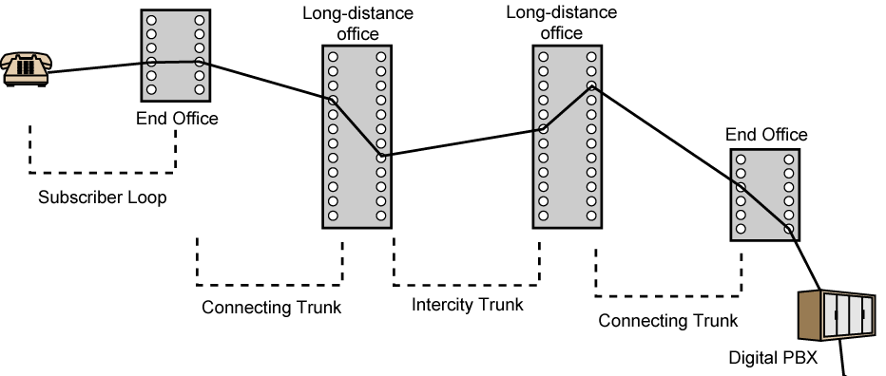
Public Circuit Switched Network
Subscribers: the devices that attach to the network.
Subscriber loop: the link between the subscriber and the network.
Exchanges: the switching centers in the network.
End office: the switching center that directly supports subscribers.
Trunks: the branches between exchanges. They carry multiple voice-frequency circuits using either FDM or synchronous TDM.

Slide 12
Packet vs. circuit switching
mesh of interconnected routers
the fundamental question: how is data transferred through net?
circuit switching: dedicated circuit per call: telephone net
packet-switching: data sent thru net in discrete “chunks”

Slide 13
Circuit Switching
End-end resources reserved for “call”
network resources (e.g., bandwidth) divided into “pieces”
link bandwidth, switch capacity
pieces allocated to calls
resource piece idle if not used by owning call
dedicated resources: no sharing
circuit-like (guaranteed) performance
call setup and admission control required

Slide 14
Circuit Switching: FDM and TDM
Example:
FDM
4 users
frequency
time
TDM
frequency
time
Notes:
Two simple multiple access control techniques.
Each mobile’s share of the bandwidth is divided into portions for the uplink and the downlink. Also, possibly, out of band signaling.
As we will see, used in AMPS, GSM, IS-54/136

Slide 15
Numerical example
How long does it take to send a file of 640,000 bits from host A to host B over a circuit-switched network?
All links are 1.536 Mbps
Each link uses TDM with 24 slots/sec
500 msec to establish end-to-end circuit
Let’s work it out!

Slide 16
Numerical example
How long does it take to send a file of 640,000 bits from host A to host B over a circuit-switched network?
All links are 1.536 Mbps
Each link uses TDM with 24 slots/sec
500 msec to establish end-to-end circuit
Let’s work it out!
1,536,000/24 = 64000 bps per time slot
640000bits/64000bps = 10 sec.
Total time = 500 msec + 10 sec = 10.5 sec

Slide 17
Case study: Circuit Switching
1890-current: Phone network
Fixed bit rate
Mostly voice
Not fault-tolerant
Components extremely reliable
Global application-level knowledge throughout network
Admission control at local switching station (dial-tone)

Slide 18
Network Core: Packet Switching
each end-end data stream divided into packets
user A, B packets share network resources
each packet uses full link bandwidth
resources used as needed
resource contention:
aggregate resource demand can exceed amount available
congestion: packets queue, wait for link use
store and forward: packets move one hop at a time
Node receives complete packet before forwarding
Bandwidth division into “pieces”
Dedicated allocation
Resource reservation

Slide 19
Packet Switching: Statistical Multiplexing
10 Mb/s
Ethernet
A
C
statistical multiplexing
1.5 Mb/s
B
queue of packets
waiting for output
link
D
E
Sequence of A & B packets does not have fixed pattern, shared on demand ➔ statistical multiplexing.
TDM: each host gets same slot in revolving TDM frame.

Slide 20
Packet switching versus circuit switching
Packet switching allows more users to use network!
N users over 1 Mb/s link
each user:
100 kb/s when “active”
active 10% of time
circuit-switching:
10 users
packet switching:
with 35 users, probability > 10 active less than .0004
Allows more users to use network
“Statistical multiplexing gain”
N users
1 Mbps link
Q: how did we get value 0.0004?

Slide 21
Packet switching versus circuit switching
Is packet switching a “slam dunk winner?”
Great for bursty data
resource sharing
simpler, no call setup
Bad for applications with hard resource requirements
Excessive congestion: packet delay and loss
Need protocols for reliable data transfer, congestion control
Applications must be written to handle congestion
Q: How to provide circuit-like behavior?
bandwidth guarantees needed for audio/video apps
still an unsolved problem (chapter 7)
Common practice: over-provision

Slide 22
Problems with packet switching
Packet loss and queuing delay
packets queue in router buffers
packet arrival rate to link exceeds output link capacity
packets queue, wait for turn
when packet arrives to full queue, packet is dropped (aka lost)
lost packet may be retransmitted by previous node, by source end system, or not retransmitted at all
packet being transmitted (delay)
A
B
packets queueing (delay)
free (available) buffers: arriving packets
dropped (loss) if no free buffers

Slide 23
Four sources of packet delay
1. nodal processing:
check bit errors
determine output link
2. queueing
time waiting at output link for transmission
depends on congestion level of router
transmission
A
propagation
B
nodal
processing
queueing

Slide 24
Delay in packet-switched networks
3. Transmission delay:
R=link bandwidth (bps)
L=packet length (bits)
time to send bits into link = L/R
4. Propagation delay:
d = length of physical link
s = propagation speed in medium (~2x10⁸ m/sec)
propagation delay = d/s
transmission
A
propagation
B
nodal
processing
queueing

Slide 25
Nodal delay
d_{proc} = processing delay
typically a few microsecs or less
d_{queue} = queuing delay
depends on congestion
d_{trans} = transmission delay
= L/R, significant for low-speed links
d_{prop} = propagation delay
a few microsecs to hundreds of msecs

Slide 26
Transmission delay example
L
R
R
R
Packet switching
Store-and-forward
Packet completely received before being transmitted to next node
Takes L/R seconds to transmit (push out) packet of L bits on to link or R bps
Entire packet must arrive at router before it can be transmitted on next link: store and forward
delay = 3L/R (assuming zero propagation delay)
Example:
L = 7.5 Mbits
R = 1.5 Mbps
delay = 15 sec
more on delay shortly …

Slide 27
Problem
L
R1
R2
Consider a packet of length L that begins at system A, travels over one link to a packet switch over a second link to a destination end system.
Let d_{i}, s_{i} and R_{i} denote the length, propagation speed and transmission rate of link i, for i=1,2.
The packet switch delays each packet by d_{proc}
Assuming no queuing delays, what is the total end-to-end delay?

Slide 28
Problem
A router buffer of infinite size has certain queuing delay. Let L be the size of packets coming to the router and R be the rate(bits/sec) at which packets are sent out of the queue. What is the average routing delay if N packets arrive simultaneously every NL/R seconds.

Slide 29
Case study: Packet Switching
1970/80s-current: Internet network
Variable bit rate
Mostly data
Fault-tolerant
Components not extremely reliable (versus phone components)
Distributed control and management

Slide 30
Why did the Internet win?
Packet switching over circuit switching
End-to-end principle and “Hourglass” design
Layering of functionality
Distributed design, decentralized control
Superior organizational process

Slide 31
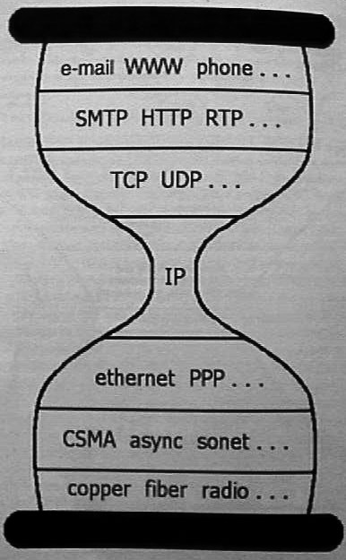
End-to-end principle and Hourglass design

Slide 32
End-to-end principle
J. H. Saltzer, D. P. Reed and D. D. Clark “End-to-end arguments in system design”, Transactions on Computer Systems, Vol. 2, No. 4, 1984
http://www.acm.org/pubs/citations/journals/tocs/1984-2-4/p277-saltzer/

Slide 33
Hourglass design
D. Clark, “The design philosophy of the DARPA Internet”, SIGCOMM 1988, August 16 - 18, 1988.
http://www.acm.org/pubs/citations/proceedings/comm/52324/p106-clark/

Slide 34
End-to-end principle
Where to put the functionality?
In the network? At the edges?
End-to-end functions best handled by end-to-end protocols
Network provides basic service: data transport
Intelligence and applications located in or close to devices at the edge
Violate principle as a performance enhancement
Leads to innovation at the edges
Phone network: dumb edge devices, intelligent network
Internet: dumb network, intelligent edge devices

Slide 35
Hourglass design
End-to-end principle leads to “Hourglass” design of protocols
Only one protocol at the Internet level
Minimal required elements at narrowest point
IP – Internet Protocol
http://www.rfc-editor.org/rfc/rfc791.txt
http://www.rfc-editor.org/rfc/rfc1812.txt
Unreliable datagram service
Addressing and connectionless connectivity
Fragmentation and assembly

Slide 36
Hourglass design
Simplicity allowed fast deployment of multi-vendor, multi-provider public network
Ease of implementation
Limited hardware requirements (important in 1970s)
Is it relevant now with today’s semiconductor speeds?
Eventual economies of scale
Designed independently of hardware
No link-layer specific functions
Hardware addresses decoupled from IP addresses
IP header contains no data/physical link specific information
Allows IP to run over any fabric

Slide 37
Hourglass design
Waist expands at transport layer
Two dominant services layered above IP
TCP – Transmission Control Protocol
Connection-oriented service
http://www.rfc-editor.org/rfc/rfc793.txt
UDP – User Datagram Protocol
Connectionless service
http://www.rfc-editor.org/rfc/rfc768.txt

Slide 38
Hourglass design
TCP – Transmission Control Protocol
Reliable, in-order byte-stream data transfer
Acknowledgements and retransmissions
Flow control
Sender won’t overwhelm receiver
Congestion control
Senders won’t overwhelm network
UDP – User Datagram Protocol
Unreliable data transfer
No flow control
No congestion control

Slide 39
Hourglass design
What uses TCP?
HTTP, FTP, Telnet, SMTP, NNTP, BGP, IMAP, POP
What uses (mainly) UDP?
SNMP, NTP, NFS, RTP (streaming media, IP telephony, teleconferencing), multicast applications
Many protocols can use both
Check out /etc/services on *nix or C:\WIN*\system32\services
IANA
http://www.iana.org/assignments/port-numbers

Slide 40
Hourglass design
Question?
Are TCP, UDP, and IP enough?
What other functionality would applications need?

Slide 41
Hourglass design
Security?
IPsec/SSL/TLS
Quality-of-service?
RSVP, int-serv, diff-serv
Reliable, out-of-order delivery service?
SCTP
Handling greedy sources?
Accounting and pricing support?

Slide 42
End-to-end principle and the Hourglass design
The good
Basic network functionality allowed for extremely quick adoption and deployment using simple devices
The bad
New network features and functionality are impossible to deploy, requiring widespread adoption within the network
IP Multicast, QoS

Slide 43
Why did the Internet win?
Packet switching over circuit switching
End-to-end principle and “Hourglass” design
Layering of functionality
Distributed design, decentralized control
Superior organizational process

Slide 44
Layering
Modular approach to network functionality
Simplifies complex systems
Each layer relies on services from layer below and exports services to layer above
Hides implementation
Eases maintenance and updating of system
Layer implementations can change without disturbing other layers (black box)

Slide 45
Layering
Examples:
Topology and physical configuration hidden by network-layer routing
Applications require no knowledge of routes
New applications deployed without coordination with network operators or operating system vendors
Application
Host-to-host connectivity
Link hardware

Slide 46
Layering essential in Protocols
Set of rules governing communication between network elements (applications, hosts, routers)
Protocols specify:
Interface to higher layers (API)
Interface to peer
Format and order of messages
Actions taken on receipt of a message
Interface defines interaction
Notes:
Human analogy – social customs

Slide 47
Layering: OSI Model
Physical
how to transmit bits
Data link
how to transmit frames
Network
how to route packets host-to-host
Transport
how to send packets end2end
Session
how to tie flows together
Presentation
byte ordering, formatting
Application: everything else
Application
Presentation
Session
Transport
Network
Data Link
Physical
Host

Slide 48
Layering: Internet protocols
application: (L7 & L6 of OSI) supporting network applications
FTP, SMTP, HTTP
transport: (L5 & L4 of OSI) host-host data transfer
TCP, UDP
network: routing of datagrams from source to destination
IP, routing protocols
link: data transfer between neighboring network elements
PPP, Ethernet
physical: bits “on the wire”
application
transport
network
link
physical

Slide 49
Layers in action
source
message
M
application
transport
network
link
physical
segment
H_{t}
M
datagram
H_{n}
H_{t}
M
frame
H_{l}
H_{n}
H_{t}
M
H_{l}
H_{n}
H_{t}
M
link
physical
H_{l}
H_{n}
H_{t}
M
switch
destination
H_{n}
H_{t}
M
network
link
physical
H_{n}
H_{t}
M
M
application
transport
network
link
physical
H_{l}
H_{n}
H_{t}
M
H_{l}
H_{n}
H_{t}
M
H_{t}
M
H_{n}
H_{t}
M
H_{l}
H_{n}
H_{t}
M
router

Slide 50
Layering
Is Layering always good?
Sometimes not..
Layer N may duplicate lower level functionality (e.g., error recovery)
Layers may need same info (timestamp, MTU)
Strict adherence to layering may hurt performance

Slide 51
Why did the Internet win?
Packet switching over circuit switching
End-to-end principle and “Hourglass” design
Layering of functionality
Distributed design, decentralized control
Superior organizational process

Slide 52
Distributed design and control
Requirements from DARPA
Must survive a nuclear attack
Reliability
Intelligent aggregation of unreliable components
Alternate paths, adaptivity
Distributed management & control of networks
Allows individual networks to independently develop without large amounts of coordination
Exceptions: TLDs and TLD servers, IP address allocation (ICANN)

Slide 53
Superior organizational process
IAB/IETF process allowed for quick specification, implementation, and deployment of new standards
Free and easy download of standards
Rough consensus and running code
2 interoperable implementations
Bake-offs
http://www.ietf.org/
ISO/OSI
Comparison to IETF left as an exercise

Slide 54
Problem 1
Consider the queuing delay in a router buffer (preceding an outbound link). Suppose all packets are L bits, the transmission rate is R bps and that N packets simultaneously arrive at the buffer every LN/R seconds. Find the average queuing delay of a packet

Slide 55
Internet history

Slide 56
How old is the Internet?
Guesses?
Hint
It used to be the case that everyone in this class remembered the “pre-Internet” days

Slide 57
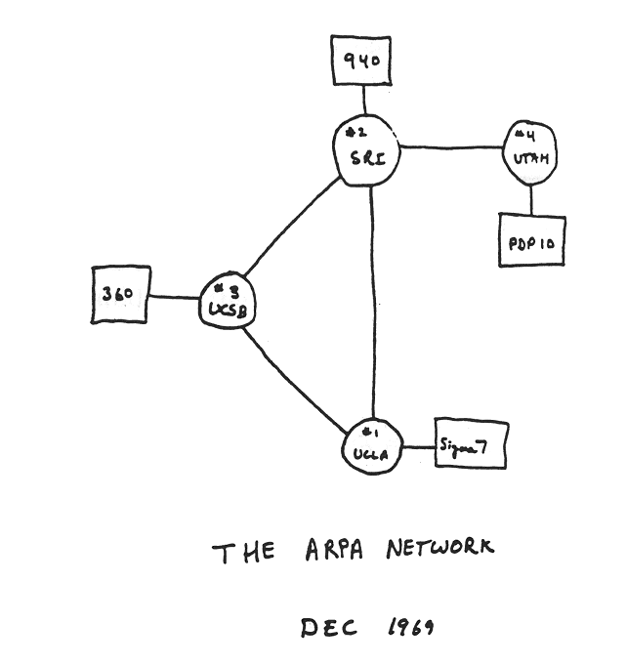
Internet History
1961-1972: Early packet-switching principles
1961: Kleinrock - queueing theory shows effectiveness of packet-switching
1964: Baran - packet-switching in early military nets
1967: ARPAnet conceived by Advanced Research Projects Agency
1969: first ARPAnet node operational
1972:
ARPAnet public demonstration
NCP (Network Control Protocol) first host-host protocol
first e-mail program
ARPAnet has 15 nodes

Slide 58
Internet History
1972-1980: Internetworking, new and proprietary nets
1970’s: proprietary network architectures developed: DECnet, SNA, XNA
1974: Cerf and Kahn - architecture for interconnecting networks
1976: Ethernet at Xerox PARC
1979: ARPAnet has 200 nodes
Cerf and Kahn’s internetworking principles:
minimalism, autonomy - no internal changes required to interconnect networks
best effort service model
stateless routers
decentralized control
define today’s Internet architecture

Slide 59
Internet History
1980-1990: new protocols, a proliferation of networks
1983: deployment of TCP/IP
1983: smtp e-mail protocol defined
1983: DNS defined for name-to-IP-address translation
1985: ftp protocol defined
1988: TCP congestion control
Late 1980s, Early 1990s: new national networks: Csnet, BITnet, NSFnet, Minitel
100,000 hosts connected to confederation of networks

Slide 60
Internet History
1990, 2000’s: commercialization, the Web, new apps
Early 1990’s: ARPAnet decommissioned
1991: NSF lifts restrictions on commercial use of NSFnet (decommissioned, 1995)
early 1990s: Web
hypertext [Bush 1945, Nelson 1960’s]
HTML, HTTP: Berners-Lee
1994: Mosaic, later Netscape
late 1990’s: commercialization of the Web
Late 1990’s – 2000’s:
more killer apps: instant messaging, P2P file sharing
network security to forefront
est. 50 million host, 100 million+ users
backbone links running at Gbps

Slide 61
Internet History
2007:
~500 million hosts
Voice, Video over IP
P2P applications: BitTorrent (file sharing) Skype (VoIP), PPLive (video)
more applications: YouTube, gaming
wireless, mobility

Slide 62
Internet in a nutshell (protocols in practice)

Slide 63
A day in the life of an Internet host…
Booting
Dynamically configure network settings
DHCP request
UDP (unreliable datagrams)
IP and data-link broadcast
DHCP response from listening server
IP address of host
Netmask (i.e. 255.255.255.0) to determine network ID
Default router
Local DNS server

Slide 64
A day in the life of an Internet host…
Web request http://www.yahoo.com/index.html
Step #1: Locate DNS server
if (netmask & IP_{Host} == netmask & IP_{DNS}) {
DNS server on local network
ARP for hardware address of IP_{DNS}
} else {
DNS server on remote network
ARP for hardware address of IP_{DefaultRouter}
}
ARP (Address Resolution Protocol)
IP address to hardware address mapping
Request broadcast for all hosts on network to see
Reply broadcast for all hosts to cache

Slide 65
A day in the life of an Internet host…
Step #2: ARP request and reply

Slide 66
A day in the life of an Internet host…
Step #3: DNS request/reply
UDP, IP, data-link header
DNS request to local DNS server from host
DNS reply from local DNS server to host

Slide 67
A day in the life of an Internet host…
Step #4: TCP connection establishment
TCP 3-way handshake (SYN, SYN-ACK, ACK)
Session establishment to support reliable byte stream

Slide 68
A day in the life of an Internet host…
Step #5: HTTP request and reply
HTTP (application data), TCP, IP, data-link header
HTTP request
HTTP reply

Slide 69
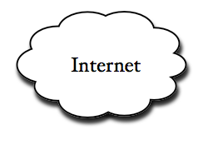

tcpdump example
http://thefengs.com/wuchang/work/courses/cs594/trace.txt
ren.cse.ogi.edu
129.95.50.113
www.cse.ogi.edu
129.95.20.2
129.95.50.0/24
cse2-gw.net.ogi.edu
129.95.50.54
church.cse.ogi.edu
129.95.50.2

Slide 70
A day in the life of an Internet host…
Role of TCP and UDP?
Demultiplex at end hosts.
Which process gets this request?
FTP
HTTP
NV
TFTP
TCP
UDP
Network
IP
TCP/UDP
IPX
IP
NET₁
NET₂
…
NET_{n}
Type Field
Protocol Field
Port Number

Slide 71
A day in the life of an Internet host….
What about….
Reliability
Corruption
Lost packets
Flow and congestion control
Fragmentation
Out-of-order delivery
The beauty of TCP, IP, and layering
All taken care of transparently

Slide 72
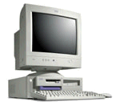
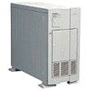
What if the Data is Corrupted?
Problem: Data Corruption
GET index.html
GET windex.html
Internet
Solution: Add a checksum
X
0,9
9
6,7,8
21
4,5
7
1,2,3
6

Slide 73
What if the Data is Lost?
Problem: Lost Data
GET index.html
Internet
Solution: Timeout and Retransmit
GET index.html
GET index.html
Internet
GET index.html

Slide 74
What if receiver has no resources (flow control)?
Problem: Overflowing receiver buffers
PUT remix.mp3
Internet
Solution: Receiver advertised window
PUT remix.mp3
Internet
16KB free

Slide 75



What if Network is Overloaded?
Short bursts: buffer
What if buffer overflows?
Packets dropped and retransmitted
Sender adjusts rate until load = resources
Called “Congestion control”

Slide 76
What if the Data Doesn’t Fit?
Problem: Packet size
On Ethernet, max IP packet is 1.5kbytes
Typical web page is 10kbytes
Solution: Fragment data across packets
ml
x.ht
inde
GET
GET index.html

Slide 77
What if the Data is Out of Order?
Problem: Out of Order
ml
inde
x.th
GET
GET x.thindeml
Solution: Add Sequence Numbers
ml
4
inde
2
x.th
3
GET
1
GET index.html

Slide 78
The rest of the course
From birds-eye view, we will now focus on specific components
Review these lectures for perspective when looking at the components
Mostly classical material with some references to newer technologies

Slide 79
Acknowledgements
Material taken from course slides by Srini Seshan’s Computer Networking course at http://www.cs.cmu.edu/~srini/15-744/S01/

Slide 80
Extra slides

Slide 81
Layering
Need for exposing underlying layers for optimal application performance
D. Tennenhouse and D. Clark. Architectural Considerations for a New Generation of Protocols. SIGCOMM 1990.
Application Layer Framing (ALF)
Enable application to process data as soon as it can
Expose application processing unit (ADU) to protocols
Integrated Layer Processing (ILP)
Layering convenient for architecture but not for implementations
Combine data manipulation operations across layers

Slide 82
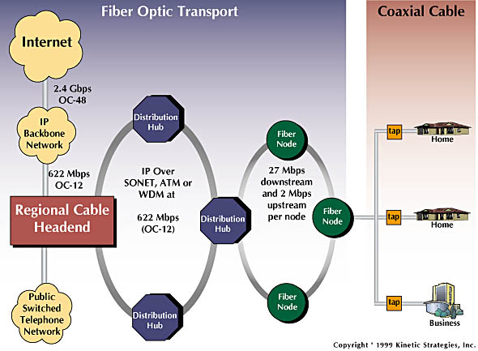
Residential access: cable modems
Diagram: http://www.cabledatacomnews.com/cmic/diagram.html

Slide 83
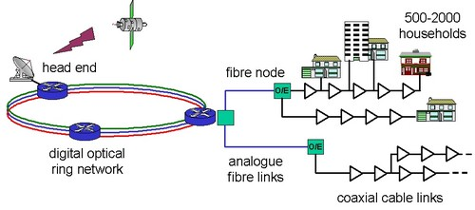
Cable Network Architecture: Overview

Slide 84
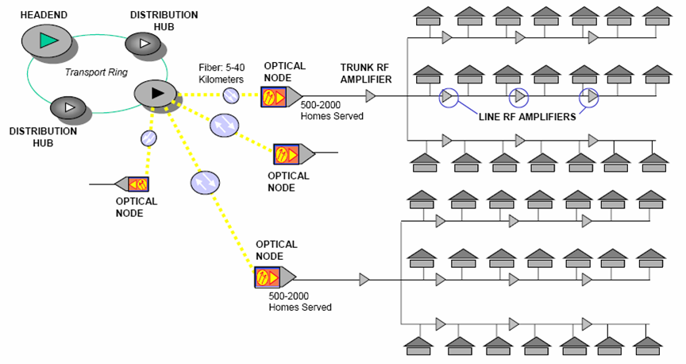
Residential access: cable modems

Slide 85
Residential access: cable modems
HFC: hybrid fiber coax
asymmetric: up to 27Mbps downstream, 2 Mbps upstream
Limited upstream bandwidth due to multiple noise sources vs. downstream case with one controllable noise source (headend)
network of cable and fiber attaches homes to ISP router
homes share access to router
deployment: available via cable TV companies

Slide 86
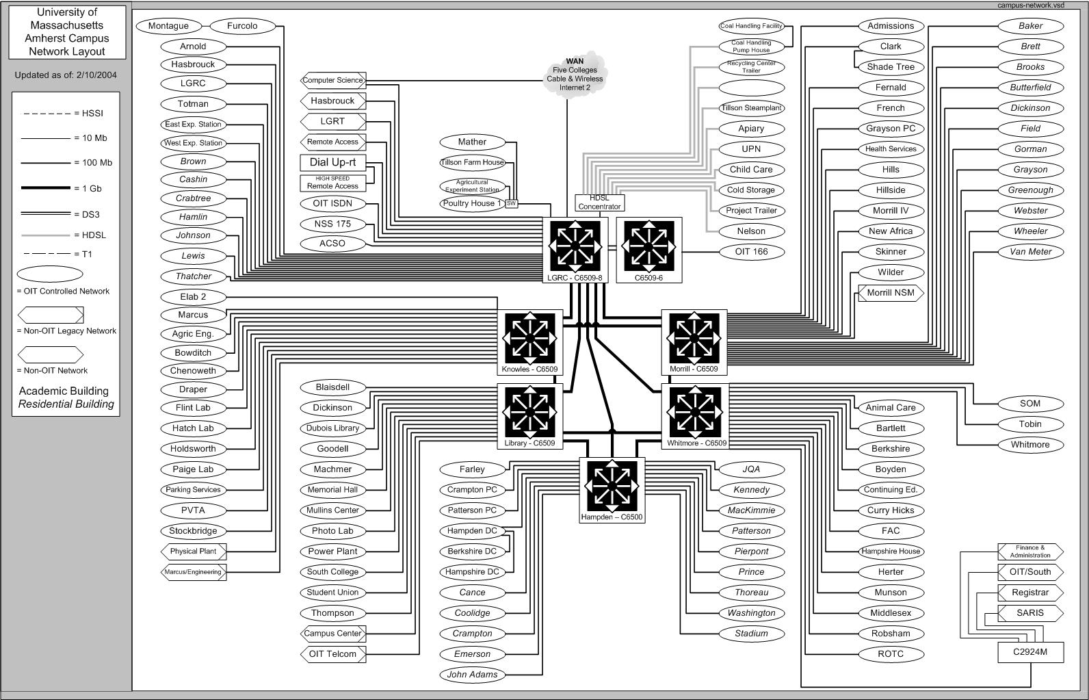
UMass Campus Network

Slide 87
Internet History
Those who ignore the past are doomed to repeat it
http://www.worldcom.com/about_the_company/cerfs_up/
Where did it come from?
Who built it?
Why does it work?
Most of the original designers (old-timers) still around and active…
internet-history-request@postel.org

Slide 88
Internet timeline
1961 Kleinrock proposes packet switching
1962 Licklider proposes “galactic” network
Goes to DARPA as head of CS research
1966 Roberts proposes galactic network using packet switching
Goes to ARPA to build it (ARPANET)
1968 RFQs to build routers (Interface Message Processors)
1968 Kahn separates hardware addresses from network addresses
ARPANET to run over any hardware
1969 Crocker initiates RFC notes to document protocols
Freely available
1969 First node of ARPANET UCLA (September)
1969 4-node ARPANET at UCLA, SRI, Utah, UCSB (December)
Initial hosts.txt name database
1970 Crocker develops NCP (host-to-host protocol for applications)
Precursor to TCP
1972 Tomlinson develops e-mail (@)

Slide 89
Internet timeline
1972 Issues with NCP and ARPANET arise
NCP relied on ARPANET for end2end reliability (assumed no packet loss)
Can not work over satellite or packet radio links
NCP addressing tied to ARPANET
1973 Kahn redesigns protocols
Communication on a “best-effort” basis
Least-common denominator
End points in charge of retransmission, reassembly, flow control
No per-flow state in gateways between networks
Simple, avoids adaptation and recovery from failure
Addressing
8-bit network number, 24 bit host number
Fails to forsee development of the LAN
Later split into Class A (national), B (regional), and C (LAN)
1974 Kahn, Cerf develop TCP (with IP included) (December)
IP later separated for unreliable applications, UDP added
1981 RFCs for TCP and IP
Initial applications: file transfer, e-mail, voice/video, login

Slide 90
Internet timeline
1978-1983: NCP replaced by TCP/IP
Implementations of TCP/IP on many platforms (Clark)
Mandate from to switch all users on ARPANET from NCP to TCP/IP (1980)
Not well received
One-day shutoff of NCP in mid-1982 makes people angry, but not sufficiently convincing
January 1983: NCP banned from ARPANET “Flag Day” -> The Internet is born
Some older computers allowed to operate with old NCP for a short time
Full transition takes several months, finishes at end of 1983
“I survived the TCP/IP transition” buttons (Y2K bug?)
Will there be an “IPv6 day?”

Slide 91
Internet timeline
1982-1985 Application protocols
SMTP (1982)
Mockapetris develops DNS (1983)
telnet (1983)
ftp (1985)
1980s Jealous non-interoperable competitors
DOE: MFENet (Magnetic Fusion Energy scientists)
DOE: HEPNet (High Energy Physicists)
NASA: SPAN (Space physicists)
NSF: CSNET (CS community)
NSF: NSFNet (Academic community) 1985
AT&T: USENET with Unix, UUCP protocols
Academic networks: BITNET (Mainframe connectivity)
Xerox: XNS (Xerox Network System)
IBM: SNA (System Network Architecture)
Digital: DECNet
UK: JANET (Academic community in UK) 1984

Slide 92
Internet timeline
1986-1995 NSFNet (Jennings/Wolff with funding assist from Al Gore)
Network for academic/research community
Selects TCP/IP as mandatory for NSFNet
Builds out wide area networking infrastructure
Develops strategy for developing and handing it over eventually to commercial interests
Prohibit commercial use of NSFNet to encourage commercial backbones
Leads to PSINet, UUNET, ANS, CO+RE backbone development
1989 WWW
Tim Berners-Lee develops initial web browser supporting URLs, HTTP, HTML

Slide 93
Internet timeline
Early 1990s Privatization
ARPANET decommissioned (1990)
NSFNet decommissioned (1995) ($200 million spent from 1986-1995)
Early 1990s Architectural issues
Address depletion
Multi-class addressing to break 8/24 network/host split in address bits
Routing table explosion
Hierarchy and CIDR
Congestion
TCP congestion control
1994 Andreessen
Mosaic web browser

Slide 94
Packet switching
Kleinrock, MIT (July 1961)
Theoretical feasibility of communications using packets instead of circuits
L. Kleinrock, "Information Flow in Large Communication Nets", RLE Quarterly Progress Report, July 1961.
L. Kleinrock, Communication Nets: Stochastic Message Flow and Delay, Mcgraw-Hill (New York), 1964.

Slide 95
Conceptual “Internet”
J.C.R. Licklider, W. Clark, MIT (August 1962)
“On-line Man Computer Communication”
“Galactic network” concept of globally interconnected set of computers
Licklider goes to DARPA as head of computer research program (Oct. 1962)

Slide 96
ARPANET
Roberts, (1966)
Puts idea of galactic computer network and packet switching together
Goes to DARPA as program manager
Plans for building “ARPANET” based on system
L. Roberts, "Multiple Computer Networks and Intercomputer Communication", ACM Gatlinburg Conf., October 1967.

Slide 97
ARPANET
Structure and specification (August 1968)
RFQ to build IMPs (Interface Message Processors)
Packet switches which route packets
BBN (Bolt, Beranek, and Newman) wins contract
Kahn at BBN updates ARPANET design
Run over any fabric (separation of hardware and network addresses)
Support for multiple independent networks
First node UCLA (Sept. 1969)
4 node ARPANET (Dec. 1969) SRI, UCSB, Utah
Initial hostname/address database (flat file: hosts.txt)

Slide 98
RFCs
1969: Crocker establishes RFC series of notes
Official protocol documentation
Printed on paper and snail mailed at first
Then available via ftp and now http
Open and free access to RFCs mandated
Effective, positive feedback loop
Key to quick development process (“time-to-market”)
Has changed considerably as of late...
Jon Postel RFC editor and protocol number assignment

Slide 99
NCP
Crocker
Connectivity implemented
Require a host-to-host protocol standard for two ends to talk to each other
NCP (Network Control Protocol) defined (Dec. 1970)
Precursor to TCP
Deployed from 1971-1972
Allows applications to be developed on top of network

Slide 100
E-mail
BBN’s Tomlinson (Mar. 1972)
Time-shared systems at the time allow users to leave messages for each other
Extended to remote systems
Writes first e-mail application to send and read
Infamous “@” used

Slide 101
Internetting
ARPANET not the only network in town...
International Network Working Group (Sept. 1973)
Goal: run protocols over packet satellite net, packet radio net, and wired ARPANET
Problems
NCP can only address networks connected to IMPs on ARPANET
NCP relied on ARPANET for end2end reliability
NCP assumed no packet loss: applications halt upon loss
NCP had no end-end host error control
Kahn redesigns protocols for internetworking

Slide 102
Internetting
Kahn’s Architecture
Each network stands alone
No changes required to connect to Internet
Communication between networks handled by gateways
Communication on a “best-effort” basis
Least-common denominator
Source in charge of retransmission
Host-to-Host flow control (sliding windows and acks)
Black boxes interconnecting networks (gateways and routers) have no per-flow information
Simple, avoids complicated adaptation and recovery from failure
No global control at the operations level

Slide 103
Internetting
Other issues
Host-to-Host data pipelining (multiple packets en route)
Gateway interprets IP headers for routing and performs fragmentation to other networks
end2end checksums, reassembly of fragments, duplicate detection at end-hosts (much of TCP’s virtual circuit model)
Global addressing via 32-bit address (IP’s limitation)
8-bit network number, 24 bit host number
Fails to forsee development of the LAN
Later split into Class A (national), B (regional), and C (LAN)
Interfaces to operating systems
R. Kahn, Communications Principles for Operating Systems. Internal BBN memo, Jan. 1972.

Slide 104
Internetting
Kahn brings in Cerf (Stanford) to help implement ideas on multiple OS platforms
V. Cerf, R. Kahn “A protocol for packet network intercommunication” IEEE Transactions on Communications, May 1974
TCP draft produced (includes IP) Dec. 1974
ARPA sponsors 3 groups to implement on hosts
Stanford (Cerf), BBN (Tomlinson), UCL (Kirstein)
All interoperate
IP later separated (not all apps need reliability)
UDP added

Slide 105
Internetting
IP
Internet Protocol (Sept. 1981) Postel
http://www.rfc-editor.org/rfc/rfc791.txt
TCP
Transmission Control Protocol (Sept. 1981) Postel
http://www.rfc-editor.org/rfc/rfc793.txt
Initial applications
Goal is resource sharing of systems on ARPANET
File transfer
Remote login (telnet)
E-mail
Packet voice, packet video (late 1970s)

Slide 106
Application protocols
SMTP
Simple Mail Tranfer Protocol (Aug. 1982) Postel
http://www.rfc-editor.org/rfc/rfc821.txt
DNS
Hostnames server, SRI (Mar. 1982) Harrenstien
http://www.rfc-editor.org/rfc/rfc811.txt
Current hierarchical architecture (Aug. 1982) Su, Postel
http://www.rfc-editor.org/rfc/rfc819.txt
Domain Name System standard (Nov. 1983) Mockapetris
http://www.rfc-editor.org/rfc/rfc882.txt
http://www.rfc-editor.org/rfc/rfc882.txt
Notes:
Before DNS, pushing around an /etc/hosts file

Slide 107
Application protocols
Telnet
Telnet protocol (May 1983) Postel, Reynolds
http://www.rfc-editor.org/rfc/rfc854.txt
FTP
File transfer protocol (Oct. 1985) Postel, Reynolds
http://www.rfc-editor.org/rfc/rfc959.txt

Slide 108
NSFNet
Structure
6 nodes with 56kbs links
Jointly managed exchange points
Statistical, non-metered peering agreements
Cost-sharing of infrastructure
Seek out commercial, non-academic customers
Help pay for and expand regional academic facilities
Economies of scale
Prohibit commercial use of NSFNet to encourage commercial backbones
Leads to PSINet, UUNET, ANS, CO+RE backbone development

Slide 109
TCP/IP software proliferation
Widespread dispersal leads to critical mass
Case study: Berkeley Unix
Unix TCP/IP available at no cost (DoD)
Incorporates BBN TCP/IP implementation
Large-scale dissemination of code base
Eventual economies of scale

Slide 110
Privatization
Commercial interconnection
US Federal Networking Council (1988-1989)
MCI Mail allowed
ARPANET decommissioned (1990)
NSFNet decommissioned (1995)
21 nodes with multiple T3 (45Mbs) links
Regional academic networks forced to buy national connectivity from private long haul networks
TCP/IP supplants and marginalizes all others to become THE bearer service for the Internet
Total cost of NSF program?
$200 million from 1986-1995

Slide 111
Growing pains
Address depletion
Multi-class addressing to break up 8-bit network/24-bit host
Explosion of networks
Routing initially flat, each node runs the same distributed routing algorithm
Moved to hierarchical model to match commercial reality (IGP, EGP)
Reduces table size, distributes control (a bit)
Classless addressing (CIDR)
Reduces table size
Congestion
Network “brown-outs”, congestion collapse
Add congestion control to TCP protocol, not IP

Slide 112
WWW
CERN (European Organization for Nuclear Research)
Berners-Lee, Caillau work on WWW (1989)
First WWW client (browser-editor running under NeXTStep)
Defines URLs, HTTP, and HTML
Berners-Lee goes to MIT and LCS to start W3C
Responsible for evolving protocols and standards for the web
http://www.w3.org/People

Slide 113
WWW
NCSA (National Center for Supercomputing Applications)
Federally funded research center at University of Illinois at Urbana-Champaign
Andreessen: Mosaic and eventually Netscape (1994)
http://www.dnai.com/~thomst/marca.html

Slide 114
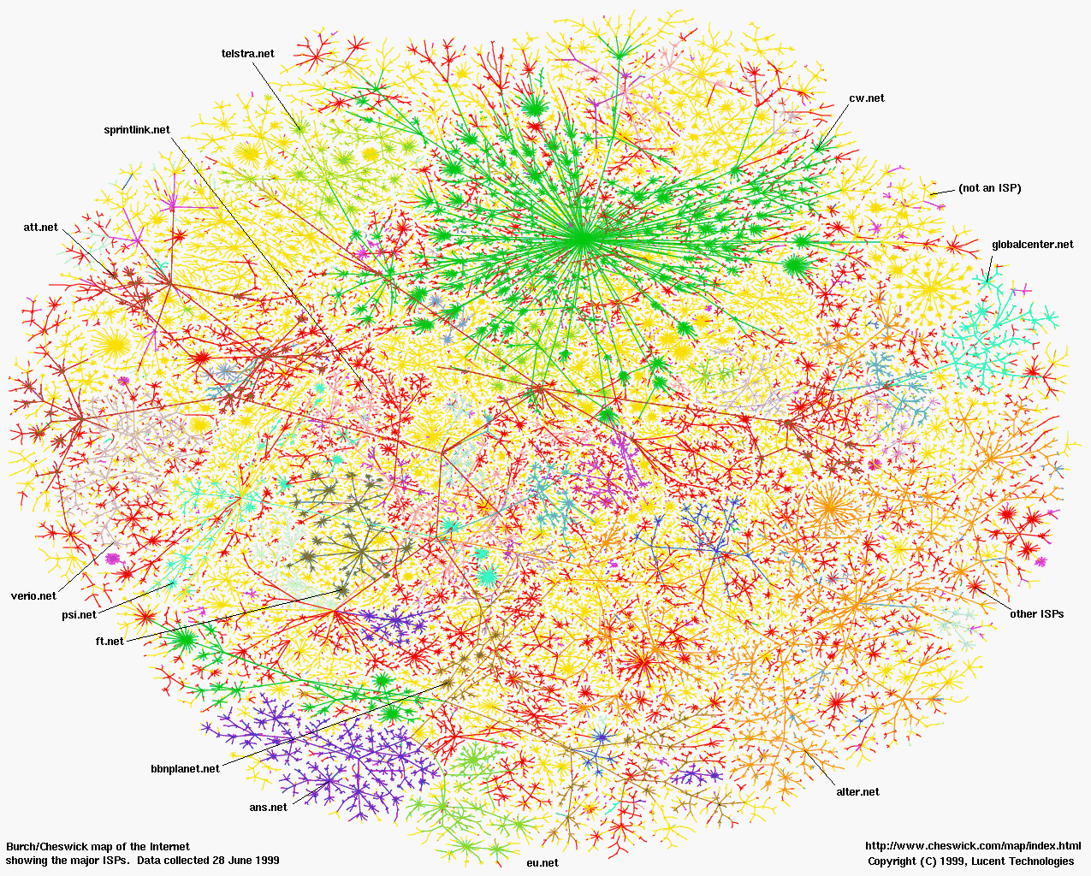

Slide 115
Today’s Internet

Slide 116
Residential access
Driven by networks already in place to the home
Most common
Cable TV lines
Phone lines
Less common
Satellite television
Power lines
Notes:
SATV = 1974, CATV = 1948, Phone = 1890

Slide 117
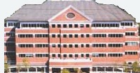
Residential access: cable
Originally one-way distribution
cable headend
cable distribution
network (simplified)
home

Slide 118
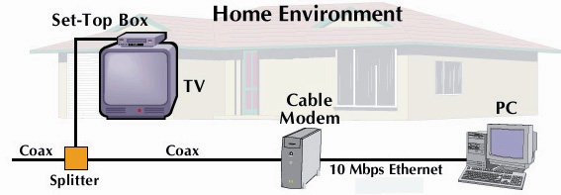
Residential access: cable
cable headend
cable distribution
network (simplified)
home

Slide 119
Residential access: cable
FDM:
C
O
N
T
R
O
L
V
I
D
E
O
V
I
D
E
O
V
I
D
E
O
V
I
D
E
O
V
I
D
E
O
V
I
D
E
O
D
A
T
A
D
A
T
A
1
2
3
4
5
6
7
8
9
Channels
cable headend
cable distribution
network
home

Slide 120
Residential access: cable
Download faster than upload
Noise issues with one source vs. many
cable headend
cable distribution
network
home

Slide 121
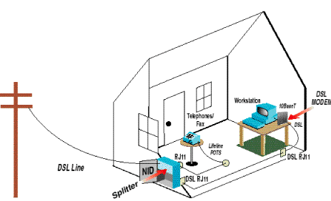
Residential access: DSL

Slide 122
Residential access: DSL
Uses high-frequency spectrum
Data superimposed onto voice using high-frequencies on existing telephone line
Voice transmitted in low-frequency spectrum
Transmissions may disrupt each other
Low-pass filters typically added to protect legacy devices and DSL modems from each other

Slide 123
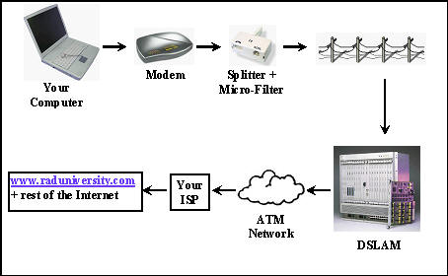
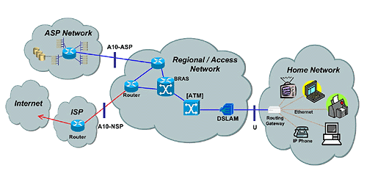
Residential access: DSL

Slide 124
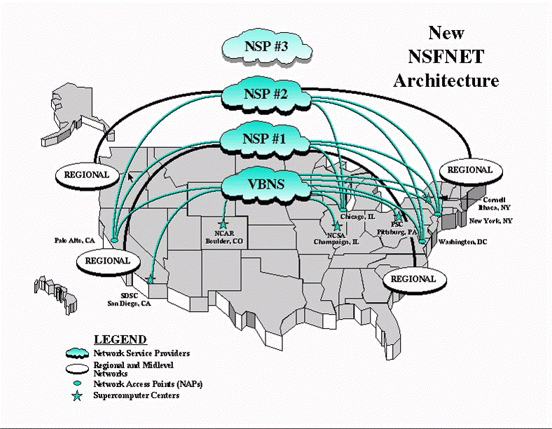
Internet structure: network of networks
Influenced by decommissioning of NSFNet
Academic network connecting NSF’s supercomputing sites
NSF wanted out of the ISP business
Provided peering points for multiple competing commercial ISPs

Slide 125
Internet structure: network of networks
roughly hierarchical
at center: “tier-1” ISPs (e.g., Verizon, Sprint, AT&T, Cable and Wireless), national/international coverage
treat each other as equals
Peers with every other network to reach Internet
Tier-1 providers interconnect (peer) privately
Tier 1 ISP
Tier 1 ISP
Tier 1 ISP

Slide 126
Tier-1 ISP: e.g., Sprint
POP: point-of-presence
to/from backbone
…
peering
….
…
…
…
to/from customers

Slide 127
Internet structure: network of networks
“Tier-2” ISPs: smaller (often regional) ISPs
Peers with some networks, but still purchases IP transit from tier-1 ISP to reach some portion of the Internet
Tier-2 ISPs also peer privately with each other.
Tier-2 ISP pays tier-1 ISP for connectivity to rest of Internet
tier-2 ISP is customer of
tier-1 provider
Tier-2 ISP
Tier-2 ISP
Tier 1 ISP
Tier 1 ISP
Tier 1 ISP
Tier-2 ISP
Tier-2 ISP
Tier-2 ISP

Slide 128
Internet structure: network of networks
“Tier-3” ISPs and local ISPs
last hop (“access”) network (closest to end systems)
solely purchases transit from other networks to reach Internet
local
ISP
Tier 3
ISP
local
ISP
local
ISP
local
ISP
Local and tier- 3 ISPs are customers of
higher tier ISPs
connecting them to rest of Internet
Tier-2 ISP
Tier-2 ISP
Tier 1 ISP
Tier 1 ISP
Tier 1 ISP
Tier-2 ISP
Tier-2 ISP
Tier-2 ISP
local
ISP
local
ISP
local
ISP
local
ISP

Slide 129
Internet structure: network of networks
a packet passes through many networks!
local
ISP
Tier 3
ISP
local
ISP
local
ISP
local
ISP
Tier-2 ISP
Tier-2 ISP
Tier 1 ISP
Tier 1 ISP
Tier 1 ISP
Tier-2 ISP
Tier-2 ISP
Tier-2 ISP
local
ISP
local
ISP
local
ISP
local
ISP

Slide 130
Introduction: Summary
Covered a “ton” of material!
Internet overview
what’s a protocol?
network edge, core, access network
packet-switching versus circuit-switching
Internet/ISP structure
performance: loss, delay
layering and service models
history
You now have:
context, overview, “feel” of networking
more depth, detail to follow!

