Slide 1
Public Key Cryptography and the
RSA Algorithm
Cryptography and Network Security
by William Stallings
Lecture slides by Lawrie Brown
Edited by Dick Steflik

Slide 2
Private-Key Cryptography
traditional private/secret/single key cryptography uses one key
Key is shared by both sender and receiver
if the key is disclosed communications are compromised
also known as symmetric, both parties are equal
  hence does not protect sender from receiver forging a message & claiming is sent by sender
Notes:
So far all the cryptosystems discussed have been private/secret/single key (symmetric) systems. All classical, and modern block and stream ciphers are of this form.

Slide 3
Public-Key Cryptography
probably most significant advance in the 3000 year history of cryptography
uses two keys – a public key and a private key
asymmetric since parties are not equal
uses clever application of number theory concepts to function
complements rather than replaces private key cryptography
Notes:
Will now discuss the radically different public key systems, in which two keys are used. Anyone knowing the public key can encrypt messages or verify signatures, but cannot decrypt messages or create signatures, counter-intuitive though this may seem. It works by the clever use of number theory problems that are easy one way but hard the other. Note that public key schemes are neither more secure than private key (security depends on the key size for both), nor do they replace private key schemes (they are too slow to do so), rather they complement them.

Slide 4
Public-Key Cryptography
public-key/two-key/asymmetric cryptography involves the use of two keys:
  a public-key, which may be known by anybody, and can be used to encrypt messages, and verify signatures
  a private-key, known only to the recipient, used to decrypt messages, and sign (create) signatures
is asymmetric because
  those who encrypt messages or verify signatures cannot decrypt messages or create signatures

Slide 5

Public-Key Cryptography
Notes:
Stallings Fig 9-1.

Slide 6
Why Public-Key Cryptography?
developed to address two key issues:
  key distribution – how to have secure communications in general without having to trust a KDC with your key
  digital signatures – how to verify a message comes intact from the claimed sender
public invention due to Whitfield Diffie & Martin Hellman at Stanford U. in 1976
  known earlier in classified community
Notes:
The idea of public key schemes, and the first practical scheme, which was for key distribution only, was published in 1977 by Diffie & Hellman. The concept had been previously described in a classified report in 1970 by James Ellis (UK CESG) - and subsequently declassified in 1987. See History of Non-secret Encryption (at CESG). Its interesting to note that they discovered RSA first, then Diffie-Hellman, opposite to the order of public discovery!

Slide 7
Public-Key Characteristics
Public-Key algorithms rely on two keys with the characteristics that it is:
  computationally infeasible to find decryption key knowing only algorithm & encryption key
  computationally easy to en/decrypt messages when the relevant (en/decrypt) key is known
  either of the two related keys can be used for encryption, with the other used for decryption (in some schemes)
Notes:
Public key schemes utilise problems that are easy (P type) one way but hard (NP type) the other way, eg exponentiation vs logs, multiplication vs factoring. Consider the following analogy using padlocked boxes: traditional schemes involve the sender putting a message in a box and locking it, sending that to the receiver, and somehow securely also sending them the key to unlock the box. The radical advance in public key schemes was to turn this around, the receiver sends an unlocked box to the sender, who puts the message in the box and locks it (easy - and having locked it cannot get at the message), and sends the locked box to the receiver who can unlock it (also easy), having the key. An attacker would have to pick the lock on the box (hard).

Slide 8

Public-Key Cryptosystems
Notes:
Stallings Fig 9-4.
Here see various components of public-key schemes used for both secrecy and authentication. Note that separate key pairs are used for each of these – receiver owns and creates secrecy keys, sender owns and creates authentication keys.

Slide 9
Public-Key Applications
can classify uses into 3 categories:
  encryption/decryption (provide secrecy)
  digital signatures (provide authentication)
  key exchange (of session keys)
some algorithms are suitable for all uses, others are specific to one

Slide 10
Security of Public Key Schemes
like private key schemes brute force exhaustive search attack is always theoretically possible
but keys used are too large (>512bits)
security relies on a large enough difference in difficulty between easy (en/decrypt) and hard (cryptanalyse) problems
more generally the hard problem is known, its just made too hard to do in practise
requires the use of very large numbers
hence is slow compared to private key schemes
Notes:
Public key schemes are no more or less secure than private key schemes - in both cases the size of the key determines the security. Note also that you can't compare key sizes - a 64-bit private key scheme has very roughly similar security to a 512-bit RSA - both could be broken given sufficient resources. But with public key schemes at least there's usually a firmer theoretical basis for determining the security since its based on well-known and well studied number theory problems.

Slide 11
RSA
by Rivest, Shamir & Adleman of MIT in 1977
best known & widely used public-key scheme
based on exponentiation in a finite (Galois) field over integers modulo a prime
  nb. exponentiation takes O((log n)³) operations (easy)
uses large integers (eg. 1024 bits)
security due to cost of factoring large numbers
  nb. factorization takes O(e ^{log n log log n}) operations (hard)
Notes:
RSA is the best known, and by far the most widely used general public key encryption algorithm.

Slide 12
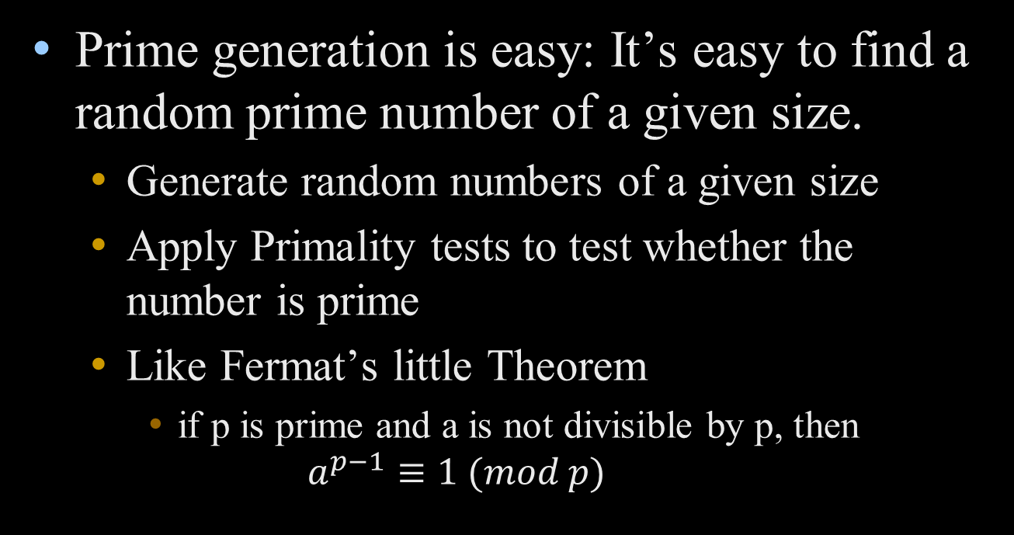
The Maths Behind RSA

Slide 13
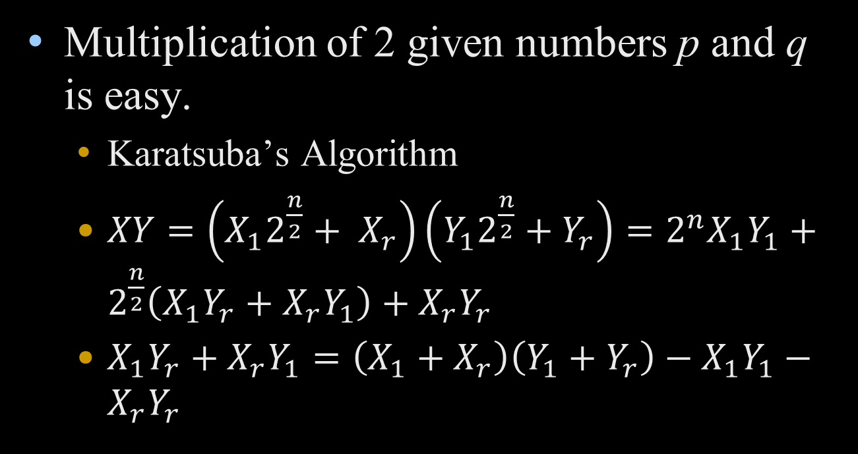
The Maths Behind RSA

Slide 14
The Maths Behind RSA
Factoring is hard: Given an n=pq, it appears to be quite hard to recover the prime factors p and q.
Modular exponentiation is easy: Given n, m, and e, it’s easy to compute c = m^{e} mod n.

Slide 15
RSA Key Setup
each user generates a public/private key pair by:
selecting two large primes at random - p, q
computing their system modulus N=p.q
  note ø(N)=(p-1)(q-1)
selecting at random the encryption key e
    where 1<e<ø(N), gcd(e,ø(N))=1
solve following equation to find decryption key d
  e.d=1 mod ø(N) and 0≤d≤N
publish their public encryption key: KU={e,N}
keep secret private decryption key: KR={d,p,q}
Notes:
This key setup is done once (rarely) when a user establishes (or replaces) their public key. The exponent e is usually fairly small, just must be relatively prime to ø(N). Need to compute its inverse to find d. It is critically important that the private key KR={d,p,q} is kept secret, since if any part becomes known, the system can be broken. Note that different users will have different moduli N.

Slide 16
RSA Use
to encrypt a message M the sender:
  obtains public key of recipient KU={e,N}
  computes: C=Me mod N, where 0≤M<N
to decrypt the ciphertext C the owner:
  uses their private key KR={d,p,q}
  computes: M=C^{d} mod N
note that the message M must be smaller than the modulus N (block if needed)

Slide 17
Why RSA Works
because of Euler's Theorem:
a^{ø(n)}mod N = 1
  where gcd(a,N)=1
in RSA have:
  N=p.q
  ø(N)=(p-1)(q-1)
  carefully chosen e & d to be inverses mod ø(N)
  hence e.d=1+k.ø(N) for some k
hence :
C^{d} = (Me)^{d} = M^{1+k.ø(N)} = M¹.(M^{ø(N)})^{q} = M¹.(1)^{q} = M¹ = M mod N
Notes:
Can show that RSA works as a direct consequence of Euler’s Theorem.

Slide 18
RSA Example
Select primes: p=17 & q=11
Compute n = pq =17×11=187
Compute ø(n)=(p–1)(q-1)=16×10=160
Select e : gcd(e,160)=1; choose e=7
Determine d: de=1 mod 160 and d < 160 Value is d=23 since 23×7=161= 10×160+1
Publish public key KU={7,187}
Keep secret private key KR={23,17,11}
Notes:
Here walk through example using “trivial” sized numbers.
Selecting primes requires the use of primality tests.
Finding d as inverse of e mod ø(n) requires use of Inverse algorithm (see Ch4)

Slide 19
RSA Example cont
sample RSA encryption/decryption is:
given message M = 88 (nb. 88<187)
encryption:
  C = 88⁷ mod 187 = 11
decryption:
  M = 11²³ mod 187 = 88
Notes:
Rather than having to laborious repeatedly multiply, can use the "square and multiply" algorithm with modulo reductions to implement all exponentiations quickly and efficiently (see next).

Slide 20
Exponentiation
can use the Square and Multiply Algorithm
a fast, efficient algorithm for exponentiation
concept is based on repeatedly squaring base
and multiplying in the ones that are needed to compute the result
look at binary representation of exponent
only takes O(log₂ n) multiples for number n
  eg. 7⁵ = 7⁴.7¹ = 3.7 = 10 mod 11
  eg. 3¹²⁹ = 3¹²⁸.3¹ = 5.3 = 4 mod 11

Slide 21
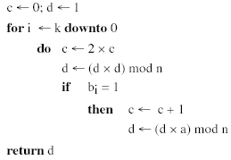
Exponentiation

Slide 22
RSA Key Generation
users of RSA must:
  determine two primes at random - p, q
  select either e or d and compute the other
primes p,q must not be easily derived from modulus N=p.q
  means must be sufficiently large
  typically guess and use probabilistic test
exponents e, d are inverses, so use Inverse algorithm to compute the other
Notes:
Both the prime generation and the derivation of a suitable pair of inverse exponents may involve trying a number of alternatives, but theory shows the number is not large.

Slide 23
RSA Security
three approaches to attacking RSA:
  brute force key search (infeasible given size of numbers)
  mathematical attacks (based on difficulty of computing ø(N), by factoring modulus N)
  timing attacks (on running of decryption)

Slide 24
Factoring Problem
mathematical approach takes 3 forms:
  factor N=p.q, hence find ø(N) and then d
  determine ø(N) directly and find d
  find d directly
currently believe all equivalent to factoring
  have seen slow improvements over the years
    as of Aug-99 best is 130 decimal digits (512) bit with GNFS
  biggest improvement comes from improved algorithm
    cf “Quadratic Sieve” to “Generalized Number Field Sieve”
  barring dramatic breakthrough 1024+ bit RSA secure
    ensure p, q of similar size and matching other constraints
Notes:
See Stallings Table 9-3 for progress in factoring.
Best current algorithm is the “Generalized Number Field Sieve” (GNFS), which replaced the earlier “Quadratic Sieve” in mid-1990’s. Do have an even more powerful and faster algorithm - the “Special Number Field Sieve” (SNFS) which currently only works with numbers of a particular form (not RSA like). However expect it may in future be used with all forms. Numbers of size 1024+ bits look reasonable at present, and the factors should be of similar size

Slide 25
Timing Attacks
developed in mid-1990’s
exploit timing variations in operations
  eg. multiplying by small vs large number
  or IF's varying which instructions executed
infer operand size based on time taken
RSA exploits time taken in exponentiation
countermeasures
  use constant exponentiation time
  add random delays
  blind values used in calculations

Slide 26
Summary
have considered:
  principles of public-key cryptography
  RSA algorithm, implementation, security

