Slide 1


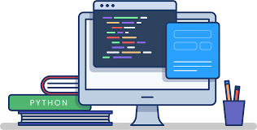
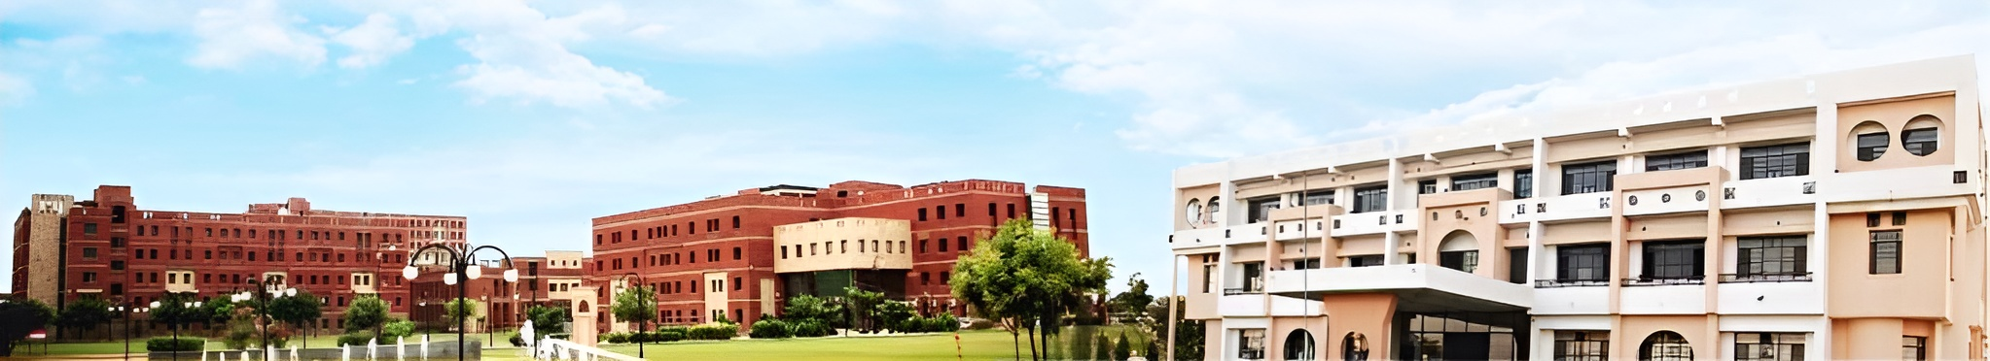
NATIONAL HEALTHCARE HACKATHON
JECRC UNIVERSITY

Slide 2


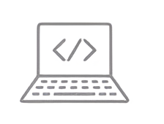

MEET THE TEAM
Team Name : HACK TO HEAL
Team Number : 23
Yash Joshi
B.Tech. CSE
Contact:
📧 yjjoshi2003@gmail.com
📱 +91 9748600721
Arunil Keshri
B.Tech. CSE
Contact:
📧 arunilkeshri03@gmail.com
📱 +91 8690197069
Ayan Raj
MBBS
Contact:
📧 ayan452006@gmail.com
📱 +91 9427349521

Slide 3
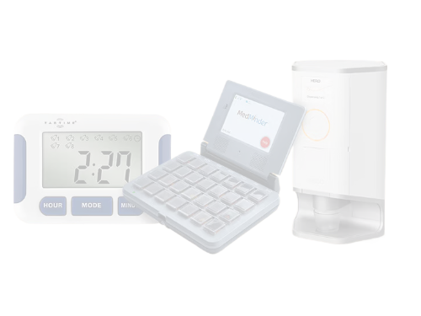
PROBLEM STATEMENT
Number : 23
Title : Innovation of Medicine Dispenser with Voice Reminder for Elderly Patients
Key Objective :
Create an IoT-powered solution to address medication non-adherence in elderly patients.
Use simple automation and human-centered design principles for effective medication reminders.
Improve patient independence and reduce caregiver dependency.
Enhance healthcare outcomes by ensuring timely medication intake.

Slide 4
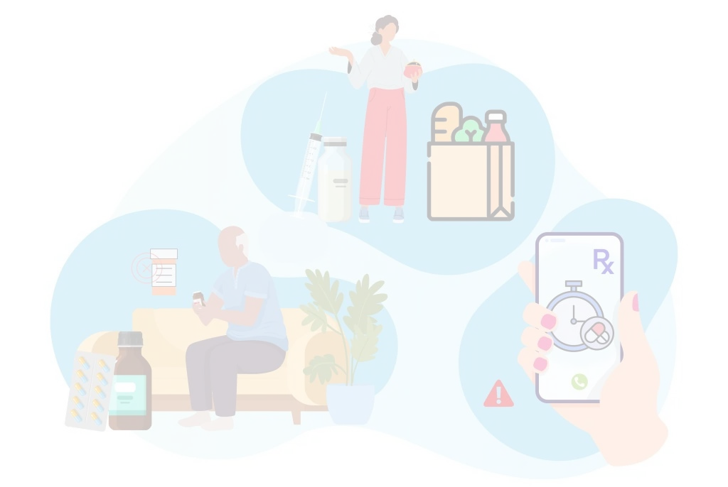
PROBLEM UNDERSTANDING
Medication non-adherence is a significant challenge in healthcare, particularly among elderly patients.
Over 50% of elderly individuals fail to follow prescribed medication schedules, leading to worsened health conditions and increased hospitalizations.
Caregiver dependency for reminders adds pressure, especially in resource-limited settings.
This problem not only affects patients’ health but also drives up healthcare costs and reduces overall quality of life.

Slide 5

SmartMed
Smart Medicine Dispenser with Voice Reminder
Key Features and Functionalities :
Scheduled Reminders : LED & voice alerts for timely medication.
Acknowledgment Button : Confirm medication and log data.
Customizable Schedule : Tailored to individual needs.
Voice System : Adjustable volume & language for accessibility.
Remote Monitoring : Syncs with app for caregiver tracking.
Simple Interface : Easy-to-use buttons for elderly users.

Slide 6
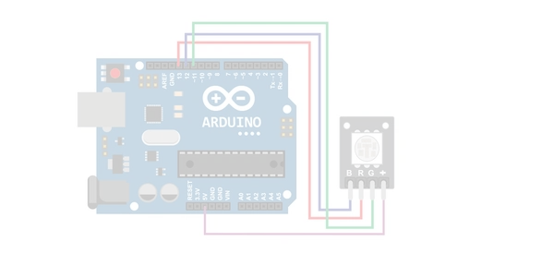
Tech-driven Approach
Core Technologies
ESP32 Microcontroller : Powers scheduling, LED control, and voice alerts.
RTC Module (DS3231) : Ensures precise, time-based medication reminders.
LED & Speaker System : Multi-sensory cues for enhanced visibility and accessibility.
Mobile/Web App : Enables remote tracking of medication adherence.
Arduino IDE : Seamless programming and device control.
Methodology
Multi-Sensory Alerts: Combining LED and voice for clear reminders.
Real-Time Data Logging: Tracks intake for caregivers' reference.
Adherence Monitoring: Automated notifications for missed doses.
User-Centric Design Testing: Ensures accessibility for elderly users.

Slide 7

INNOVATION & UNIQUENESS
Multi-Sensory Reminders: Voice modulation + LED alerts for seamless adherence.
Customizable Alerts: Adjustable tone, volume, and language options.
Data-Driven Monitoring: Logs reminders and actions for tracking and intervention.
Elderly-Friendly Design: Large buttons, simple setup, and intuitive operation.
Cost-Effective & Scalable: Ideal for homes, hospitals, and rural healthcare setups.

Slide 8
Implementation Approach
Step-by-Step Development Plan :
Component Integration: Assemble ESP32, RTC module, LEDs, speaker, and acknowledgment button.
Core Programming: Schedule reminders, sync LED and voice alerts, and program acknowledgment functionality.
Testing: Test with real-world scenarios to refine accuracy and reliability.
Feedback Loop: Usability testing with elderly users to improve design accessibility.
Final Prototype: Develop a compact, robust system for deployment.

Slide 9

Implementation Approach
Real-World Feasibility:
Hospital Application: Ideal for ward-level or patient-specific medication management.
Home Settings: Accessible and affordable for independent elderly patients.
Scalability: Modular design for multiple patients or healthcare facilities.
Anticipated Challenges & Solutions:
Technical Issues: Use high-quality components and extensive testing to ensure reliability.
Accessibility: Optimize interface for non-tech-savvy users with simpler design.
Cost Management: Focus on affordable hardware while maintaining functionality.
Adoption Resistance: Demonstrate ease of use and benefits through demos and training.

Slide 10
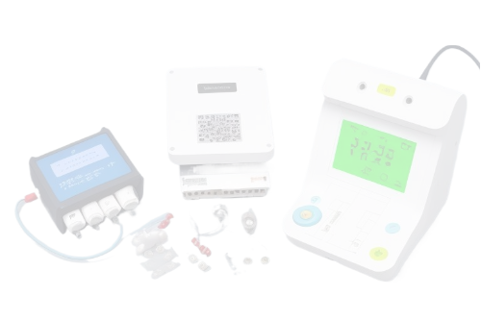
Expected Outcomes And Impact
For Patients: Ensures timely medication, improving health outcomes and independence.
For Caregivers/Attendants: Reduces burden through automated reminders and adherence tracking.
For Doctors: Provides reliable data on medication adherence for better treatment decisions.
For Hospitals: Lowers readmissions and enhances patient care efficiency.
For Nursing Staff: Minimizes manual intervention, enabling focus on critical care tasks.
Overall, promotes better healthcare accessibility and cost-effectiveness.

