Slide 1

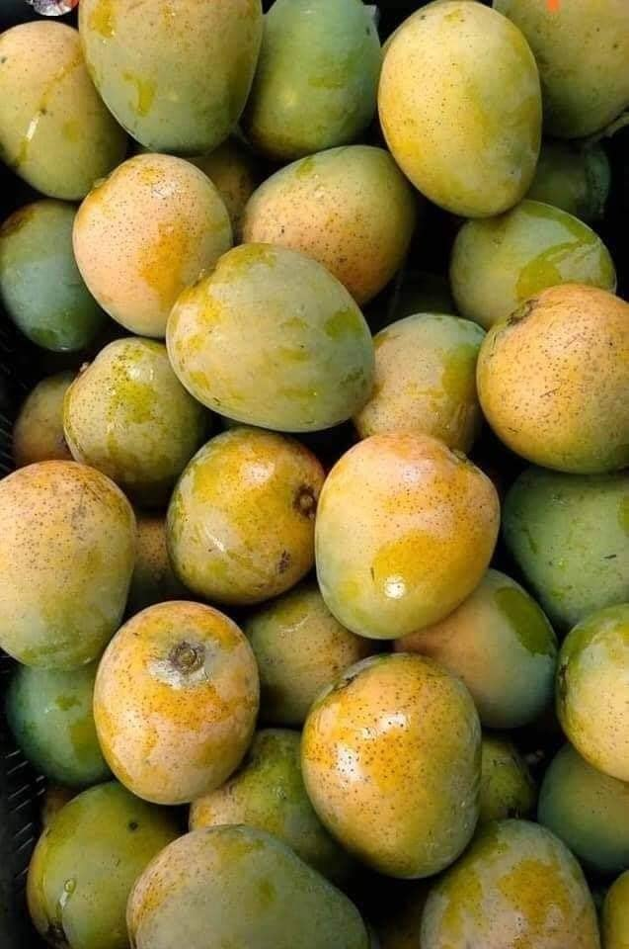
A profitable Himsagar mango pilot for Hyderabad
Kolkata Himsagar Mango | Nizampet + Gachibowli opportunity for bigbasket
Analytics-led launch proposal
Prepared by
Arunima Nandi Pal
Freelance MBA — Analytics & Data Science
Target outcome: prove a high-margin, low-risk seasonal category expansion that can earn a recruiter call.

Slide 2
Why Himsagar in Hyderabad is a smart pilot
A premium Bengali mango with a clear diaspora hook and broader premium-fruit appeal.
1
Ethnic demand base
Nizampet + Gachibowli have concentrated east-Indian and tech migrant households; Bengali users are likely to convert at higher intent.
2
Premium differentiation
Himsagar is a GI-tagged Bengal cultivar, known for aroma, fibre-free pulp, and short-season scarcity.
3
Supply-chain fit
bigbasket can test using a 2,500 kg controlled batch before scaling to 20,000–25,000 kg seasonal demand.
20,000–25,000 kg
₹1.4 lakh
₹300–₹320/kg
Seasonal demand estimate
Pilot contribution estimate
Retail price band
Prepared by Arunima Nandi Pal | Freelance MBA Analytics & Data Science
02

Slide 3
Market sizing: two demand engines
Demand is split between “homesick Bengali households” and premium non-Bengali discovery.
Arunima Nandi Pal
User funnel — target micro-markets
Demand build-up
Local population
5.0 lakh
Likely app users
1.4 lakh
Bengali app users
0.26 lakh
Premium non-Bengali users
1.10 lakh
Modeled using population, app penetration and segment shares from the source deck.
Assumption check: only 10% non-Bengali conversion already produces ~13,200 kg, making it the key upside lever.
Prepared by Arunima Nandi Pal | Freelance MBA Analytics & Data Science
03

Slide 4
Unit economics: high gross margin even with blended sourcing
Standardized to ₹/kg and Indian currency notation.
Arunima Nandi Pal
₹310/kg
Revenue price
₹181/kg
Blended procurement cost
~₹57/kg
Contribution after ops*
*After 8% wastage, ₹35/kg logistics/packing and pilot marketing allocation. Recommendation: sell as a limited Kolkata Himsagar SKU, not a commodity mango SKU.
Prepared by Arunima Nandi Pal | Freelance MBA Analytics & Data Science
04

Slide 5
Pilot P&L: 2,500 kg launch batch
Wastage is handled by reducing sellable kg; it is not double-counted as a separate cost.
Arunima Nandi Pal
Profit & Loss Statement
Purchased quantity
2,500 kg
Full batch sourced for pilot
Sellable quantity after 8% wastage
2,300 kg
2,500 kg × 92%
Revenue
₹7.13 lakh
2,300 kg × ₹310/kg
Arunima Nandi Pal
Procurement cost
₹4.53 lakh
2,500 kg × ₹181/kg
Logistics + packaging
₹0.88 lakh
2,500 kg × ₹35/kg
Launch marketing allocation
₹0.30 lakh
App banner + push test
Predicted pilot profit
₹1.43 lakh
Revenue − total cost
P&L conclusion: the pilot remains positive even after wastage and fulfilment costs because the ₹310/kg premium price leaves enough margin room.
Prepared by Arunima Nandi Pal | Freelance MBA Analytics & Data Science
05

Slide 6
Predicted profit of the Himsagar pilot and scale-up
Scenario graph uses kg-based volume, 8% wastage, ₹310/kg selling price, ₹181/kg procurement, and ₹35/kg logistics/packing.
Arunima Nandi Pal
₹1.43 lakh
Pilot profit
₹15.13 lakh
Arunima Nandi Pal
25,000 kg profit
~₹57–₹61/kg
Profit per purchased kg
Scale decision: start with 2,500 kg; scale only if conversion ≥12%, repeat rate ≥25%, and wastage stays under 8%.
Prepared by Arunima Nandi Pal | Freelance MBA Analytics & Data Science
06

Slide 7
Go-to-market: ethnic precision + premium discovery
Low-cost targeting via mango buyers, fish buyers, and premium basket cohorts.
Bengali trigger
“Miss Kolkata mango? Himsagar is back.”
Push: 6–9 PM, Friday–Sunday
Premium discovery
“Fibre-free, aromatic GI-tagged Bengal mango.”
App banner + search boost
Family basket
2 kg + 3 kg packs with fish/sweets recommendations
Combo offer + limited stock badge
Creative principle: present the SKU as a short-season cultural delicacy, not just another mango.
Prepared by Arunima Nandi Pal | Freelance MBA Analytics & Data Science
07

Slide 8
Operations dashboard: control conversion, repeat, and waste
Run the pilot as a measurable analytics experiment.
Arunima Nandi Pal
Decision rules
12%
25%
8%
Scale to 10,000 kg
If conversion >12% and wastage <8% by day 5
Conversion target
Repeat target
Wastage max
Hold price
If repeat purchases exceed 25% by day 10
Discount exit
If ripeness risk rises after day 4 in inventory
Track daily cohort metrics: views → add-to-cart → conversion → repeat → returns → wastage.
Prepared by Arunima Nandi Pal | Freelance MBA Analytics & Data Science
08

Slide 9
What bigbasket gains from approving the pilot
A quick, data-backed category experiment with a clear learning loop.
Incremental seasonal revenue
Recruitable analytics signal
₹57.04–₹71.30 lakh at 20,000–25,000 kg purchased volume
Shows cohort targeting, SKU pricing, and operations KPIs in one experiment
Lower downside
Brand upside
Start with 2,500 kg, cap wastage, expand only on measured conversion
Regional delicacy positioning helps bigbasket own “authentic seasonal produce”
Ask: Approve a 2,500 kg pilot for Nizampet + Gachibowli, with a 14-day KPI readout.
Prepared by Arunima Nandi Pal | Freelance MBA Analytics & Data Science
09

Slide 10
Data sources, records & assumptions
External records support the opportunity; exact Bengali user data is modeled and should be validated with bigbasket first-party data.
Provided source deck
Base assumptions on Nizampet + Gachibowli population, app penetration, conversion, order sizes, sourcing costs and original profit range.
Census 2011 / Govt. population releases
Hyderabad population base used to contextualize metro demand and migration-led ethnic micro-markets.
GI Registry / Govt. of West Bengal
Malda Khirsapati (Himsagar) Mango is a registered GI product, supporting premium authenticity positioning.
Reuters, 2025 / Bain-Flipkart report coverage
India quick-commerce/e-grocery demand continues to expand, creating room for local seasonal premium SKUs.
Retail and mandi sanity checks
Premium Himsagar retail pricing and mango market price bands should be replaced with live supplier quotes before purchase order.
Model caveat: No exact public Bengali population or bigbasket cohort data is available. Proposal uses transparent assumptions and recommends validation through first-party user cohorts.
Prepared by Arunima Nandi Pal | Freelance MBA Analytics & Data Science
10

