Slide 1
MICRO PROJECT
Free and Open Source Software Lab

Slide 2
Team Members
Arunima Raj B – Roll no:29
Arya Babu M.B – Roll no:30
Ashil Sathyanath – Roll no:31
Aswin T Anil – Roll no:32

Slide 3
Shell programming
A shell script is a computer program designed to be run by the Unix shell , a command-line interpreter.] The various dialects of shell scripts are considered to be scripting languages. Typical operations performed by shell scripts include file manipulation, program execution, and printing text. A script which sets up the environment, runs the program, and does any necessary cleanup, logging, etc. is called a wrapper.
The term is also used more generally to mean the automated mode of running an operating system shell; in specific operating systems they are called other things such as batch files (MSDos-Win95 stream, OS/2), command procedures (VMS), and shell scripts (Windows NT stream and third-party derivatives like 4NTarticle is at cmd.exe), and mainframe operating systems are associated with a number of terms.

Slide 4
If you are using any major operating system you are indirectly interacting to shell. If you are running Ubuntu, Linux Mint or any other Linux distribution, you are interacting to shell every time you use terminal. In this article I will discuss about Linux shells and shell scripting so before understanding shell scripting we have to get familiar with following terminologies –
#Kernel #Shell #Terminal
What is Shell? A shell is special user program which provide an interface to user to use operating system services. Shell accept human readable commands from user and convert them into something which kernel can understand. It is a command language interpreter that execute commands read from input devices such as keyboards or from files. The shell gets started when the user logs in or start the terminal.
Shell is broadly classified into two categories –
Command Line Shell
Graphical shell
Command Line Shell Shell can be accessed by user using a command line interface. A special program called Terminal in linux/macOS or Command Prompt in Windows OS is provided to type in the human readable commands such as “cat”, “ls” etc. and then it is being execute. The result is then displayed on the terminal to the user.
Graphical Shells Graphical shells provide means for manipulating programs based on graphical user interface (GUI), by allowing for operations such as opening, closing, moving and resizing windows, as well as switching focus between windows. Window OS or Ubuntu OS can be considered as good example which provide GUI to user for interacting with program. User do not need to type in command for every actions.

Slide 5
Shell Scripting
Usually shells are interactive that mean, they accept command as input from users and execute them. However some time we want to execute a bunch of commands routinely, so we have type in all commands each time in terminal. As shell can also take commands as input from file we can write these commands in a file and can execute them in shell to avoid this repetitive work. These files are called Shell Scripts or Shell Programs. Shell scripts are similar to the batch file in MS-DOS. Each shell script is saved with .sh file extension.
A shell script have syntax just like any other programming language. If you have any prior experience with any programming language like Python, C/C++ etc. it would be very easy to get started with it. A shell script comprises following elements –
Shell Keywords – if, else, break etc.
Shell commands – cd, ls, echo, pwd, touch etc.
Functions
Control flow – if..then..else, case and shell loops etc.
There are many reasons to write shell scripts –
To avoid repetitive work and automation
System admins use shell scripting for routine backups
System monitoring
Adding new functionality to the shell etc.
Advantages of shell scripts
The command and syntax are exactly the same as those directly entered in command line, so programmer do not need to switch to entirely different syntax
Writing shell scripts are much quicker
Quick start
Interactive debugging etc.

Slide 6
Py-Qt
PyQt is a set of Python v2 and v3 bindings for The Qt Company's Qt application framework and runs on all platforms supported by Qt including Windows, OS X, Linux, iOS and Android. PyQt5 supports Qt v5. PyQt4 supports Qt v4 and will build against Qt v5. The bindings are implemented as a set of Python modules and contain over 1,000 classes.
PyQt4 and Qt v4 are no longer supported and no new releases will be made. PyQt5 and Qt v5 are strongly recommended for all new development.
PyQt is dual licensed on all supported platforms under the GNU GPL v3 and the Riverbank Commercial License. Unlike Qt, PyQt is not available under the LGPL. You can purchase the commercial version of PyQt here. More information about licensing can be found in the License FAQ.
PyQt does not include a copy of Qt. You must obtain a correctly licensed copy of Qt yourself. However, binary wheels of the GPL version of PyQt5 are provided and these include a copy of the LGPL version of Qt.
PyQt brings together the Qt C++ cross-platform application framework and the cross-platform interpreted language Python.
Qt is more than a GUI toolkit. It includes abstractions of network sockets, threads, Unicode, regular expressions, SQL databases, SVG, OpenGL, XML, a fully functional web browser, a help system, a multimedia framework, as well as a rich collection of GUI widgets.
Qt classes employ a signal/slot mechanism for communicating between objects that is type safe but loosely coupled making it easy to create re-usable software components.
Qt also includes Qt Designer, a graphical user interface designer. PyQt is able to generate Python code from Qt Designer. It is also possible to add new GUI controls written in Python to Qt Designer.
Python is a simple but powerful object-orientated language. Its simplicity makes it easy to learn, but its power means that large and complex applications can be created. Its interpreted nature means that Python programmers are very productive because there is no edit/compile/link/run development cycle.
PyQt combines all the advantages of Qt and Python. A programmer has all the power of Qt, but is able to exploit it with the simplicity of Python.

Slide 7
To print the currently loaded kernal modules.
import sys
import subprocess
from PyQt5 import QtCore, QtGui, QtWidgets
from PyQt5.QtWidgets import QMainWindow, QAction, QMenu, QApplication,QTextEdit
class Example(QMainWindow):
def __init__(self):
super().__init__()
self.initUI()
def initUI(self):
menubar = self.menuBar()
fileMenu = menubar.addMenu('Show')
impMenu = QMenu('Kernel Modules', self)
impAct = QAction('Currently Loaded', self)
impMenu.addAction(impAct)
impAct.triggered.connect(self.moDule)
fileMenu.addMenu(impMenu)
self.textbox = QTextEdit(self)
self.textbox.move(25, 20)
self.textbox.resize(750,600)
self.setGeometry(800, 800, 800, 800)
self.setWindowTitle('Shell Program')
self.show()
def moDule(self):
p1 = subprocess.run('lsmod', stdout=subprocess.PIPE)
self.textbox.moveCursor(QtGui.QTextCursor.End)
self.textbox.insertPlainText(p1.stdout.decode())
if __name__ == '__main__':
app = QApplication(sys.argv)
ex = Example()
sys.exit(app.exec_())

Slide 8
GUI OUTLOOK

Slide 9
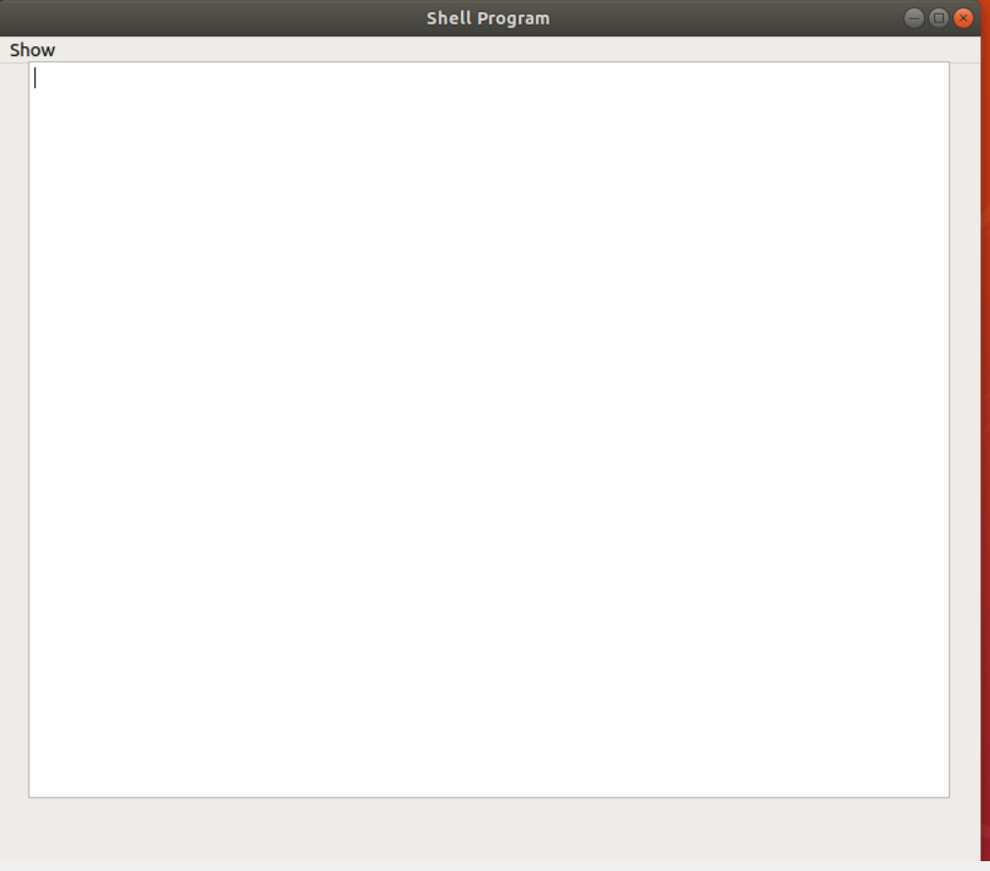

Slide 10
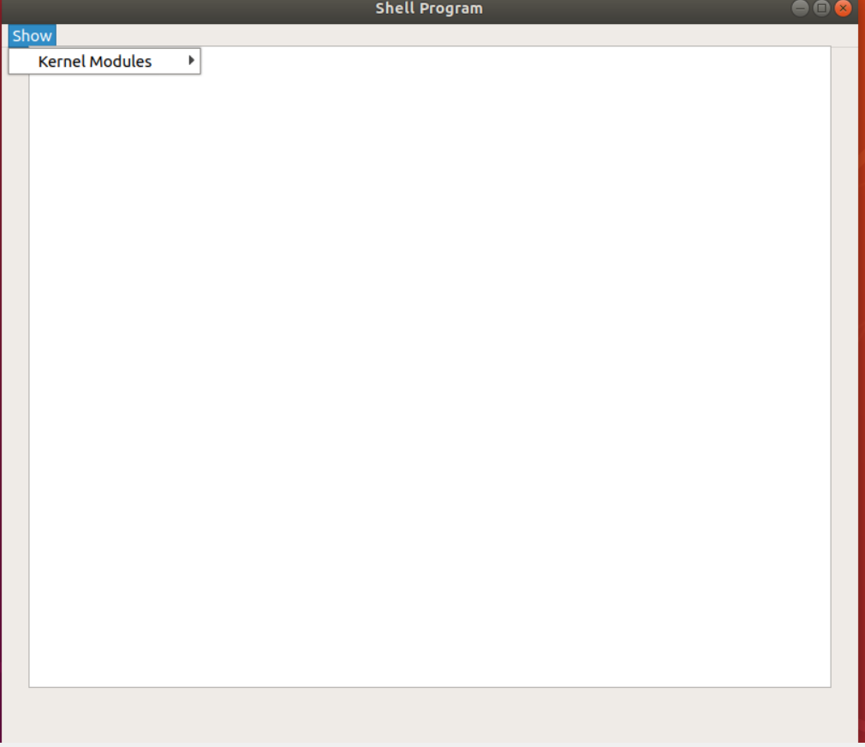

Slide 11
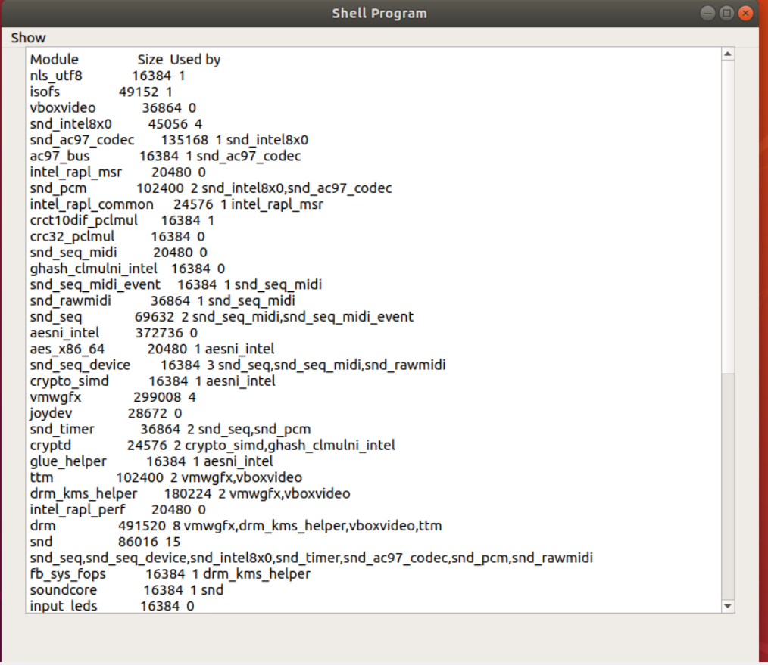

Slide 12
THANK YOU

