Slide 1
WATER FLOW MONITORING IN SMART CITIES
Submitted by,
Arunima V S
Arya M R
Lekshmi V
Ameena M

Slide 2
CONTENTS
Introduction
Literature Survey
Goals and Objectives
Advantages
Existing System
Proposed System
Module Description
Hardware Connections
Web Page
Demonstration

Slide 3
INTRODUCTION
Pipeline connections are subjected to cracks and leakage of water through these pipelines are a major source of loss for the government as of today.
A device which can provide a flow monitoring mechanism and detect the leakage of water supply is of great significance.
The project aims at developing a flow monitoring mechanism for the municipality pipelines.
The product will be attached nearer to the check valves of pipeline to measure the flow rate along the valve using sensor modules. Flow rate is updated to cloud time to time.

Slide 4
Any considerable variation in flow rate makes the leakage of water supply evident which is notified on to the nearest water authority office via web application.
The product attaches a leakage detecting module along the sides of pipeline to detect any leakage and thereby updates the server if any considerable amount of water got leaked.
Water authority can also check for the leakage point with the help of leakage module to get the possible point of leakage in the pipeline and the nearest check valve to the leakage point.
The authorities can also actuate to automate the check valves to do for closing it whenever required.

Slide 5
Sensors are placed near check valves of which the outputs are given to the microcontroller system which detects the water level and flow rate of water.
Leakage detecting module are also attached along the pipeline to detect the presence of any leakage.
Electrodes are used along with moisture sensors so that the municipal water gets uniquely identified.
The outputs are fetched by the microcontroller system which then pushes this information onto the cloud using an ESP module.
The information is extremely useful as the location of the damage can easily be identified.
A web server is constantly updated with the information about the water distribution along each check valves.

Slide 6
The web server contains the location, flow rate and position of the valve.
Whenever any considerable change in flow rate is detected, the authorities are immediately notified through a web application and the rest of the details are to be fetched from the web server.

Slide 7
LITERATURE SURVEY
Leaks waste both a precious natural resource and money.
A large percentage of water usually is lost from the distribution systems in transit from the treatment plant to the consumer. According to an inquiry made in 1991 by the International Water Supply Association (IWSA), the amount of lost or unaccounted for water is typically 20 to 30 percent of total water production.
Leaky pipes also create a public health risk, as every leak is a potential entry point for contaminants if pressure should drop in the system. Economic cost and scarcity of public water sources mandate that a systemic leakage control program be developed.
Water audits measure water flow into and out of the distribution system, or parts of it, and to help identify those parts of the distribution system that have excessive leakage.

Slide 8
Biological Methods: Experienced personnel or trained dogs may detect and locate leaks by visual inspection, order or sound.
Hardware-Based Methods: Different hardware devices are used to assist in the detection and location of leaks. Typical devices used include acoustic sensors, gas detectors, negative pressure detectors and infrared thermography.
Software–Based Methods: Various computer software packages are used to detect leaks in a pipeline. The complexity and reliability of these packages vary significantly. Examples of these methods are flow/pressure change detection, mass/volume balance, the dynamic model-based system, and pressure point analysis.
Acoustic equipment (a Hardware-Based method) is the most used among the leak detection methods. In general, it has a fair percentage of success in metal pipes, however, the effectiveness of this traditional method for plastic pipes is limited. The equipment was developed primarily for metal pipes, however the acoustical characteristics of leak signals in plastic pipes are not as pronounced as in metal pipes.

Slide 9
Detection of fluid loss due to leakage from underground distribution pipes represents a major challenge to scientists and engineers. The key to the solution is threefold: selection of the right combination of sensing equipment, proper adaptation of procedure for each field operation, and data analysis.

Slide 10
GOALS AND OBJECTIVES
Monitors the quantity of water flow and thereby determines the
possibility of existence of leakage at the earliest as possible.
Informs the concerned authorities about leakage such that the
malfunction can be rectified without delay.
Point out the exact point of leakage which helps to save tons of water
from being wasted through leakage.
The leakage can be controlled to a great extent as the valves are
automated.

Slide 11
ADVANTAGES
Enables real time municipality pipeline leakage detection
Check valve automation enables flow control.
Reduce the tedious time consuming work of manual closing underground check valve which affects the public conveyance as well.
Maintaining a well developed data server that can be efficiently used to give a track of pipeline path.
The exact tracking of the pipelines along with the check valves bring into notice, the precise location of the leakage.

Slide 12
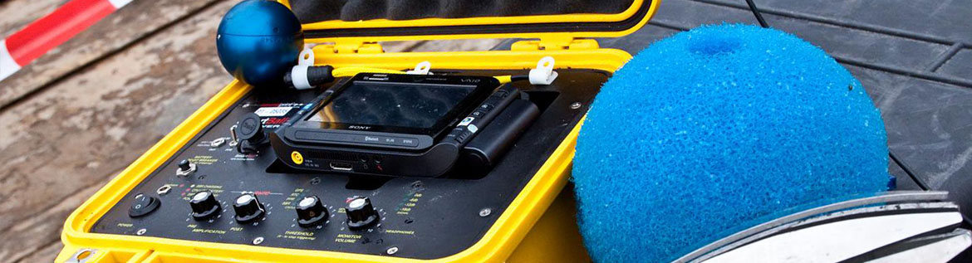
EXISTING SYSTEM
1.Smart Ball
Smart Ball is a free-swimming acoustic leak detector capable of detecting very small leaks. The cost of one such ball is about Rs. 6.5 lakhs and has a spongy texture with a diameter of about 150 mm.
It can be used only in pipelines that are not less than 350 mm in diameter . Smart Ball will be inserted only after the successful insertion and retrieval of a dummy ball at the marked points.
The disadvantages of the system include :
Inability to pinpoint the leak location, and the high rate of false alarms. These systems are also very expensive for monitoring a large network of pipes

Slide 13

2.Sahara Pipeline Inspection System.
The Sahara system is inserted into a live pipeline through a clear bore tapping with a minimum diameter of 1-7/8 inches. The insertion assembly is attached to a 2-inch full port valve with a 2-inch female NPT connection.
The sensor is propelled by the flow of water using a drag chute that carries the tethered sensor head through the pipeline for distances up to 6,000 feet per insertion as the data cable is unreeled from the cable drum. Common entry points include existing air valves or gauging points (flow/meter taps).

Slide 14
PROPOSED SYSTEM
1. Sensor Module
2. Hardware Implementations
3.Software Specification
4. IoT communication and computation
5. Actuation

Slide 15
MODULE DESCRIPTION
1) Sensor Module
The system aims to check the amount of water flowing in between two check valves.
The water flow from the main pipe will be at a constant rate that any considerable change in flow rate from one valve to the next makes it evident about the water leakage.
Leakage detecting sensors are attached to the pipe in between the check valves to detect any considerable amount of leakage and to ensure presence of municipal water and thereby confirming the leakage.

Slide 16
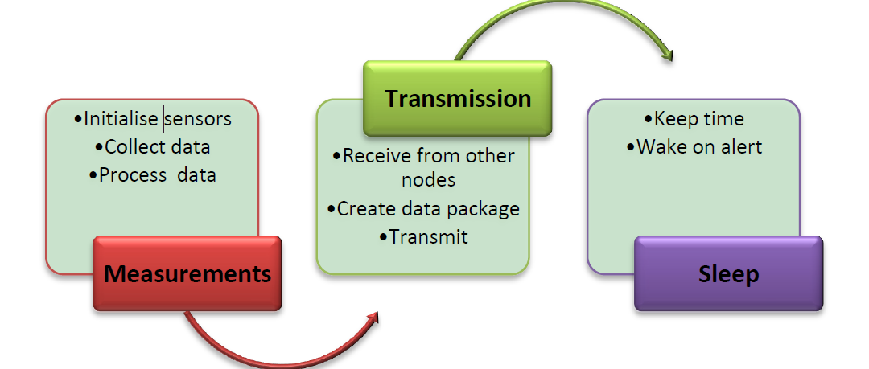
We use flow meters to check the amount of water flow, moisture detecting sensors to detect the presence of water, electrodes to confirm the leakage of municipal water.

Slide 17
2) Hardware implementations
All sensor modules are connected to the microcontroller. Controller detects the amount of water flowing in between the check valves and the water flow rate at each check point which is updated onto the cloud from time to time.
Sensor modules attached to different points of pipe detect any moisture content on the pipe. If any moisture content is detected, the electrodes identify the presence of water and any considerable amount of leakage is pushed onto the cloud for further analysis.
To check the presence of municipal water, we use the time delay mechanism which detects if the water content is due to rain or not.

Slide 18
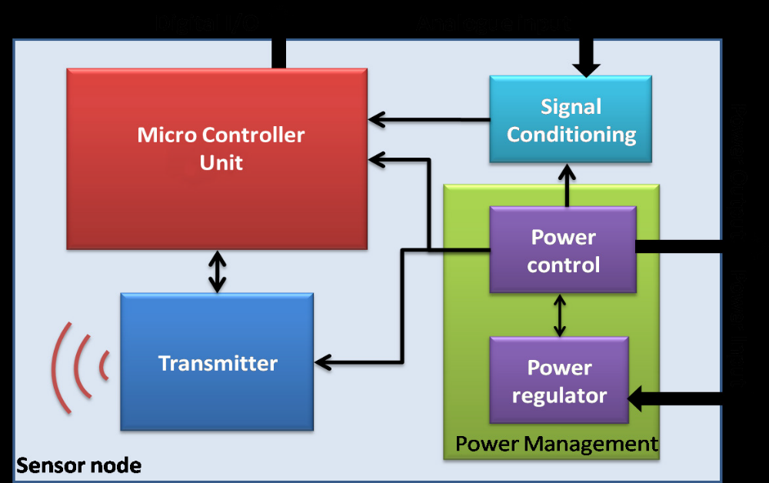

Slide 19
3.Communication and computation
All the data from the hardware is pushed on to a cloud with the help of ESP module.
The data in cloud is retrieved to compute overall performance of pipeline at various check points.
The server is already updated with the name of leakage detecting modules attached to several points of pipe and also the distance of each sensor module from the check valves using an NRF module consisting of 2 transmitters and 1 receiver.
Water will be flowing at a constant rate from the main pipe which is initially noted down by the primary stakeholder and is updated onto the database.
The amount of water that reaches the second check valve is considered and compared with initial flow rate which when is noted to be decreased proves the evident presence of a leakage.

Slide 20
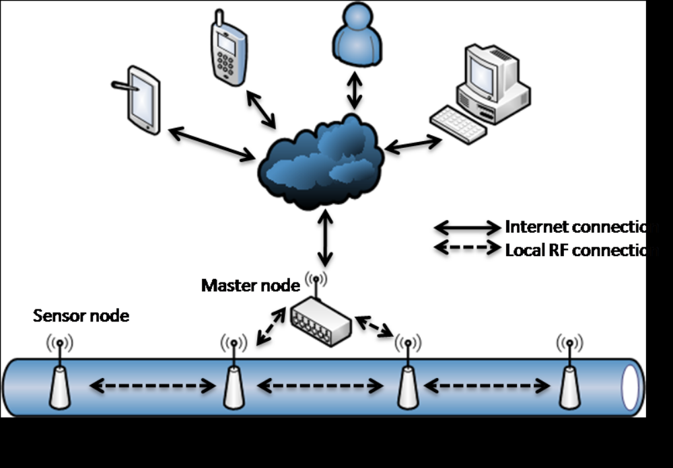
Further the values in the cloud updated from sensor module attached to the points of pipe is checked to detect the leakage point.

Slide 21
4) Actuation
It enables the automation of the check valve nearest to the sensor module that detects the leakage.
When a leakage is detected and if it is above a threshold value, then there is a need to close down the nearest check valve for the work and for avoiding the water wastage.
Since the check valve gets closed when there is an intense leakage, the wastage is optimized.
This part also enables flow control so that the amount of water flowing through a particular check valve can be automated and controlled as per the requirements.

Slide 22
HARDWARE CONNECTION
The system contains three sections :
Wireless Transmission Module -1
The transmitter block collects the sensor values and send it to the reception module over an NRF module.
The main parts in the transmitter section are
UNO board
Power Transformer
NRF Module (Transmitter)

Slide 23
2) Wireless Transmission Module - 2
The main parts in the transmitter section are
Arduino Atmega-2560
NRF Module (Transmitter)
3) Wireless Reception Module (Internet-enabled)
This reception module receives sensor data through NRF module and sends it to cloud.
This block contains parts such as
Arduino Uno
NRF module (reception)
ESP module

Slide 24
WEB PAGE
http://www.smartnodes.in/wm is the webpage created for water flow monitoring in smart cities.
The webpage consists of the check valve points along with its location and the information about the leakage.
It also consists of the amount of flow through the check valve.
The automation of the check valve can be done if there is a leakage.

Slide 25
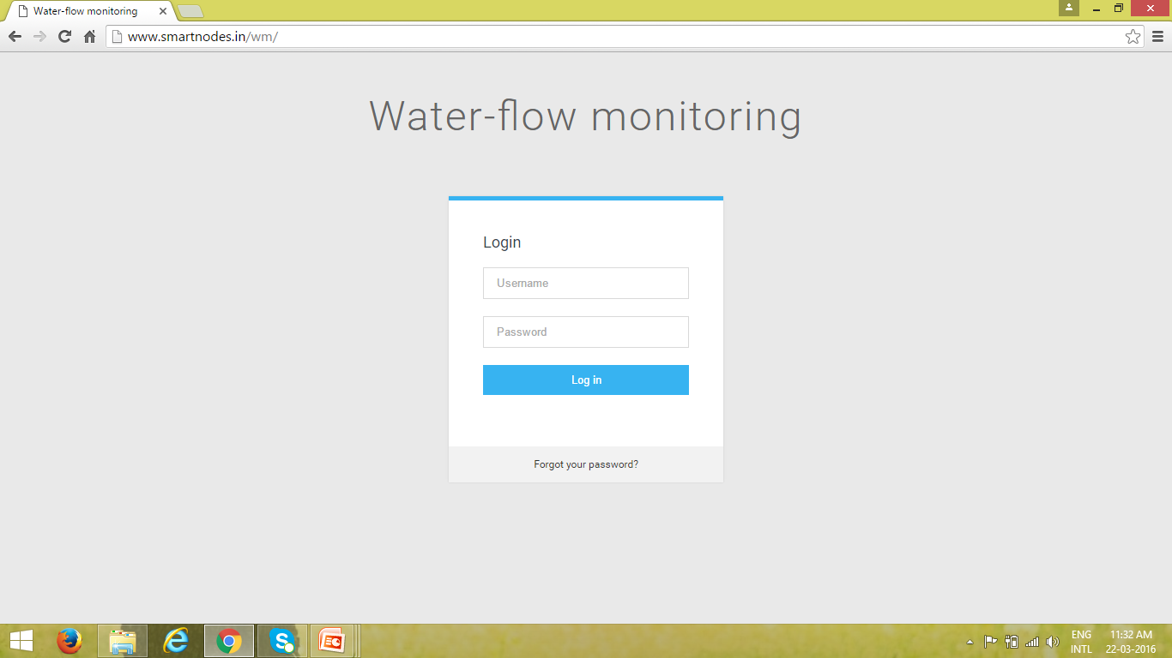
LOGIN PAGE

Slide 26
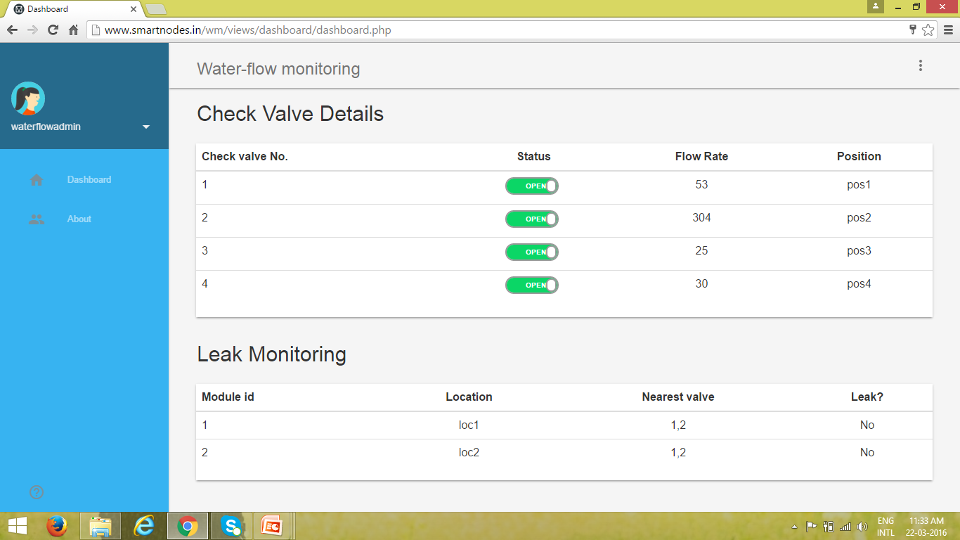
DASHBOARD

Slide 27
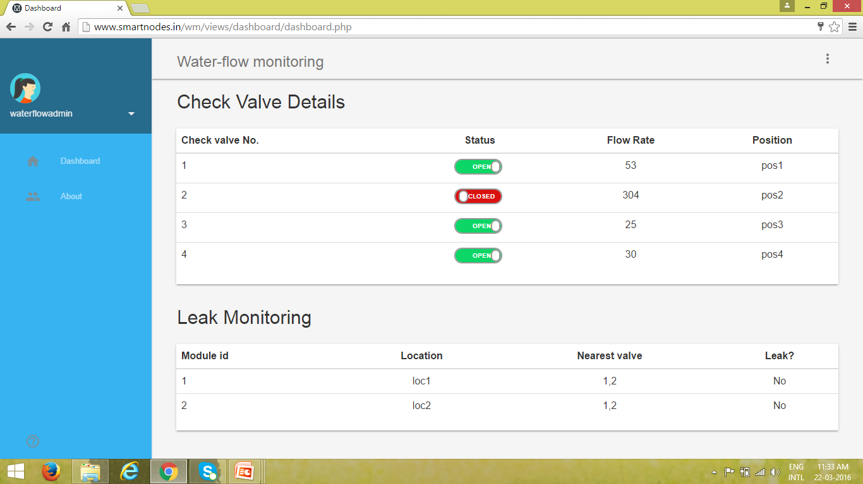
AUTOMATION

