Slide 1
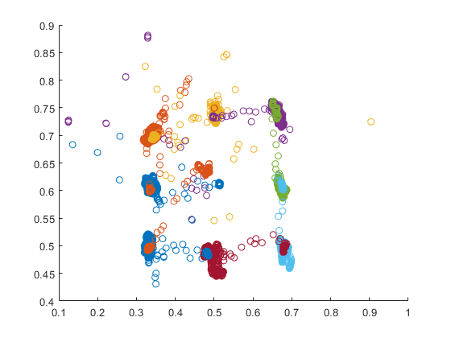
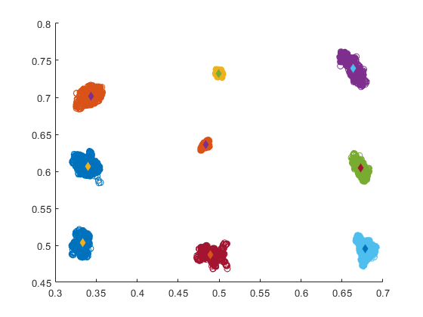
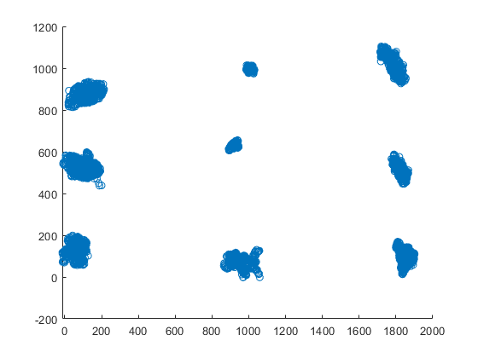
Gaze Calibration
Unfiltered raw gaze data as recorded
Filtered gaze data. Diamonds represent
centroid of point clusters
Calibrated gaze for monitor resolution 1920 x 1080

Slide 2
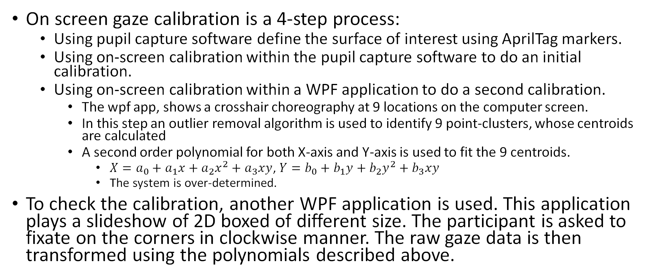
Gaze calibration method
On screen gaze calibration is a 4-step process:
Using pupil capture software define the surface of interest using AprilTag markers.
Using on-screen calibration within the pupil capture software to do an initial calibration.
Using on-screen calibration within a WPF application to do a second calibration.
The wpf app, shows a crosshair choreography at 9 locations on the computer screen.
In this step an outlier removal algorithm is used to identify 9 point-clusters, whose centroids are calculated
A second order polynomial for both X-axis and Y-axis is used to fit the 9 centroids.
$X=a_{0}+a_{1}x+a_{2}x^{2}+a_{3}xy$, $Y=b_{0}+b_{1}y+b_{2}y^{2}+b_{3}xy$
The system is over-determined.
To check the calibration, another WPF application is used. This application plays a slideshow of 2D boxed of different size. The participant is asked to fixate on the corners in clockwise manner. The raw gaze data is then transformed using the polynomials described above.

Slide 3
Gaze Calibration Test 2560 x 1080 on a friend

Slide 4
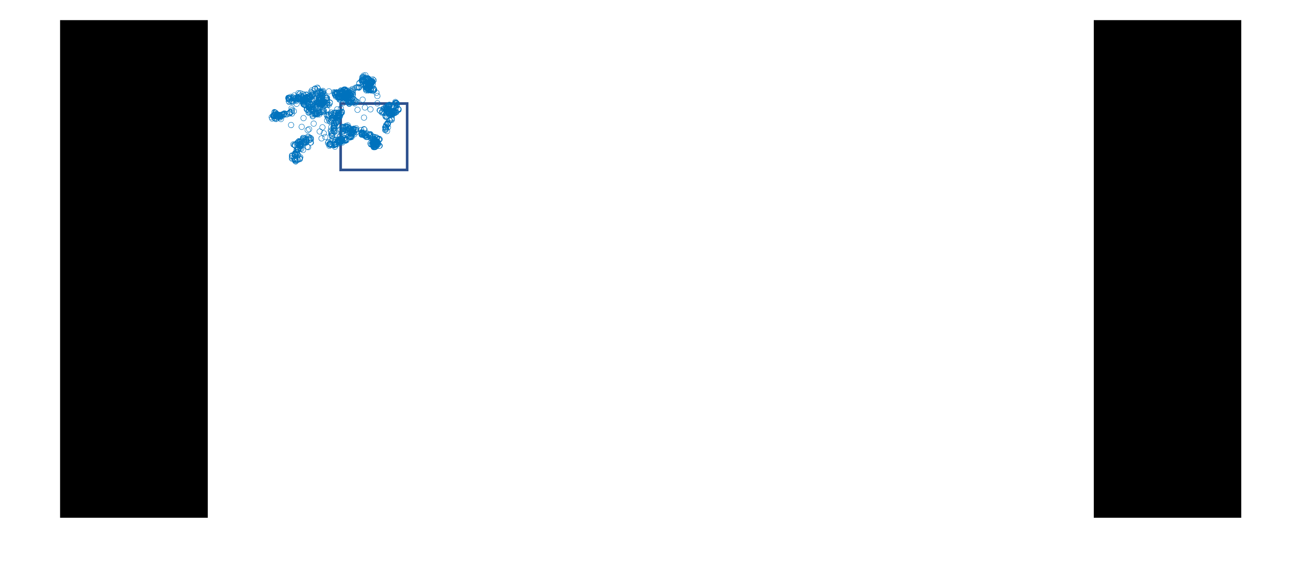
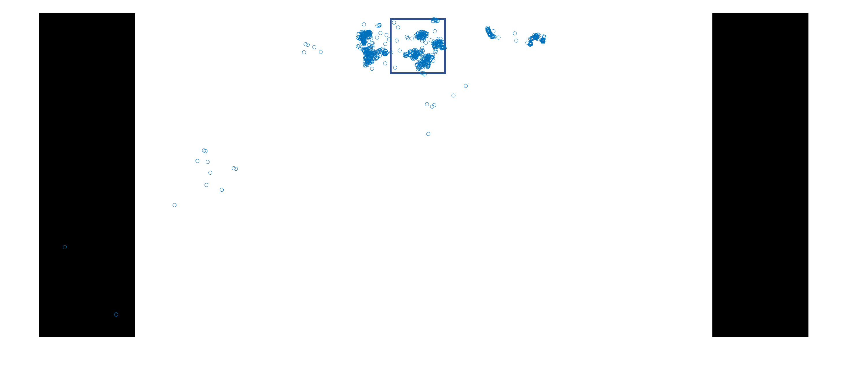
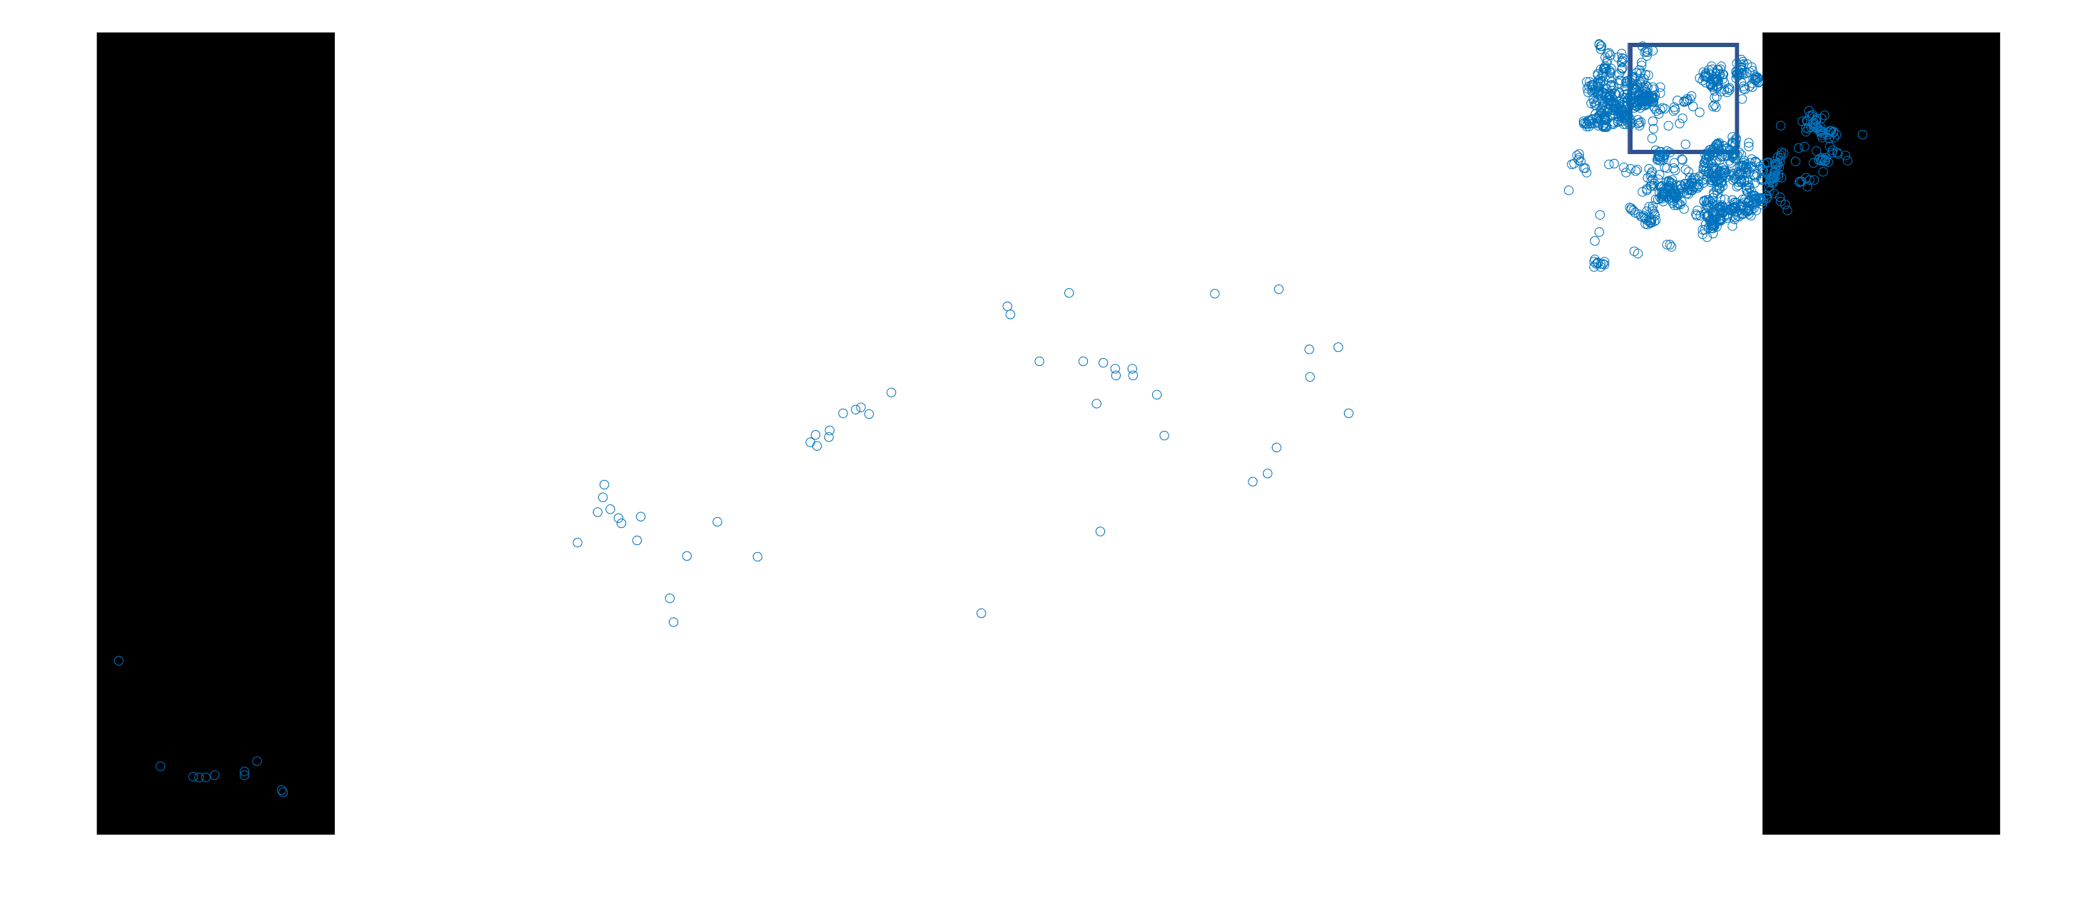

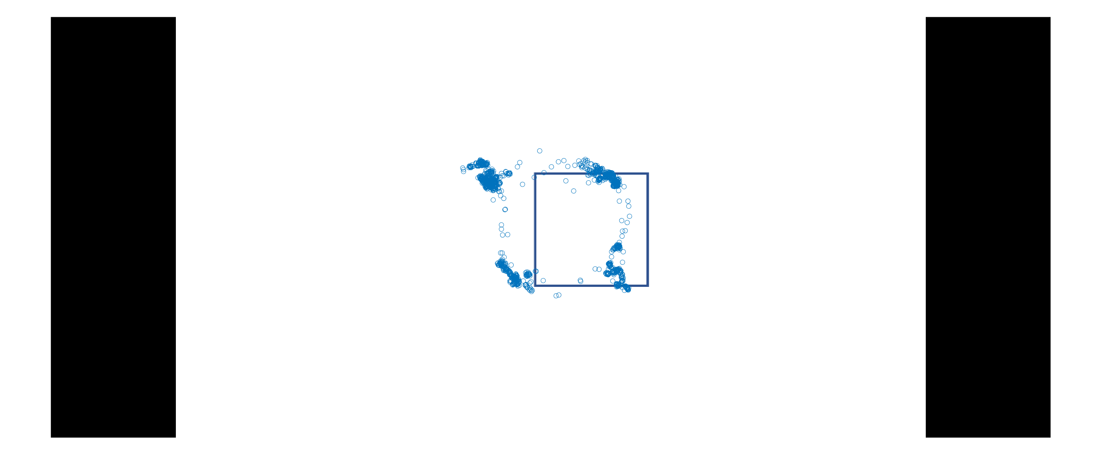
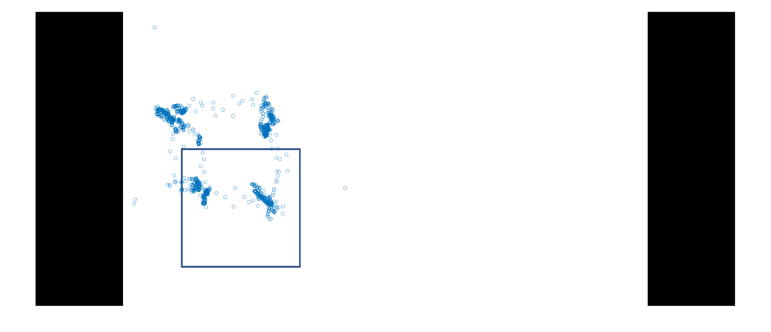
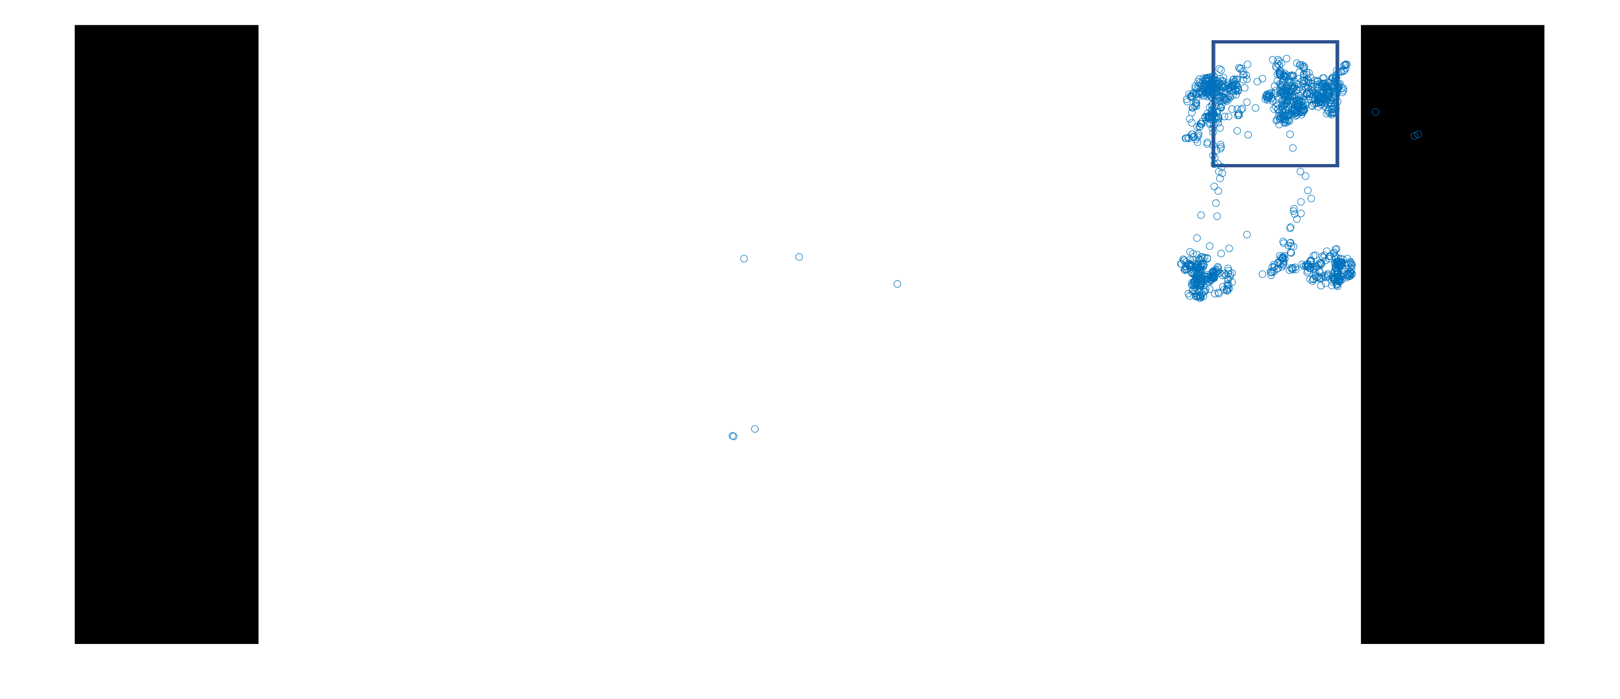
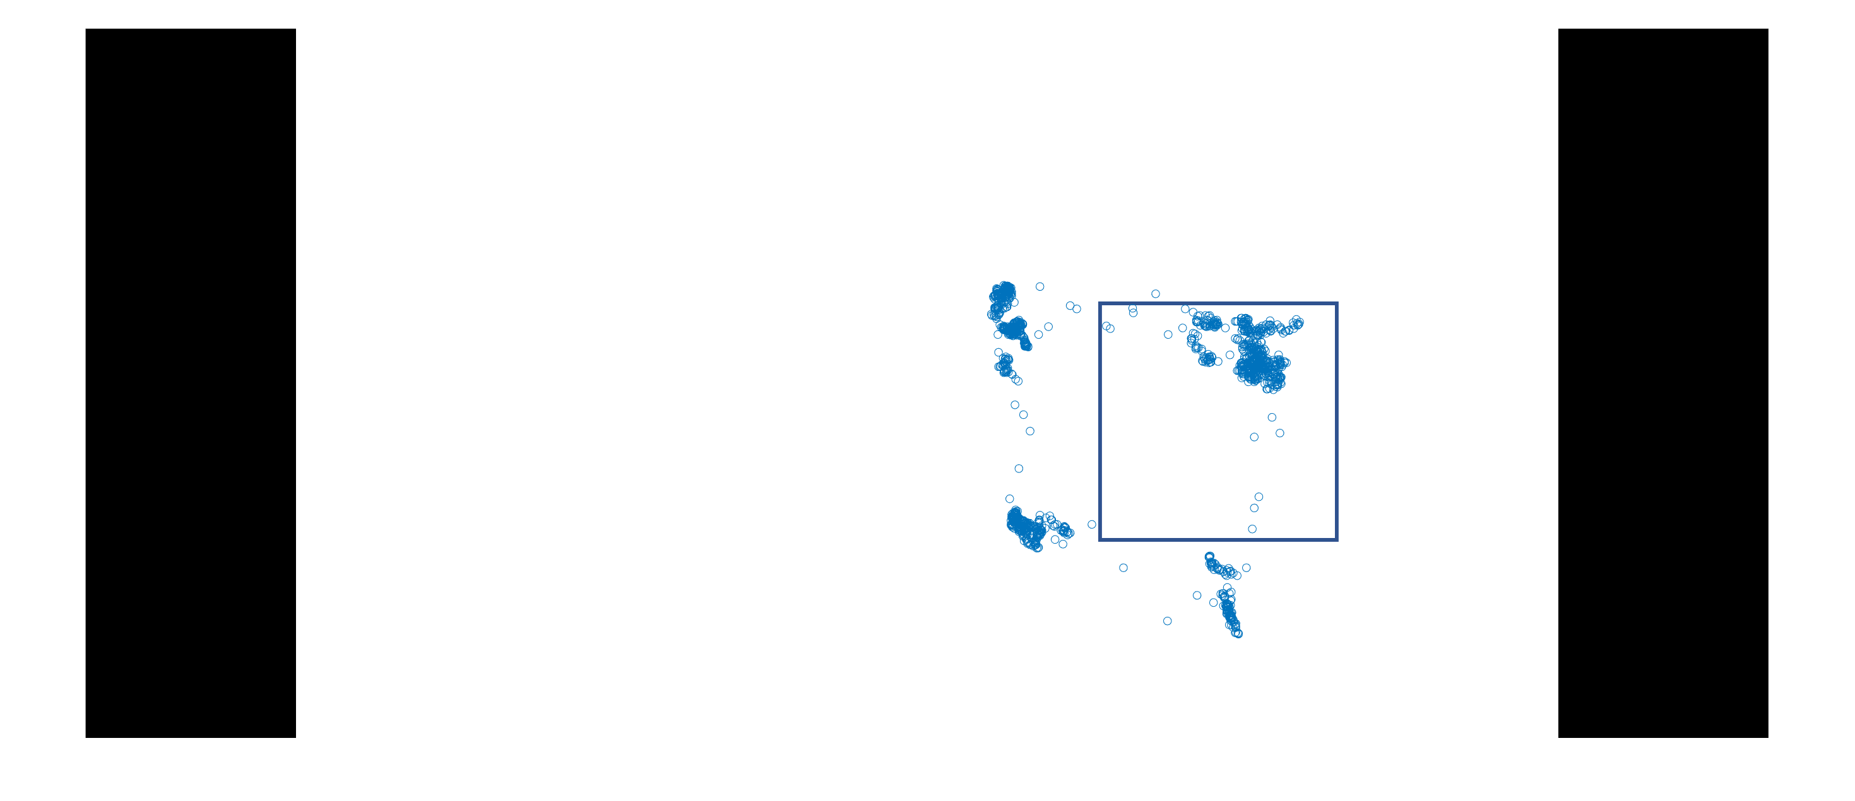

Slide 5
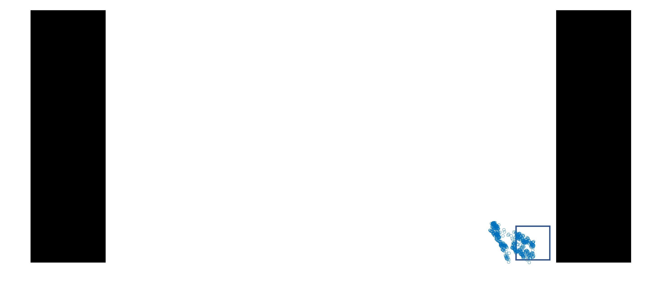
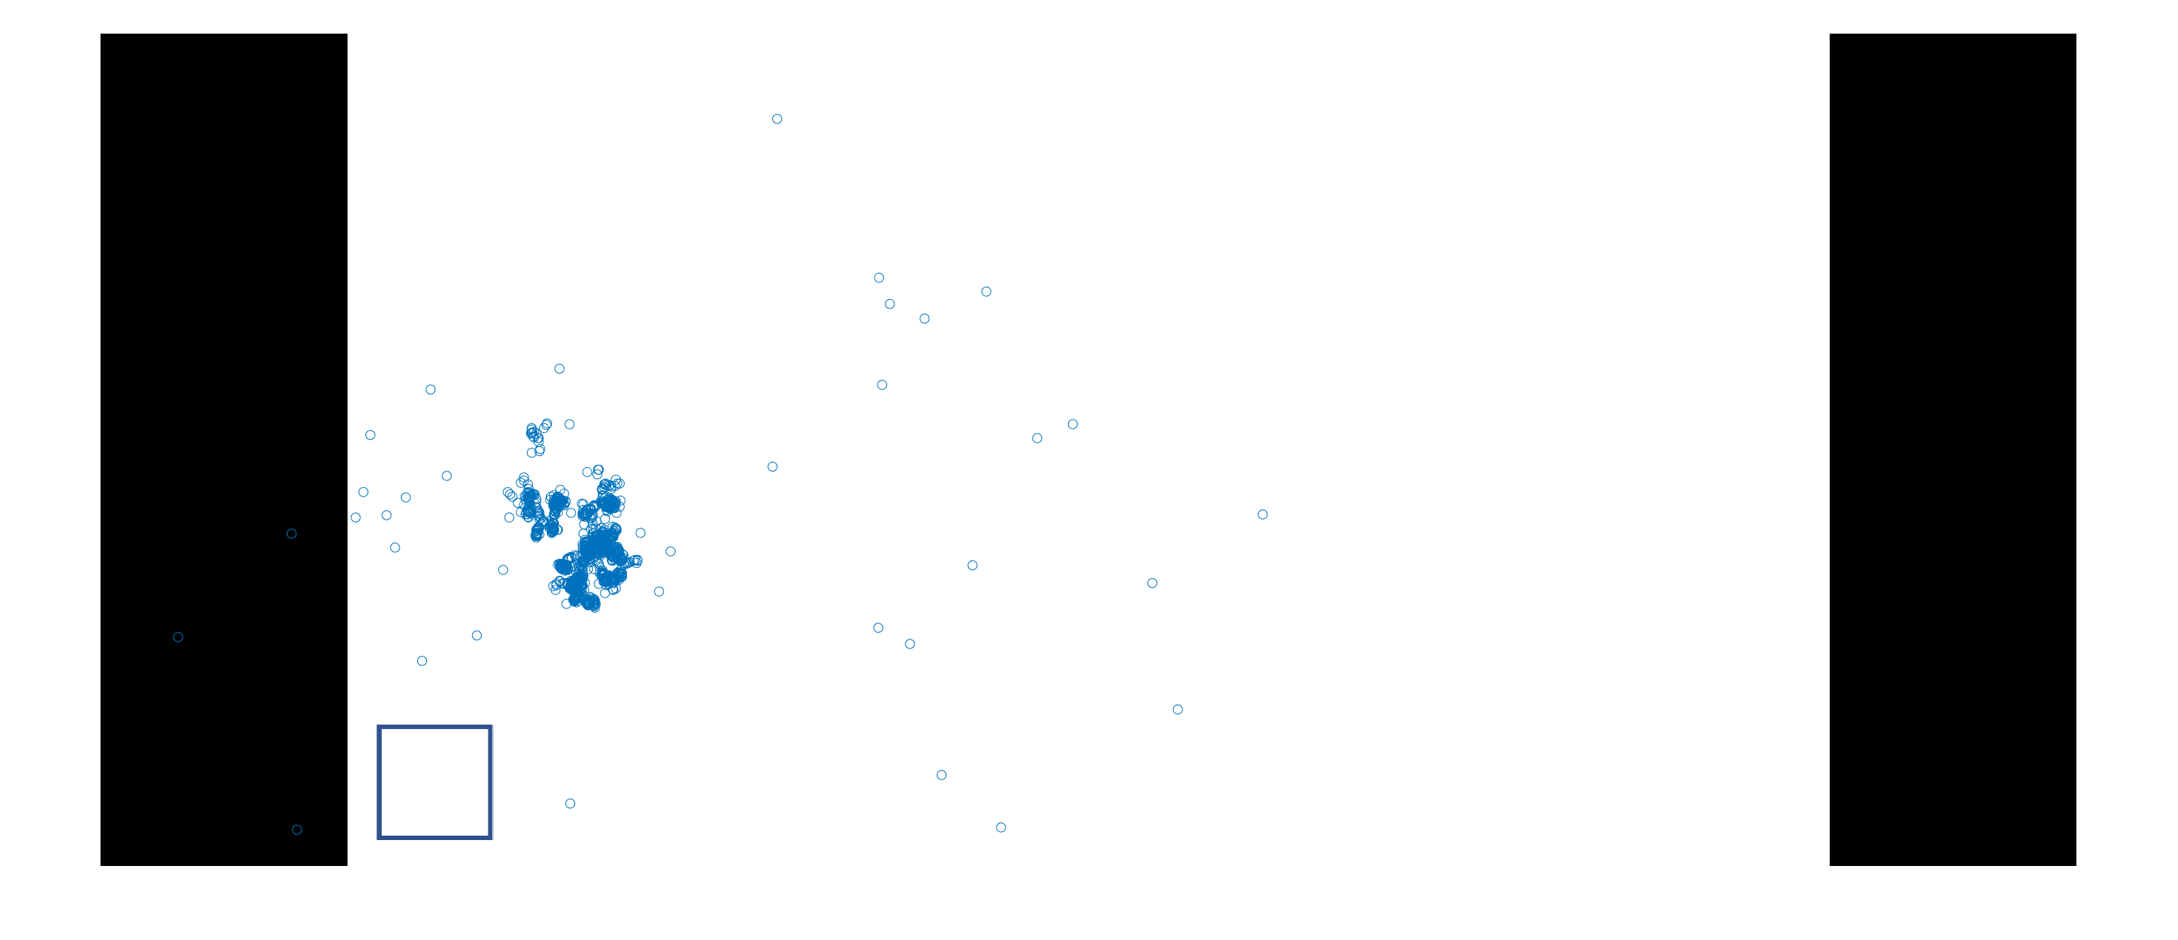

Slide 6
Gaze Calibration Test 2560 x 1080

Slide 7


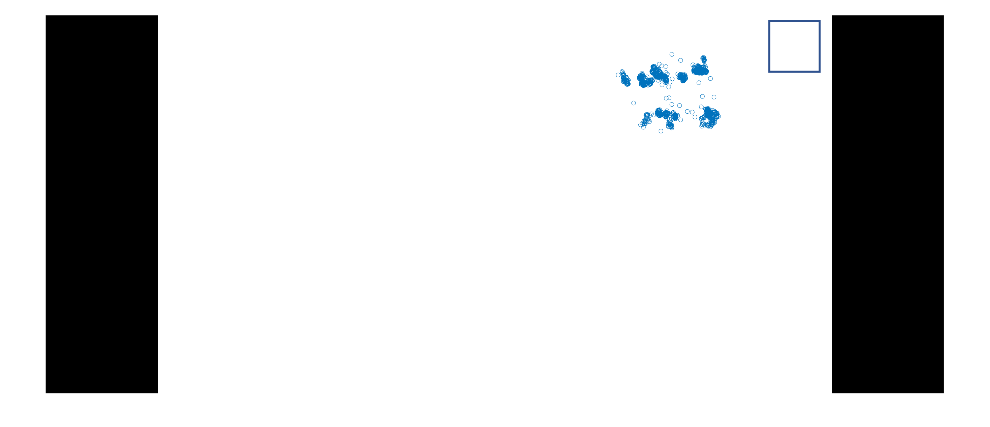
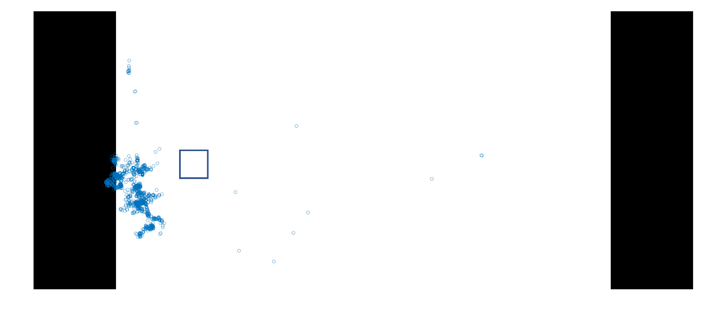
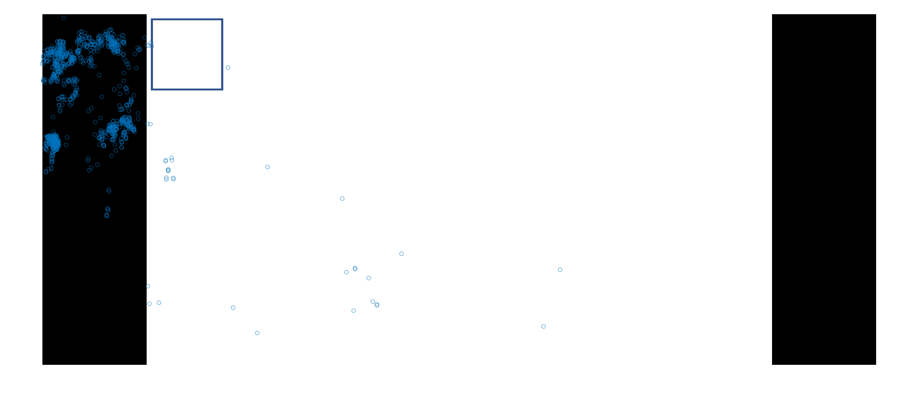
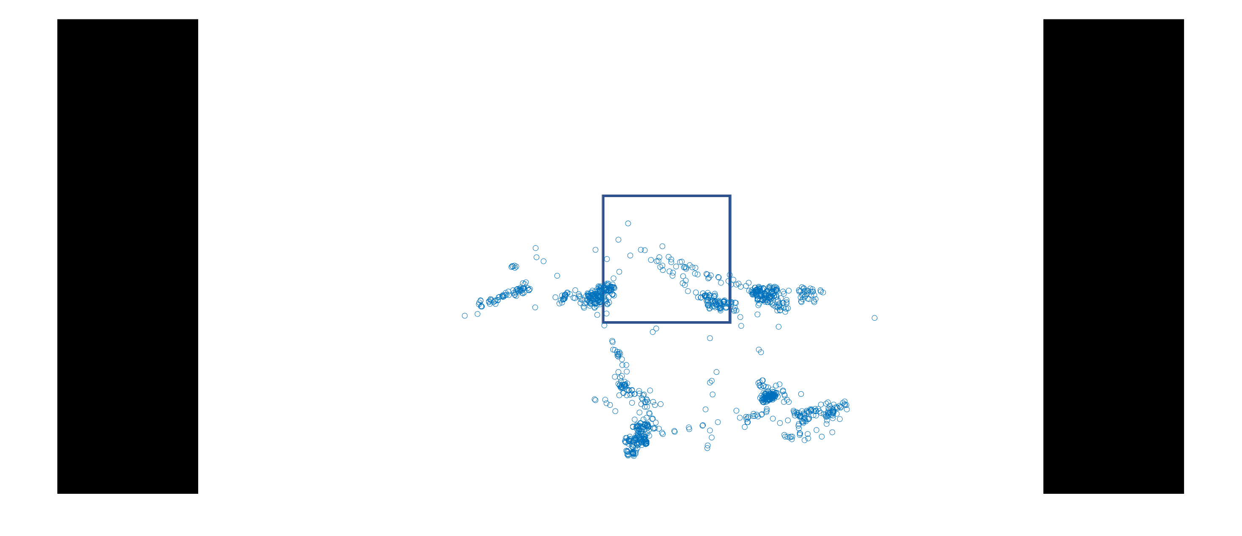
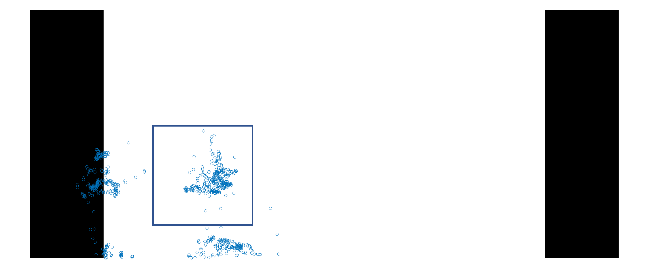
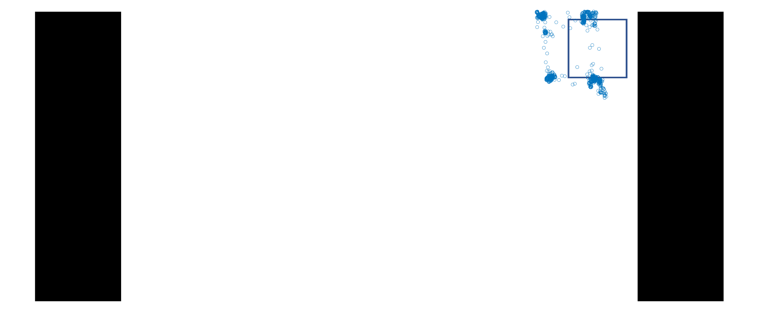
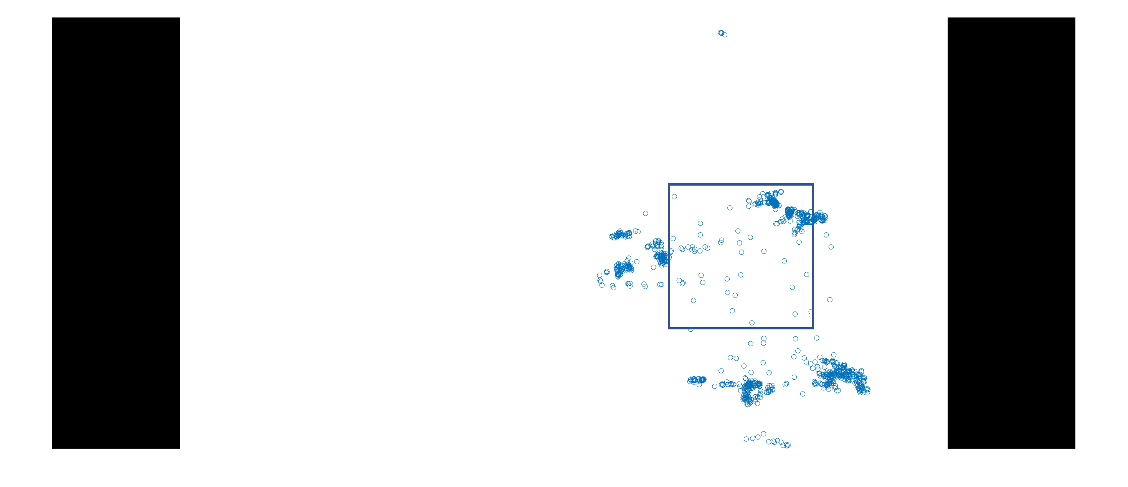

Slide 8
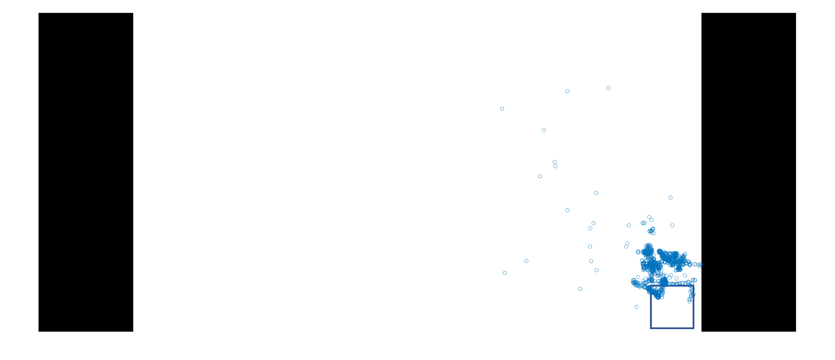
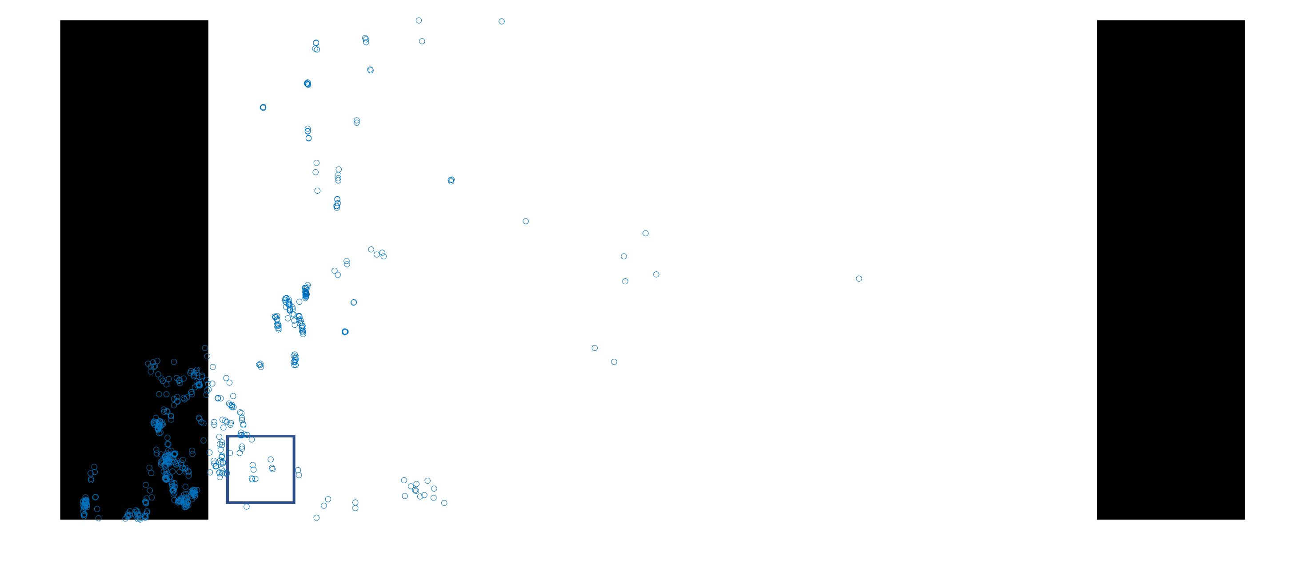

Slide 10
Gaze Calibration Test 1920 x 1080

Slide 11
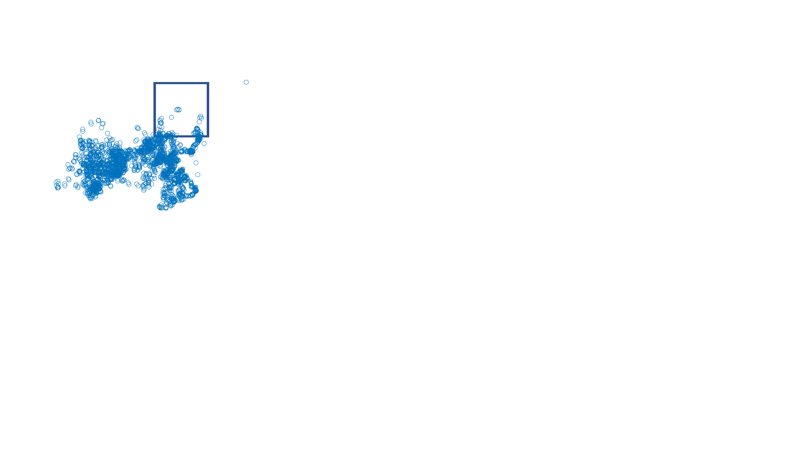
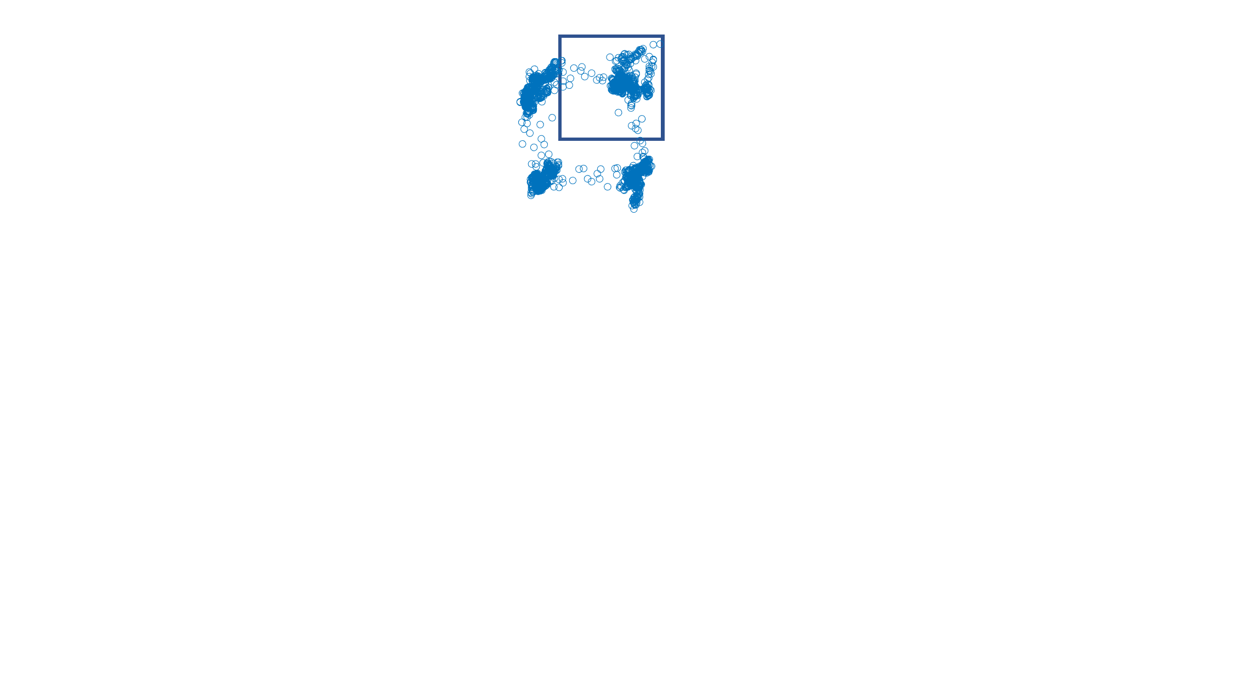
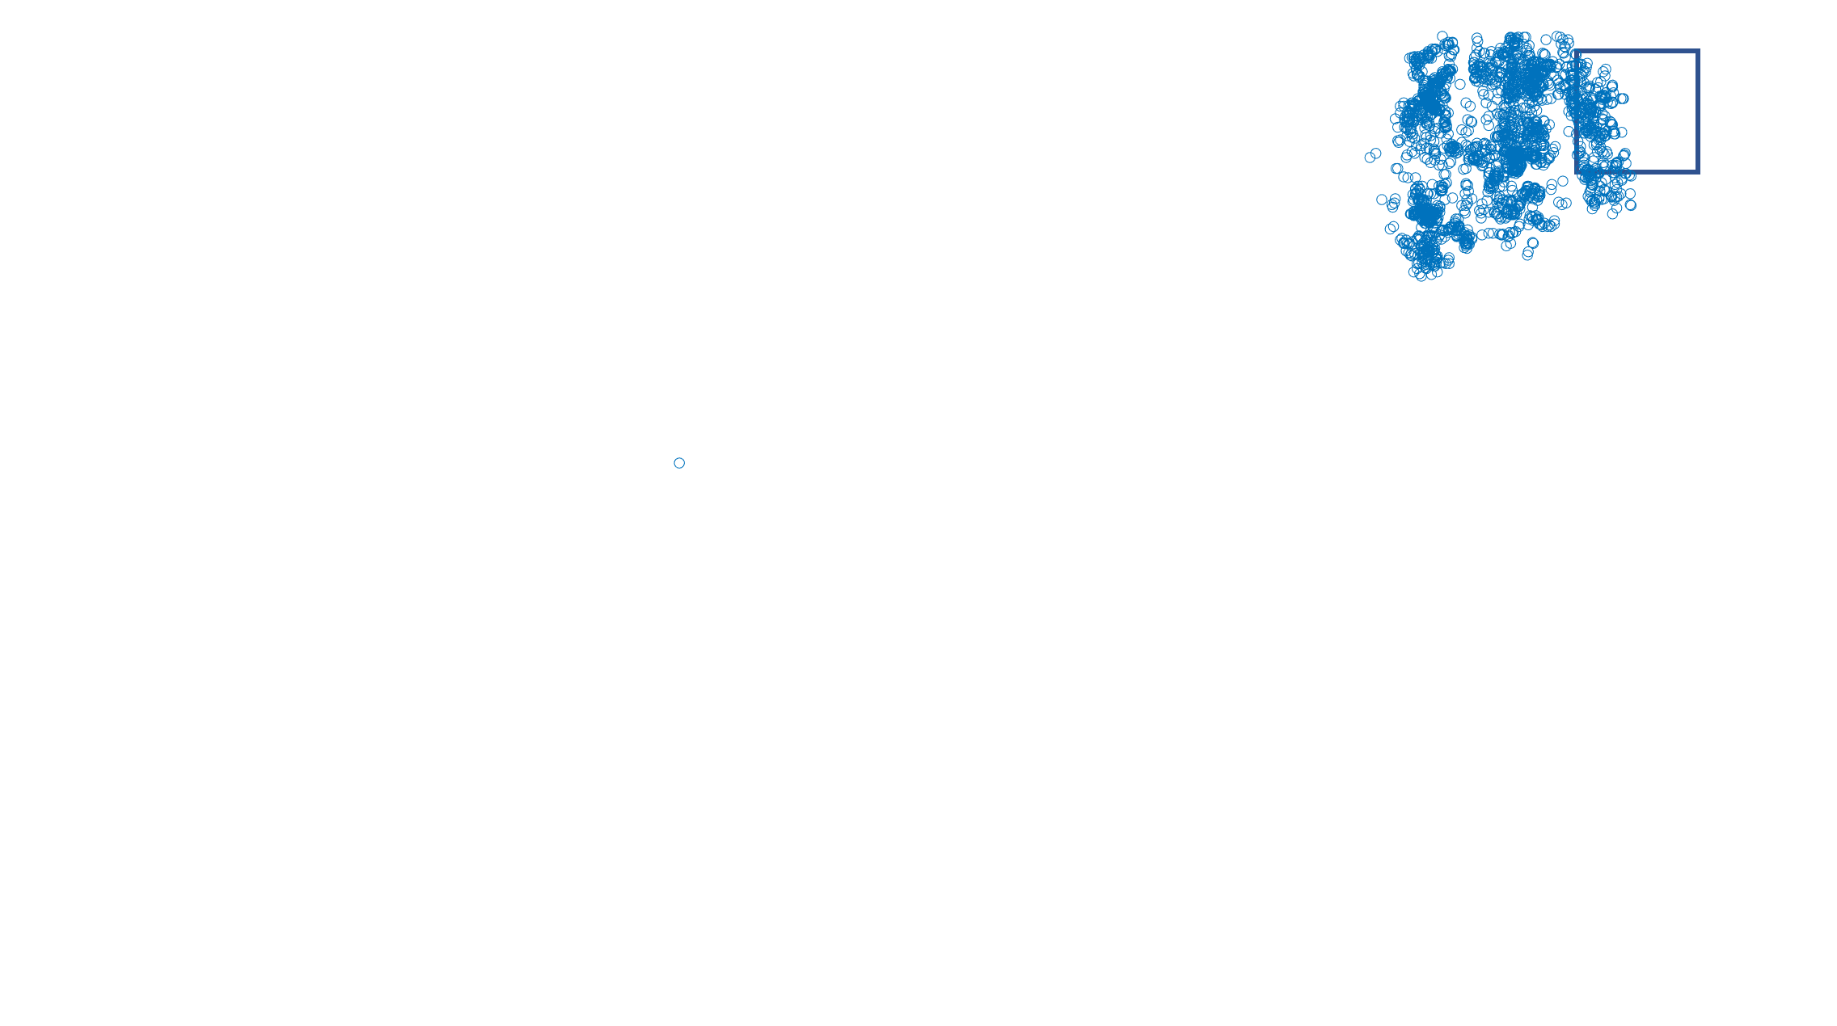
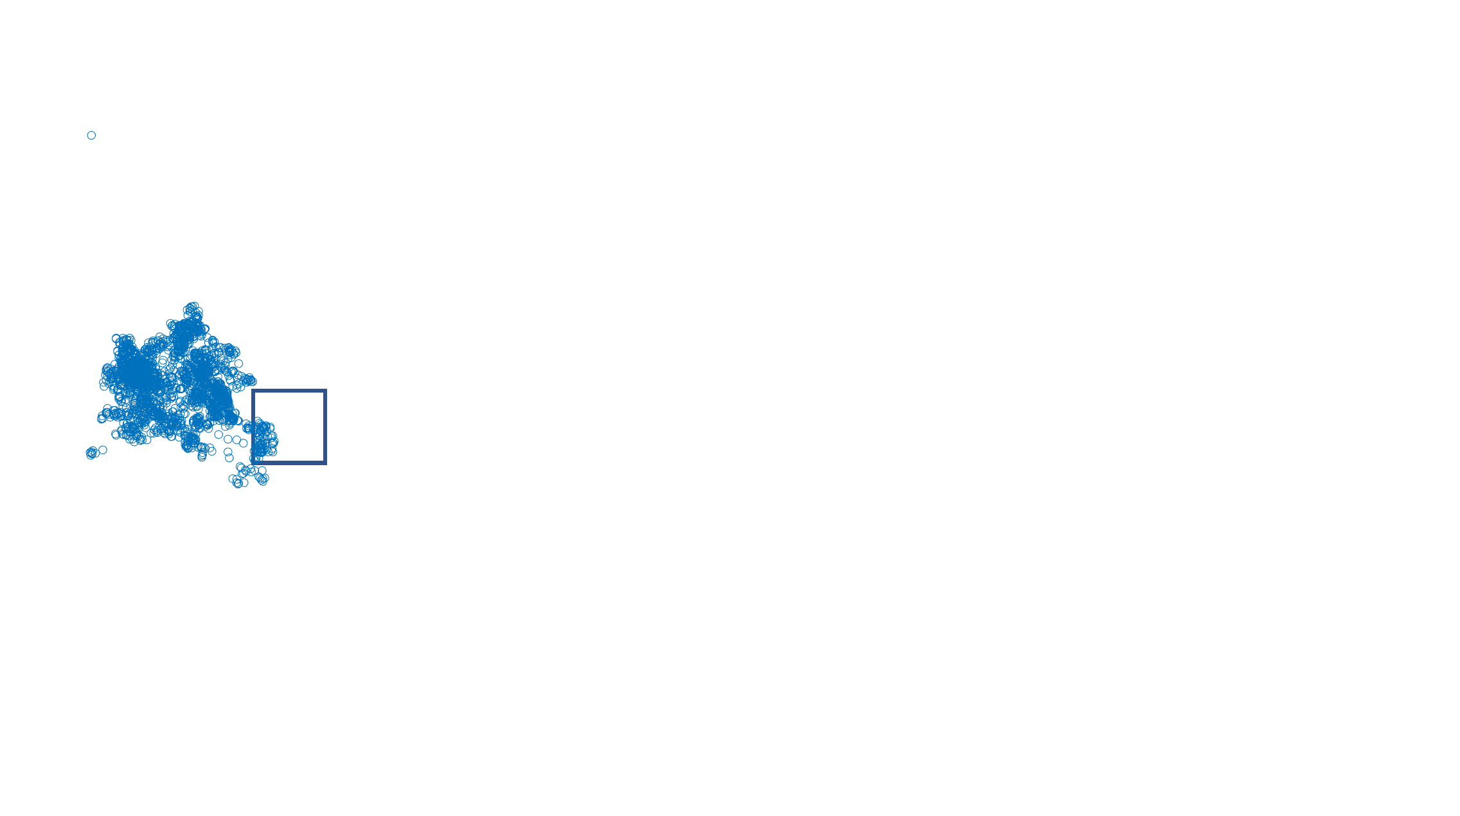
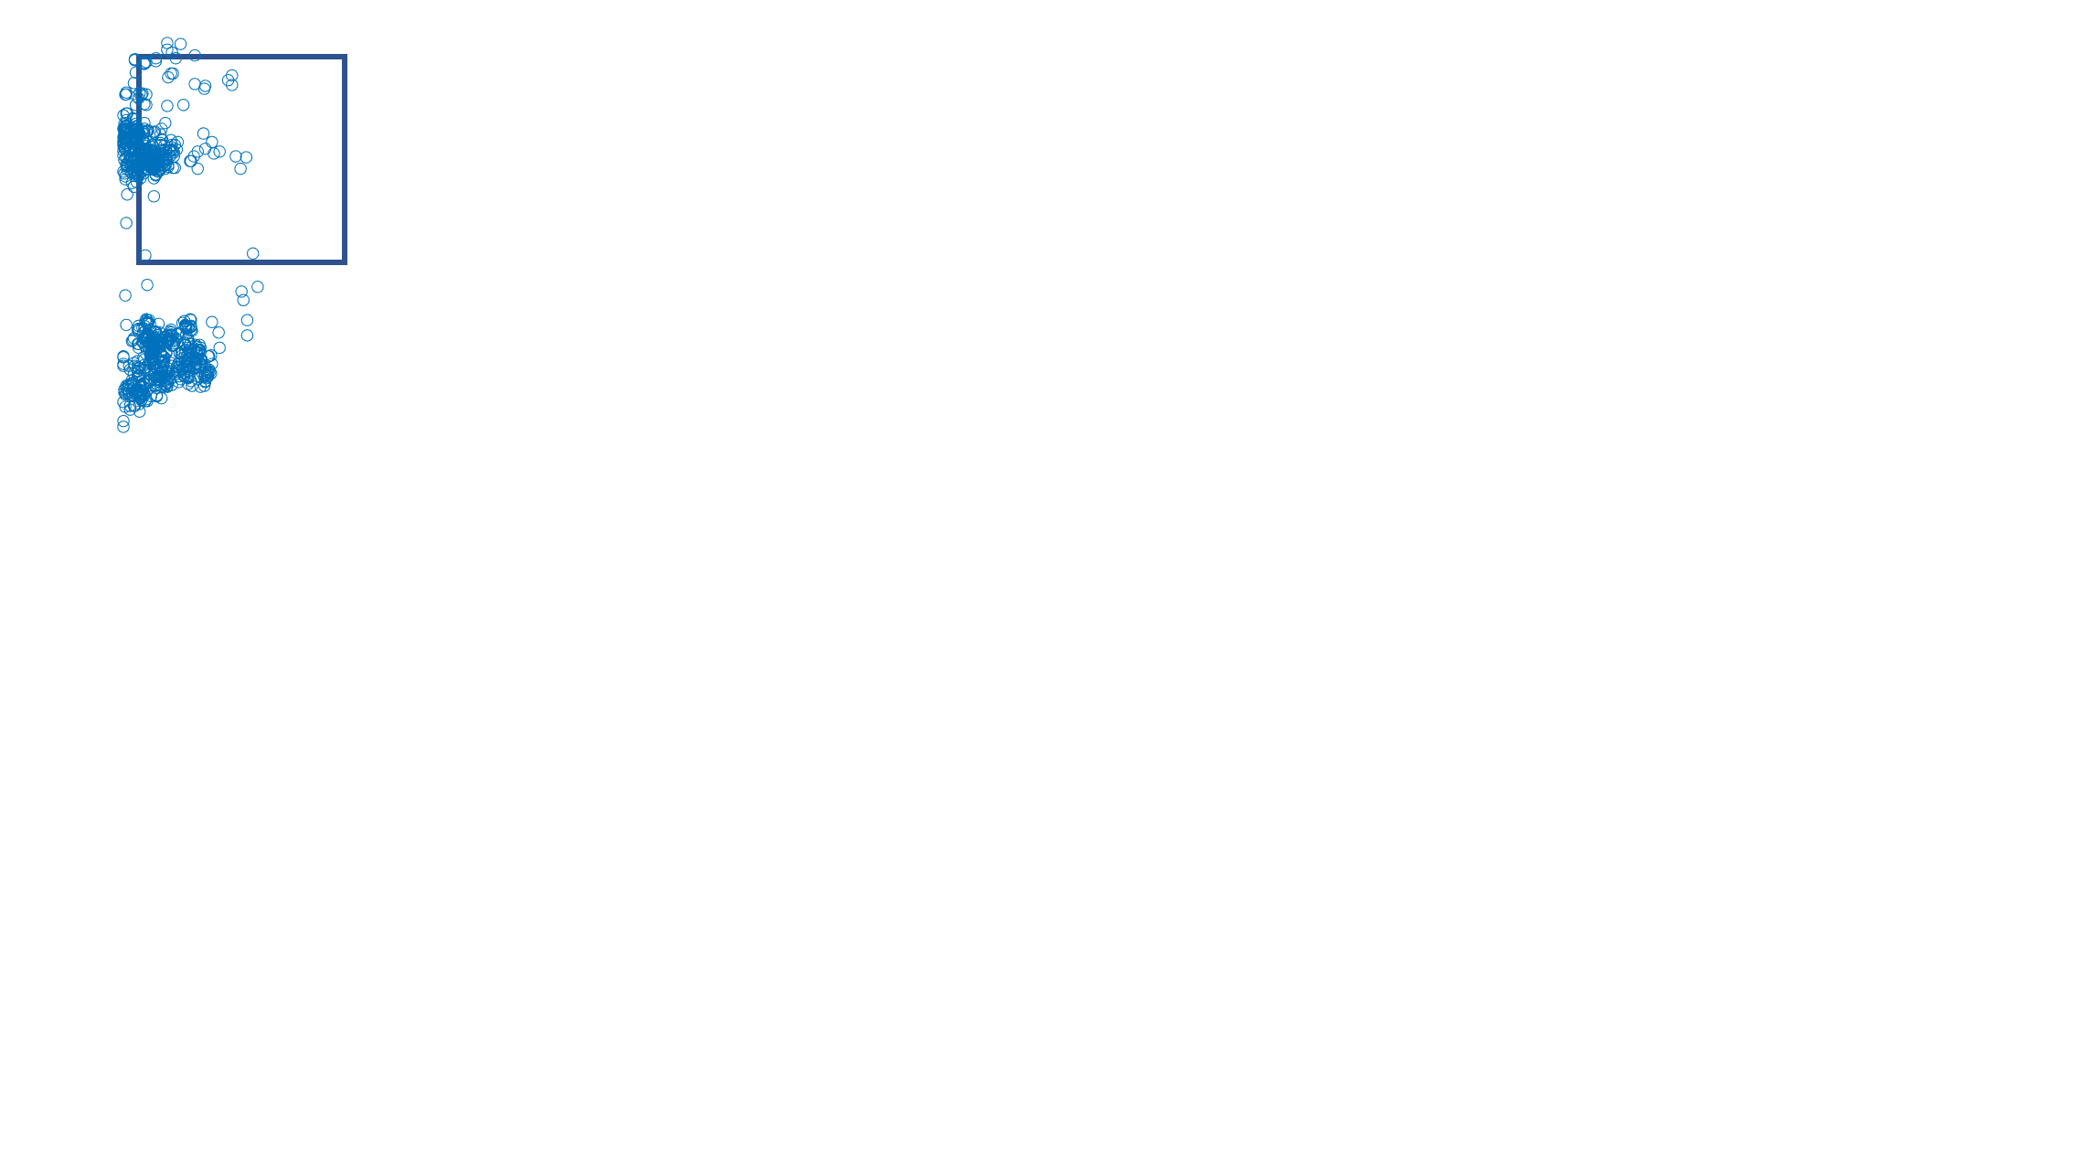
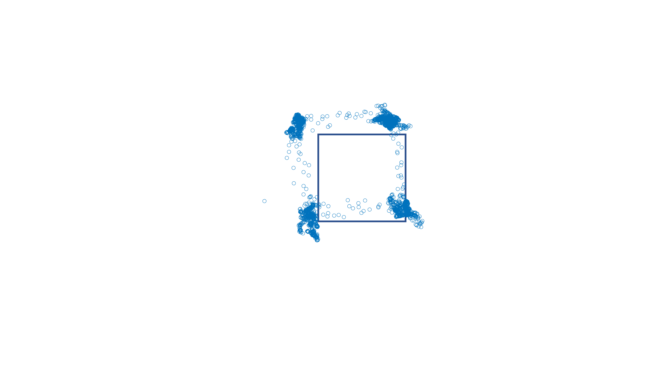
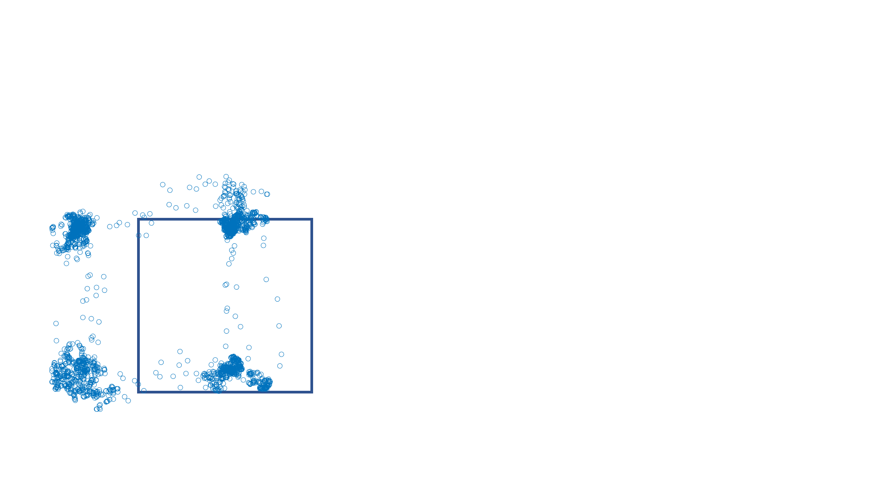
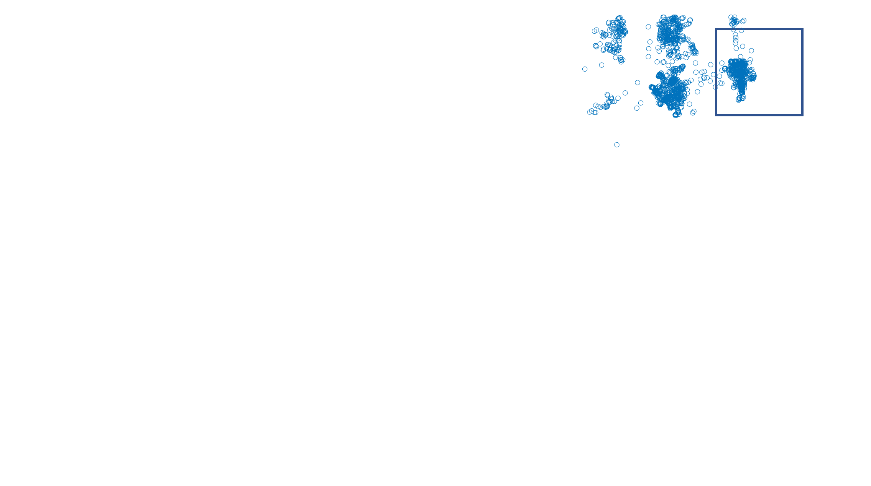
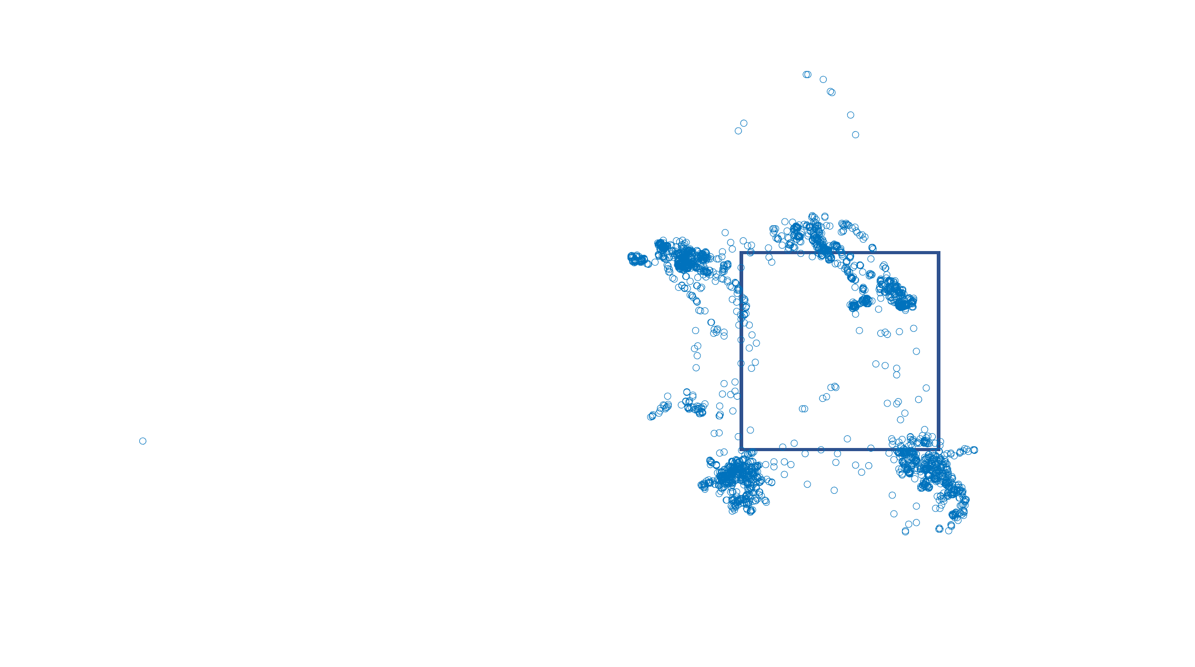

Slide 12
