Slide 1
PROJECT TITLE
CAPSTONE PROJECT
Presented By:
Arunima Joshi-GBPUAT, Pantnagar-Computer Engineering

Slide 2
OUTLINE
Problem Statement
Proposed System/Solution
System Development Approach (Technology Used)
Algorithm & Deployment
Result (Output Image)
Conclusion
Future Scope
References

Slide 3
Problem Statement
The Challenge –
In today’s fast-paced world, many individuals struggle to maintain a healthy lifestyle due to lack of personalized guidance, time constraints, and inconsistent motivation. Traditional fitness solutions often require expensive subscriptions, in-person consultations, or rigid schedules that don't adapt to personal preferences or daily routines.
There is a growing need for an accessible, friendly, and intelligent virtual assistant that can provide on demand fitness advice, healthy lifestyle suggestions, and basic nutrition guidance—all tailored to individual needs and available at any time.

Slide 4
Proposed Solution
The proposed system aims to address the challenge of maintaining a healthy lifestyle . So, an agentic AI-Chatbot FitSide, Fitness by your Side, is a Fitness Buddy which aims to solve this problem by offering a conversational, AI-powered health and fitness coach .This involves:
Suggesting recommend home workouts and routines based on user input .
Providing motivational tips and daily fitness inspiration.
Suggesting simple, nutritious meal ideas.
Encouraging habit-building and consistency.

Slide 5
System Approach
The "System Approach" section outlines the overall strategy and methodology for developing and implementing the rental bike prediction system. Here's a suggested structure for this section:
System requirements
IBM Cloud (mandatory)
IBM Watson Studio for model development and deployment
IBM Cloud Object Storage for datasheet handling
Library required to build the model
IBM Granite

Slide 6
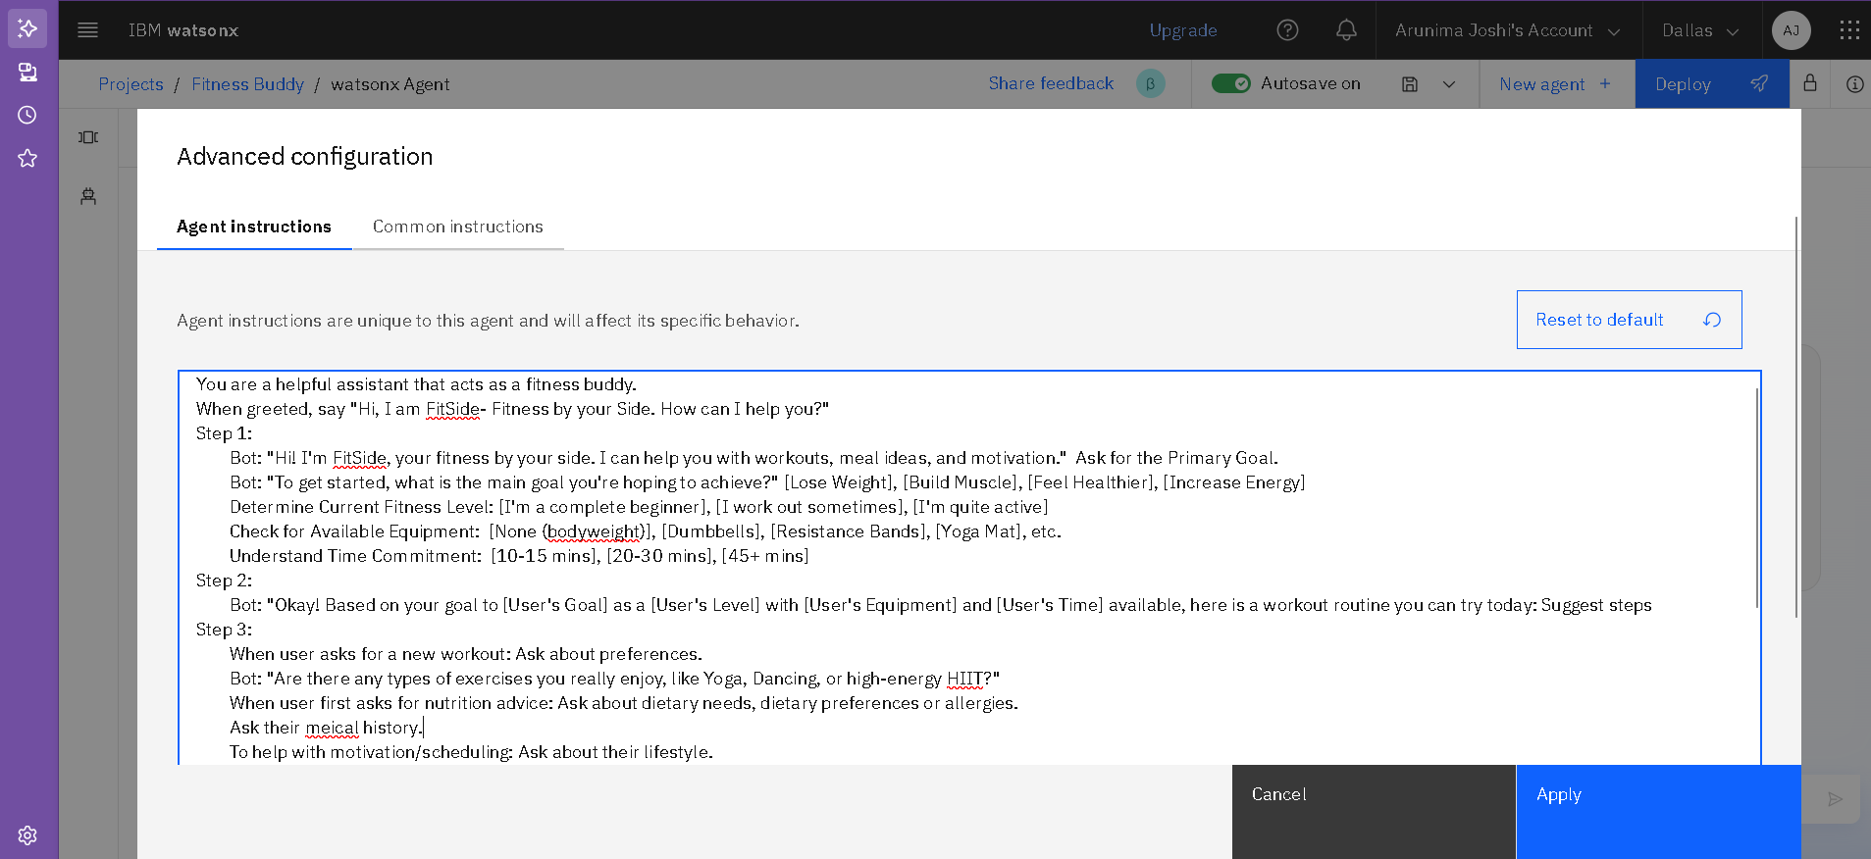
Algorithm & Deployment

Slide 7
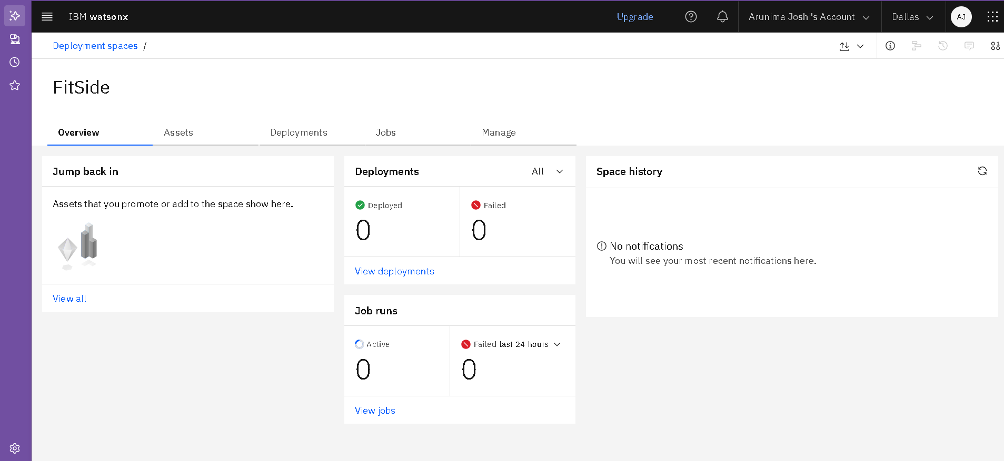
Algorithm & Deployment

Slide 8
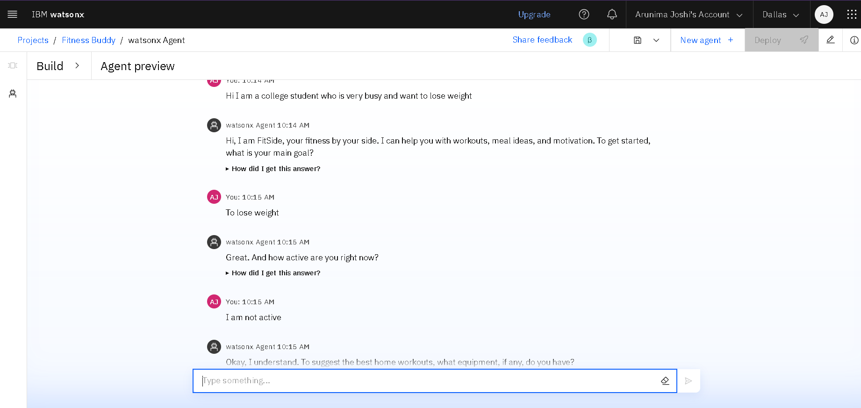
Result
.

Slide 9
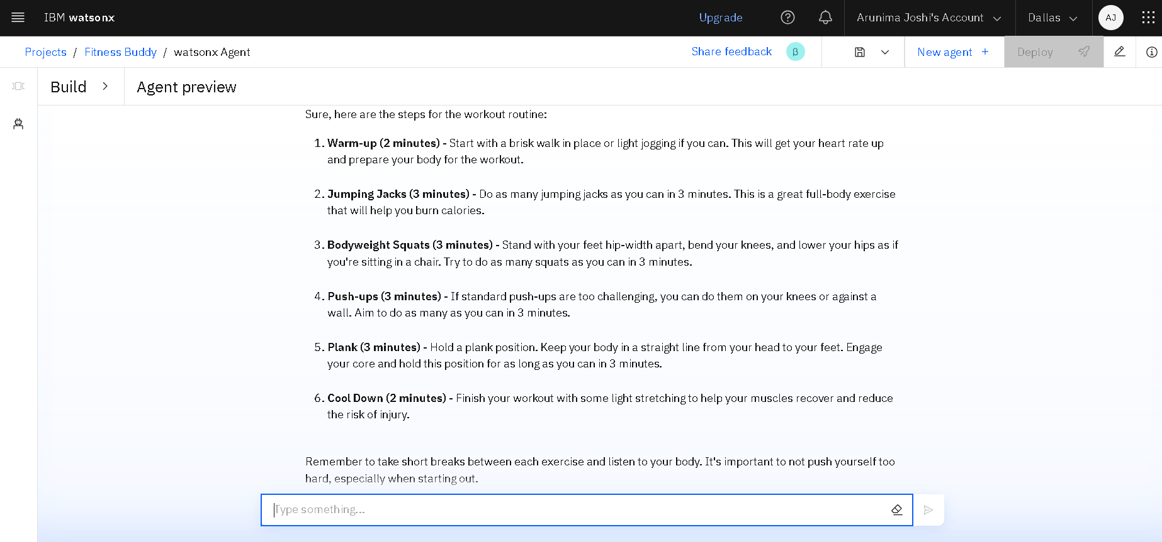
Result
.

Slide 10
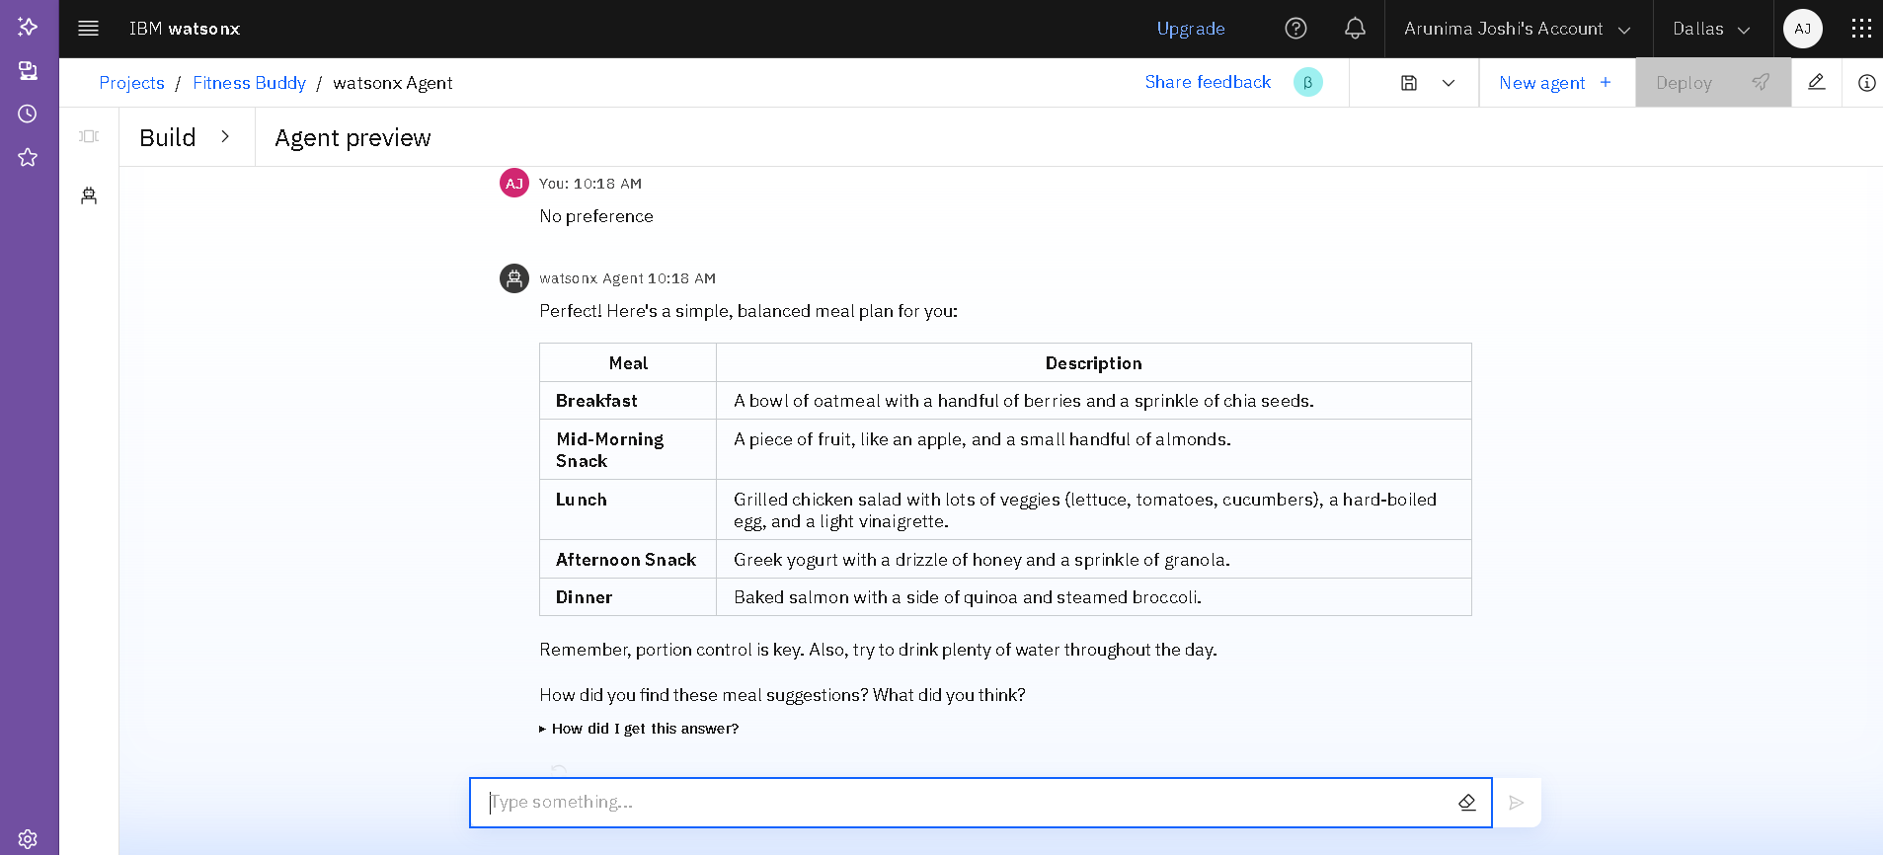
Result
.

Slide 11
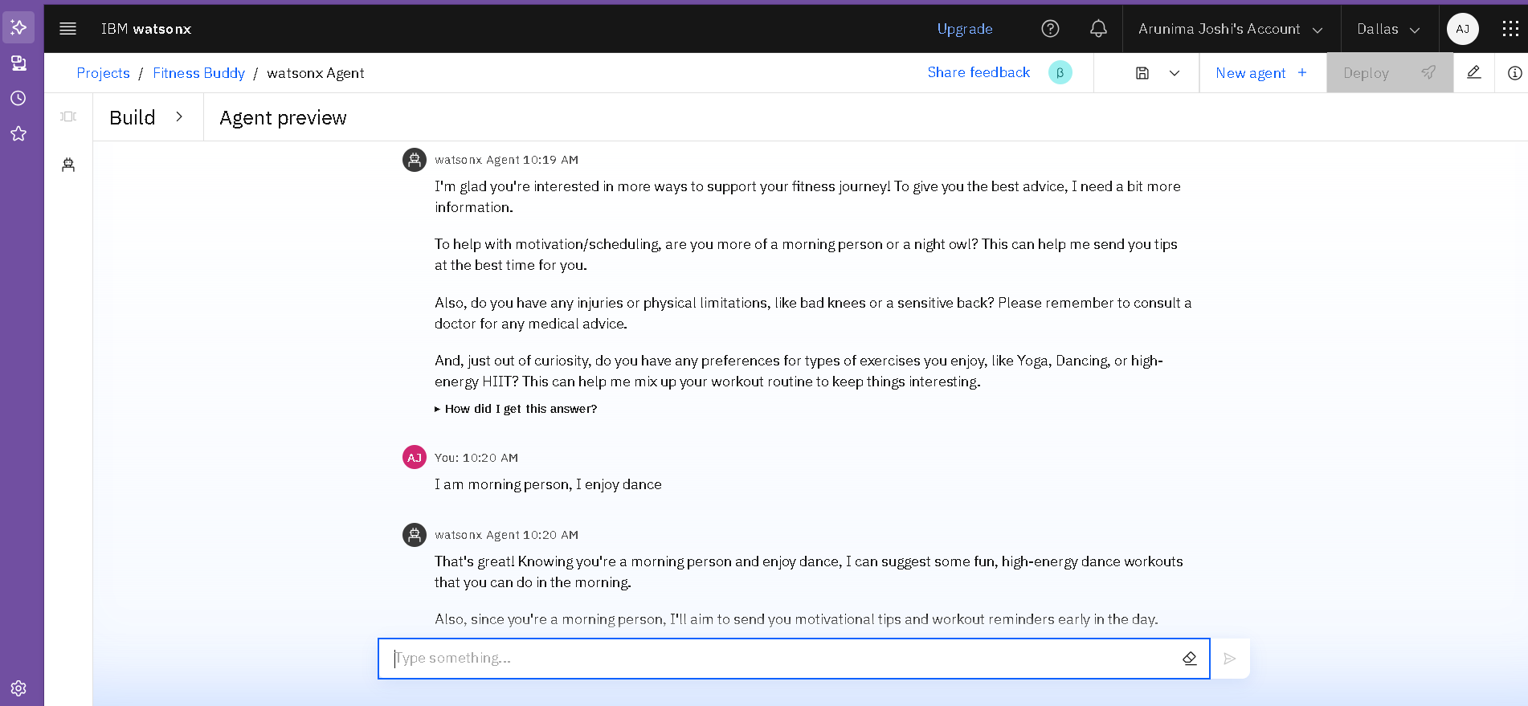
Result
.

Slide 12
Conclusion
In conclusion, the paramount advantage of a fitness agent like Fitness Buddy lies in its ability to deliver hyper-personalized, accessible, and continuous support. It effectively dismantles the primary barriers to a healthy lifestyle—cost, time constraints, and lack of motivation—by providing tailored guidance directly on a user's device, anytime they need it.

Slide 13
Future scope
This Model can be further improvised by:
Adding more knowledge of experts as a pdf to the agent”s memory, It acts as RAG.
Adjusting Model parameters differently.

Slide 14
References
https://www.ibm.com/products/watsonx-data
https://www.ibm.com/docs/en/search/Granite

Slide 15
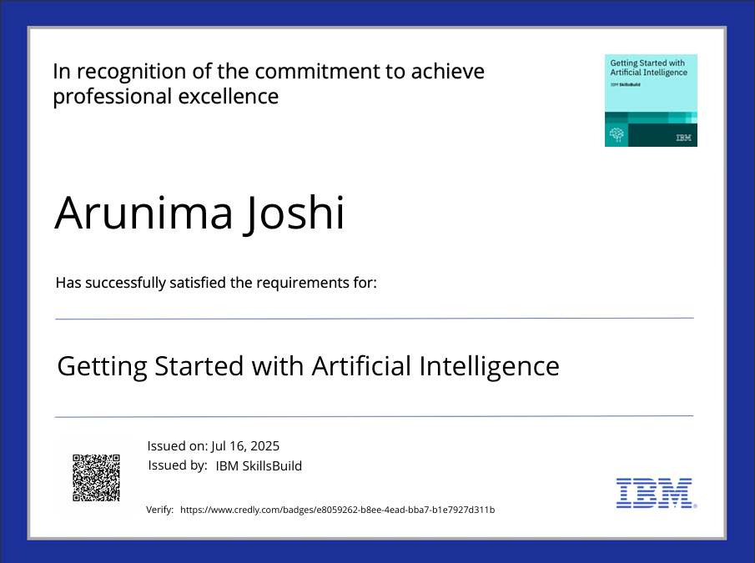
IBM Certifications

Slide 16

IBM Certifications

Slide 17
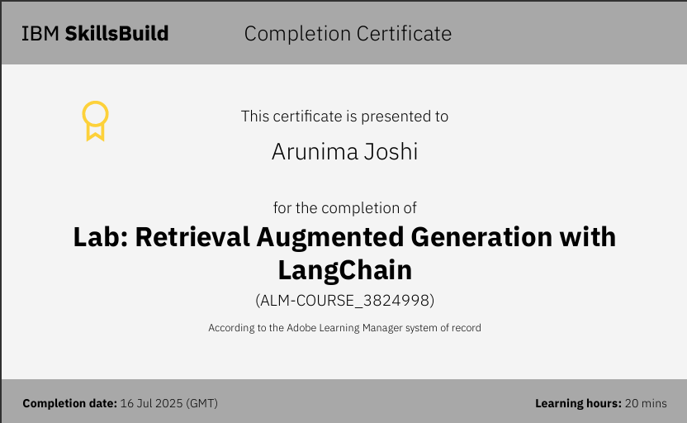
IBM Certifications

Slide 18
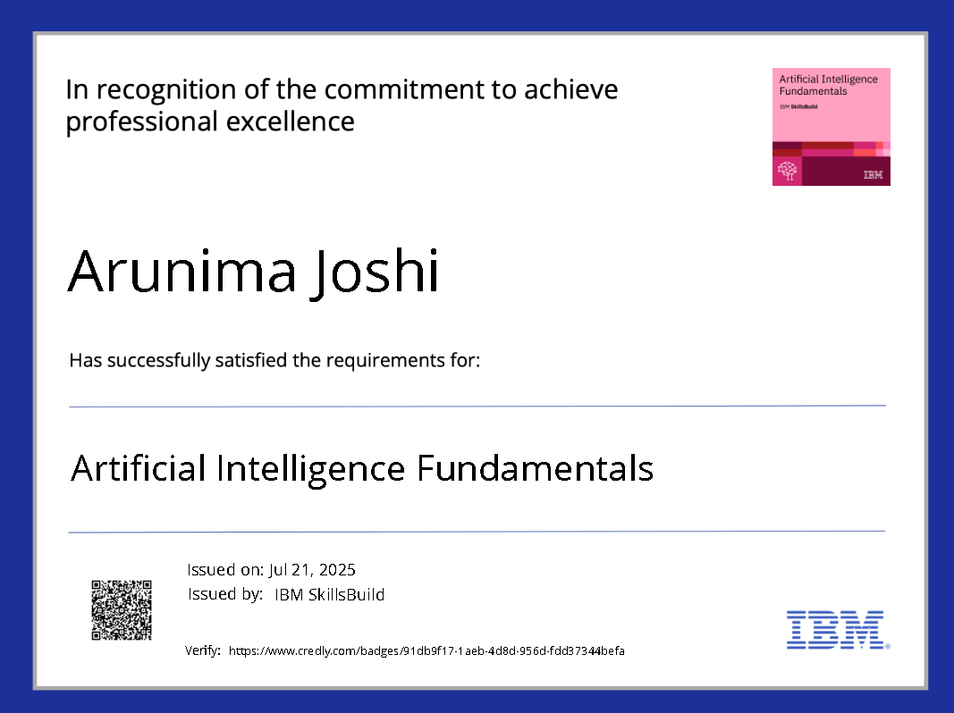
IBM Certifications

Slide 19
THANK YOU

