Slide 1
Cloud Manager :: Client
Outlook
MVC Architecture
Client Components
Main Features :: WebClient
Java-Code :: Main Components
Screen-shots :: WebClient
Installation & Code

Slide 2








Outlook
http requests (json)
http responses (json)
Storage Manager
http requests
http responses
OCCI-Server
XML-RPC
Cloud Manager
Integration
Testing
User interaction

Slide 3








Outlook
WebServer
http requests (json)
http responses (json)
CDMI-bundle
Storage Manager
http requests
OCCI-bundle
http responses
OCCI-Server
Web-GUI
XML-RPC
Cloud Manager
Web-GUI
interaction

Slide 4
Outlook
WebServer
http requests (json)
http responses (json)
CDMI-bundle
Storage Manager
http requests
OCCI-bundle
http responses
OCCI-Server
Web-GUI
XML-RPC
Cloud Manager
Web-GUI
interaction

Slide 5


Client ::: Main Components
CRUD :: Containers
CRUD :: VM Images
CDMI-bundle
CdmiManagerImpl
( JavaBean :: Spring )
Http
Request
(CDMI spec 1.0.1 :: json)
Http
Response
(CDMI spec 1.0.1 :: json)
Web-GUI
Http
Request
(OCCI Spec. 0.3)
CRUD :: Network
CRUD :: Storage
CRUD :: Compute
Http
Response
(OCCI Spec. 0.3)
OCCI-bundle
OcciOneManagerImpl
( JavaBean :: Spring )

Slide 6

Client ::: MVC Architecture
Web-GUI
Incomming
request
Delegate
request
CloudWeb
Controller
Spring
Controller
model
Delegate
rendering
of response
Return
response
Return
control
model
Render
response
Templates
FreeMarker
ViewResolver
Get
view
. Login / Menu
. Network
. Storage
. Compute
. Container
. Images
Return
view

Slide 7
Java Bundles
Main Bundles
CDMI Bundle :: implementation of CDMI spec 1.0.1 (json)
OCCI Bundle :: implementation of OCCI Spec. 0.3
Web Bundle :: freemarker 2.3 and jquery 1.8
Main Features:
Available for OSGi and also as maven libraries
Spring framework-based (3.0)
Automatic deployment in Virgo (3.0)

Slide 8
Java Code
* Interfaces *

Slide 9
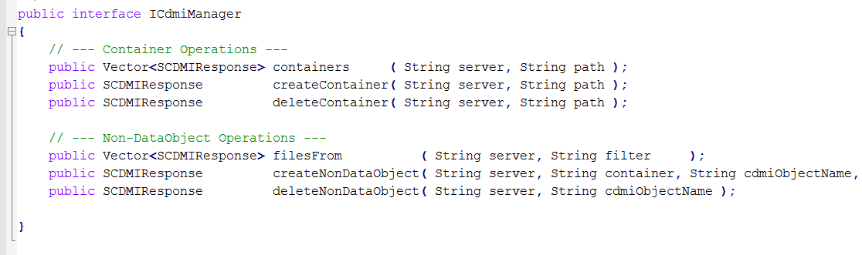
CDMI Bundle (1)

Slide 10
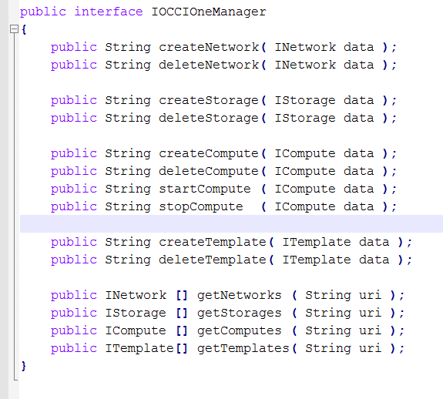
OCCI Bundle (1)

Slide 11
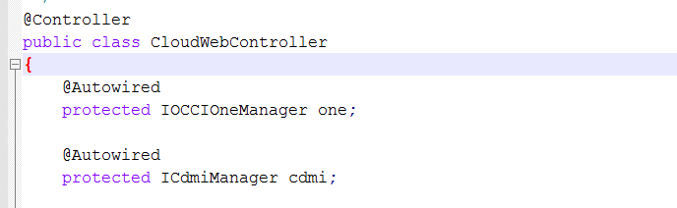
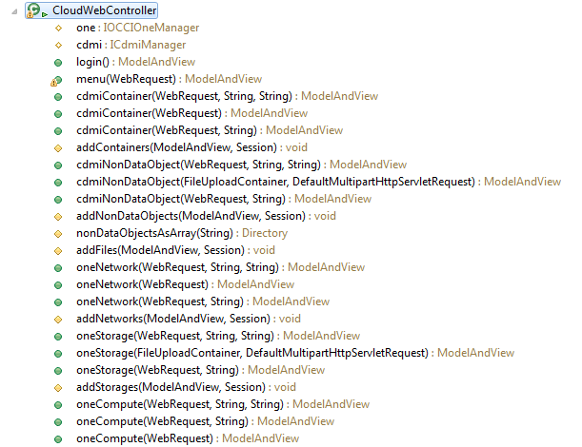
Web-Bundle (1)

Slide 12
Screenshots

Slide 13
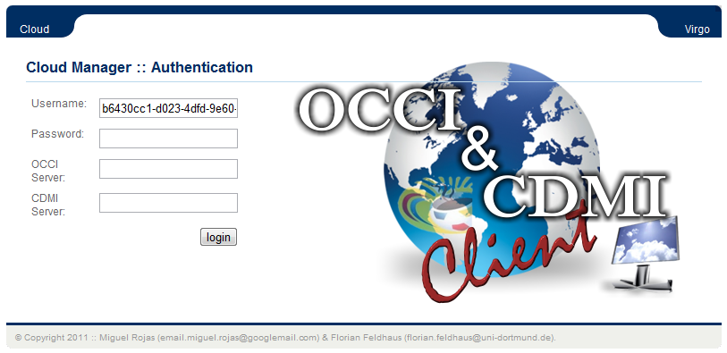
Web-GUI

Slide 14
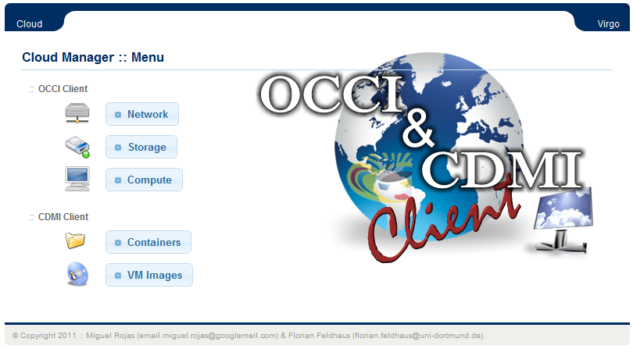
Web-GUI

Slide 15
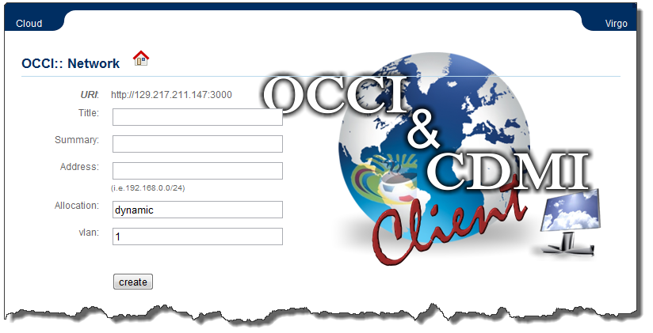
Web-GUI :: OCCI : Network

Slide 16
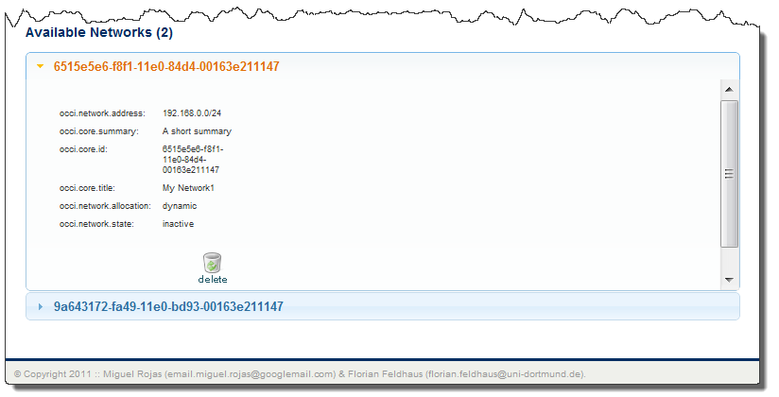
Web-GUI :: OCCI : Network

Slide 17
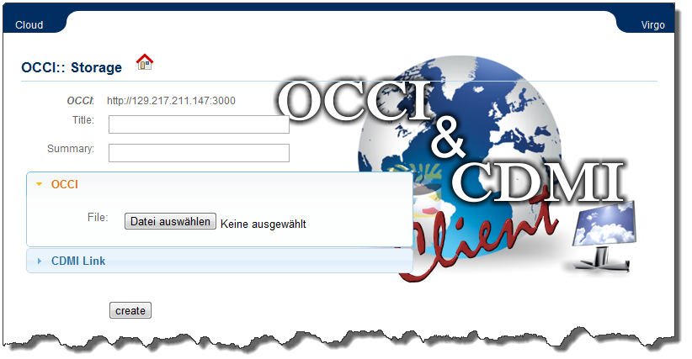
Web-GUI :: OCCI : Storage

Slide 18
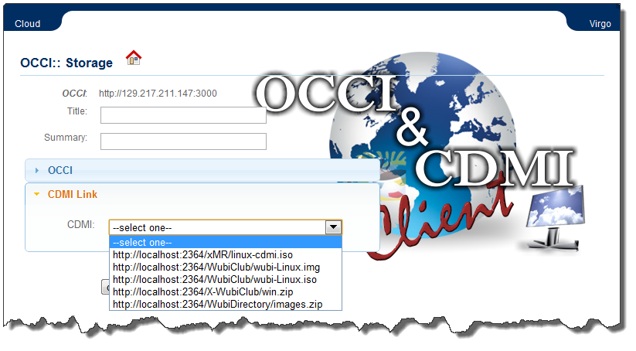
Web-GUI :: OCCI : Storage

Slide 19
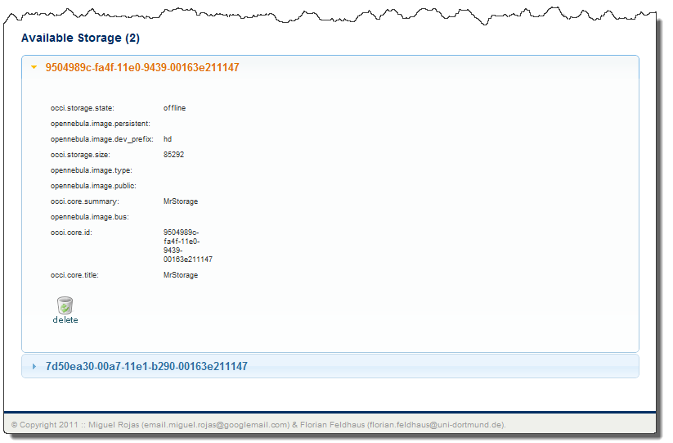
Web-GUI :: OCCI : Storage

Slide 20
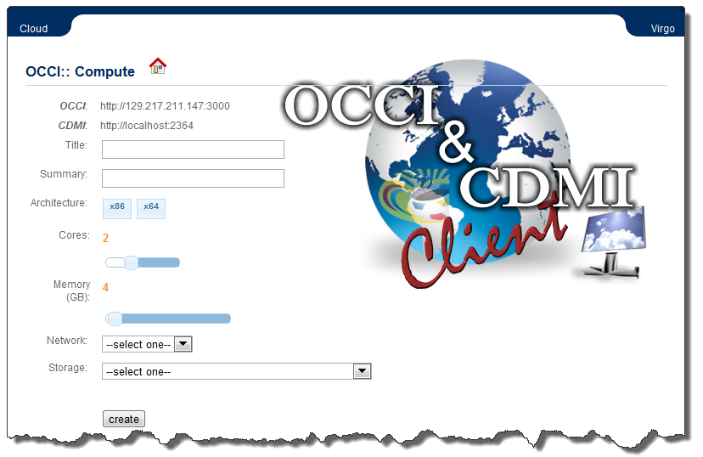
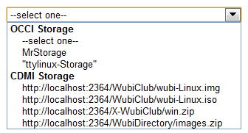
Web-GUI :: OCCI : Compute

Slide 21
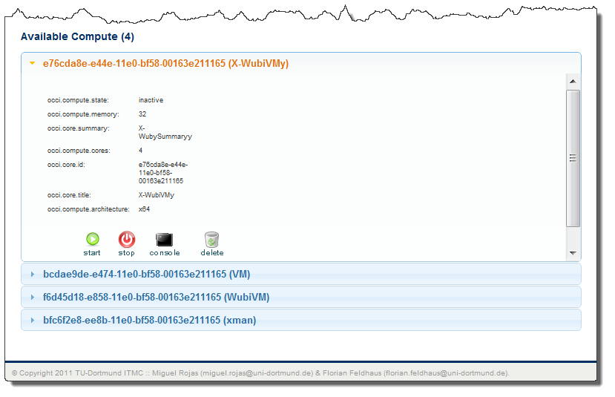
Web-GUI :: OCCI : Compute

Slide 22
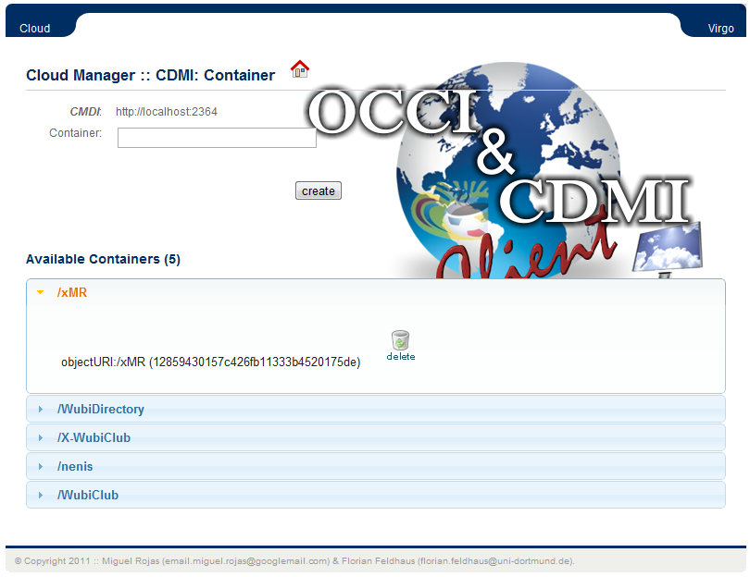
Web-GUI :: CDMI : Container

Slide 23
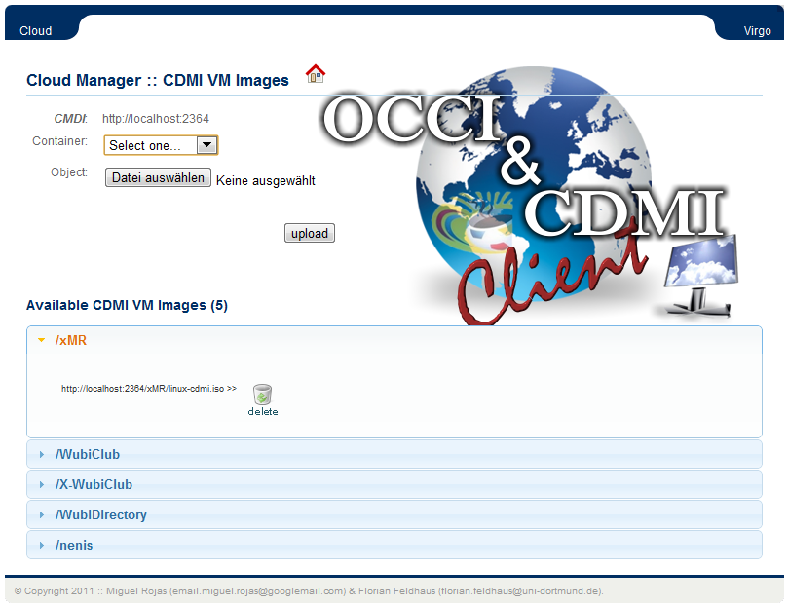
Web-GUI :: CDMI : VM Images

Slide 24
Instalation & Code
JDK 1.6 64bits
Maven 3.0.3
Virgo WebServer (tomcat-based)
http://www.eclipse.org/virgo/download
** JAVA_OPTS=-Xms1024m -Xmx2048m -XX:PermSize=1024m
Availability of Code : Open Source
Location: tobe defined.

Slide 25
Thanks for your
Attention !

