Slide 1
Predicting optimal location for establishing a restaurant in Mumbai city
Applied Data Science Capstone Project by Arunit Maity

Slide 2
Problem Statement
To find an optimal location for setting up a restaurant. Specifically, this project is targeted to stakeholders interested in setting up any food-joint/restaurant in Mumbai, Maharashtra, India. We try to detect locations that are not already crowded with restaurants and are as close to the city centre as possible.

Slide 3


Data Acquisition
Following data sources will be needed to extract/generate the required information:
names of all neighbourhoods will be extracted from the website ‘http://pincode.india-server.com/cities/mumbai/’ using Pandas package in python
approximate addresses of centres of these neighbourhoods will be obtained using GeoPy Geocoder package in python
number of restaurants and their type and location in every neighbourhood will be obtained using Foursquare API

Slide 4
Data Cleaning
The initial 239 neighbourhoods were filtered down to 103 neighbourhoods with a 3-stage filtering process:
First, 239 neighbourhoods were filtered down to 172 due to lack of location data.
Then, they were further filtered down to 145 neighbours with the criterion that only neighbourhoods within 25 Kms from the city centre are to be considered.
Finally, these neighbourhoods were furthered filtered down to 103 due to lack of data for proper clustering of neighbourhoods.

Slide 5
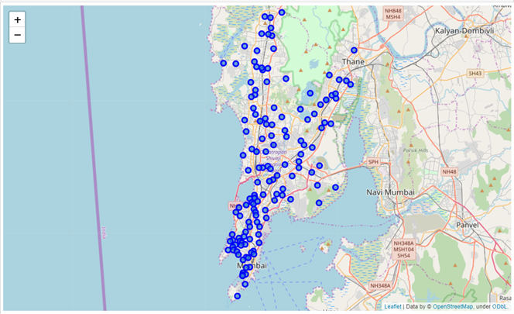
Map of Mumbai with relevant neighbourhoods

Slide 6
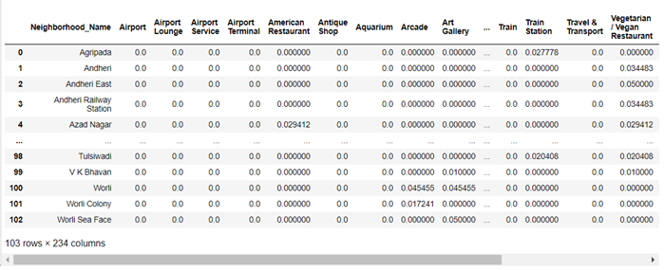
DataFrame fed to K-Means Clustering Algorithm

Slide 7
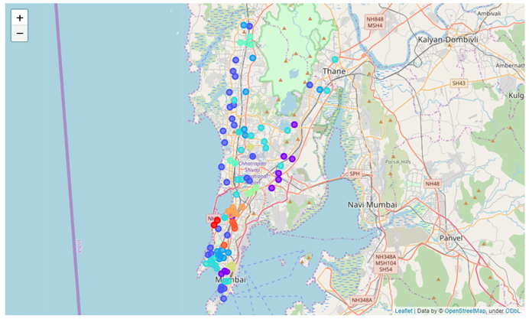
Map of Mumbai with neighbourhoods color-coded according to their clusters.

Slide 8
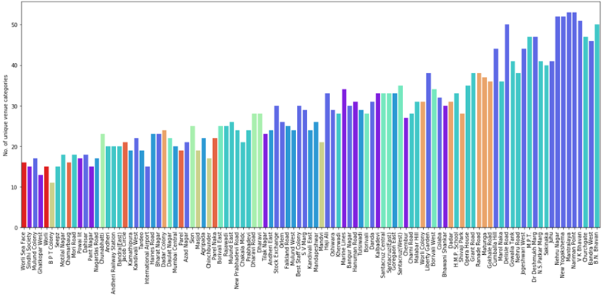
Bar graph
The bar graph below shows the diversity of amenities along Y axis and corresponding neighborhood names along X axis.
The bars are color coded according to their cluster number.

Slide 9
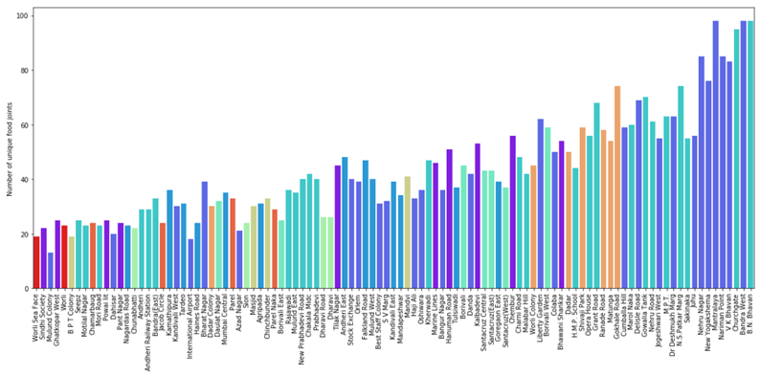
Bar graph
The bar graph below shows the number of food joints along Y axis and corresponding neighborhood names along X axis.
The bars are color coded according to their cluster number.

Slide 10
Conclusion
Optimal locations were identified as those neighbourhoods which are part of the best clusters (having neighbourhoods with most diverse amenities) yet have the least number of food joints. The optimal locations obtained are:
Mulund Colony
Dahisar
Motilal Nagar
Mori Road
International Airport
Final decision on optimal restaurant location will be made by stakeholders based on specific characteristics of neighbourhoods and their locations, taking into consideration additional factors like attractiveness of each location (proximity to park or water), levels of noise / proximity to major roads, real estate availability, prices, social and economic dynamics of every neighbourhood etc.

