Slide 1

R. V. COLLEGE OF ENGINEERING
(Autonomous Institution Affiliated to VTU, Belagavi)
R.V. Vidyanikethan, Bengaluru-560059
DEPARTMENT OF MASTER OF COMPUTER APPLICATIONS
ERP Solutions-Comparative studies
Prepared By
Anand Kumar K.(1RZ16MCA09)
Deepu Nagarajan(1RZ16MCA24)
Roopshri Mishra(1RZ16MCA53)
Sunidhi Sinha(1RZ16MCA59)
Under the guidance of
Dr. Preethi N Patil
Faculty In-charge:
Mrs. Savitha S.

Slide 2
Contents
Software tools available
Algorithms used for processing
Business benefits
Competitive advantage
Conclusion
References

Slide 3
Software Tools Available:
GREYTIP
Workflow Management
Human Resource Management and Payroll
Comprehensive coverage of every single aspect of payroll management including statutory compliance.
Accurate and super fast payroll processing. Easy to learn, easy to use.
Powerful reconciliation tools & reports to audit and review before payroll release
Ready to print payslips, reports, statements, etc.
Configurable, Analytical Dashboards
A live, up to date dashboard gives you instant updates about the state of your company. Employee costs, Statutory costs, attrition, average years in service, etc. and many other performance indicators are easily tracked, automatically.

Slide 4
DESKERA
Human Resource Management and Payroll
Paperless hiring, performance appraisals, payroll, timesheets.
Analytics(inventory, HR)
Highly customized and intuitive inventory reports provide a comprehensive view of what has been ordered, delivered and purchased. These reports are generated to support decision making. Inventory reports allow users to compare data between stock cycles and stores for customized time periods.
Other tools: Purchase Management, Sales Management

Slide 5
ACGIL
Human Resource Management and Payroll
Monthly and daily payroll process(salary and wages calculation) can be automatically computed
Analytics(inventory, HR)
Generates reports for complete stock status of all items in every department and stage
Other tools:
Purchase Management, Sales Management

Slide 6
Algorithms Used For Processing:
DECISION TREE
LINEAR REGRESSION
SUPPORT VECTOR MACHINE

Slide 7
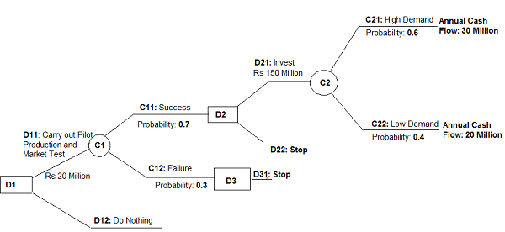
DECISION TREE ALGORITHM

Slide 8
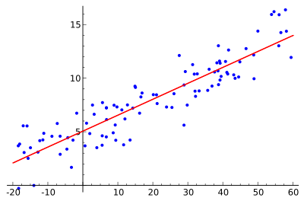
LINEAR REGRESSION ALGORITHM

Slide 9
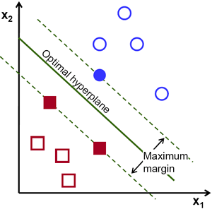
SUPPORT VECTOR MACHINE ALGORITHM

Slide 10
BUSINESS BENEFITS:
All in one solution to the business needs:
a typical ERP system manages functions and activities as different as the bills of materials, order entry, purchasing, accounts payable, human resources, and inventory control. For instance Deskera and ACGIL provide complete ERP solutions for various functional aspects of an organization while Greytip’s greytHR payroll software covers all aspects of payroll management.
Improved Productivity:
Self service can be leveraged. Data and operations can be forwarded to employees efficiently, and they can also access important information and transactions through various access terminals. The Employee self service module offered by Deskera helps the employees to edit/view their timesheet, download their payslip, apply for internal jobs etc.

Slide 11
Improvement in Financial Management :
A better visibility of the organization’s financial status can be obtained.
For example Analytical dashboard by Greytip gives the easy access to imformation about Employee costs, Statutory costs, average years in service, etc.
Deskera provides financial report in the form of profit/loss statements, balancesheets etc..
ACGIL’s finance and accounting module generates balancesheets along with costing and profitability reports with respect to a division or unit.
Ensuring Regulatory Compliance: Powerful ERP solutions will keep track of regulations within the industry and monitor changes in compliance. Statutory modules of Deskera, Greytip, and Acgil contribute to the ensurance of statutory compliance needs of an organization.
Improved efficiency: An ERP solution eliminates repetitive processes and greatly reduces the need to manually enter information.

Slide 12
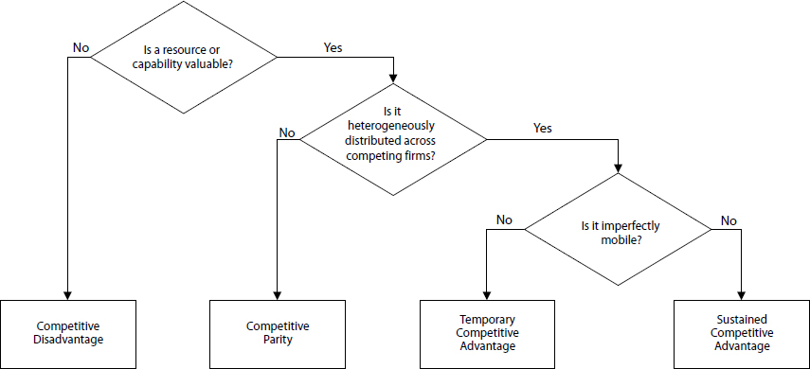
COMPETITIVE ADVANTAGE

Slide 13
The first criterion in the framework is: Does a particular resource add value to the firm? This question is related to the possibility to reduce costs or increase revenue by product differentiation when exploiting the resource.
The second criterion in the framework is: Is a particular resource or capability heterogeneously distributed across competing firms? If all firms have access to the same resources, the resources will not give a competitive advantage. It will most likely result in competitive parity.
The third criterion in the framework is: Is a resource or capability imperfectly mobile? If firms without valuable resources have no problem in acquiring, developing, and using it compared with firms that already possess this resource, then it will only be a source of temporary competitive advantage for the firms that originally controlled it. If a resource is hard to imitate, the firms that control this resource are in a position to achieve a sustainable competitive advantage through this resource

Slide 14
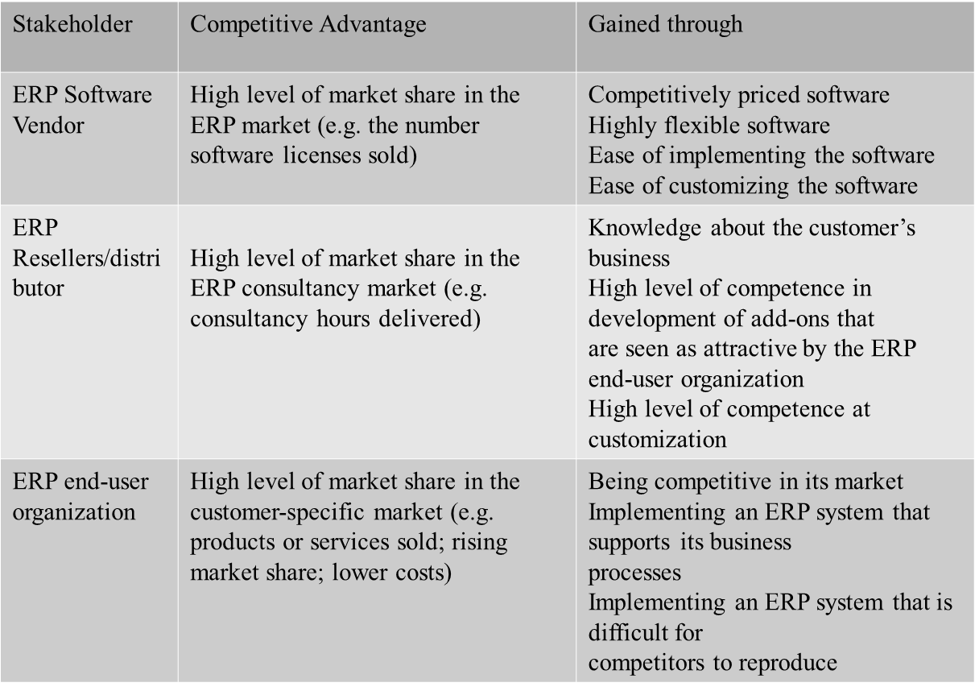

Slide 15
CONCLUSION:
Implementation of ERP systems results in business integration and improved data accuracy:
Automation of tasks: The ERP systems automate repetitive tasks formerly performed by hand (generation of delivery notes, invoices etc..
Planning and MIS:As a part of MIS, an ERP system, contains many inbuilt standard reports and also a report writer that produce ad hoc reports, as and when needed.
Cost Reduction: This reduction is due both to the economy of time, and to improvements in the control and analysis of business decisions.
Although ERP provides many advantages; its implementation is a strategic decision, involving significant resources (both financial and human), proper evaluation and business process re-engineering. There must be a commitment from all levels. A failed implementation may lead to bankruptcy of an organization.

Slide 16
REFERENCES:
http://www.referenceforbusiness.com/small/DiEq/Enterprise-Resource-Planning-ERP.html#ixzz4h2B6jFVE
https://www.greythr.com/in/features/statutory-compliances/
http://www.myacme.org/ACMEProceedings09/p6.pdf
http://aisel.aisnet.org/cgi/viewcontent.cgi?article=1733&context=amcis2009
http://www.diku.dk/~henglein/3gERP-workshop-2008/papers/fosser-leister-moe-newman.pdf
http://www.managementstudyguide.com/enterprise-resource-planning.htm

