Slide 1
Linkedin-Grad
Linkedin’s subsidiary app for graduates
Product Owner: Arun Joshi
© 2019 Udacity. All rights reserved.

Slide 2


Background
Why Are We Here?
New grads and college students don’t know how to identify specific jobs and employers that fit their education, skills and career interests.
source
© 2019 Udacity. All rights reserved.

Slide 3
Business Case
© 2019 Udacity. All rights reserved.
Notes:
[ALL PARTICIPATION]

Slide 4
Initial Focus
Where are we starting?
As a leading platform to connect world’s professionals, with a vision to “create economic opportunities for every member of global workforce”, it is eminent that we address recent graduate’s issues to identify a workplace that suits their interests.
© 2019 Udacity. All rights reserved.

Slide 5
Opportunity
What’s the problem?
According to research by Grad Staff
70% new grads don’t know how to identify jobs that fits their interests.
80% graduating seniors leave campus without a job.
© 2019 Udacity. All rights reserved.

Slide 6

Opportunity
What’s the problem?
A platform that is specifically catered to the needs of graduating students can help them find their dream job all the while onboarding a large customer base into Linkedin ecosystem every year.

Slide 7


Target User
Graduating or recently graduated
Loves smart phone and social media
Used to online assessments
Wants to work at jobs that align with their life goals, career interests and personal values
Does not know how to look for jobs and employer that fit their education, skills and career interest

Slide 8
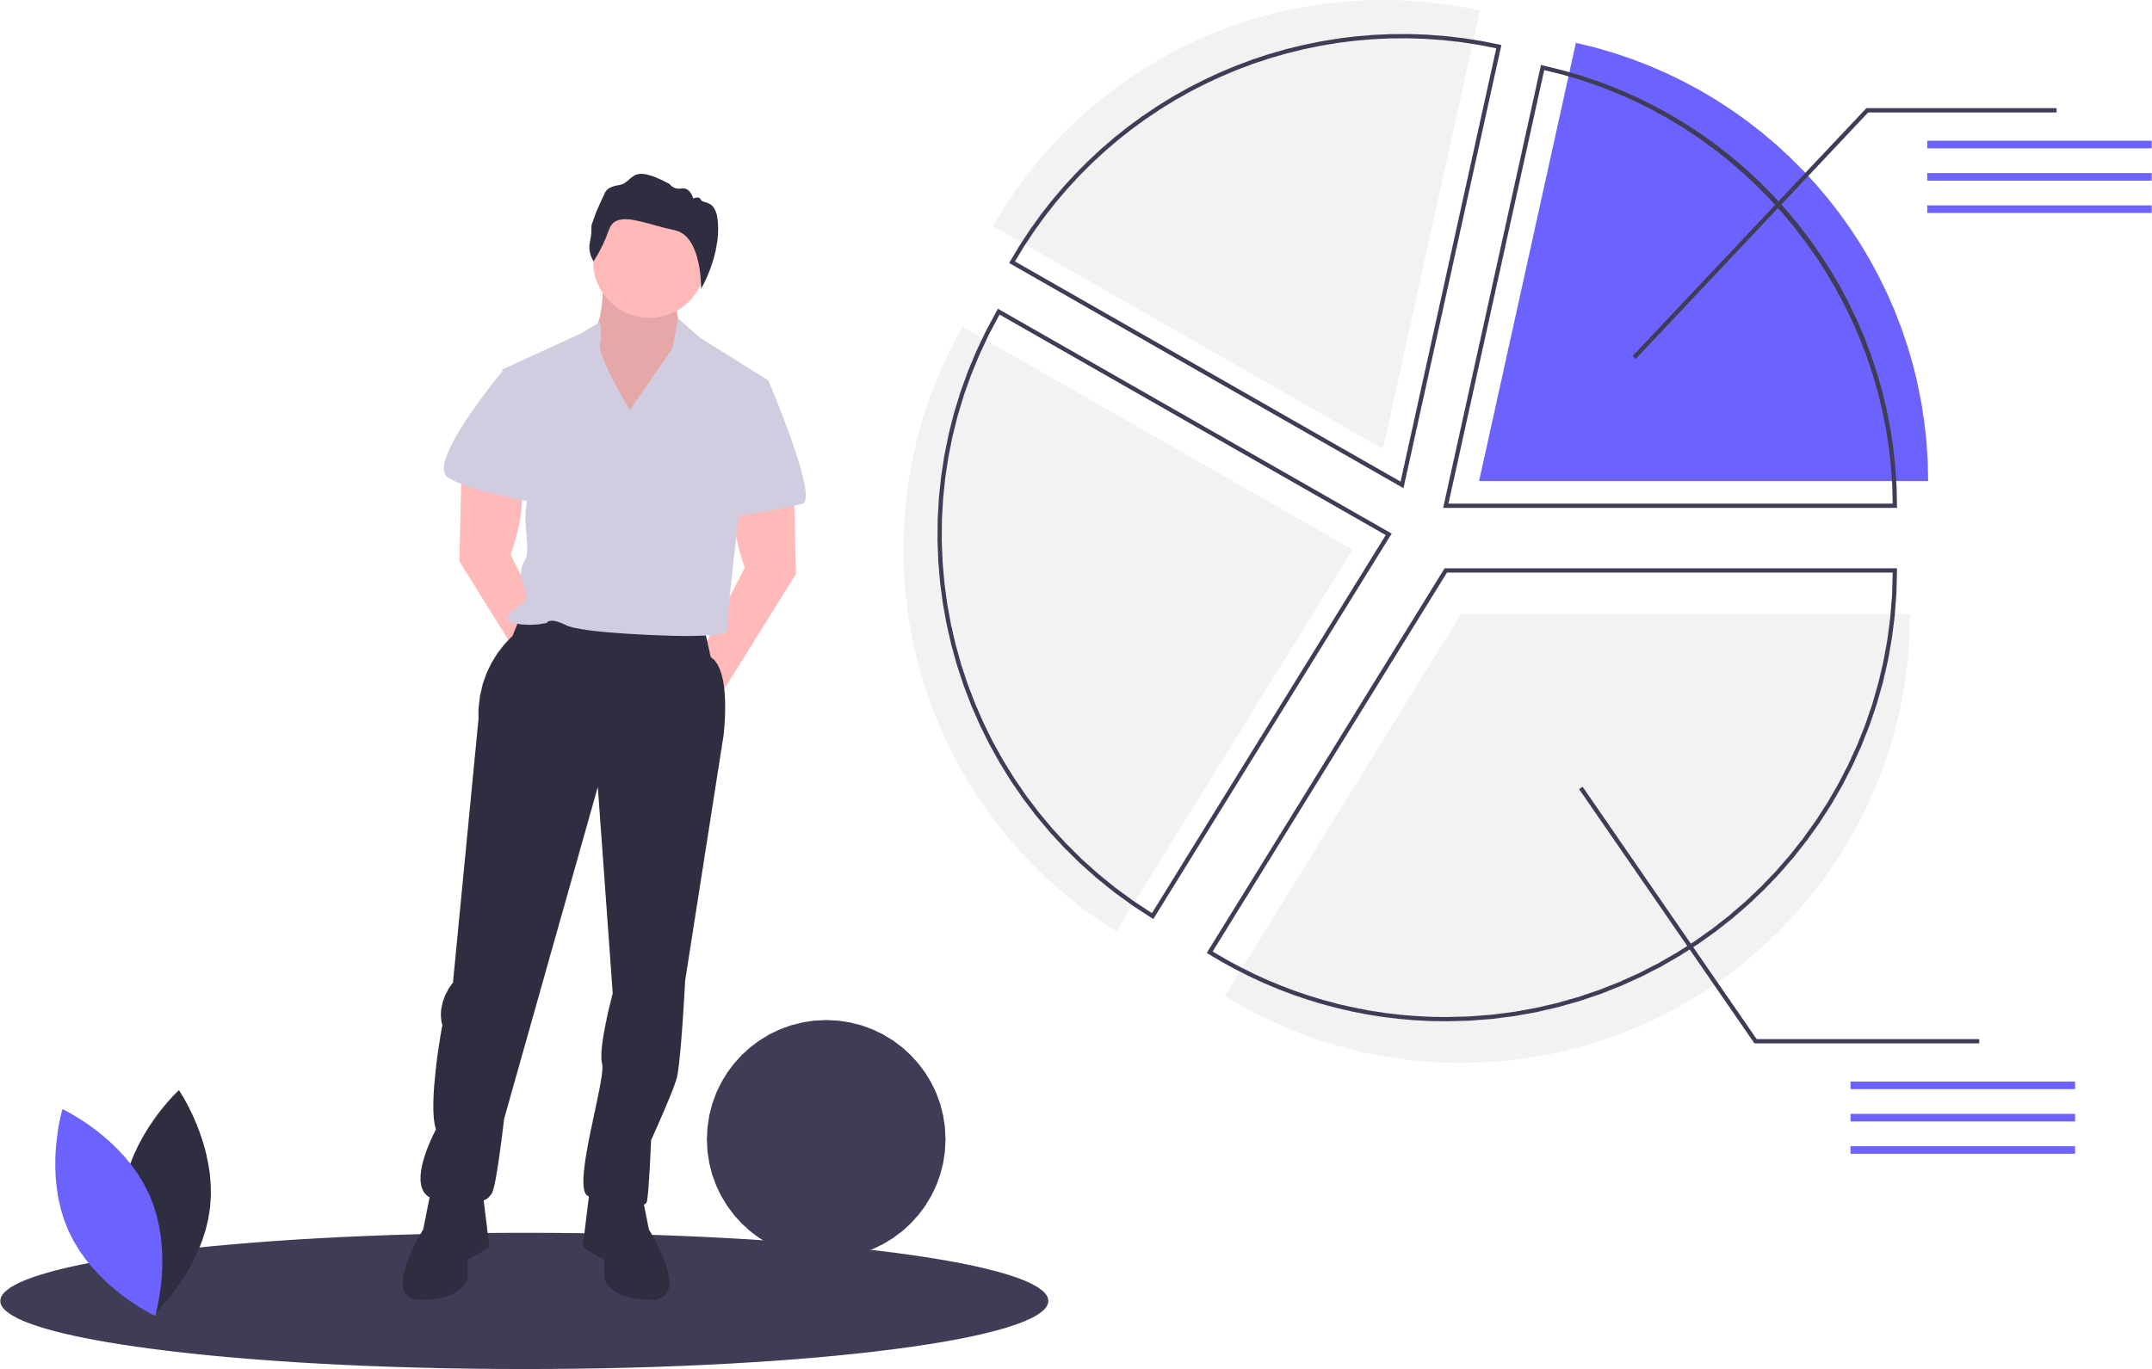
Total Addressable Market(TAM)
According to world bank, total higher education students in the world = approximately 200million
Linkedin Grad subscription (linkedin premium, linkedin salary, linkedin learning included) = $29.99 (only or verified students and recent grads)
Total Addressable market = total users*29.99 = 5.998B=~6 Billion dollars

Slide 9
Proposal
What’s Our Solution?
Job recommendation engine based on user interactions, skills, test scores, education and life goals.
Online lessons, training material, Industry standard assessment tests and certifications.
Interactive virtual career fares.
facilitate alumni networking and referral requests.
© 2019 Udacity. All rights reserved.

Slide 10
Return On Investment
What can we do?
Total development time = 1 year (14 employees)
Total development cost (avg salary*14) = 112,000*14 $1,920,000
PR and marketing budget $1,000,000
Expected fixed operational cost per year = $1,000,000
Total cost = $3,420,000 = $0.00342Billion
Expected users per year = 35 Million
Total revenue = 35 million*subscription price= 0.035*29.99 Billion = $1.05 Billions
ROI = (1.05B- 0.00342)/0.00342 = 30,601.7%
© 2019 Udacity. All rights reserved.

Slide 11
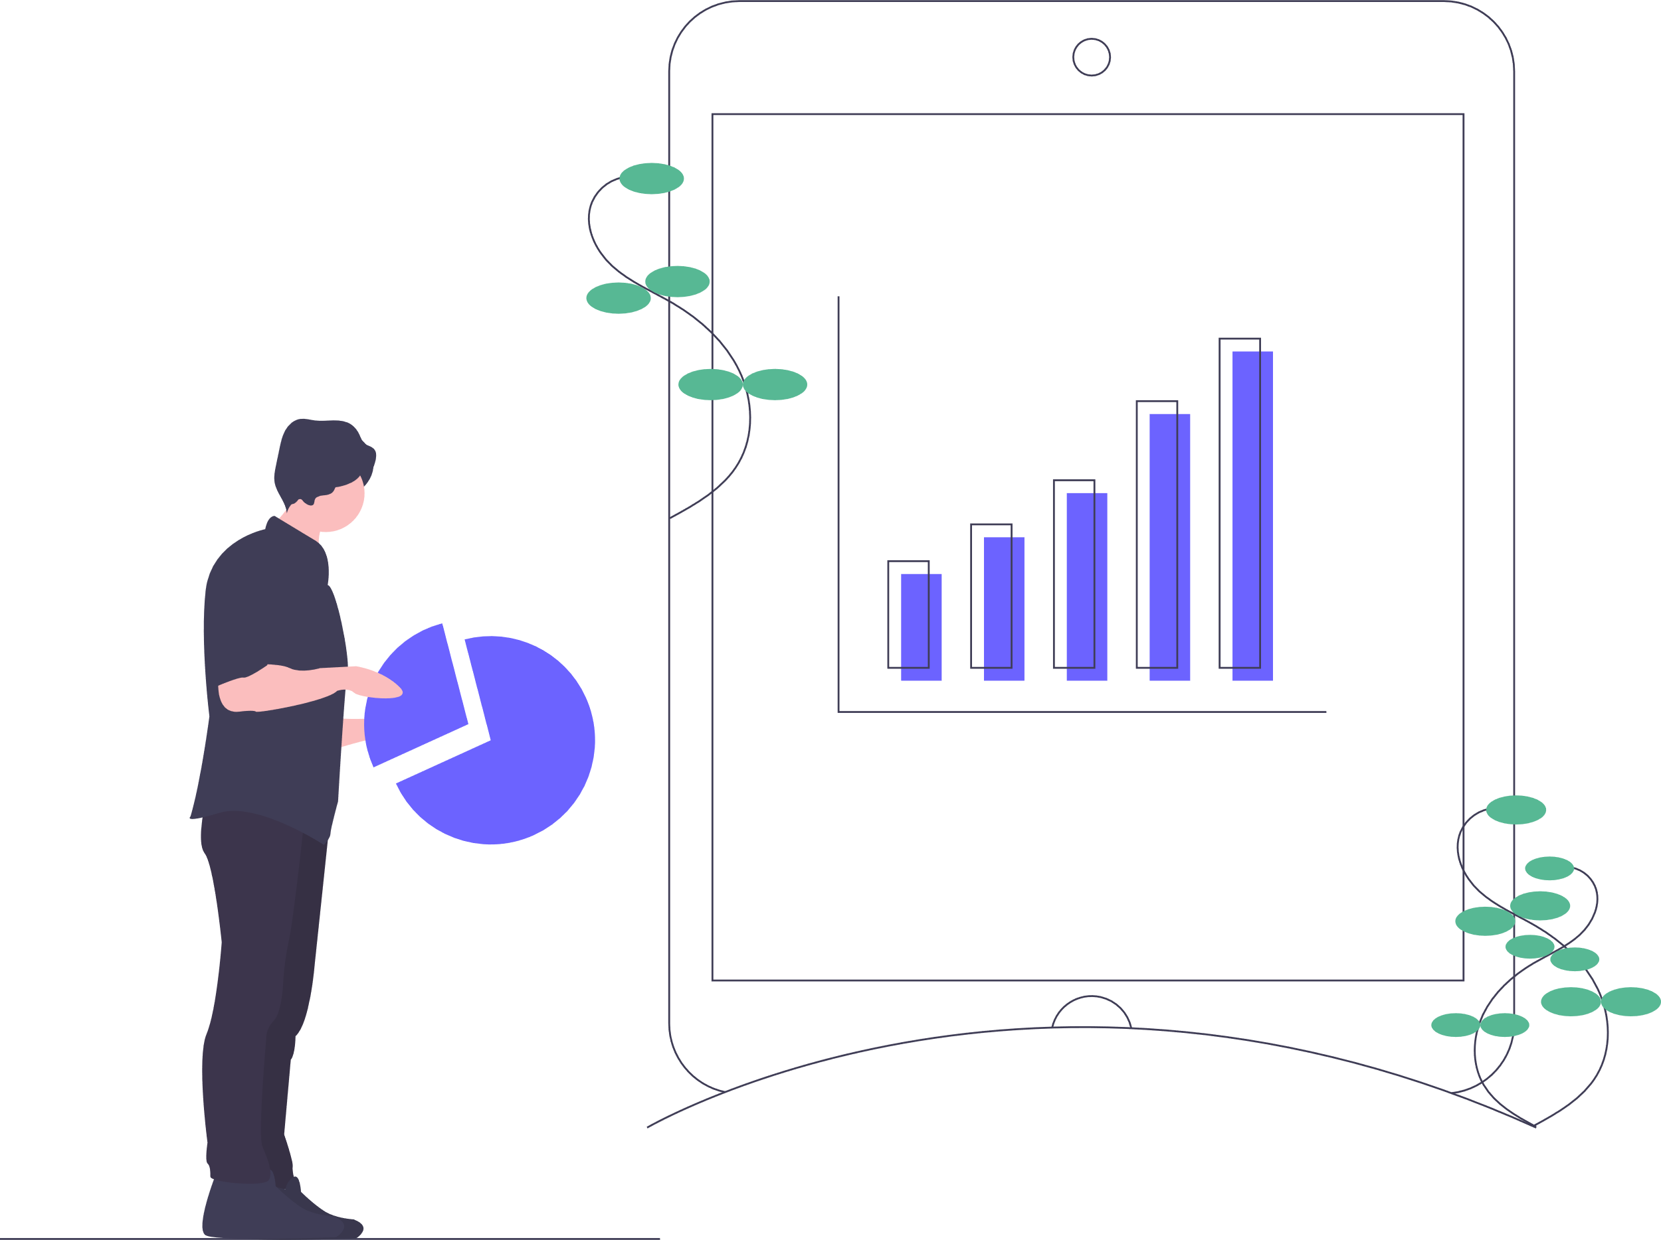
Measurement
How will we know if we’re successful?
35 million+ subscribed users
1 Billion dollars in revenue per year
20%+ students graduate with an employment offer.
50 million+ app downloads
>3.8 rating in app stores
© 2019 Udacity. All rights reserved.

Slide 12
Competitors
© 2019 Udacity. All rights reserved.
Notes:
[ALL PARTICIPATION]

Slide 13

aftercollege.com
discover entry level jobs and internships
Patented AI powered job recommendation engine
400,000 entry-level jobs and internships from 25,000+ employers
AfterCollege reaches more than 5,000,000 students each year
Contacts at over 2,000 colleges and universities
© 2019 Udacity. All rights reserved.

Slide 14

Handshake
Committed to democratizing opportunity
More than 500,000 employers
Exclusive virtual career fairs and events
Handshake partners with more than 1,000 colleges and universities.
Involvement of school’s career center for resume review and career support.
Annual revenue 43.1 Million dollars
© 2019 Udacity. All rights reserved.

Slide 15

College recruiter
Founded in 1996 before google, yahoo and linkedin
Partnered with 7,400+ one, two- and four-year colleges and universities
Customers are primarily Fortune 1,000 companies, government agencies, and other employers who are hiring at scale
Special demographic targeted email campaigns
© 2019 Udacity. All rights reserved.
Notes:
https://www.collegerecruiter.com/advertising/

Slide 16
Our Advantages
Why are we better?
Single platform for company profiling, online learning, assessments and job search
77% recruiters already use Linkedin
Over 50 million companies have profiles on LinkedIn
Already 46 million student users
Global reach
source
© 2019 Udacity. All rights reserved.

Slide 17
Roadmap and Vision
© 2019 Udacity. All rights reserved.
Notes:
[ALL PARTICIPATION]

Slide 18
Roadmap Pillars
Where do we go from here?
Empower every graduating student by providing access to available employment opportunities and training materials to embark on their professional journey.
Three important segments of the product
-Online learning and assessments
-Career support
-Job hunt
© 2019 Udacity. All rights reserved.

Slide 19
Online learning and assessment
Provide information about what skills are valued in the industry and suggest courses and certificates.
Host online assessments for large array of skills.
Recruiters will have access to user scores and can reach out to qualifying students.
Companies will be able to design assessments that fit their requirements.
© 2019 Udacity. All rights reserved.

Slide 20
Career Support
Partner with school’s career support organizations to help students with resume and interview preparation.
Facilitate Alumni networking and referral request
Host virtual school/organization wide career fairs.
© 2019 Udacity. All rights reserved.

Slide 21
Job Hunt
Provide information about company demographics, salary and vision.
Generate a user profile using assessment scores, school grades, alumni placement and user interaction to recommend jobs using machine learning models.
© 2019 Udacity. All rights reserved.

Slide 22
Where do we go from here?
Widening the scope
Linkedin Grad can be the staple for every graduating student to look for opportunities that aligns with their career goals. These users that are onboarded can also be a revenue source down the line for Linkedin.
© 2019 Udacity. All rights reserved.

