Slide 1
P12: Automatic Generation of a Slide Show from Text
9:30am
Shanka Sai Sudheer Kumar
Rohit Girdhar
Arun JVS

Slide 2
P12: Automatic Generation of a Slide Show from Text
Motivation
Authors of technical papers often use slides to effectively present their ideas in conferences and meetings
Want to automate this – and generate a starting point presentation with organized headings, images, summarized text and references that can be further tuned into a final presentation
Problem Definition
Take a HTML version of a paper and generate a neat summarized version of it in the form of a presentation

Slide 3
Related Work
M. Sravanthi, C. Ravindranath Chowdary and P. Sreenivasa Kumar. “SlidesGen: Automatic Generation of Presentation Slides for a Technical Paper Using Summarization” at FLAIRS Conference 2009
Key Idea: LaTeX input already preserves rich structural information, they convert LaTeX -> XML+Config -> LaTeX
Use only statistical processing, without NLP
Use graph based summarization algorithm (QueSTS)
Results: Subjective evaluation of questions on 8 users like
How much information is covered? (9.25/10)
What is the level of coherence of slides? (9/10)
How good a starting point is it? (8.5/10)
Conclusion: Simple statistical methods are a good starting point
Brandon Beamer and Roxana Girju. “Investigating Automatic Alignment Methods for Slide Generation from Academic Papers” in Proceedings of CoNLL 2009. Pages 111-119
Key Idea: Formulated around an alignment model of matching already available paper-presentation pairs instead of generating them
Conclusion: Important insights: TF-IDF along with simpler metrics like count of matched terms works better. Uncontrolled “generic” keyword expansion reduces quality of a “technical” presentation

Slide 4

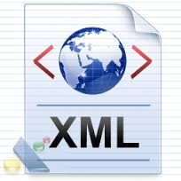


Our Methodology
Key Idea: A robust pipeline of a parser, summarizer and generator, incorporating lessons learnt from previous methods, and our own heuristics.
Parser is self written; and very robust and complex, and outputs a clean xml:
Does deep recursive analysis of dirty and non-uniform heading hierarchy
Scans for images and associates them with possible captions in neighborhood
Smoothens line splits and tags lines with images and references they point to
Handles some instances of broken tag nesting and dirty character encodings
Summarizer essentially prunes the xml keeping the most informative content. Uses multiple heuristics:
Expand keywords using co-occurrence frequency, but filter stop words
Uses keywords to summarize abstract (occurrence), abstract to summarize introduction (TF-IDF)
For sections with numbered points, select them right away
Boost scores of lines tagged to images
Use a list of “conclusive” words for summarizing conclusion: ex. showed, concluded, proposed, contributed
Generator is relatively straight forward
Converts the summarized xml into a neat LaTeX presentation
Performs necessary conversion of image file formats
Parser
Summarizer
Generator
HTMLSanitizer
KeywordExpander
Neat Fitting
SectionSplitter
SectionSummarizer
XMLSanitizer
LineSplitter
TFIDF Scores
Image format conversion
pdflatex
LineTagger
Boosted image selection heuristics

Slide 5
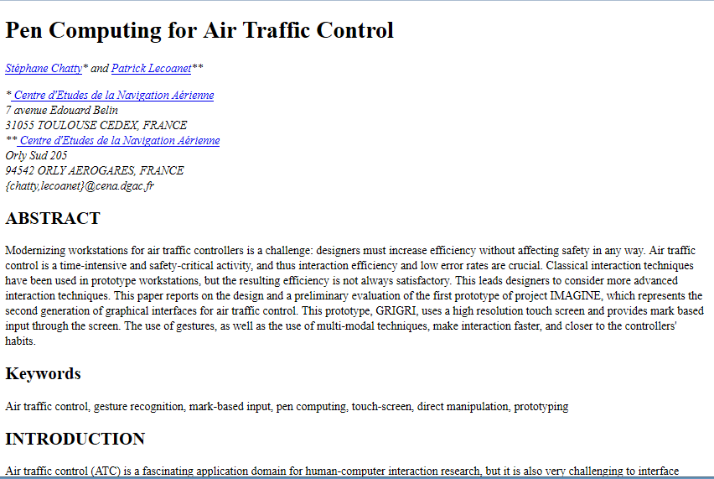
Results: HTML as seen in browser

Slide 6
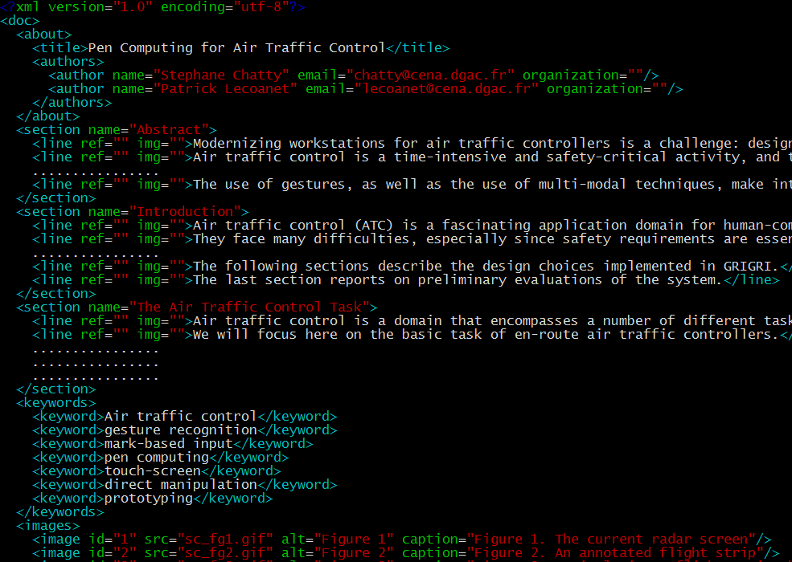
Results: HTML converted to XML

Slide 7
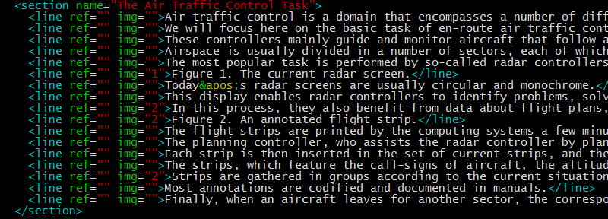
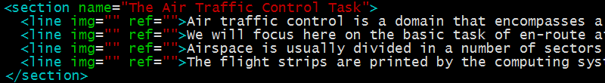
Results: XML to Summarized XML
Keyword Expansion:
Original: Air traffic control, gesture recognition, mark-based input, pen computing, touch-screen, direct manipulation, prototyping
New: Air, Domain, interaction, control, traffic

Slide 8
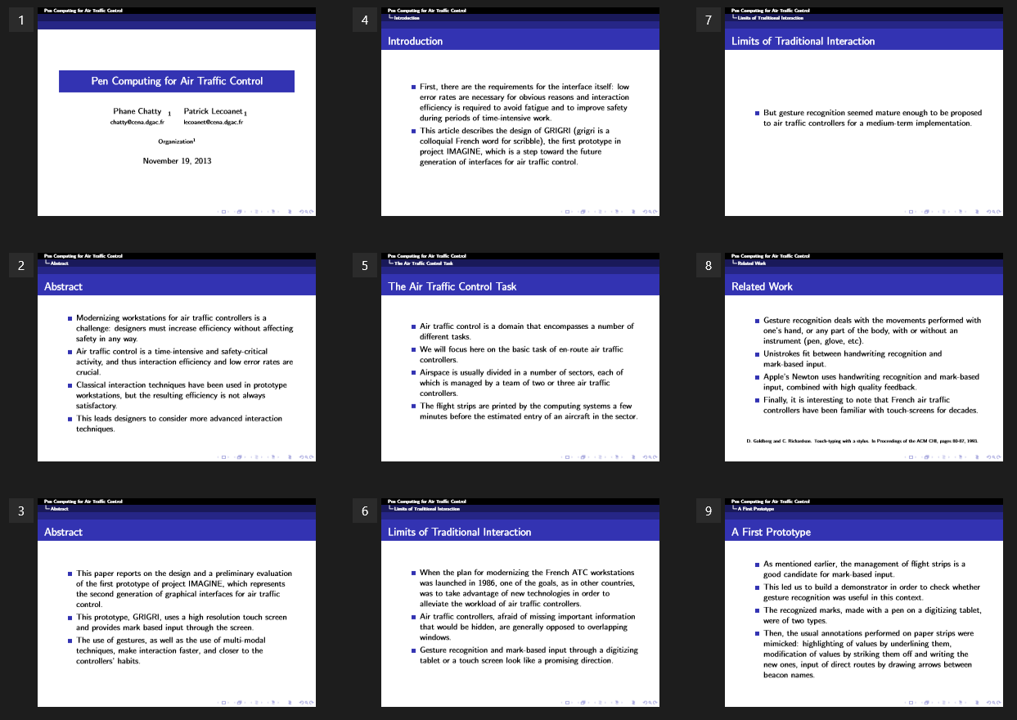
Results: Generated Presentation

Slide 9
Summary
Dataset: 40/53 Papers in HTML from SIGCHI 96
Remaining ones were rejected by parser due to
Incompletely downloaded \ corrupted html
No heading hierarchy \ flat text dump without sections
Irreparable errors in html tag structure
Missing Abstract\Introduction
Results are very subjective
Tweaked heuristics until all of the team members agreed on quality
What did you learn from this project?
Automated summarization of a technical paper into a presentation is quite doable. The output is a good starting point for a presenter to tweak it into the final presentation.
Future work
Our approach and the mix of papers we used – all use statistical methods like similarity between keywords, abstract, introduction and the inner sections
More “natural” and “smoother” summarization is possible using Natural Language Processing (NLP) methods

