Slide 1

Introduction to Maharishi Valmiki
• Maharishi Valmiki is revered as the 'Adi Kavi' (First Poet) of Sanskrit literature.
• He is the author of the epic Ramayana, one of the foundational texts of Hinduism.
• His life story exemplifies a profound transformation from a bandit named Ratnakara to a revered sage.
• Valmiki's work introduced the Anushtubh meter, a cornerstone of classical Sanskrit poetry.
• He is considered a divine sage who witnessed and documented the life of Lord Rama.

Slide 2
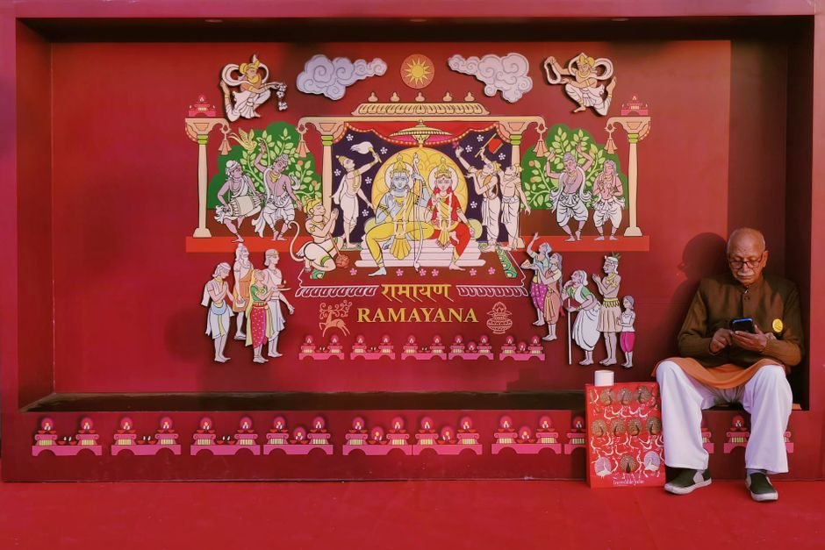
The Saga of the Ramayana
• The Ramayana is an ancient Indian epic poem depicting the life of Lord Rama, an avatar of Vishnu.
• Valmiki composed the Ramayana after witnessing the grief of a Krauncha bird, inspiring the first 'shloka'.
• The epic spans over 24,000 verses, divided into seven books (kandas).
• It narrates themes of dharma, sacrifice, devotion, duty, and the triumph of good over evil.
• Valmiki also served as a mentor, teaching the Ramayana to Lord Rama's sons, Luv and Kush.

Slide 3

Legacy and Enduring Influence
• Valmiki's Ramayana has profoundly shaped Indian culture, art, philosophy, and moral values for millennia.
• He is celebrated for pioneering the 'Adi Kavya' (First Epic) and establishing the foundations of Sanskrit poetry.
• His teachings emphasize righteousness (dharma), courage, devotion, and the pursuit of truth.
• The Ramayana continues to be performed, read, and studied globally, transcending religious and cultural boundaries.
• Maharishi Valmiki remains an eternal source of inspiration as a poet, philosopher, and sage.

