Slide 1

Addressing Integrity Concerns in National Examinations: The NEET Context
• The National Eligibility cum Entrance Test (NEET) is pivotal for medical admissions.
• Recent allegations of paper leaks threaten the exam's sanctity and fairness.
• Impacts millions of aspiring students, their families, and national educational trust.
• Highlights an urgent need for comprehensive analysis and proactive intervention.
• This presentation outlines the issue, its far-reaching impact, and potential solutions.

Slide 2

Far-Reaching Consequences: Erosion of Trust and Student Morale
• Students face immense mental stress, anxiety, and demotivation.
• Undermines public faith in the integrity and reliability of the examination system.
• Jeopardizes meritocracy, potentially allowing undeserving candidates to gain entry.
• Triggers legal challenges and prolonged administrative uncertainty for stakeholders.
• Damages India's reputation for conducting fair and transparent competitive exams.

Slide 3
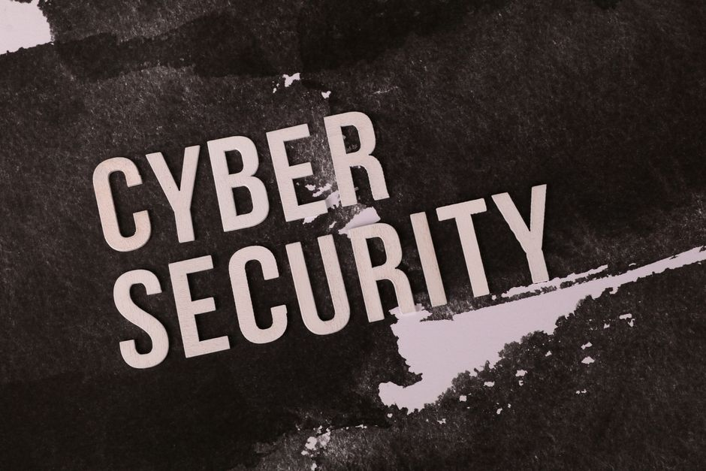
Unpacking the Dynamics: Factors Contributing to Exam Leaks
• Weak points in the exam paper supply chain and distribution security.
• Organized criminal networks exploiting systemic loopholes for financial gain.
• Lack of robust digital security and advanced anti-cheating technologies.
• Potential for insider collusion and insufficient accountability mechanisms.
• Inadequate regulatory oversight and slow response to security breaches.

Slide 4

Strategic Interventions for Enhanced Exam Security
• Implement advanced encryption and tamper-proof digital delivery systems for papers.
• Strengthen physical security across all test centers and storage facilities.
• Utilize AI-powered surveillance, biometrics, and real-time anomaly detection.
• Establish an independent oversight body with swift investigative powers.
• Enforce severe penalties for perpetrators and abettors of paper leaks.
• Foster collaboration between law enforcement, educators, and technology experts.

Slide 5

Upholding Meritocracy: A Commitment to Fair and Secure Examinations
• The NEET paper leak issue demands immediate and decisive action from all stakeholders.
• Restoring student and public trust is paramount for the integrity of the education system.
• Requires a multi-faceted approach addressing technology, policy, and enforcement.
• Long-term vision for a transparent, equitable, and secure examination framework.
• Collective responsibility of government, institutions, and civil society is crucial for lasting change.

