Slide 1

The Computer: Foundation of the Modern World
• Computers are ubiquitous, fundamentally shaping our daily lives and global economy.
• From smartphones to supercomputers, they drive innovation across all sectors.
• Understanding their principles is crucial for navigating technological advancements.
• This presentation will explore the definition, evolution, components, and impact of computers.

Slide 2

Defining the Computer: An Essential Overview
• An electronic device that takes input, processes data, stores information, and produces output.
• Operates based on programmed instructions (software) controlling its hardware components.
• Core functions include computation, data manipulation, and logical operations.
• Fundamentally built on binary code, representing data as 0s and 1s.
• Comprises both physical components (hardware) and intangible programs (software).

Slide 3
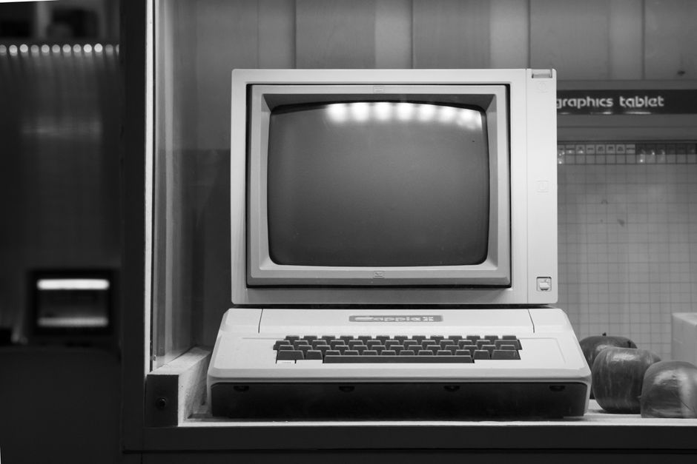
From Abacus to AI: A Timeline of Computing Evolution
• Early mechanical aids like the abacus and analytical engine laid conceptual groundwork.
• First-generation computers (1940s-50s) used vacuum tubes, were massive and energy-intensive.
• Transistors (1950s) enabled smaller, faster, and more reliable second-generation machines.
• Integrated circuits (1960s) led to microprocessors and the personal computer revolution.
• Modern computing emphasizes miniaturization, connectivity, and artificial intelligence.

Slide 4
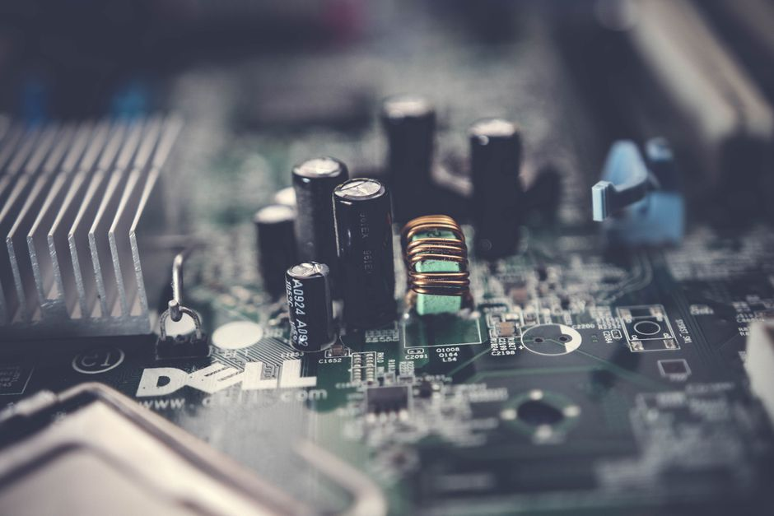
Deconstructing the Machine: Hardware Architecture
• CPU (Central Processing Unit): The "brain," executing instructions and performing calculations.
• Memory (RAM): Volatile storage for active programs and data, enabling quick access.
• Storage (HDD/SSD): Non-volatile persistence for operating systems, applications, and files.
• Input/Output Devices: Peripherals like keyboards, monitors, printers facilitate interaction.
• Motherboard: The central circuit board connecting all components and allowing communication.

Slide 5
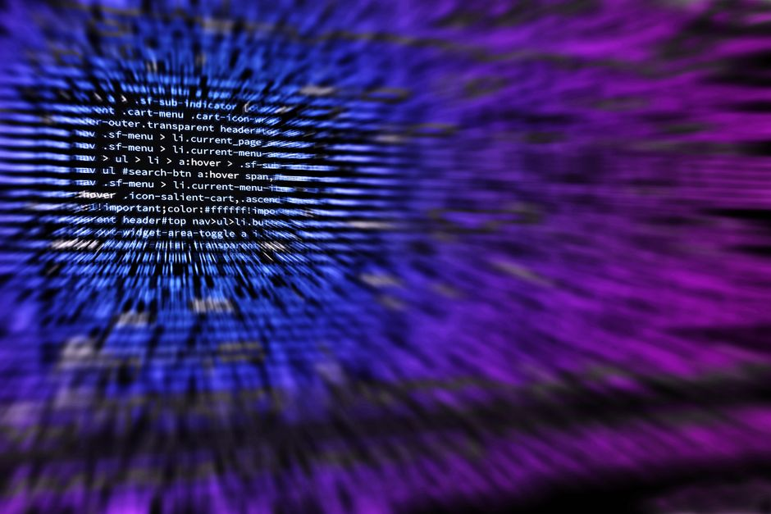
The Software Layer: Operating Systems and Applications
• Operating System (OS): Manages hardware, software resources, and provides user interface (e.g., Windows, macOS, Linux).
• Application Software: Programs designed for specific tasks (e.g., word processors, web browsers, games).
• System Software: Utilities, drivers, and firmware that support the OS and hardware.
• Software is developed using various programming languages, translated into machine code.
• Continuous updates enhance security, performance, and introduce new functionalities.

Slide 6
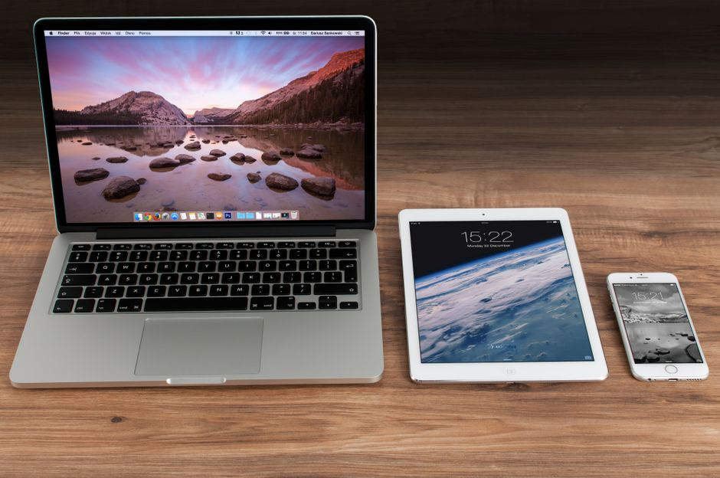
Categorizing Computers: From Personal to Supercomputing
• Personal Computers (PCs): Desktops, laptops, tablets, designed for individual user tasks.
• Mobile Devices: Smartphones, wearables, optimized for portability and connectivity.
• Servers: Powerful machines providing services, data, and resources over a network.
• Embedded Systems: Specialized computers within other devices (e.g., cars, appliances, IoT).
• Supercomputers: Extremely powerful, used for complex scientific and engineering computations.

Slide 7

Societal Transformation: The Computer's Profound Impact
• Communication: Revolutionized with email, instant messaging, and social media.
• Education: Enhanced learning tools, online courses, and digital libraries.
• Healthcare: Advanced diagnostics, medical research, and patient management systems.
• Business & Economy: Increased automation, global commerce, and data-driven decisions.
• Entertainment: Digital media, gaming, and streaming services are now commonplace.

Slide 8

The Horizon of Computing: Emerging Technologies
• Artificial Intelligence (AI): Machine learning, deep learning, natural language processing driving automation and insights.
• Quantum Computing: Revolutionary computation paradigms for complex problems beyond classical limits.
• Internet of Things (IoT): Network of interconnected physical devices with sensors, software, and other technologies.
• Edge Computing: Processing data closer to its source, reducing latency and bandwidth usage.
• Augmented Reality (AR) / Virtual Reality (VR): Immersive experiences changing interaction and training.

Slide 9
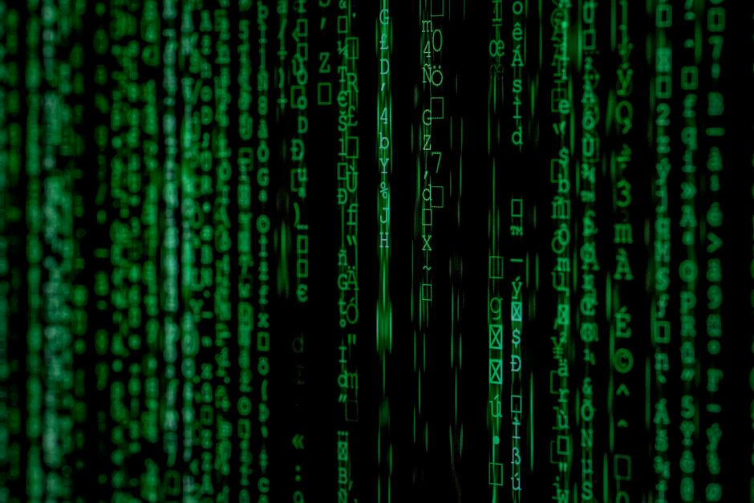
Navigating the Digital Age: Challenges and Ethics
• Data Privacy & Security: Protecting personal and sensitive information from breaches.
• Cybercrime & Hacking: Constant threat of malicious attacks and data theft.
• Digital Divide: Inequality in access to technology and its benefits globally.
• Automation & Job Displacement: Impact of AI and robotics on the workforce.
• Ethical AI: Ensuring fairness, transparency, and accountability in AI development and deployment.

Slide 10

Conclusion: The Enduring Power of Computing
• Computers are fundamental, evolving tools that define our modern technological landscape.
• Their impact spans every aspect of society, driving progress and innovation.
• Understanding hardware, software, and their interdependencies is crucial for future literacy.
• As technology advances, new opportunities and ethical responsibilities emerge continuously.
• The journey of computing continues, promising even more transformative developments ahead.

