Slide 1
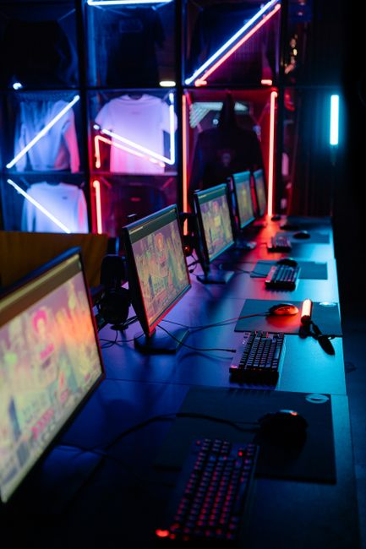
Understanding the Computer: An Introduction
• A computer is an electronic device designed to process, store, and retrieve data based on programmed instructions.
• Its core functions include inputting data, processing information, outputting results, and storing data for future use.
• Computers have evolved from simple calculators to complex systems, profoundly shaping every aspect of modern society.
• They serve as fundamental tools in communication, education, business, science, and entertainment.

Slide 2
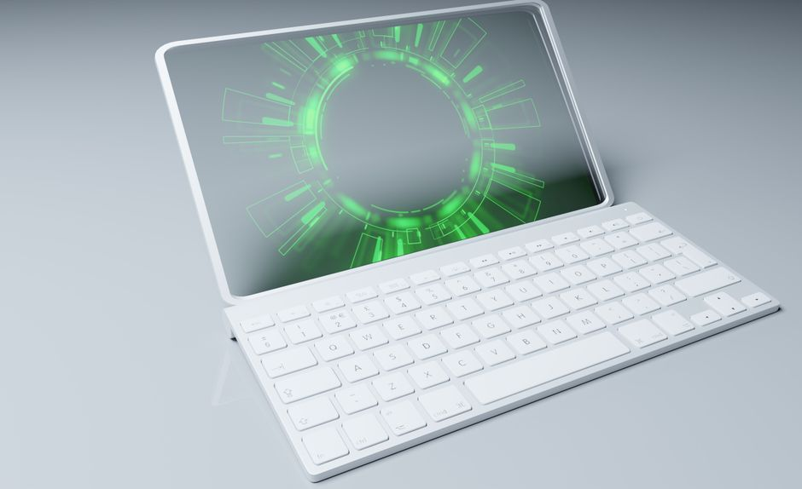
The Enduring Impact and Future of Computers
• Computers remain indispensable tools, driving innovation and efficiency across all industries and daily life.
• Continuous advancements in areas like AI, quantum computing, and IoT promise even more transformative capabilities.
• Their adaptability and increasing intelligence will further redefine human-computer interaction and problem-solving.
• The journey of computing underscores humanity's relentless pursuit of knowledge and technological progress.

