Slide 1
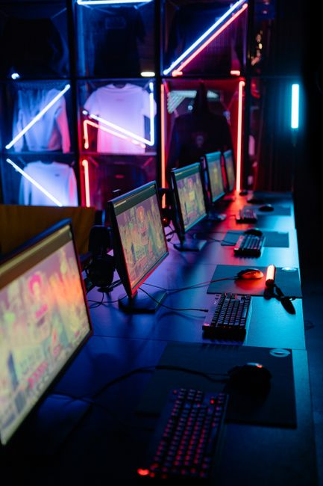
Introduction to Computers
• A computer is an electronic device that processes data, performs calculations, and executes tasks based on programmed instructions.
• It consists of hardware (physical components) and software (programs and data).
• Computers are fundamental tools in nearly every aspect of modern life, from communication to scientific research.
• They have evolved from large, complex machines to compact, powerful devices, continuously revolutionizing industries and daily activities.

Slide 2
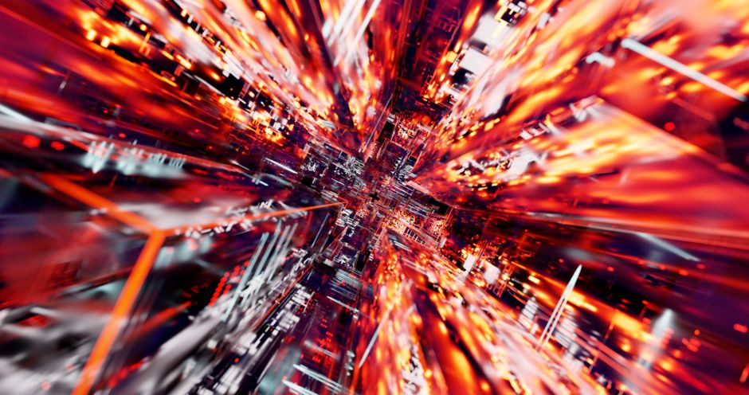
Conclusion: The Ever-Evolving World of Computing
• Computers have transformed human civilization, enabling unprecedented advancements in communication, science, education, and entertainment.
• Their influence continues to grow with emerging technologies like Artificial Intelligence, Machine Learning, and Quantum Computing.
• The ongoing miniaturization and increased processing power promise even more integrated and intelligent systems.
• Understanding computing principles remains vital for navigating and contributing to our increasingly digital world.

