Slide 1
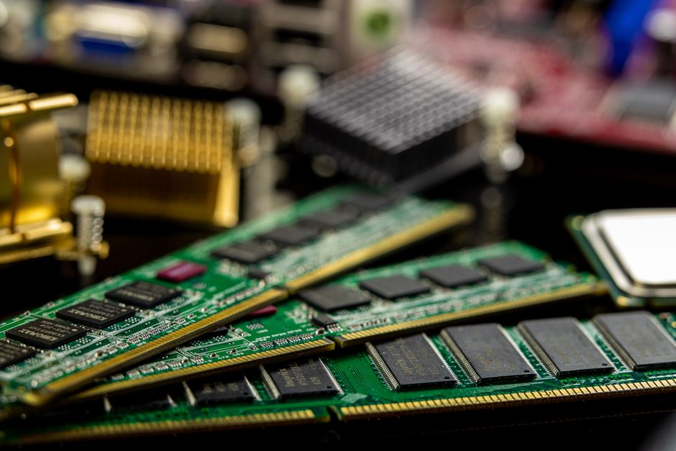
Introduction to Random Access Memory (RAM)
• RAM (Random Access Memory) is a form of computer data storage that can be accessed randomly, allowing data to be read or written quickly.
• It serves as a computer's short-term memory, temporarily holding data and program instructions that the CPU is actively using.
• RAM is a volatile memory, meaning it requires power to maintain the stored information; data is lost when the computer is turned off.
• Its high speed is crucial for efficient multitasking and rapid application responsiveness.

Slide 2
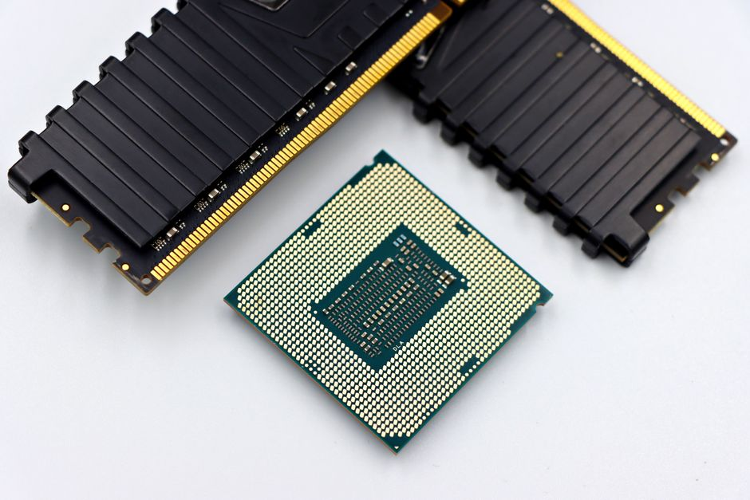
The Critical Role of RAM in System Performance
• The quantity and speed of RAM directly impact a computer's ability to run multiple applications smoothly and handle complex tasks.
• Insufficient RAM can lead to performance bottlenecks, forcing the system to rely on slower storage (like an SSD or HDD) for temporary data, known as 'swapping'.
• Adequate RAM contributes to overall system stability, reducing crashes and improving the user experience.
• As software and data demands grow, increasing RAM capacity and speed remains a key factor in future computing performance.

