Slide 1
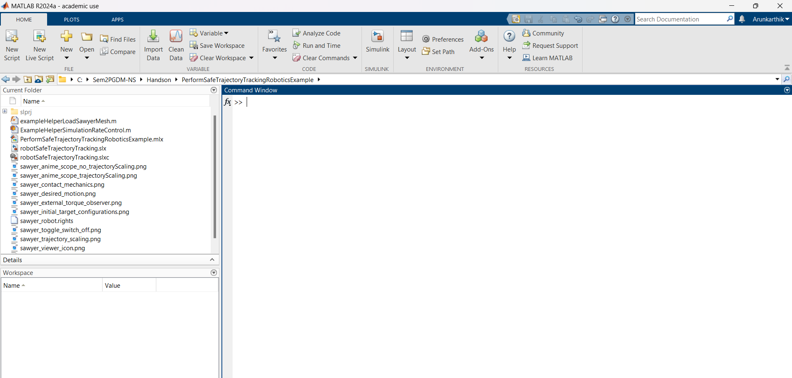
1
2
Type pyenv here

Slide 3
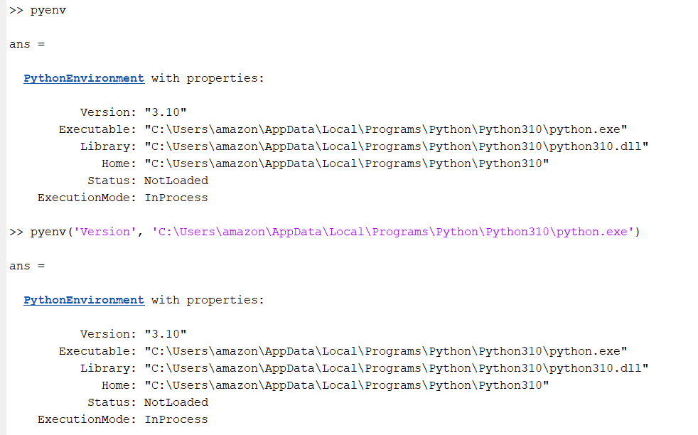
Copy and paste the path and execute this command

